Slide 1

1. The Hebrew

Slide 2


Slide 3

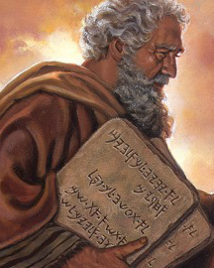
Moses the Man of God
Moses
The Man of God
Moses the Hebrew Ex 2
Moses the Fugitive Ex 2
Moses the Mediator Ex 32
Moses the Man (Exh) Num 20
Moses the Faithful Deut 34

Slide 4
Timeline
2000 1900 1800 1700 1600 1500 1400BC
215 Years in Israel
215 Years in Egypt
Abraham
1951
1776
Isaac
1851
1671
Jacob
1791
1644
Joseph
Moses
1700
1590
1526
1406
400 Years Gen 15:13, Ac 7:6
1846
430 Years Gal 3:17, Ex 12:41
1876
1661
1446

Slide 5
The Number of Israel
The Threat to Egypt (Ex 1:7)
And the children of Israel were fruitful and increased abundantly and multiplied and waxed exceeding mighty and the land was filled with them.
The Numbering of the Tribes (Num 1)
Reuben 46,500 Ephraim 40,500 Gad 45,650
Simeon 59,300 Naphtali 53,400 Dan 62,700
Issachar 54,400 Benjamin 35,400 Asher 41,500
Zebulun 57,400 Manasseh 32,200 Judah 74,600
The Thousands of Israel
Those that died in the plague ... 24,000 Num 25:9
... and fell in one day 23,000 1Cor 10:8
Levi 22,000 Num 3:39

Slide 6
JACOB
1 LEVI JUDAH JOSEPH
2 Kohath Tamar (Er) Ephraim
3 Amram Pharez Beriah
4 Moses Hezron Rephah
5 Gershom Ram Resheph
6 Amminadab Telah
7 Elisheba Nahshon Tahan
8 Laadan
9 Ammihud
10 Elishama
11 Nun
12 Joshua
The
Families
m Aaron

Slide 7
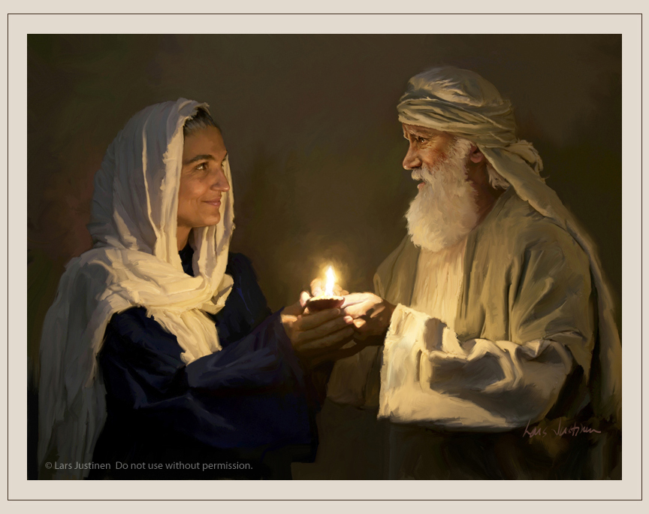
Moses’ Parents
Amram
Amram = Exalted People
Of the house of Levi Ex 2:1
Faithful before God Ex 3:6
Faithful before Man Heb 11:23
His house a sanctuary for the Truth Ac 7:20
Great example to Moses Ex 15:2, 18:4
Jochebed
Jochebed = Yah will be honoured
Daughter of Levi Num 26:59
Great example to Moses Ex 14:4, 17-18
Instrumental in saving Moses’ life Ex 2:2-3
Contrasts Pharaoh’s daughter Ex 2:9, Ac 7:20

Slide 8
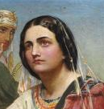
Miriam the Prophetess
Miriam
Miriam = rebellion
Faithful disposition as a young girl Ex 2:7
A Prophetess Ex 15:20
Capable Leader Ex 15:20
Led women’s choir after Red Sea Ex 15:20
Sister to Aaron Ex 15:20
Leads rebellion Num 12:1
A leprous example Deut 24:9
Sent by God Mic 6:4
First female singer recorded
No record of marriage

Slide 9
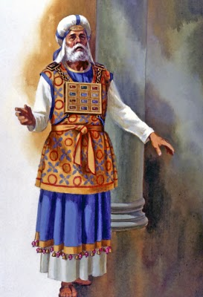
Aaron the High Priest
Aaron
Aaron = the enlightener
The Levite Ex 4:14
A Prophet Ex 7:1
Capable Speaker Ex 4:14
Loved Moses Ex 4:14
The Chief Priest Ezra 7:5
Three years older than Moses Ex 7:7
Deputised to Moses Ex 24:14
Swayed by people Ex 32:2, Num 12:1
Sent by God Mic 6:4
Chosen of God Psa 105:26
The Saint of Yahweh Psa 106:16

Slide 11
2. The Fugitive

Slide 12
Babylon
The Wisdom of the Chaldeans
And the king spake to Ashpenaz the master of his eunuchs, that he should bring certain of the children of Israel, and of the king’s seed, and of the princes;
Children in whom was no blemish, but well favoured, and skilful in all wisdom, and cunning in all knowledge, and understanding science, and such as had the ability in them to stand in the king’s palace, and whom they might teach the learning and tongue of the Chaldeans.
Dan 1:3-4

Slide 13
Egyptian
History
The Story of Joseph
He sent a man before them, even Joseph, who was sold for a servant: Whose feet they hurt with fetters: he was laid in iron: Until the time that his word came: the word of the LORD tried him.
The king sent and loosed him; even the ruler of the people, and let him go free. He made him lord of his house, and ruler of all is substance: To bind his princes at his pleasure; and to teach his senators wisdom.
Psa 105:17-22

Slide 14
It came into his Heart
The Promise to Abraham
And God said to Abram, Know of a surety that thy seed shall be a stranger in a land that is not theirs, and shall serve them; and they shall afflict them four hundred years ... but in the fourth generation they shall come hither again. Gen 15:13,16
The Promise of Joseph
Joseph said to his brethren, I die; and God will surely VISIT YOU and bring you out of this land unto the land which he sware to Abraham. Gen 50:24
Joseph the Deliverer
Joseph was thirty years old Gen 41:46
The seven years of plenty ended Gen41:53
There are yet five years of famine Gen 45:6

Slide 15
It came into his Heart
The Hand of Moses
But he that did his neighbour wrong thrust him away, saying, Who made thee a ruler and a judge over us? For he supposed his brethren would have understood that God by HIS HAND would deliver them: but they understood not.
Ac 7:27, 25
The Hand of God
This Moses whom they refused, saying, Who made the a ruler and a judge? the same did God send to be a ruler and a deliverer BY THE HAND OF THE ANGEL which appeared to him in the bush.
Ac 7:35

Slide 16
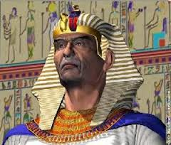
The Life of Joseph
Joseph Moses
Gen 39:6 A goodly man Ex 2:2
Gen 37:3 Nursed up in his fathers’ house Ex 2:9
Gen 39:2 God was with him Ex 3:12
Gen 41:39 Increased in wisdom Ac 7:22
Gen 41:45 Elevated by Pharaoh Ex 2:10
Gen 50:25 Forsook Egypt Heb 11:24
Gen 45:4 Accepted by brethren Ex 11:3
Gen 45:5 Delivered his brethren Ac 7:35
Gen 46:7 Brings brethren to Egypt
Leads brethren from Egypt Ex 13:3

Slide 17
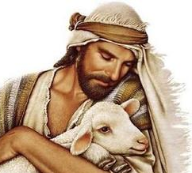
The Life of Joseph
Joseph Moses
Gen 37:2 A shepherd Ex 3:1
Gen 37:16 Sought his brethren Ac 7:23
Gen 37:18 Rejected by brethren Ex 2:14
Gen 37:8 “Shalt thou have dominion?” Ex 2:14
Gen 37:28 Exiled in Egypt Ac 7:29
Gen 39:1 A servant in Egypt Ex 3:1
Gen 41:45 Marries in Egypt Ex 2:21
Gen 41:50 Fathers two sons in Egypt Ex 18:3-4

Slide 18
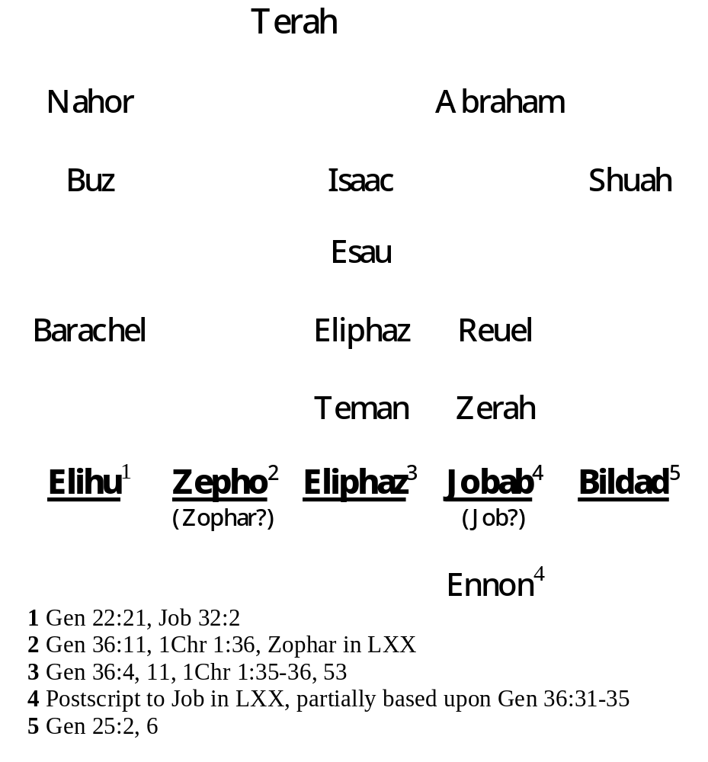
The Bene-Kedem
The Men of the East

Slide 19
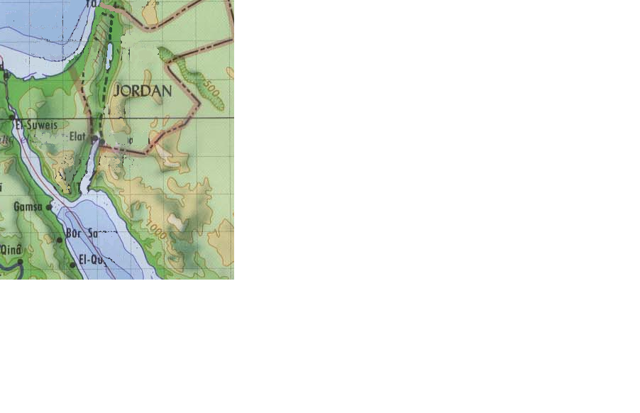
The Land of Uz
THE
EAST
Naamah
(Zophar?)
(Bildad)
Teman
(Eliphaz)
Uz
MIDIAN
Buz
(Elihu)
LAND OF UZ
Uz in Edom Lam 4:21, Jer 25:20-21
Uz a descendant of Esau Gen 36:28

Slide 20
The Humility of Midian
Nothing breeds doubt more insidiously than inactivity, there is no greater test of patience than indeterminate waiting.
It is a lesson which all disciples of Jesus must learn. So often, especially in the eager devotion of youth, obedience to the call of God is thought to imply an entire redirection of the whole life; there are new worlds to conquer, deep wrongs to right, great deeds to be done.
Slowly we realise that the Fathers’ business takes us back to the carpenter’s shop to the things we thought we might have left behind, to the slow discipline of patience and steadfast devotion, to a long period of waiting upon God.
A Life of Jesus, Melva Purkis, p33

Slide 21
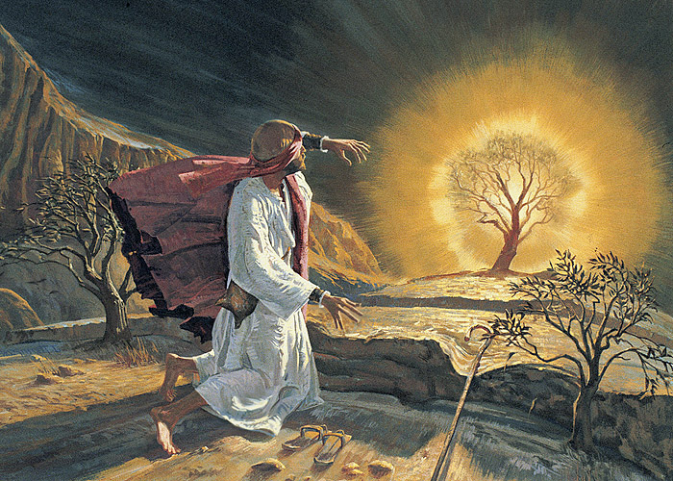
40 Years in Midian
Five Refusals
Ex 3:11 But who am I to do it?
Ex 3:13 But what am I going to tell Israel?
Ex 4:1 But Israel won’t believe me
Ex 4:10 But I am not eloquent – never have been
Ex 4:13 Send somebody else

Slide 23
3. The Mediator

Slide 24
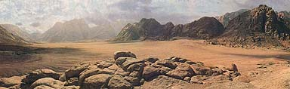
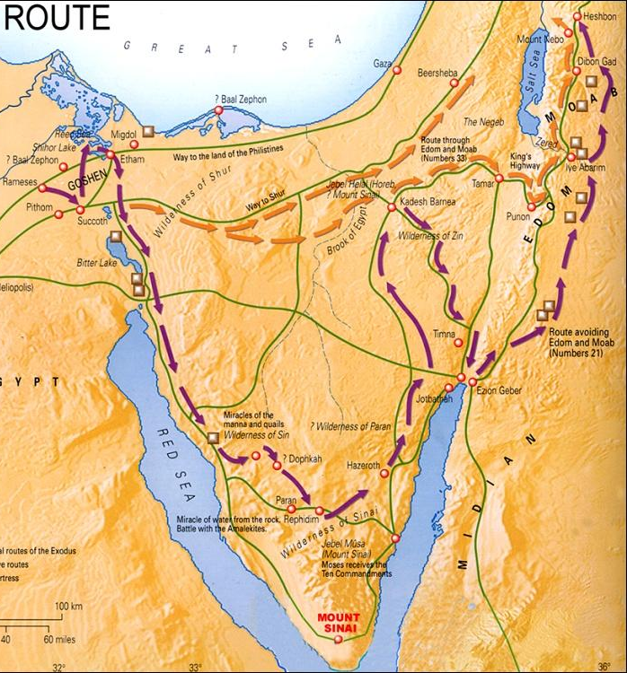
The Wilderness Wanderings

Slide 25
The Parable of the 5th Ascent
The First Advent
Ex 24:4 12 pillars = 12 apostles Gal 2:9
Ex 24:8 The blood of the covenant Mt 26:28
Ex 24:9 3 selected men Mt 26:37
Ex 24:10 The representative of God Jn 14:9
Ex 24:13 Moses rose up Ac 1:9
Ex 24:14 Tarry, till we come again Ac 1:11
The Absence
Ex 24:18 40 days and 40 nights Lu 19:12
The Second Advent
Ex 32:1 Moses is delayed Mt 24:48
Ex 32:6 Ate, drank, rose up to play Mt 24:49
Ex 32:1 We wot not what is become Mt 24:50
Ex 32:27 Slay every man his brother Mt 24:51
Ex 32:25 Naked unto their shame Rev 16:15

Slide 26
Moses and Israel
MOSES
Desired God’s Glory Ex 33:18
Sought God’s Ways Ex 33:13
Sacrificed in Covenant Ex 24:5
Ascended the Mount Ex 20:21
Saw God’s Ways Psa 103:7
Faithful at the Red Sea Heb 11:29
Faithful at the Red Sea Ex 14:31
Saw God’s Acts Psa 103:7
Fled from the Mount Ex 20:18
Sacrificed in Apostasy Ex 32:6
Forgot God’s Acts Psa 106:13
Disgraced God’s Glory Psa 106:20
ISRAEL

Slide 27
Events at Sinai
Ascent
Descent
1 The Promise of Priesthood Ex 19:3-6
People respond willingly
2 Sanctify the People Ex 19:8-13
People wash and stand at distance
3 People to Stand Afar Off Ex 19:20-25
10 Commandments, people afraid
4 Social laws, Angel Promised Ex 20:21-24:3
People respond, Covenant made
5 Pattern of Tabernacle, Tables given Ex 24:9-32:18
Golden calf, Tables broken
6 Intercedes, Angel taken Ex 32:31-33:3
Tent of meeting, Angel reinstated
7 Divine Name, Tables rewritten Ex 34:4-29
Moses’ face shines, Tabernacle built

Slide 28
Moses and Israel
Moses Israel
Fled from Egypt Ex 2:15 Ex 14:5
Humbled in Wilderness Ex 3:11 Deut 8:3
40 Years Sojourn Ac 7:30 Deut 8:4
Angel at Sinai Ex 3:1 Ex 19:2
Angel Speaks out of Fire Ex 3:2 Ex 19:18
Do Not Come Near Ex 3:5 Ex 19:12
Angel is Angry Ex 4:14 Ex 32:10
Angel seeks to Kill Ex 4:24 Ex 32:10
Forsook Egypt Heb 11:27
Returned to Egypt Ac 7:39

Slide 30
4. The Man

Slide 32
5. The Faithful

Slide 33
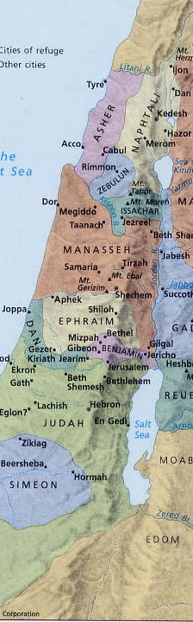
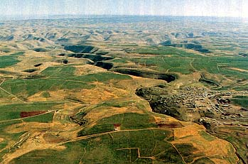
That Good Land

Slide 34
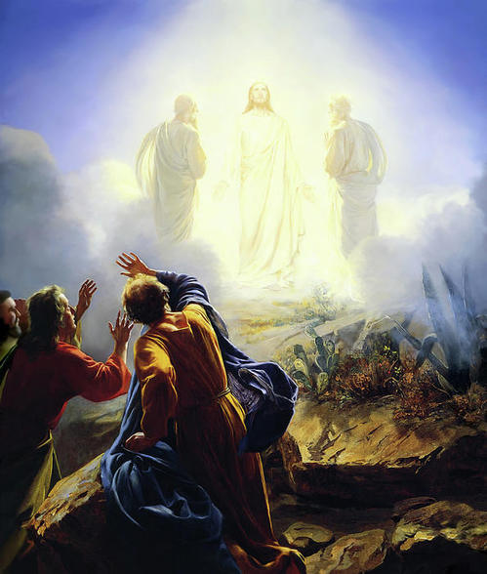
The Trans-figuration

Slide 35
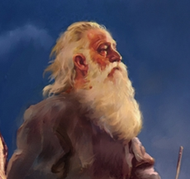
The Trans-figuration
Sinai Hermon
Ex 3:10 Led an Exodus (Decease) Lu 9:31
Ex 24:13 Moses rose up (LXX anastas) Lu 9:30
Ex 24:13 Ascended a Holy Mount 2Pet 1:18
Ex 24:15 Surrounded by cloud Mt 7:5
Ex 31:18 Received the Word Jn 1:14
Ex 33:11 Spake to God Mt 17:3
Ex 33:18 “Shew me thy glory” Lu 9:32
Ex 33:20 “Thou canst not see my face” 2Cor 4:6
Ex 34:29 Moses’ face shone Lu 9:31
Deut 18:15 Unto him shall ye hearken Mt 17:5

Slide 37
Two Personal Requests
“Shew me Thy Glory” Ex 33:18
... merciful, gracious, longsuffering, and abundant in goodness and truth, keeping mercy for thousands, fogiving iniquity and transgression and sin.
Ex 34:6-7
Ex 32:10 Let me alone ... that I may consume them
Num 14:12 I will smite them ... and disinherit them
Num 16:21 Separate ... that I may consume them
Num 16:45 Get you up ... that I may consume them
“Let me go Over” Deut 3:25
Ye shall not bring this congregation into the land which I have given them. Num 20:12
But Yahweh was wroth with me for your sakes, and would not hear me. Deut 3:26

Slide 38
4. The Father

Slide 39
Moses
Moses
The Man of God
Moses the Hebrew Ex 2
Moses the Fugitive Ex 2
Moses the Mediator Ex 32
Moses the Father Num 11
Moses the Man Num 20
Moses the Faithful Deut 34

Slide 40
The Challenge
of Korah
The proposed grounds of this challenge were of the usual sort. The truth was not put in the front. In reality the challenge was the offspring of ambitious aspiration in the part of the challengers—men small-minded enough to aspire to headship, but not large-minded enough to be qualified to exercise it, which, had they been, they would not have desired it: for the men fit to exercise authority are not those who find a personal gratification in it. But the real grounds are never put forward in such a case. Consciously or unconsciously men in such an attitude play the hypocrite. They put forward pleas that are serviceable, but not sincere—sincere enough as regards the earnest use made of them, but not sincere as regards the real motive at work. And they usually take the garb of a professed regard for somebody else’s rights, or for justice in the abstract—to both of which, in ordinary circumstances, the class in question exhibits a total indifference.
Robert Roberts, The Visible Hand of God, p174

