Slide 1

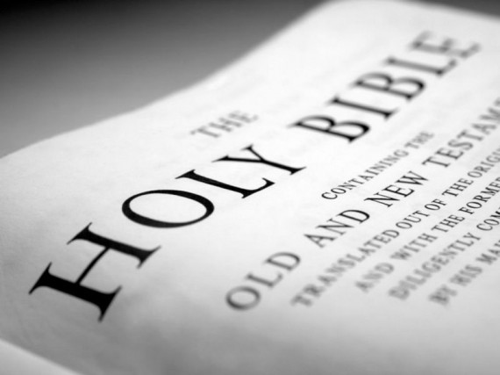
Developing a Godly Conscience
Individual Application of the word of God

Slide 2
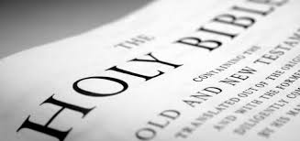
Conscience Defined
I say the truth in Christ, I lie not, my conscience also bearing me witness in the Holy Spirit. Rom 9 v 1
They show that what the law requires is written on their hearts, while their conscience also bears witness, and their conflicting thoughts accuse or even excuse them. Rom 2 v 15 (RSV)
Notes:
Assessing mechanism of ourselves and our actions

Slide 3
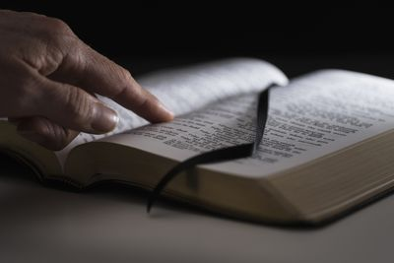

God’s Standard of Morality
God is and defines morality Ex 34 v 6-7
God determines good and evil Isa 45 v 7
God’s morality is fixed and constant Isa 5 v 20 unlike man’s often opposing view
God’s morality has to be learnt Isa 1 v 16-17
God’s view of morality is to hate evil Rom 12 v 9 and be joined to good
Notes:
Our immoral world filled with violence are the ruling passions of human civilisation. What God has caused to be called evil is now called good and what God called good is evil.

Slide 4
What is a Godly Conscience?
Changing dynamic always increasing or decreasing in us
Knowledge and understanding of God’s standards varies between believers and therefore causes different moral decisions
Part of the transforming process to develop the mind of Christ

Slide 5
Interface of the Godly Conscience
Standards, Rules, Goals
God’s Morality
God’s Word
God’s Kingdom
Thoughts
Emotions
Godly Conscience
Creating
Evaluating
Analysing
Applying
Understanding
Remembering
Guilt
Shame
Empathy
Sympathy
Pride
Fear
The Wonder of Forgiveness – The Conscience, Emotions and Habits p88 adapted

Slide 6
God’s Word is the Essential Input
God’s standards/rules of right and wrong and goal in life Word of God to determine our morality and personal goal of seeking the Kingdom of God and His righteousness.
God’s thoughts Word of God to impact on our thinking, the thoughts we have as we meditate on what we read and how it applies to us, and wanting to know and understand our Heavenly Father.
God’s emotions Word of God to impact on our emotions, wanting His emotions to be ours, to bring pleasure to Him and be at peace with Him and others through our covenant relationship.
Notes:
The values demonstrated by those who influenced us most in their care of us as children, which at first is the family unit, then the extended family unit and then wider community/ecclesia

Slide 7


Godly Conscience Eliminates Natural Behaviours
SPIRITUAL MIND
Open
E) AGAPE LOVE
SPIRITUAL RESOURCES
A GODLY CONSCIENCE
Close
Open
Open
Open
D) SELF DECEPTION
Open
C) YAHWEH’S VALUES
HUMAN RESOURCES
NATURAL MIND
Open
SOCIETY’S CONSCIENCE
Open
B) CHANGE
Moral decision to be made
LIFE EXPERIENCES
Close
A) STATUS QUO
Modification of Bro Frank Abel ‘s Conscience Diagram

Slide 8

The Challenge of Developing a Godly Conscience
‘We live in a world that knows not God and His Laws. As a consequence, as in the days of the Judges, ‘every ones does that which is right in his own eyes’, and the result is chaos in all stratas of society … Man’s thoughts are consequently the deciding factor in determining right and wrong for him. No longer is human behaviour subject to the fear of God, nor does ‘judgement to come’ enter into the question. As man’s thoughts are governed by his lusts, ‘the lust of the flesh, the lust of the eyes and the pride of life’ (1 Jn 2 v 16) ... he is thus unenlightened and ignorant of God’s will and purpose. It is the Word of God which provides light and true wisdom.’
Be Ye Doers Of The Word – A Life of Obedience p305

Slide 9
3 Key Components for Development
Knowledge
Prov 1 v 2
Understanding
Prov 1 v 2
Application
Prov 1 v 3

Slide 10
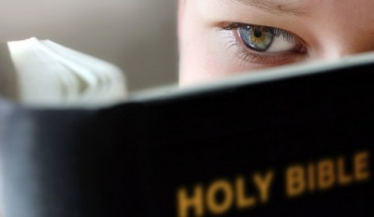
Developing a Godly Conscience - Knowledge
Gain a knowledge of God and His ways Hosea 4 v 6
Respond with a fear of the LORD Deut 10 v 12
Perceive God’ s presence as a reality Acts 23 v 1
Absorb the Word of God to challenge Heb 4 v 12 natural thoughts
Develop a love of God and His law Rom 7 v 22-23
Discern any laws of the land that Acts 5 v 29 contravene God’s law

Slide 11
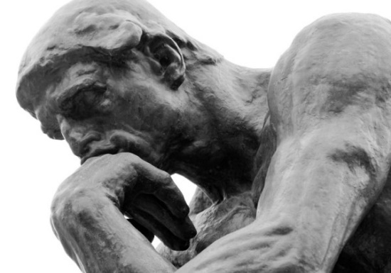
Developing a Godly Conscience - Understanding
Cultivate Godly friendships to help understanding Prov 27 v 17
Pray for understanding James 1 v 5
Struggle between natural and spiritual thinking Rom 7 v 19-23
Test what is acceptable and shun evil Eph 5 v 8-11
Examine our way of life and be alert to dangers 2 Cor 13 v 5
Apply effort and self control to respond obediently 1 Peter 1 v 13
Perceive God sees our suffering for following His ways 1 Peter 2 v 19

Slide 12

Developing a Godly Conscience – Application
Follow the faithful examples of others Phil 3 v 17
Application becomes a way of life Acts 23 v 1
Follow God’s standards of right and wrong Deut 10 v 12-13
Keep separate from all appearance of evil 1Thess 5 v 22,
Overcome evil with good habits motivated by love Eph 4 v 24-ch 5 v 2
Make Godly choices not to offend God Acts 24 v 16
Do not be give up in well doing 2 Thess 3 v 13
Regular use of the Godly conscience makes it Heb 5 v 14 more effective to distinguish good from evil
Notes:
Do all to the glory of God – 1 Cor 10 v 31
Adapting our own behaviour to due to the weak conscience of others 1 Cor 8 v 7,10,12

Slide 13


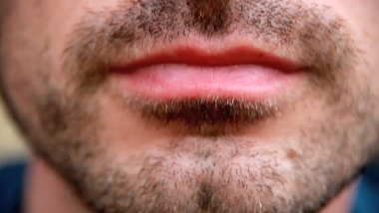

Apply God’s Principles in our Lives
Determining what we see
Psa 119 v 18, 37, Prov 21 v 2, Matt 18 v 9, Luke 11 v 34
Determining what we hear
Job 34 v 3, Prov 5 v 13, 18 v 15, 25 v 9, Luke 8 v 8, 1 Tim 4 v 3
Determining what we say
Matt 12 v 36, Matt 15 v 18, Eph 4 v 29, 31-32, Phil 2 v 14, Col 4 v 6
Determining what we do
Deut 15 v 7-8, Ecc 9 v 10, Matt 5 v 30, Gal 6 v 10, Col 3 v 17, 1Cor 10 v 31
Notes:
So how do we develop a Godly Conscience? Clue in the picture – Read the Bible Cor 10 v 31, le seeking to understand and put into practice principles – What God declares is the right way that finds its expression in 4 key ways.

Slide 14
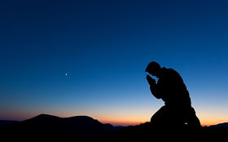

Our Response
Acts 24:16
And herein do I exercise myself, to have always a conscience void of offence toward God, and toward men. Acts 24 v 16
Notes:
We are to copy the Apostle Paul who disciplines himself to have a conscience that does not lead one to sin before God, to stumble and fall short of the glory of God.

