Slide 1
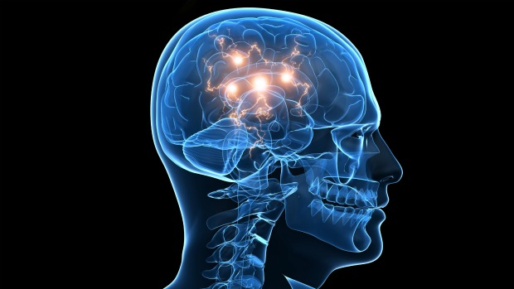
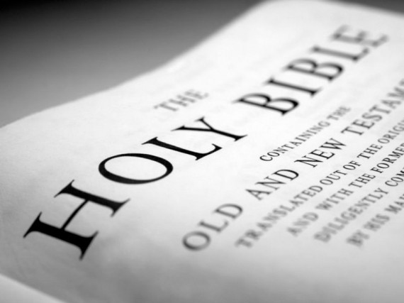
Developing a Godly Conscience
SuppoRTING ITS DEVELOPMENT IN OTHERS

Slide 2
Interface of the Godly Conscience
Standards, Rules, Goals
God’s Morality
God’s Word
God’s Kingdom
Thought
Emotions
Godly Conscience
Creating
Evaluating
Analysing
Applying
Understanding
Remembering
Guilt
Shame
Empathy
Sympathy
Pride
Fear
The Wonder of Forgiveness – The Conscience, Emotions and Habits p88 adapted

Slide 3
3 Key Components for Development
Knowledge
Prov 1 v 2
Understanding
Prov 1 v 2
Application
Prov 1 v 3

Slide 4
Conscience Relationship to Direct Instruction
The Law of Christ
Forbidden Commanded
Weak Weak (Succumbs) (Doesn’t do)
Strong Strong
(Abstains) (Does)
Sin Sin
Conscience
Strong Weak
(Allows) (Disallows)
Glory to God
Steve McGeorge – The Atonement in Daily Life

Slide 5
Working with the Consciences of our Brothers and Sisters
Knowledge not developed equals a weaker Godly 1 Cor 8 v 4, 7 conscience in that issue
Knowledge developed equals a stronger Godly 1 Cor 8 v 1-2, 8 conscience in that issue but can cause arrogance and loss of perspective before God and others
A strong Godly conscience on that issue can cause 1 Cor 8 v 9-12 those with a weak conscience on the same issue to sin

Slide 6
Working with the Consciences of our Brothers and Sisters
Godly conscience causes the brother/sister who sees 1 Cor 8 v 13 no sin in a behaviour, in love, to modify their behaviour in the presence of a brother/sister who does
Conscience causes the same brother/sister who sees no sin 1 Cor 10 v in a behaviour not to modify if shared by that brother/sister 24-26
Both behaviours are lawful before God due to the brother/ 1 Cor 8 v 8, sister’s conscience, but not both are edifying 10 v 23

Slide 7
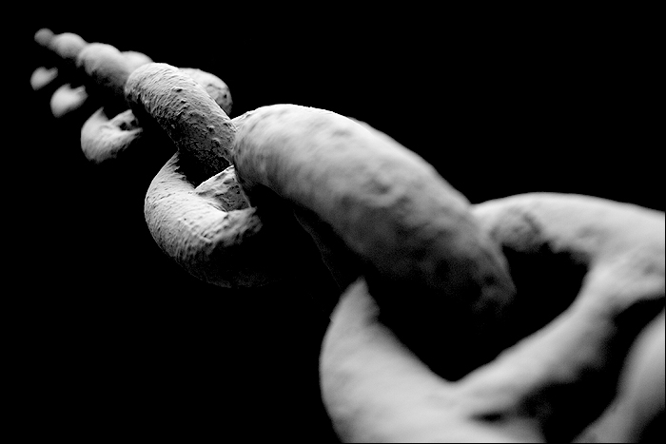
What our Godly Conscience allows must be kept in perspective
‘It means that a disciple must not be mastered by the lawful things which he allows and enjoys. The liberty to use anything ceases when it enslaves. Keep the right perspective and you are safe; give it priority and you are in danger.’
Genius of Discipleship – Individuality p70

Slide 8

Godly Conscience impacted by our different backgrounds/experiences
Paul uses his conscience position to save others 1 Cor 9 v 20-22
We must seek to be flexible if we have a strong conscience 1 Cor 9 v 22 on an issue to help save others
We must not impose our conscience position on others Gal 2 v 14
We must be self-restrained and self-disciplined being clear 1 Cor 9 v 25-27 in our conscience lest we fail ourselves
Notes:
Different nationalities within Enfield - Flags

Slide 9
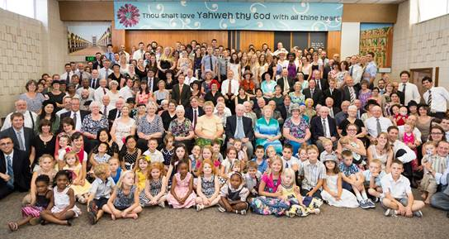
Our Godly Conscience can change our level of vulnerability
Conscience of the strong can cause them to be 1 Cor 10 v 12-14 vulnerable and become weak
Conscience of the weak can cause them to separate 1 Cor 10 v 19-21 and become strong
Conscience varies and so we seek to edify others 1 Cor 10 v 23-24
Conscience behaviours are to the glory of God and 1 Cor 10 v 31-33 modified for the salvation of our brothers and sisters
Notes:
Ecclesial photograph

Slide 10

The Decline and Death of a Godly Conscience
Do not give opportunity for lust to reign Rom 13 v 14
Recognise we gain what we put time and effort into Gal 6 v 7-8
Pride in our strong conscience excludes self-examination 1 Cor 10 v 12-13 leading to self-deception
Ungodly company will corrupt our Godly morals 1 Cor 15 v 33
Apathy and humanism put away a Godly conscience 1 Tim 1 v 19
Leaving the ecclesia our conscience is insensitive to God’s word 1 Tim 4 v 1-2
Deliberate sin demonstrates the death of Godly conscience Heb 10 v 26
Unbelieving have a defiled conscience unable to Titus 1 v 15-16 distinguish between good and evil
No Godly conscience causes evil behaviours and Rom 1 v 28, 32 pleasure in them

Slide 11
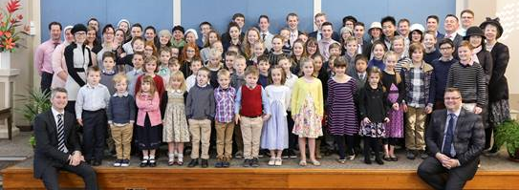
Developing a Godly Conscience in the next generation – Deut 6 v 6-9
Plant the word of God in their hearts as soon as they come into existence through Bible stories, readings and meditating about God’s word
Develop an awareness and dependency on God through family and 1 to 1 prayers
Talk about God’s principles and how we are trying to apply them at family meetings to the situations of life that we encounter
Talk about our vision of the Kingdom making it real with detail that relates to them
Discipline them in love, obeying God’s commandments as we try to obey our heavenly Father, praying about the behaviour when older
Notes:
Ecclesial Sunday School Picture

Slide 12
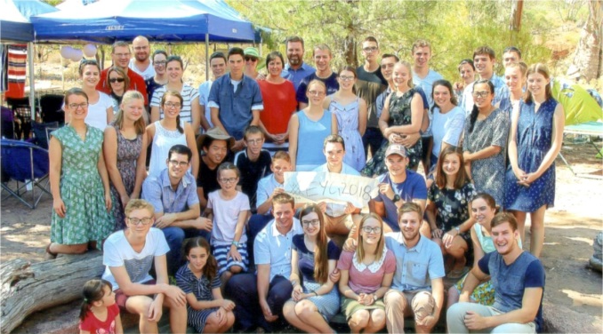
Developing a Godly Conscience in the next generation – Deut 6 v 6-9
Show the word of God in action as parents, aunties and uncles in a range of contexts where that comes first and self second
Emphasise and experience the blessings of our ecclesial/brotherhood fellowship in practical support, speaking positively about our ecclesia
Demonstrate Godly choices in our decisions at many different levels
Encourage and provide opportunities for them to take increasing responsibility to develop their own Godly conscience e.g. listening to talks/reading books/doing one of the daily readings
Gradually hand more responsibility to them to help them develop their ability to make Godly choices, giving guidance when needed

Slide 13

Critical aspects for the development of a Godly Conscience in the 21st Century
Regular intake of God’s word - Know God’s standard of right and wrong and then apply in our thoughts, determining our moral decisions shown in our behaviour.
Personal example of critical emotional relationships – Values learnt from parents, grandparents, extended family, aunties and uncles, Sunday School teachers, youth group leaders, Heritage teachers and later brothers and sisters, spouse and in-laws.
Quality of close friends – Values held and demonstrated in their speech and behaviour reflecting Godly attitudes.
Quality of personal life experiences – In our own families/extended families/relatives, friendship groups, ecclesia, trips to different cultures/places, wider brotherhood.
Discernment of propaganda in the media/social media – Social agendas pushed to change the public conscience on moral issues that challenge the Godly conscience e.g. euthanasia, abortion, marriage relationships.
Notes:
Age and stages of conscience development making the right decision

Slide 14

Witness of a Godly Conscience
Preach the Truth to others and rejoice if we suffer Acts 5 v 40-42 for this
Witness to our hope displaying God’s morality 1 Peter 3 v 15-17 in our way of life
Obey civil laws unless they contravene God’s law Rom 13 v 5-7, 1 Peter 2 v 13-19
Develop a reputation of being a God-fearing citizen 2 Cor 1 v 12
Appeal to the conscience developed within others 2 Cor 4 v 2
Shown in the attitude of how we judge others John 8 v 9

Slide 15

Key Milestones for a Godly Conscience
Growth in awareness of God and one’s position as a sinner before Him
Baptism, coming into covenant relationship with God and the Lord Jesus Christ, and so seen as righteous, gaining the hope of salvation
Life of striving to be faithful to God’s will as a son/daughter in our moral decisions
Responsibility to respect the consciences of other brethren and sisters through modifying our own behaviour
Faithfully upholding God’s morality to non-believers, preaching by example
Death in Christ, awaiting the fulfilment of the covenants of promise or our life being interrupted by the coming of Christ
Judgement of our Godly conscience as part of the mind of Christ we have developed
Reward of physical regeneration due to the mental/moral regeneration (Godly conscience-driven mind) that occurred in the time of our probation
Notes:
Milestone Pic

Slide 16
Our Response
And herein do I exercise myself, to have always a conscience void of offence toward God, and toward men. Acts 24 v 16

Slide 18
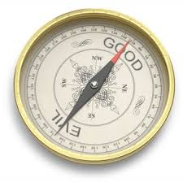
Conscience = Determining Control of Moral Decisions
Teach men that they are not responsible for their thoughts and actions (No conscience) that there is no such thing as freewill, that environment is everything, and that they cannot with justice be praised for well-doing, or blamed for their sins and they will relax all effort, give free rein to habits and sink very much into the automatic machines they believe themselves to be.
Teach them that they are responsible, that they can ‘refuse the evil and choose the good’, and can even exercise a control over their thoughts, (Conscience) and they rise to the occasions. There will be a conscious choice, a conscious struggle against evil tendencies and evil environment, and a consequent development of personality. It is out of such a struggle that the sons/daughters of God are born.’
Conviction and Conduct –Control of Thought page 138

