Slide 1


Slide 2
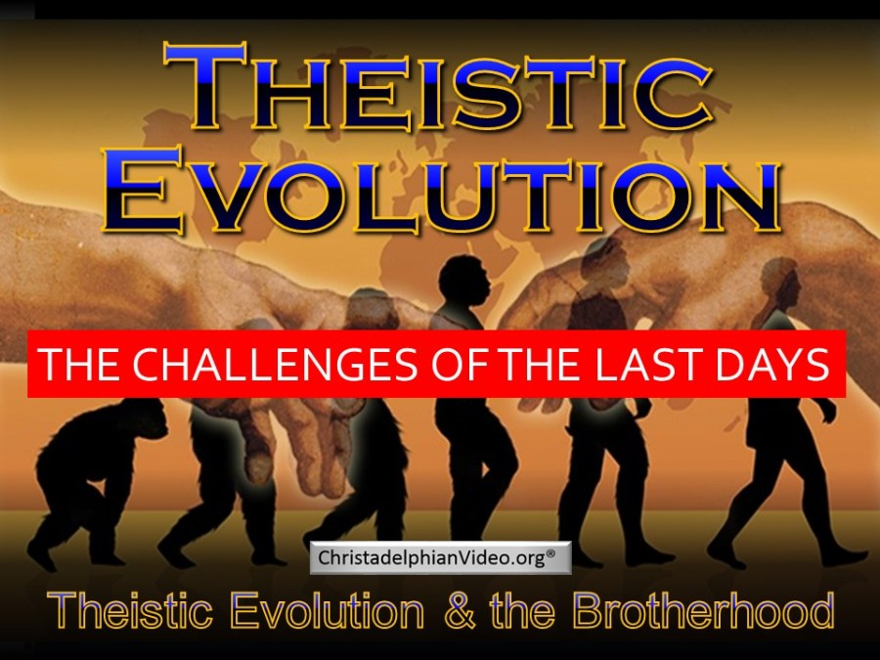
1.3 hour video on Youtude.com by Rugby Christadelphians

Slide 3

There are various versions of this idea

Slide 4
Compilation of evidence against some parts of Theistic Evolution
The Deception
of
Theistic
Evolution
Mark Allfree
Matthew Davies
BIBLE STUDY PUBLICATIONS
“Woodlyn”, The Park, Mansfield, Nottinghamshire NG18 2AT, UK
Mainly deals with the Solid Dome Theory and demon possession
Download at: Christadelphianvideo.org

Slide 5

Romans 5:12-14
Death is not a random act of Evolution
12 Therefore, just as through one man sin entered the world, and death through sin, and thus death spread to all men, because all sinned — 13 (For until the law sin was in the world, but sin is not imputed when there is no law. 14 Nevertheless death reigned from Adam to Moses, even over those who had not sinned according to the likeness of the transgression of Adam, who is a type of Him who was to come.
The Bible makes it clear that death is the result of Sin – humans did not die until Adam & Eve sinned!

Slide 6
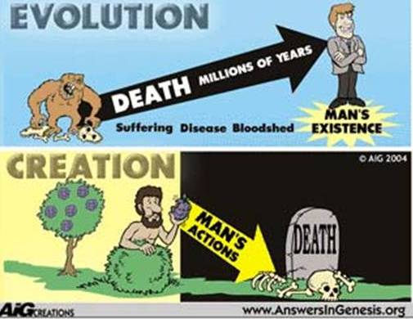

Slide 7
Genesis 3:17-19
Sin brought physical death
17 Then to Adam He said, "Because you have heeded the voice of your wife, and have eaten from the tree of which I commanded you, saying, 'You shall not eat of it':
"Cursed is the ground for your sake; In toil you shall eat of it all the days of your life. 18 Both thorns and thistles it shall bring forth for you, And you shall eat the herb of the field. 19 In the sweat of your face you shall eat bread till you return to the ground, for out of it you were taken; For dust you are, and to dust you shall return."
Adam’s physical death is a
direct consequence of his sin

Slide 8
Exodus 20:11
Moses’ understanding
For in six days the Lord made the heavens and the earth, the sea, and all that is in them, and rested the seventh day. Therefore the Lord blessed the Sabbath day and hallowed it.
Exodus 31:17
For in six days the Lord made the heavens and the earth, and on the seventh day He rested and was refreshed.'"
Moses believed in a 6-day creation

Slide 9
Matthew 19:4-6
Jesus’ Testimony
4 And He answered and said to them, "Have you not read that He who made them at the beginning 'made them male and female,' 5 and said, 'For this reason a man shall leave his father and mother and be joined to his wife, and the two shall become one flesh'? 6 So then, they are no longer two but one flesh. Therefore what God has joined together, let not man separate."
This affects how you view marriage: Our marriage relationship is based on how God made Adam & Eve

Slide 10
You can’t mix Evolution & Genesis 1
Note the different sequences
Day | Bible sequence | Evolution sequence
3 | Plants & Trees | Fish
5 | Fish | Plants & Trees
5 | Birds | Insects
6 | Mammals | Reptiles
6 | Reptiles | Birds
6 | Insects | Mammals
6 | Humans | Humans
You have to make a choice!

Slide 11
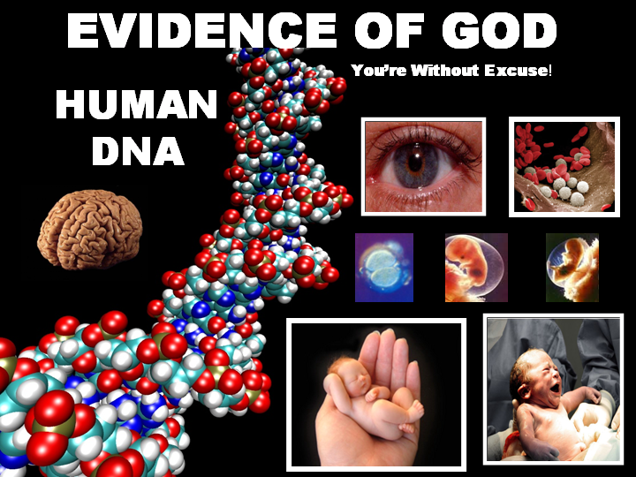

Slide 12
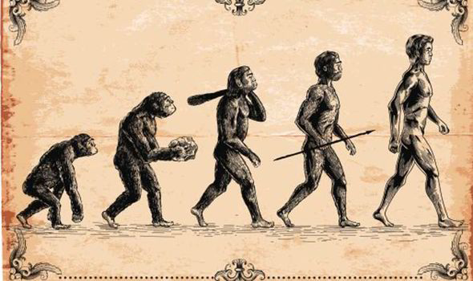
This is what most people think when they hear “Evolution”
G
This is MacroEvolution

Slide 13
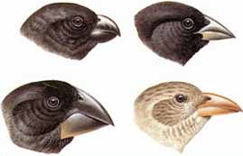
Definition of Evolution Today
Now defined in a
very broad way:
Any change in the genes or
gene frequencies of a population
This definition means that we should not say “I don’t believe in Evolution”.
It’s like saying today: “I don’t believe in the devil” or “there is no heaven”

Slide 14
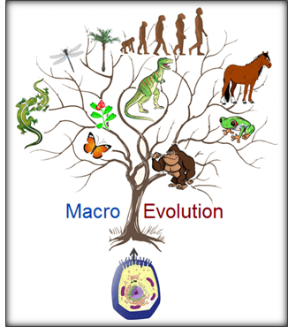
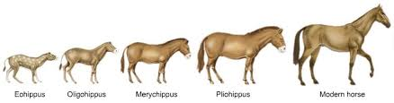
MacroEvolution
is the idea that species can change into new species over millions of years

Slide 15

Even Evolutionists admit that this has no practical impact on our lives today!
What does matter, is the small changes that can take place in species over short periods of time
This is MicroEvolution

Slide 16
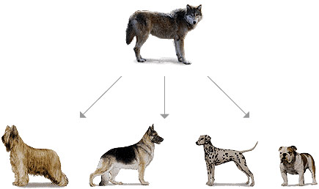
Two areas of Evolution today
1) MicroEvolution: any genetic changes in a population from one generation to the next
This can be verified with experiments
2) MacroEvolution: Development of new species
This has never been
verified with experiments!

Slide 17
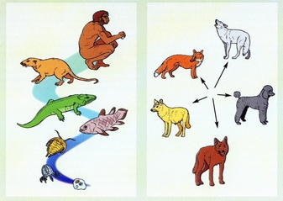
MacroEvolution vs MicroEvolution

Slide 18
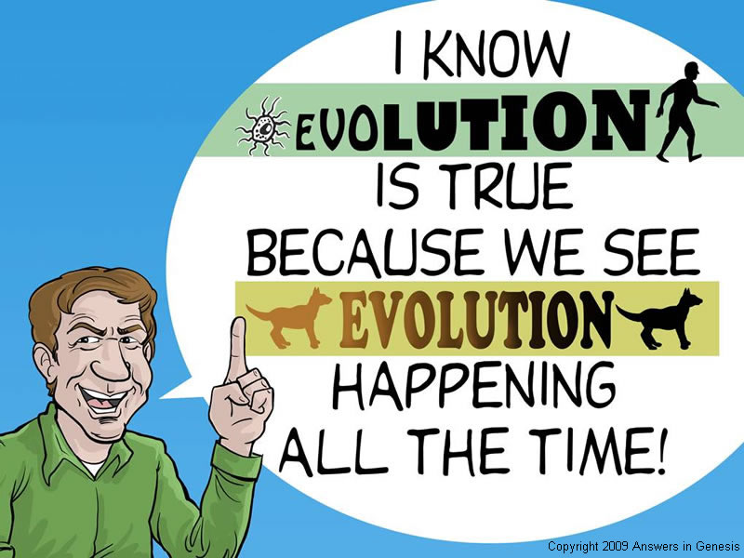
The Great Mistake!
Macro
Micro

Slide 19

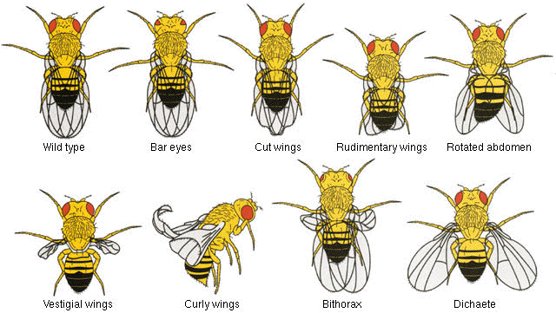
MacroEvolution cannot be Verified by Experiments
Since 1910, Geneticists have documented over 3000 mutations in Fruit Flies.
They bombarded them with x-rays for years, but still have not produced a new species.

Slide 20
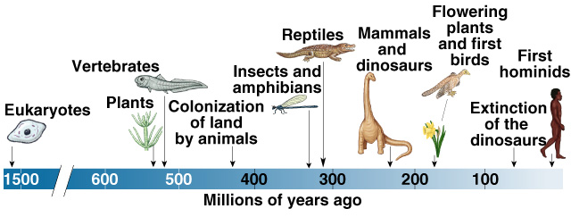
Evolutionary Scientists now claim Macroevolution takes too long to verify with experiments!
This is when MacroEvolution becomes “bad science”

Slide 21
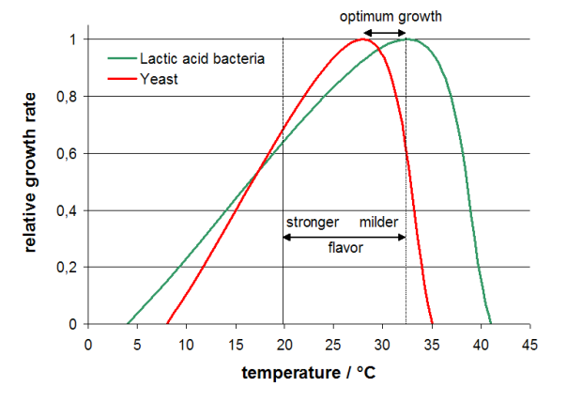
MacroEvolution is an extrapolation of data
Growth rates of Yeast & Bacteria for Sourdough bread
All researchers know Extrapolation is risky

Slide 22

Bottom line: MacroEvolution cannot be verified by experiments and it is a risky extrapolation of MicroEvolution events
MacroEvolution

Slide 23
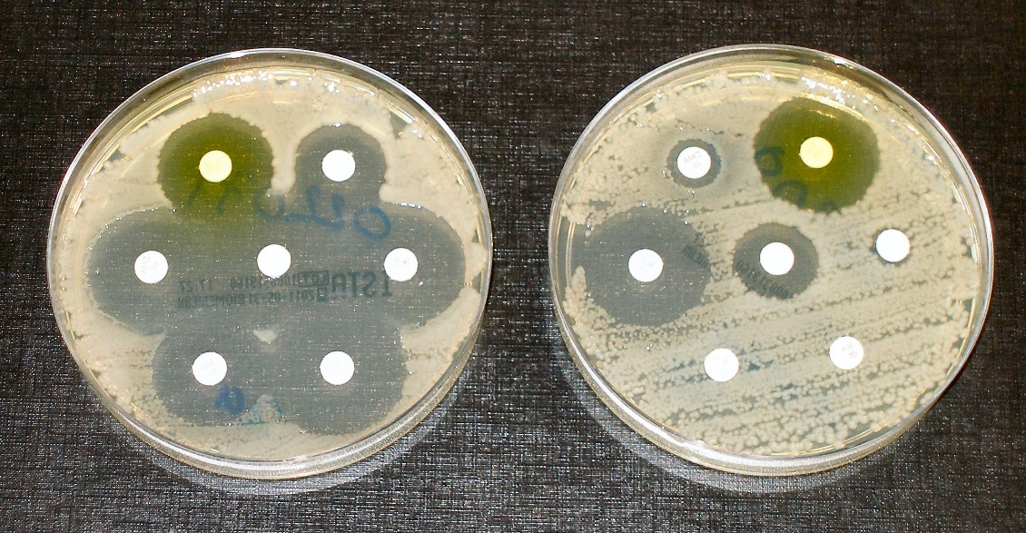
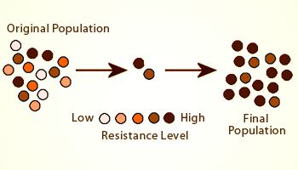
MicroEvolution has practical value
Antibiotic Resistance and MicroEvolution

Slide 24

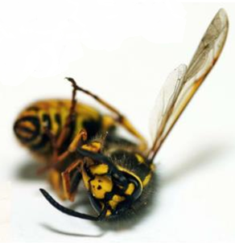

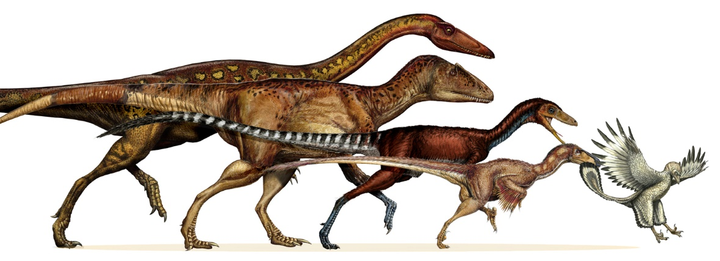
The Good and the Bad of Evolution
MicroEvolution can be verified with experiments & has great practical value today
Insecticide Resistance
MacroEvolution cannot be verified with experiments & has no practical value today
Dinosaurs evolve to birds

Slide 25

The weight of evidence is for creation!

Slide 26


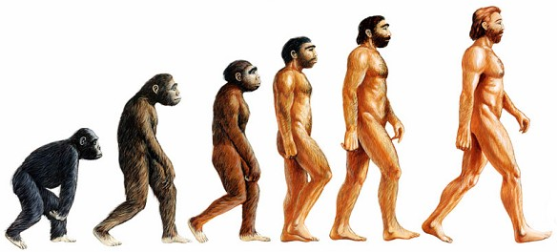

Where is your Faith?
In a loving God who designed our world so we can join His family & gives us prophecy to prove it!
In a scientific theory that cannot be tested?
or

Slide 28
2
W
17
!

Slide 29
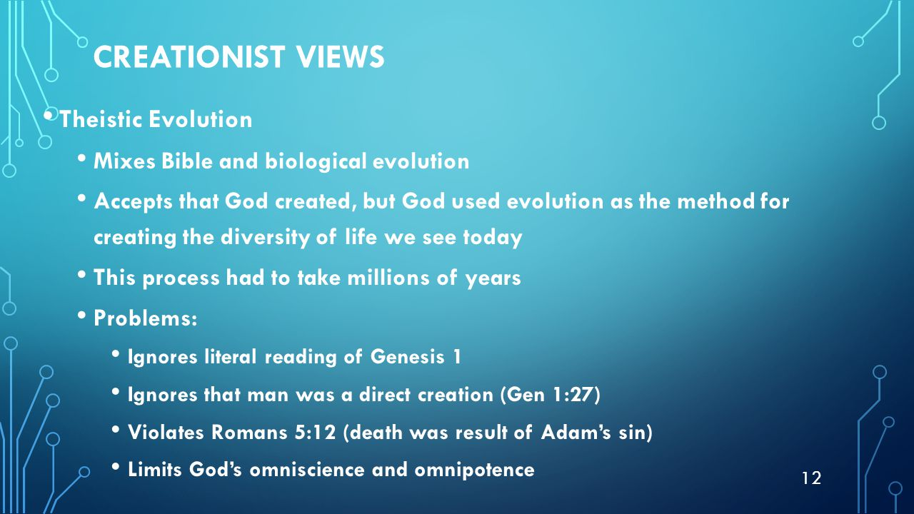

Slide 30

Lessons from Today
Appreciate our

Slide 31
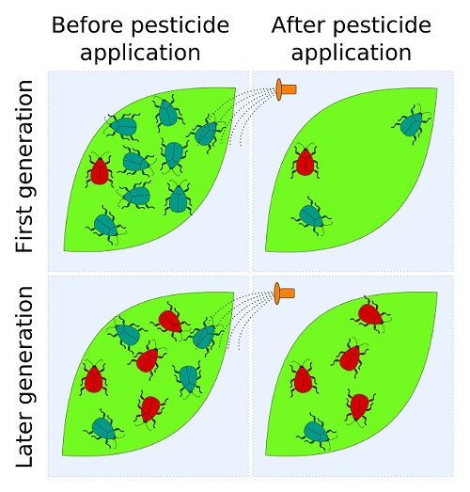
MicroEvolution Pesticide Resistance
Note: The pesticide did not make the variation – it was already there. The pesticide simply selected which variation of bugs would survive best

Slide 32


Slide 33
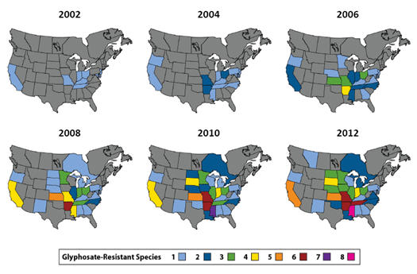
MicroEvolution Glyphosate Resistance

Slide 34
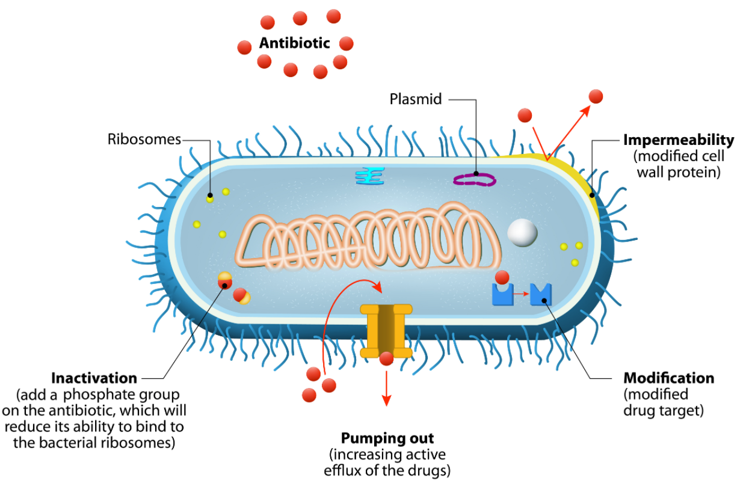
Mechanisms of Antimicrobial Resistance

Slide 35

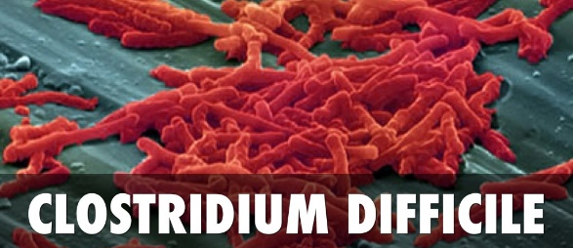

Slide 36
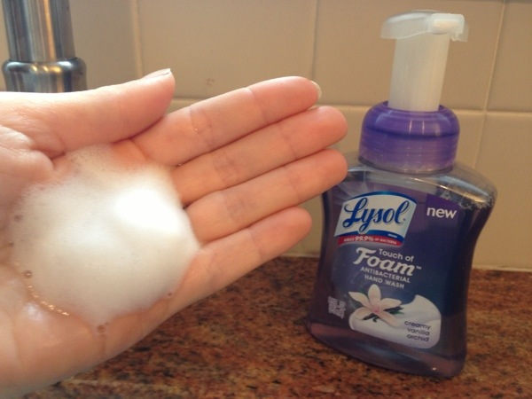
What’s the problem with using antibacterial hand sanitizer all through the day?

Slide 37
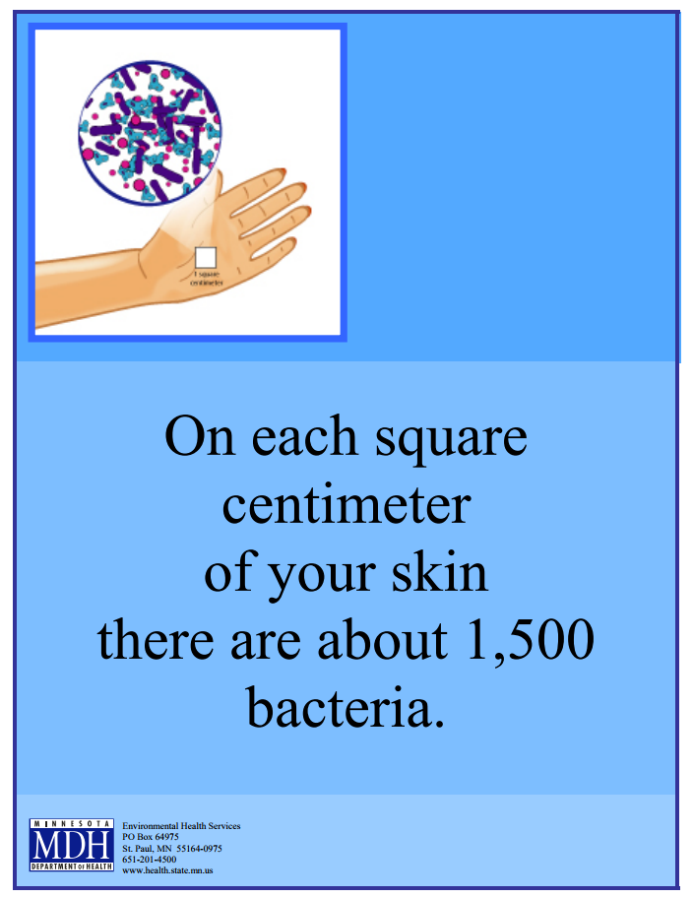
Both hands together are about 1000 cm², so that’s about 1.5 million bacteria on our hands. If the soap leave 0.1% alive, that’s about 1500 bacteria who survive to reproduce without any bacterial competitors!

Slide 38
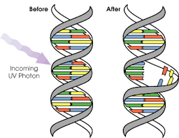
Mechanisms required for
Evolutionary Theory
1) Mutations: any changes in the DNA genetic code
  provide genetic diversity and variations in traits in species
  Some mutations (like antibiotic resistance) make an organism better able to survive in a specific environment

Slide 39
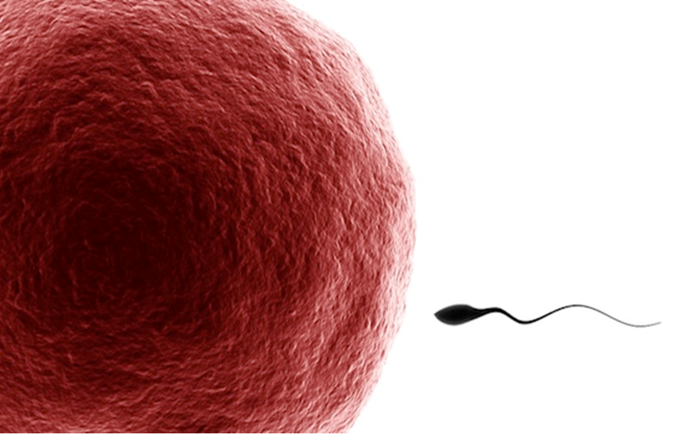
In sexually reproducing organisms, only mutations in eggs and sperm
can actually provide
new DNA that
could lead to the
evolution of a
population
Why???

Slide 40
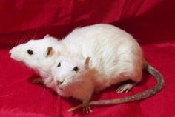

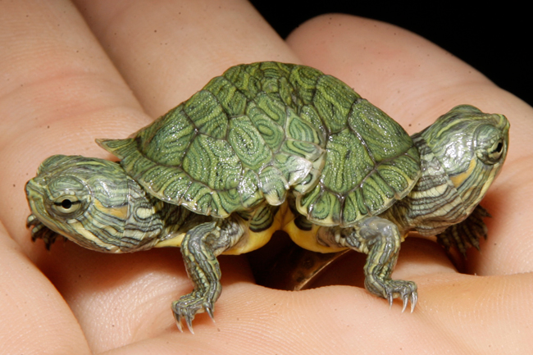
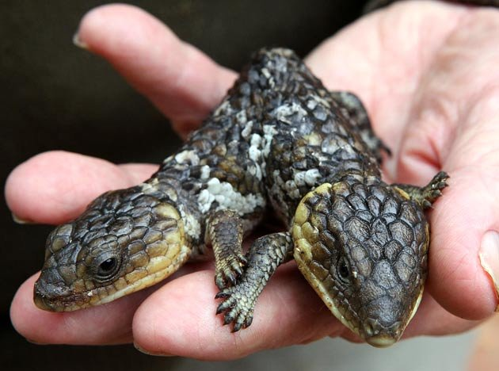
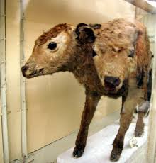
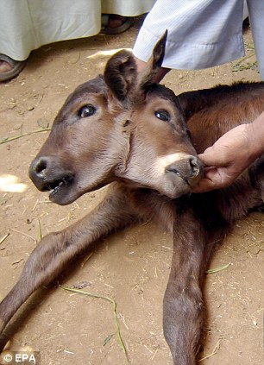


These are not inherited

Slide 41
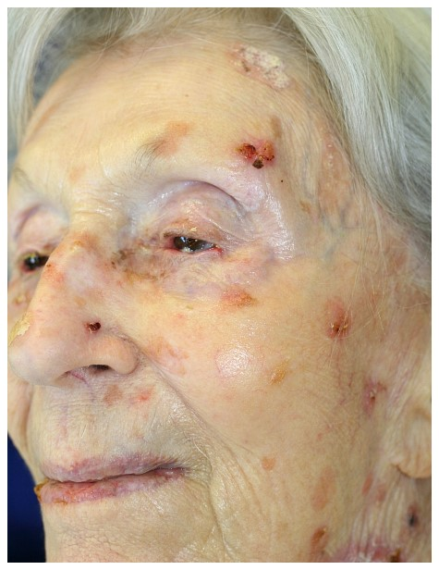
Cancer is the result of mutations
Is Cancer inherited?
Why???
The mutated genes are not in our sex cells
Only the tendency for cancer can be inherited

Slide 42
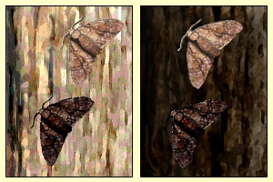
Mechanisms required for
Evolutionary Theory
2) Natural Selection: “survival of the fittest”. Only the varieties of a species that are well suited to the environment will survive and reproduce.
  determines which variations survive & reproduce
  Over time the population changes and the individuals become better adapted to their environment

Slide 43
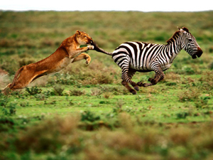
Natural Selection in action
Which zebras will survive?

Slide 44
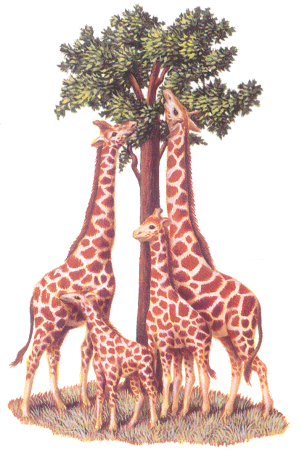
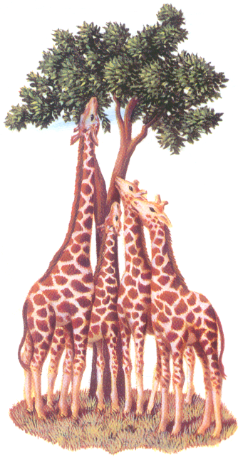
Natural Selection in action
Standard Textbook example
Time
The average height will increase for a while

Slide 45
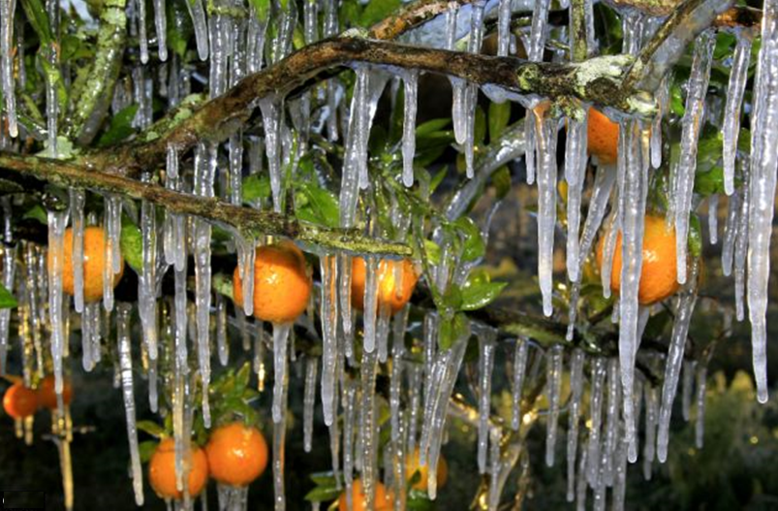
Natural Selection in action
Which orange trees will survive?

Slide 46
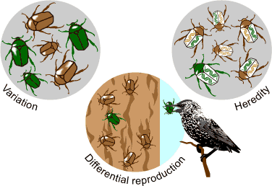
Natural Selection in action

Slide 47
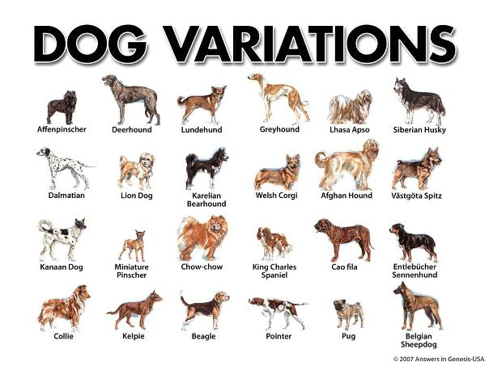
Humans can select too!

Slide 48

Racehorses have been selectively bred for 100’s of years!
Do they keep getting faster?

Slide 49
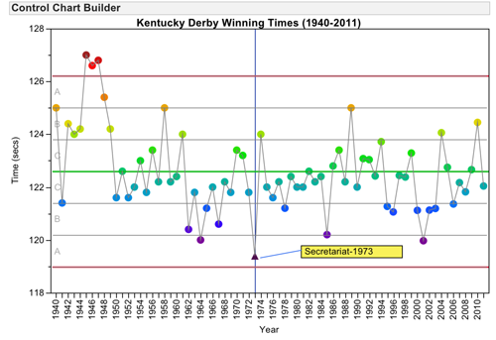
Speeds haven’t changed much in the last 70 years
Kentucky Derby winning times
* 2015 American Pharaoh

Slide 50
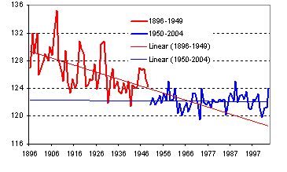
Is this Really linear decline today?
Kentucky Derby winning times
Why has it leveled off?

Slide 51
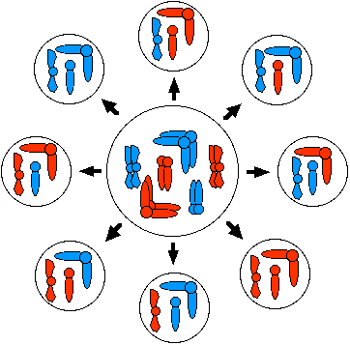
Once you get the best combinations of genes in the gene pool, you cannot improve without some wonderful mutation!
And positive mutations are very rare, if they occur at all!

Slide 52
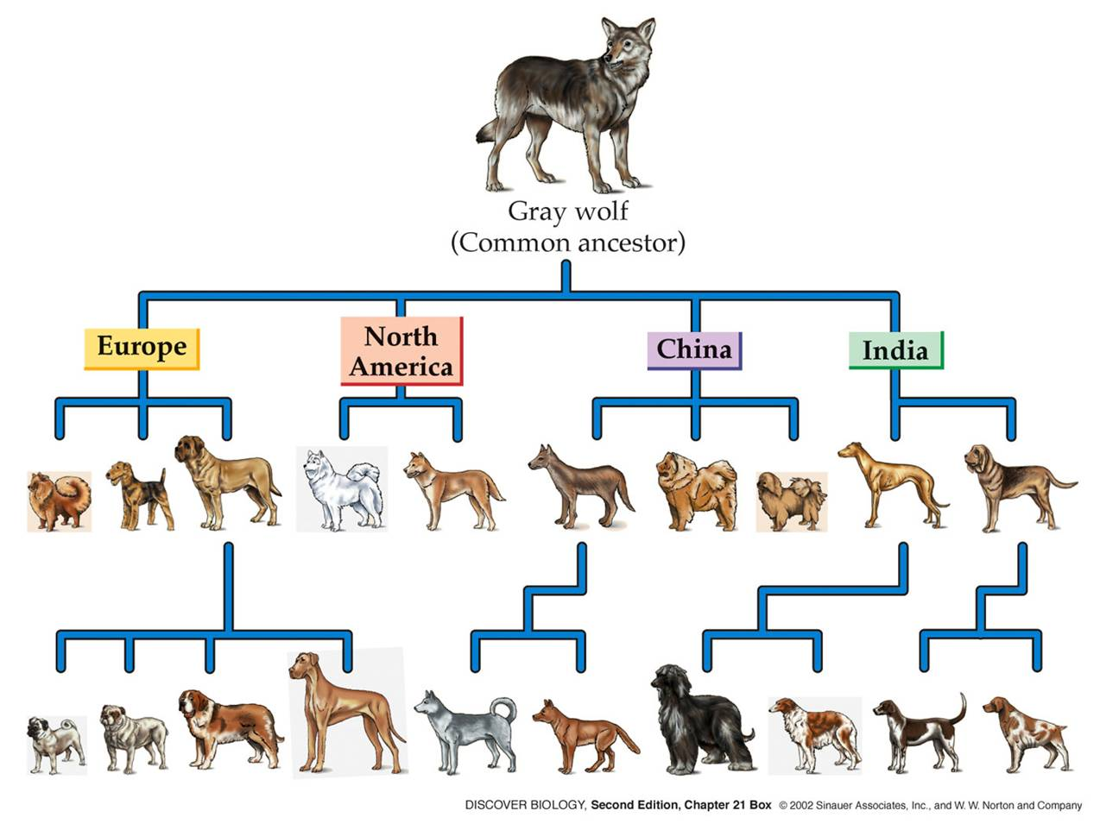
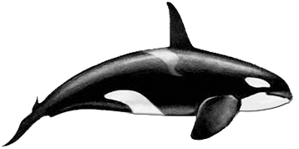
Natural Selection is limited by the gene pool
Wolves only have the genes to produce wolves & dogs
You won’t get a whale from a wolf!

Slide 53
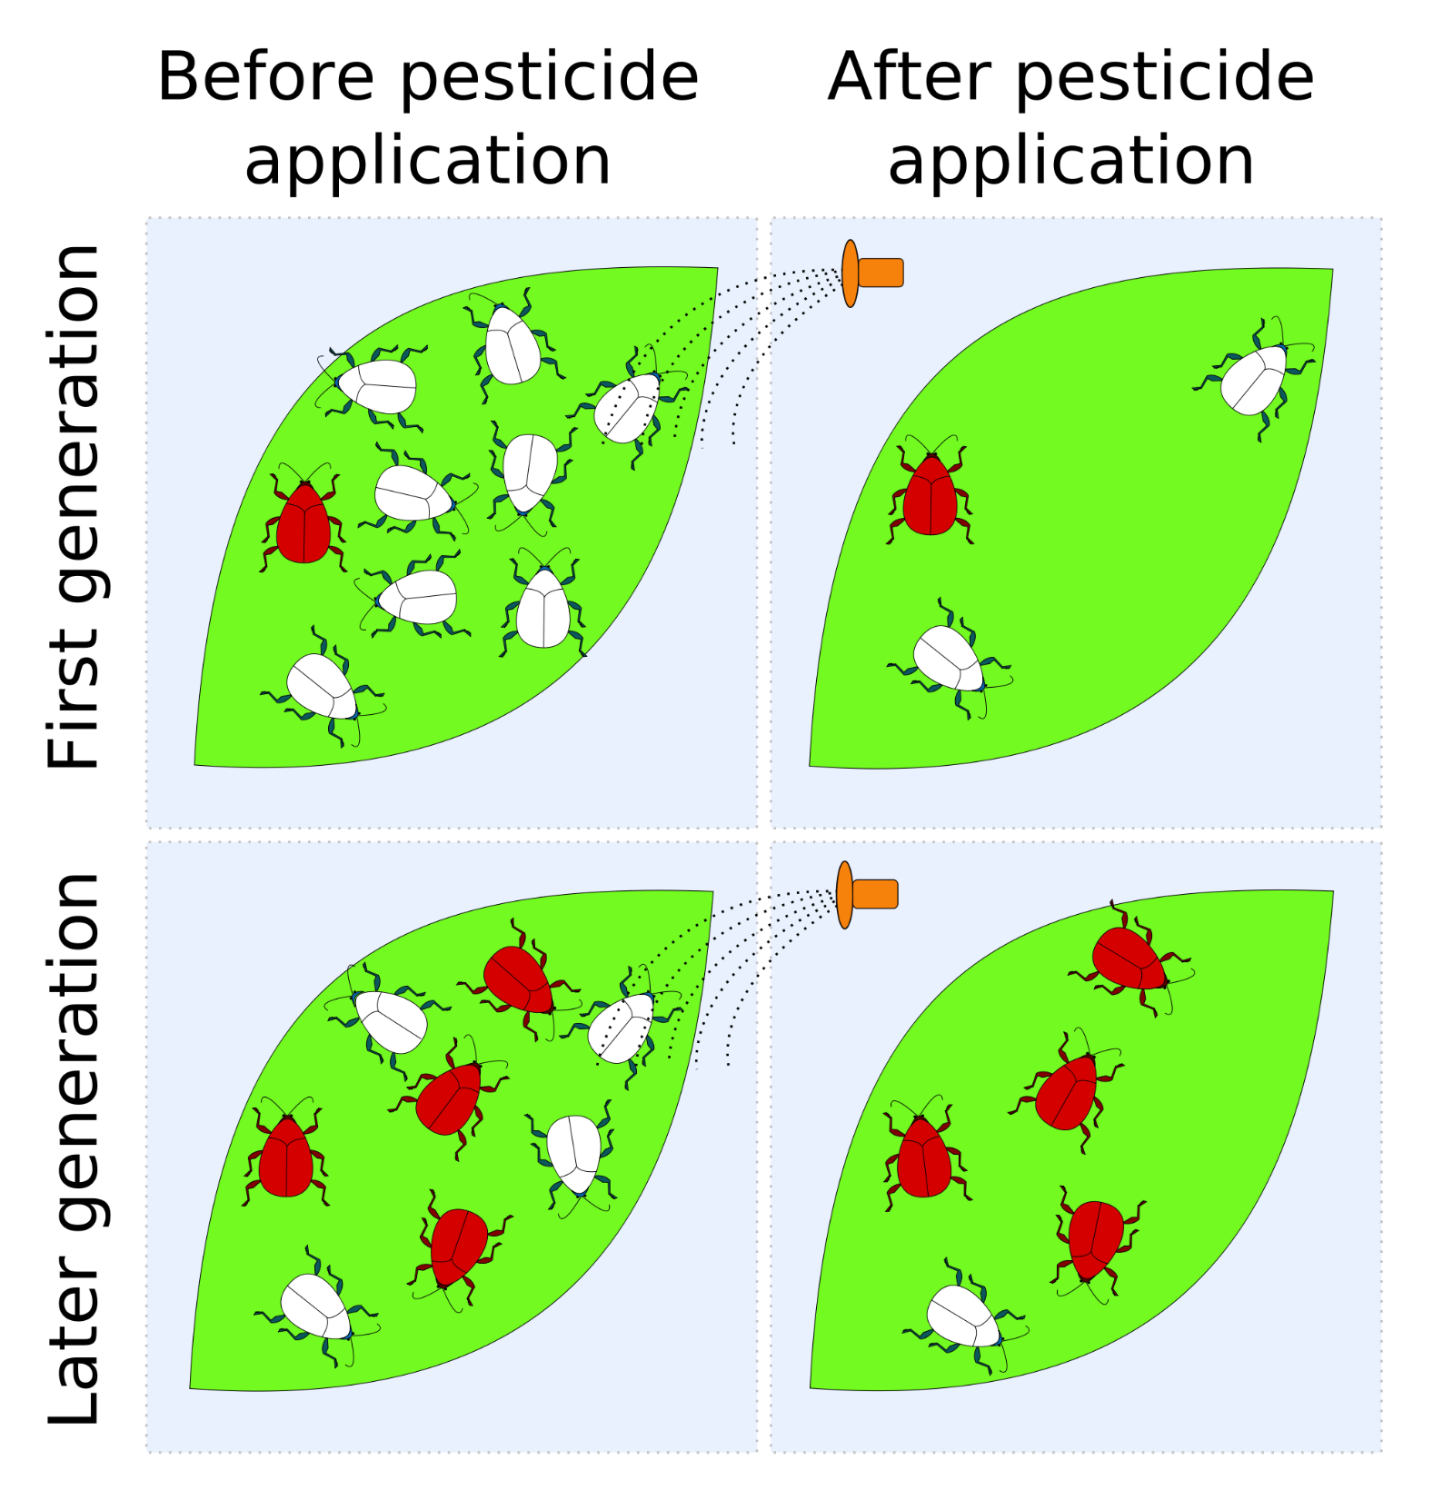
Natural Selection just selects!
It cannot produce new genes or new species

Slide 55
Don’t Deny the Evidence
Accept the evidence and investigate how it might support the Bible
Don’t bury or deny scientific evidence – that leads to a blind faith
G

Slide 56
Evolutionists can accommodate change or no change
If evidence shows change over time, then that is evidence of the positive changes of evolution
If evidence shows no change over time, then that indicates there is no need for evolution
Either way, the evidence is interpreted to support evolution

Slide 57
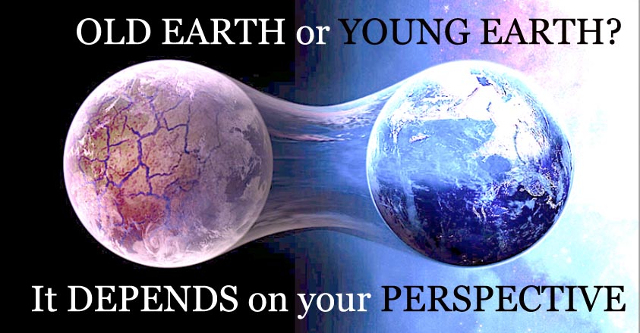

Slide 58
2
W
17
!

Slide 59
2
W
17
!

Slide 60
2
W
17
!

Slide 61
2
S
G

Slide 62
2
W
17
!

Slide 63
2
S
G

