Slide 1
God Consciousness
Building a relationship with God

Slide 2
Embracing God in your life

Slide 3
God’s presence
“Can any hide himself in secret places that I shall not see him? saith the LORD. Do not I fill heaven and earth? saith the LORD.”
Jer 23:24
“The eyes of the LORD are in every place, beholding the evil and the good”
Prov 15:3
God is everywhere and sees everything

Slide 4
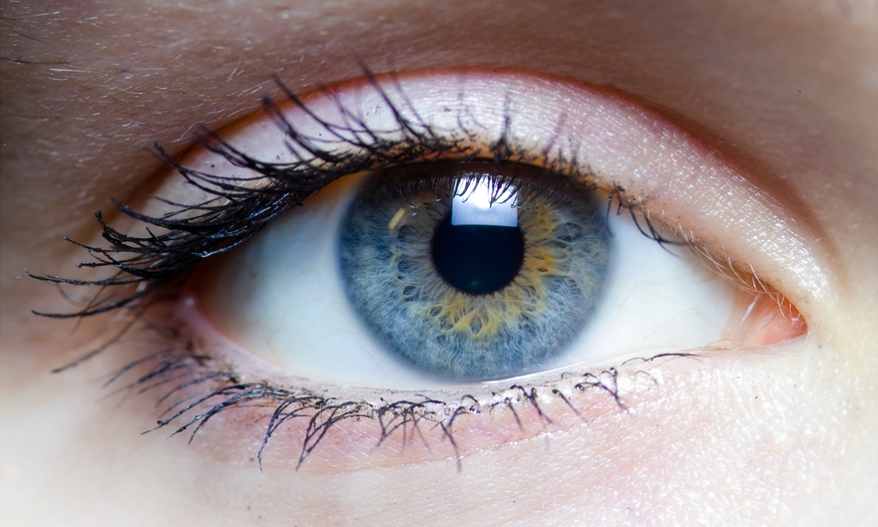


The eye only sees what the mind is prepared to comprehend

Slide 6

God Consciousness
- Building a relationship with God -
d
d
d
d
d
d
Exhort
Being Conscious of God
Class 4 Remembering God
Class 3
Fearing God
Class 2
Knowing God
Being Known of God
Class 1
Embracing God in your life
Knowing God
Build our relationship w/ God by increasing our awareness of Him

Slide 7
Scriptural relevance
“Presence” (lit. face) of God
  Adam and Eve hid from face of God (Gen 3:8) – didn’t work
  Jonah fled from face of God (Jon 1:3) – didn’t work
Eyes of the LORD
  ways of man are before the eyes of the LORD, He ponders all his goings (Prov 5:21)
  Eyes of the LORD roam to and fro in whole earth (Zech 4:10)
  All things are naked and opened unto the eyes… (Heb 4:13)
Sight of the LORD
  Children of Israel did evil in the sight of the LORD (Judges 8x)
  Kings of Israel doing evil in sight of the LORD (>50x)
  Thy Father which seeth in secret (Matt 6:4, 6, 18)
Christ walks in midst of ecclesias (Rev 2:1)
Done it unto least of my brethren, done it unto me (Matt 25:40)
Scripture is full of language driving a consciousness of God

Slide 8
God’s face
Whither shall I go from thy spirit or whither shall I flee from thy presence (lit. face)?
Psa 139:7

Slide 9
Psa 139 - OMNISCIENCE
Emphasized 7x in Psalm (knowledge/know)
  Heb: Yada (6x), da’ath (1x)
Who | Verse | Significance
God | 1 | All-encompassing – everything about David
 | 2 | When David sits/rises – everything he does
 | 4 | Words before he speaks – everything he thinks
David | 6 | Beyond comprehension – Recognition
 | 14 | Purposed for man’s good – Acceptance
 | 23 (2x) | Appeal to know thoughts/intents - Invitation
First 3x speak to God’s omniscience

Slide 10
Psa 139 - OMNISCIENCE
David’s analysis of God’s knowledge
“searched” (v.1) = searching in earth by digging (Gesenius)
Ways that God dug into David:
  Knows everything he does/thinks… even from afar! (v.2)
  Where he goes (v.3)
    “compassest” = scatter/winnow
  In all he does (v.3)
    “acquainted” = inhabit
  Knows every word before he says it (v.4)
God’s knowledge is all encompassing

Slide 11
Psa 139 - OMNISCIENCE
David views himself as trapped!
God’s knowledge was not bound by time nor space!
⁵“Thou hast beset me behind and before, and laid thine hand upon me”
A
B
C
D
^{A} Tsuwr = besiege (21/38x in OT)
^{B} Achowr = time to come → future
^{C} Qedem = time of old → past
^{D} Kaph = palm of hand (Gesenius)
David was besieged! Inside/out, past, present, future…
His whole existence was in the palm of God’s hand!

Slide 12
Psa 139 - omnipresence
God is everywhere present in his creation (v.11-12)
Man thinks | Reality with God
Darkness shall cover me | Night shall be light around me
Darkness hideth | not from thee
Night | shineth as the day
Darkness and light | both alike to thee
Man thinks that darkness conceals
Reality is that God sees all
Everything is fully visible to God

Slide 13
Psa 139 - Providence
God’s provision began from David’s inception
¹³“For thou hast possessed my reins: thou hast covered me in my mother’s womb.”
A
B
C
^{A} qanah = bought/purchased → redemption!
    Boaz: “Buy” field, “purchased” Ruth (Ruth 4:4,5,8,9,10)
^{B} kilyah = kidneys → seat of innermost desires/affections
    God searches the heart and tries the reins (Jer 17:10)
^{C} caqaq = make a hedge → Divine protection in the womb
God purchased David’s heart.
God protected David while still in the womb!

Slide 14
Psa 139 - Providence
God’s provision began from David’s inception
¹⁵“My substance was not hid from thee, when I was made in secret, and curiously wrought in the lowest parts of the earth.”
A
B
^{A} bones/body
    God involved in construction of David’s bones!
^{B} raqam = embroider various materials into 1 product (9x in OT)
    Only ever used regarding tabernacle worship
      Door (Ex 26:36), gate of court (Ex 27:16), girdle (Ex 28:39)
        Blue – Divine thinking (Num 15:38-41)
        Purple – Royalty (Jn 19:2)
        Fine-twined linen – Righteousness (Rev 19:8)
        Scarlet – sin or sin-nature (Isa 1:18)
God was constructing a ‘living tabernacle’ (1 Pet 2:4-10)

Slide 15
Psa 139 - Providence
God’s provision began from David’s inception
16“Thine eyes did see my substance, yet being unperfect; and in thy book all my members were written, which in continuance were fashioned, when as yet there were none of them.”
A
B
^{A} golem = embryo
    All David’s features designed ahead of time by God!
    Written in God’s book (Ex 32:32-33)
^{B} ’like a potter with clay’ (Gesenius)
    Same word when God ‘formed’ Adam (Gen 2:7)
God had a design and shaped each one of us!

Slide 16
Psa 139 - OMNISCIENCE
Emphasized 7x in Psalm (knowledge/know)
  Heb: Yada (6x), da’ath (1x)
Who | Verse | Significance
God | 1 | All-encompassing – everything about David
 | 2 | When David sits/rises – everything he does
 | 4 | Words before he speaks – everything he thinks
David | 6 | Beyond comprehension – Recognition
 | 14 | Purposed for man’s good – Acceptance
 | 23 (2x) | Appeal to know thoughts/intents - Invitation
First 3x speak to God’s omniscience
Last 4x speak to David’s response
Recognize → Accept for good → Invite God into our life

Slide 17
Psa 139 - process
Recognize God knows everything about us and is everywhere
    v. 1, 2, 4
Acknowledge our inability to comprehend God’s ways
    v. 6
Understand God has a purpose in knowing everything about us
    v. 10, 13, 16
Decide to reject or embrace God’s presence in our lives
  Rejection: resentment and continual attempts to flee
    v. 5, 7-9, 11-12
  Embrace: confidence/comfort that God is in our lives
    v. 10, 14, 17-18
Accountability to reject wickedness from our lives
    v. 19-22
Invite God to search us, cleanse us, lead us to the kingdom
    v. 23-24
Knowledge + Humility
Understanding + Believing
Decision
Commitment
Relationship
Righteousness + Eternal Life

Slide 18
Summary
Being conscious of God is fundamental to developing a relationship with God
Our behavior reflects our level of God consciousness
God is everywhere present in His creation
We must run to God in faith, not from Him in fear
Each of us is specially designed to complete God’s plan
We must know & believe God, commit to Him, and work to develop a relationship with Him

Slide 19
Knowing God

Slide 20
God Consciousness
- Building a relationship with God -
d
d
d
d
d
d
Exhort
Being Conscious of God
Class 4 Remembering God
Class 3
Fearing God
Class 2
Knowing God
Being Known of God
Class 1
Embracing God in your life
Knowing God
Build our relationship w/ God by increasing our awareness of Him

Slide 21
Knowing God
“In flaming fire taking vengeance on them that know not God, and that obey not the gospel of our Lord Jesus Christ” (2 Thess 1:8)
“And this is life eternal, that they might know thee the only true God, and Jesus Christ, whom thou hast sent”
(Jn 17:3)
“Nature can tell us God is, because He must be. But nature can tell us no more. It tells us nothing of His being His character, His purpose, His will with regard to man, nor His object in constructing our universe.”
(Christendom Astray p. 133)

Slide 22
Merciful
Rachuwm (adj.)
Only used of God in the Bible* – 13x in OT
Usage connects why God forgives
  Deut 4:31; 2 Chron 30:9; Psa 86:15, 103:8, 111:4, 112:4, 145:8; Joel 2:13; Jonah 4:2 → Genuine appeals for forgiveness
  Neh 9:17,31; Psa 78:38 → No spirit of repentance
    Yet, God still forgave because He is merciful!
Root is Racham (verb) – to cherish, love
  God’s love for His people (Isa 14:1)
  Israel’s enemies who will have no love (‘mercy’) for them
    His people must decide what they will receive!
*Psa 112:4 is possible exception
God not just desire to forgive, it is His character to forgive

Slide 23
Gracious
channuwn (adj.)
Only used of God in the Bible* – 13x in OT
  Ex 22:27, 24:6; 2Chr 30:9; Neh 9:17, 31; Psa 86:15, 103:8; 111:4; 112:4; 116:5; 145:8; Joel 2:13; Jon 4:2
Almost always used with ‘mercy’ – 1 exception
  Grace w/out mercy: Ex 22:27
    Addresses why God will hear the poor – “for I am gracious”
    Grace is showing favor, when nothing one can do to secure it
Mercy almost always used w/ ‘grace’ – 2 exceptions
  Mercy w/out grace: Deut 4:31; Psa 78:38
    Speak of God’s willingness to forgive
*Psa 112:4 is possible exception
Grace speaks of undeserved favor from God
Mercy speaks of God’s forgiveness to those who sin

Slide 24
Merciful + Gracious
New Testament Usage – Decoder verse
Romans 9:15 – “I will have mercy on whom I will have mercy, and I will have compassion on whom I will have compassion.”
- compare -
Ex 33:19 – “will be gracious to whom I will be gracious, and will show mercy on whom I will show mercy”
A
B
A
Mercy = Eleeo (verb) – equivalent of ‘gracious’ in OT
  Sept. most frequently used for ‘to be gracious’ (Thayer)
  Charis (noun) – grace/favor in NT (Lk 1:30, 2:52)
Compassion = Oiktiro (verb) – ‘merciful’ in OT
  ‘forgiveness’ (Col 3:12-13; Heb 10:28)
B
NT usage of mercy/grace follows working definition in OT

Slide 25
Merciful + Gracious
Working Definitions from Scripture:
Merciful = not giving us what we deserve
  God’s forgiveness to those who commit sin
Gracious = giving us what we don’t deserve
  Undeserved favor shown by God toward us
Scriptural Examples
Unforgiving Servant (Matt 18:21-35)
Golden Rule (Luke 6:27-36)
God expects that we forgive and show kindness to others

Slide 26
Merciful + Gracious
Matt 18:21-35: Unforgiving Servant
Initiated by question on ‘limits of forgiveness’ (v.21)
Answers question, ‘how do I develop compassion?’
Man 1: Man owes insurmountable debt
  1 talent (32.3 kg) vs ‘day’s wage’ = 1 denarius (3.9g) Matt 20:2
    1 talent = 23 yrs… 10,000 talent = 230,056 years!
  Appeals for “patience” (v.26)
Master: ‘Moved with compassion’
  Splagchnizomai – lit. to have the bowels yearn
  Jesus experiences and it drives him to action
    Mt 14:14 – heal; 15:32 – feed; 18:27 – forgive; Mk 6:34 – teach
  Expected man to show same grace (v.33), forgiveness (v.35)
God only shows grace/mercy if we do same-from the heart!

Slide 27
Process of grace/mercy
Matt 18
God shows undeserved favor (grace) toward us (v.27)
God demonstrates grace by patiently (longsuffering) forgiving (mercy) us (v.26,27)
We reflect on God’s faithfulness (truth) toward us and develop a deep appreciation (v.32-33)
We identify with plight of others and patiently (longsuffering) have compassion (grace) on them (v.29,33)
We genuinely forgive (mercy) others and are faithfully (truth) obedient to our Heavenly Father (v.35)
Receive
Reflect
Reciprocate
We must wholeheartedly show to others what God shows to us

Slide 28
longsuffering
arek aph (adj.) – used 15x in OT
Lit. “long nose”
  Image of slow inhale/exhale through nostrils
    i.e. ‘take a deep breath’
11x applied to God
  Num 14:18; Neh 9:17; Psa 86:15, 103:8, 145:8; Jer 15:15; Eze 17:3; Joel 2:13; Jonah 4:2; Nah 1:3
    Because God is ‘slow to anger’, not quick to destroy
4x applied to man
  Prov 14:29, 16:32; Eccl 7:8; Prov 15:18
“Let every man be swift to hear, slow to speak, slow to wrath: for the wrath of man worketh not the righteousness of God” (James 1:19-20)

Slide 29
longsuffering
When we are impatient, we react to our circumstances rather than use godly principles to drive our behavior
God is only willing to have patience with us when we show that same patience to others (Matt 18:26, 29, 34)

Slide 30
Abundant in goodness
Rab chesed
248x in OT – used regularly of God and man
Generally refers to acts of kindness shown to someone
Example of goodness: Psalm 107
God’s goodness must generate a response from us!
Our response must be abiding – ‘abundant’ (Hos 6:4,6)
Aspect Emphasized |  | Verses
God’s goodness | What | 1, 8, 15, 21, 31, 43
Answering those in distress | How | 6, 13, 19, 28
People praise, rejoice, give thanks | Response | 1, 8, 15, 21, 31-32, 42
God’s abiding goodness to us →
our abiding goodness to God/others

Slide 31
Abundant in goodness
Rab chesed
God expects we “love mercy (chesed)” (Mic 6:8)
What does this mean?
God not retain anger because He delights in chesed (Mic 7:18)
And be ye kind one to another, tenderhearted, forgiving one another, even as God for Christ’s sake hath forgiven you (Eph 4:32)
When we “love mercy” we look for opportunities to show kindness and be forgiving – we consistently initiate

Slide 32
Abundant in truth
Rab emeth
Occurs 127x in OT and is used to convey 3 things
  God is right
  God is faithful in fulfilling His promises
  God expects faithfulness from those who serve Him
1 Sam 12:21-24
People are to serve God “in truth with all heart” (v.24)
God “will not forsake His people for His great name’s sake” (v.22)
Therefore, they are not to ‘take His name in vain’ (v.21)
God is right, He is faithful → expects us to be faithful to Him

Slide 33
Summary
Knowing God is vital to creating a relationship w/ God
God’s power primarily manifested in who He saves, not in what He destroys
  Mercy: Not giving others what they deserve = forgiveness
  Grace: Showing undeserved kindness
  Patience: Using godly principles to drive behavior instead of reacting
  Goodness: Proactively looking for ways to show kindness
  Truth: Being faithful to the commitment we have made
God’s nature drives Him to show these characteristics toward us. But He will only do so if we show to each other.

Slide 34
Fearing God

Slide 35
God Consciousness
- Building a relationship with God -
d
d
d
d
d
d
Exhort
Being Conscious of God
Class 4 Remembering God
Class 3
Fearing God
Class 2
Knowing God
Being Known of God
Class 1
Embracing God in your life
Knowing God
Build our relationship w/ God by increasing our awareness of Him

Slide 36
Known of god
“But now, after that ye have known God, or rather are known of God, how turn ye again to the weak and beggarly elements, whereunto ye desire again to be in bondage?” (Gal 4:9)
“Nevertheless the foundation of God standeth sure, having this seal, the Lord knoweth them that are his. And, let everyone that nameth the name of Christ depart from iniquity.” (2 Tim 2:19)

Slide 37
Known of god
Abraham
“For I know him, that he will command his children and his household after him, and they shall keep the way of the LORD…” (Gen 18:19)
Moses
“I will do this thing that thou hast spoken: for thou hast found grace in my sight, and I know thee by name.” (Ex 33:17)
“There arose not a prophet since in Israel like unto Moses, whom the LORD knew face to face.” (Deut 34:10)

Slide 38
Fear of god
Final words of Joshua
“Now therefore, fear the LORD, and serve Him in sincerity and in truth…” (Josh 24:14)
Final words of Samuel’s tenure
“Only fear the LORD, and serve Him in truth with all your heart: for consider how great things He hath done for you.” (1 Sam 12:24)
Final words of Solomon
“Let us hear the conclusion of the whole matter: Fear God and keep His commandments…” (Eccl 12:13)

Slide 39
What is “fear”?
Fear of God
Fear of God is the starting line
  “Fear of LORD is beginning of knowledge” (Prov 1:7)
  “Fear of LORD is beginning of wisdom” (Prov 9:10)
Meaning of ‘fear’
  Fear of dread – terrified
    Not what God desires of saints – “Fear not!”
      Gen 15:1; 26:24; 46:3; Dan 10:2…
  Fear of reverence – deep respect
    This is what God desires
Reverential fear of God is the starting line!

Slide 40
What is “fear of god”?
Aspects and Implications of Godly Fear
Prov 8:13
“Hate evil: pride, arrogance, the evil way, perverted speech”
  Separate ourselves from evil
Psa 34:11-18
Don’t speak wickedly/dishonestly
Separate from evil, do good, seek peace (cp Amos 5:15; Gal 5:16)
  Eternal life (v.12), God’s provision + hear our prayers (v.15)
  Deliverance from affliction (v.17) and trial (v.18)
Prov 3:7-9
Humility, avoid evil
  Honor God by giving Him first and best
Avoid evil, do good, give God first and best!

Slide 41
Obtaining “fear of god”
How do we obtain fear of God?
Deut 17:14,18-20
Personally write out the law (v.18)
Read God’s law ‘every day’ (v.19)
  ‘Learn fear of LORD’ and do His commands humbly (v.20)

Slide 42
Obtaining fear of the Lord
“When all Israel is come to appear before the LORD thy God in the place which He shall choose, thou shalt read this law before all Israel in their hearing.
Gather the people together, men, and women, and children, and thy stranger that is within thy gates, that they may hear, and that they may learn and fear the LORD your God, and observe to do all the words of this law:
And that their children, which have not known anything, may hear, and learn to fear the LORD your God, as long as ye live in the land…”
Deut 31:11-13
Read Bible → Hear → learn Fear of LORD → Obedience

Slide 43
Obtaining “fear of god”
How do we obtain fear of God?
Deut 17:14,18-20
Personally write out the law (v.18)
Read God’s law ‘every day’ (v.19)
  ‘Learn fear of LORD’ and do His commands humbly (v.20)
Deut 31:11-13
Read Bible → Hear → learn Fear of LORD → be obedient
Prov 2:2-5
Apply effort (v.2), pray (v.3), diligent searching (v.4)
  Understand fear of LORD
Humble ourselves, read/study Bible, and be persistent!

Slide 44
Fear of god
What is it?
Separation from evil
Actively pursue/do what is good
Give God our first and best!
What does it do for us?
God’s provision
Hearing of our prayers
Deliverance from this life, leading to eternal life
How do we get it?
Read/study God’s word
Humble ourselves in recognizing He is right
Be persistent in prayer and our desire to understand

Slide 45
Command to kings
3 specific commands to kings in Deut 17
Do not multiply horses (military) – v.16
  Transgression: 2 Chron 9:25-28; 1 Kings 10:26
    4000 stalls for chariots
    12,000 horsemen in chariot cities
  Failing: 1 Kings 11:25
    Weapons finally never secured peace
Do not multiply wives – v.17
  Transgression: 1 Kings 11:1-3
    700 wives and 300 concubines
  Failing: 1 Kings 11:4
    Wives turned away heart from following God
Do not multiply wealth – v. 17
  Transgression: 2 Chron 1:15; 9:27, 1 Kings 10:14, 25-29
    Silver as stones in Jerusalem (10:27)
    Gold rate per year was 666 (10:14)
  Failing: 1 Kings 12:4
    Thy father made our yoke grievous – too much taxation
Solomon did not follow these commands

Slide 46
But why, solomon?
“That his heart be not lifted up above his brethren, and that he turn not aside from the commandment…”
Deut 17:20
Solomon thought that he was above the law
  He was conducting a royal experiment (Eccl 1:13, 16; 2:1-11)
  He could handle it – “by wisdom” (Eccl 1:13; 2:3,9)
  It was for the greater good – solution to this life! (Eccl 1:13)
BUT
Solomon created an empire that engulfed him
Lesson: None of us, no matter how wise, is immune or above the effects of sin!
Fear God and keep His commandments! (Eccl 12:13)

Slide 47
The starting line
“The fear of man will keep a man straight in many things; but in times of temptation - when the eye of man has no bearing - when a man is left only to the power of what is in his own heart - if the fear of God be not there [in his heart], he will go wrong and depart from wisdom to his destruction.
To ‘fear God and do His commandments,’ is Ecclesiastes summary of the whole duty of man.
There is no other rule of wisdom or line of safety. The fear of the Lord is the beginning of wisdom. A man/woman who has not acquired this has not made a beginning on road to life.” (RR 1882, p210)

Slide 48
Known of god
“Then they that feared the LORD spake often one to another: and the LORD hearkened, and heard it, and a book of remembrance was written before Him for them that feared the LORD, and that thought upon His name.
And they shall be mine, saith the LORD of hosts, in that day when I make up my jewels; and I will spare them, as a man spareth his own son that serveth him.
Then shall ye return, and discern between the righteous and the wicked, between him that serveth God and him that serveth Him not.”
Mal 3:16-18

Slide 49
Summary Slide
KEY POINTS – ADD HERE

Slide 50
Remembering God

Slide 51
God Consciousness
- Building a relationship with God -
d
d
d
d
d
d
Exhort
Being Conscious of God
Class 4 Remembering God
Class 3
Fearing God
Class 2
Knowing God
Being Known of God
Class 1
Embracing God in your life
Knowing God
Build our relationship w/ God by increasing our awareness of Him

Slide 52
memory
What are the stages of memory?
Encoding
  Receiving, processing, and combining of new information
Storage
  Creation of permanent record of encoded info in short/long term memory
Recall/Retrieval
  Calling back of stored info in response to cue for use in a process or activity
‘Remembering’ requires all 3 stages of memory

Slide 53
remembrance
Objectives:
Scriptural use of ‘Remembrance’
  Deuteronomy
Danger of Forgetting
  Psalm 10
Examples of Success & Failure
  Joseph, Hagar, Jacob
Benefit of Remembering
  Psalm 103

Slide 54
Remember!
Lessons from Wilderness in Deuteronomy
Aspect to Remember | Action it Drives
Slaves in Egypt but God delivered - (5:15; 15:15 16:3,12; 24:18,22) | Keeping the Sabbath (5:15) Gift when releasing Hebrew (15:15) Keeping the Feasts (16:1,10,16) Providing for poor (24:17,19)
God destroyed Egyptians (7:18 2x) | Overcome fear of inhabitants – God will do it again! (7:17,20-24)
40 years to prove/humble them (8:2) Wealth is b/c of God’s power (8:18) Not for their righteousness given land - Provoked God in Wilderness (9:7) | Keep commands, walk in His ways, fear LORD (8:6) + love Him and serve with all heart/soul (10:12-13)
Treatment by Amalekites (25:17) | Blot out Amalekites (25:19)
Days of trial in Wilderness (32:7) | Teach to next generations (32:46)
‘Remembering’ results in faithful service to God/man

Slide 55
Danger of forgetting (Psa 10)
Wicked vs. Godly – suggested Bible Marking
Wicked
“Wicked” (v. 2,3,4,13,15)
“adversity” (v.6)
“evil” (v.15)
“pride” (v.2,4)
“boasteth” (v.3)
“imagined” (v.2)
“heart’s desire” (v.3)
“his thoughts” (v.4)
“in his heart” (v.6,11,13)
Godly
“poor” (v. 2,8,9,9,10,14)
“fatherless” (v.14,18)
“oppressed” (v.18)
“innocent” (v.8)
“humble” (v.12,17)
“commit… thee” (v.14)
Identity
color
Root
outline
Heart
underline
Thoughts of Wicked and Godly are contrasted in Psa 10

Slide 56
Process of denial (Psa 10)
Wicked gradually becomes emboldened against God
‘thoughts’/’heart’ of the wicked
Denial of God’s existence/presence
  “There is no God” (mg. v.4)
Confident self-reliance
  “I will not be moved” (v.6)
God doesn’t see/care
  “God hath forgotten…He will never see” (v.11)
God won’t punish me for it
  “Thou wilt not require it” (v.13)
Emboldened against God as conscience sears

Slide 57
Danger of forgetting (Psa 10)
Thinking of the Wicked does not match reality
Wicked think | But reality is
“God hath forgotten” (v.11) | “forget not!” (v.12)
“He will never see it” (v.11) | “thou hast seen it” (v.14)
“I shall not be moved” (v.6) | “Requite it…” (v.14)
“I shall never be in evil” (v.6) | “Break… arm…evil” (v.15)
“Thou wilt not require (darash)” (v.13) | “Seek (darash) out” (v.15)
Despite contrary appearance, God sees, hears, and will require the thoughts, words, and deeds of His creation

Slide 58
Examples of success & failure
God consciousness in real-life examples
Overcoming temptation – Joseph
Committing to God – Hagar
Relying on God – Jacob

Slide 59
Joseph
God consciousness: facing temptation
Successful in Egypt b/c God was with him
  Gen 39:2, 3, 3, 5, 5, 21, 23
Shared his faith with others
  39:3 – Potiphar recognizes God is with Joseph
  39:14,17 – Joseph is called “Hebrew”
Conscious of God’s presence and accountability to Him
  Sin against God (39:9). See also 40:8; 41:16, 51-52; 45:5,7,8,9; 50:20
God Consciousness shown by actions during temptation
  Does not get close to her (39:10 cp. Rom 13:14; Psa 101:3)
  “left, fled, got him out” (39:12, 13, 15, 18) cp. to 1 Cor 6:18
Sees God’s presence in trials w/ brethren
  Could see God’s hand in mistreatment by others (50:19-20)
When faced with temptation, we must remember Joseph:
Sin is against God, make no provision for the flesh, God sees all!

Slide 60
Hagar
God consciousness: deciding to commit
Naturally, was a slave of Egypt (i.e. sin)
  16:1,3,8; 21:9,10,13
Fled from household of faith… her name means ‘flight’
  16:6, 8 – usurped her role [‘despised’ (v.4) = ‘cursed’ (12:3)]
God ‘hears’ her and ‘finds’ her in wilderness
  16:7, 11 – (Ishmael = “God shall hear” cp. 21:17,19,20)
God instructs her to ‘return’ and ‘submit’
  16:9 – repent and be obedient in household of faith
Recognizes God’s presence
  16:13, 14 (Beerlahairoi = “well of him that lives and sees me”)
Is never converted, son persecutes promised seed
  21:9, 10 – cp. to Gal 4:25, 29, 30
When God calls, we must repent and obey – we decide!

Slide 61
Jacob
God consciousness: Relying on God
Yahweh is in this place and I knew it not! (Gen 28:16)
Summarizes life based on God’s providence
  Gen 48:3-4 – God Almighty appeared to me
  48:15 – God, before (paniym) whom my fathers… did walk
  48:15 – God which fed me all my life
  48:16 – Angel which redeemed me from all evil
Wrestles with his faith, but prevails over self
  Gen 32:25-28 – hip put out of joint, clings to God for blessing
  32:28 – becomes prince with God (Hos 12:3-4)

Slide 62
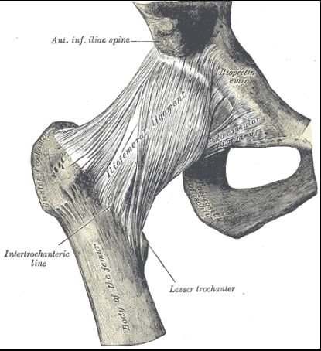
Jacob
Strongest ligament in entire body!
Tensile strength > 350kg (772lbs)

Slide 63
Jacob
God consciousness: Relying on God
Yahweh is in this place and I knew it not! (Gen 28:16)
Summarizes life based on God’s providence
  Gen 48:3-4 – God Almighty appeared to me
  48:15 – God, before (paniym) whom my fathers… did walk
  48:15 – God which fed me all my life
  48:16 – Angel which redeemed me from all evil
Wrestles with his faith, but prevails over self
  Gen 32:25-28 – hip put out of joint, clings to God for blessing
  32:28 – becomes prince with God (Hos 12:3-4)
Walks before God in God’s strength
  32:30 – Peniel = “face of God”
  32:31 – Physically weakened, but faith made strong (2 Cor 12:9)
Must learn to see God’s providence in all aspects of life
True reliance on God is often when our strength removed

Slide 64
Practical examples
God consciousness in real-life examples
Overcoming temptation - Joseph
  Sin is against God, make no provision for the flesh, God sees all
  No matter how others behave, God is at work
Committing to God - Hagar
  When God calls, must repent, be baptized, obey – we decide!
Relying on God - Jacob
  Must learn to see God’s providence in all aspects of life
  True reliance on God is often when our strength removed
God consciousness drives behavior/relationship with God
We must remember!!

Slide 65
Benefit of remembering
(Psalm 103)
Our attitude toward God
Bless the LORD (v. 1, 2, 20, 21, 22, 22)
Forget not! (v.2)
God’s Benefits
Forgiveness (v.2,9,10,12)
Healing (v.3)
Redemption (v.4)
Kindness + mercy (v.5)
Source of Benefits – God’s character
Mercy (v.8, 11, 17)
Gracious, patient (v.8)
Omniscience (v.14)
Daily provision (v.5)
Justice for oppressed (v.6)
Pity (v.13)
Remembers (v.14)
Righteous (v.17)

Slide 66
Benefit of remembering
(Psalm 103)
Requirements to Receive – Relationship!
Fear Him (v.11, 13, 17)
Keep His covenant (v.18)
Remember His commandments → do them (v.18)
Do commandments, listen to word, study (v.20, 21)
Our Response
Bless the LORD (v.1, 2, 20, 21, 22, 22)
Forget not! (v.2)
We must not forget all God does for us!

Slide 67
warnings
“And then will I profess unto them, I never knew you: depart from me ye that work iniquity.”
(Matt 7:23)
“Lord, Lord, open to us. But he answered and said, ‘Verily I say unto you, I know you not.’”
(Matt 25:11-12)

Slide 68
encouragement
“But unto you that fear my name shall the Sun of righteousness arise with healing in his wings; and ye shall go forth, and grow up as calves of the stall.
And ye shall tread down the wicked; for they shall be ashes under the soles of your feet in the day that I shall do this, saith the LORD of hosts.
Remember ye the law of Moses my servant, which I commanded unto him in Horeb for all Israel, with the statutes and judgments.”
Mal 4:2-4
Fear the LORD and Remember to keep His commandments!
Always be conscious of Him in our lives…

Slide 69
Summary Slide
KEY POINTS – ADD HERE

Slide 70
Class 6
Workshop: Bible Characters

Slide 71
God’s ‘Reminders’
Rainbow (Gen 9:15)
  everlasting covenant to not destroy the earth with a flood
Passover (Ex 13:3, Deut 16:3)
  Deliverance from Egypt and redemption from sin
  Sabbath (Ex 20:8; Deut 5:15)
  Slavery in Egypt and God’s deliverance of them
Blue fringe (Lev 15:38-40)
  Commands of LORD, to do them, seek not after own heart and own eyes, and be holy (i.e. separate)
Shewbread (Lev 24:7)
  Israelite as a living sacrifice unto God
  Feasts (Deut 16:12)
  bondage in Egypt
Bread/Wine (1 Cor 11:24-25)
  Life, death, and resurrection of Jesus
Remembering must be a part of our daily life!

Slide 72
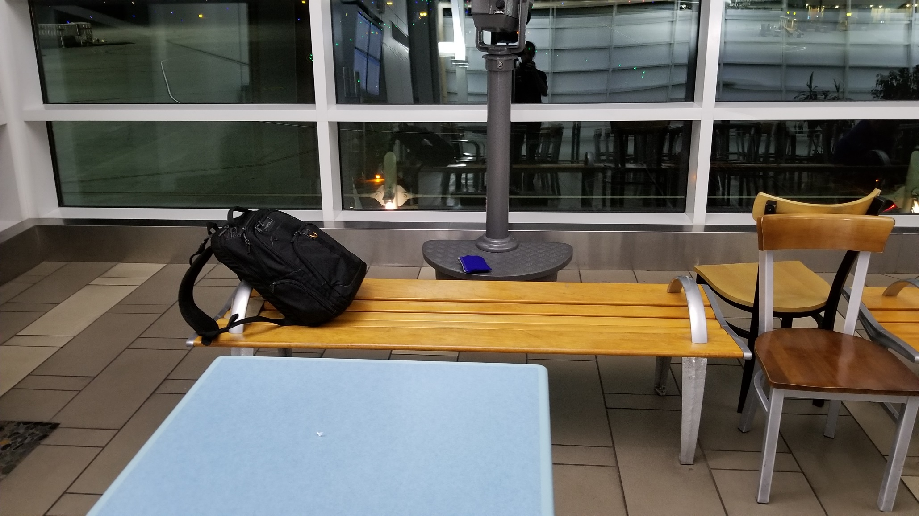
Gen 28:16…

Slide 73
Remember!
Lessons from Wilderness in Deuteronomy
Aspect to Remember | Action it Drives
Slaves in Egypt but God delivered - (5:15; 15:15 16:3,12; 24:18,22) | Keeping the Sabbath (5:15) Gift when releasing Hebrew (15:15) Keeping the Feasts (16:1,10,16) Providing for poor (24:17,19)
God destroyed Egyptians (7:18 2x) | Overcome fear of inhabitants – God will do it again! (7:17,20-24)
40 years to prove/humble them (8:2) Wealth is b/c of God’s power (8:18) Not for their righteousness given land - Provoked God in Wilderness (9:7) | Keep commands, walk in His ways, fear LORD (8:6) + love Him and serve with all heart/soul (10:12-13)
Treatment by Amalekites (25:17) | Blot out Amalekites (25:19)
Days of trial in Wilderness (32:7) | Teach to next generations (32:46)
‘Remembering’ results in faithful service to God/man

Slide 74
Don’t forget!
Lessons from Wilderness in Deuteronomy
Aspect to ‘Forget Not’ | Consequence
God’s provision in Wilderness (4:9) | Scattered in the earth (4:24-27) Destroyed from earth (6:15)
Their covenant with God (4:23)
God saved them from Egypt (6:12)
God’s provision in Land – (8:11,14,19) | Heart lifted up in pride (8:14) Serve other gods/destroyed (8:19-20)
Provoking God in Wilderness (9:7) | Destruction (9:8,14,19-20,25)
Declaration at firstfruits – ‘I have not forgotten’ (26:13) | Blessing of God (26:15)
Song of Moses (31:21) | Witness when forget God (31:21)
Mindful of God’s provision (32:18) | God hide His face from them (32:20)
‘Forgetting’ → behavior that excludes us from kingdom

Slide 75
Abraham
God consciousness: friendship with God
Enters into a relationship with God (17:2,4,7,10,11)
  Gen 17:1 – based on walking before God’s face in perfection
  Gen 22:1,11 – “Here am I” – when God called
Characterized as “friend of God”
  2 Chr 20:7; Isa 41:8; James 2:23
  Jn 15:12-15 – friendship based on doing God’s commands
    Friend is told intent and secrets (v.15)
Angel declares reason for friendship (Gen 18:17-19)
  ‘I know him’ – life consistently faithful (Gen 12,13,14,15,17)
  ‘He will command’ – continue to instruct household in future
  ‘they shall keep’ – guarding truth by doing right
Friendship with God is based on consistent obedience
God will reveal His will to us if we are His friends

Slide 76
summary
What are we to learn from the Name of God?
Aspect | God does | God expects of us
Merciful + Gracious | - Not give us what we deserve → forgives - Give us what we don’t deserve → favor | - Forgive others as He forgives… from heart (Lk 6:36; Mt 18:35) - Care for others… even if don’t deserve and can’t repay • (Lk 6:27-35; Mt 18:33)
Longsuffering | - Continue to be merciful and gracious (despite repeated failures) | - Be patient with others by forgiving others without limits • (Mt 18:21-22,29)
Goodness + Truth | - Answer prayers, delivers us, provides needs • (Psa 107, 136) - Defines what is right and faithfully keeps His promises | - ‘Love’ to show kindness and forgiving others • (Mic 6:8; Eph 4:32) - Faithfully uphold God’s Truth • (Zech 7:9)
God expects us to reflect on His Name and manifest Him

