Slide 1
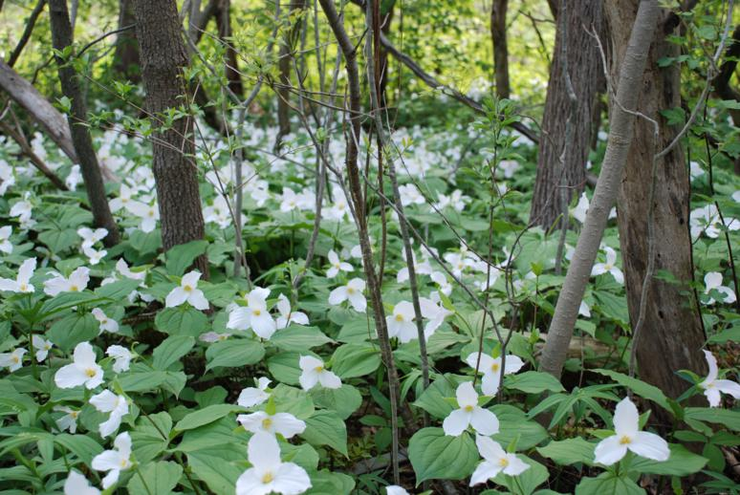
Whatshan Lake Bible School – 2018
Class 2: “The Peace of God”

Slide 2
Finding “The God of Peace”
Review of Class 1
The Scriptures were written for our investigation.
YHWH is “The God of Peace”.
Peace involves harmony.
YHWH uses the process of chastening to warn us of behaviour that needs correction.
He expects us to be able to detect it in our lives and respond.
YHWH works with the principle “turn unto me and I will turn unto you” to restore harmony.
We are directed to “follow peace”.
The Lord Jesus Christ now comforts us with the words: “Peace I leave with you, my peace I give unto you”

Slide 3
“The Peace of God”
(Our Classes for the Week)
Class 1: “I make peace” (Isaiah 45:7)
Class 2: “The peace of God” (Philippians 4:6-7)
Class 3: “No peace … to the wicked” (Isaiah 57:19-21)
Class 4: “Go in peace” (Mark 5:33-34)
Class 5: “Peace with one another” (Mark 9:49-50)
Class 6: “The Peace of Jerusalem” (Psalm 122:6-9)

Slide 4
“The God of Peace” is Active
Romans 15:33 KJV “Now the God of peace be with you all. Amen.”
Romans 16:20 KJV “And the God of peace shall bruise Satan under your feet shortly. The grace of our Lord Jesus Christ be with you. Amen.”
2 Corinthians 13:11 KJV “Finally, brethren, farewell. Be perfect, be of good comfort, be of one mind, live in peace; and the God of love and peace shall be with you.”

Slide 5
“The Peace of God”
His Influence
Philippians 4:7 KJV “And the peace of God, which passeth all understanding, shall keep your hearts and minds through Christ Jesus.”
Colossians 3:15 KJV “And let the peace of God rule in your hearts, to the which also ye are called in one body; and be ye thankful.”

Slide 6
Samples of Things that:
Do Not make for peace
Being too busy.
Feeling listless.
Missing the Bible readings.
Over spending.
Sick children.
Forgetfulness.
Unprepared … again.
Being double-minded.
Lacking understanding.
Bad news.

Slide 7
“Sown in peace” … hence ‘peaceable’ in prospect!
James 3:17-18 KJV
17 But the wisdom that is from above is first pure, then peaceable, gentle, and easy to be intreated, full of mercy and good fruits, without partiality, and without hypocrisy.
18 And the fruit of righteousness is sown in peace of them that make peace.

Slide 8
Peaceful Promises:
“All things work together”
Romans 8:27-29 KJV
27 And he that searcheth the hearts knoweth what is the mind of the Spirit, because he maketh intercession for the saints according to the will of God.
28 And we know that all things work together for good to them that love God, to them who are the called according to his purpose.
29 For whom he did foreknow, he also did predestinate to be conformed to the image of his Son, that he might be the firstborn among many brethren.

Slide 9
Peaceful Promises:
“Make a Way to Escape”
1 Corinthians 10:13-14 KJV
13 There hath no temptation taken you but such as is common to man: but God is faithful, who will not suffer you to be tempted above that ye are able; but will with the temptation also make a way to escape, that ye may be able to bear it.
14 Wherefore, my dearly beloved, flee from idolatry.

Slide 10
Peaceful Promises:
“all ministering spirits”
Hebrews 1:13-14 KJV
13 But to which of the angels said he at any time, Sit on my right hand, until I make thine enemies thy footstool?
14 Are they not all ministering spirits, sent forth to minister for them who shall be heirs of salvation?

Slide 11
Searching for “the Peace of God’
Jacob
Genesis 32:10-12 KJV
10 I am not worthy of the least of all the mercies, and of all the truth, which thou hast shewed unto thy servant; for with my staff I passed over this Jordan; and now I am become two bands.
11 Deliver me, I pray thee, from the hand of my brother, from the hand of Esau: for I fear him, lest he will come and smite me, and the mother with the children.
12 And thou saidst, I will surely do thee good, and make thy seed as the sand of the sea, which cannot be numbered for multitude.

Slide 12
Searching for “The God of Peace”
Esau is Peaceable
Genesis 33:9-11 KJV
9 And Esau said, I have enough, my brother; keep that thou hast unto thyself.
10 And Jacob said, Nay, I pray thee, if now I have found grace in thy sight, then receive my present at my hand: for therefore I have seen thy face, as though I had seen the face of God, and thou wast pleased with me.
11 Take, I pray thee, my blessing that is brought to thee; because God hath dealt graciously with me, and because I have enough. And he urged him, and he took it.

Slide 13

Isaiah 26:3 KJV
“Thou wilt keep him in perfect peace, whose mind is stayed on thee: because he trusteth in thee.”

Slide 14
The Peace of God:
“Perfect Peace”
Isaiah 26:3 KJV
3 Thou wilt keep him in perfect peace, whose mind is stayed on thee: because he trusteth in thee.
Mind STR H3336 yêtser
yay'-tser
From H3335; a form; figuratively conception (that is, purpose): - frame, thing framed, imagination, mind, work.
Stayed STR H5564 sâmak saw-mak'
A primitive root; to prop (literally or figuratively); reflexively to lean upon or take hold of (in a favorable or unfavorable sense):
Trusteth STR H982 bâṭach baw-takh'
A primitive root; properly to hie for refuge; figuratively to trust, be confident or sure:

Slide 15
The Peace of God:
“Which passeth all understanding”
Philippians 4:6-7 KJV
6 Be careful for nothing; but in every thing by prayer and supplication with thanksgiving let your requests be made known unto God.
7 And the peace of God, which passeth all understanding, shall keep your hearts and minds through Christ Jesus.
Philippians 4:6-7 ESV
6 Do not be anxious about anything, but in everything by prayer and supplication with thanksgiving let your requests be made known to God.
7 And the peace of God, which surpasses all understanding, will guard your hearts and your minds in Christ Jesus.

Slide 16
Therefore:
“By Prayer and Supplication”
Philippians 4:6-7 ESV
6 Do not be anxious about anything, but in everything by prayer and supplication with thanksgiving let your requests be made known to God.
7 And the peace of God, which surpasses all understanding, will guard your hearts and your minds in Christ Jesus.
Prayer STR G4335 proseuchē
pros-yoo-khay'
From G4336; prayer (worship); by implication an oratory (chapel): - X pray earnestly, prayer.
Supplication G1162 deēsis
Thayer Definition:
1) need, indigence, want, privation, penury
2) a seeking, asking, entreating, entreaty to God or to man

Slide 17
The Peace of God:
“Which Surpasses all Understanding”
Philippians 4:6-7 ESV
6 Do not be anxious about anything, but in everything by prayer and supplication with thanksgiving let your requests be made known to God.
7 And the peace of God, which surpasses all understanding, will guard your hearts and your minds in Christ Jesus.
Surpasses (passeth) G5242
huperechō hoop-er-ekh'-o
From G5228 and G2192; to hold oneself above, that is, (figuratively) to excel; participle (as adjective, or neuter as noun) superior, superiority: - better,
Understanding G3563
Nous nooce
Probably from the base of G1097; the intellect, that is, mind (divine or human; in thought, feeling, or will); by implication meaning: - mind, understanding.
Notes:
1. Yet human understanding is the route we usually first take when dealing with our troubles.

Slide 18
Peace beyond Understanding:
King Hezekiah
Isaiah 37:14-15 KJV
14 And Hezekiah received the letter from the hand of the messengers, and read it: and Hezekiah went up unto the house of the LORD, and spread it before the LORD.
15 And Hezekiah prayed unto the LORD, saying,

Slide 19
A Parallel Thought:
“Above all that we ask or think”
Ephesians 3:16-21 KJV
16 That he would grant you, according to the riches of his glory, to be strengthened with might by his Spirit in the inner man;
17 That Christ may dwell in your hearts by faith; that ye, being rooted and grounded in love,
18 May be able to comprehend with all saints what is the breadth, and length, and depth, and height;
19 And to know the love of Christ, which passeth knowledge, that ye might be filled with all the fulness of God.
20 Now unto him that is able to do exceeding abundantly above all that we ask or think, according to the power that worketh in us,
Notes:
Surpasses i.e. goes beyond simple knowledge

Slide 20
The Peace of God:
“Will guard your hearts”
Philippians 4:6-7 ESV
6 Do not be anxious about anything, but in everything by prayer and supplication with thanksgiving let your requests be made known to God.
7 And the peace of God, which surpasses all understanding, will guard your hearts and your minds in Christ Jesus.
Guard G5432 phroureō froo-reh'-o
From a compound of G4253 and G3708; to be a watcher in advance, that is, to mount guard as a sentinel (post spies at gates); figuratively to hem in, protect: - keep (with a garrison).
Hearts G2588 kardia kar-dee'-ah
Prolonged from a primary κάρ kar (Latin cor, “heart”); the heart, that is, (figuratively) the thoughts or feelings (mind); also (by analogy) the middle: - (+ broken-) heart (-ed).
Notes:
1. This is beyond our ability to understand – all things work together for good, etc.

Slide 21
The Peace of God:
“Will guard your hearts and minds”
Philippians 4:6-7 ESV
6 Do not be anxious about anything, but in everything by prayer and supplication with thanksgiving let your requests be made known to God.
7 And the peace of God, which surpasses all understanding, will guard your hearts and your minds in Christ Jesus.
Minds G3540 noēma no'-ay-mah
From G3539; a perception, that is, purpose, or (by implication) the intellect, disposition, itself: - device, mind, thought.

Slide 22
Wherefore:
“Think on these things”
Philippians 4:8 KJV
8 Finally, brethren, whatsoever things are true, whatsoever things are honest, whatsoever things are just, whatsoever things are pure, whatsoever things are lovely, whatsoever things are of good report; if there be any virtue, and if there be any praise, think on these things.

Slide 23
The God of Peace:
“Shall be with you”
Philippians 4:9 KJV
9 Those things, which ye have both learned, and received, and heard, and seen in me, do: and the God of peace shall be with you.

Slide 24
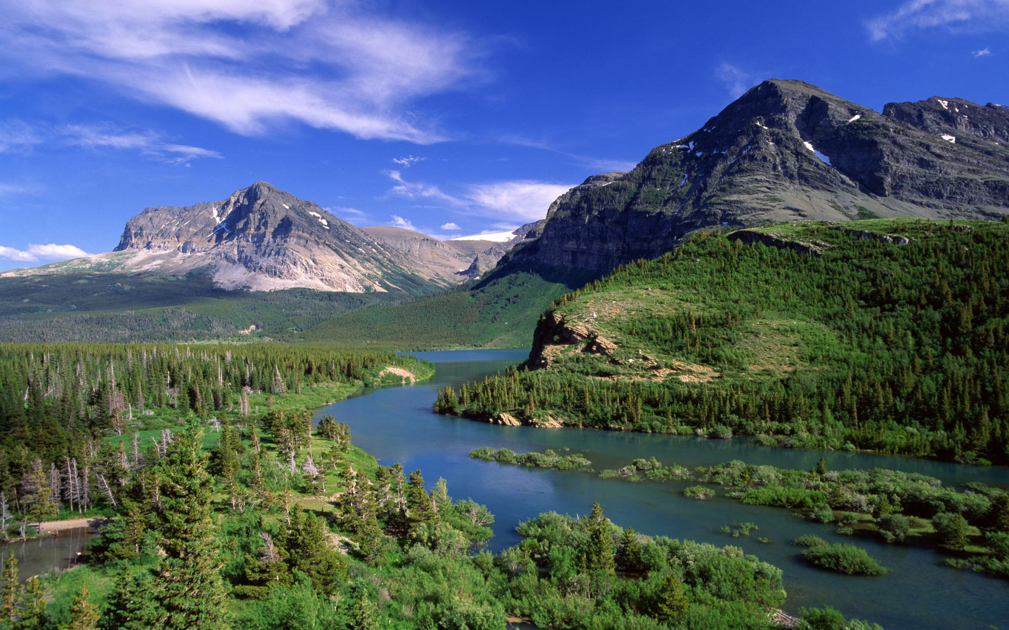
Isaiah 55:12 KJV
“For ye shall go out with joy, and be led forth with peace: the mountains and the hills shall break forth before you into singing, and all the trees of the field shall clap their hands.”

Slide 25
The God of Peace:
“Found of him in peace, without spot”
2 Peter 3:14-15 KJV
14 Wherefore, beloved, seeing that ye look for such things, be diligent that ye may be found of him in peace, without spot, and blameless.
15 And account that the longsuffering of our Lord is salvation; even as our beloved brother Paul also according to the wisdom given unto him hath written unto you;

Slide 26
The God of Peace:
We need to Know Him!
2 Peter 1:2-4 KJV
2 Grace and peace be multiplied unto you through the knowledge of God, and of Jesus our Lord,
3 According as his divine power hath given unto us all things that pertain unto life and godliness, through the knowledge of him that hath called us to glory and virtue:
4 Whereby are given unto us exceeding great and precious promises: that by these ye might be partakers of the divine nature, having escaped the corruption that is in the world through lust.

Slide 27
The work of righteousness:
“Shall be Peace”
Isaiah 32:16-18 KJV
16 Then judgment shall dwell in the wilderness, and righteousness remain in the fruitful field.
17 And the work of righteousness shall be peace; and the effect of righteousness quietness and assurance for ever.
18 And my people shall dwell in a peaceable habitation, and in sure dwellings, and in quiet resting places;

Slide 28
“The God of Peace be with you all”
The Object of Life
Romans 15:33 KJV
33 Now the God of peace be with you all. Amen.

Slide 29
THE END

