Slide 1
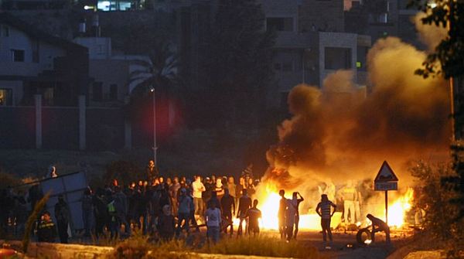
Whatshan Lake Bible School - 2018
Theme: The Peace of God;
Class 3: “No peace to the wicked”

Slide 2
The Peace of God
Summary of Class 2
The Peace of God is ‘sown’.
The God of Peace can bring ‘harmony’ out of chaos.
Jacob prayed for peace according to the promises made to him.
Perfect peace belongs to those who trust YHWH.
The peace of God surpasses understanding.
King Hezekiah prayed for what was humanly ‘impossible.’
The “peace of God” guards our heart and mind.

Slide 3
“The Peace of God”
(Our Classes for the Week)
Class 1: “I make peace” (Isaiah 45:7)
Class 2: “The peace of God” (Philippians 4:6-7)
Class 3: “No peace … to the wicked” (Isaiah 57:19-21)
Class 4: “Go in peace” (Mark 5:33-34)
Class 5: “Peace with one another” (Mark 9:49-50)
Class 6: “The Peace of Jerusalem” (Psalm 122:6-9)

Slide 4

Isaiah 57:20-21 KJV
20 But the wicked are like the troubled sea, when it cannot rest, whose waters cast up mire and dirt.
21 There is no peace, saith my God, to the wicked.

Slide 5
The Thinking of the Natural Man
Is the root of Wickedness
Romans 8:5-8 KJV
5 For they that are after the flesh do mind the things of the flesh; but they that are after the Spirit the things of the Spirit.
6 For to be carnally minded is death; but to be spiritually minded is life and peace.
7 Because the carnal mind is enmity against God: for it is not subject to the law of God, neither indeed can be.
8 So then they that are in the flesh cannot please God.

Slide 6
Due to the timing of Judgment
The wicked defy God!
Ecclesiastes 8:11 KJV
11 Because sentence against an evil work is not executed speedily, therefore the heart of the sons of men is fully set in them to do evil.

Slide 7
Due to the timing of Judgment
The Righteous have nearly slipped!
Psalms 73:1-3 KJV
1 A Psalm of Asaph. Truly God is good to Israel, even to such as are of a clean heart.
2 But as for me, my feet were almost gone; my steps had well nigh slipped.
3 For I was envious at the foolish, when I saw the prosperity of the wicked.
Psalms 73:16-17 KJV
16 When I thought to know this, it was too painful for me;
17 Until I went into the sanctuary of God; then understood I their end.

Slide 8
“No Peace to the wicked”
Those who will not listen
Proverbs 1:28-31 KJV
28 Then shall they call upon me, but I will not answer; they shall seek me early, but they shall not find me:
29 For that they hated knowledge, and did not choose the fear of the LORD:
30 They would none of my counsel: they despised all my reproof.
31 Therefore shall they eat of the fruit of their own way, and be filled with their own devices.

Slide 9
“No Peace to the wicked”
Peace, peace, when there is no peace
Jeremiah 8:10-12 ESV
10 Therefore I will give their wives to others and their fields to conquerors, because from the least to the greatest everyone is greedy for unjust gain; from prophet to priest, everyone deals falsely.
11 They have healed the wound of my people lightly, saying, 'Peace, peace,' when there is no peace.
12 Were they ashamed when they committed abomination? No, they were not at all ashamed; they did not know how to blush. Therefore they shall fall among the fallen; when I punish them, they shall be overthrown, says the LORD.

Slide 10
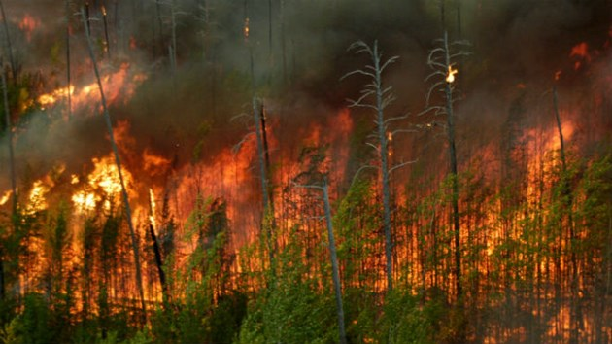
Revelation 6:4 KJV
“And there went out another horse that was red: and power was given to him that sat thereon to take peace from the earth, and that they should kill one another: and there was given unto him a great sword.”

Slide 11
“No Peace to the Wicked”
Pharoah
Exodus 14:5-6 KJV
5 And it was told the king of Egypt that the people fled: and the heart of Pharaoh and of his servants was turned against the people, and they said, Why have we done this, that we have let Israel go from serving us?
6 And he made ready his chariot, and took his people with him:

Slide 12
“No Peace unto the Wicked”
The Syrians Encamped about Samaria
2 Kings 7:6-7 KJV
6 For the Lord had made the host of the Syrians to hear a noise of chariots, and a noise of horses, even the noise of a great host: and they said one to another, Lo, the king of Israel hath hired against us the kings of the Hittites, and the kings of the Egyptians, to come upon us.
7 Wherefore they arose and fled in the twilight, and left their tents, and their horses, and their asses, even the camp as it was, and fled for their life.

Slide 13
“No Peace unto the Wicked”
An Evil Thought - Ahab
1 Kings 22:3 KJV
3 And the king of Israel said unto his servants, Know ye that Ramoth in Gilead is ours, and we be still, and take it not out of the hand of the king of Syria?

Slide 14
No Peace unto the Wicked
“Athaliah … destroyed all the royal seed”
2 Kings 11:1-3 KJV
1 And when Athaliah the mother of Ahaziah saw that her son was dead, she arose and destroyed all the seed royal.
2 But Jehosheba, the daughter of king Joram, sister of Ahaziah, took Joash the son of Ahaziah, and stole him from among the king's sons which were slain; and they hid him, even him and his nurse, in the bedchamber from Athaliah, so that he was not slain.
3 And he was with her hid in the house of the LORD six years. And Athaliah did reign over the land.

Slide 15
“No Peace unto the Wicked”
Ananias & Sapphira
Acts 5:1-3 KJV
1 But a certain man named Ananias, with Sapphira his wife, sold a possession,
2 And kept back part of the price, his wife also being privy to it, and brought a certain part, and laid it at the apostles' feet.
3 But Peter said, Ananias, why hath Satan filled thine heart to lie to the Holy Ghost, and to keep back part of the price of the land?

Slide 16
“No Peace unto the Wicked”
Gog of the land of Magog
Ezekiel 38:10-12 KJV
10 Thus saith the Lord GOD; It shall also come to pass, that at the same time shall things come into thy mind, and thou shalt think an evil thought:
11 And thou shalt say, I will go up to the land of unwalled villages; I will go to them that are at rest, that dwell safely, all of them dwelling without walls, and having neither bars nor gates,
12 To take a spoil, and to take a prey; to turn thine hand upon the desolate places that are now inhabited, and upon the people that are gathered out of the nations, which have gotten cattle and goods, that dwell in the midst of the land.

Slide 17
No Peace unto the Wicked
“My Lord delayeth his coming”
Matthew 24:48-51 KJV
48 But and if that evil servant shall say in his heart, My lord delayeth his coming;
49 And shall begin to smite his fellowservants, and to eat and drink with the drunken;
50 The lord of that servant shall come in a day when he looketh not for him, and in an hour that he is not aware of,
51 And shall cut him asunder, and appoint him his portion with the hypocrites: there shall be weeping and gnashing of teeth.

Slide 18
No Peace unto the Wicked
“eat, drink, and be merry”
Luke 12:17-19 KJV
17 And he thought within himself, saying, What shall I do, because I have no room where to bestow my fruits?
18 And he said, This will I do: I will pull down my barns, and build greater; and there will I bestow all my fruits and my goods.
19 And I will say to my soul, Soul, thou hast much goods laid up for many years; take thine ease, eat, drink, and be merry.

Slide 19
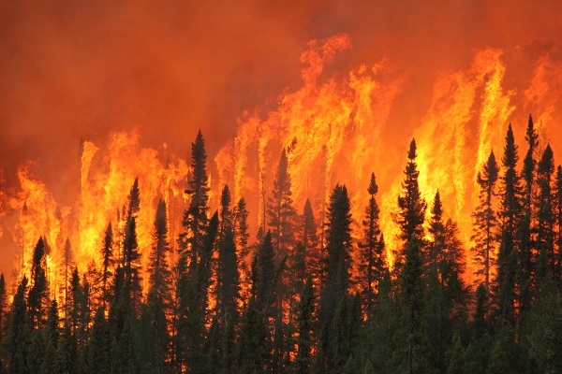
Jeremiah 30:5 KJV
“For thus saith the LORD; We have heard a voice of trembling, of fear, and not of peace.”

Slide 20
Choices on the field of Battle
Elpis Israel; Pg. 113; Brother John Thomas; The Christadelphian
“This is the way the Prince of Peace spoke when on earth. The doctrine he taught is distasteful to the natural mind; and , by the purity of its principles, and astonishing nature of its promises, excites the enmity and incredulity of the flesh. Loving sin and hating righteousness, the carnal mind becomes the enemy and persecutor of those who advocate it. The enmity on the part of the faithless is inveterate: and where they have power, they stir up war even at the domestic hearth. If the believer will agree to be silent, or to renounce his faith, there will then be “peace and love” such as the world, that “loves its own”, is able to afford. But the true believers are not permitted to make any compromise of the kind.”

Slide 21
Choices on the field of Battle
Peace or Division?
Luke 12:51-52 KJV
51 Suppose ye that I am come to give peace on earth? I tell you, Nay; but rather division:
52 For from henceforth there shall be five in one house divided, three against two, and two against three.

Slide 22
Choices on the field of Battle
“I came not to send Peace, but a sword”
Matthew 10:34-39 KJV
34 Think not that I am come to send peace on earth: I came not to send peace, but a sword.
35 For I am come to set a man at variance against his father, and the daughter against her mother, and the daughter in law against her mother in law.
36 And a man's foes shall be they of his own household.
37 He that loveth father or mother more than me is not worthy of me: and he that loveth son or daughter more than me is not worthy of me.
38 And he that taketh not his cross, and followeth after me, is not worthy of me.
39 He that findeth his life shall lose it: and he that loseth his life for my sake shall find it.

Slide 23
Choices on the field of Battle
War between flesh and spirit
Galatians 5:15-18 KJV
15 But if ye bite and devour one another, take heed that ye be not consumed one of another.
16 This I say then, Walk in the Spirit, and ye shall not fulfil the lust of the flesh.
17 For the flesh lusteth against the Spirit, and the Spirit against the flesh: and these are contrary the one to the other: so that ye cannot do the things that ye would.
18 But if ye be led of the Spirit, ye are not under the law.

Slide 24
Choices on the field of Battle
Who can Defy God in this Matter?
Deuteronomy 29:19-20 KJV
19 And it come to pass, when he heareth the words of this curse, that he bless himself in his heart, saying, I shall have peace, though I walk in the imagination of mine heart, to add drunkenness to thirst:
20 The LORD will not spare him, but then the anger of the LORD and his jealousy shall smoke against that man, and all the curses that are written in this book shall lie upon him, and the LORD shall blot out his name from under heaven.

Slide 25
No Peace to the Wicked
“Blessed is the man …”
Psalms 32:1-4 KJV
1 A Psalm of David, Maschil. Blessed is he whose transgression is forgiven, whose sin is covered.
2 Blessed is the man unto whom the LORD imputeth not iniquity, and in whose spirit there is no guile.
3 When I kept silence, my bones waxed old through my roaring all the day long.
4 For day and night thy hand was heavy upon me: my moisture is turned into the drought of summer. Selah.

Slide 26
Peace to the Repentent
… unto whom YHWH imputeth not iniquity”
Psalms 32:5-6 KJV
5 I acknowledged my sin unto thee, and mine iniquity have I not hid. I said, I will confess my transgressions unto the LORD; and thou forgavest the iniquity of my sin. Selah.
6 For this shall every one that is godly pray unto thee in a time when thou mayest be found: surely in the floods of great waters they shall not come nigh unto him.

Slide 27
THE END

