Slide 1
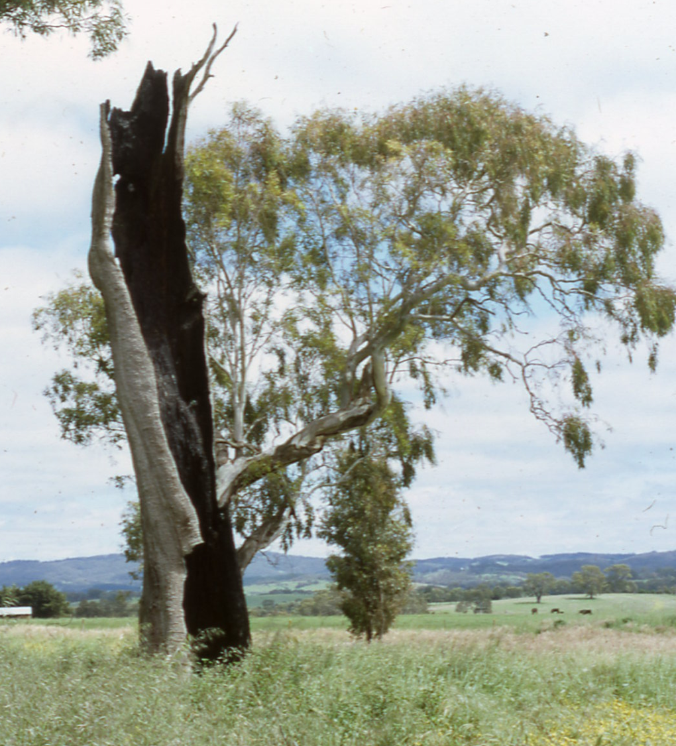
Class 4 “Go in Peace”
Whatshan Lake Bible School - 2018
Theme: The Peace of God
Class 4 “Go in peace!”

Slide 2
The Peace of God
Summary of Class 3
There is no peace to the wicked.
There is no real peace in carnal thinking.
The longsuffering of God can be misunderstood.
Wicked people often become a victim of their own wickedness.
Do we love anything more than our God?
There is an ongoing warfare between flesh and spirit.
“Blessed is the man unto whom YHWH imputeth not iniquity …”

Slide 3
“The Peace of God”
(Our Classes for the Week)
Class 1: “I make peace” (Isaiah 45:7)
Class 2: “The peace of God” (Philippians 4:6-7)
Class 3: “No peace … to the wicked” (Isaiah 57:19-21)
Class 4: “Go in peace” (Mark 5:33-34)
Class 5: “Peace with one another” (Mark 9:49-50)
Class 6: “The Peace of Jerusalem” (Psalm 122:6-9)

Slide 4
Peace: A Blessing from God
Numbers 6:22-27 KJV
22 And the LORD spake unto Moses, saying,
23 Speak unto Aaron and unto his sons, saying, On this wise ye shall bless the children of Israel, saying unto them,
24 The LORD bless thee, and keep thee:
25 The LORD make his face shine upon thee, and be gracious unto thee:
26 The LORD lift up his countenance upon thee, and give thee peace.
27 And they shall put my name upon the children of Israel; and I will bless them.

Slide 5
Blessed with peace
Bless STR H1288 bârak baw-rak'
A primitive root; to kneel; by implication to bless God (as an act of adoration), and (vice-versa) man (as a benefit);
Peace STR H7965 shâlôm shâlôm
shaw-lome', shaw-lome'
From H7999; safe, that is, (figuratively) well, happy, friendly; also (abstractly) welfare, that is, health, prosperity, peace:
Psalms 29:11 KJV
11 The LORD will give strength unto his people; the LORD will bless his people with peace.

Slide 6
“Go in Peace”
1 Samuel 1:14-17 KJV
14 And Eli said unto her, How long wilt thou be drunken? put away thy wine from thee.
15 And Hannah answered and said, No, my lord, I am a woman of a sorrowful spirit: I have drunk neither wine nor strong drink, but have poured out my soul before the LORD.
16 Count not thine handmaid for a daughter of Belial: for out of the abundance of my complaint and grief have I spoken hitherto.
17 Then Eli answered and said, Go in peace: and the God of Israel grant thee thy petition that thou hast asked of him.

Slide 7
“Jonathan said to David, Go in peace …”
1 Samuel 20:42 KJV
42 And Jonathan said to David, Go in peace, forasmuch as we have sworn both of us in the name of the LORD, saying, The LORD be between me and thee, and between my seed and thy seed for ever. And he arose and departed: and Jonathan went into the city.

Slide 8
Elisha to Naaman: “Go in Peace”
2 Kings 5:18-19 KJV
18 In this thing the LORD pardon thy servant, that when my master goeth into the house of Rimmon to worship there, and he leaneth on my hand, and I bow myself in the house of Rimmon: when I bow down myself in the house of Rimmon, the LORD pardon thy servant in this thing.
19 And he said unto him, Go in peace. So he departed from him a little way.

Slide 9

“Go in Peace”

Slide 10
An issue of blood
Leviticus 15:25 KJV
25 And if a woman have an issue of her blood many days out of the time of her separation, or if it run beyond the time of her separation; all the days of the issue of her uncleanness shall be as the days of her separation: she shall be unclean.

Slide 11
A Woman Desperate for Help
Mark 5:24-27KJV
24 And Jesus went with him; and much people followed him, and thronged him.
25 And a certain woman, which had an issue of blood twelve years,
26 And had suffered many things of many physicians, and had spent all that she had, and was nothing bettered, but rather grew worse,
27 When she had heard of Jesus, came in the press behind, and touched his garment.

Slide 12
A Woman Desperate for Help
A Woman
Sick for 12 years
All that time without peace
Unclean by reason of her sickness
Suffered by the hands of the physicians
Had spent all
Was getting worse
Heard of Jesus’ healing
Secretly came to Jesus
Touched his garment

Slide 13
She Believed
Mark 5:28-31 KJV
28 For she said, If I may touch but his clothes, I shall be whole.
29 And straightway the fountain of her blood was dried up; and she felt in her body that she was healed of that plague.
30 And Jesus, immediately knowing in himself that virtue had gone out of him, turned him about in the press, and said, Who touched my clothes?
31 And his disciples said unto him, Thou seest the multitude thronging thee, and sayest thou, Who touched me?

Slide 14
“Go in Peace” (G1515)
Mark 5:32-34 KJV
32 And he looked round about to see her that had done this thing.
33 But the woman fearing and trembling, knowing what was done in her, came and fell down before him, and told him all the truth.
34 And he said unto her, Daughter, thy faith hath made thee whole; go in peace, and be whole of thy plague.

Slide 15
“go in peace”
“The truth was out – in front of all these people too – and she did not care anymore. Let the world know. Their condition was the same as hers; she had been no better than they; no better than the humblest of them. They all needed Christ. She listened and the gracious words came, “Daughter, be of good comfort; your faith has made you whole; go in peace, and be whole of your plague”. His compassion enfolded her and she stood on an island of peace looking at him with grateful eyes.”
Sister Gwyneth Roe; The Woman of the Bible; The Christadelphian; 1982

Slide 16

“Go in Peace”

Slide 17
Basic Understanding & Simple Faith
John 9:30-33 KJV
30 The man answered and said unto them, Why herein is a marvellous thing, that ye know not from whence he is, and yet he hath opened mine eyes.
31 Now we know that God heareth not sinners: but if any man be a worshipper of God, and doeth his will, him he heareth.
32 Since the world began was it not heard that any man opened the eyes of one that was born blind.
33 If this man were not of God, he could do nothing.

Slide 18
A Blind man now at Peace
John 9:35-41 KJV
35 Jesus heard that they had cast him out; and when he had found him, he said unto him, Dost thou believe on the Son of God?
36 He answered and said, Who is he, Lord, that I might believe on him?
37 And Jesus said unto him, Thou hast both seen him, and it is he that talketh with thee.
38 And he said, Lord, I believe. And he worshipped him.

Slide 19
This man could have departed “in peace”
Matthew 19:20-22 KJV
20 The young man saith unto him, All these things have I kept from my youth up: what lack I yet?
21 Jesus said unto him, If thou wilt be perfect, go and sell that thou hast, and give to the poor, and thou shalt have treasure in heaven: and come and follow me.
22 But when the young man heard that saying, he went away sorrowful: for he had great possessions.

Slide 20
This ‘Leper’ did depart “in Peace”
But what about the others?
Luke 17:15-19 KJV
15 And one of them, when he saw that he was healed, turned back, and with a loud voice glorified God,
16 And fell down on his face at his feet, giving him thanks: and he was a Samaritan.
17 And Jesus answering said, Were there not ten cleansed? but where are the nine?
18 There are not found that returned to give glory to God, save this stranger.
19 And he said unto him, Arise, go thy way: thy faith hath made thee whole.

Slide 21
The Peace of Stagnation
The Genius of Discipleship; pg.36; Brother Dennis Gillett; The Christadelphian
“He is not rich necessarily but he is comfortable. He is not worried by the market. Tomorrow’s bread and next year’s holidays give him no cause for concern. He is able to satisfy his desires as they arise. He is never biting his nails about the rent, the mortgage or the bank statement. On the level of day to day needs he is at peace. What are called the cares of life give him no anxiety. He is never upset by controversy because he never bothers to be involved in it. His defense against the spiritual dangers of life is indifference. Ignore them and they will do you no harm. He is never aggravated by his faith being challenged because he never makes it known. So in a certain sense he is at peace – but it is not the peace of God. It is the peace of stagnation.”

Slide 22
The Peace of Human Ambition
The Genius of Discipleship; pg.37; Brother Dennis Gillett; The Christadelphian
“The writer has observed in some people a remarkable sense of peace secured through spending their whole time working. It is often achieved through satisfaction – the satisfaction of drawing near to or reaching a goal; a far-away ambition becoming more possible with every new effort; a spirit that cannot rest if it is compelled for some reason to endure rest.
The pursuit of a cause continually and relentlessly brings a kind of tranquillity. To pause is a reproach. To abandon the work, however briefly, is a disgrace. The only satisfying way to live is to keep working: the peace of toil. Commendable in many ways, but because it is the whole-hearted devotion of life to human ambitions, it cannot be true for the disciple of Christ. Because it is the dedication of human powers to human aims, it cannot be the way of finding the peace of God.”

Slide 23
What ‘agape’ Isn’t
1 Corinthians 13:1-3 KJV
1 Though I speak with the tongues of men and of angels, and have not charity, I am become as sounding brass, or a tinkling cymbal.
2 And though I have the gift of prophecy, and understand all mysteries, and all knowledge; and though I have all faith, so that I could remove mountains, and have not charity, I am nothing.
3 And though I bestow all my goods to feed the poor, and though I give my body to be burned, and have not charity, it profiteth me nothing.

Slide 24
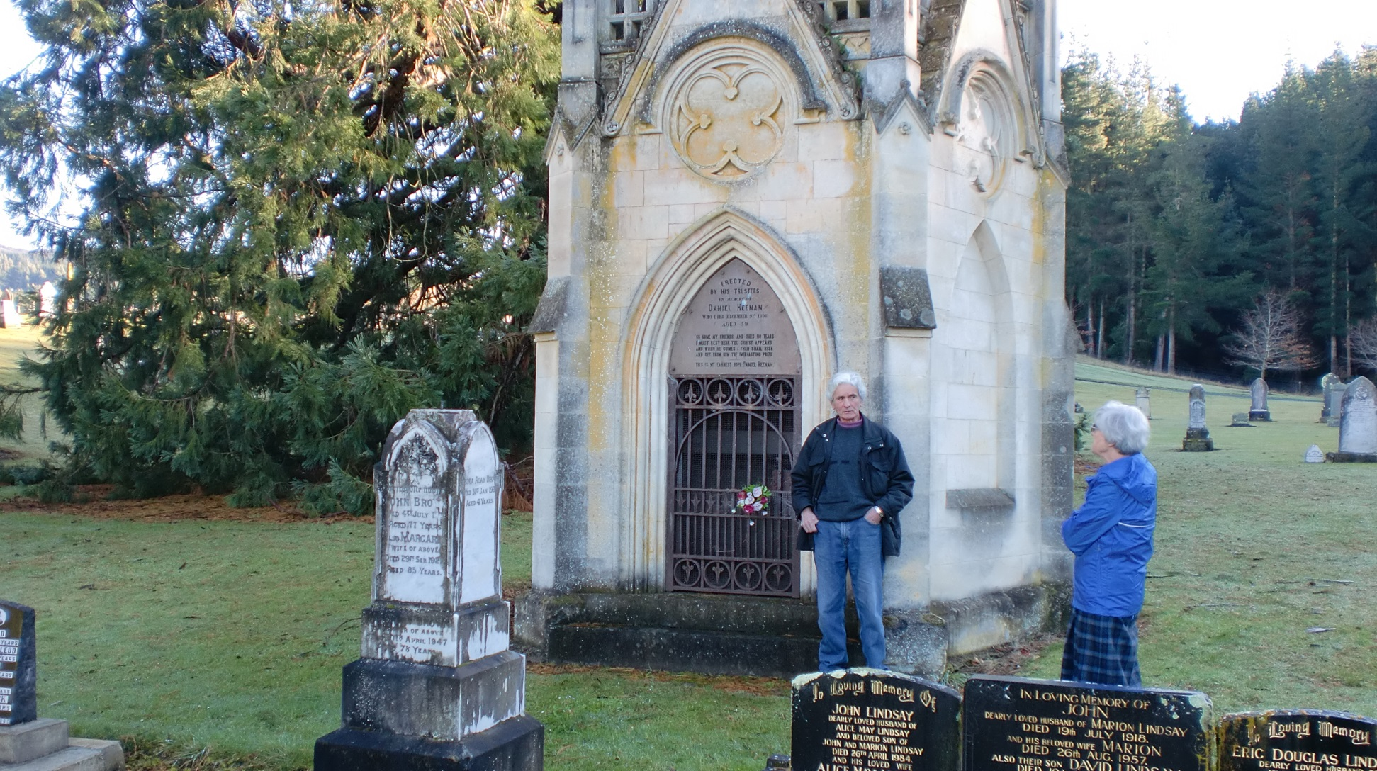
The Memorial of Brother Heenan
Dunedin, New Zealand

Slide 25
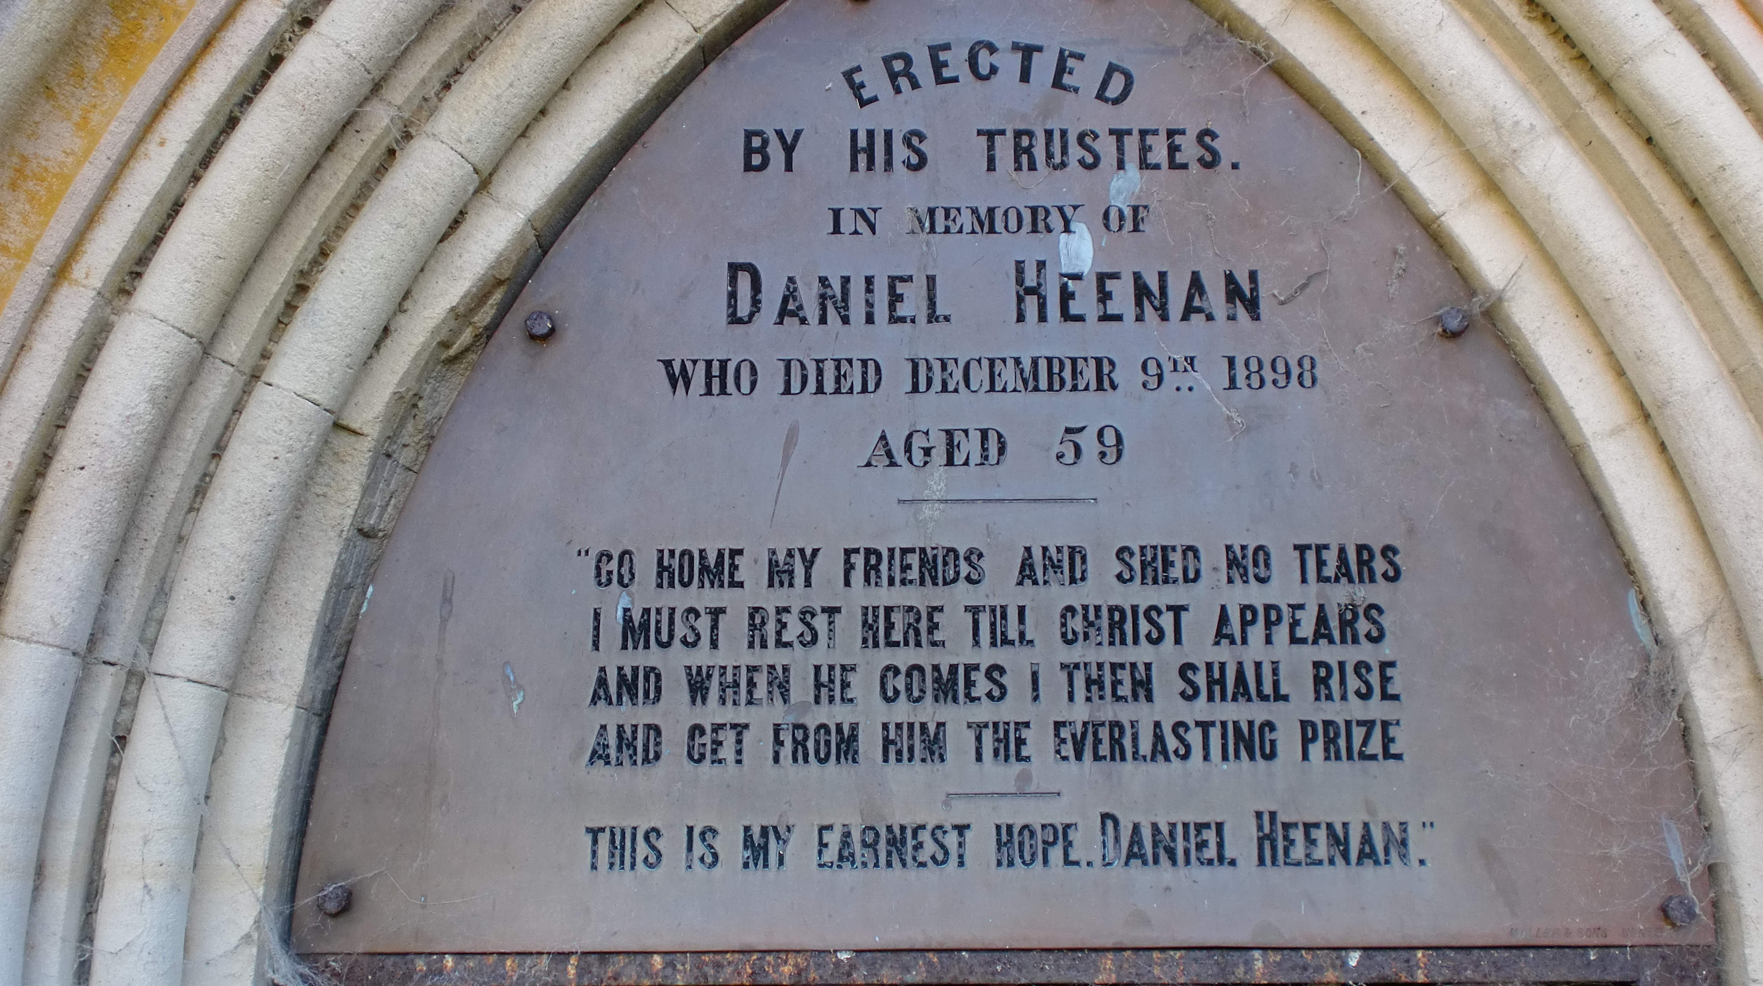
“Go in Peace”

Slide 26
When Human Suffering is Necessary
Understanding Leads to Peace
2 Corinthians 12:7-9 KJV
7 And lest I should be exalted above measure through the abundance of the revelations, there was given to me a thorn in the flesh, the messenger of Satan to buffet me, lest I should be exalted above measure.
8 For this thing I besought the Lord thrice, that it might depart from me.
9 And he said unto me, My grace is sufficient for thee: for my strength is made perfect in weakness. Most gladly therefore will I rather glory in my infirmities, that the power of Christ may rest upon me.

Slide 27
When Forgiveness is at stake
The ‘forgiven’ departs in Peace
John 8:9-11 KJV
9 And they which heard it, being convicted by their own conscience, went out one by one, beginning at the eldest, even unto the last: and Jesus was left alone, and the woman standing in the midst.
10 When Jesus had lifted up himself, and saw none but the woman, he said unto her, Woman, where are those thine accusers? hath no man condemned thee?
11 She said, No man, Lord. And Jesus said unto her, Neither do I condemn thee: go, and sin no more.

Slide 28
Through the 20 years to think it over who lived in peace?
Genesis 50:18-21 KJV
18 And his brethren also went and fell down before his face; and they said, Behold, we be thy servants.
19 And Joseph said unto them, Fear not: for am I in the place of God?
20 But as for you, ye thought evil against me; but God meant it unto good, to bring to pass, as it is this day, to save much people alive.
21 Now therefore fear ye not: I will nourish you, and your little ones. And he comforted them, and spake kindly unto them.

Slide 29
My peace I give unto you
John 14:27-29 KJV
27 Peace I leave with you, my peace I give unto you: not as the world giveth, give I unto you. Let not your heart be troubled, neither let it be afraid.
28 Ye have heard how I said unto you, I go away, and come again unto you. If ye loved me, ye would rejoice, because I said, I go unto the Father: for my Father is greater than I.
29 And now I have told you before it come to pass, that, when it is come to pass, ye might believe.

Slide 30
THE END

