Slide 1
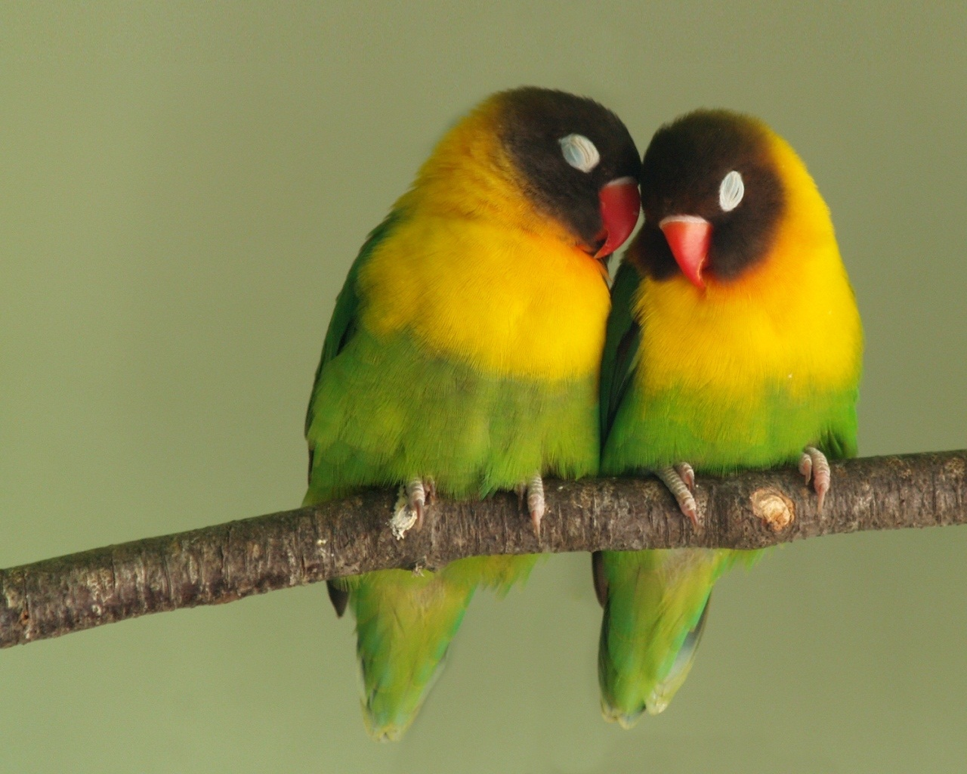
Whatshan Lake Bible School - 2018
Theme: The God of Peace ;
Class 5 “Peace one with another”

Slide 2
The Peace of God
Summary of Class 4
YHWH will bless his people with Peace.
“Go in Peace” after years of conflict.
‘Peace’ by not being involved?
‘Peace’ by working all the time?
Peace and riches?
Peace and thanksgiving.
Sometimes peace comes with a burden to be borne.

Slide 3
“The Peace of God”
(Our Classes for the Week)
Class 1: “I make peace” (Isaiah 45:7)
Class 2: “The peace of God” (Philippians 4:6-7)
Class 3: “No peace … to the wicked” (Isaiah 57:19-21)
Class 4: “Go in peace” (Mark 5:33-34)
Class 5: “Peace with one another” (Mark 9:49-50)
Class 6: “The Peace of Jerusalem” (Psalm 122:6-9)

Slide 4
“The Peace of God”
Baptismal Peace
Ephesians 2:12-14 KJV
12 That at that time ye were without Christ, being aliens from the commonwealth of Israel, and strangers from the covenants of promise, having no hope, and without God in the world:
13 But now in Christ Jesus ye who sometimes were far off are made nigh by the blood of Christ.
14 For he is our peace, who hath made both one, and hath broken down the middle wall of partition between us;

Slide 5
“Peace with one another”
Peace between Jew and Gentile
Ephesians 2:15-17 KJV
15 Having abolished in his flesh the enmity, even the law of commandments contained in ordinances; for to make in himself of twain one new man, so making peace;
16 And that he might reconcile both unto God in one body by the cross, having slain the enmity thereby:
17 And came and preached peace to you which were afar off, and to them that were nigh.

Slide 6
“Peace with one another”
The Great Equalizer
Galatians 3:26-29 KJV
26 For ye are all the children of God by faith in Christ Jesus.
27 For as many of you as have been baptized into Christ have put on Christ.
28 There is neither Jew nor Greek, there is neither bond nor free, there is neither male nor female: for ye are all one in Christ Jesus.
29 And if ye be Christ's, then are ye Abraham's seed, and heirs according to the promise.

Slide 7
“Peace one with another”
The Brotherhood
Hebrews 10:24-25 KJV
24 And let us consider one another to provoke unto love and to good works:
25 Not forsaking the assembling of ourselves together, as the manner of some is; but exhorting one another: and so much the more, as ye see the day approaching.

Slide 8
“Peace with one another”
To what end?
Luke 22:32-34 KJV
32 But I have prayed for thee, that thy faith fail not: and when thou art converted, strengthen thy brethren.
33 And he said unto him, Lord, I am ready to go with thee, both into prison, and to death.
34 And he said, I tell thee, Peter, the cock shall not crow this day, before that thou shalt thrice deny that thou knowest me.

Slide 9
“Peace one with another”
The Brotherhood
Matthew 12:47-50 KJV
47 Then one said unto him, Behold, thy mother and thy brethren stand without, desiring to speak with thee.
48 But he answered and said unto him that told him, Who is my mother? and who are my brethren?
49 And he stretched forth his hand toward his disciples, and said, Behold my mother and my brethren!
50 For whosoever shall do the will of my Father which is in heaven, the same is my brother, and sister, and mother.

Slide 10
“Peace one with another”
Working Together
Nehemiah 3:27-29 KJV
27 After them the Tekoites repaired another piece, over against the great tower that lieth out, even unto the wall of Ophel.
28 From above the horse gate repaired the priests, every one over against his house.
29 After them repaired Zadok the son of Immer over against his house. After him repaired also Shemaiah the son of Shechaniah, the keeper of the east gate.

Slide 11
“Living in peace”
“Striving together”
Philippians 1:27 KJV
27 Only let your conversation be as it becometh the gospel of Christ: that whether I come and see you, or else be absent, I may hear of your affairs, that ye stand fast in one spirit, with one mind striving together for the faith of the gospel;

Slide 12
“Living in peace”
“Striving together”
“Striving together” STR sunathleō
soon-ath-leh'-o
From G4862 and G118; to wrestle in company with, that is, (figuratively) to seek jointly: - labour with, strive together for.
Total KJV occurrences: 2

Slide 13
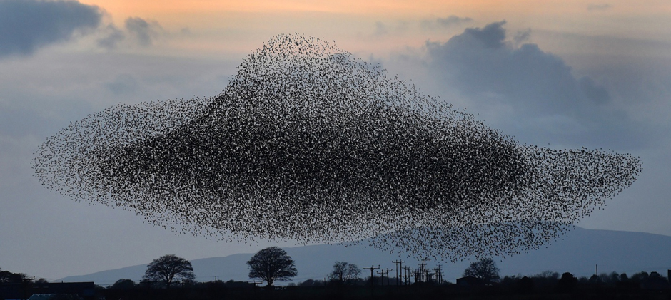
“Peace with one another”

Slide 14
“Have salt in yourselves and have peace one with another”
Mark 9:49-50 KJV
49 For every one shall be salted with fire, and every sacrifice shall be salted with salt.
50 Salt is good: but if the salt have lost his saltness, wherewith will ye season it? Have salt in yourselves, and have peace one with another.

Slide 15
“Have salt in yourselves and have peace one with another”
Proverbs 27:6 KJV
6 Faithful are the wounds of a friend; but the kisses of an enemy are deceitful.

Slide 16
Salt & Peace
A complex Situation
2 Samuel 19:4-5 KJV
4 But the king covered his face, and the king cried with a loud voice, O my son Absalom, O Absalom, my son, my son!
5 And Joab came into the house to the king, and said, Thou hast shamed this day the faces of all thy servants, which this day have saved thy life, and the lives of thy sons and of thy daughters, and the lives of thy wives, and the lives of thy concubines;

Slide 17
“live peaceably with all men”
Romans 12:17-19 KJV
17 Recompense to no man evil for evil. Provide things honest in the sight of all men.
18 If it be possible, as much as lieth in you, live peaceably with all men.
19 Dearly beloved, avenge not yourselves, but rather give place unto wrath: for it is written, Vengeance is mine; I will repay, saith the Lord.

Slide 18
“Be not unequally yoked together”
It brings Compromise
2 Corinthians 6:14-16 KJV
14 Be ye not unequally yoked together with unbelievers: for what fellowship hath righteousness with unrighteousness? and what communion hath light with darkness?
15 And what concord hath Christ with Belial? or what part hath he that believeth with an infidel?
16 And what agreement hath the temple of God with idols? for ye are the temple of the living God; as God hath said, I will dwell in them, and walk in them; and I will be their God, and they shall be my people.

Slide 19
Seeking Peace with Others:
Not for the Naïve!
Acts 20:29-31 KJV
29 For I know this, that after my departing shall grievous wolves enter in among you, not sparing the flock.
30 Also of your own selves shall men arise, speaking perverse things, to draw away disciples after them.
31 Therefore watch, and remember, that by the space of three years I ceased not to warn every one night and day with tears.

Slide 20
Jehoshaphat and Ahab
A Mistake
2 Chronicles 19:1-3 KJV
1 And Jehoshaphat the king of Judah returned to his house in peace to Jerusalem.
2 And Jehu the son of Hanani the seer went out to meet him, and said to king Jehoshaphat, Shouldest thou help the ungodly, and love them that hate the LORD? therefore is wrath upon thee from before the LORD.
3 Nevertheless there are good things found in thee, in that thou hast taken away the groves out of the land, and hast prepared thine heart to seek God.

Slide 21
“Must worship him in spirit and truth”
It brings peace
John 4:22-24 KJV
22 Ye worship ye know not what: we know what we worship: for salvation is of the Jews.
23 But the hour cometh, and now is, when the true worshippers shall worship the Father in spirit and in truth: for the Father seeketh such to worship him.
24 God is a Spirit: and they that worship him must worship him in spirit and in truth.

Slide 22
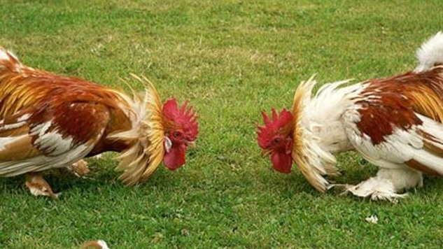
Peace with one another ?

Slide 23
“Blessed are the peacemakers”
Amongst the Disciples
Mark 10:42-44 KJV
42 But Jesus called them to him, and saith unto them, Ye know that they which are accounted to rule over the Gentiles exercise lordship over them; and their great ones exercise authority upon them.
43 But so shall it not be among you: but whosoever will be great among you, shall be your minister:
44 And whosoever of you will be the chiefest, shall be servant of all.

Slide 24
“Blessed are the peacemakers”
Amongst the Disciples
Matthew 5:9 KJV
9 Blessed are the peacemakers: for they shall be called the children of God.

Slide 25
“Peace one with another”
Jonathan and David
1 Samuel 18:1-2 KJV
1 And it came to pass, when he had made an end of speaking unto Saul, that the soul of Jonathan was knit with the soul of David, and Jonathan loved him as his own soul.
2 And Saul took him that day, and would let him go no more home to his father's house.

Slide 26
“Peace one with another”
David and Ittai
2 Samuel 15:19-20 KJV
19 Then said the king to Ittai the Gittite, Wherefore goest thou also with us? return to thy place, and abide with the king: for thou art a stranger, and also an exile.
20 Whereas thou camest but yesterday, should I this day make thee go up and down with us? seeing I go whither I may, return thou, and take back thy brethren: mercy and truth be with thee.

Slide 27
“Peace one with another”
David and Ittai
2 Samuel 15:21-22 KJV
21 And Ittai answered the king, and said, As the LORD liveth, and as my lord the king liveth, surely in what place my lord the king shall be, whether in death or life, even there also will thy servant be.
22 And David said to Ittai, Go and pass over. And Ittai the Gittite passed over, and all his men, and all the little ones that were with him.

Slide 28
“Peace one with another”
Peter and John
Mark 10:35-37 KJV
35 And James and John, the sons of Zebedee, come unto him, saying, Master, we would that thou shouldest do for us whatsoever we shall desire.
36 And he said unto them, What would ye that I should do for you?
37 They said unto him, Grant unto us that we may sit, one on thy right hand, and the other on thy left hand, in thy glory.

Slide 29
“Peace one with another”
Peter and John Later
Acts 4:12-13 KJV
12 Neither is there salvation in any other: for there is none other name under heaven given among men, whereby we must be saved.
13 Now when they saw the boldness of Peter and John, and perceived that they were unlearned and ignorant men, they marvelled; and they took knowledge of them, that they had been with Jesus.

Slide 30
“Peace one with another”
Jeremiah & Ebedmelech
Jeremiah 38:7-9 KJV
7 Now when Ebedmelech the Ethiopian, one of the eunuchs which was in the king's house, heard that they had put Jeremiah in the dungeon; the king then sitting in the gate of Benjamin;
8 Ebedmelech went forth out of the king's house, and spake to the king, saying,
9 My lord the king, these men have done evil in all that they have done to Jeremiah the prophet, whom they have cast into the dungeon; and he is like to die for hunger in the place where he is: for there is no more bread in the city.

Slide 31
“The Things that make for Peace”
Defined by Scripture
Romans 14:17-19 KJV
17 For the kingdom of God is not meat and drink; but righteousness, and peace, and joy in the Holy Ghost.
18 For he that in these things serveth Christ is acceptable to God, and approved of men.
19 Let us therefore follow after the things which make for peace, and things wherewith one may edify another.

Slide 32
THE END

