Slide 1
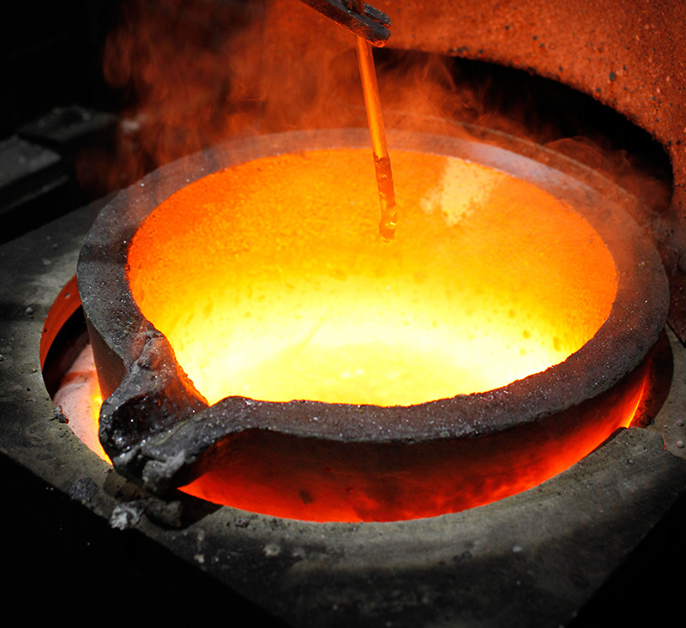
Whatshan Lake Bible School – 2018
.
Class 6 “The Peace of Jerusalem”

Slide 2
“The God of Peace”
Review of Class 1
The Scriptures were written for our investigation.
YHWH is “The God of Peace”.
Peace involves harmony.
YHWH uses the process of chastening to warn us of behaviour that needs correction.
He expects us to be able to detect it in our lives and respond.
YHWH works with the principle “turn unto me and I will turn unto you” to restore harmony.
We are directed to “follow peace”.
The Lord Jesus Christ now comforts us with the words: “Peace I leave with you, my peace I give unto you”

Slide 3
“The Peace of God”
Summary of Class 2
The Peace of God is ‘sown’.
The God of Peace can bring ‘harmony’ out of chaos.
Jacob prayed for peace according to the promises made to him.
Perfect peace belongs to those who trust YHWH.
The peace of God surpasses understanding.
King Hezekiah prayed for what was humanly ‘impossible.’
The “peace of God” guards our heart and mind.

Slide 4
“No peace to the wicked”
Summary of Class 3
There is no peace to the wicked.
There is no real peace in carnal thinking.
The longsuffering of God can be misunderstood.
Wicked people often become a victim of their own wickedness.
Do we love anything more than our God?
There is an ongoing warfare between flesh and spirit.
“Blessed is the man unto whom YHWH imputeth not iniquity …”

Slide 5
“Go in peace”
Summary of Class 4
YHWH will bless his people with Peace.
“Go in Peace” after years of conflict.
‘Peace’ by not being involved?
‘Peace’ by working all the time?
Peace and riches?
Peace and thanksgiving.
Sometimes peace comes with a burden to be borne.

Slide 6
“Have peace one with another”
Summary of Class 5
Peace gained at our baptisms.
“When thou art converted.”
Working together on the walls.
Striving together in the Master’s service.
Have ‘salt in yourselves’ and peace one with another.
Seeking peace is not for the naïve.
“Blessed are the peacemakers.”

Slide 7
“The Peace of God”
(Our Classes for the Week)
Class 1: “I make peace” (Isaiah 45:7)
Class 2: “The peace of God” (Philippians 4:6-7)
Class 3: “No peace … to the wicked” (Isaiah 57:19-21)
Class 4: “Go in peace” (Mark 5:33-34)
Class 5: “Peace with one another” (Mark 9:49-50)
Class 6: “The Peace of Jerusalem” (Psalm 122:6-9)

Slide 8
The Conditions of Peace
The enigma of ‘works’
We cannot do anything to add to the work of our Lord to secure our ‘eternal peace’.
We have become co-workers in ‘maintaining the peace’.
Having secured it we can lose ‘peace’ by not continuing in the work.

Slide 9
At Peace with God
“we are labourers together with God”
1 Corinthians 3:6-9 KJV
6 I have planted, Apollos watered; but God gave the increase.
7 So then neither is he that planteth any thing, neither he that watereth; but God that giveth the increase.
8 Now he that planteth and he that watereth are one: and every man shall receive his own reward according to his own labour.
9 For we are labourers together with God: ye are God's husbandry, ye are God's building.

Slide 10
At Peace with God
“we are labourers together with God”
1 Corinthians 3:9 KJV
9 For we are labourers together with God: ye are God's husbandry, ye are God's building.
“Labourers together” STR
G4904 sunergos
soon-er-gos'
From a presumed compound of G4862 and the base of G2041; a co-laborer, that is, coadjutor: - companion in labour, (fellow-) helper (-labourer, -worker), labourer together with, workfellow.
Total KJV occurrences: 13

Slide 11
At Peace with God
“always labouring fervently for you in prayers ”
Colossians 4:12-13 KJV
12 Epaphras, who is one of you, a servant of Christ, saluteth you, always labouring fervently for you in prayers, that ye may stand perfect and complete in all the will of God.
13 For I bear him record, that he hath a great zeal for you, and them that are in Laodicea, and them in Hierapolis.

Slide 12
We have Surrendered to God
Don’t forget the ‘Conditions of Peace’
Jude 1:5 KJV
5 I will therefore put you in remembrance, though ye once knew this, how that the Lord, having saved the people out of the land of Egypt, afterward destroyed them that believed not.

Slide 13
Principles Governing Peace
Action consistent with Knowledge
James 4:17 KJV
17 Therefore to him that knoweth to do good, and doeth it not, to him it is sin.

Slide 14
Peace in our Ecclesia
Action consistent with our continuing Struggle
Revelation 2:25-27 KJV
25 But that which ye have already hold fast till I come.
26 And he that overcometh, and keepeth my works unto the end, to him will I give power over the nations:
27 And he shall rule them with a rod of iron; as the vessels of a potter shall they be broken to shivers: even as I received of my Father.

Slide 15
Peace in Thyatira
Action consistent with knowledge
Revelation 2:21-23 KJV
21 And I gave her space to repent of her fornication; and she repented not.
22 Behold, I will cast her into a bed, and them that commit adultery with her into great tribulation, except they repent of their deeds.
23 And I will kill her children with death; and all the churches shall know that I am he which searcheth the reins and hearts: and I will give unto every one of you according to your works.

Slide 16
Peace in Philadelphia
Action consistent with Status
Revelation 3:11 KJV
11 Behold, I come quickly: hold that fast which thou hast, that no man take thy crown.

Slide 17
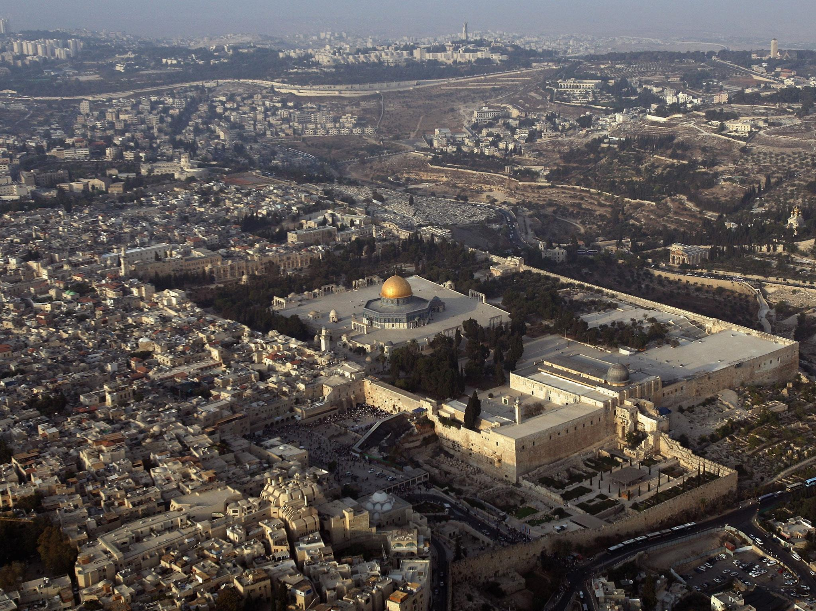
The Peace of Jerusalem
Jeremiah 29:4-7 KJV
4 Thus saith the LORD of hosts, the God of Israel, unto all that are carried away captives, whom I have caused to be carried away from Jerusalem unto Babylon;
5 Build ye houses, and dwell in them; and plant gardens, and eat the fruit of them;
6 Take ye wives, and beget sons and daughters; and take wives for your sons, and give your daughters to husbands, that they may bear sons and daughters; that ye may be increased there, and not diminished.
7 And seek the peace of the city whither I have caused you to be carried away captives, and pray unto the LORD for it: for in the peace thereof shall ye have peace.

Slide 18
The Lord Jesus Christ
“The Prince of Peace”
Isaiah 9:6-7 KJV
6 For unto us a child is born, unto us a son is given: and the government shall be upon his shoulder: and his name shall be called Wonderful, Counsellor, The mighty God, The everlasting Father, The Prince of Peace.
7 Of the increase of his government and peace there shall be no end, upon the throne of David, and upon his kingdom, to order it, and to establish it with judgment and with justice from henceforth even for ever. The zeal of the LORD of hosts will perform this.

Slide 19
The Kings Dilemma:
“If thou hadst known”
Luke 19:40-42 KJV
40 And he answered and said unto them, I tell you that, if these should hold their peace, the stones would immediately cry out.
41 And when he was come near, he beheld the city, and wept over it,
42 Saying, If thou hadst known, even thou, at least in this thy day, the things which belong unto thy peace! but now they are hid from thine eyes.

Slide 20
The Preparation of the King
“The spirit of YHWH shall rest upon him”
Isaiah 11:1-3 KJV
1 And there shall come forth a rod out of the stem of Jesse, and a Branch shall grow out of his roots:
2 And the spirit of the LORD shall rest upon him, the spirit of wisdom and understanding, the spirit of counsel and might, the spirit of knowledge and of the fear of the LORD;
3 And shall make him of quick understanding in the fear of the LORD: and he shall not judge after the sight of his eyes, neither reprove after the hearing of his ears:

Slide 21
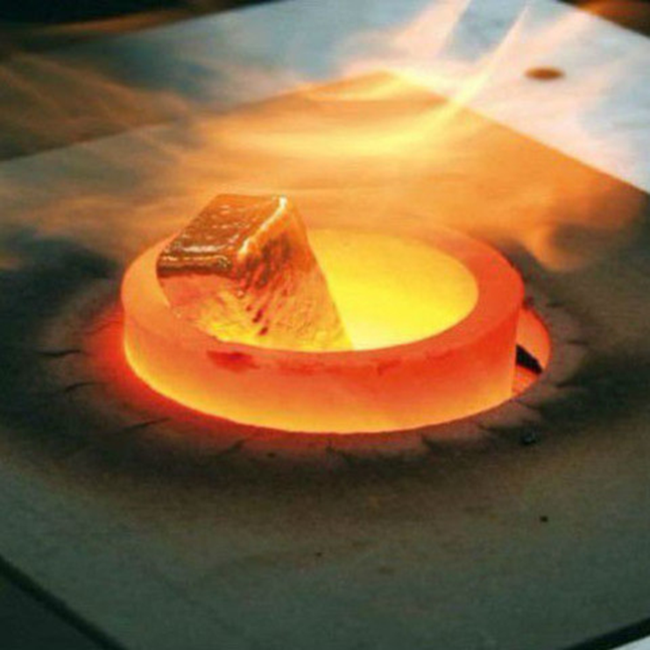
Jerusalem
“a burdensome stone”
Zechariah 12:3 KJV
“And in that day will I make Jerusalem a burdensome stone for all people: all that burden themselves with it shall be cut in pieces, though all the people of the earth be gathered together against it.”

Slide 22
Jerusalem’s Future
“they know not the thoughts of YHWH”
Micah 4:11-13 KJV
11 Now also many nations are gathered against thee, that say, Let her be defiled, and let our eye look upon Zion.
12 But they know not the thoughts of the LORD, neither understand they his counsel: for he shall gather them as the sheaves into the floor.
13 Arise and thresh, O daughter of Zion: for I will make thine horn iron, and I will make thy hoofs brass: and thou shalt beat in pieces many people: and I will consecrate their gain unto the LORD, and their substance unto the Lord of the whole earth.

Slide 23
Judgment first … then Peace
Isaiah 26:9-10 KJV
9 With my soul have I desired thee in the night; yea, with my spirit within me will I seek thee early: for when thy judgments are in the earth, the inhabitants of the world will learn righteousness.
10 Let favour be shewed to the wicked, yet will he not learn righteousness: in the land of uprightness will he deal unjustly, and will not behold the majesty of the LORD.

Slide 24
Jerusalem must fall again!
Zechariah 14:1-3 KJV
1 Behold, the day of the LORD cometh, and thy spoil shall be divided in the midst of thee.
2 For I will gather all nations against Jerusalem to battle; and the city shall be taken, and the houses rifled, and the women ravished; and half of the city shall go forth into captivity, and the residue of the people shall not be cut off from the city.
3 Then shall the LORD go forth, and fight against those nations, as when he fought in the day of battle.

Slide 25
World Government
The Time of Peace
Micah 4:1-2 KJV
1 But in the last days it shall come to pass, that the mountain of the house of the LORD shall be established in the top of the mountains, and it shall be exalted above the hills; and people shall flow unto it.
2 And many nations shall come, and say, Come, and let us go up to the mountain of the LORD, and to the house of the God of Jacob; and he will teach us of his ways, and we will walk in his paths: for the law shall go forth of Zion, and the word of the LORD from Jerusalem.

Slide 26
The Time of Peace
“none shall make them afraid”
Micah 4:3-4 KJV
3 And he shall judge among many people, and rebuke strong nations afar off; and they shall beat their swords into plowshares, and their spears into pruninghooks: nation shall not lift up a sword against nation, neither shall they learn war any more.
4 But they shall sit every man under his vine and under his fig tree; and none shall make them afraid: for the mouth of the LORD of hosts hath spoken it.

Slide 27
Our Peace:
“To Reign with Him for 1000 years”
Revelation 20:6 KJV
6 Blessed and holy is he that hath part in the first resurrection: on such the second death hath no power, but they shall be priests of God and of Christ, and shall reign with him a thousand years.

Slide 28
Human Nature let Free
Peace was Maintained
Revelation 20:2-3 KJV
2 And he laid hold on the dragon, that old serpent, which is the Devil, and Satan, and bound him a thousand years,
3 And cast him into the bottomless pit, and shut him up, and set a seal upon him, that he should deceive the nations no more, till the thousand years should be fulfilled: and after that he must be loosed a little season.

Slide 29
Human Nature is Destroyed
The End of the real Obstacle of Peace
1 Corinthians 15:24-26 KJV
24 Then cometh the end, when he shall have delivered up the kingdom to God, even the Father; when he shall have put down all rule and all authority and power.
25 For he must reign, till he hath put all enemies under his feet.
26 The last enemy that shall be destroyed is death.

Slide 30
“The End of that Man is Peace”
“Because they trust in him”
Psalms 37:37-40 KJV
37 Mark the perfect man, and behold the upright: for the end of that man is peace.
38 But the transgressors shall be destroyed together: the end of the wicked shall be cut off.
39 But the salvation of the righteous is of the LORD: he is their strength in the time of trouble.
40 And the LORD shall help them, and deliver them: he shall deliver them from the wicked, and save them, because they trust in him.

Slide 31

This study of ‘PEACE’
The End of the Beginning

