Slide 1
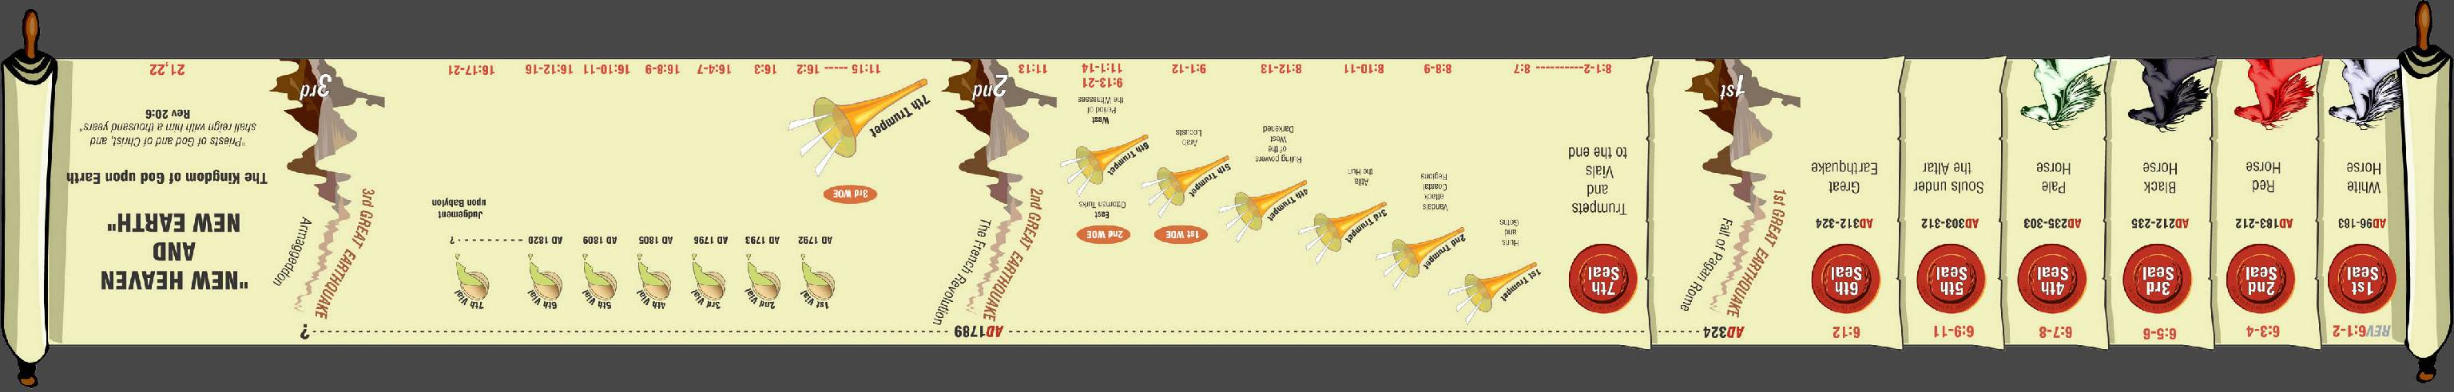
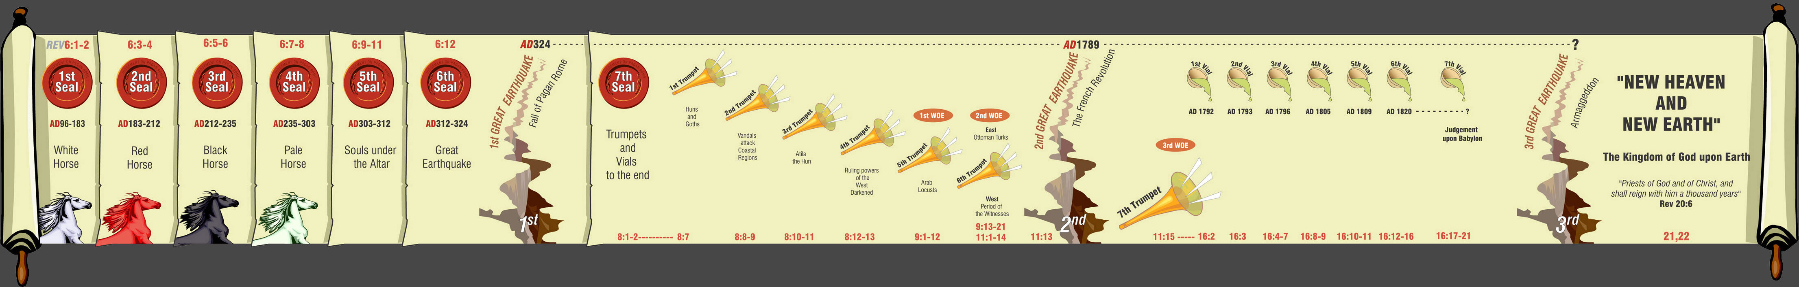
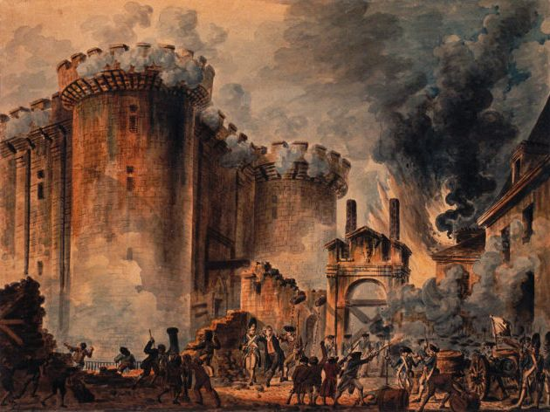

“I will give power unto
my two witnesses”
Study 2
9:13-21
11:1-14
Winfield Bible School 2008
TTG Bible Class 2008
3

Slide 2

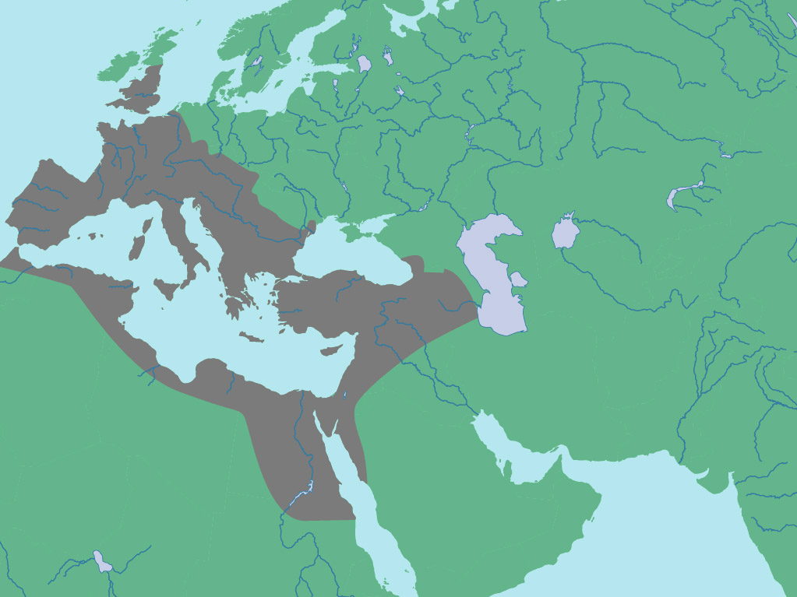
“Behold I come !
Two parts to the 6th Trumpet
Blessed is he that Watcheth”
7
Seals
7
1 2 3 4 5 6
Trumpets
7
1 2 3 4 5 6
Vials
Judgement - Pagan Rome
1 2 3 4 5 6
Judgement - Christian Rome
Rev.6
Judgement- Holy Roman Empire
LATIN WEST
Rev.8 & 9
AD 96 – AD 324
HELLENIC EAST
AD 395 – AD 1685
HELLENIZED EAST
Trumpets 1- 4
AD 1789 – AD 1820
Trumpet 6
Rev.16
Trumpet 5
Armageddon
2

Slide 3
“I will give power unto
my two witnesses”
9:13-21
11:1-14
2
TTG Bible Class 2008
Winfield Bible School 2008
3

Slide 4
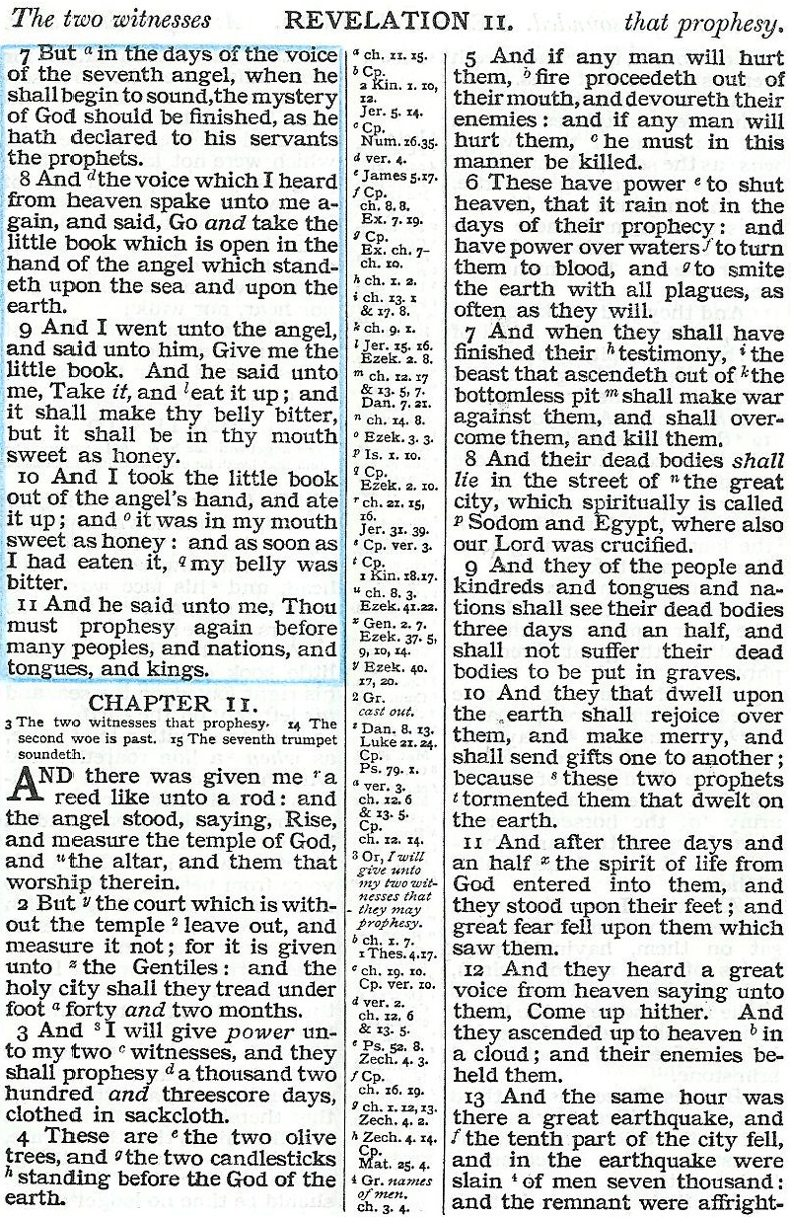

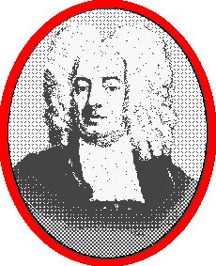
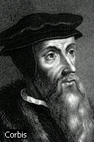
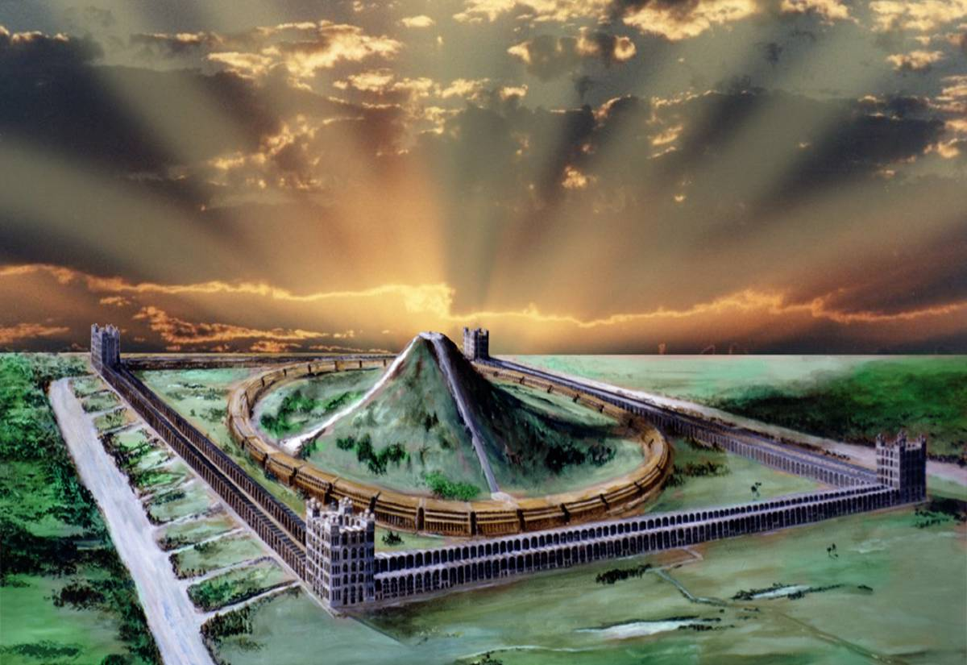
Fight!
Cotton Mather
(1663-1728)
~Congregationalist~
John Calvin
(1509-1564)
~Presbyterian~
Take away peace!
Psa. 72:6-7
?
'The oracles of God foretold the rising of an
Antichrist in the Christian Church; and in
the pope of Rome all the characteristics of
that Antichrist are so marvelously answered,
Killed!
'Some persons think as too severe
when we call the Roman pontiff Antichrist...
How can those holding religious error or those who are not religious at all, be called my witnesses?
And why are they called olive trees and lampstands?
I shall briefly show that Pauls words (2Thess. 2)
are not capable of any other interpretation
than that which applies them to the Papacy.'
that if any who read the Scriptures do not see
it, there is a marvelous blindness upon them.'
The Fall of Babylon
Come back to life!
Measured!
Speak out!
4

Slide 5
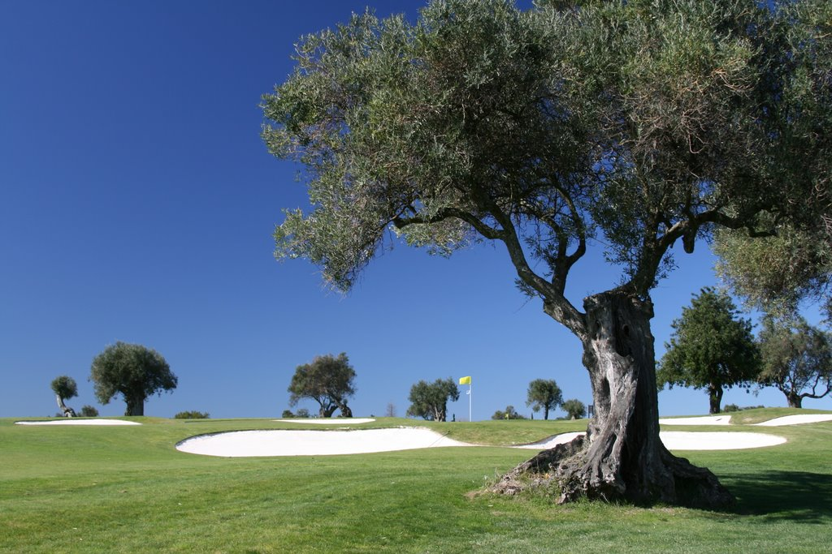



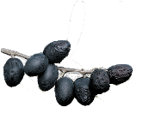
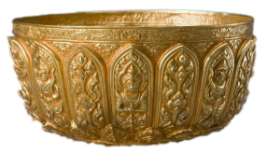


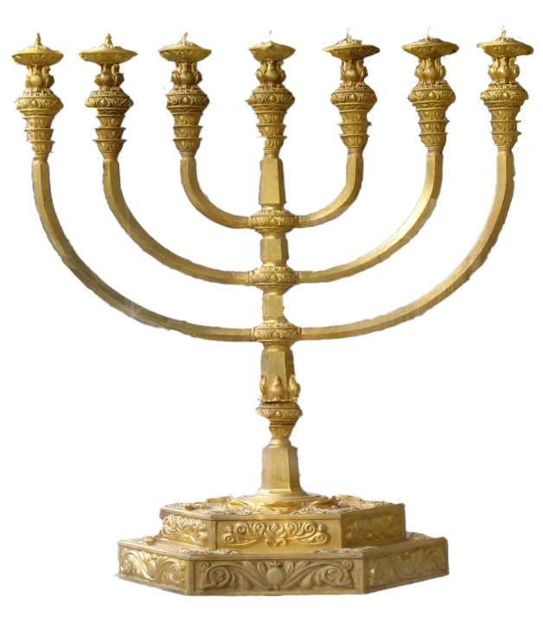
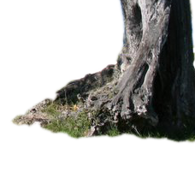
TWO OLIVE TREES
ONE LAMPSTAND
ZECHARIAH 4

Slide 6
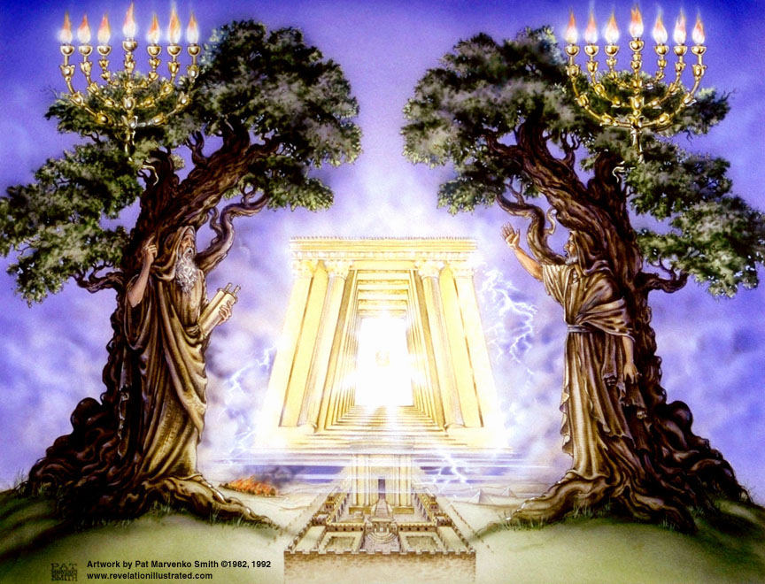
THE TWO WITNESSES

Slide 7
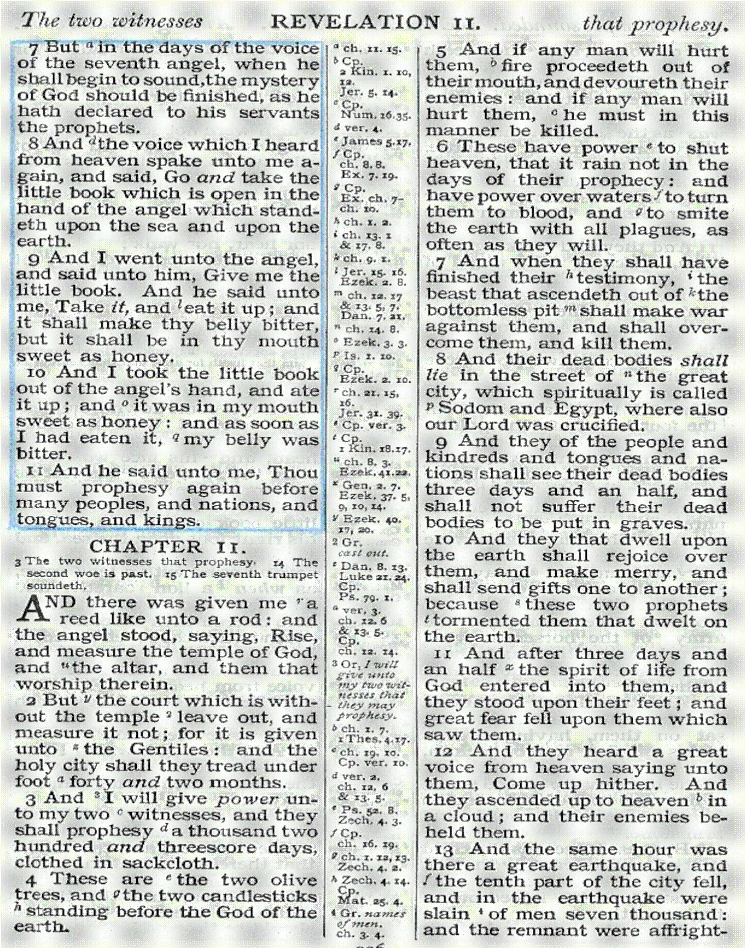
“ And there was given unto me a reed like unto a rod and the angel stood saying, Rise, and measure the temple of God, and the altar, and them that worship therein.”
Rabdos
1Cor.4:21
Rev.11:1
Heb.13:10
Saints
2Cor.6:16
1Cor.9:13
“and the holy city shall they tread under foot….”
Note: Rev.11:19
A community in the court, claiming to be Christian; but a group with whom the holy city has no fellowship. Eph.4:17-18
5

Slide 8
The Holy City and the 2 Witnesses
Rev.11:1-4
Treading down of the Holy City 42 months
Vv1-2
Two witnesses 1260 days
Vv3-4
Same period expressed in different terms
Starting point
Saints contrasted to Anti-Papal witnesses
Power given to the beast to continue 42 months
Rev. 13:2,4-5
6

Slide 9
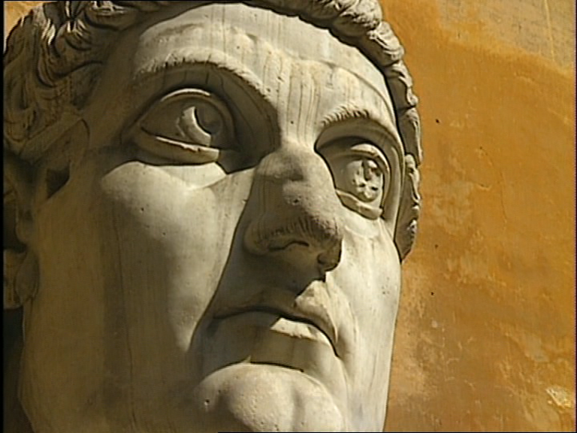
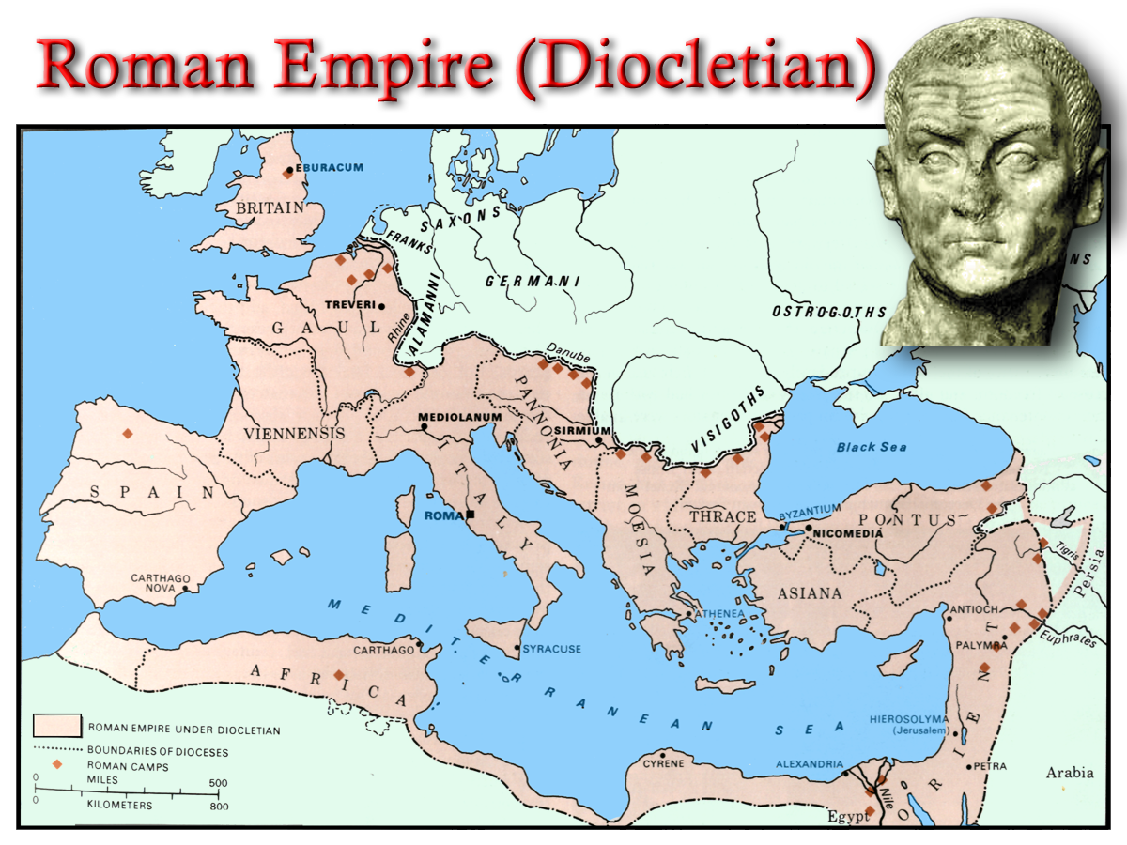
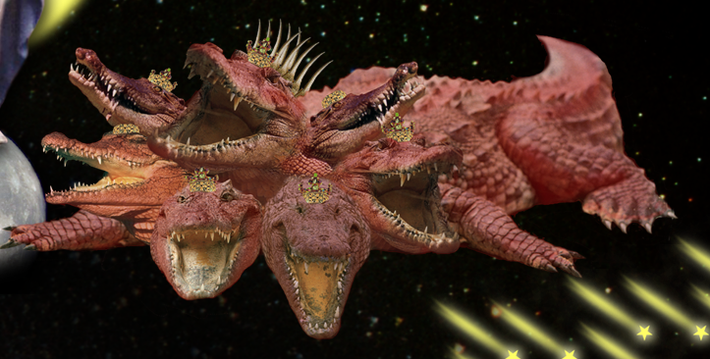
Struggle for Imperial Title
324 AD
326 AD
7

Slide 10
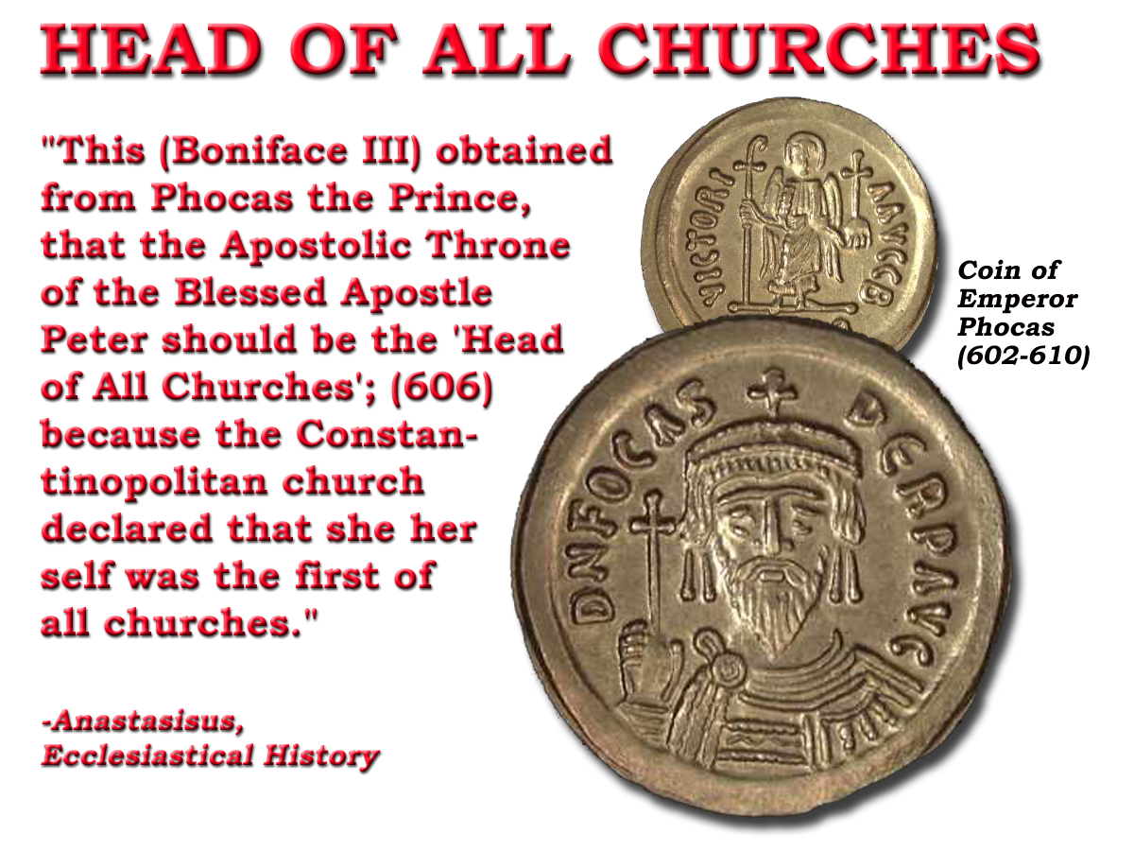
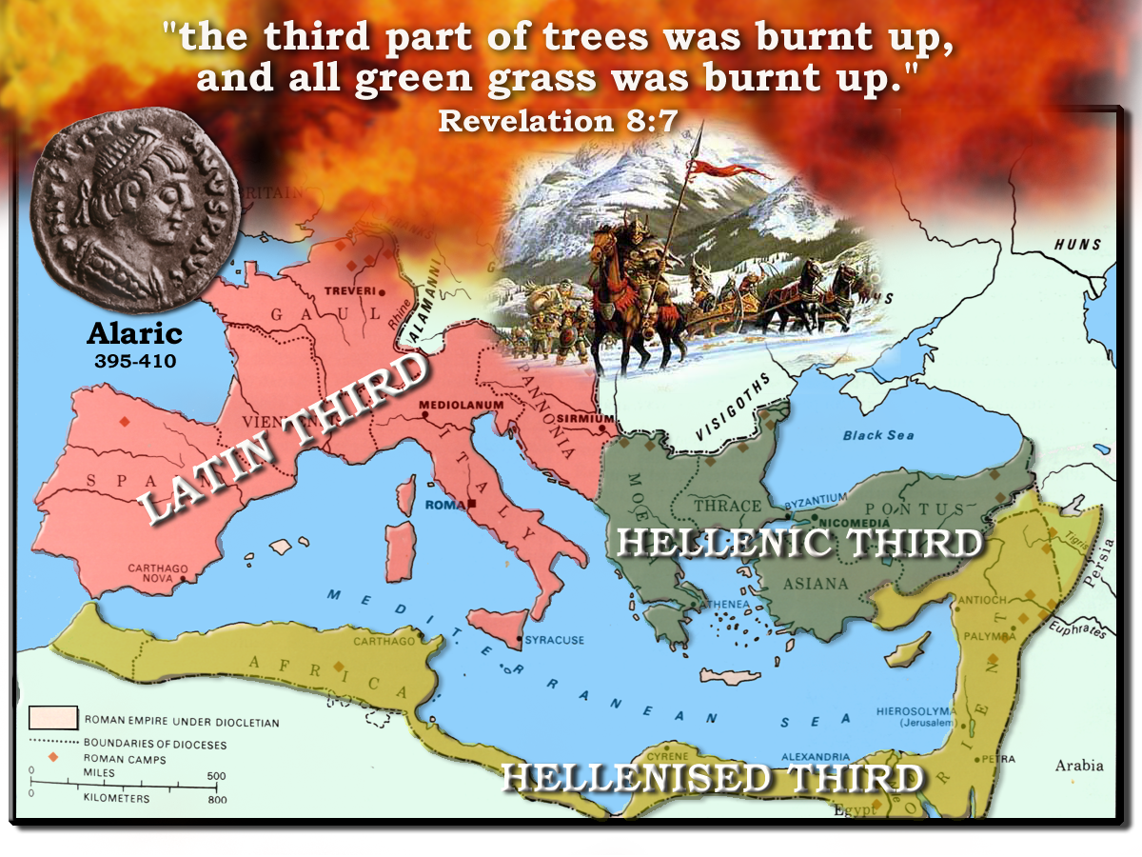
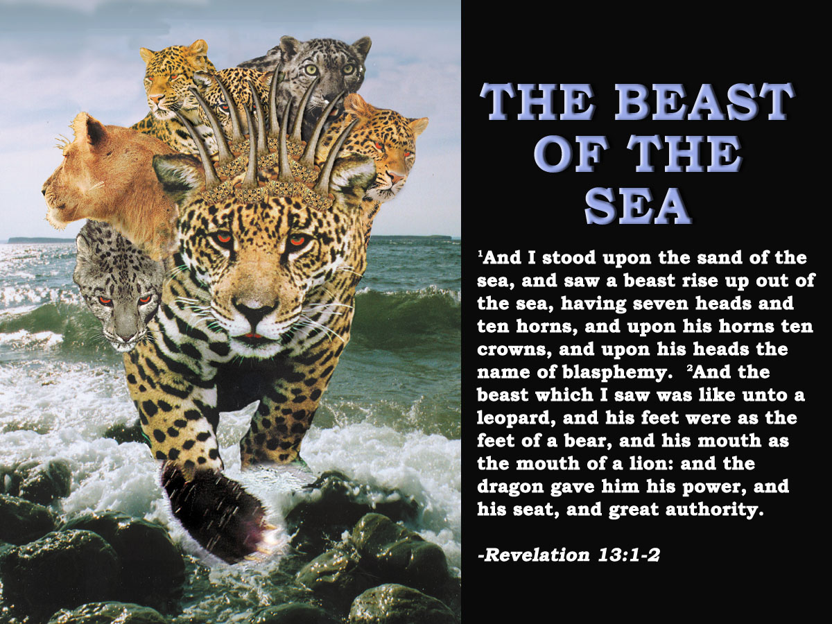
The Further Rising of the Sea Beast
Barbarians invade West 400 AD
Sea Beast
608-610 AD
Ostrogoths
530-533 AD
“Justinian made the Roman bishop spiritual head of the empire, but his supremacy was not acknowledged by the toe kingdoms until about 75yrs after.” E.I. p.359
In 533 the supremacy of Rome in ecclesiastical affairs was recognized by Justinian:
“We ordain that the most holy Pope of the Elder Rome be the first of all priests”
476 AD Collapses
533-540 AD
8

Slide 11
“Dragon gives power to the Beast…to continue 42 months” - Rev.13:4-5
Justinian revised Roman law. Proclaimed bishop of Rome, Universal Bishop AD.529 - 533
Phocus reaffirms power to bishops in Rome and gives them authority to transfer it AD.608 - 610
75 years
42 months
42 months
1260 years
1260 years
Pope loses temporal power
1868 - 1870
French Revolution
1789 - 1793
75 years

Slide 12
The Holy City and the 2 Witnesses
Rev.11:1-4
Treading down of the Holy City 42 months
Vv1-2
Two witnesses 1260 days
Vv3-4
Same period expressed in different terms
Starting point
Saints contrasted to Anti-Papal witnesses
Power given to the beast to continue 42 months
Rev. 13:5
608-610 AD
608-610 + 1260 = 1868-1870

Slide 13

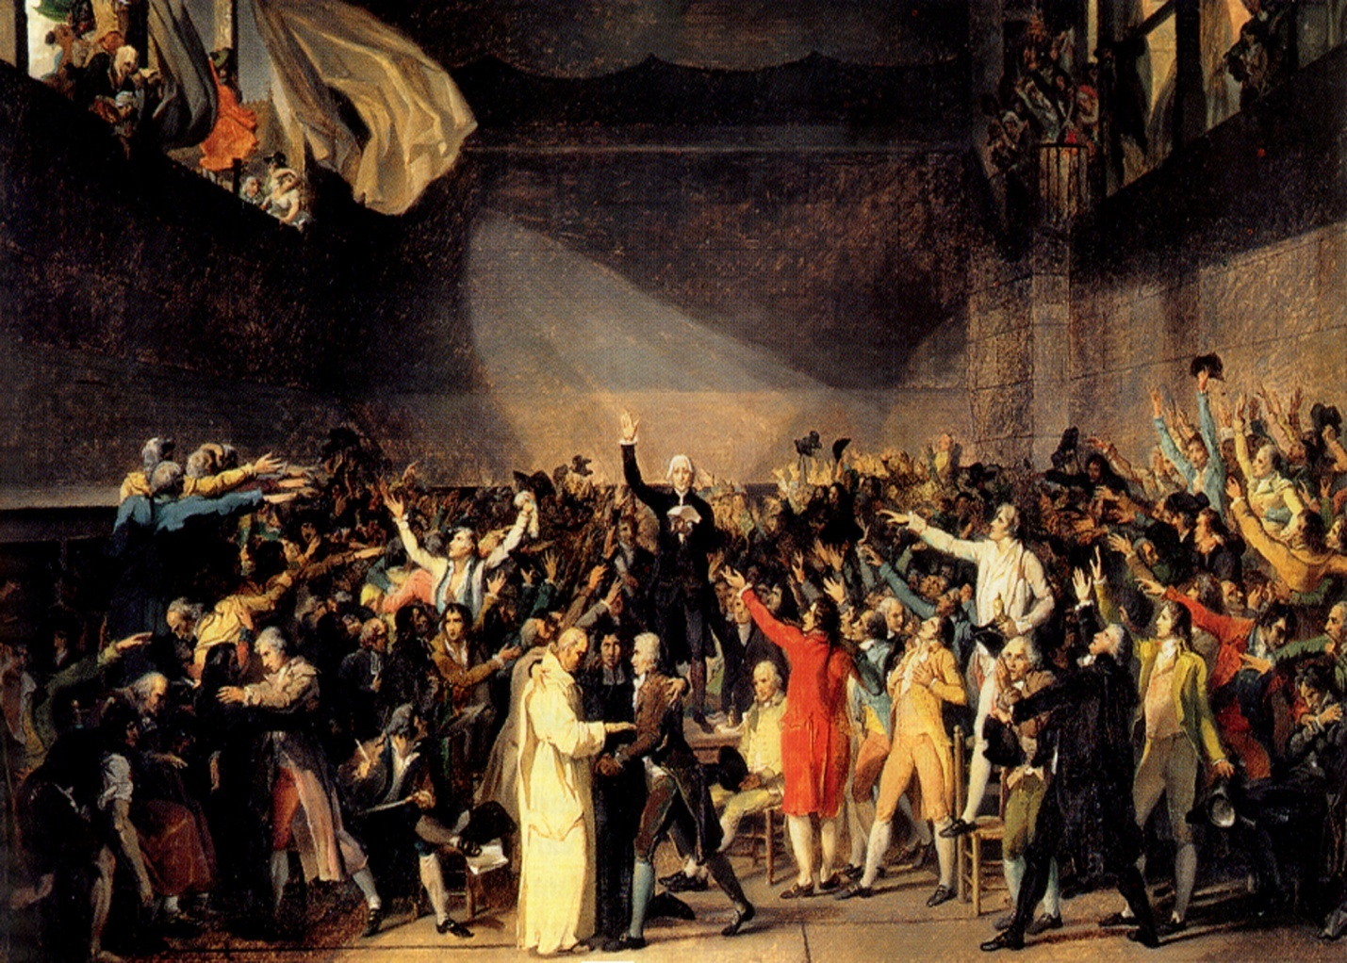
7
Seals
7
1 2 3 4 5 6
Trumpets
7
1 2 3 4 5 6
Vials
Judgement - Pagan Rome
1 2 3 4 5 6
Judgement - Christian Rome
Judgement - Holy Roman Empire
Next Session
“And they stood upon their feet….And the same hour there was a great earthquake”
Whatshan Lake Bible School 2018

Slide 15
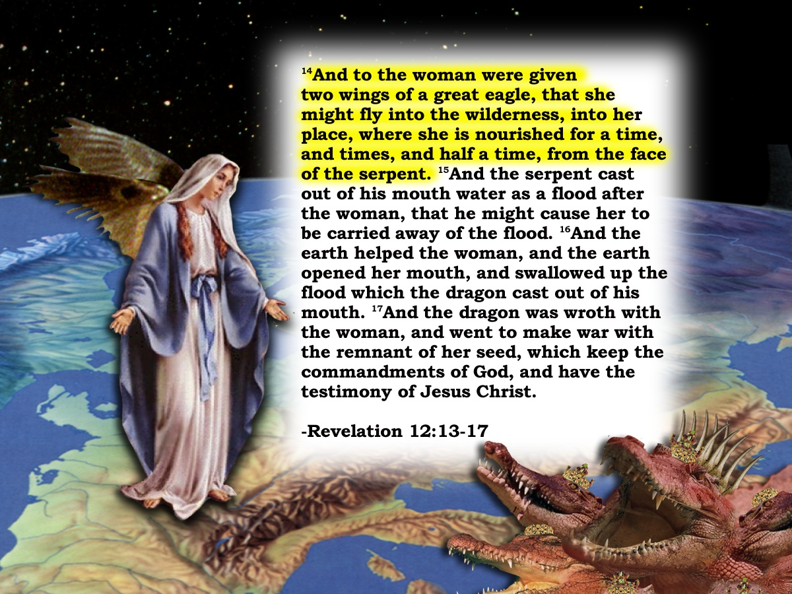
The Holy City and the 2 Witnesses
Rev.11:1-4
Treading down of the Holy City 42 months
Vv1-2
Two witnesses 1260 days
Vv3-4
Rev.12
Same period expressed in different terms
15
“And the serpent cast out of his mouth water as a flood after the woman, that he might cause her to be carried away of the flood.
Starting point
And the earth helped the woman, and the earth opened her mouth, and swallowed up the flood ………
Starting point
16
Saints contrasted to Anti-Papal witnesses
17
And the dragon was wroth with the woman, and went to make war with the remnant of her seed, which keep the commandments of God, ….”
Power given to the beast to continue 42 months
Rev. 13:2,4-5
Woman fleeing – fed 1260 days
Rev. 12:6
608-610 AD
312 AD
608-610 + 1260 = 1868-1870
312 + 1260 = 1572

Slide 16
“The second Woe is past; and, behold,
the third Woe cometh quickly"
Next Session
(God Willing)

Slide 17
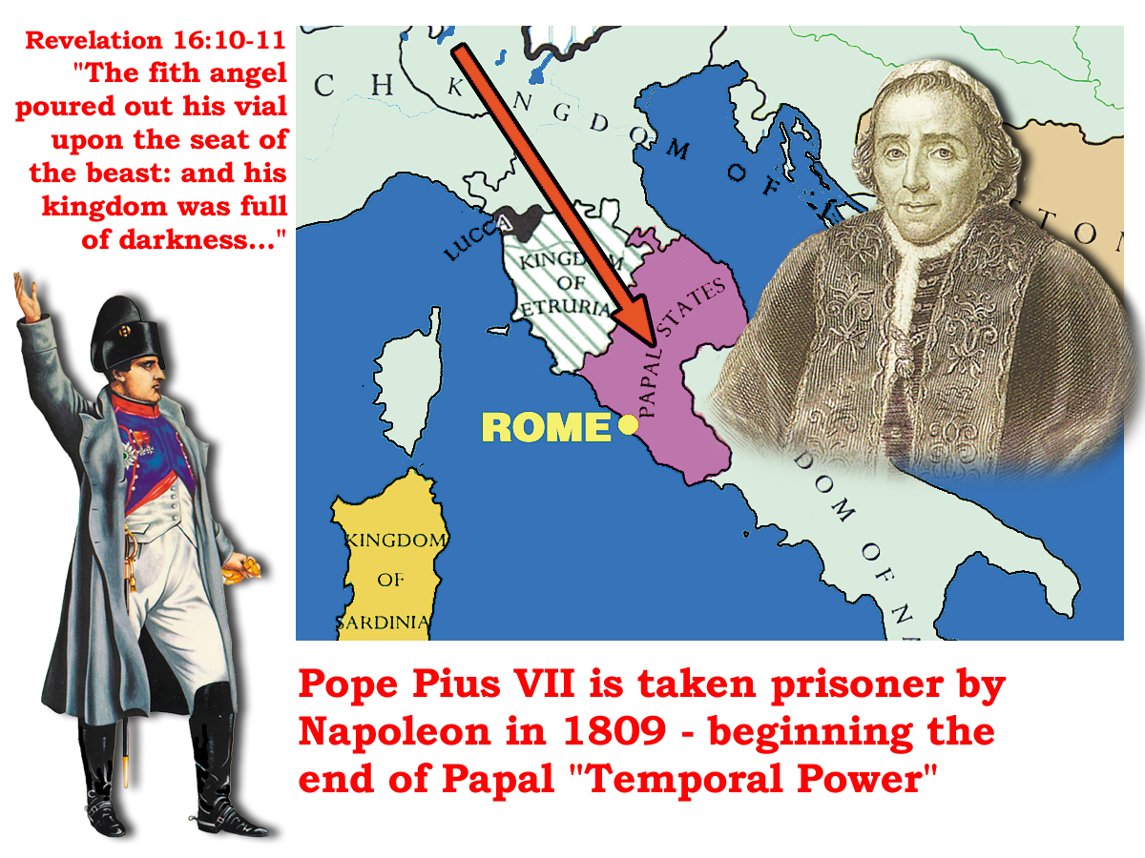
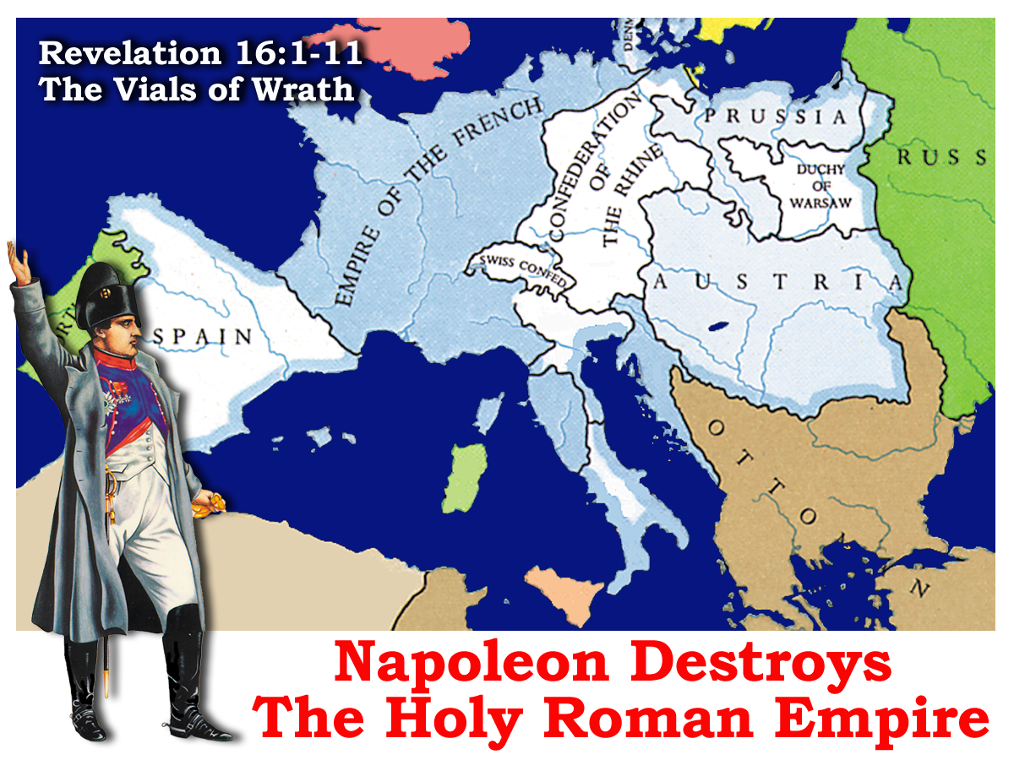
“Dragon gives power to the Beast…to continue 42 months” - Rev.13:4-5
“Rendering honour to the Apostolic throne and to your Holiness….Therefore we have hastened both to subject and to unite to the Throne of your holiness all the priests of the whole eastern region.”
Justinian revised Roman law. Proclaimed bishop of Rome, Universal Bishop AD.529 - 533
Phocus reaffirms power to bishops in Rome and gives them authority to transfer it AD.608 - 610
“We ordain that the most holy Pope of the Elder Rome be the first of all priests”
75 years
42 months
42 months
1260 years
1260 years
French Revolution
1789 - 1793
Pope loses temporal power
1868 - 1870
75 years

Slide 18
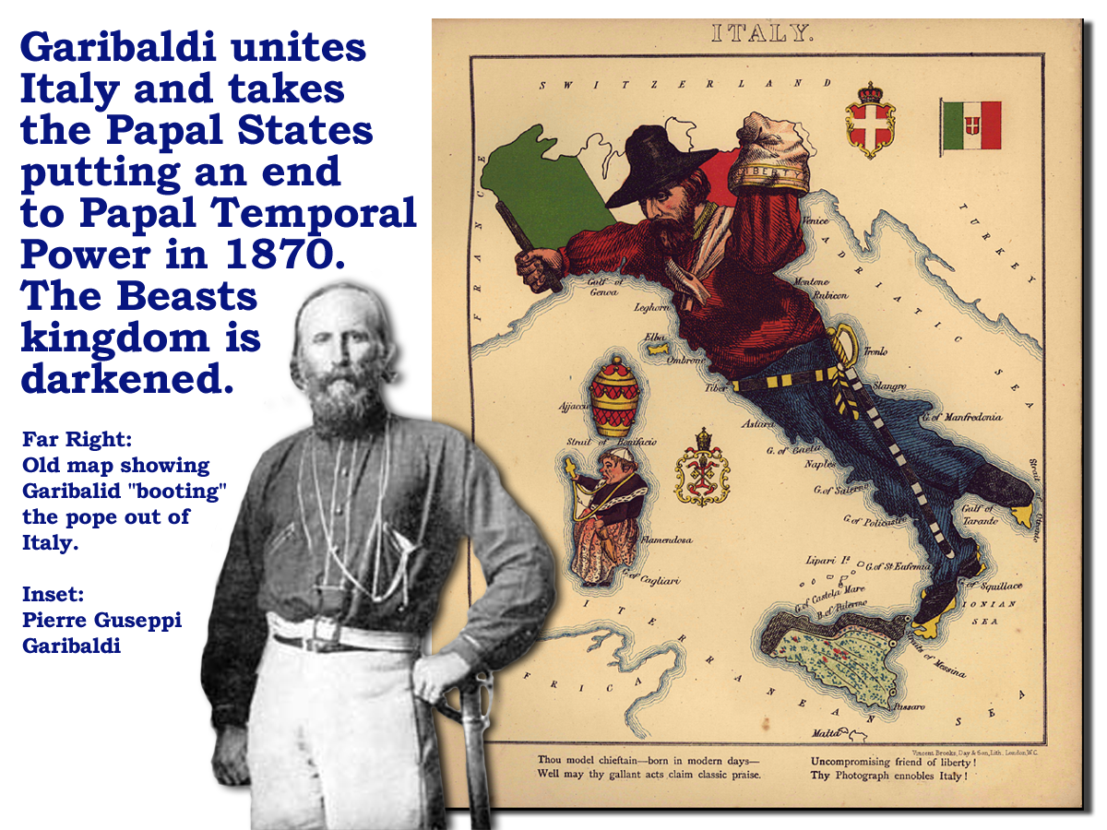
“Dragon gives power to the beast…to continue 42 months” - Rev.13:4-5
Justinian revised Roman law. Proclaimed bishop of Rome, Universal Bishop AD.529 - 533
Phocas reaffirms power to bishops in Rome and gives them authority to transfer it AD.608 - 610
75 years
42 months
42 months
Daniel 7:25-26
1260 years
1260 years
French Revolution
1789 - 1793
Pope loses temporal power
1868 - 1870
75 years
Time, Times and Dividing of time

Slide 19
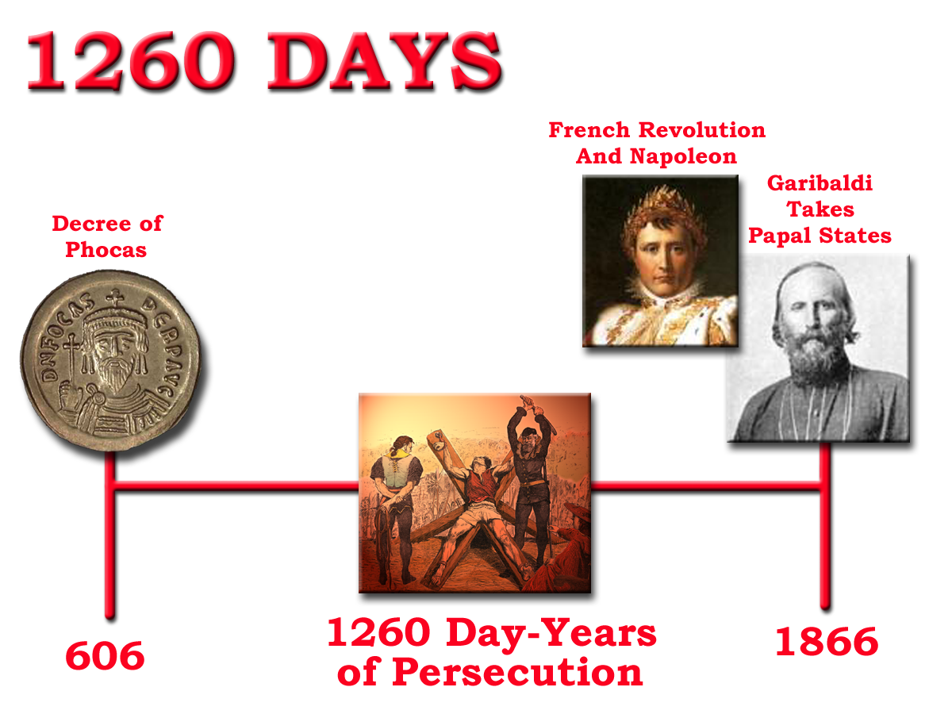
Notes:
The power of the political body of Europe (sea beast) under the influence of the Catholic church to persecute the saints was 1260 days
From Phocus – until Napoleon removed their power, and Garibaldi took the Papal states (during the vial judgments of the book of revelation)

