Slide 1

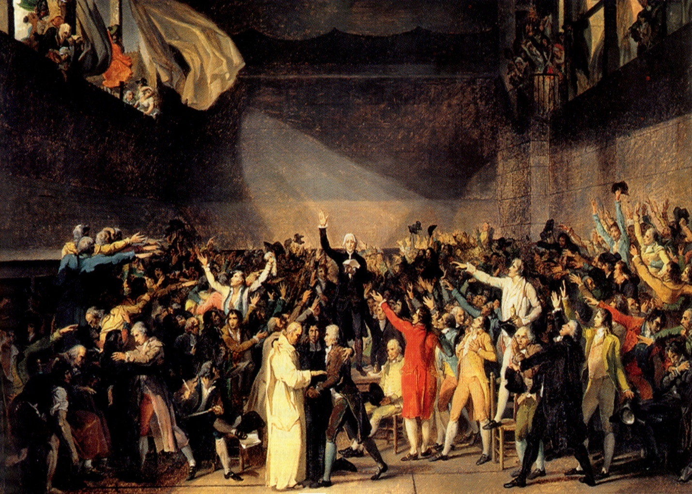
7
Seals
7
1 2 3 4 5 6
Trumpets
7
1 2 3 4 5 6
Vials
Judgement - Pagan Rome
1 2 3 4 5 6
Judgement - Christian Rome
Judgement - Holy Roman Empire
“And they stood upon their feet….And the same hour there was a great earthquake”
Study 3

Slide 2
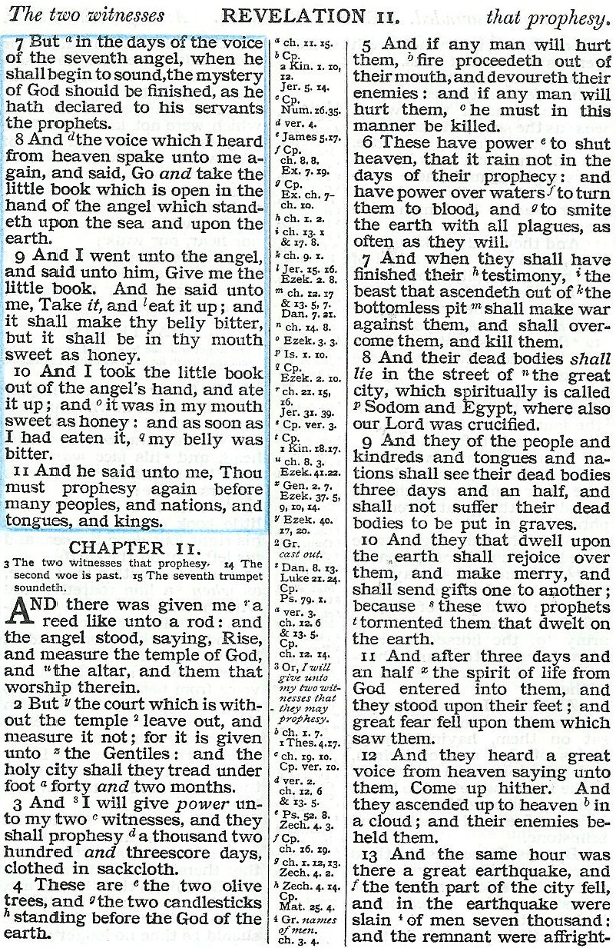


Fight!
Take away peace!
Killed!
Come back to life!
Measured!
Speak out!

Slide 3
“Dragon gives power to the Beast…to continue 42 months” - Rev.13:4-5
Justinian revised Roman law. Proclaimed bishop of Rome, Universal Bishop AD.529 - 533
Phocus reaffirms power to bishops in Rome and gives them authority to transfer it AD.608 - 610
75 years
42 months
42 months
1260 years
1260 years
Pope loses temporal power
1868 - 1870
French Revolution
1789 - 1793
75 years

Slide 4
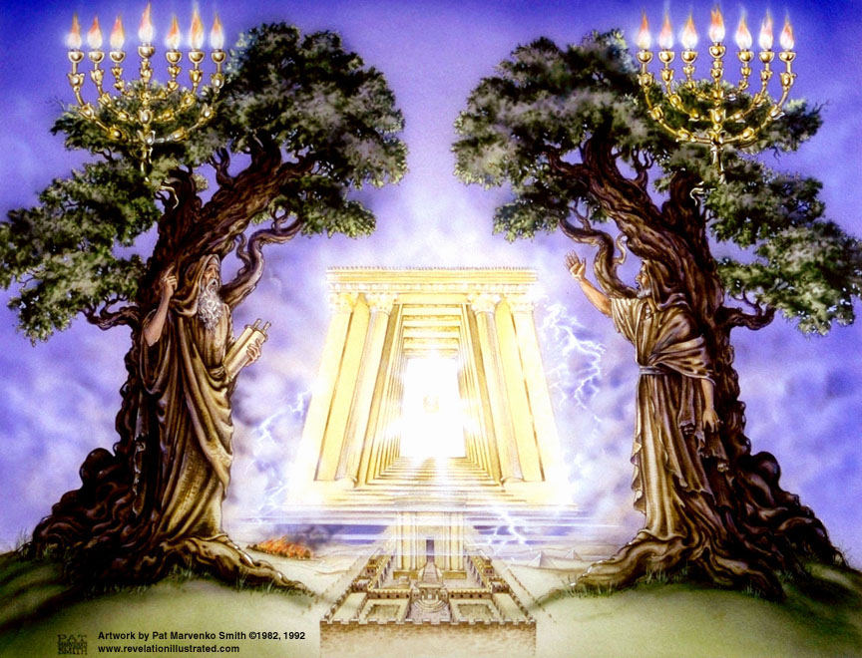
The Holy City and the 2 Witnesses
Rev.11:1-4
Treading down of the Holy City 42 months
Vv1-2
Two witnesses 1260 days
Vv3-4
Same period expressed in different terms
Starting point
Saints contrasted to Anti-Papal witnesses
Power given to the beast to continue 42 months
Rev. 13:5
608-610 AD
608-610 + 1260 = 1868-1870

Slide 5
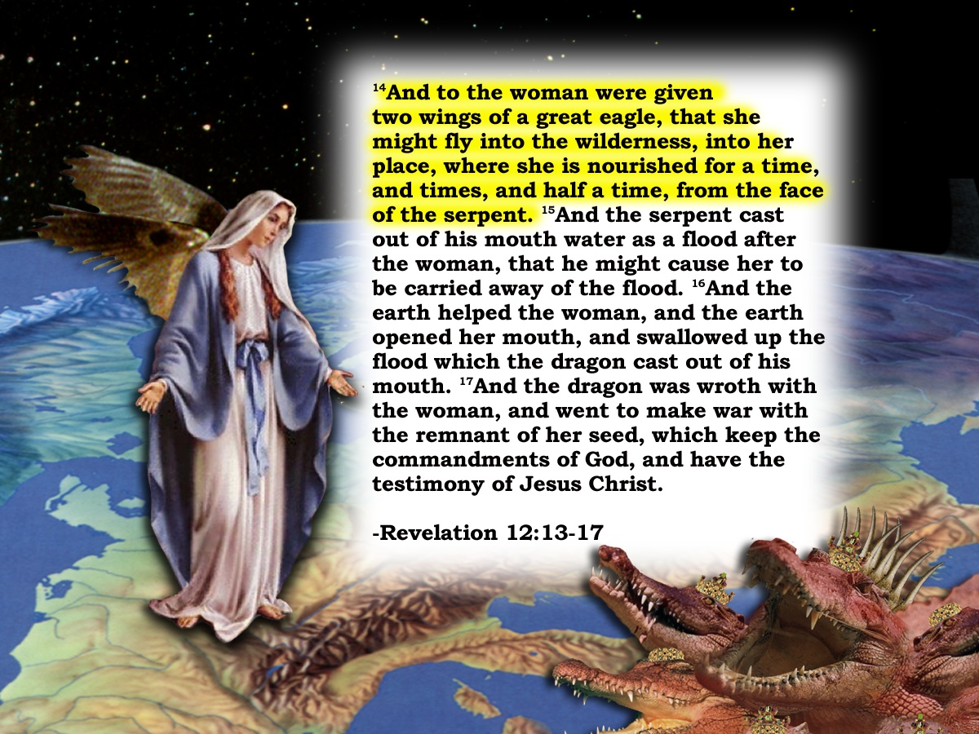
The Holy City and the 2 Witnesses
Rev.11:1-4
Treading down of the Holy City 42 months
Vv1-2
Two witnesses 1260 days
Vv3-4
Rev.12
Same period expressed in different terms
15
“And the serpent cast out of his mouth water as a flood after the woman, that he might cause her to be carried away of the flood.
Starting point
And the earth helped the woman, and the earth opened her mouth, and swallowed up the flood ………
Starting point
16
Saints contrasted to Anti-Papal witnesses
17
And the dragon was wroth with the woman, and went to make war with the remnant of her seed, which keep the commandments of God, ….”
Power given to the beast to continue 42 months
Rev. 13:2,4-5
Woman fleeing – fed 1260 days
Rev. 12:6
608-610 AD
312 AD
608-610 + 1260 = 1868-1870
312 + 1260 = 1572

Slide 6
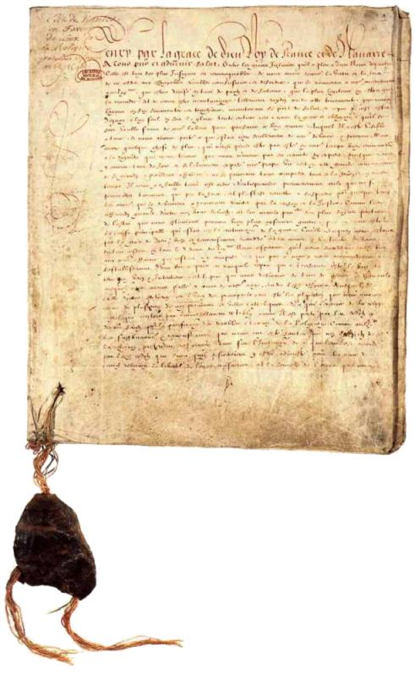
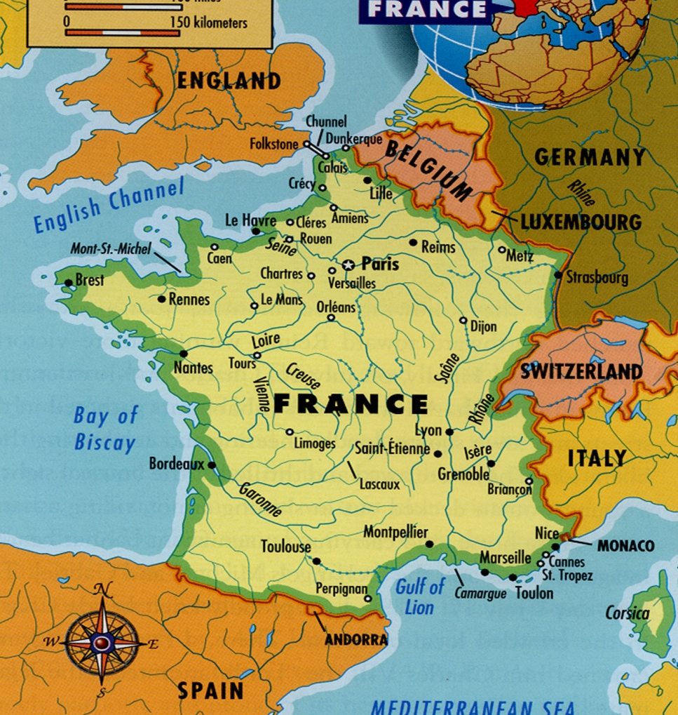
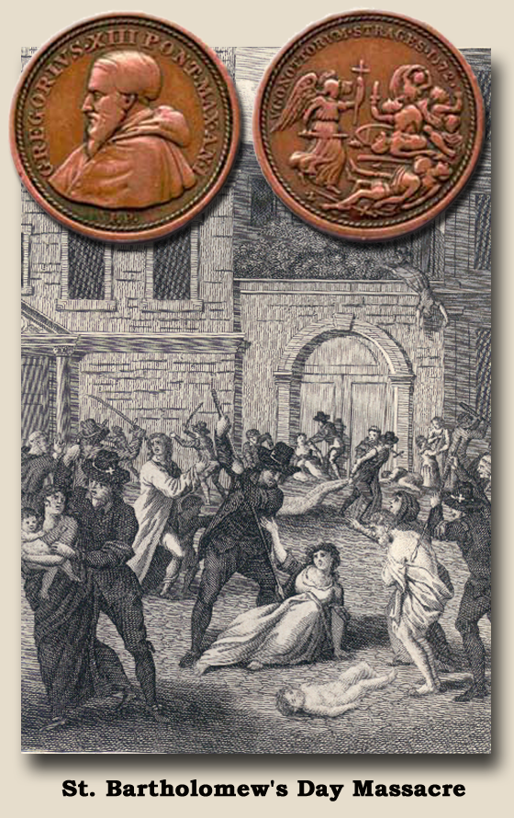
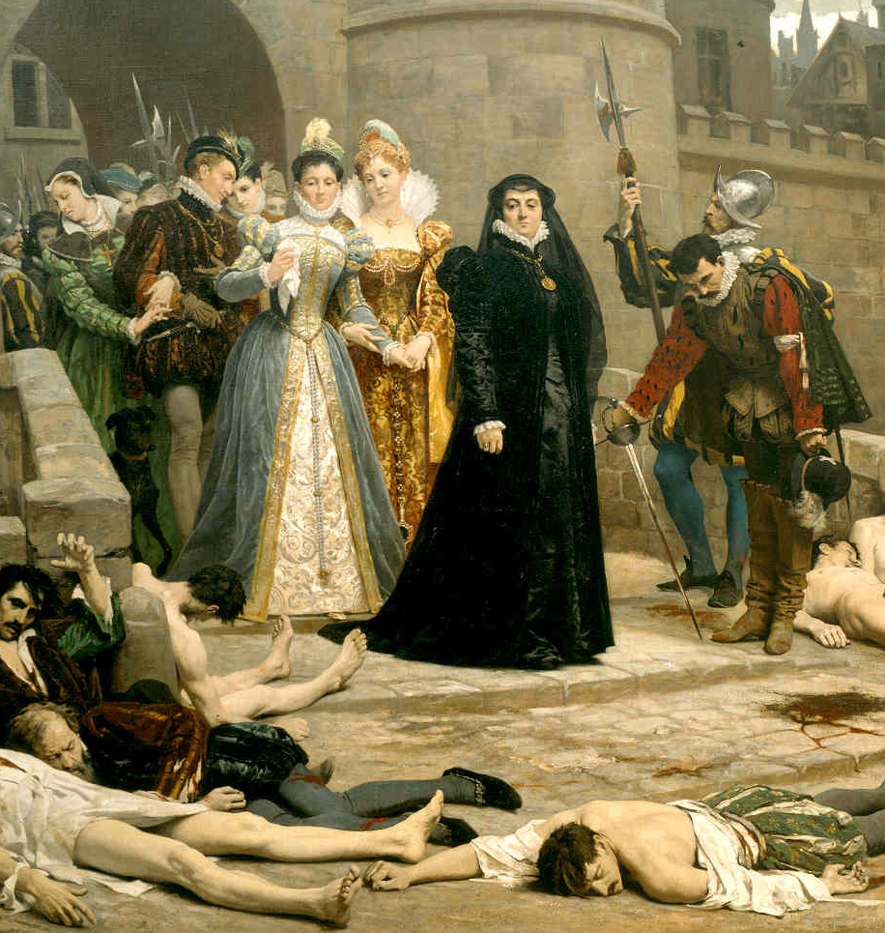

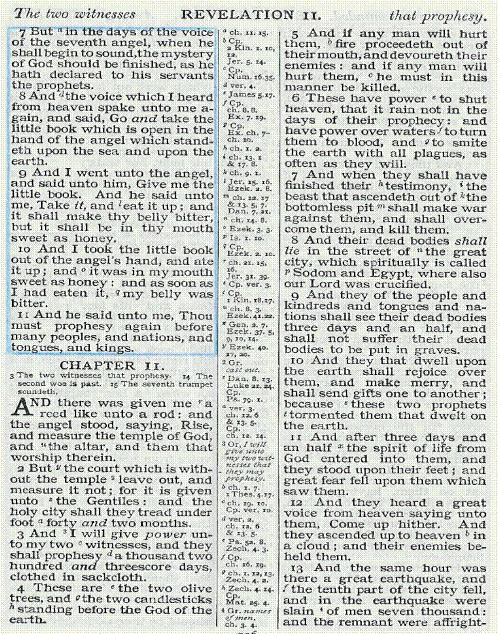
The 2 Witnesses
Rev.11
Secular/Religious (Anti-Papal)
312AD
1572AD
1685AD
1260yrs
1598AD
Ch. 11:10
Edict of Nantes
Woman & Earth
Revocation of Edict of Nantes (Witnesses suffer extreme political death) Rev. 11:8-9
Rev.11:3
Rev.12:6, 14-17
Massacre St Bartholomew's day
(slaying of witnesses began)
Rev.11:7

Slide 7
The broad place – the plateau
France was Papal Rome’s special protector and principal thoroughfare of the great city of spiritual Babylon. France called : “The eldest son of the church”
Rev.11:8,13
“And their dead bodies shall lie in the street of the great city, which spiritually is called Sodom and Egypt, where also our Lord was crucified”
v.8
“The frontiers of the empire were the limits of the city of Rome.
Rome
“and the tenth part of the city fell,…….”
v.13
14:.8 16:19 17:18 18:10,16
Caracalla
France

Slide 8
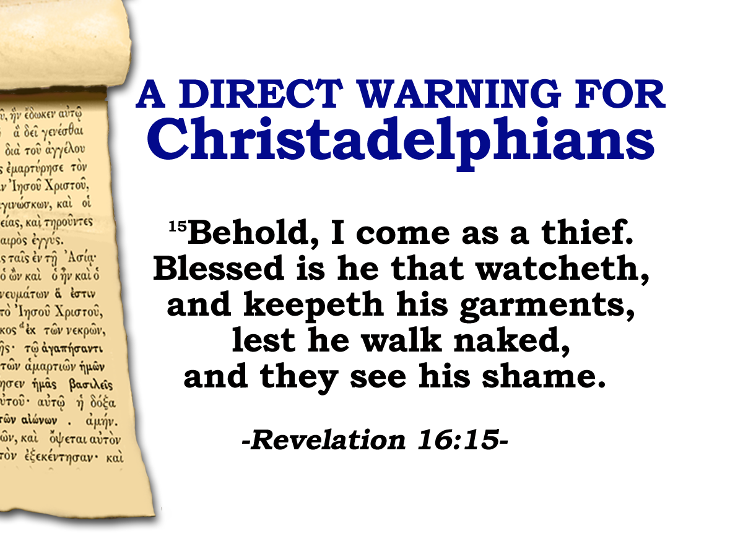
1639: Thomas Goodwin
“By the tenth part of the city, I understand some one tenth part of Europe.”
1689: Pierre Jurieu
“The tenth part of the city which here fell, will at some future time, appear to be the kingdom of France, where a revolution will take place about
the year 1785, and a
separation from the
the papacy will follow,”
The Apocalypse
Notes:
Our WATCHING is directly related to our position before Christ at the Judgment seat.
Having a consciousness of the nearness of Christ’s return impresses the reality of the things concerning the Kingdom of God upon our minds
It helps us detach our affections from the “FLEETING PRESENT” to the world to come
It is take us right back to where we started:

Slide 9
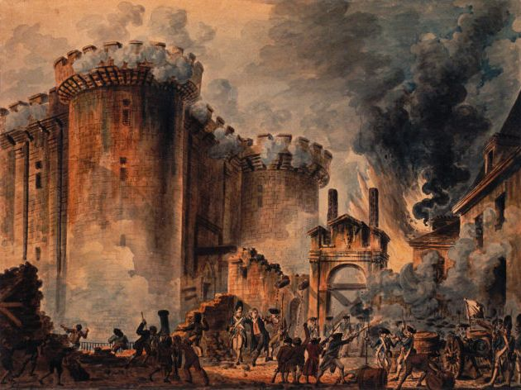
1687: Jacques Phillipott
“As the King of France did his utmost to enhance
the glory of Popery – it will
be the King of France who will mostly
contribute to her ruin … I take it for granted, first, that the city here mentioned is Babylon – that is the Papal Empire, the Church of Rome, the Empire of the Antichrist… why
should there be any hesitation in concluding that this tenth part of the city which shall fall is France?”
The Apocalypse
Notes:
Our WATCHING is directly related to our position before Christ at the Judgment seat.
Having a consciousness of the nearness of Christ’s return impresses the reality of the things concerning the Kingdom of God upon our minds
It helps us detach our affections from the “FLEETING PRESENT” to the world to come
It is take us right back to where we started:

Slide 10


“And their dead bodies shall lie in the street of the great city, which spiritually is called Sodom and Egypt, ……”
During the French Revolution … the area was renamed Place de la Révolution. The new revolutionary government erected the guillotine in the square … where King Louis XVI was executed in 1793. In 1795 … the square was renamed Place de la Concorde as a gesture of reconciliation.
PLACE DE LA CONCORDE

Slide 11

“And their dead bodies shall lie in the street of the great city, which spiritually is called Sodom and Egypt, ……”
PYRAMID WHERE HUGUENOTS SLAIN

Slide 12
The 2 Witnesses
Rev.11
Secular/Religious (Anti-Papal)
3 ½ days (105yrs)
312AD
1572AD
1685AD
1789AD
1260yrs
1598AD
Edict of Nantes
Woman & Earth
Revocation of Edict of Nantes (Witnesses suffer extreme political death) Rev. 11:7-9
Rev.11:3
Rev.12:6, 14-17
Massacre St Bartholomew's day
(slaying of witnesses began)
Rev.11:7

Slide 13

Death of the Witnesses
Rev. 11:9-11
Die politically.
3 ½ days later they are raised politically.
3 ½ days = 105yrs.
Bodies remained in a state of non decay. Could not therefore be called a death of 105 days.
1685 - 1789
Decorum of the symbol requires another solution!
Days = Lunar days (ie. time it takes for the moon to revolve once around the earth. = 30 of our days.)
Summary. 1 Lunar day = 30 of our days.
3 ½ Lunar days x 30 = 105days = 105yrs.

Slide 14
The 2 Witnesses
Rev.11
Secular/Religious (Anti-Papal)
Note v.9
3 ½ days (105yrs)
312AD
1572AD
1685AD
1789AD
1260yrs
“ The Huguenots, though no longer permitted to exist as a state within a state, remained for the hundred years between the revocation of the Edict of Nantes and the outbreak of the French revolution a powerful and ever-watchful body”
1598AD
Rev.11:3
Rev.12:16
Edict of Nantes
Revocation of Edict of Nantes (Witnesses suffer extreme political death) Rev. 11:7-9
Woman & Earth
Massacre St Bartholomew's day
(slaying of witnesses began)
Rev.11:7
Belloc, The French Revolution, p,231

Slide 15
Revelation 11
Protestant countries outside of France
Netherlands
Germany
Switzerland
England
Ireland
Was at this time the word refugee came into the English language
Anti Papal witnesses
Papacy and Catholic rulers

Slide 16
The 2 Witnesses
Rev.11
Secular/Religious (Anti-Papal)
3 ½ days (105yrs)
312AD
1572AD
1685AD
1789AD
1260yrs
“ The Huguenots, though no longer permitted to exist as a state within a state, remained for the hundred years between the revocation of the Edict of Nantes and the outbreak of the French revolution a powerful and ever-watchful body”
1598AD
Rev.11:3
Rev.12:16
Edict of Nantes
Woman & Earth
French Revolution Rev. 11:11-13
Massacre St Bartholomew's day
(slaying of witnesses began)
Rev.11:7
Belloc, The French Revolution, p,231

Slide 17
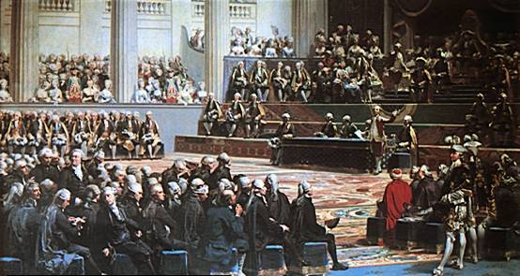
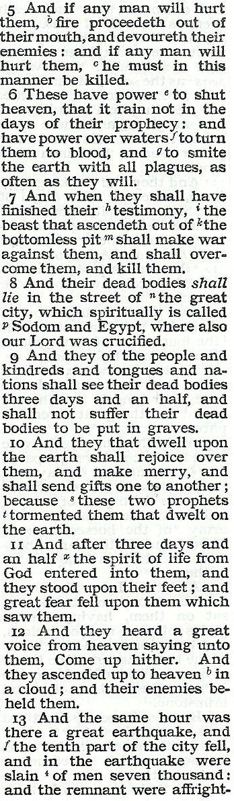
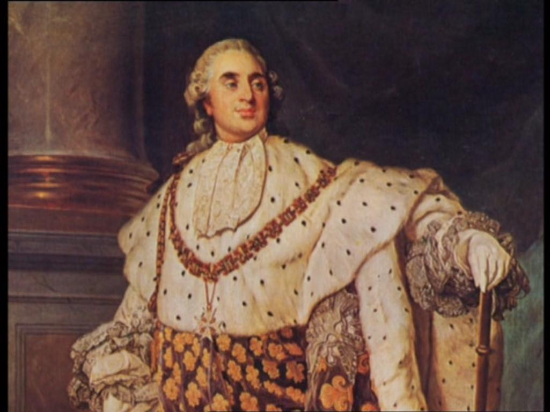
1789
Estates-General convened on May 5, 1789, by Louis XVI, at Versailles, in a desperate attempt to stave off civil unrest.
Established in 1302, the Estates-General was a French legislative body comprising members of three groups, or estates, of society: clergy, nobility, and commoners.
However, the Commoners (3rd Estate) voted June 17th to make themselves a permanent National Assembly.(With or without the other two)
Louis's efforts to repress the new assembly caused widespread rioting and ushered in the French Revolution.

Slide 18
The new National Assembly published a decree proclaiming liberty of opinions. (religious and political)
Rev.11:11-13
“The property of exiled Huguenots unsold at that date should be restored to the rightful heirs.”
“……they stood on their feet…”
v.11
Scene is set for opening of Rev.16:1
To be an aristocrat meant death!
To be a suspect meant death!
A breath of opposition to the course of events meant death!
Reign of terror
1793 - 1794
5

Slide 19

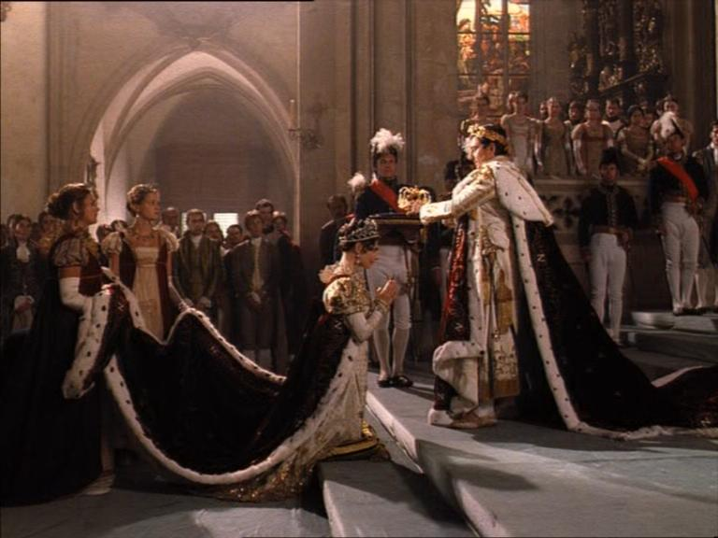

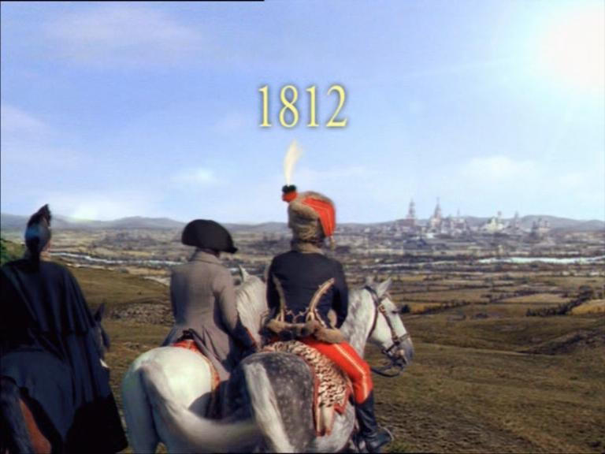
"Go your ways, and pour
out the vials of the wrath
of God …."
Next Session
God Willing
Vials 1-5
Revelation 16
1804
1796
1812

Slide 21
The Holy City and the 2 Witnesses
Rev.11:1-4
Treading down of the Holy City 42 months
Vv1-2
Two witnesses 1260 days
Vv3-4
Same period expressed in different terms
Starting point
Saints contrasted to Anti-Papal witnesses
Power given to the beast to continue 42 months
Rev. 13:5
608-610 AD
608-610 + 1260 = 1868-1870

Slide 22
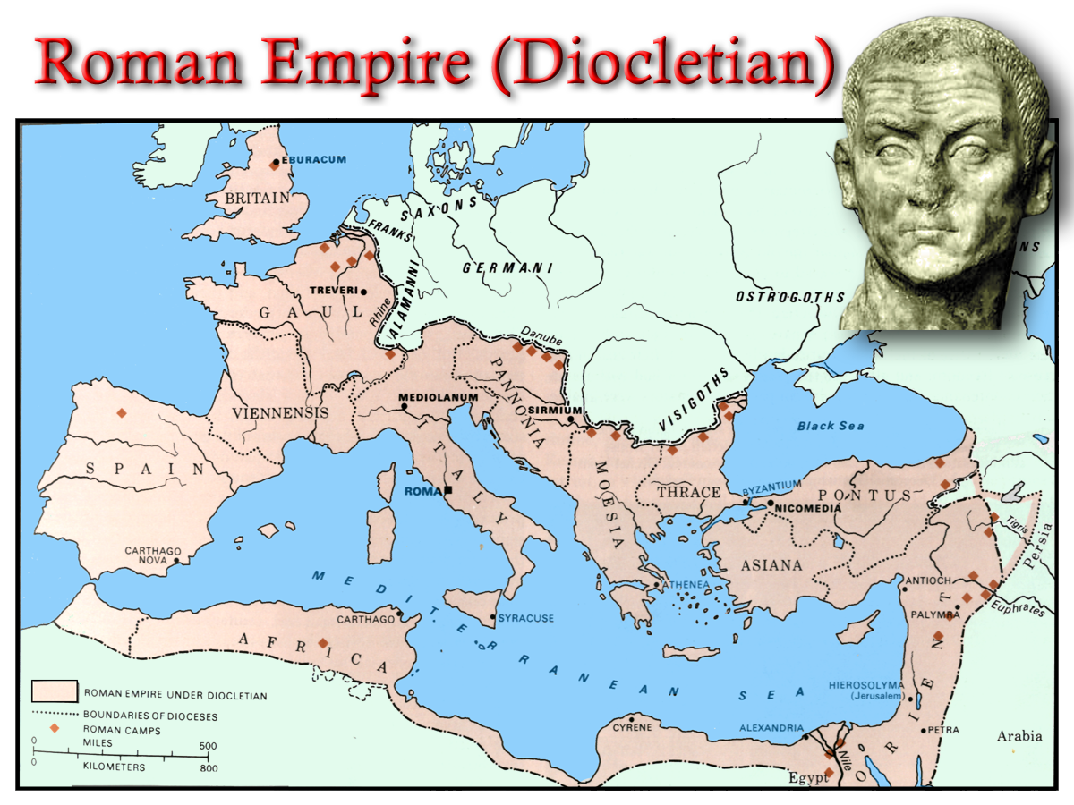
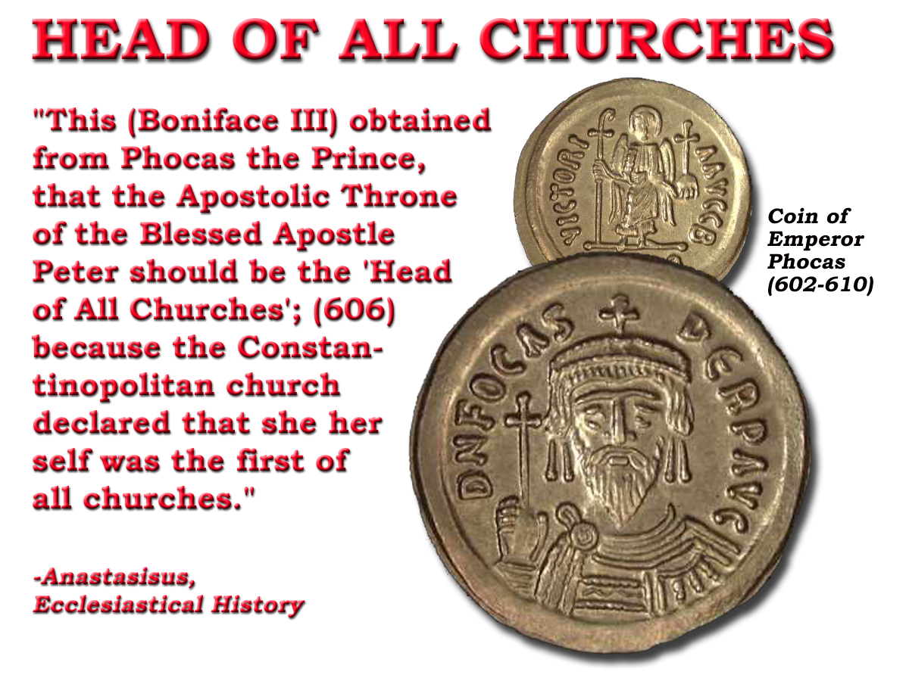
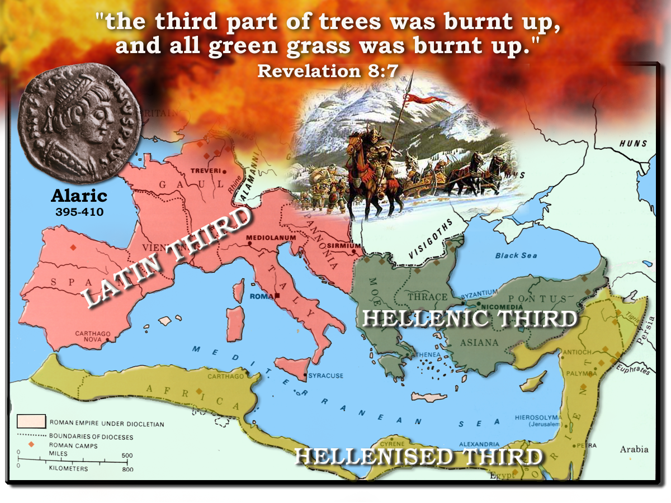

The Further Rising of the Sea Beast
Barbarians invade West 400 AD
Sea Beast
608-610 AD
Ostrogoths
530-533 AD
“Justinian made the Roman bishop spiritual head of the empire, but his supremacy was not acknowledged by the toe kingdoms until about 75yrs after.” E.I. p.359
In 533 the supremacy of Rome in ecclesiastical affairs was recognized by Justinian:
“We ordain that the most holy Pope of the Elder Rome be the first of all priests”
476 AD Collapses
533-540 AD
8

Slide 23
The Holy City and the 2 Witnesses
Rev.11:1-4
Treading down of the Holy City 42 months
Vv1-2
Two witnesses 1260 days
Vv3-4
Same period expressed in different terms
Starting point
Saints contrasted to Anti-Papal witnesses
Power given to the beast to continue 42 months
Rev. 13:2,4-5
6

Slide 24
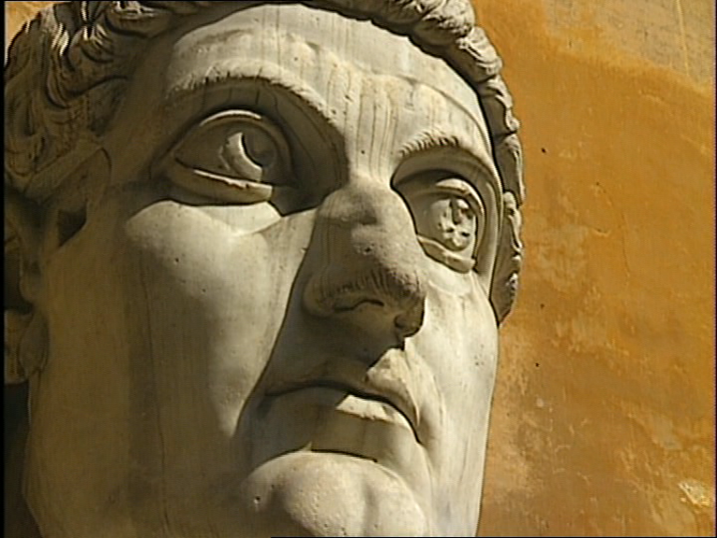

Struggle for Imperial Title
324 AD
326 AD
7

Slide 25
The Further Rising of the Sea Beast
Barbarians invade West 400 AD
Sea Beast
608-610 AD
Ostrogoths
530-533 AD
“Justinian made the Roman bishop spiritual head of the empire, but his supremacy was not acknowledged by the toe kingdoms until about 75yrs after.” E.I. p.359
In 533 the supremacy of Rome in ecclesiastical affairs was recognized by Justinian:
“We ordain that the most holy Pope of the Elder Rome be the first of all priests”
476 AD Collapses
533-540 AD
8

Slide 26
The 2 Witnesses
Rev.11
Secular/Religious (Anti-Papal)
312AD
1572AD
1685AD
1260yrs
1598AD
Ch. 11:10
Edict of Nantes
Woman & Earth
Revocation of Edict of Nantes (Witnesses suffer extreme political death) Rev. 11:8-9
Rev.11:3
Rev.12:6, 14-17
Massacre St Bartholomew's day
(slaying of witnesses began)
Rev.11:7

