Slide 1

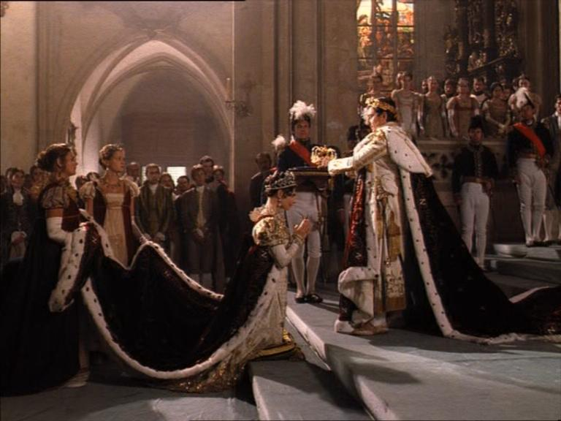
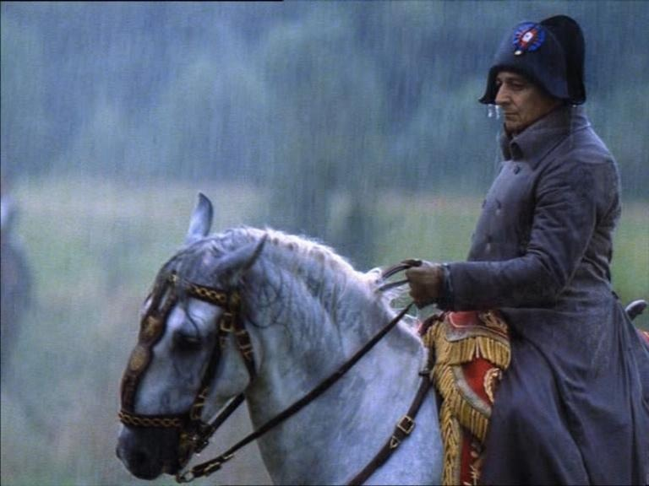
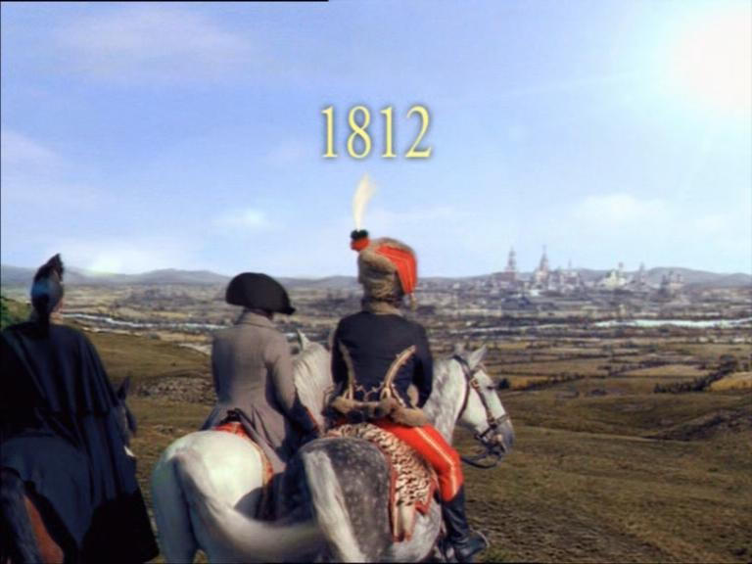
"Go your ways, and pour
out the vials of the wrath
of God …."
Vials 1-5
Study 4
Revelation 16
1804
1796
1812

Slide 2
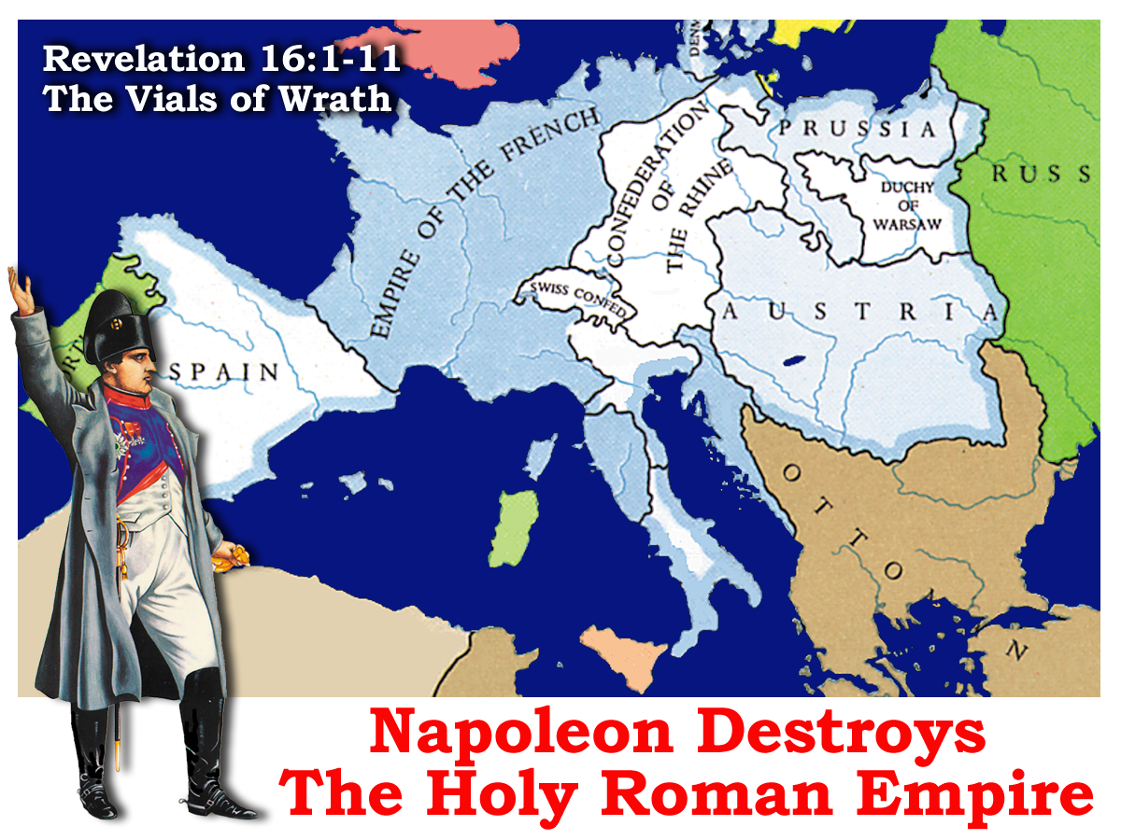
Napoleon - “The heir to the revolution”.
Re-organised France / Conquered Europe

Slide 3
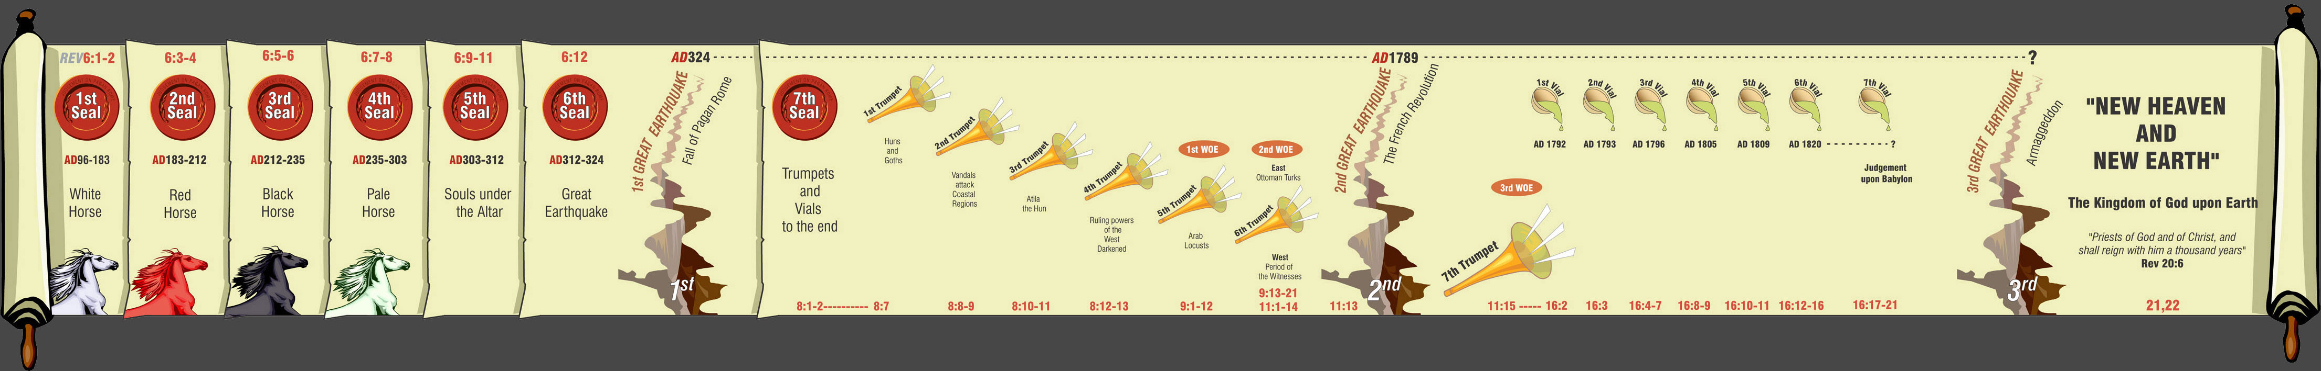
Linking Chapters 11 & 16
7
Trumpets
7
1 2 3 4 5 6
Vials
1 2 3 4 5 6
Judgement on Christian Rome
Judgement- Holy Roman Empire
Rev.8 & 9
Rev.16
The second woe is past; and, behold, the third woe cometh quickly.
30yrs!
198yrs!
Rev.11:14
AD 1789 – AD 1820
Armageddon
“The third woe cometh quickly.”

Slide 4
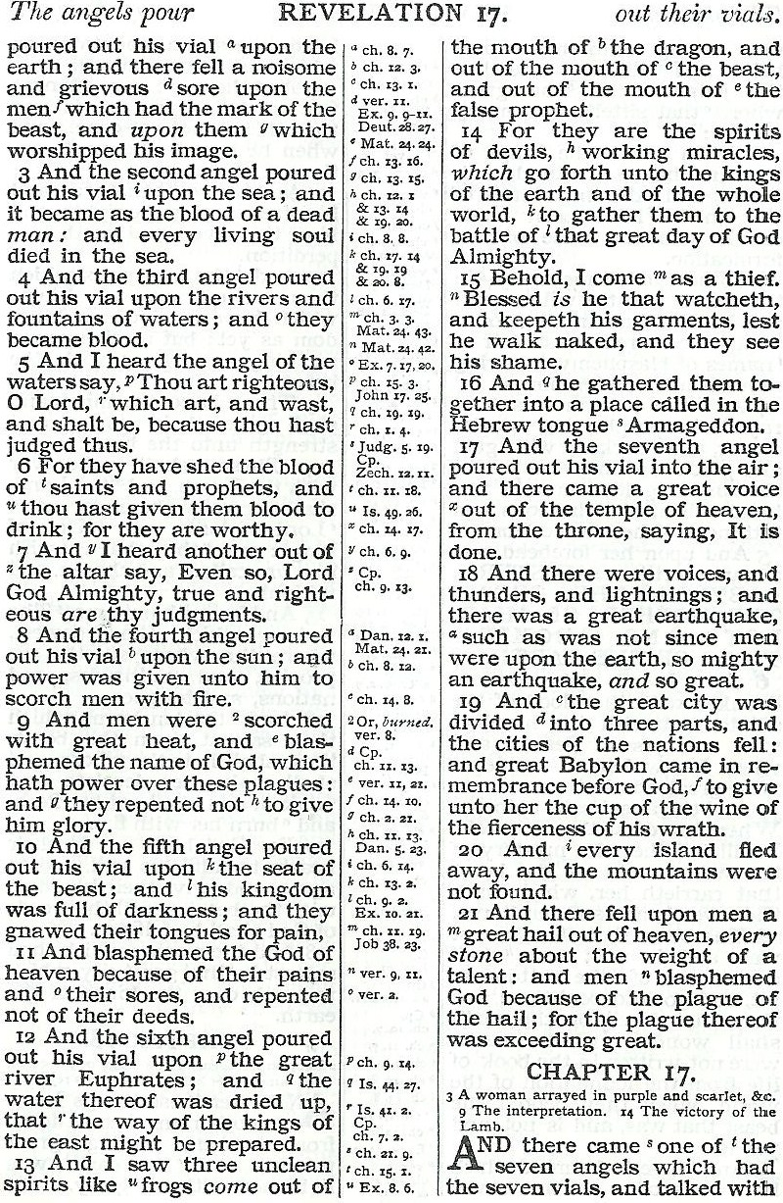
3
4
17
8
10
12

Slide 5
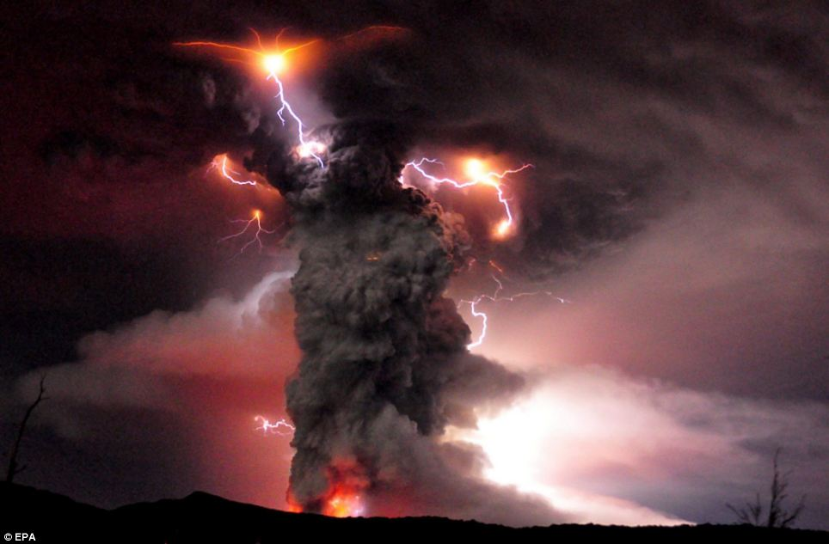
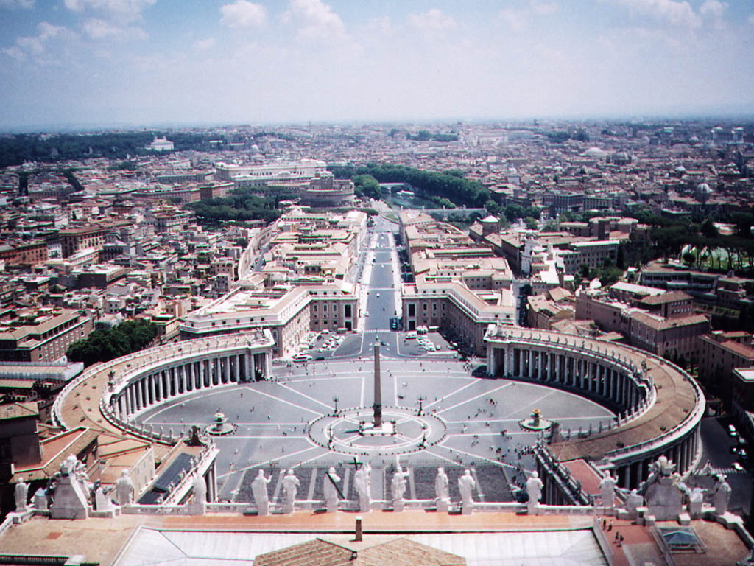
The Seven Last Plagues
15:1
Thus with violence shall that great city Babylon be thrown down, and shall be found NO MORE AT ALL. Rev 18:21
French Revolution
British Naval Blockade
1789
Alpine Campaigns
1793
1796
European Wars
Papacy Repressed
1805
Ottoman Eclipse
1808
1820

Slide 6
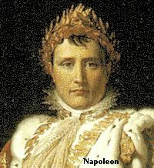
Napoleon was an unwitting instrument of judgement on the Holy Roman Empire and the Catholic Church.
His campaigns brought untold suffering to Italy, Austria and Prussia – fitting vengeance for the blood of God’s servants and anti-Papal witnesses who had been persecuted mercilessly in previous centuries.
‘I am the instrument of Providence, she will use me as long as I accomplish her designs, then she will break me as a glass.’

Slide 7
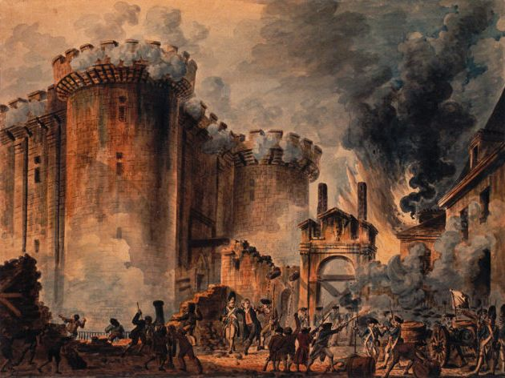
A Malignant Ulcer
Revelation 16:2
AD 1789
2
And the first went, and poured out his vial upon the earth; and there fell a grievous sore upon men which had the mark of the beast, and upon them which worshipped his image.
Rev. 11:4
The First Vial
AD 1789 - 1793

Slide 8
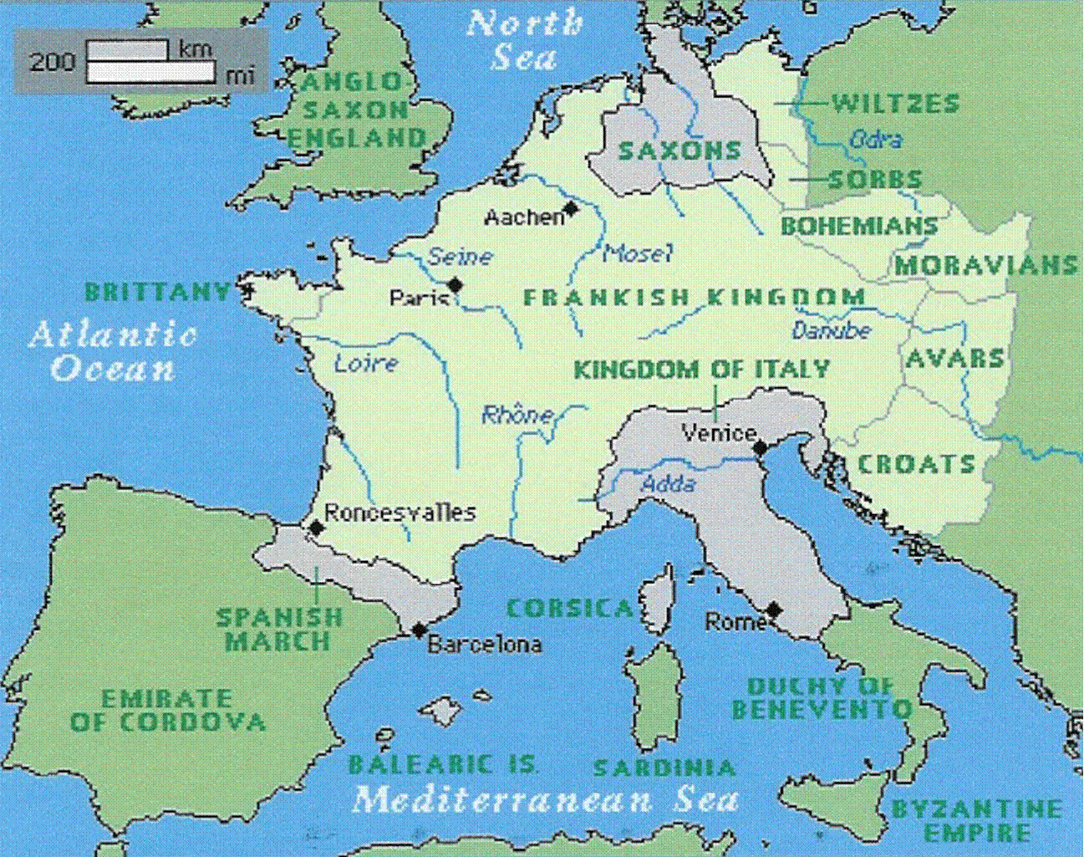
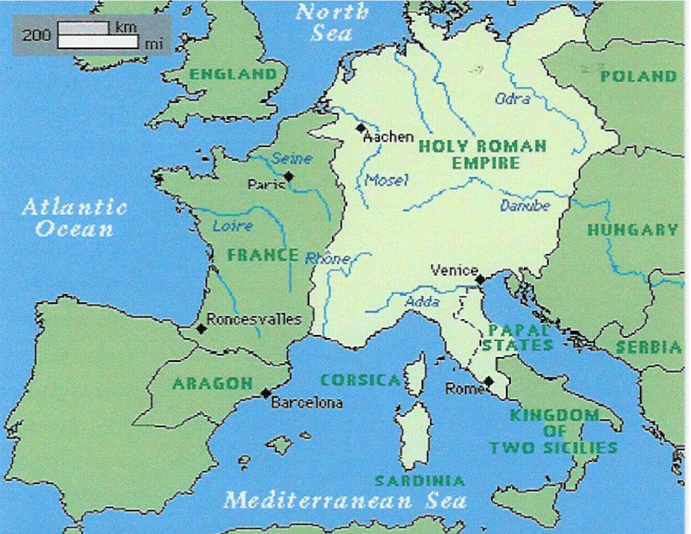
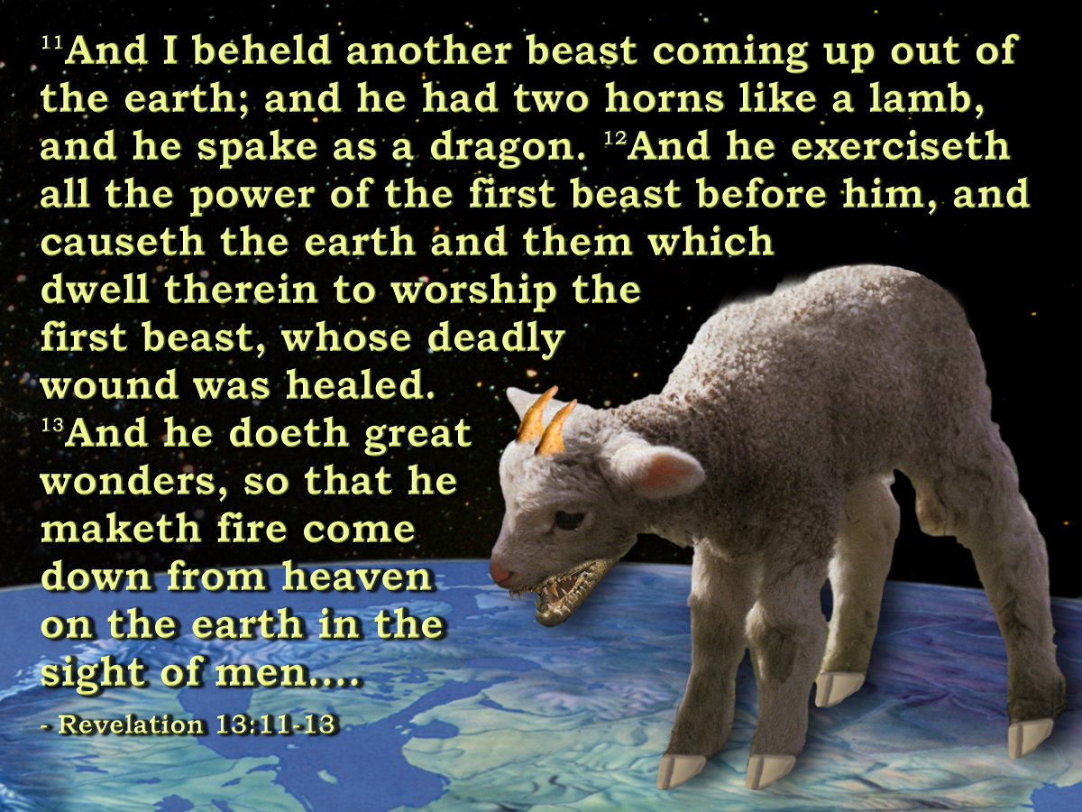
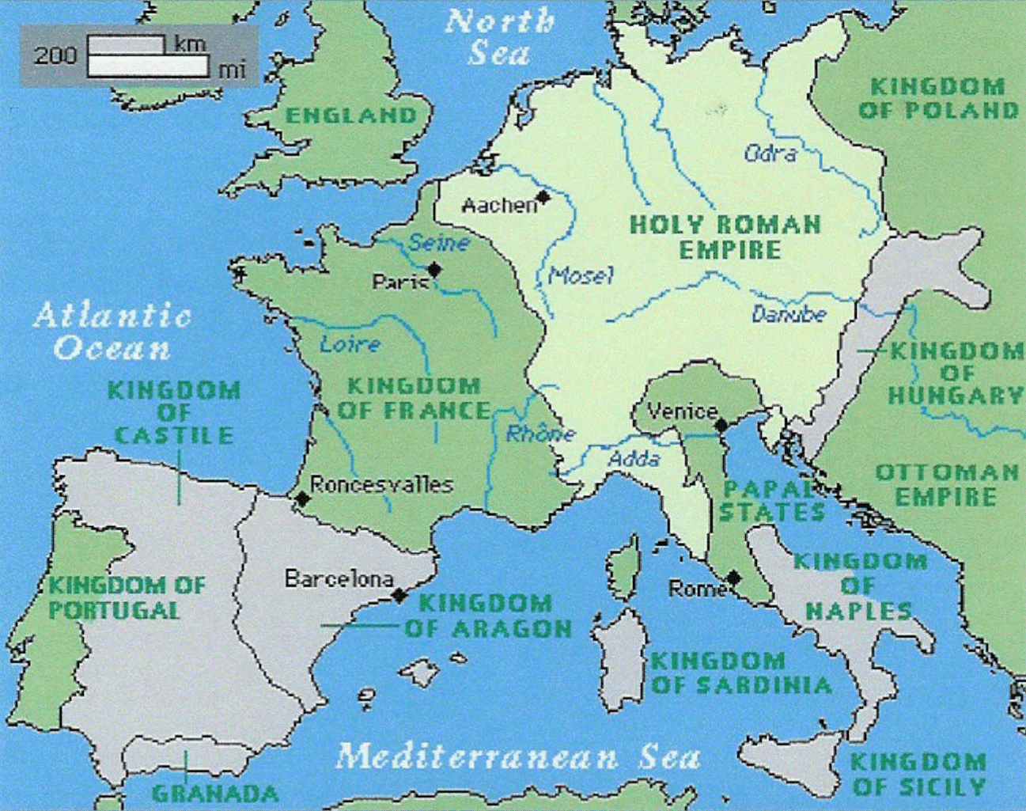
The Holy Roman Empire ‘poured his vial upon the earth.’
Earth Beast
800
1250
1530
Vials of the wrath of God

Slide 9
A Malignant Ulcer
Revelation 16:2
AD 1789
“And a foul and painful sore came on those who had the mark of the beast,……” RSV
2
And the first went, and poured out his vial upon the earth; and there fell a noisome and grievous sore upon men which had the mark of the beast, and upon them which worshipped his image.
GK.= poneros – hurtful. Lit. “an evil, malignant ulcer”.
The First Vial
AD 1789 - 1793

Slide 10
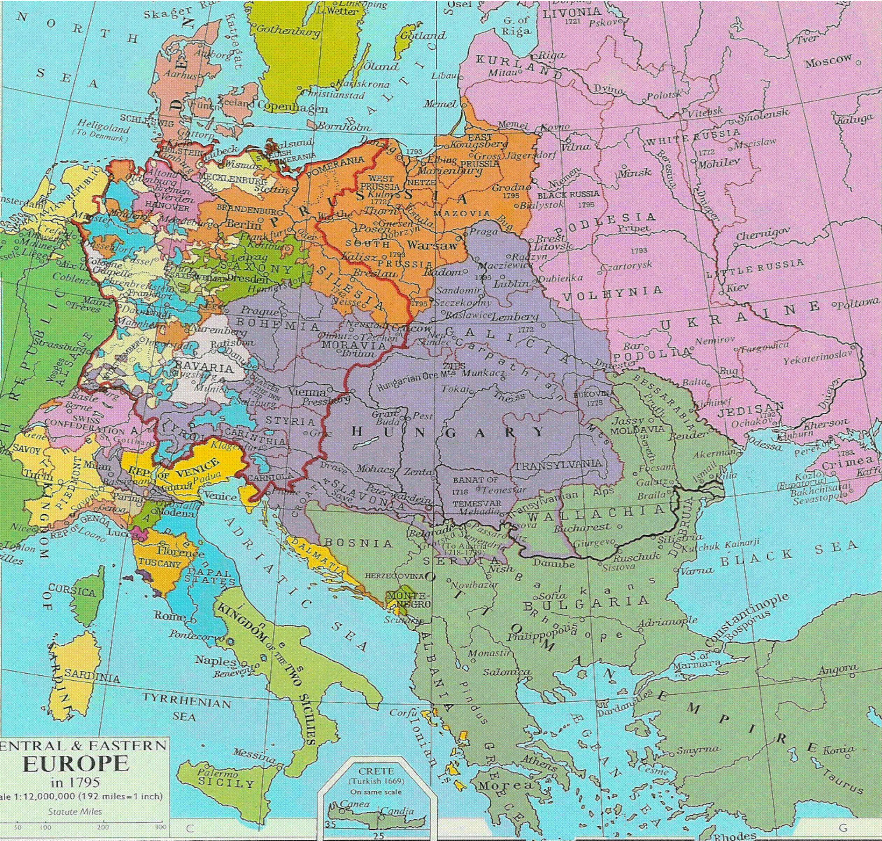
And the first went, and poured out his vial upon the earth;
Because of their co-operation with the Papacy in the persecution of the witnesses. Ch.11
Ulcer
Beginning in France with the proclamation of the Republic in 1792, the effects of the French Revolution spread as a “malignant ulcer” throughout Europe.
Millions died as result of the revolution and the
wars in Europe.
Overthrow of the Catholic Church in France.
Commenced a shockwave of revolution
throughout Europe.
1795

Slide 11
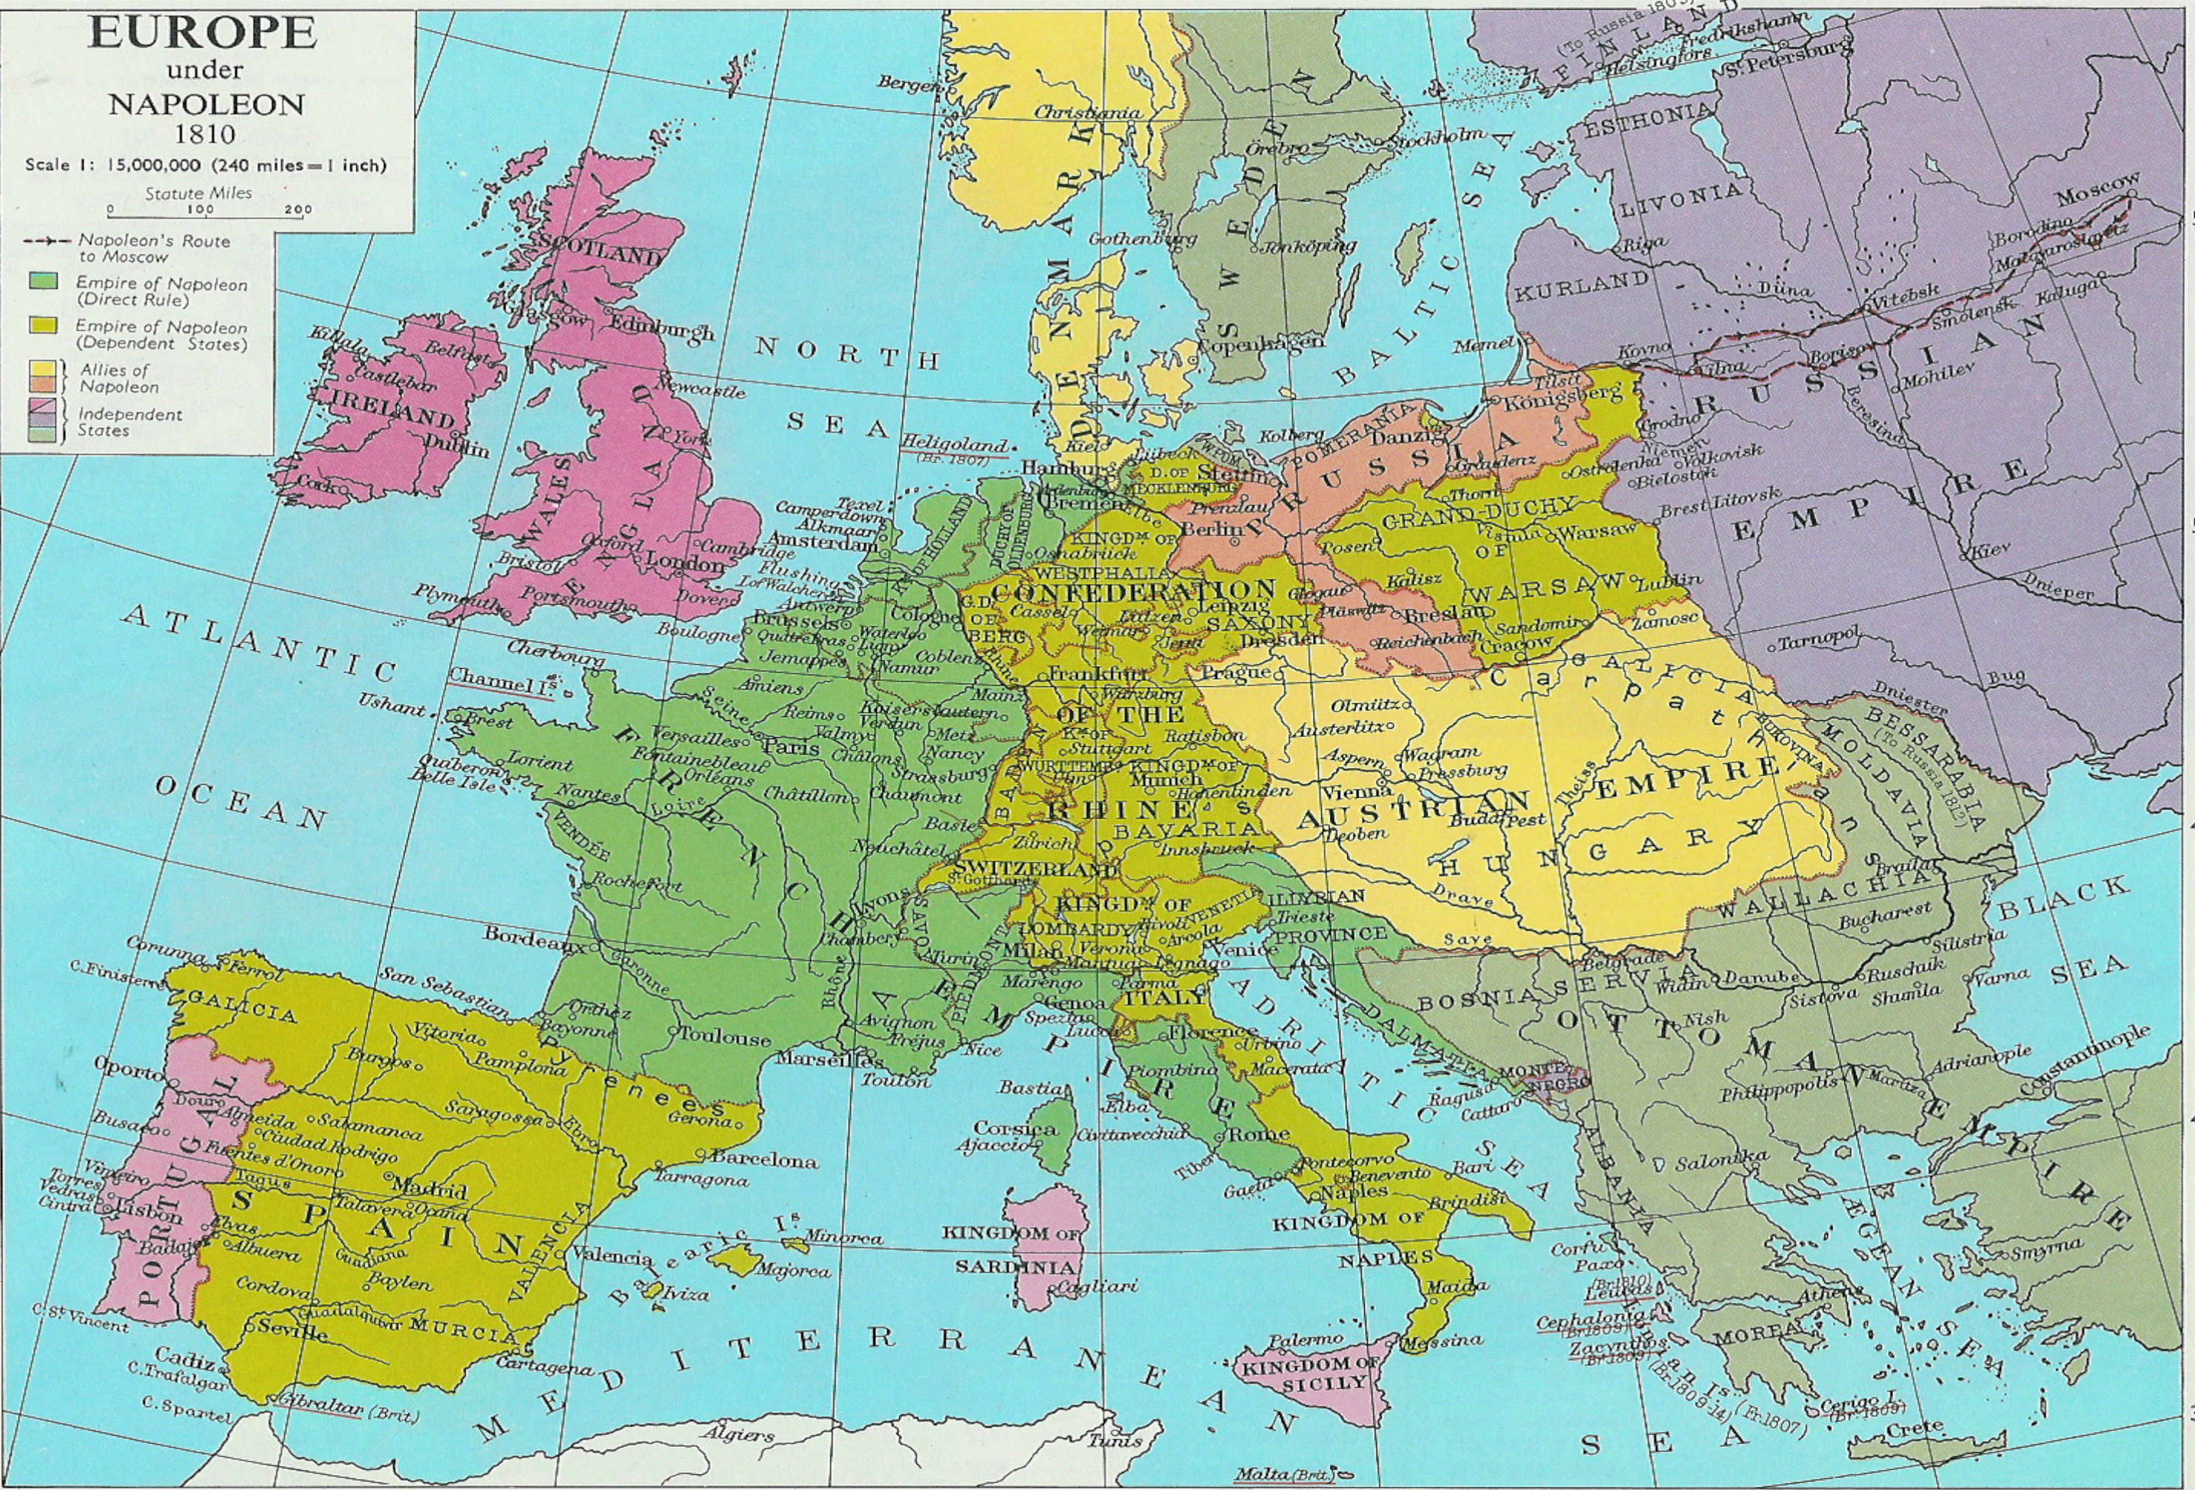
And the first went, and poured out his vial upon the earth;
Defeat!
Defeat!
Victory!
Defeat!

Slide 12
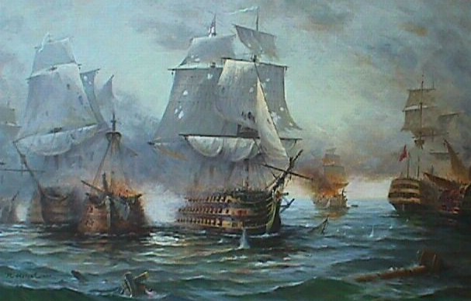
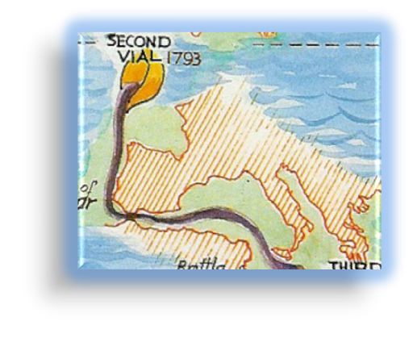
As the blood of a dead man
Revelation 16:3
The blockade of Europe by maritime forces. Britain dominates the sea.
The Mediterranean and the seas surrounding Europe
3
And the second angel poured out his vial upon the sea; and it became as the blood of a dead man : and every living soul died in the sea.
The Second Vial
AD 1793 - 1805

Slide 13
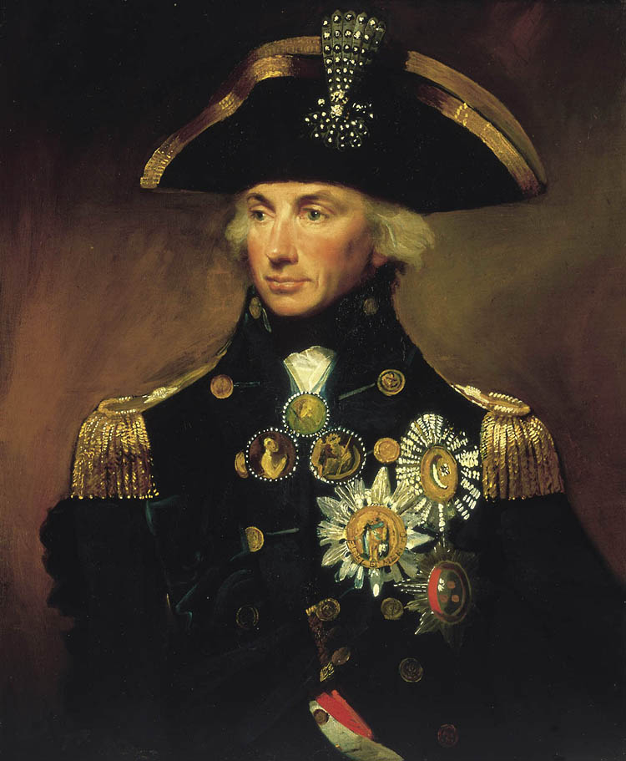
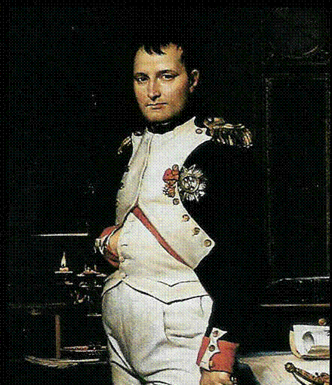
As the blood of a dead man
Revelation 16:3
“We must put all our strength upon the sea; we must destroy England, and the Continent is at our feet.” Napoleon.
3
And the second angel poured out his vial upon the sea; and it became as the blood of a dead man : and every living soul died in the sea.
The Second Vial
AD 1793 - 1805

Slide 14
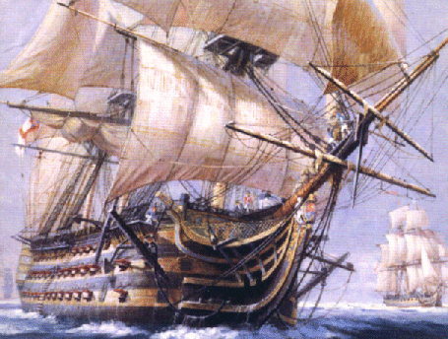
Admiral Nelson and the Victory
God used the tactical genius of Admiral Horatio Nelson to defeat numerically superior forces.
By 1805, Britain completely dominated the seas and did so for the next 50 years.
Earth
1789
1793
Sea
1805
1806
1
2
5
Seat of the Beast
1796
3
1804
4
Fountains & Rivers of Waters
Sun
1809

Slide 15
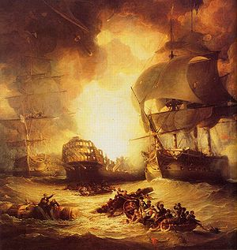
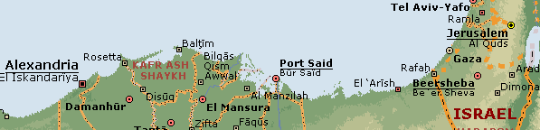
The Battle of the Nile
In August 1798 a French fleet was defeated by a smaller British armada commanded by Admiral Nelson at the Battle of the Nile at Abu Qir, Egypt.
The defeat left Napoleon stranded in Egypt, and led to a coalition of European states against France.

Slide 16
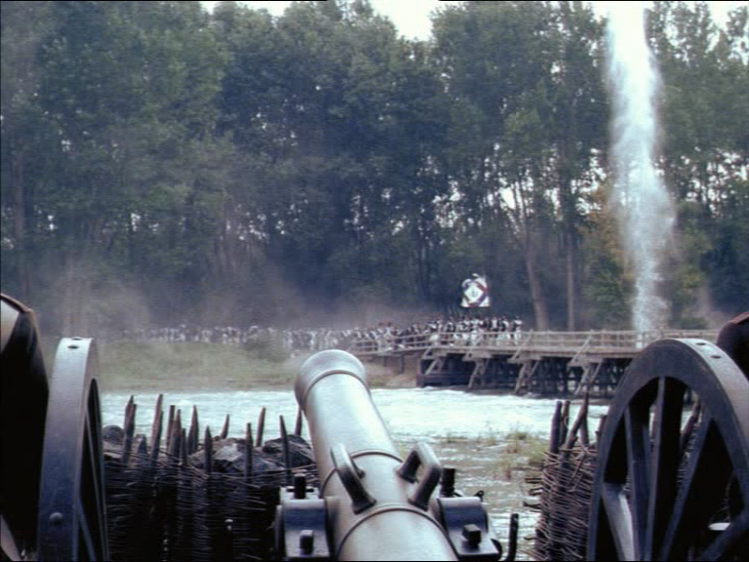
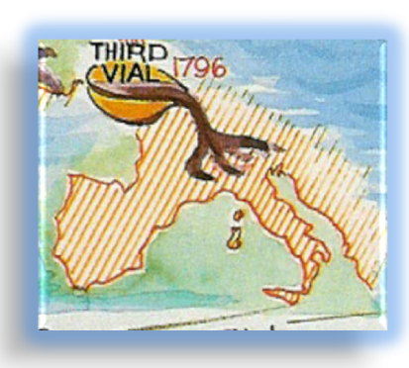
Rivers and Fountains of
Waters become blood
Note v.6
Revelation 16:4-7
Napoleon’s Alpine campaign.
Napoleon takes northern Italy. The Pope is taken prisoner.
4
And the third angel poured out his vial upon the rivers and fountains of waters; and they became blood.
The Third Vial
AD 1796 - 1804

Slide 17
Napoleon: 1769 - 1821
30yrs. old -1799
Seized power
Marries Josephine
27yrs. old -1796
26yrs. old -1795
Promoted Major General
Reign
of
Terror
Made Brigadier General
24yrs. old -1793
Promoted to Captain
23yrs. old -1792
Commissioned 2nd Lieutenant
16yrs. old -1785
Entered French military school
9yrs. old -1778
Vials of the wrath of God

Slide 18
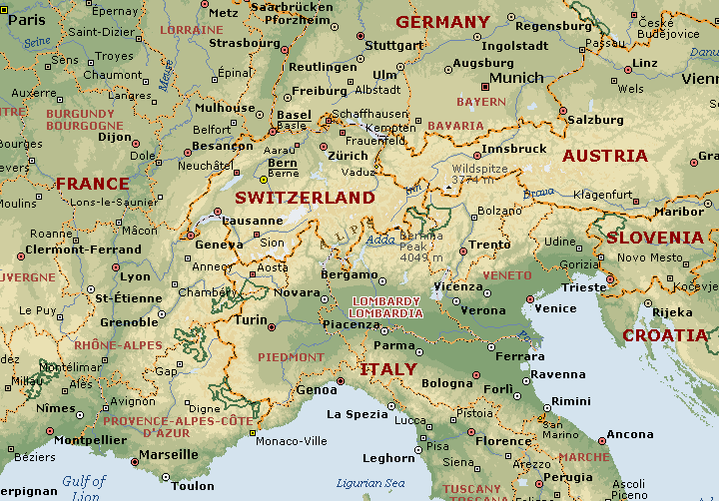
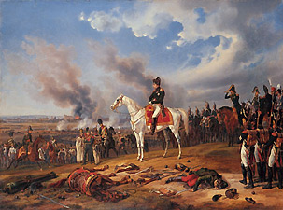
The Pope Given Blood to Drink
After defeating the Austrians in Lombardy, Napoleon turned on the Papacy.
Defeated at Faenza and Ancona, and with Napoleon advancing on Rome, the Pope sued for peace.
4
1796
And the third angel poured out his vial upon the rivers and fountains of waters; and they became blood.

Slide 19
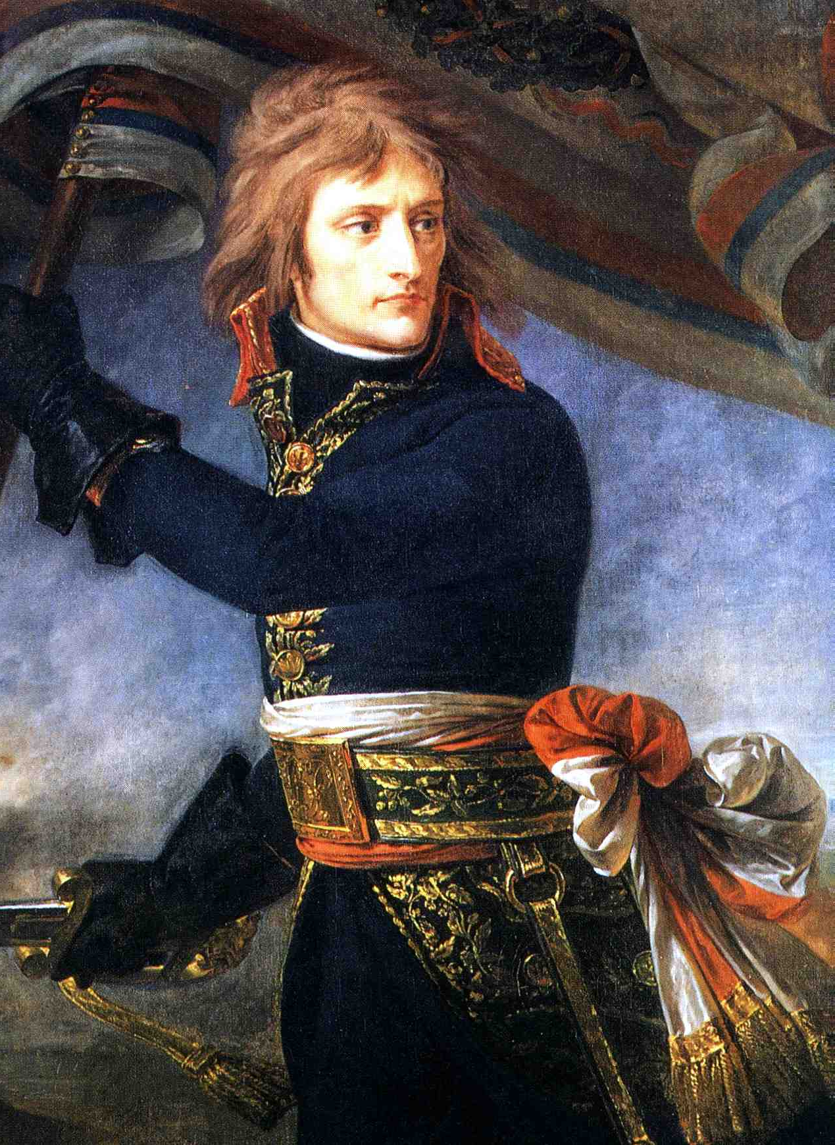
Napoleon Bonaparte
After his triumph in Italy, Napoleon returned to Paris. He’s dangerous! Government needed him busy! England?? Egypt – 1798.
In Napoleon’s absence the
Austrians with help from Russia had retaken Italy with huge slaughter
and suffering on both sides.
He forsook his army in Egypt and returned to Paris where by turn of events he became First Consul after the coup of 1799.

Slide 20
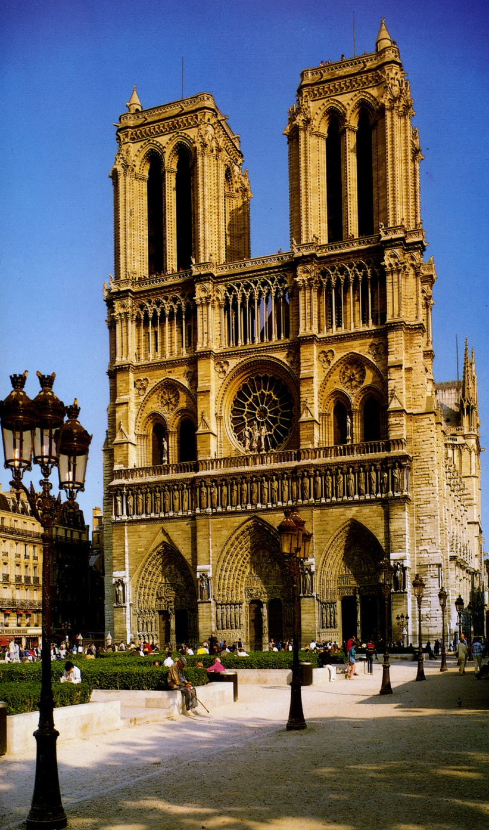
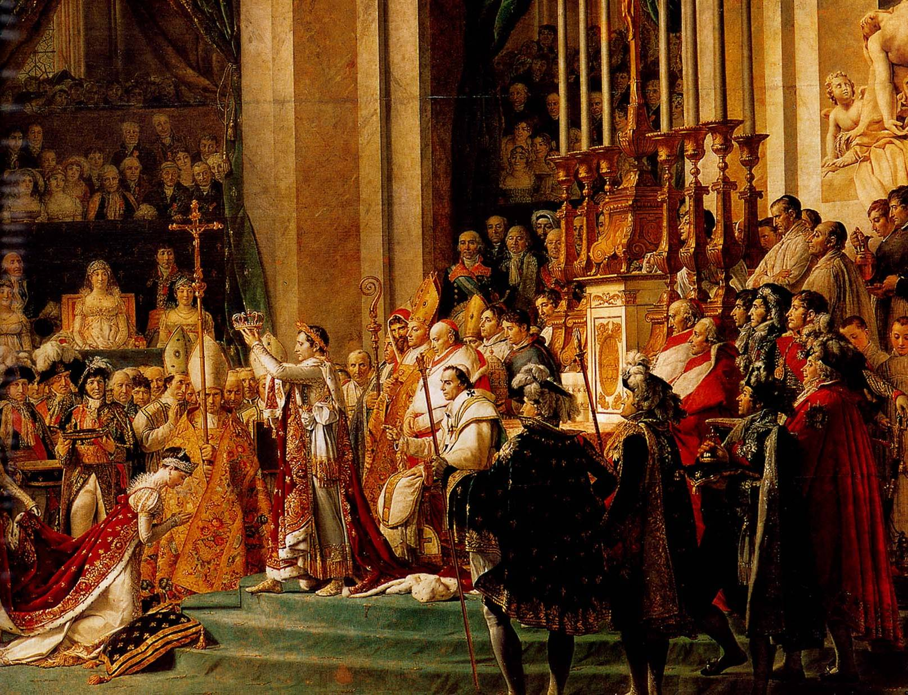
Emperor Napoleon Bonaparte
Notre’ Dame
Cathedral
Napoleon consolidated his
power and by a series of
plebiscites created a dictatorship.
Finally he crowned himself
Emperor in 1804.

Slide 21
Coronation of Napoleon
December 2, 1804

Slide 22
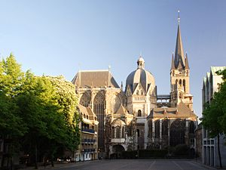
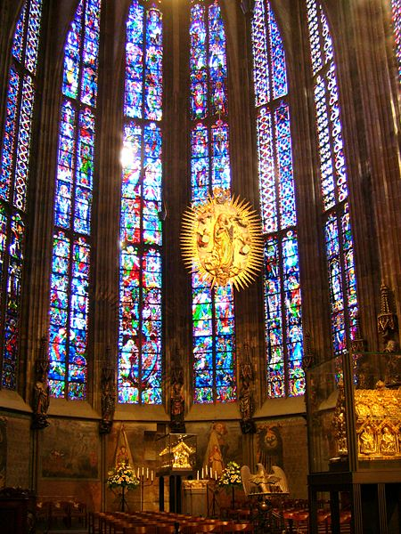
Aachen Cathedral
Men scorched with fire
Revelation 16:8-9
Napoleon’s Austrian campaign. Napoleon enters Vienna. Austria is defeated.
Napoleon’s campaigns
against the
Holy Roman Empire
8
And the fourth angel poured out his vial upon the sun; and power was given unto him to scorch men with fire.
From 1438 – 1806 the rulers came almost invariably from Austria. The ruler of Austria was regarded as the ruler of the Holy Roman Empire.
Political power Psa. 89:36, Rev.8:12, Rev.12:1
The Sun of Europe had been the Holy Roman Empire since 800AD.
The Beast!
The Fourth Vial
AD 1805

Slide 23
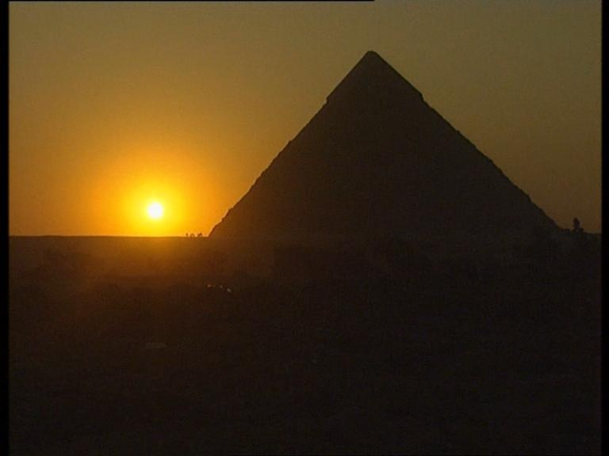
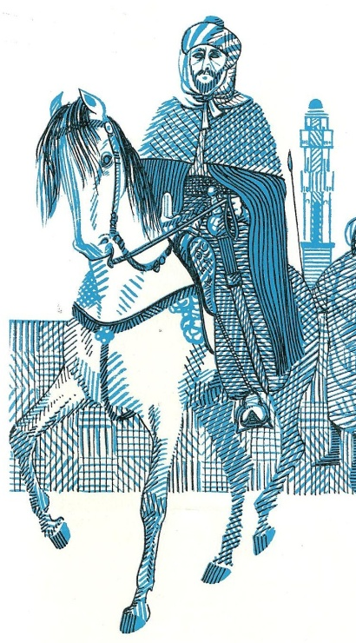
Men scorched with fire
Revelation 16:8-9
8
And the fourth angel poured out his vial upon the sun; and power was given unto him to scorch men with fire.
“Many of the Mamelukes threw themselves into the Nile in panic of flight. Many were cut down by the pursuing French. Those who escaped carried to all parts of Egypt the fame and terror of Sultan Kebir, the King of Fire! – Napoleon!”
The story of Napoleon Henrietta Marsh
The Fourth Vial
AD 1805

Slide 24
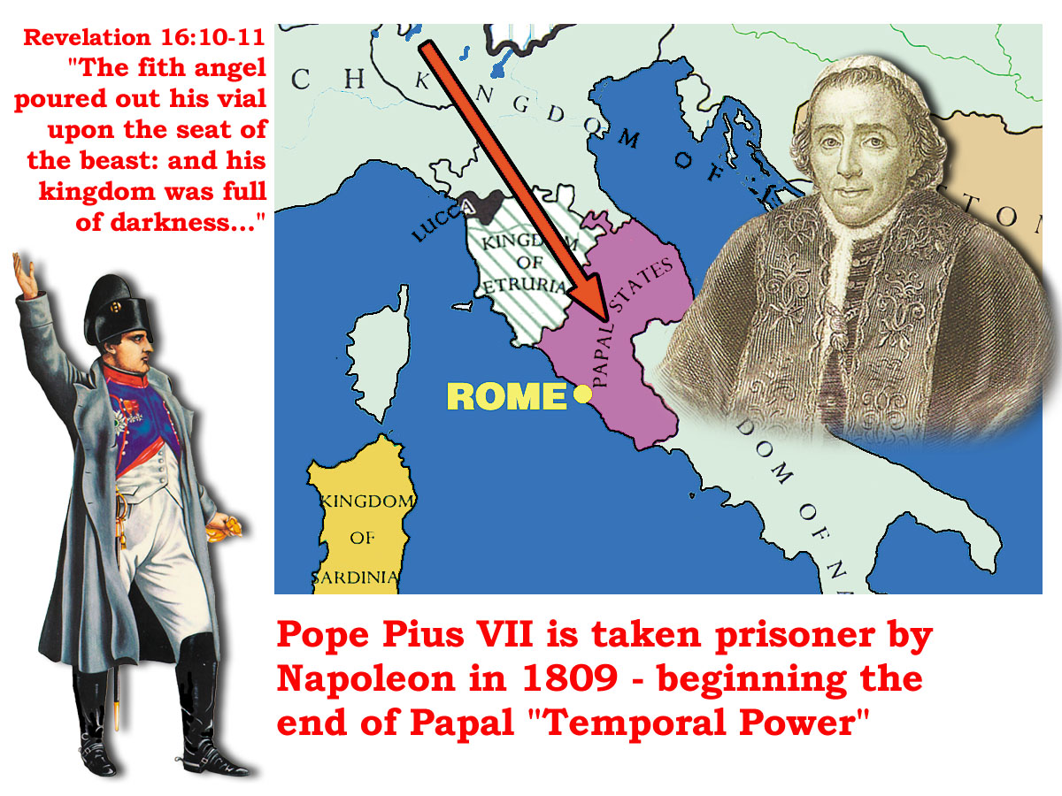
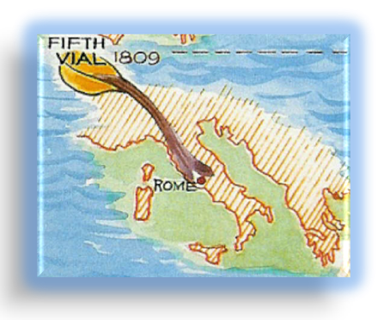
Kingdom full of darkness
Revelation 16:10-11
In April 1809 Napoleon took the Pope prisoner.
The Roman State was abolished; the Pope banished from Rome.
Napoleon’s Italian campaign. Papal states fall and Rome is taken.
10
And the fifth angel poured out his vial upon the seat of the beast; and his kingdom was full of darkness; and they gnawed their tongues for pain,
The Fifth Vial
AD 1809

Slide 25
Kingdom full of darkness
Revelation 16:10-11
11
And blasphemed the God of heaven because of their pains and their sores, and repented not of their deeds.
The Papal Throne had been abolished. Napoleon’s work was done and his further campaigns simply added to the absolute misery already experienced by the worshippers of the Beast and his Image.
1824 circulation of scriptures without Romish interpretations denounced as poisonous pastures
5th. VIAL
Napoleon’s
Campaigns
against
the Papacy
And Rome
1854 doctrine of the immaculate conception.
1870 dogma of papal infallibility.
The Fifth Vial
AD 1809

Slide 26

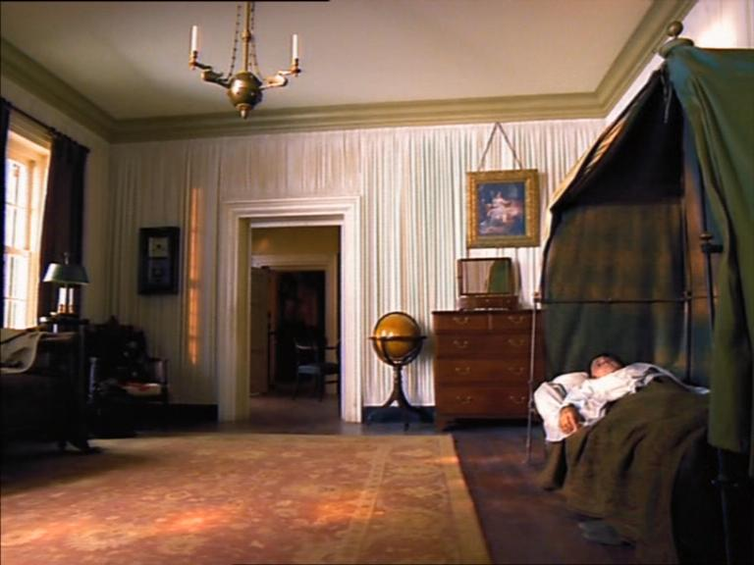
Defeated at Waterloo on 18 June 1815.
Exiled to the remote Atlantic island of St Helena, Napoleon died in 1821 at 52yrs.
John Thomas was 16yrs old

Slide 27
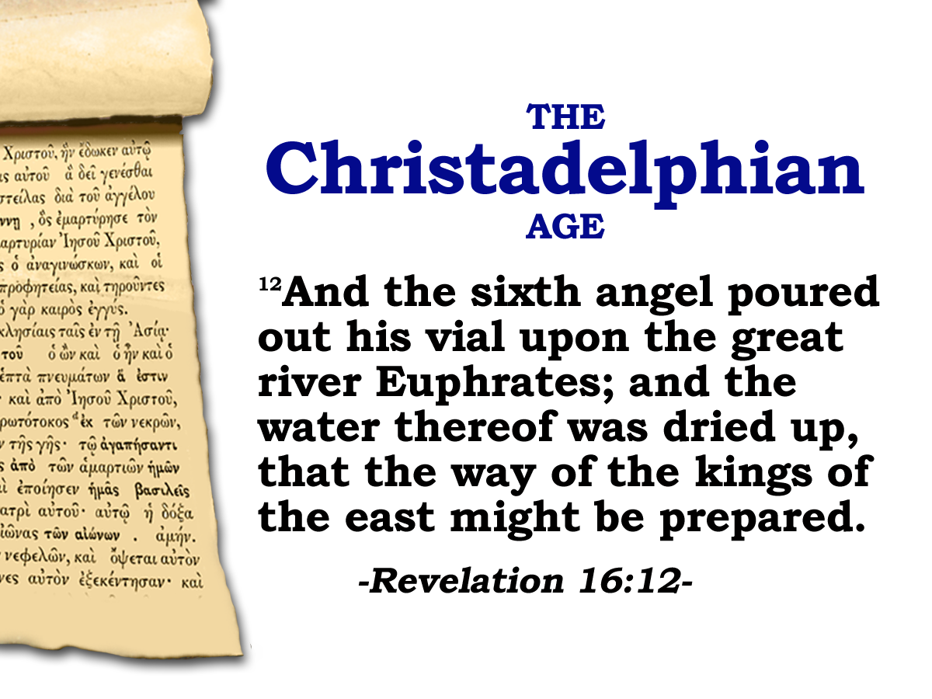
If the French Revolution had not
happened.
If the wars in Europe did not
take place.
If the church and state had not
been separated.
We would not be here!
Notes:
The Christadelphian body watched the sixth angel pour out his vial upon the river Euphrates
We have anticipated it, lectured about it – and seen it happen

Slide 28

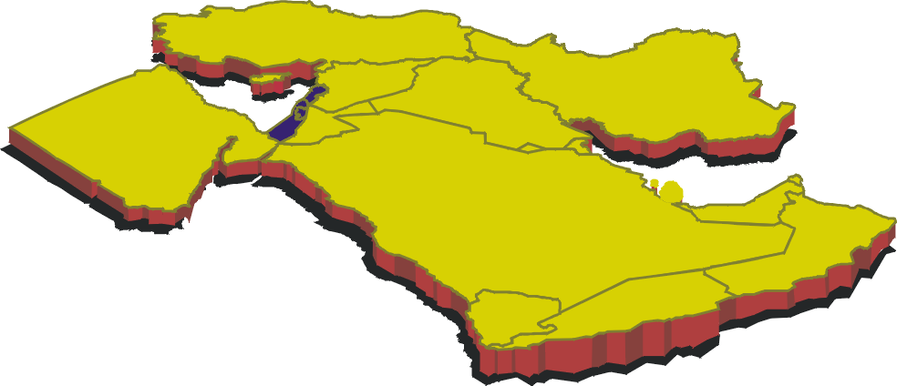
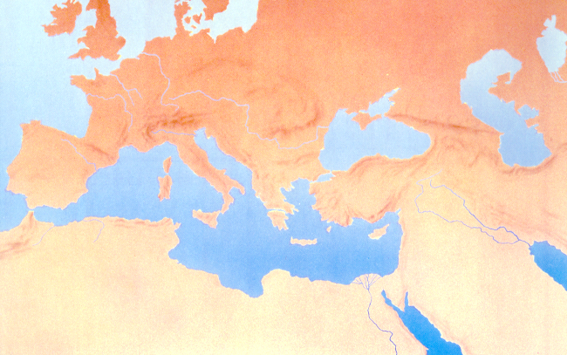
“A way prepared"
Vial 6
Next Session
(God willing)
Revelation 16

Slide 30
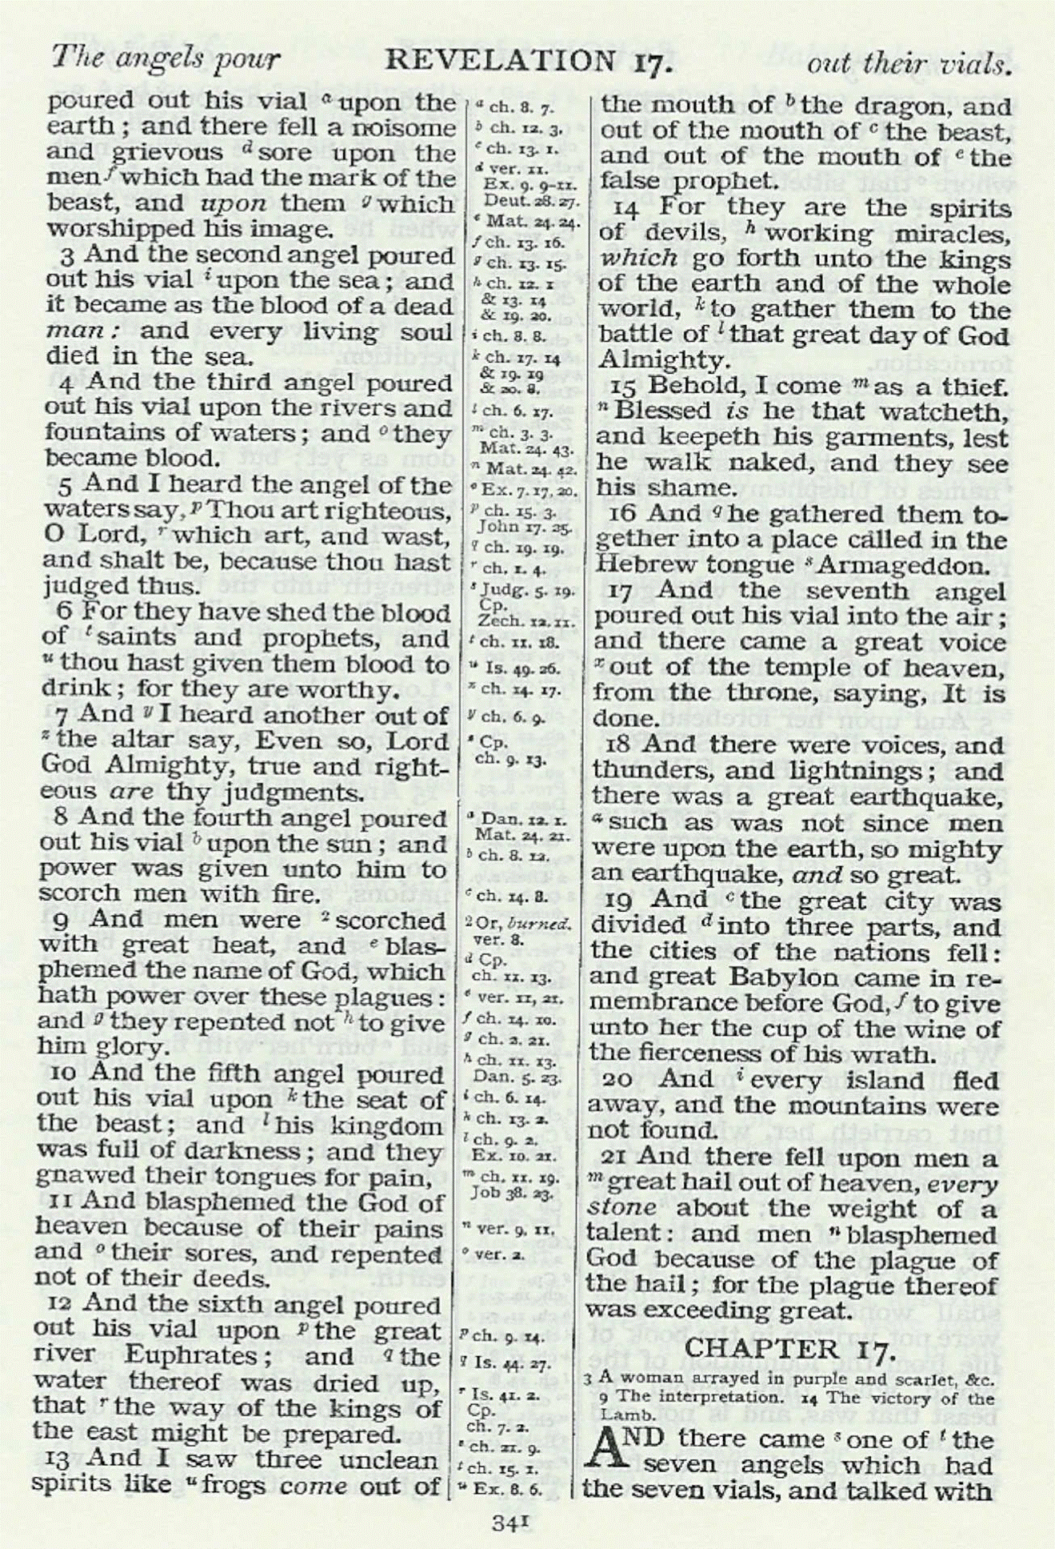
The vials – Revelation 16
2nd
The second Vial ensured the Third was poured out in the arena and toward the people God had intended.
Earth
1789
1793
Sea
1805
1806
1
2
3rd
1796
3
1804
4
Fountains & Rivers of Waters
Sun
Vials of the wrath of God

Slide 31
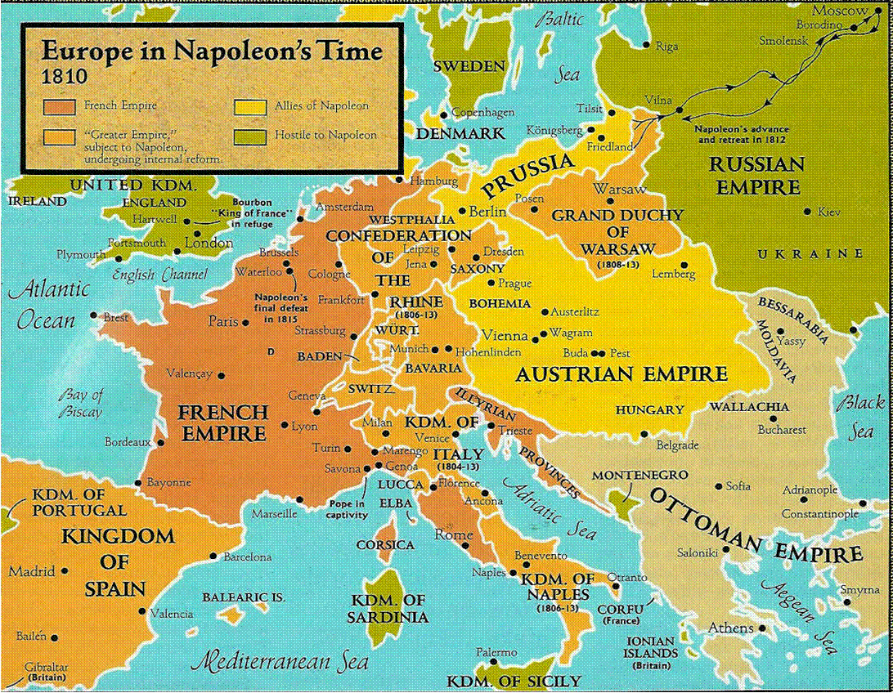
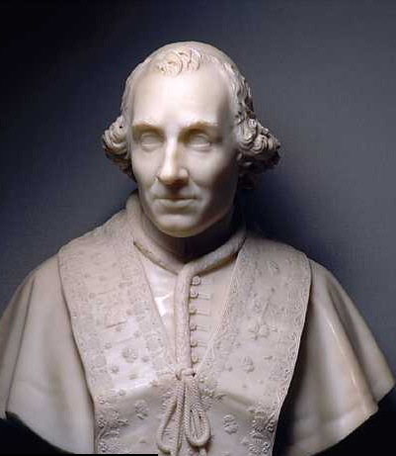
The seat of the Beast
Revelation 16:10-11
Pope Pius VI deposed by Napoleon in February 1798
and died in captivity in
France in 1799.
A new Pope (Pius VII) was elected in 1800 and returned to power in Rome.
In April 1809 Napoleon took the Pope prisoner to Savona in July, and then to Fontainbleau.
The Roman State was abolished and the Pope banished from Rome.
Papacy angered.
Supports England in its war against France.
Excommunicates the French.
The Papal Throne had been abolished.
Napoleon’s work was done.
The 5th Vial had been poured out.
Territorial possessions and monasteries confiscated.
Priests vestments publicly burnt.
Catholic worship forbidden.
“and his kingdom was full of darkness”

Slide 32
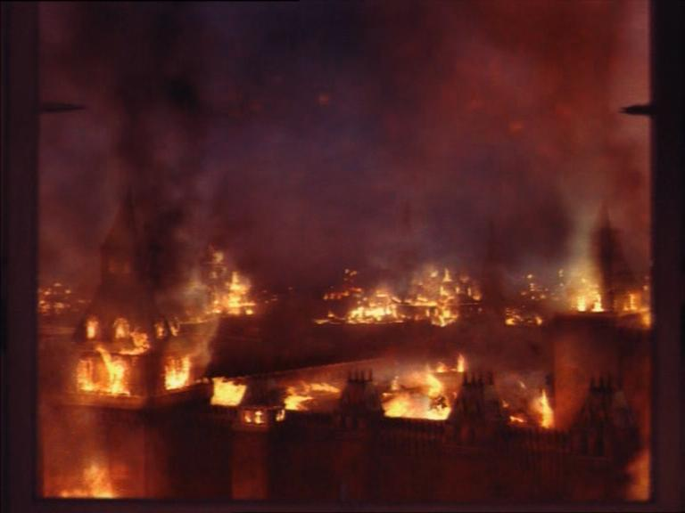
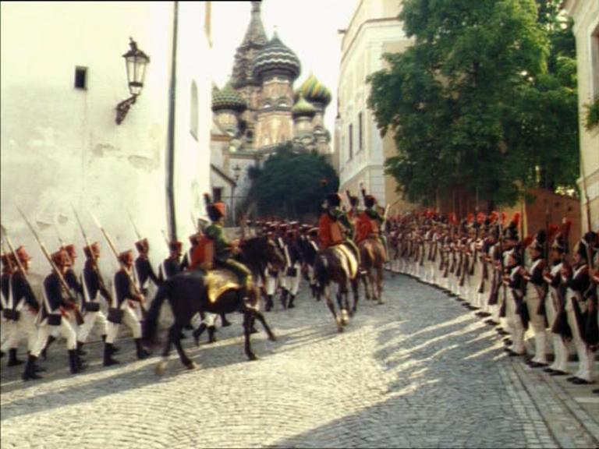
The combined armies of Napoleon numbered 600,000 as he invaded Russia in 1812.
Russia!
As the Russians retreated, Napoleon pressed towards Moscow and entered it , whereupon the Russians set fire to the city.

Slide 33
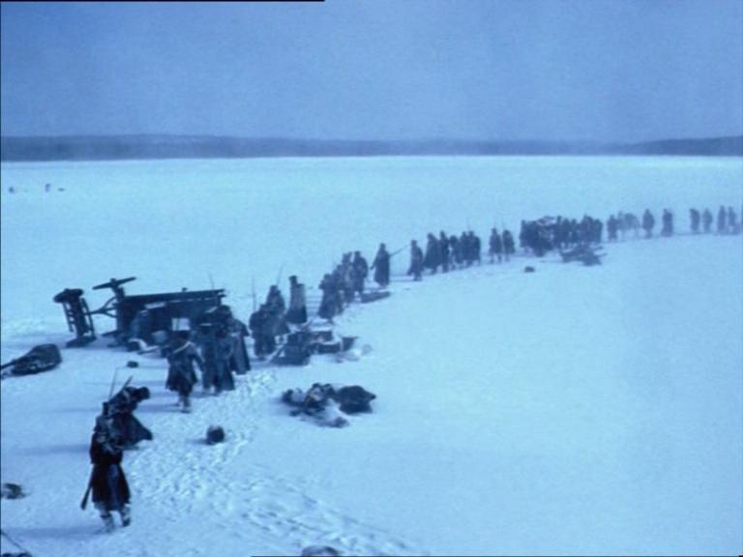
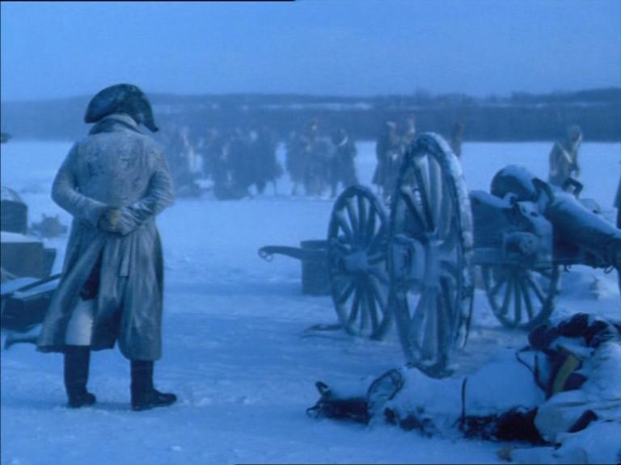
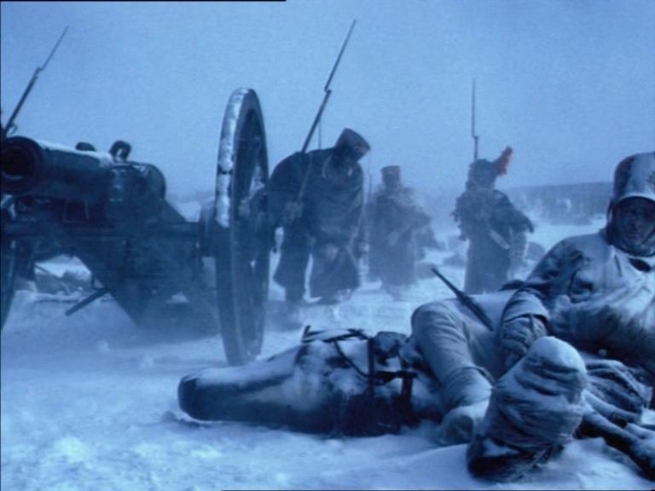
Napoleons army was without food and was forced to make a dash south as the weather turned to blizzards.
Over 500,000 soldiers perished during the retreat. Napoleon’s rule was rapidly approaching its end.
The Papal Throne had been abolished. Napoleon’s work was done and his further campaigns simply added to the absolute misery already experienced by the worshippers of the Beast and his Image

Slide 34
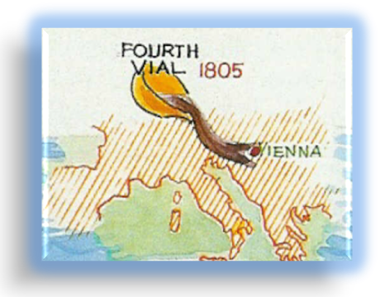
Men scorched with fire
Revelation 16:8-9
8
And the fourth angel poured out his vial upon the sun; and power was given unto him to scorch men with fire.
24 Who gave Jacob for a spoil, and Israel to the robbers? Did not the LORD, he against whom we have sinned? For they would not walk in his ways, neither were they obedient unto his law.
25 Therefore he hath poured upon him the fury of his anger, and the strength of battle: and it hath set him on fire round about, yet he knew not; and it burned him, yet he laid it not to heart.
Napoleon’s campaigns
against the
Holy Roman Empire
Imperial Horn
Papal Horn
The Beast!
Isa.42
The Fourth Vial
AD 1805

Slide 35
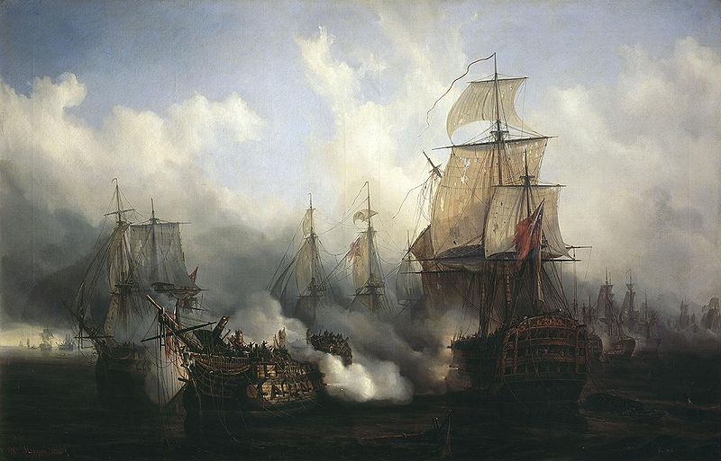
The British fleet consisting of 27 ships commanded by Admiral Nelson engaged the French and Spanish fleet on 21 October 1805.
The Battle of Trafalgar 1805
By day’s end 20 French and Spanish ships were lost. Not a single British ship was lost.

Slide 36


“and gave glory to the God of heaven” Verse 13
As a culmination of their campaign of moral regeneration, the National Convention (first met Sept.1792) authorised the creation of a civic religion. The cult of the Supreme Being” (May 1794)
Robespierre introduced the legislation with a speech entitled , On the principles of political morality “ Immorality,” he declared, “is the basis of despotism, as virtue is the essence of the republic.”
The new National Assembly published a decree proclaiming liberty of opinions. (religious and political)
Rev.11:11-13
“The property of exiled Huguenots unsold at that date should be restored to the rightful heirs.”
“……they stood on their feet…”
v.11
He proposed the following decree which was adopted by acclamation.
The French people acknowledge the existence of the Supreme Being and Immortality of the Soul.
It acknowledges that the worship most worthy of the Supreme Being is the practice of the duties of man.
Scene is set for opening of Rev.16:1
To be an aristocrat meant death!
To be a suspect meant death!
A breath of opposition to the course of events meant death!
Reign of terror
1793 - 1794
5

