Slide 1
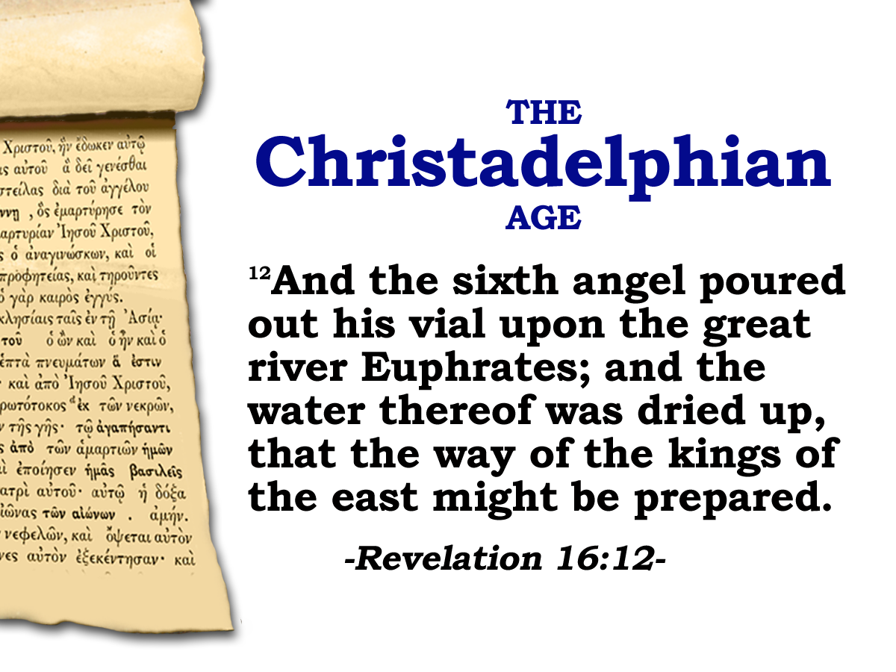

the way of the kings of
the east
Study 5

Slide 2
7th Seal
7
Trumpets
7
1 2 3 4 5 6
Vials
1 2 3 4 5 6
the way of the kings of
Judgement - Christian Rome
the east
Judgement- Holy Roman Empire
Rev.8 & 9
Rev.16
Armageddon
2

Slide 3
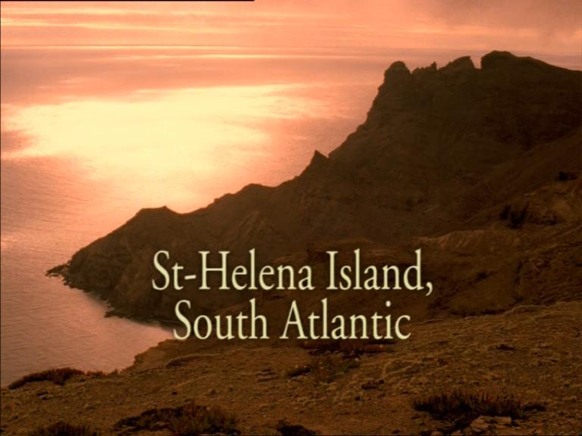
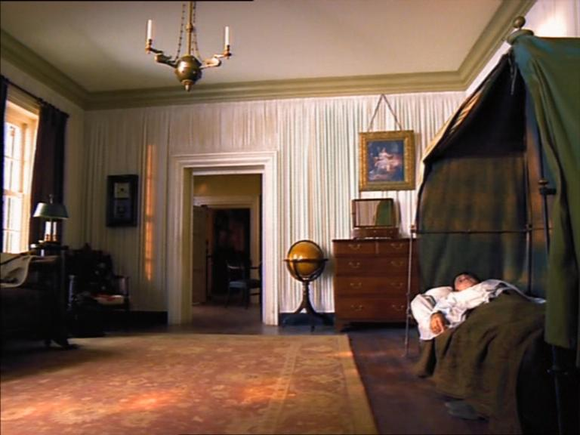
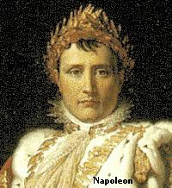
Defeated at Waterloo on 18 June 1815.
Exiled to the remote Atlantic island of St Helena. Napoleon died in 1821 at 52yrs.
John Thomas was 16yrs.
“You speak of Caesar, of Alexander, of their conquests and of the enthusiasm which they enkindled in the hearts of their soldiers; but can you conceive of a dead man making conquests, with an army faithful and entirely devoted to his memory? My armies have forgotten me even while living, as the Carthaginian army forgot Hannibal. Such is our power.
Well then I will tell you. Alexander, Caesar, Charlemagne and myself have founded great empires; but upon what did these creations of our genius depend? Upon force. Jesus alone founded His empire upon love, and to this very day millions will die for him…..I think I understand something of human nature, and I tell you, all these were men, and I am a man: none else is like him; Jesus Christ was more than a man………….”
“I have inspired multitudes with such an enthusiastic devotion that they would have died for me…..but to do this it was necessary that I should be visibly present with the electric influence of my looks, my words, of my voice .
When I saw men and spoke to them, I lighted up a flame of self devotion in their hearts…..
Christ alone has succeeded in so raising the mind of man toward the unseen, that it becomes insensible to the barriers of time and space. Across a chasm of eighteen hundred years, Jesus Christ makes a demand which is beyond all others to satisfy. He asks for the human heart”
Citied in ‘Jesus Among other Gods’ by Ravi Zacharias
From Liddon’s Brampton Lectures 1866

Slide 4
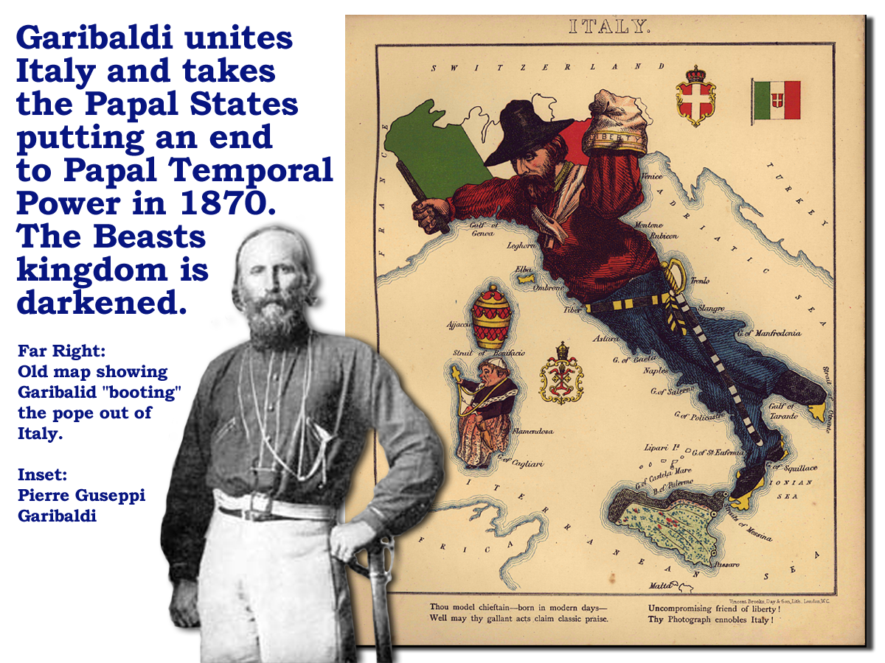
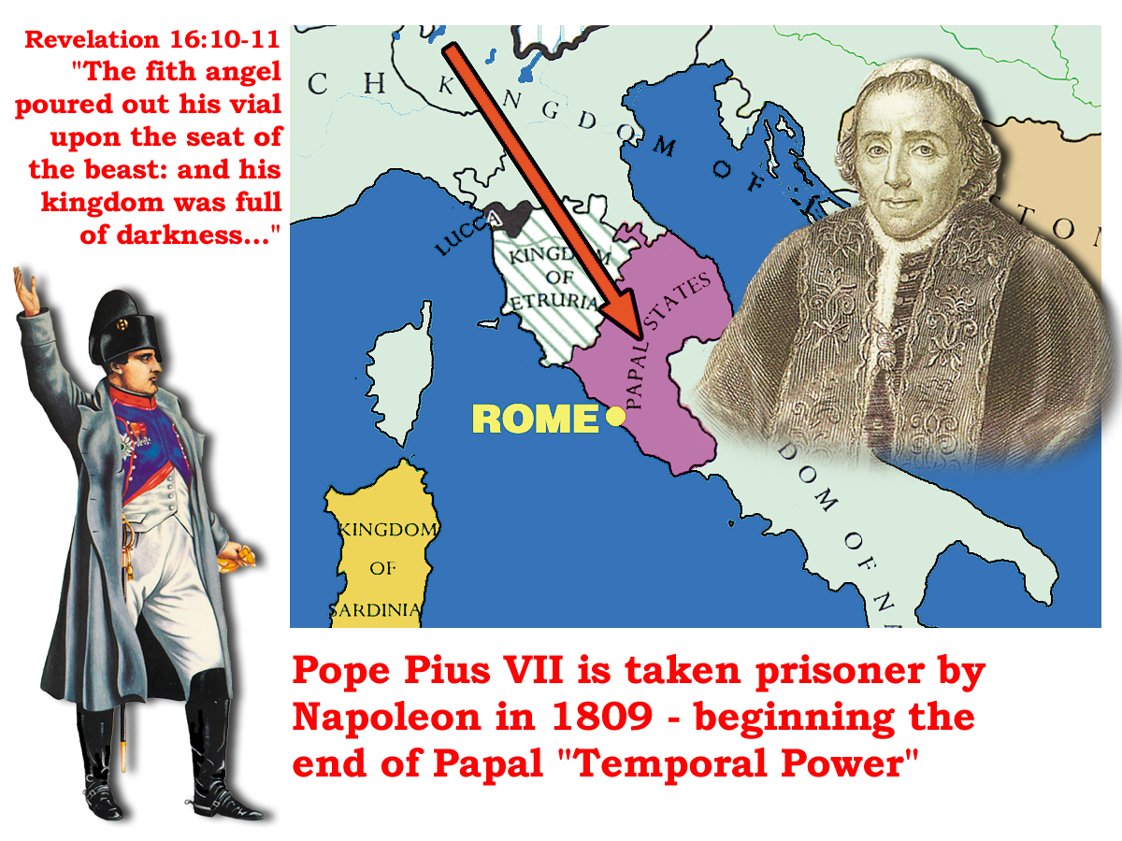
A Way Prepared
7
Vials
1 2 3 4 5 6
Why so long?
Pope at his lowest point
Judgement- Holy Roman Empire
Rev.16
30yrs!
198yrs!
AD 1789 – AD 1820
Armageddon
A Way Prepared
4

Slide 5
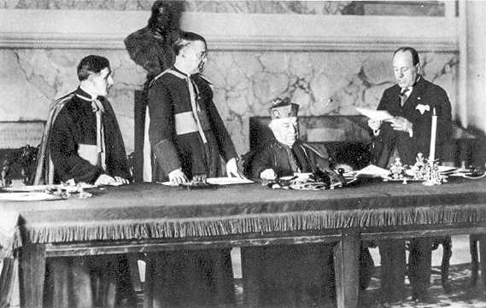
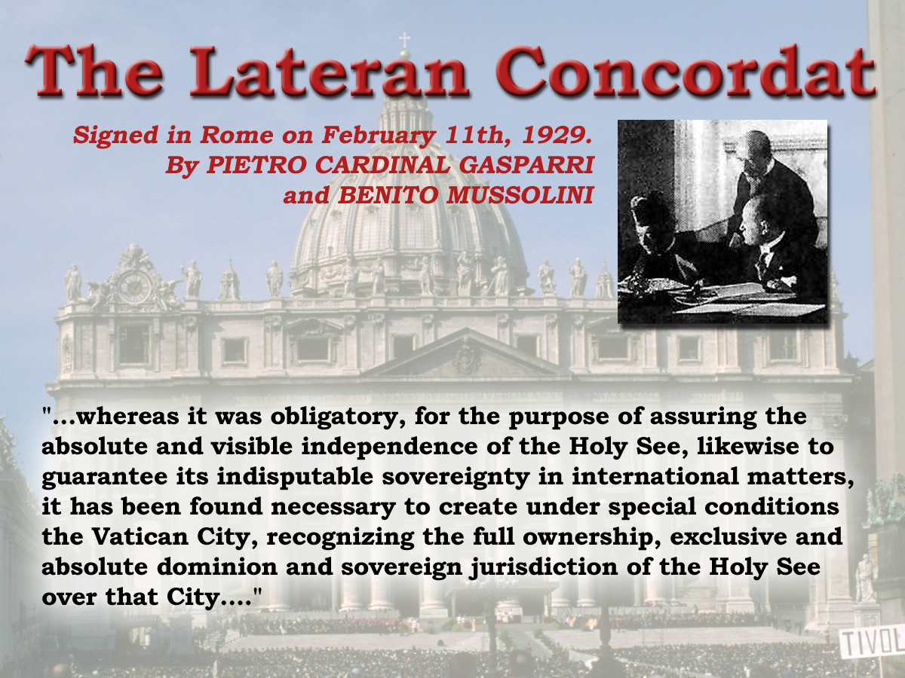
1870 Pope lost his Temporal Power. Was at his lowest point.
Rev.17
7
16 And the ten horns which thou sawest upon the beast, these shall hate the whore, and shall make her desolate and naked, and shall eat her flesh, and burn her with fire.
1789
Vials
“The blow to Papal prestige of the loss of its states in 1870 is hard to imagine at this distant time. Pius lX refused to recognise the change in sovereignty and he and his successors remained in self- imposed imprisonment within the Papal Palace, never venturing outside.”
Pius Xl accordingly decided to make an agreement with Mussolini, which resulted in the Lateran pacts of 1929….. Mussolini was prepared to go much further than the government of 1871 in that he recognised the Pope as the temporal ruler of Vatican City which was to become an independent sovereign state
Six European States -- The Church
1 2 3 4 5 6
Why so long?
Judgement- Holy Roman Empire
Rev.16
Time was needed to rebuild his power for the time of the end.
30yrs!
198yrs!
17 For God hath put in their hearts to fulfill his will, and to agree, and give their kingdom unto the beast, until the words of God shall be fulfilled.
1929
AD 1789 – AD 1820
Armageddon
A Way Prepared
5

Slide 6
A Way Prepared
7
Vials
1 2 3 4 5 6
Why so long?
Test of Faith!
Judgement- Holy Roman Empire
Test of Endurance!
Rev.16
30yrs!
198yrs!
AD 1789 – AD 1820
Armageddon
“That the way of the kings of the East might be prepared.”
6

Slide 7
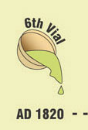
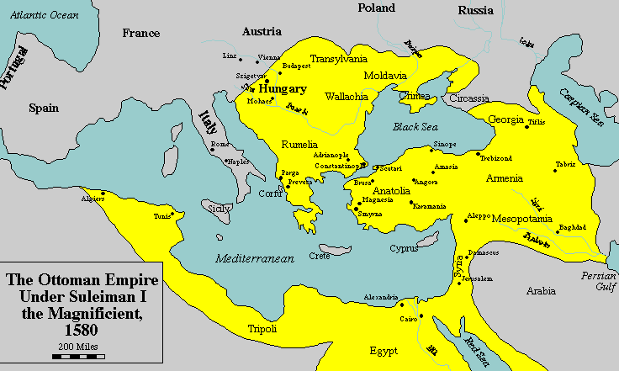
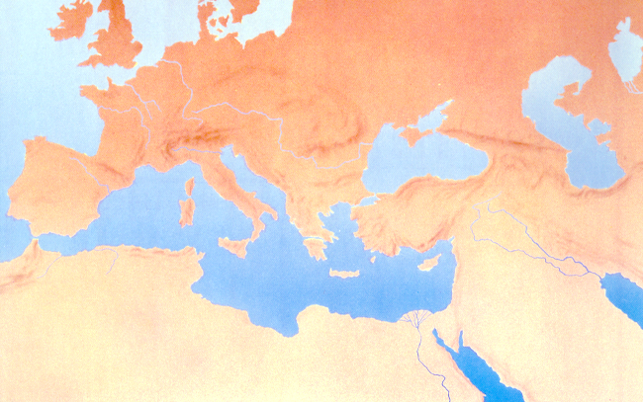
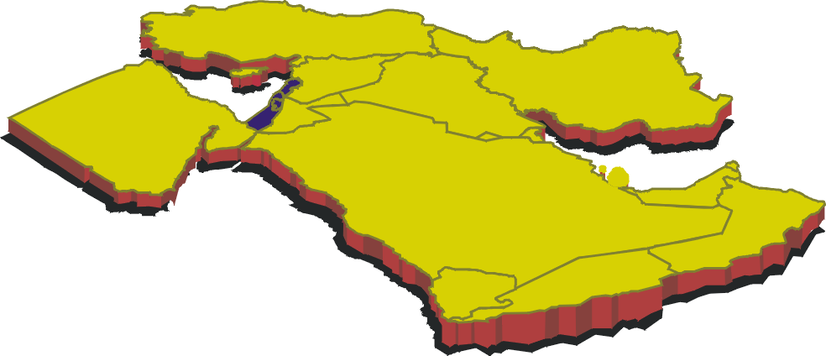
The way prepared
Revelation 16:12-16
The military power of the Ottoman Empire
Powers Isa. 8:7
12
7 Now therefore, behold, the Lord bringeth up upon them the waters of the river, strong and many, even the King of Assyria, and all his glory: and he shall come up over his channels, and go over his banks:
And the sixth angel poured out his vial upon the great river Euphrates; and the water thereof was dried up, that the way of the kings of the east might be prepared.
Isa. 8
3 And I took your father Abraham from the other side of the flood,…
Josh. 24
The military power of the Assyrian Empire
The Sixth Vial
AD 1820
7

Slide 8

The way prepared
Revelation 16:12-16
Typically set down over two thousand years ago. Isa. 41, 4 4, 45
12
And the sixth angel poured out his vial upon the great river Euphrates; and the water thereof was dried up, that the way of the kings of the east might be prepared.
Lit. = “The kings who are out of the suns rising.”
Rev.5:10,
17:14
The Sixth Vial
AD 1820
8

Slide 9
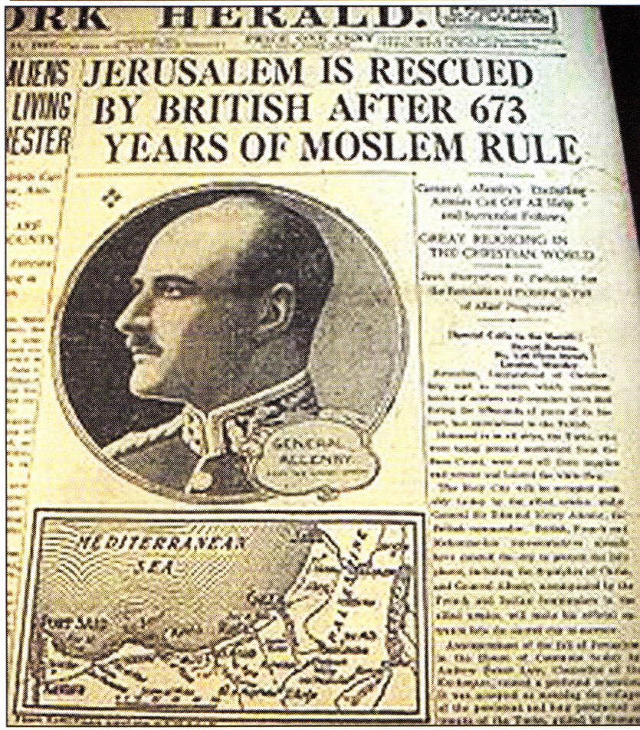
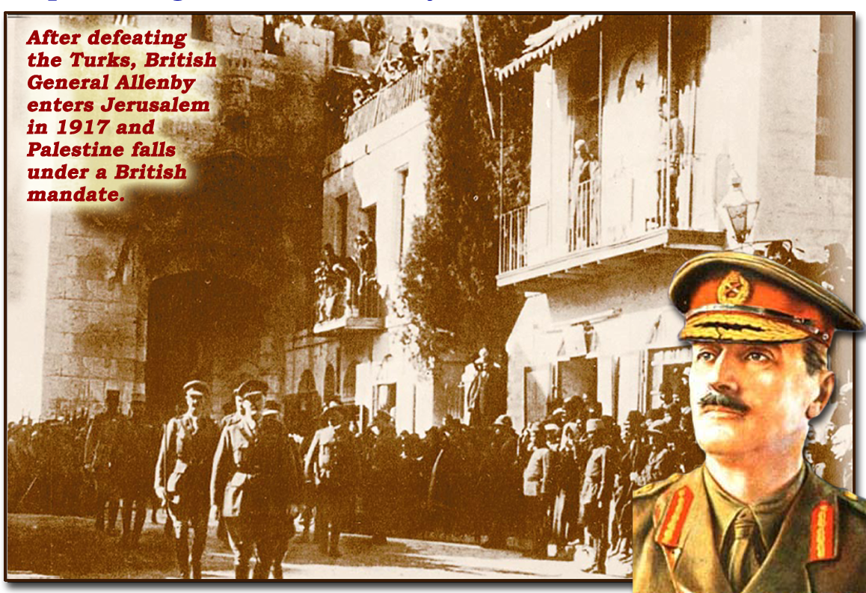

12 Then the sixth angel poured out his bowl on the great river Euphrates, and its water was dried up, so that the way of the kings from the east might be prepared.
1917
Babylon!

The Way!
9

Slide 10
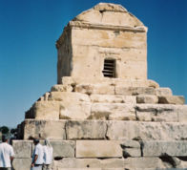
The way of the kings of the east
“O man, whoever you are and wherever you come from, for I know you will come, I am Cyrus who won the Persians their empire. Do not therefore grudge me this little earth that covers my body.”
Tomb of Cyrus
Cyrus and his immortals are history! – Dust! - Never to live again!
Christ’s immortals are future! – Will come from dust and live forever!
A Way Prepared
10

Slide 11
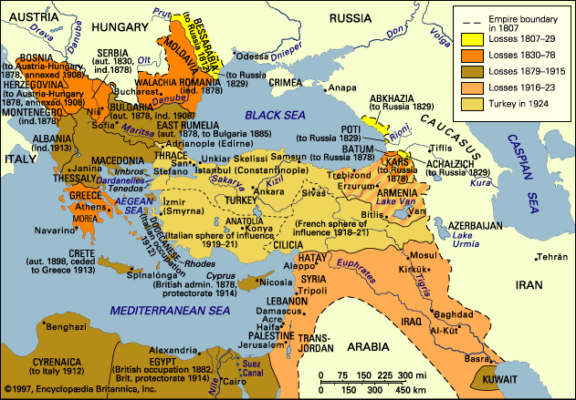
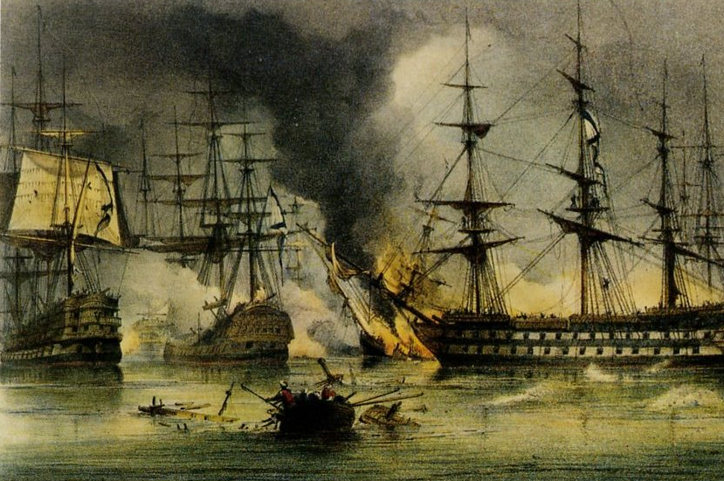
And the sixth angel poured out his vial upon the great river Euphrates; and the water thereof was dried up, that the way of the kings of the east might be prepared.
1916. ANZACS withdraw to Egypt. Reform into E.E.F
11

Slide 12
The way prepared
Revelation 16:12-16
13
And I saw three unclean spirits like frogs come out of the mouth of the dragon, and out of the mouth of the beast, and out of the mouth of the false prophet.
The Sixth Vial
AD 1820
12

Slide 13
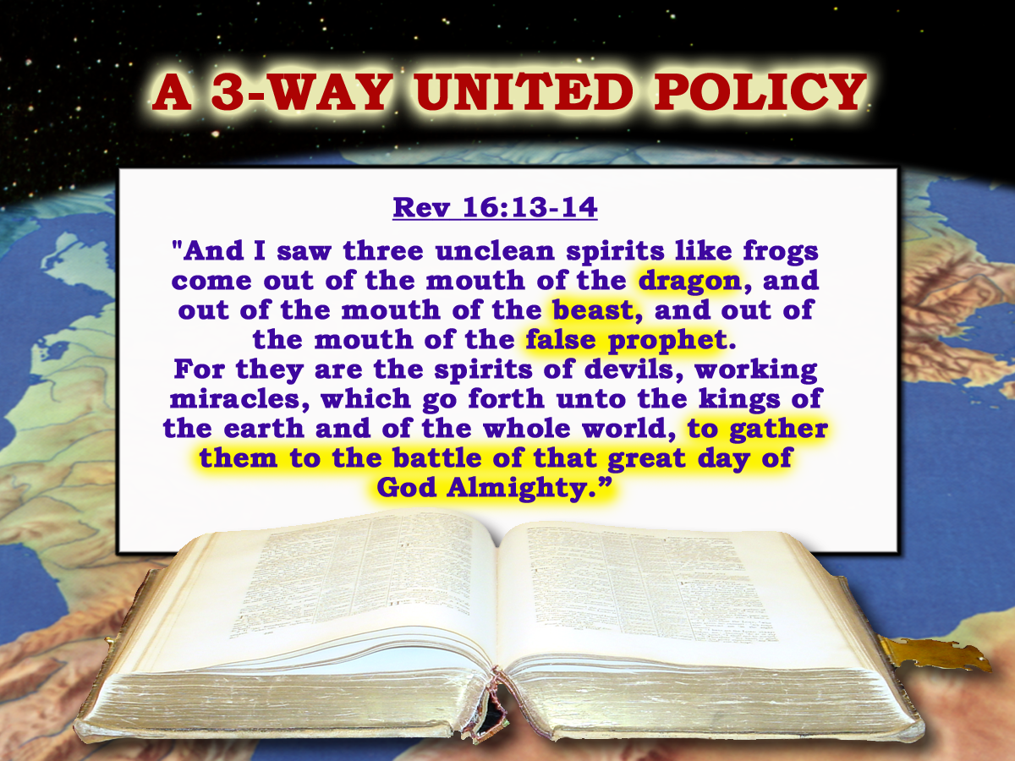
Note: v10.
The area of central Europe
Russia in Constantinople.
Rev.13:4
The Catholic Hierarchy.
2 Peter 2:1
2 Thess.2
13

Slide 14
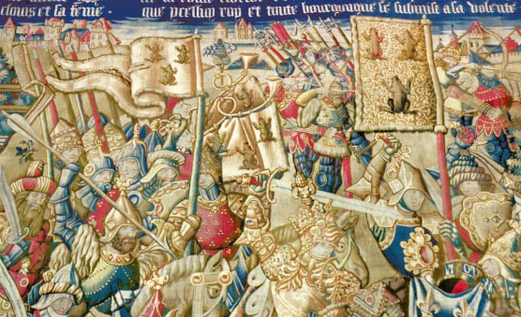
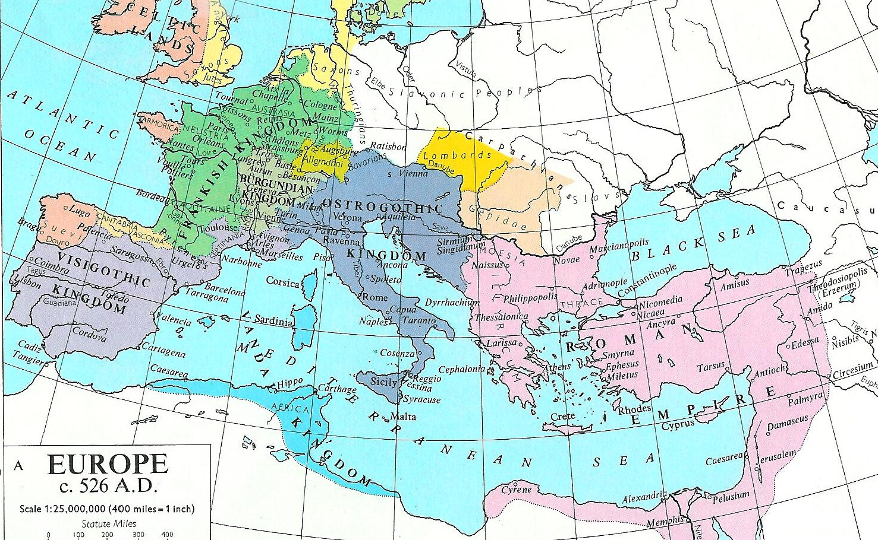
The way prepared
Revelation 16:12-16
“The love of liberty was the ruling passion of the Frankish barbarians. They deserved, they assumed, they maintained the honourable epithet of the Franks, or free men.” Gibbon
13
And I saw three unclean spirits like frogs come out of the mouth of the dragon, and out of the mouth of the beast, and out of the mouth of the false prophet.
Marsh lands of Westphalia
526 AD
The Frankish kings used the emblem of the frog as part of their heraldry
Shield of Pharamond
420 AD
The Sixth Vial
AD 1820
14

Slide 15
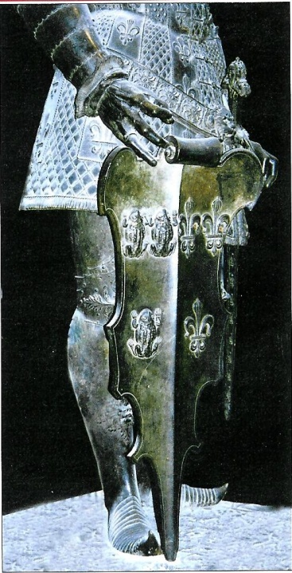
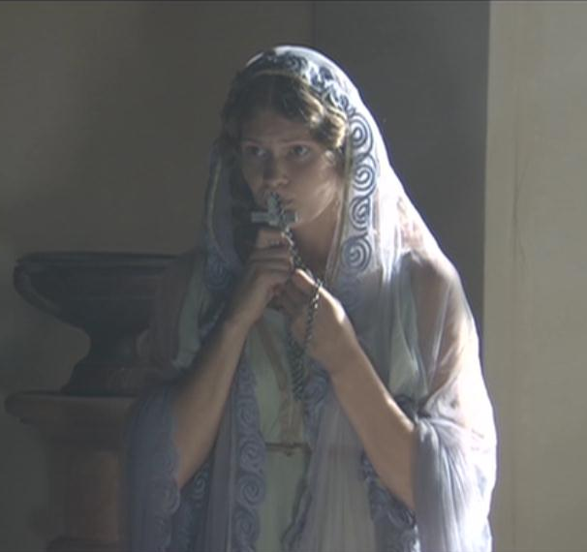
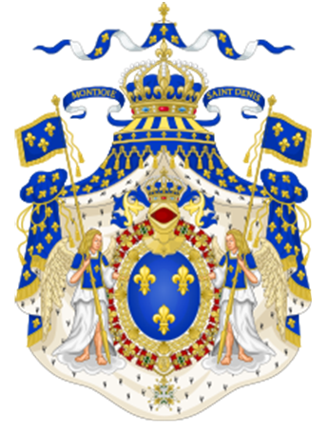
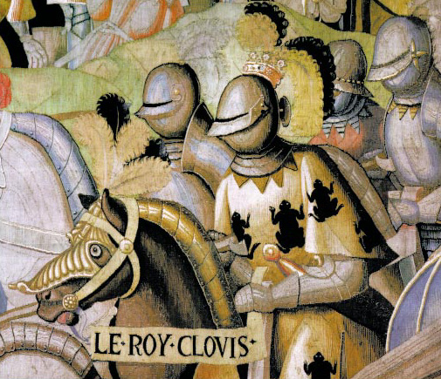
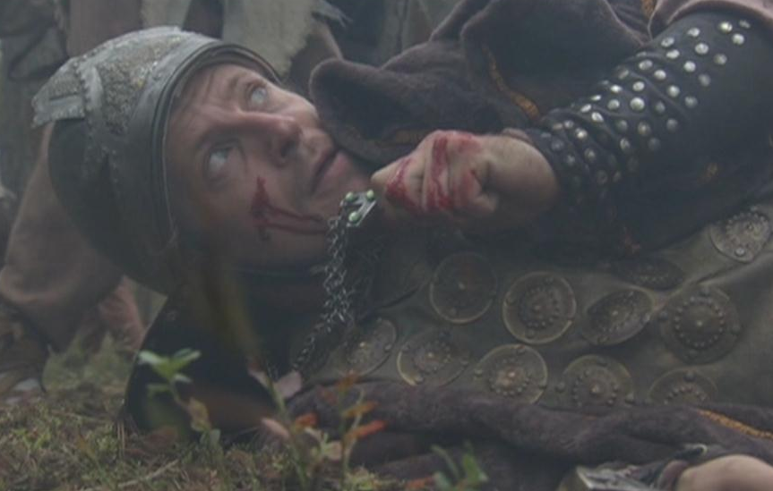
Three unclean spirits like frogs
Poster issued to commemorate the baptism of Clovis to Catholicism
Clovis was baptized at Reims on Christmas day AD 496
House of Bourbon France 1589 - 1792
A Way Prepared
1 5

Slide 16
Three unclean spirits like frogs
The frog used in only two contexts. Rev.16 & Exod.8
The frog was an Egyptian deity – a pagan god. (Idolatry)
Exodus 8:8,14 “…I will give you liberty” …. “…and the
land stank…”
A Way Prepared
16

Slide 17
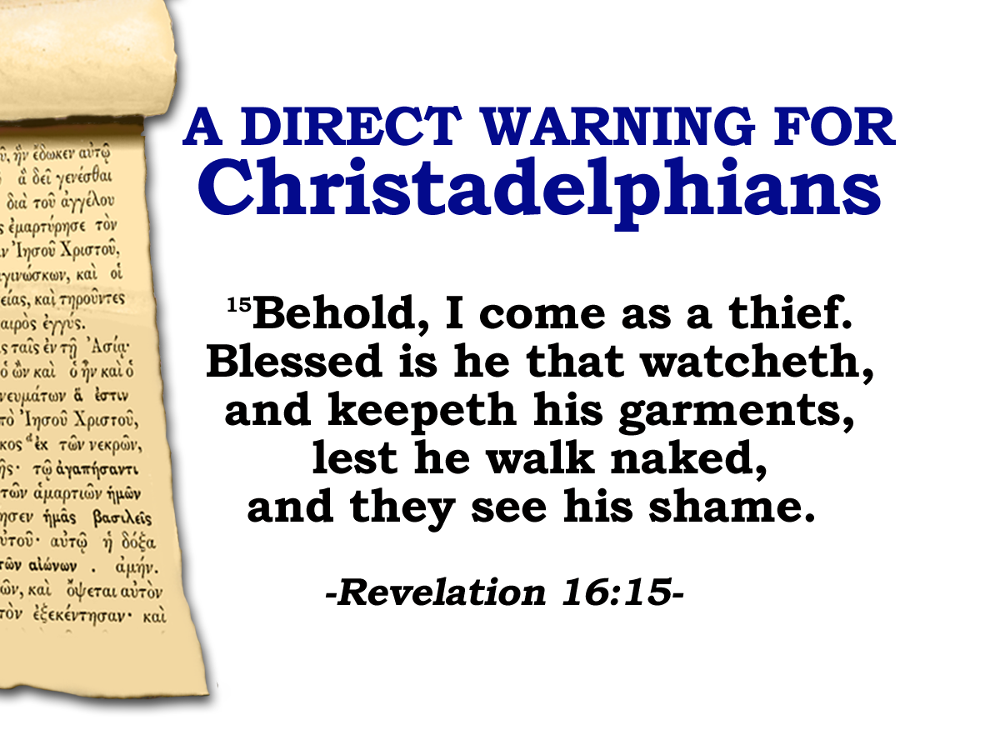
Words based on the practice of the Temple guards on duty every night in the Temple in the times of Jesus.
240 Levites and 30 Priests were appointed to guard the 24 gates of God’s house. They were to be awake and alert to the entry of the unclean or forbidden.
When they went on duty at dusk they were given a distinguishing garment of white linen.

They watched from dusk til dawn without relief.
17

Slide 18
16
And he gathered them together…
Us!
18

Slide 19
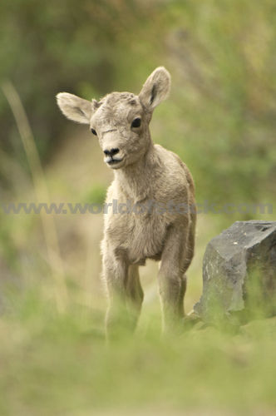

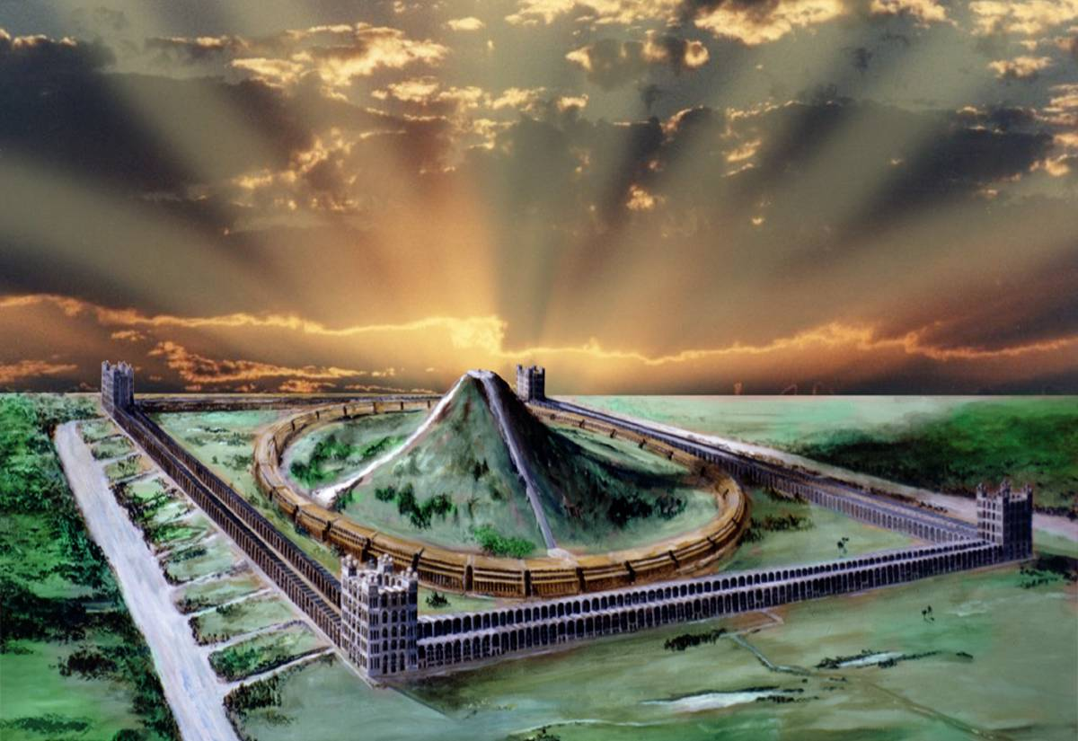
Unsealed!
Next Session
(God willing)

