Slide 1
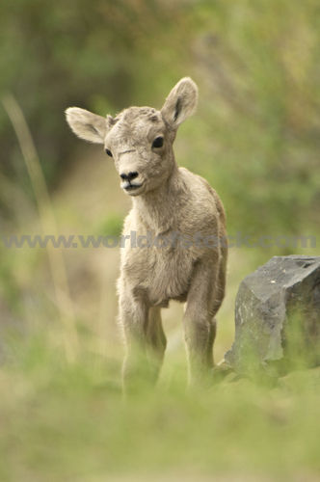
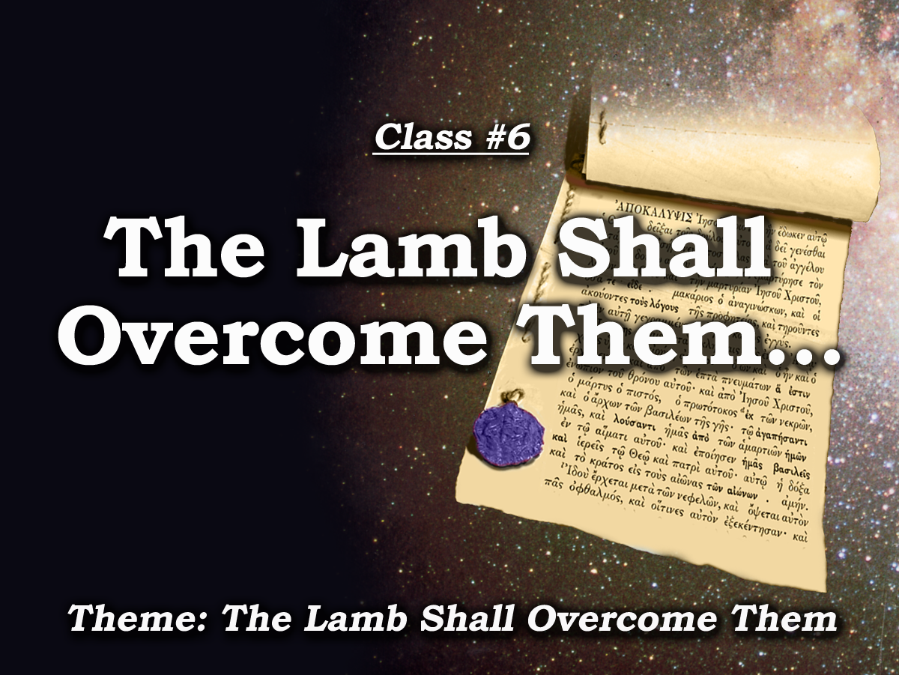
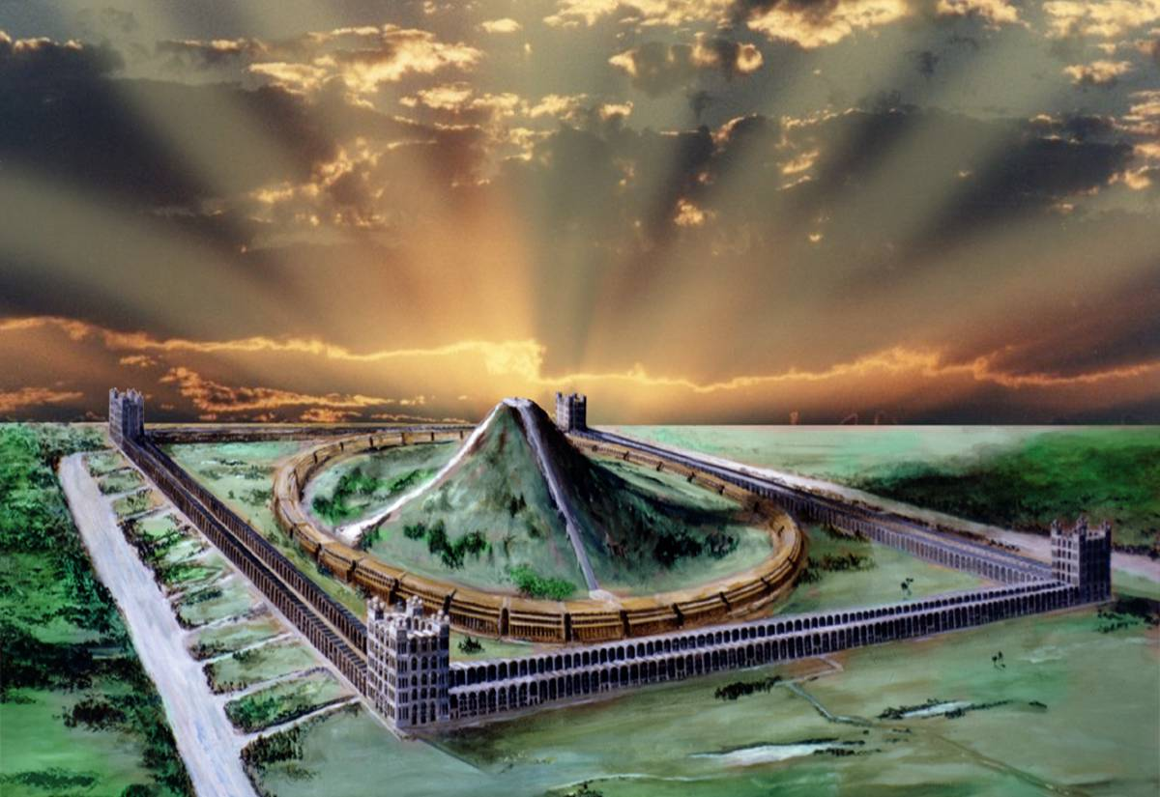
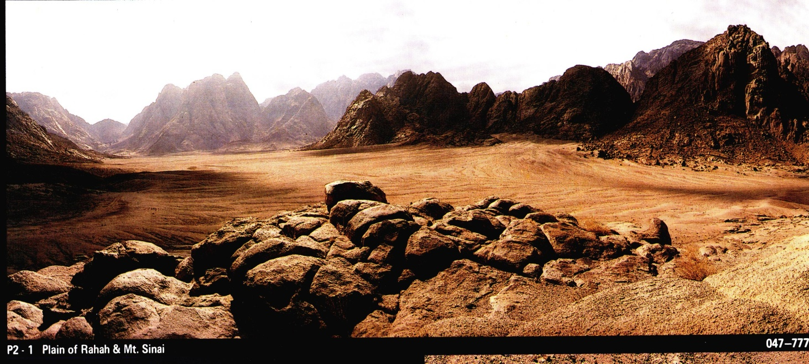
Unsealed!
Study 6

Slide 2
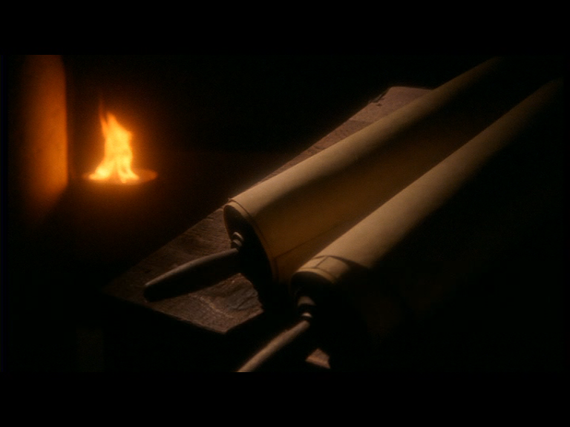
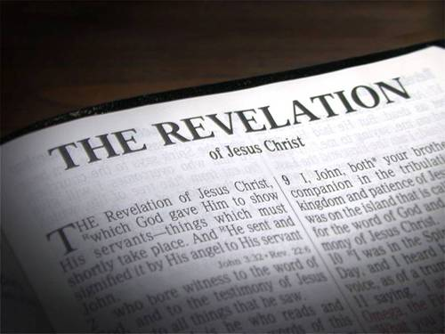
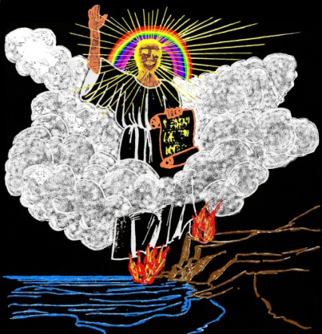
Prophecy
Where there is no vision the people perish
Prophecy
“The object of prophecy was always to reveal God to men and to
keep men with God.
It is an instrument in the
preparation of a people for the Lord
Vision
and is given primarily for the benefit of those
with whom God is working out His purpose of redemption.”
Rev.10:2,4,8-10
Bro. L. G. Sargent
2

Slide 3

7 Sealed Scroll & the Little Scroll
7
Seals
7
1 2 3 4 5 6
Trumpets
7
1 2 3 4 5 6
Vials
Judgement on Pagan Rome
1 2 3 4 5 6
Judgement on Christian Rome
Rev.6
Judgement Holy Roman Empire
T h u n d e r s
Rev.8 & 9
AD 96 – AD 324
Rev.16
AD 395 – AD 1789
AD 1789 – AD 1820
Armageddon
3

Slide 4
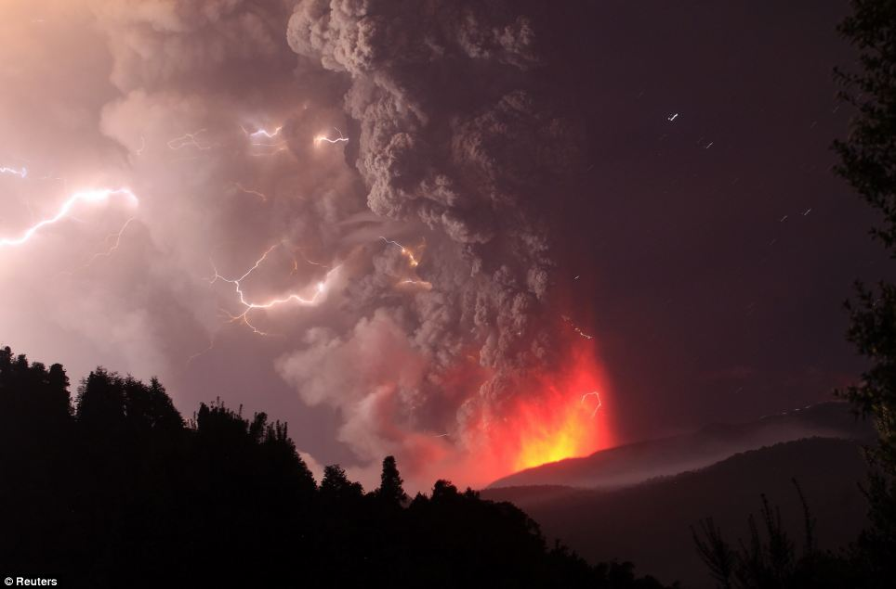
40yrs – The Most Important and Terrible in the Worlds History
The most noteworthy developments of this transition period are described in:
Ch.14, Part Ch.16 & 17, Ch.18, Ch.19, Part Ch.20
v. 17-21
v. 11-14
v. 1-2
7
Vials
1 2 3 4 5 6
T h u n d e r s
Rev.16
4

Slide 5
Events of the Jubilee Period
50yrs
10yrs
40yrs
Marriage of the Lamb.
Judgment Seat.
Mid Heaven proclamation 10 yrs.
Catholic Europe Destroyed
30 yrs
Marriage Supper.
Return of Christ
Rome Destroyed
Armageddon
Millennium Begins with Jubilee year
5

Slide 6
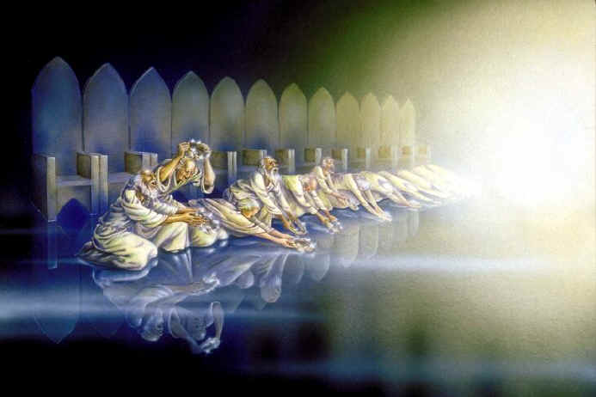
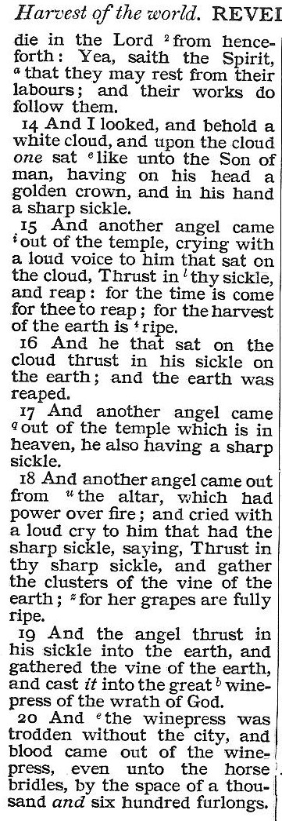
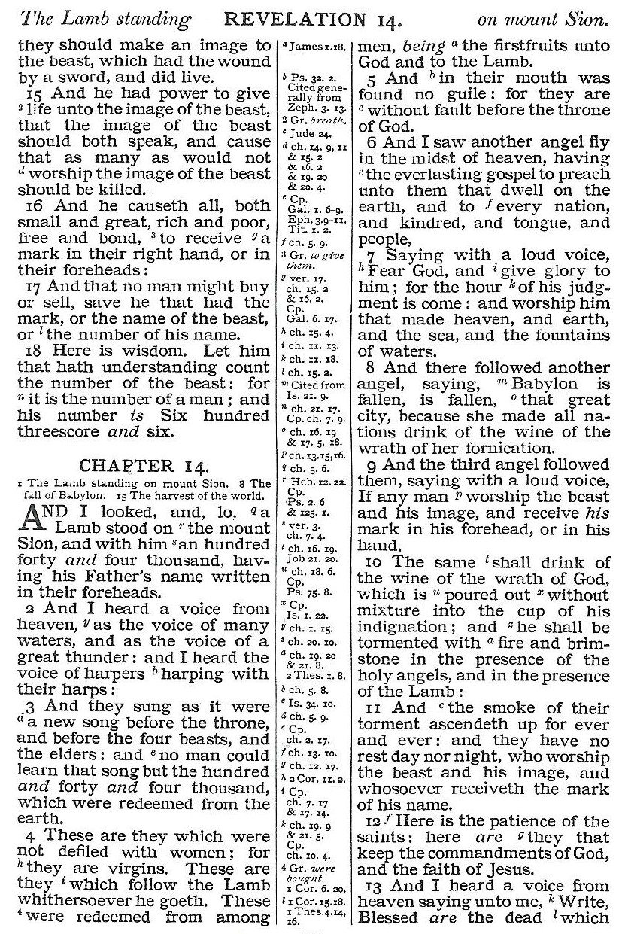
“come down from heaven,”
10:1 - 4
From heaven
8

Slide 7
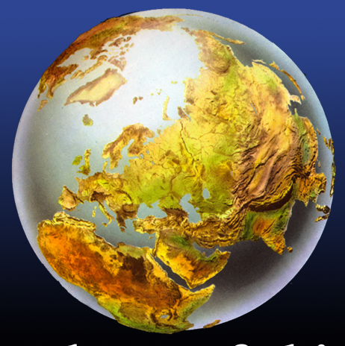
‘And I saw another mighty angel come down from heaven, ….’
Rev.10:1
Earth
Catholic Europe.
Rev.13:11
Sea
The Mediterranean powers, chief of which is the Gogian confederacy with its headquarters in Constantinople and Rome.
Rev.13:1-2
‘and he set his right foot upon the sea, and his left foot on the earth’
Rev.10:2
9

Slide 8
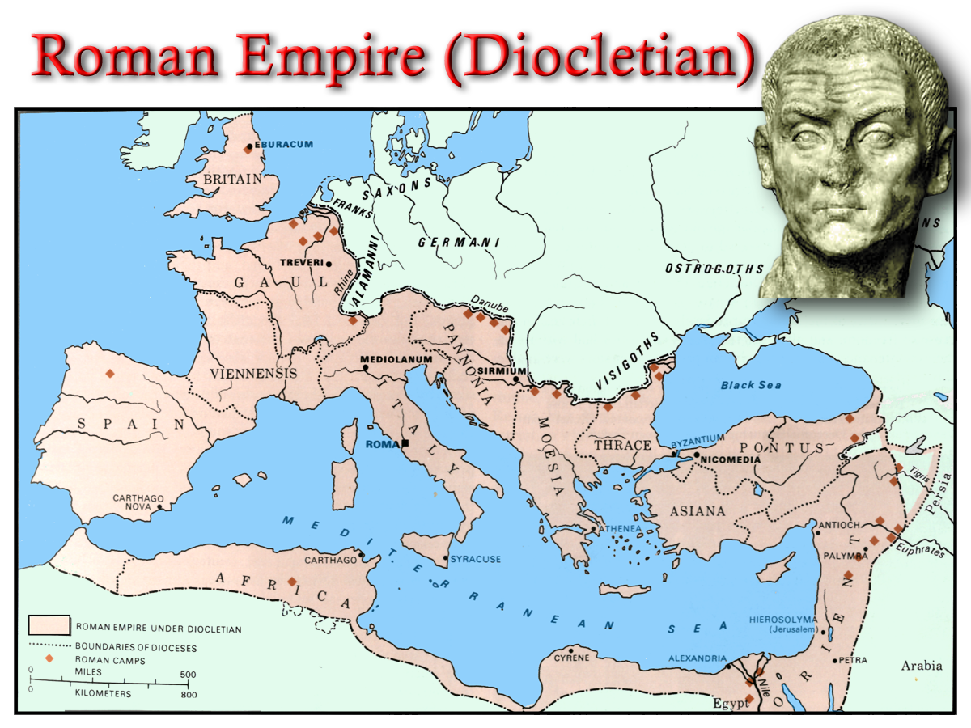
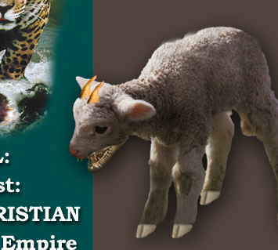
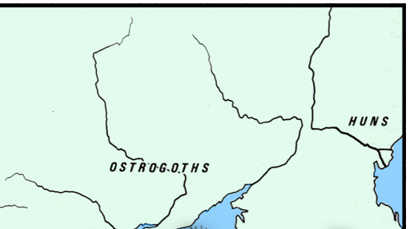
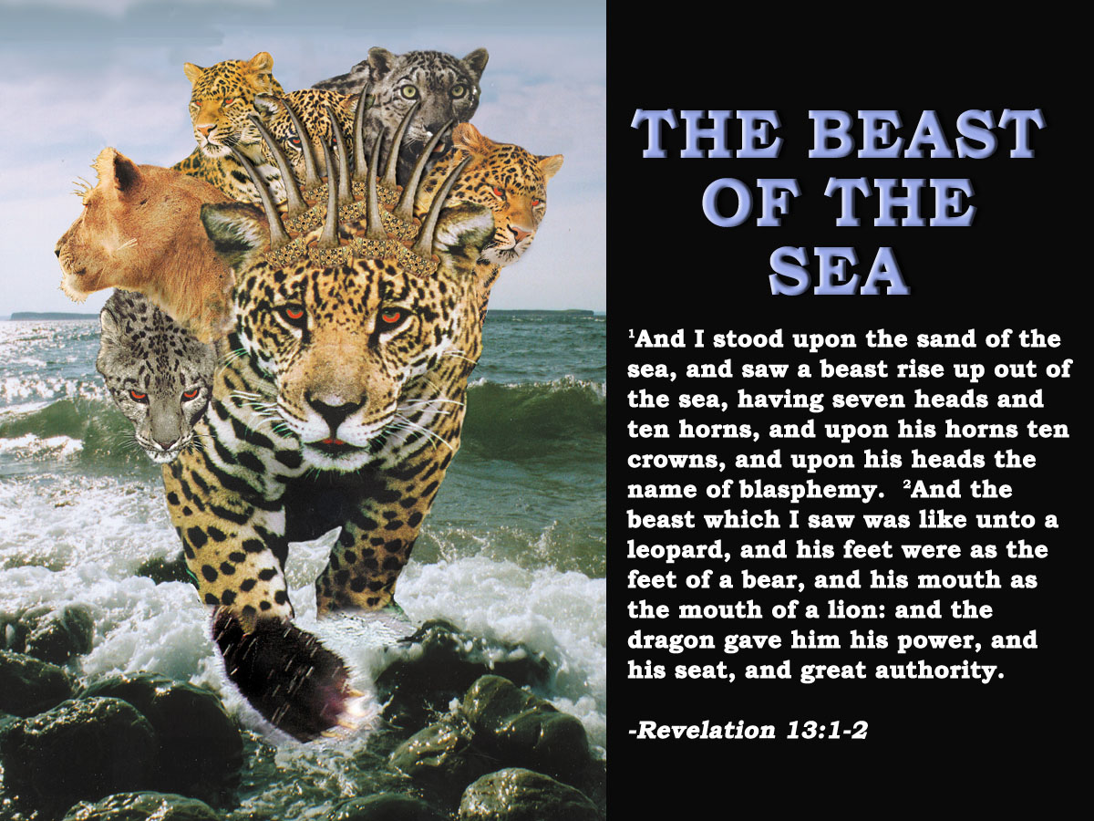
History Repeated!
Why Russia wants Constantinople!
(Mt Ida Chronicle Feb. 1917)
The third and last reason why we want Constantinople is that Constantinople is the cradle of our religion. We got our faith from Constantinople , when she was still Byzantium. A thousand years ago we called Constantinople “Czar-grad,” the Czar, the King, the Lord among towns, and all the Slavs and all the Russians know it under this name. For centuries we have fought with the Turks. The liberation of Constantinople will crown the secular efforts of Russia, of the Russian people, and it will bring them to the cradle of their faith.
Dragon
Earth Beast
Dragon
Sea Beast
10

Slide 9
40yrs
14:6-8
14:9-11
“come down from heaven,”
10:1 - 4
Mid Heaven proclamation 10 yrs.
Catholic Europe Destroyed
30 yrs
Rome Destroyed
From heaven
11

Slide 10
40yrs
‘And I saw an angel’ Diaglott.
Mid Heaven proclamation 10 yrs.
Catholic Europe Destroyed
30 yrs
10 yrs
‘And another a second’ Diaglott.
Rome Destroyed
2
12
Based on Rev.7:4-9
30 yrs
To Jews a thousand =‘family’ Jud.6:15
Here is perfected family of Israel
2
40
12

Slide 11
10 yrs
2
12
30 yrs
2
40
11

Slide 12
40yrs
‘And I saw an angel’ Diaglott.
Mid Heaven proclamation 10 yrs.
Catholic Europe Destroyed
30 yrs
10 yrs
‘And another a second’ Diaglott.
Rome Destroyed
2
12
Based on Rev.7:4-9
30 yrs
To Jews a thousand =‘family’ Jud.6:15
Here is perfected family of Israel
2
40
12

Slide 13
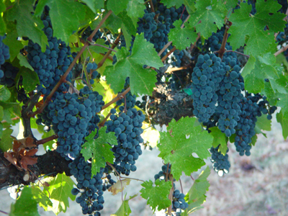
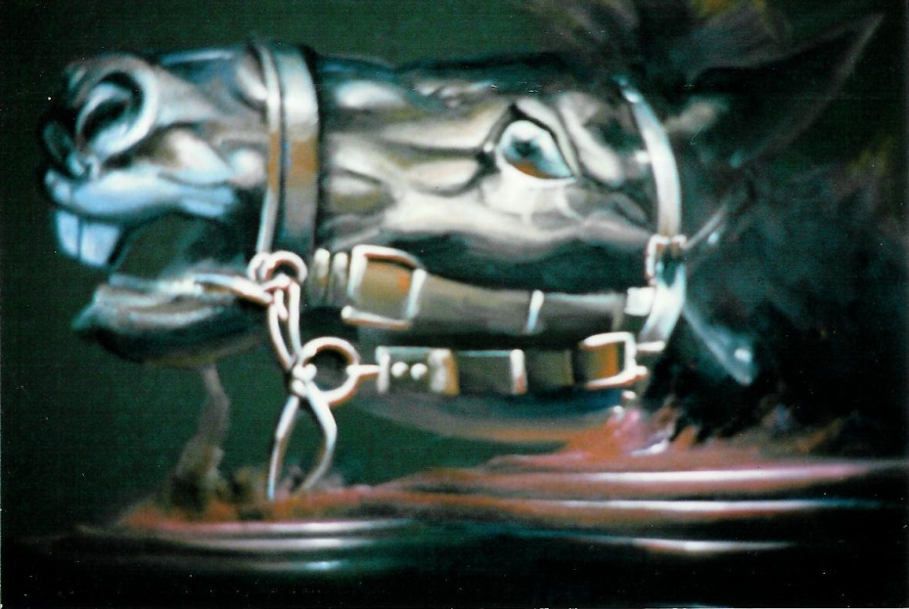
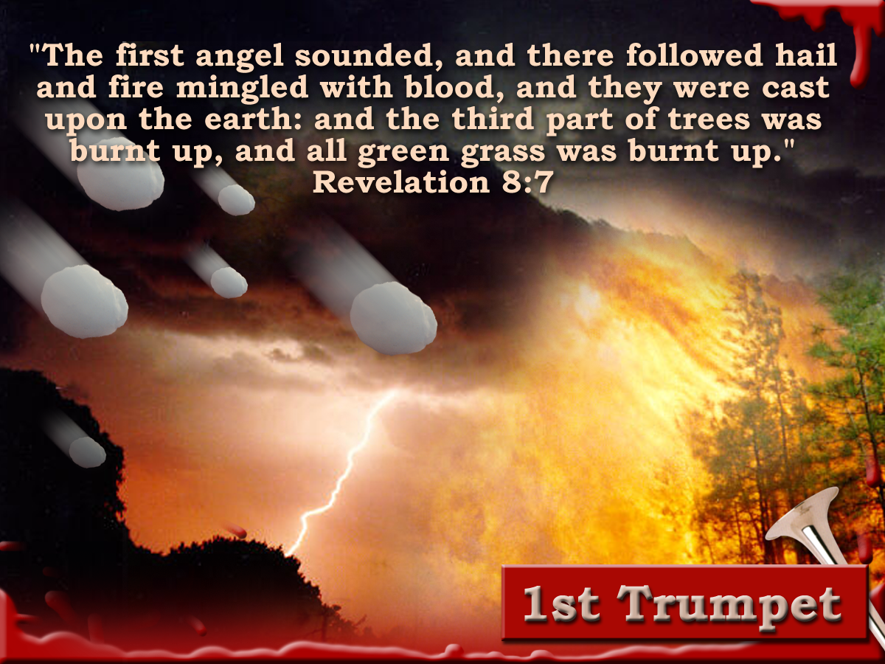
Blood and the
winepress
Rev. 14
“And with thee will I break in pieces the horse and his rider;” Jer. 51:21
Judgement!
The length or space of that judgement would be 1600 “stadion.” Gk.– “certain measure of distance.”
How long from the reaping of the Harvest by the Son of Man on the white cloud and the end of the vintage judgements when the Millennium begins?
The space of that judgement must fit the context of the chapter.
The Rider The Bridle Men
Ezek 20:33-36
20
Isa. 11:11,16
And the winepress was trodden without the city, and blood came
Micah 7:15
out of the winepress , even unto the horse bridles, by the space of a thousand and six hundred furlongs
2
40
The Seventh Vial
40yrs prior to and leading up to the Millennium
13
Notes:
The winepress is not an area, not a locality, covering approx. 280 K’s. i.e. from here to Port Augusta.
Its an area affecting all nations “without the city’.
The question is not how large the area is but how long is the blood going to flow from the winepress?

Slide 14
10 yrs
Psa. 58:10-11
10 The righteous shall rejoice when he seeth the vengeance: he shall wash his feet in the blood of the wicked.
11 so that a man shall say, Verily there is a reward for the righteous: verily he is a God that judgeth the earth.
2
12
30 yrs
2
40
14

Slide 15
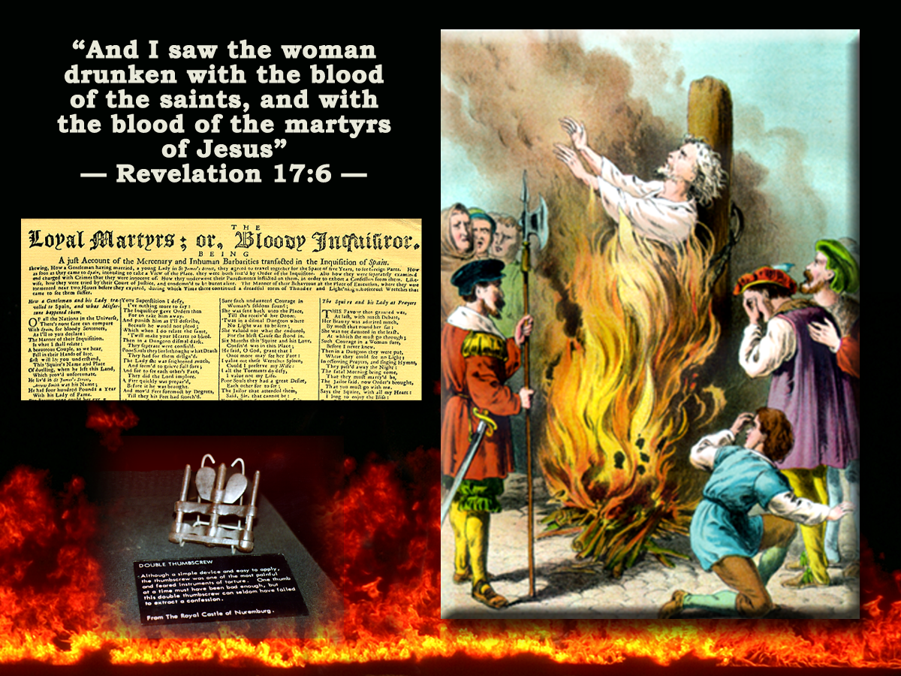
‘Blessed are the dead which
die in the lord..’
Revelation 14:13
13
And I heard a voice from heaven saying unto me, Write, Blessed are the dead which die in the lord from henceforth: Yea, saith the Spirit, that they may rest from their labours; and their works do follow them.
Isa.11:10
Heb.4:9-11
Rev. 2:26
From now! From this time!
Rev.14:11
Rev.15:8
‘That they may take rest from their labours and their works; He goeth in aid of with them.’
Bro Thomas Eureka
‘The time of blessedness is when the smoke has all cleared out of the temple; and the saints have fully executed the judgement committed to them.’ Eureka
The Seventh Vial
30yrs prior to and leading up to the Millennium
15

Slide 16
Humanism in the Churches
“ Among the many types of humanism that I have met in human history, I have found that of Jesus of Nazareth particularly attractive, although remote in time and open to completion by many more recent cultural elements. It is a humanism of universal, unselfish, brotherly love.”
J. Gomez Caffarena - Jesuit Priest.
Humanism in the Churches
Increasing tolerance of feminism, political activism and homosexuality have made the Anglican Church a spearhead in humanism.
Character of the
Redeemed
Revelation 14:1-5
Who are the women?
The Argument!
The values of the 1st Century Christians , and of the Israelites before them, were relative values.
It is argued that if something becomes culturally acceptable, it becomes morally acceptable.
Rev.17:1-2, 5
4
These are they which were not defiled with women; for they are virgins. These are they which follow the lamb withersoever he goeth. These were redeemed from among men, being the firstfruits unto God and to the lamb.
“ Humanism has come to mean a reverence for man and a concern for his dignity, morality and happiness, linked with a belief that these ends are best served by the advance of scientific outlook”
Archbishop of Canterbury
Humanism affects Moral Behaviour!
The Seventh Vial
40yrs prior to Millennium
16

Slide 17
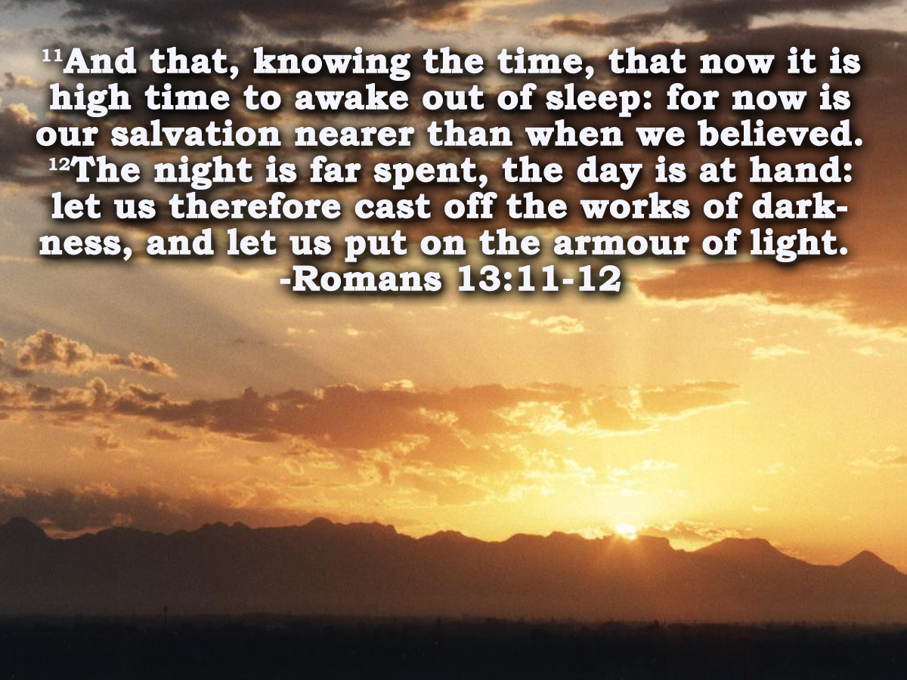
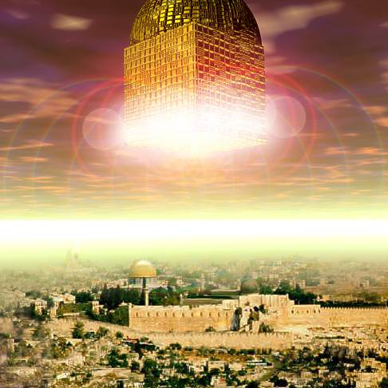
“Even so come Lord Jesus.”
Behold , I come. Blessed is he that watcheth

Slide 19
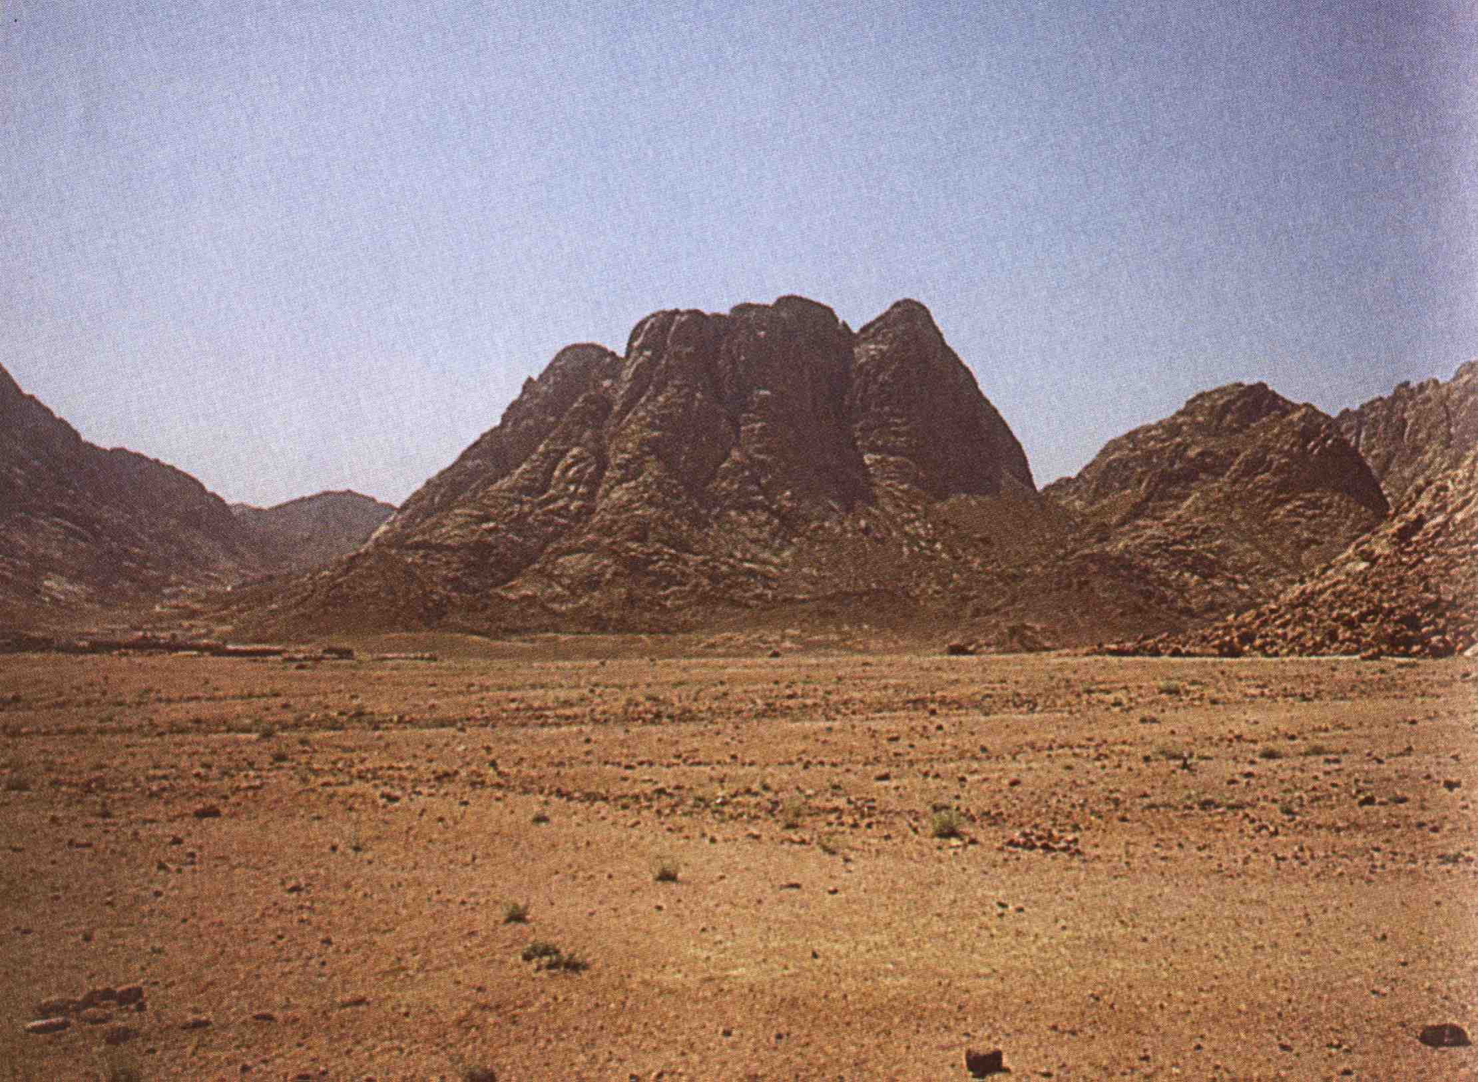
Sinai, the Angel of the Bow
& the 144,000
“Yahweh came in from Sinai” Bro. Thomas
Deut. 33
2 And he said, The LORD came from Sinai, and rose up from Seir unto them; he shined forth from mount Paran, and he came with ten thousands of saints: from his right hand went a fiery law for them.
Note v1, 28
Heb. eshdath – a fire law. Bro. Thomas – “a fiery mandate”.
A mandate of destruction in his right hand, which when executed will result in the deliverance of Israel and the overthrow of her enemies.
13

Slide 20
Importance of Vision
Heb. chazown – mental sight; root chazah – to gaze at; mentally to perceive, contemplate (with pleasure); to have a vision.
18
“Where there is no vision, the people perish: but he that keepeth the law, happy is he.”
Proverbs 29:18
Heb. para – to loosen; to expose, dismiss.
Roth. – “a people is let loose.”
Young’s Lit. – “without a vision is a people made naked.”
The Lamb shall overcome them
3

Slide 21
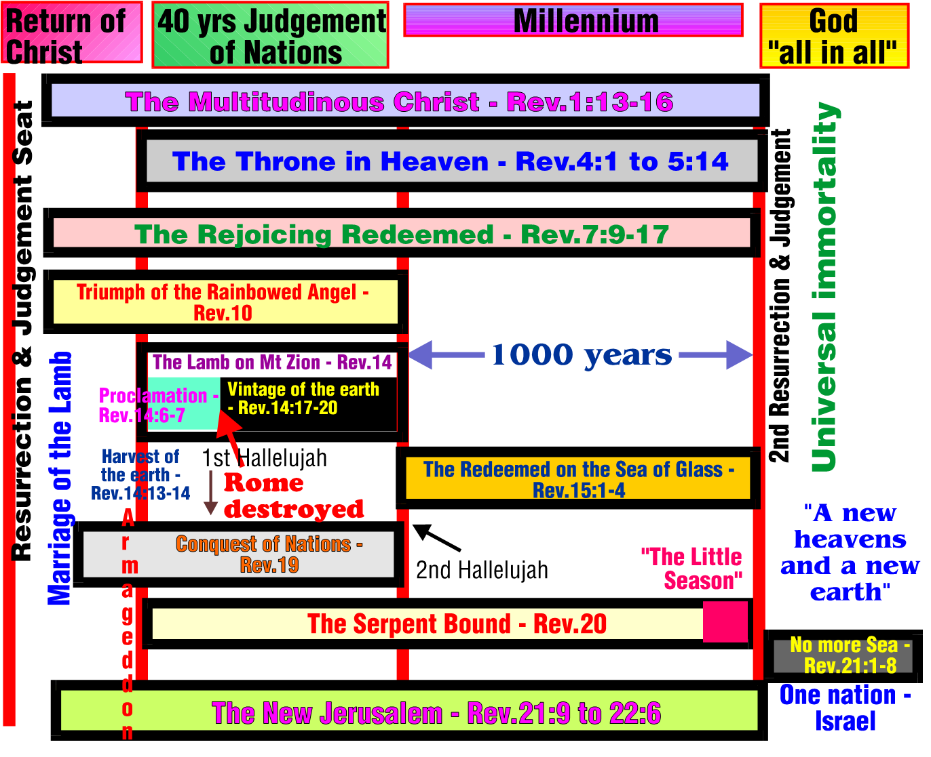
6

Slide 22
Session Outline
‘The Lamb on Mount Zion’.
  Rev.10 &14.
  The Lamb on Mt. Zion & the Angel of the Bow Ch.10 & 14.
  The Structure of Ch.14. - Angels and Times
  The 144 thousand & 1600 furlongs. Ch.14.
7

