Slide 1
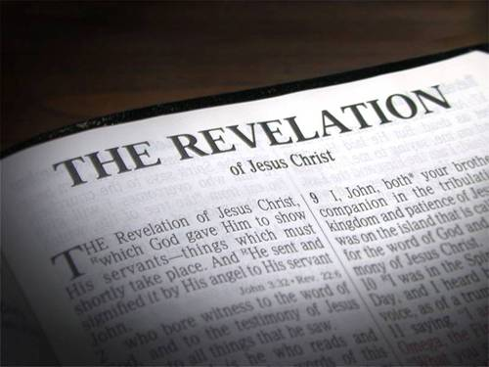
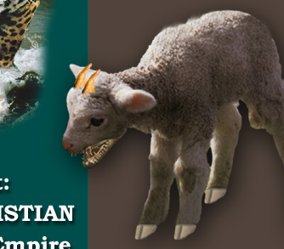
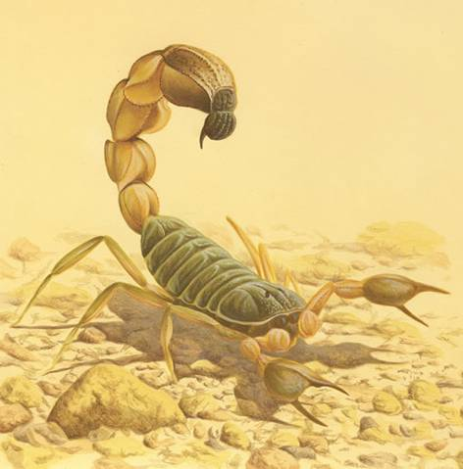

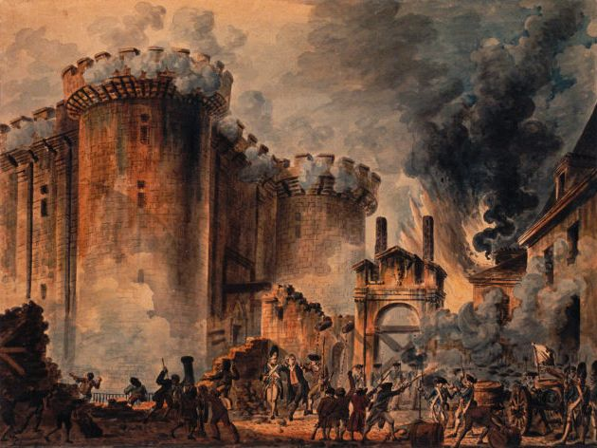
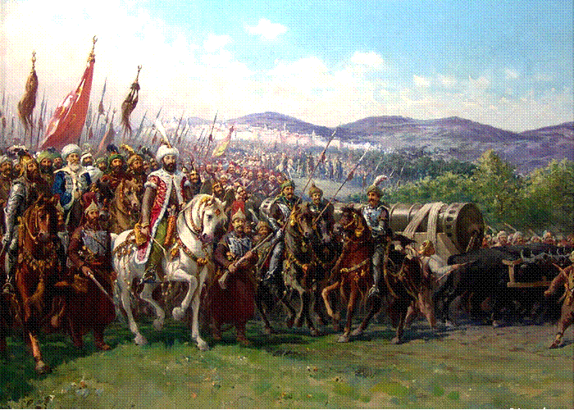
Time Periods of the Apocalypse.
“Blessed is he that Readeth”

Slide 2
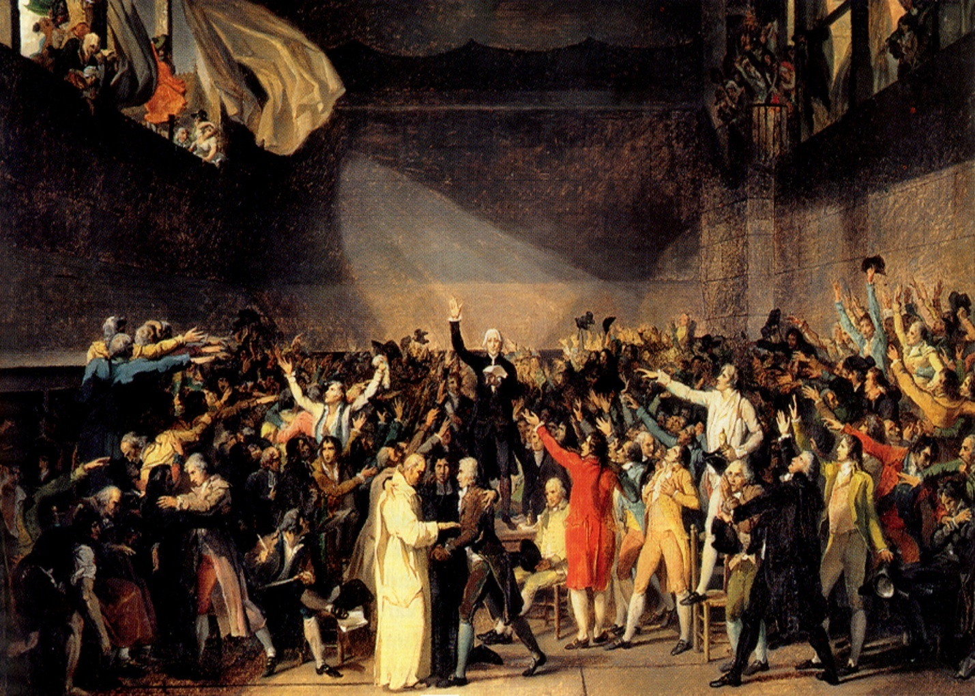
Time Periods of the Apocalypse.
  Key to unlocking time periods.
    Single conversion – Double conversion – No conversion?
      Decorum of the symbol.
      Context.
      Consistent with indisputable known's.
Day for a Year. Gen.47:9, Num.14:34, Ezek. 4:4-6, Luke13:32

Slide 3

Time Periods of the Apocalypse.
8:1 1/2hour 14yrs
8:12 1/3 day & 1/3 night 240yrs
9:5 5 months 150yrs
9:10 5 months 150yrs
9:15 1 hour-1 day–1 month–1 year 391yrs 1mth
11:2 Forty two months 1260yrs
11:3 1260 days 1260yrs
11:9 3 1/2 days 105yrs
11:13 1 hour 30yrs
12:6 1260 days 1260yrs
12:14 Time, Times, Dividing of Time 1260yrs
13:5 42 months 1260yrs
14:7 1 Hour 30yrs
17:12 1 Hour 30yrs
18:10 1 Hour 30yrs
18:17 1 Hour 30yrs
18:19 1 Hour 30yrs
Single conversions

Slide 4

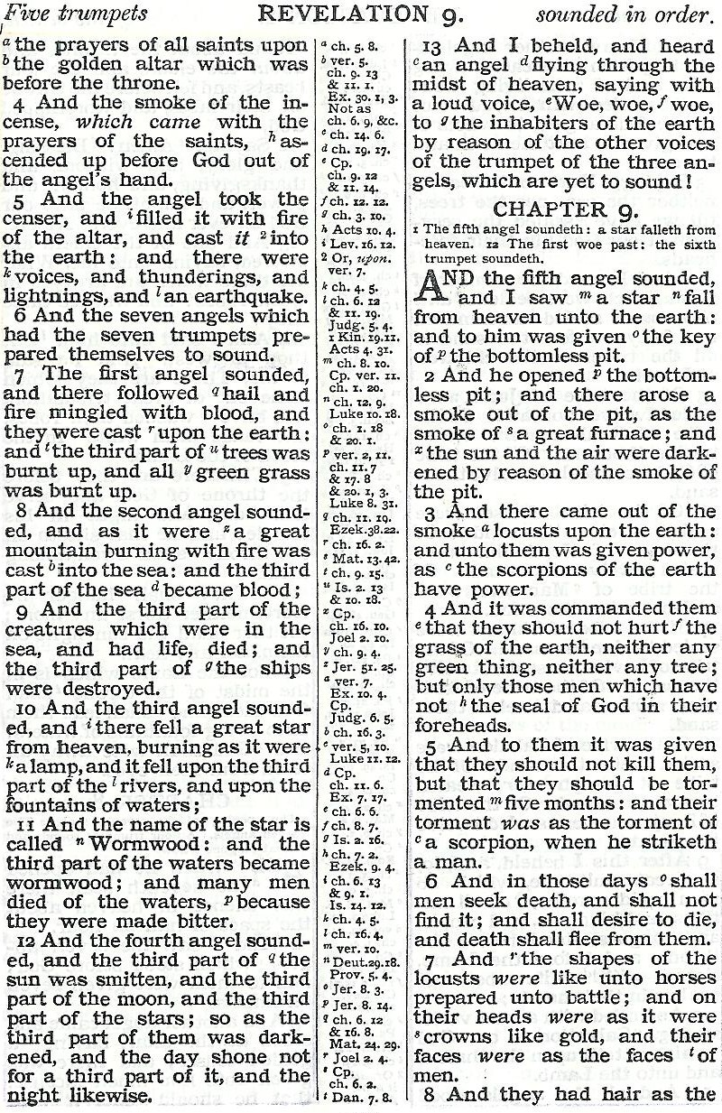
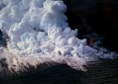
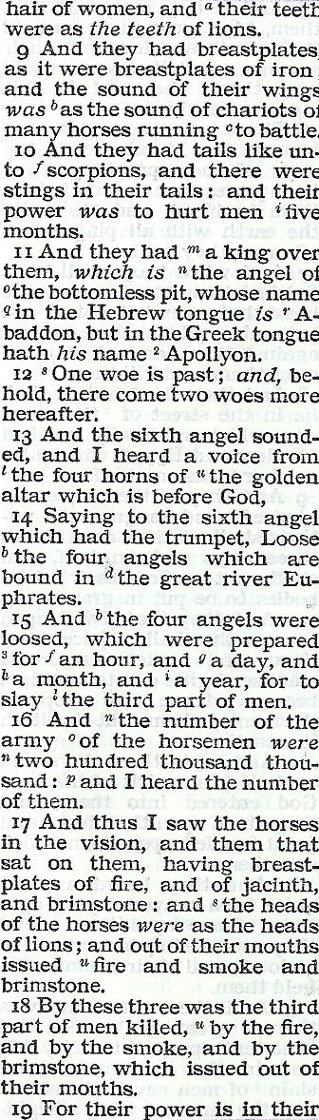
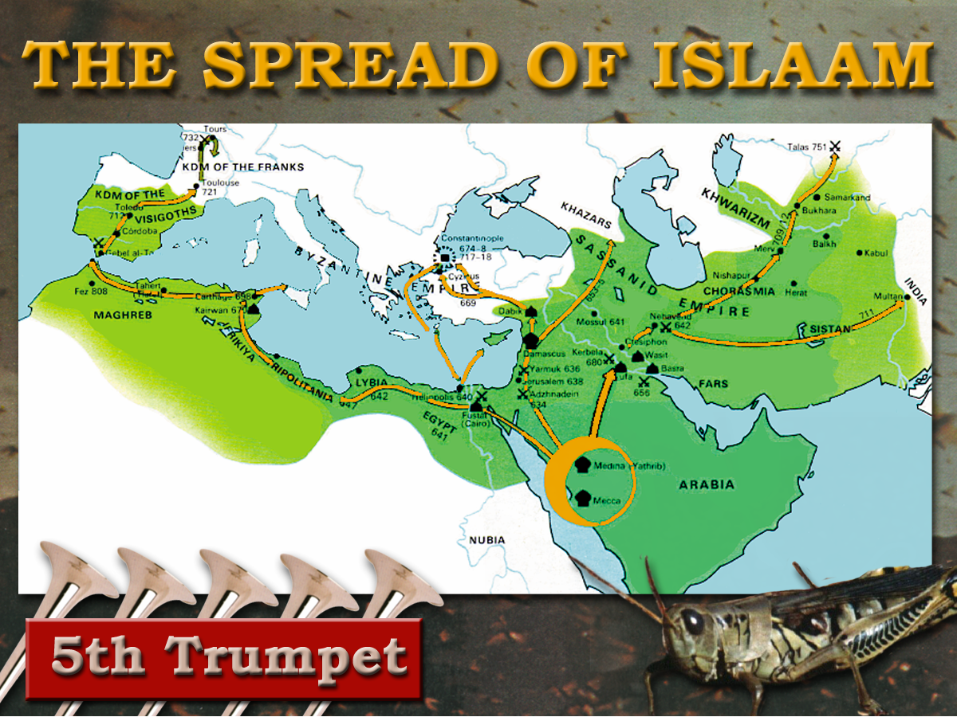
7
Trumpets
1 2 3 4 5 6
Judgement - Christian Rome

Slide 5
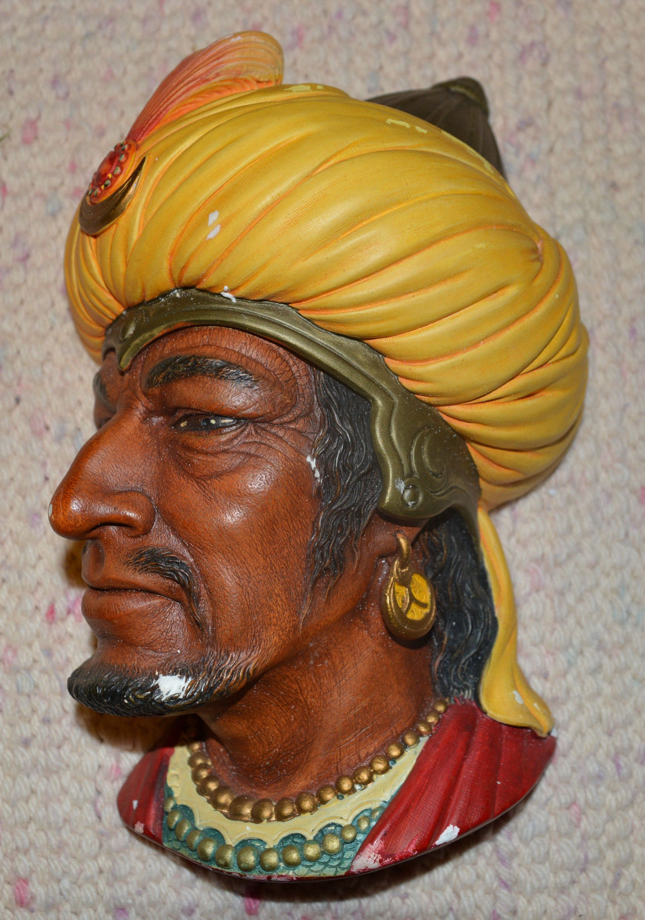
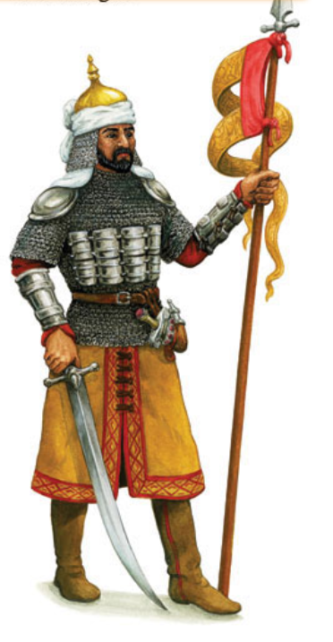
“And Allah hath given you … coats of mail which protect you in your wars”
Koran, Chap An-nahl (16), Verse 81

Slide 6
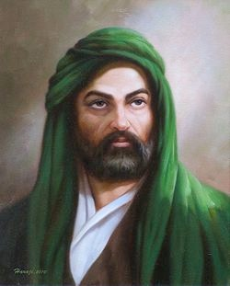
Teeth of Lions
Mohammed:
Who will be my Vizier and Lieutenant?
Ali ibn Abi Talib
O prophet, I will be thy Vizier. I am the
man. Whoever rises against thee, I will
dash out his teeth, tear out his eyes,
break his legs, rip up his belly. O
prophet, I will be thy Vizier.
Ali the Lion of Allah
Notes:
The Teeth of Lions refer to the violent manner in which Islam would treat its enemies
Ali - one of Mohammed’s followers was called “The Lion of God” - here was his ferocious mindset!
READ SLIDE.

Slide 7
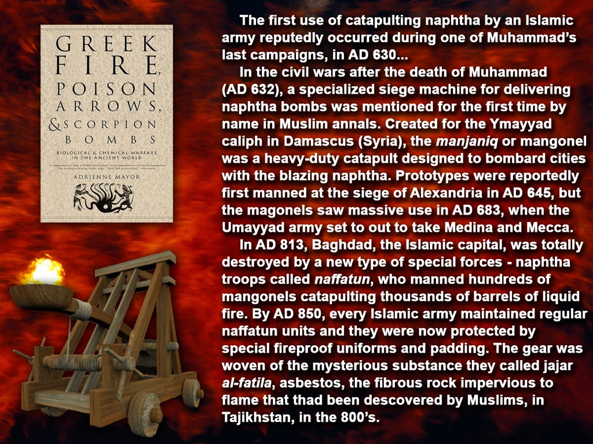
Scorpion. Dictionary definition “An ancient form of ballista or catapult for hurling stones, etc.”
“Saracen fire” Burning crude oil mixed with secret chemicals to intensify the burning.
A new and powerful sting!
AD 636 - 936

Slide 8
Time Periods of the Apocalypse.
9:5 5 months 150yrs
9:10 5 months 150yrs
9:15 1 hour-1 day–1 month–1 year 391yrs 1mth
11:2 Forty two months 1260yrs
11:3 1260 days 1260yrs
12:6 1260 days 1260yrs
12:14 Time, Times, Dividing of Time 1260yrs
13:5 42 months 1260yrs
Single conversions

Slide 9
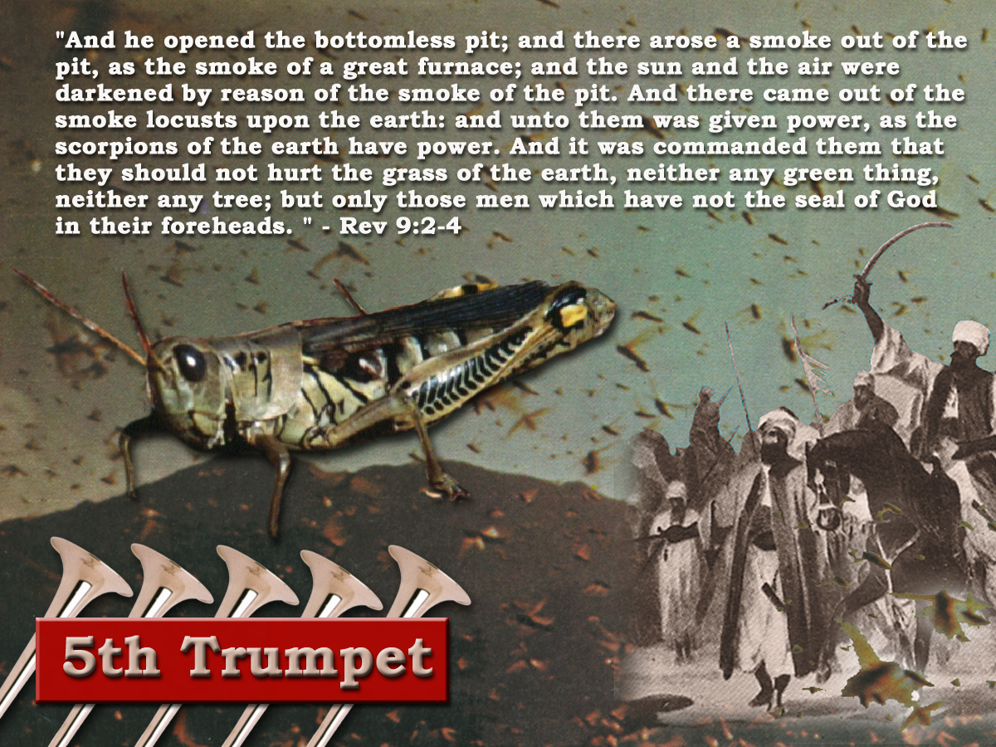
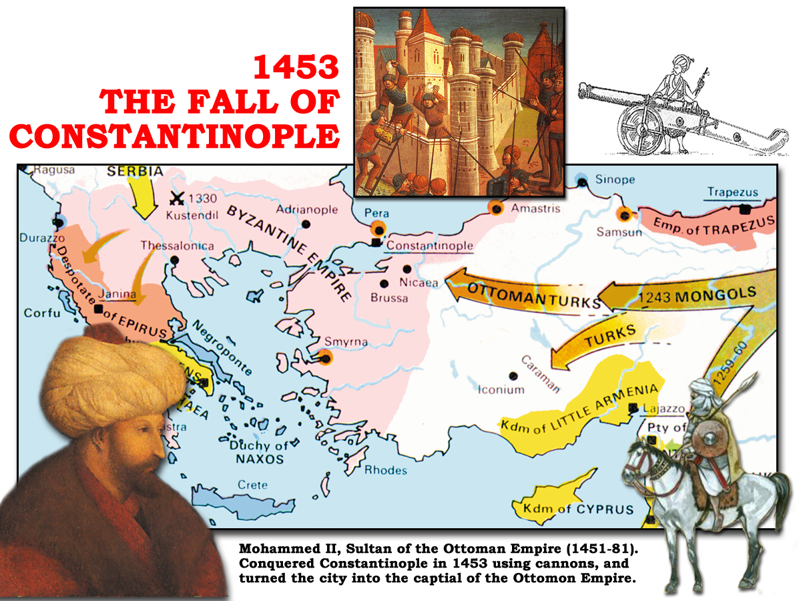
6th Trumpet
“And the four angels having been prepared were loosed for an hour, and a day, and a month, and a year, for to slay the third part of men.” Rev 9:15

Slide 10
6th Trumpet
1 hour (1/12 of a day) = 1month
1 day = 1 year
1 month (30days) = 30 years
1 year (360days) = 360 years
391years 1month
29/ 5/ 1453 Constantinople fell to Mohammed
27/ 4/ 1062 Togrul Beg married Caliph’s daughter and became head of Mohammedan faith and began series of assaults on Constantinople

Slide 11
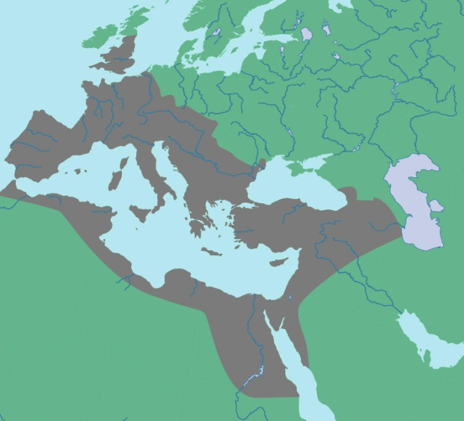
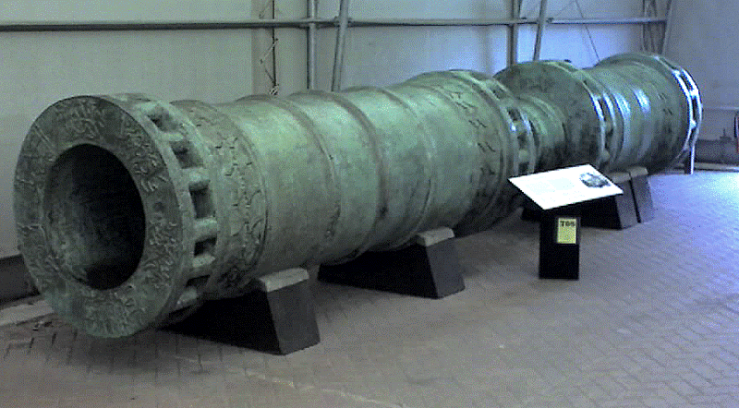
“The hinge of battle at Constantinople was gunpowder and the cannon, a weapon destined to revolutionise future warfare. And a gate left wide open.”
THE FALL OF
CONSTANTINOPLE
1453
LATIN WEST
Durschmied -The Hinges of Battle p70
HELLENIZED EAST
“And by these three was the third part of men killed, by the fire, and by the smoke, and by the brimstone, which issued out of their mouths”
HELLENIC EAST
Rev.9:18
Note v.17,19

