Slide 1
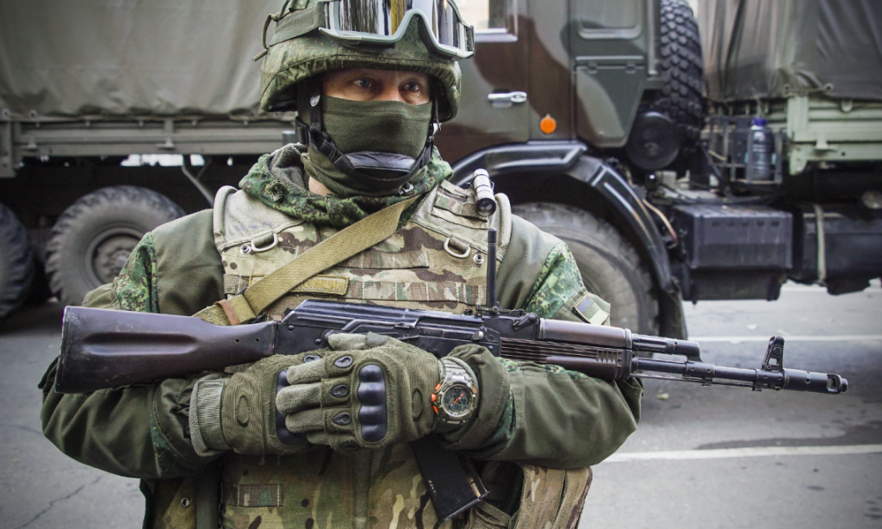
Russia on
Israel’s
Border
Whatchan Lake
August 15, 2018

Slide 2
“Maskirovka”
“Russian history is filled with similar battles in which the country’s troops have faked attacks or staged ambushes to defeat much larger opponents. They used faked tanks to mislead the Germans in a battle during the Second World War.
“Maskirovka has since morphed into a geopolitical strategy for the Russians, but the three elements involved remain the same: distract your opponent, disguise what you’re doing and spread disinformation to sow confusion and delay a response.”
By Josh Elliott, Global News, June 9, 2018
Notes:
Vas kir onka

Slide 3
“Maskirovka”
“One need look no further than Russia’s recent alleged actions in Crimea, Syria, the U.K. and the U.S. presidential election to see how effectively the Kremlin can influence other world powers while denying involvement all along.”
By Josh Elliott, Global News, June 9, 2018

Slide 4
Russia on Israel’s Border
What Does it Mean To Christadelphians?
Brother John Thomas foresaw this as he recorded it in Elpis Israel in 1848-49, 170 years ago.
There was a very influential regime in power in Russia at that time.
Since its demise, the Soviet Union has come and gone.
Now the Russian Federation has taken over.
As Christadelphians, we have always believed that the rise of the power of Russia was an indication that the invasion of the land of Israel was not far ahead!
Many thousands of our brethren have died with that belief.

Slide 5
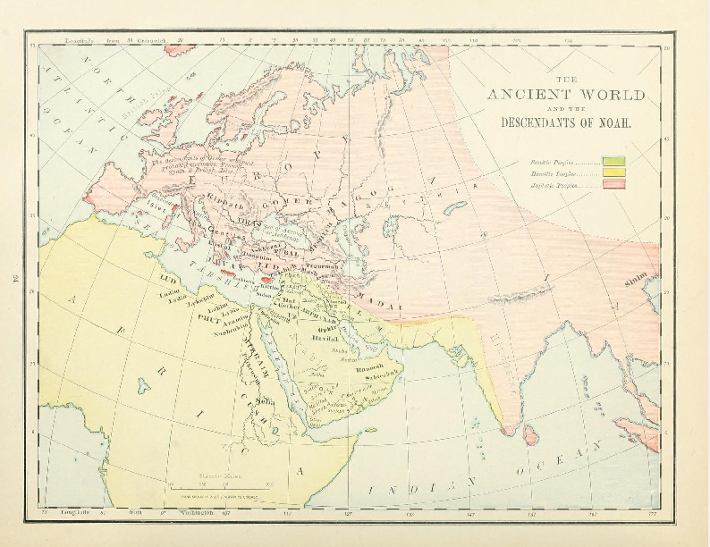
The Ancient World
The Ancient World
Genesis 10:2-5 KJV
2 The sons of Japheth; Gomer, and Magog, and Madai, and Javan, and Tubal, and Meshech, and Tiras.
3 And the sons of Gomer; Ashkenaz, and Riphath, and Togarmah.
4 And the sons of Javan; Elishah, and Tarshish, Kittim, and Dodanim.
5 By these were the isles of the Gentiles divided in their lands; every one after his tongue, after their families, in their nations.
Notes:
Note the help this series of verses has in our exposition of Ezekiel 38
This method of analysis is our strength.

Slide 6
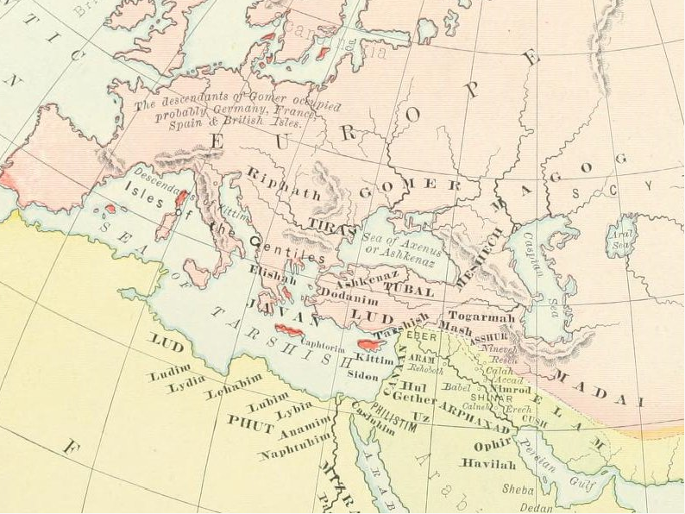
The Descendants of Noah (Rand-McNally)
Notes:
Notice that the sons of Japheth were scattered over Europe.
Noting where people lived in ancient times is supportive of our identity of the powers in Ezekiel 38.

Slide 7
The Prophecy About Russia
Ezekiel 38:1-3 KJV
1 And the word of the LORD came unto me, saying,
2 Son of man, set thy face against Gog, the land of Magog, the chief prince of Meshech and Tubal, and prophesy against him,
3 And say, Thus saith the Lord GOD; Behold, I am against thee, O Gog, the chief prince of Meshech and Tubal:
Ezekiel 38:1-3 RV
1 And the word of the LORD came unto me, saying,
2 Son of man, set thy face toward Gog, of the land of Magog, the prince of Rosh, Meshech, and Tubal, and prophesy against him,
3 and say, Thus saith the Lord GOD: Behold, I am against thee, O Gog, prince of Rosh, Meshech, and Tubal:
Notes:
Magog, Meshech and Tubal are sons of Japheth.
Note that the RV and other English versions translate “Chief” as Rosh as a proper name.

Slide 8
The Prince of Rosh, Meshech, Tubal
“Gog is a symbolic name, standing for the leader of the world powers antagonistic to God.
Meshech and Tubal are understood to have been the same as the Moschi and Tibareni of the Greeks – tribes that inhabited regions in the Caucasus. Rosh, which some would identify with Russia, must have designated a land and people somewhere in the same quarter. And therefore the Gog of Ezekiel must be viewed as in some sense the head of the high regions in the northwest of Asia. (Fairbairn’s Imperial Standard Bible Encyclopedia.)”
Amplified Bible; Commentary; Ezekiel 38; Zondervan, 1962
Notes:
Independent witness like that of the Amplified Bible Commentary

Slide 9
The Prince of Rosh, Meshech, Tubal
“Gesenius observes that it can scarcely be doubtful that the first trace of the Russians is here given. (Lange’s Commentary.)
Hengstenberg [1802-1869] could not bear to see “the poor Russians” ranged among the enemies of the kingdom of God. But the One who gave Ezekiel this vision of what was to happen “in the latter days” (verse 16), made no mistake in such a forecast, as all the world can see today.”
Amplified Bible; Commentary; Ezekiel 38; Zondervan, 1962
Notes:
Further to the Amplified Bible

Slide 10
The Prince of Rosh, Meshech, Tubal
“But what nations are signified by these three proper names? This question has been long since determined by the learned. The celebrated Bochart, about the year 1640, observed in his elaborate researches into Sacred Geography, that, Ros, is the most ancient form under which history makes mention of the name of Russia; and he contended that Ros and Mosc properly denote the nations of Russia and Moscovy. “It is credible,” says he, “that the Rhos and Mesech (that is of Rhossi and Moschi) of whom Ezekiel speaks, descended the Russians and Moscovites, nations of the greatest celebrity in European Scythia.”
Elpis Israel; John Thomas; 1848; Pg. 381
Notes:
John Thomas quoted other sources for his reasons for believing that Russia was implicated in this Prophecy.

Slide 11
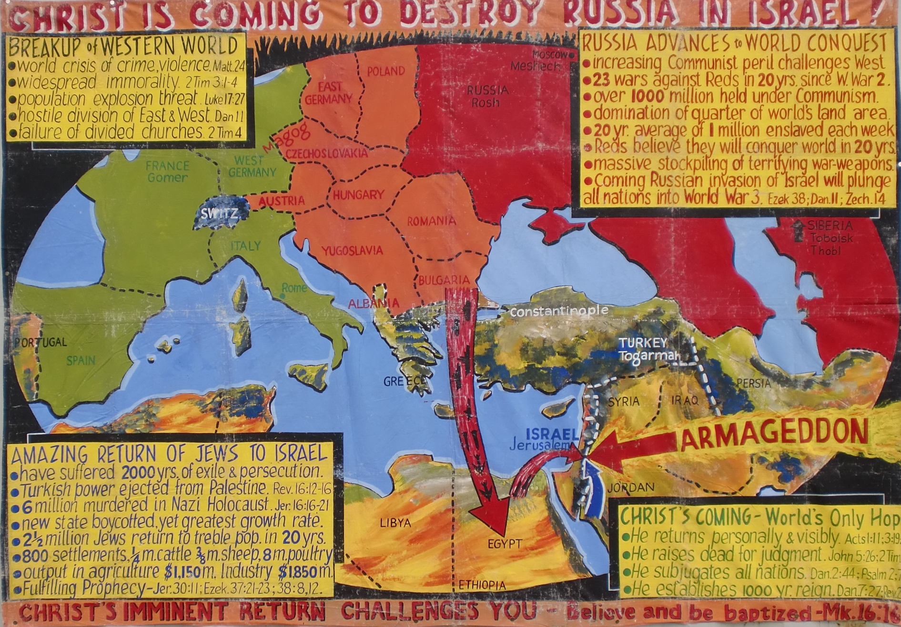
Christadelphian Witness During the 60’s
Notes:
Note our Christadelphian view of Russia in the 60s.
Note the Warsaw Pact countries linked with the USSR.

Slide 12
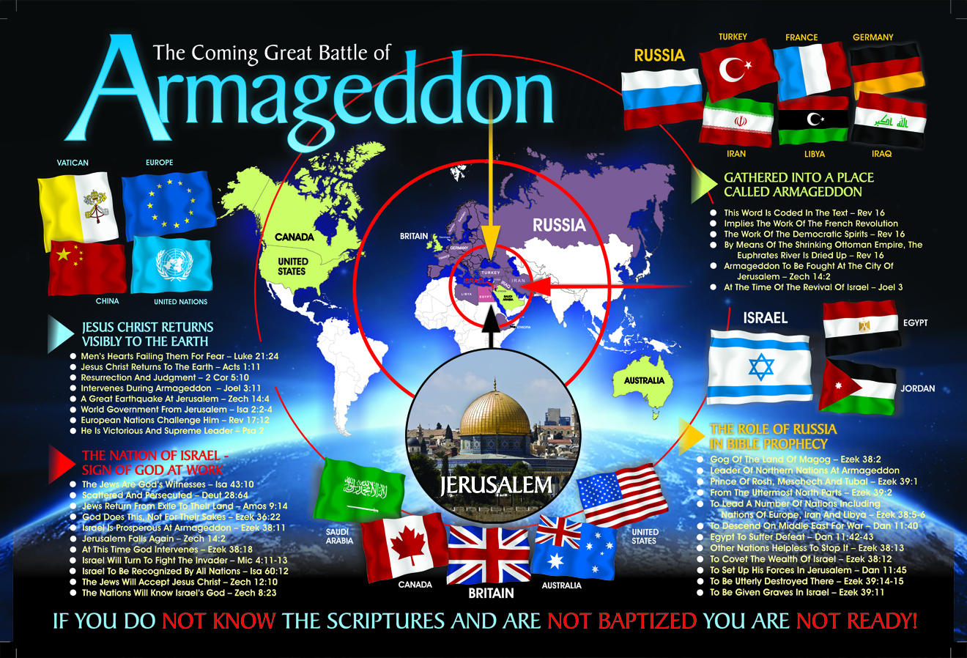
Notes:
In more recent times, at least after the fall of the USSR and the rise of Russia
We see a nation much more bent on following the line of Bible prophecy
God says, “Ezekiel 38:4 KJV
And I will turn thee back, and put hooks into thy jaws, and I will bring thee forth, and all thine army, horses and horsemen, all of them clothed with all sorts of armour, even a great company with bucklers and shields, all of them handling swords:
Note the flags of the nations and the divisions amongst them at the time of the end.

Slide 13
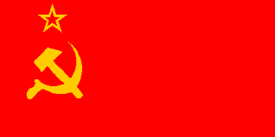
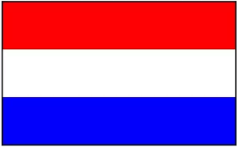
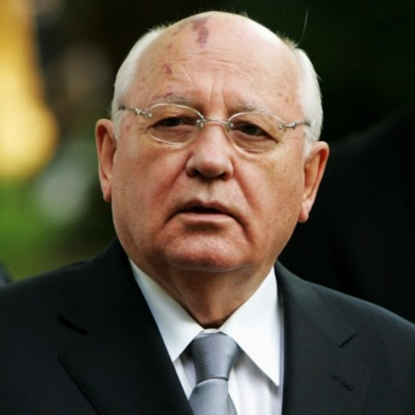
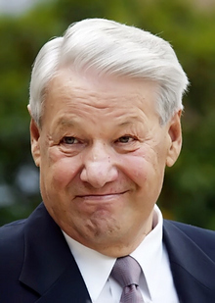
December 25, 1991
SOVIET UNION
RUSSIAN FEDERATION
Ezekiel 38:4 KJV
4 And I will turn thee back, and put hooks into thy jaws, and I will bring thee forth, and all thine army, horses and horsemen, all of them clothed with all sorts of armour, even a great company with bucklers and shields, all of them handling swords:
Mikhail Gorbachev
Boris Yeltsin
Notes:
A very significant change in Russia occurred in 1991 when the Soviet Union under Gorbachev transformed into the Russian Federation under Yeltsin.
It may have been what was meant by the Scripture, “I will turn thee back, and put hooks into thy jaws, and I will bring thee forth”
This is a work of God.

Slide 14
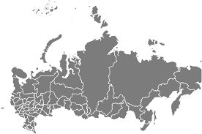
The Rise of Latter Day Russia
Ezekiel 38:1-2 KJV
1 And the word of the LORD came unto me, saying,
2 Son of man, set thy face against Gog, the land of Magog, the chief prince of Meshech and Tubal, and prophesy against him,
1917, 1957, 1991, 2000, 2014, 2015, 2017 …
Notes:
This is the King James Version and it masks the fact that the word “chief” is speaking of a distinct people of Russian descent.
What makes it valuable as a ‘sign of the time’ is that in would not take place until Israel was again a nation in their ancestral homeland. (See Ezekiel 38:8 read)
Russia has never been closer to doing this in recent times.
1917 – Communist takeover from the Czar – The days of the Soviet Union
1957 – Sputnik the 1st satellite that orbited the earth and drove the Americans into a frenzy.
1989 – The fall of the Soviet Union.
2000– Putin’s 1st term in Office.
2014 – Annexation of Crimea.
2015 – Establishes a naval military base in Syria.
2017 – Establishes military airbases on Israel’s border.
They now have military bases within the confines of the land promised to Abraham and are looking at getting a greater foothold in the middle east while America is otherwise occupied.

Slide 15
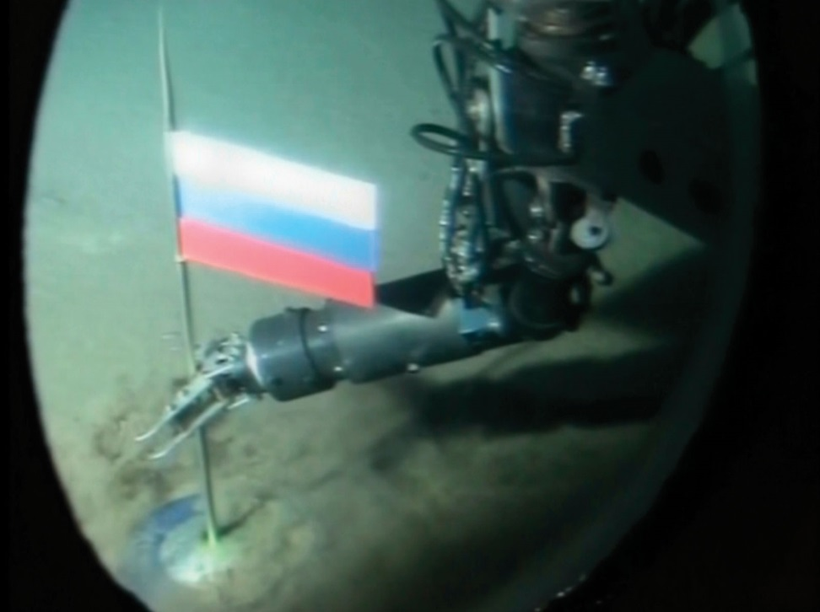
RUSSIA: from the NORTH Pole (2007)
Ezekiel 39:2 ESV
2 And I will turn you about and drive you forward, and bring you up from the uttermost parts of the north, and lead you against the mountains of Israel.
Notes:
Under his watch Russia has laid claim to the “uttermost parts of the north” placing a flag on the North Pole. (2007)
No other nation has made this claim.

Slide 16
RUSSIA: from the Uttermost parts of the NORTH
CITY | LONGITUDE | LATITUDE
St Petersburg, Russia | 30⁰ E | 60⁰ N
Moscow, Russia | 37⁰ E | 55⁰ N
Sevastopol, Crimea | 34⁰ E | 45⁰ N
Ankara, Turkey | 32⁰ E | 40⁰ N
Latakia, Syria | 35⁰ E | 35⁰ N
Beirut, Lebanon | 35⁰ E | 33⁰ N
Tel Aviv, Israel | 34⁰ E | 32⁰ N
Jerusalem, Israel | 35⁰ E | 31⁰ N
Notes:
Under his watch Russia has laid claim to the “uttermost parts of the north” placing a flag on the North Pole. (2007)
No other nation has made this claim.

Slide 17
Russia the “Guard”
Ezekiel 38:7 KJV
7 Be thou prepared, and prepare for thyself, thou, and all thy company that are assembled unto thee, and be thou a guard unto them.
Guard BDB H4929 mishmâr
1) place of confinement, prison, guard, jail, guard post, watch, observance
1a) jail, prison, guard-house
1b) guard, guard post, act of guarding
1c) observances
Notes:
Russia is to act as a “guard” unto them.
Not so much as to guard or protect them, but to guard them to keep them under control.
Russia is a “controlling” power as ordained by God.

Slide 18
This is a work of God!
Ezekiel 38:4-5 KJV
4 And I will turn thee back, and put hooks into thy jaws, and I will bring thee forth, and all thine army, horses and horsemen, all of them clothed with all sorts of armour, even a great company with bucklers and shields, all of them handling swords:
5 Persia, Ethiopia, and Libya with them; all of them with shield and helmet:
Notes:
Again, we see the Bible indicating that this is the work of God.
He is bringing these nations together to do the work He has given them.
We do not see a lot of evidence of Russia working together with France, but it’s coming.

Slide 19
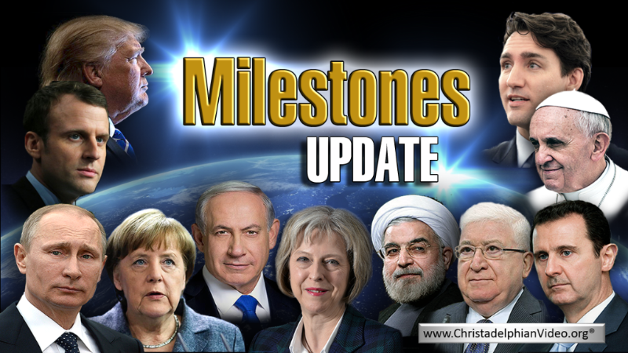
News Source for Christadelphians by Brother Don Pearce (Rugby, England)

Slide 20
Russia’s Christian Roots
“Thousands of Orthodox Christian believers marched and chanted through the streets of Moscow, Kyiv, and other cities marking the 1030th anniversary of the adoption of Christianity in the region.
The July 28 events commemortated the date in 988 of the baptism of Prince Vladimir, who was the leader of the federation of Slavic tribes knows as Kievan Rus.
Centuries later, the federation evolved into the Russian Empire.”
CR-RU:180729: (31-JUL-18):Christianization of the country on 28 July
RadioFreeEurpope 29-Jul-18

Slide 21
Russia’s Christian Roots
“Underscoring how deeply politics have become intertwined with religion, Russian President Vladimir Putin spoke to thousands of clergy and believers in Moscow, at a statue dedicated to prince Vladimir.
Adopting Christianity was “the starting point for the formation and development of Russian statehood, the true spiritual birth of our ancestors, the determination of their identity. Identity, the flowering of national culture and education,” Putin said.”
CR-RU:180729: (31-JUL-18):Christianization of the country on 28 July
RadioFreeEurpope 29-Jul-18

Slide 22
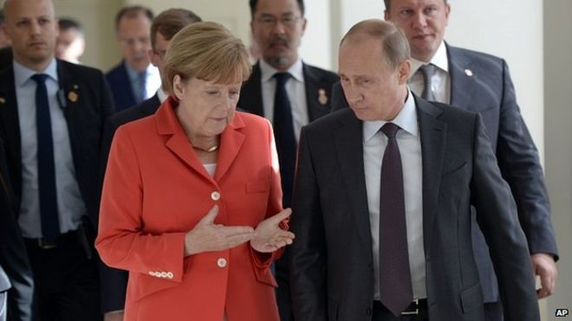
“Gog, of the land of Magog, the prince of Rosh, Meshech, and Tubal”
Notes:
Merkel and Putin

Slide 23
Putin Sees an Opening in Europe’s Fury With Trump
Mr. Putin was now gaining considerable traction by casting himself as a reliable friend and trading partner to Europe even as the Trump administration was treating its closest allies there as strategic and economic competitors.
“It is not our aim to divide anything or anybody in Europe,” Mr. Putin said in a television interview before he went to Vienna. “On the contrary, we want to see a united and prosperous European Union because the European Union is our biggest trade and economic partner. The more problems there are within the European Union, the greater the risks and uncertainties for us.”
New York Times; June 5, 2018

Slide 24
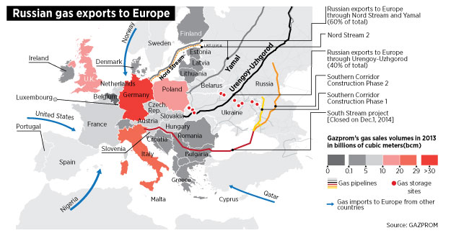
Europe Needs Russia
Notes:
One of the astonishing factors involved in the fulfilling of Bible prophecy is related to where God placed the oil deposits in this world.
Very little in Europe and very much in Russia.
As a result, in this industrial age, Europe has become dependent on Russia for fuel and Russia knows it.
Consider where it comes from.

Slide 25
INSTANCES OF RUSSIAN ENERGY COERCION
The Kremlin’s use of energy coercion began even before the USSR actually dissolved in December 1991. For instance, it interrupted oil supplies to the Baltic states in 1990 in an effort to crush the region’s budding independence movements, although to no avail. Russian energy companies— presumably with the Kremlin’s blessing— have gone on to make multiple attempts over the past 25 years to use energy supplies to gain leverage over Russia’s neighbors and advance Moscow’s strategic priorities. The author has identified at least 15 discrete instances where Russian entities used price and physical volume manipulation of crude oil or natural gas supplies—often amid political tensions—to pressure consumers located in Central and Eastern Europe and the former Soviet countries (Figure 2).
SOURCES BP Statistical Review of World Energy 2017; GADM (countries); Gazprom (pipeline routes and gas import data)
Notes:
But Russia is out for Russia not for Europe.
Notice how it deals with customers who try to wiggle away.

Slide 26
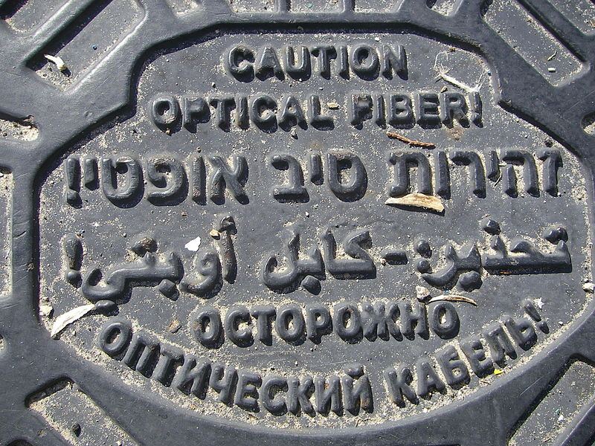
Jews from the former Soviet Union
The last Soviet census of 1989 indicated 1,449,000 Jews living in the country, of which about 877,000 had moved to Israel by October 2000. The wave of immigration in this short period of time was the greatest influx of people to Israel since the date of its creation.^{[1]} Immigrants from the former Soviet Union composed 50%–70% of the newcomers.
Writing on a man hole cover in Tel Aviv
Notes:
Note the number of Russian speaking people in Israel.
And notice that part of the Russian reason for invading Crimea was to protect its large Russian speaking population.

Slide 27
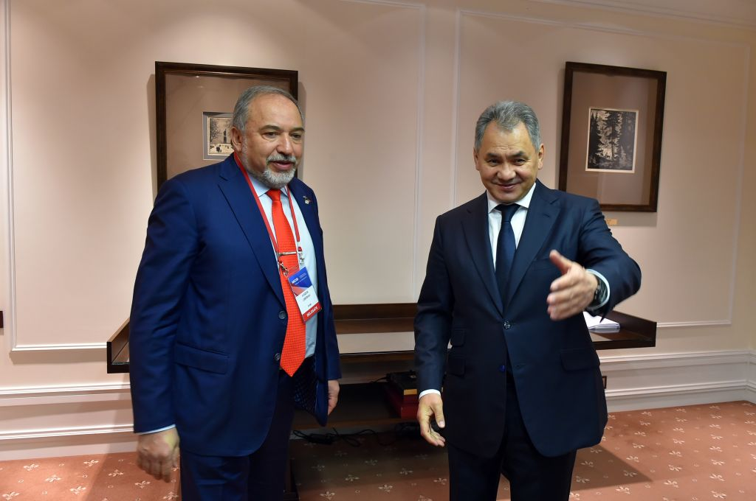
Russian Speaking Defence Ministers:
Avigdor Lieberman / Sergei Shoigu

Slide 28
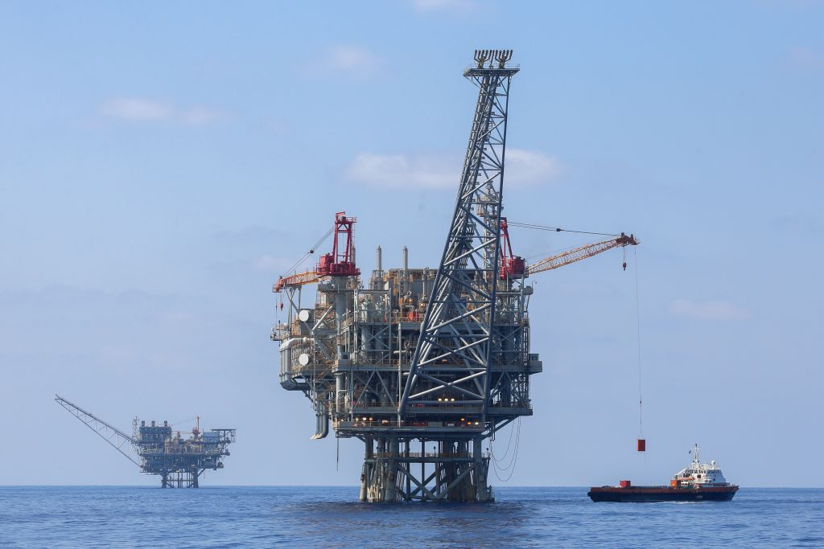
Russia & the Evil Thought
Ezekiel 38:12-13 KJV
12 To take a spoil, and to take a prey; to turn thine hand upon the desolate places that are now inhabited, and upon the people that are gathered out of the nations, which have gotten cattle and goods, that dwell in the midst of the land.
2009, 2010, 2016, 2017 …
Notes:
Read Ezekiel 38:12-13
For many years we have wondered what the spoil would be.
Young people need to remember that a major oil in Israel is a very recent event. Tamar was discovered in 2009
Since then oil and gas fields have been discovered in a number of places that makes Israel a unique location of such wealth.
2010 Leviathan was discovered
2016 Golan and Jerusalem
2017 Drilling is occurring in the plains of Jezreel.
Russia must have noticed.

Slide 29
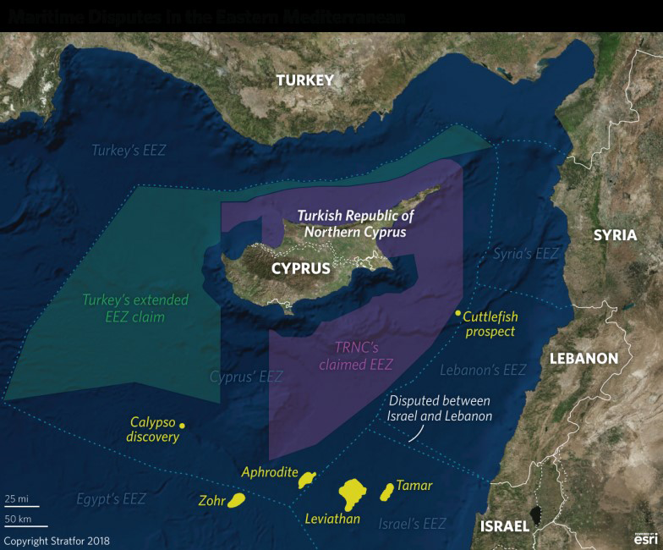
Oil/Gas Discovered in Eastern Mediterranean

Slide 30
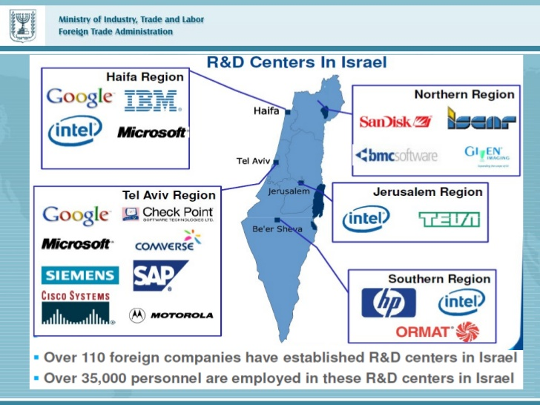
Research Centers in Israel
Notes:
Israel does a lot of Research and Development.
It has a highly educated workforce.
Note the location of the Research Centres.

Slide 31
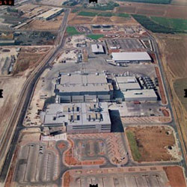
Intel to Invest further $5 Billion in Israel Semiconductor Processing Facility
“I have now received a happy message from Intel CEO [for Israel] Yaniv Gerti, who informed me that after two years of intensive work, the management of the global company accepted our proposal”
Intel Plant at Kiryat Gat, Israel
Minister of Finance Moshe Kahlon
Snippets 31-May-18

Slide 32
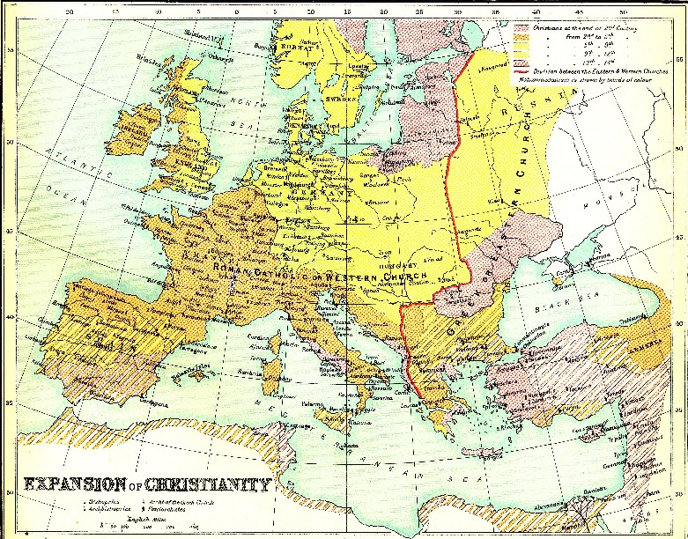
Notes:
Notice that the Nations of Europe are largely described as being Christian – Even in Russia.
You may have heard Moscow described as the 3rd Rome. Rome – Constantinople - Moscow
The revival of Religion in Russia is an interesting fact to explore and is one of the major differences between the USSR and Russia.

Slide 33
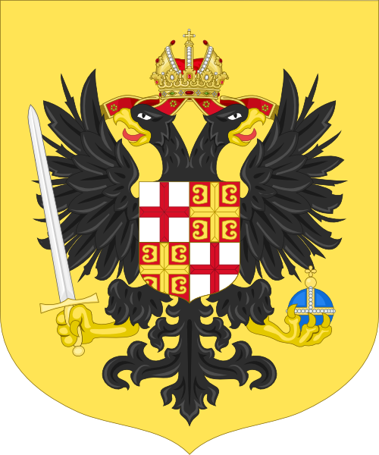
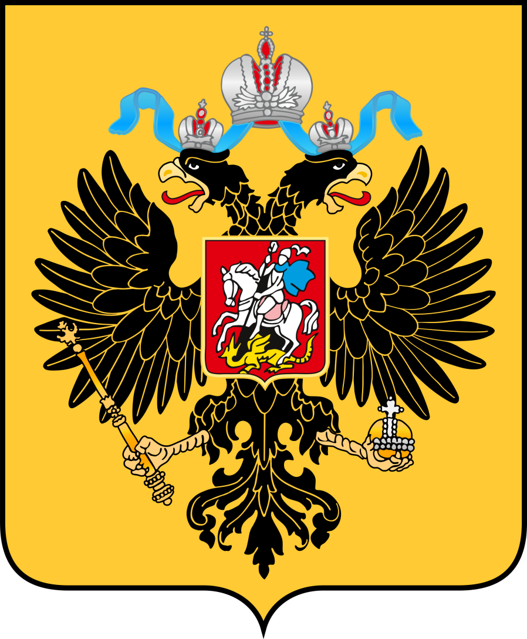
Moscow the 3rd Rome
Byzantine Coat of Arms
Russian Federation Coat of Arms

Slide 34
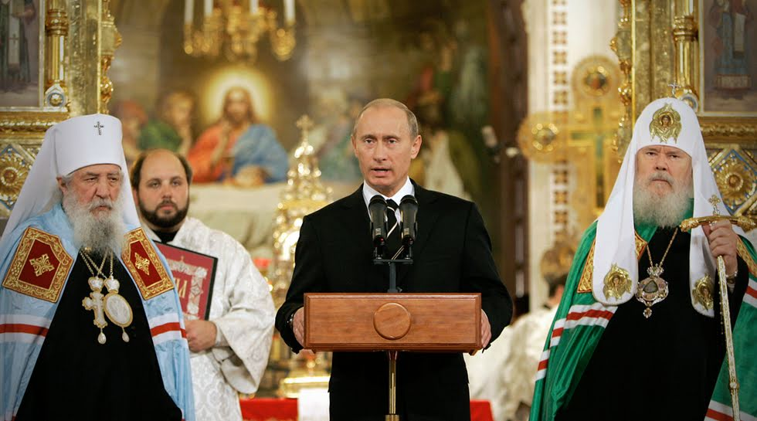
Putin and His Christian Connections from the April 06, 2015 eNews issue http://www.khouse.org
Continuing in his remarks, Putin stated that he has championed Russian laws that:
  Essentially outlawed abortion in Russia (no abortions after the 12th week, and before that time in limited cases, and also the end of financial support for abortions, reversing a previous Soviet policy);
  Strongly support traditional marriage, especially religious marriage, with financial aid to married couples having more than two children;
Notes:
President Vladimir Putin
Patriarch Kirill of the Russian Orthodox Church (2009)
Russian Orthodox Church Archpriest Vsevolod Chaplin

Slide 35
Putin and His Christian Connections from the April 06, 2015 eNews issue http://www.khouse.org
  Established compulsory religious instruction in all Russian schools;
  Made religious holidays now official Russian state holidays;
  Instituted a nationwide program of rebuilding churches that were destroyed by the Communists, the most notable being the historic Church of Christ the Savior in Moscow.
Notes:
President Vladimir Putin
Patriarch Kirill of the Russian Orthodox Church (2009)
Russian Orthodox Church Archpriest Vsevolod Chaplin

Slide 36
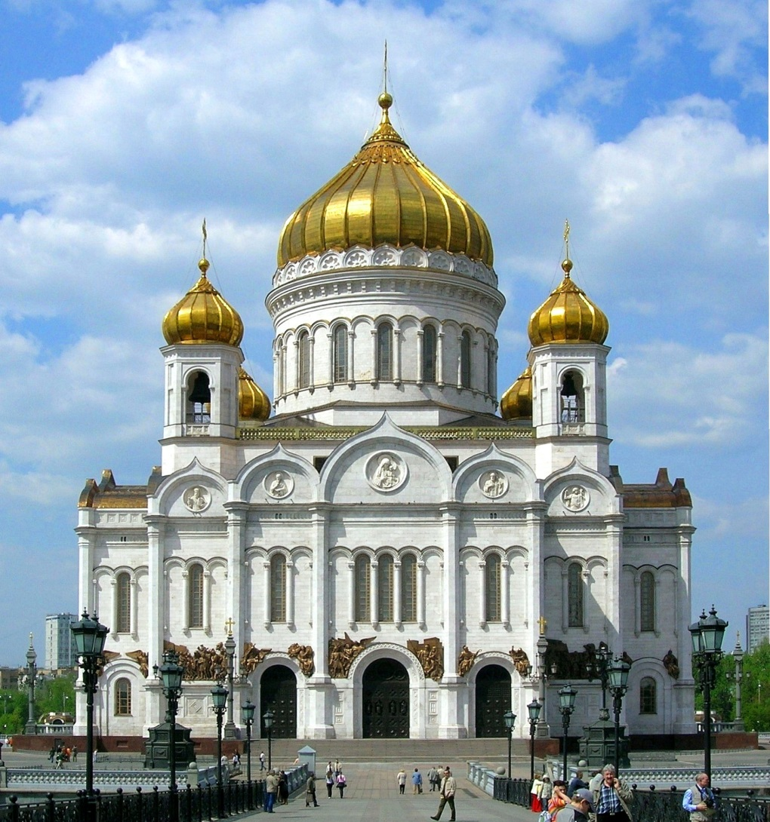
The Cathedral Of Jesus Christ
Russian Orthodox – Moscow (2000)
Notes:
Restored from ruins in 2000

Slide 37
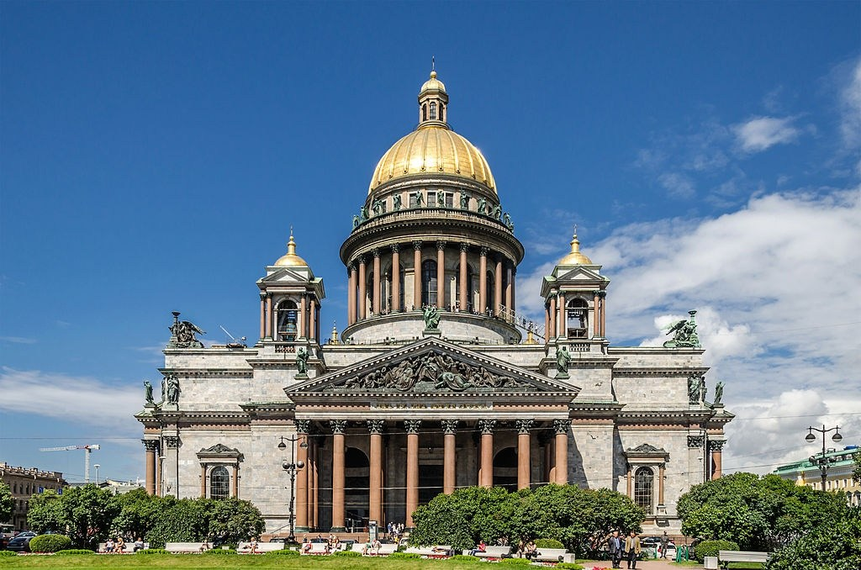
St Isaac Cathedral (Museum)
Russian Orthodox – St Petersburg (1858)
Notes:
Converted to a Museum, now both a Church and Museum.

Slide 38
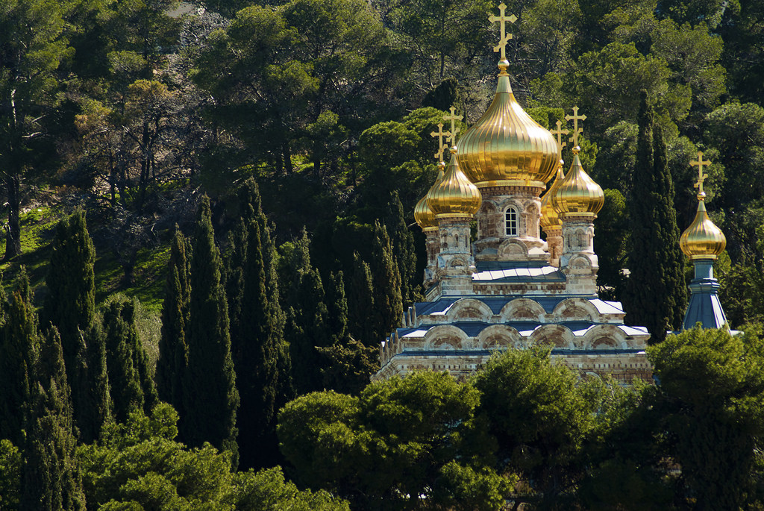
Russian Real Estate in Jerusalem

Slide 39
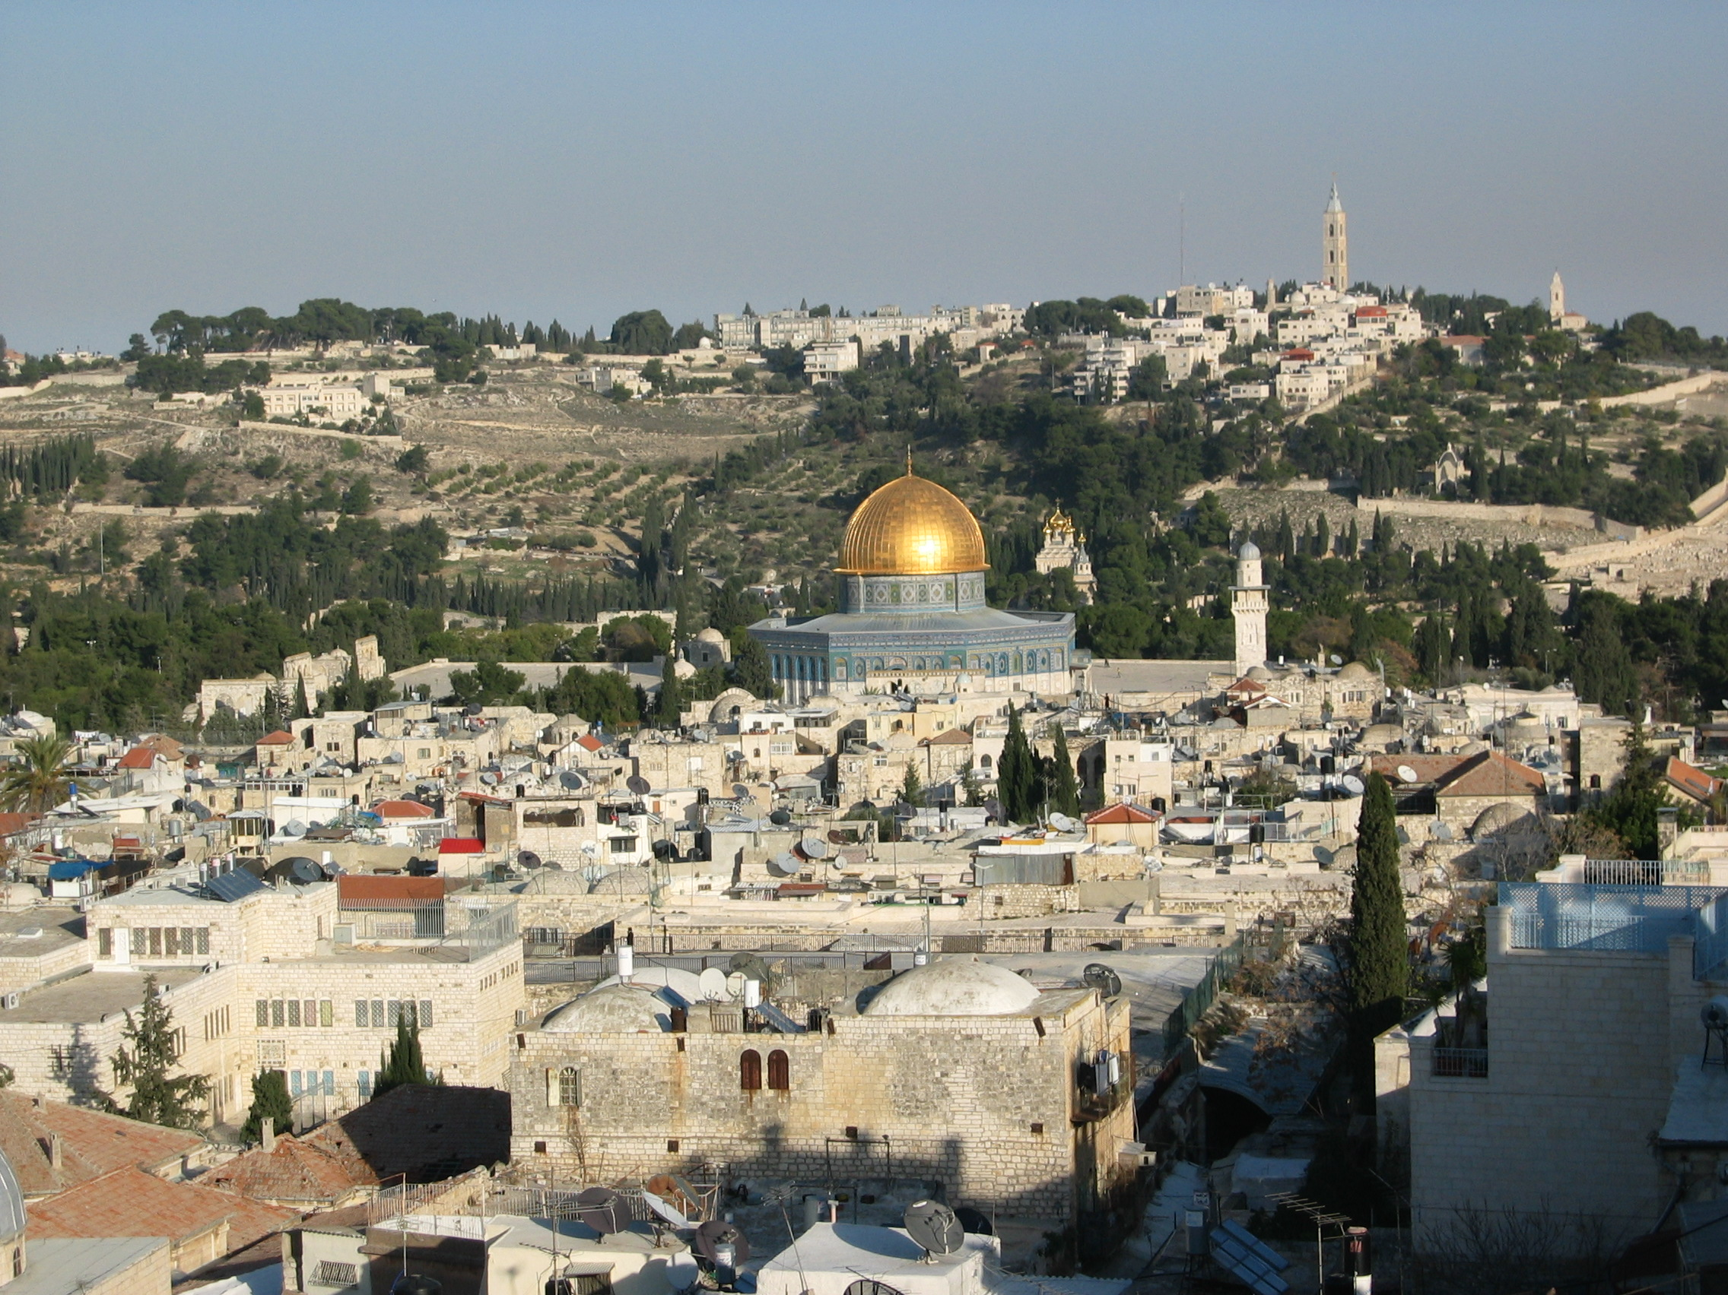
The Church of Mary Magdalene was built by Tsar Alexander III in 1888 in the traditional Russian style.
Notes:
The Church of Mary Magdalene was built by Tsar Alexander III in 1888 in the traditional Russian style. Easily spotted from the Temple Mount, the Russian church's seven golden domes have been newly gilded and sparkle in the sun. Combined with its multiple levels and sculpted white turrets, the church looks like something out of a fairytale.

Slide 40
The 64-metre tower that dominates the Mount of Olives skyline belongs to the Russian Orthodox Church of the Ascension. It was built to this height in the 1870s so that pilgrims unable to walk to the Jordan River could climb its 214 steps and at least see the river.
Notes:
The Church of Mary Magdalene was built by Tsar Alexander III in 1888 in the traditional Russian style. Easily spotted from the Temple Mount, the Russian church's seven golden domes have been newly gilded and sparkle in the sun. Combined with its multiple levels and sculpted white turrets, the church looks like something out of a fairytale.

Slide 41
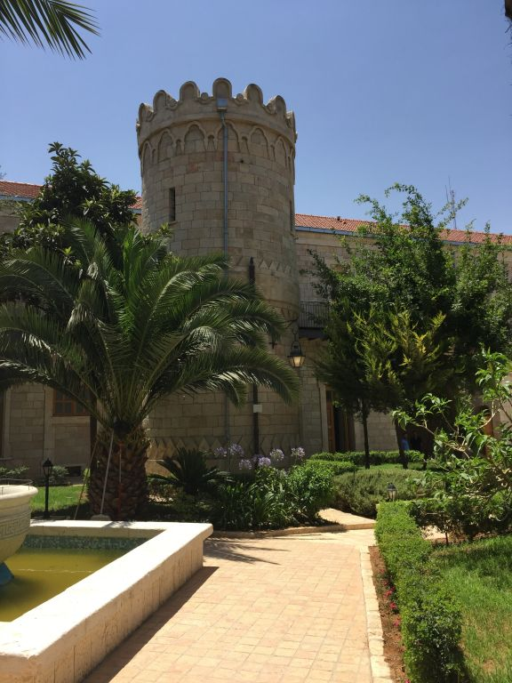
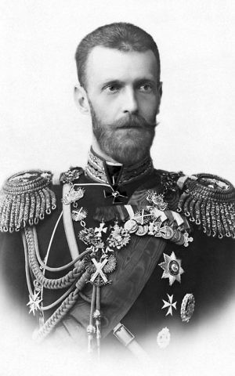
Russian Real Estate in Jerusalem
Grand Duke Sergei Alexandrovich of Russia 1857-1905
One of two restored Renaissance-styled Towers in Sergei’s Courtyard in Jerusalem

Slide 42
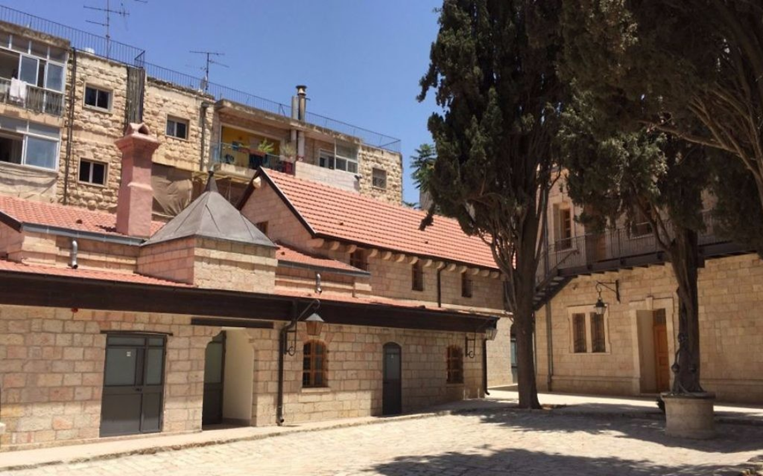
In a rare move, Russian embassy to host its National Day party in Jerusalem
Snippets: Times of Israel 29-May-18

Slide 43
“In nod to Moscow’s April 2017 recognition of western part of city as Israel’s capital, June 14 reception to be held at historic Sergei’s Courtyard.”

Slide 44
“Sergey’s Compound, which was returned to Russia in 2008, holds a unique place in the history of the Russian presence in the Holy Land,” the Russian embassy spokesperson said.”

Slide 45
“The decision to host the National Day reception there is not occasional. The Compound symbolizes our culture, traditions and represents a genuine Russian allotment in Israel and the Middle East in general.”

Slide 46
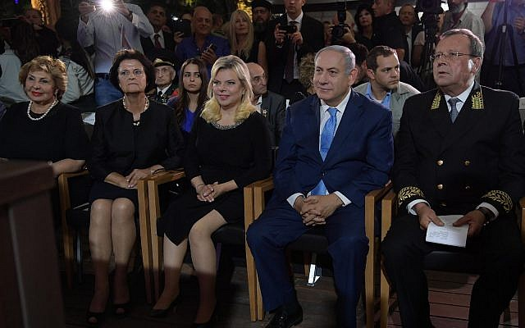
Prime Minister Benjamin Netanyahu at a reception marking Russia Day in Sergei’s Courtyard, Jerusalem, June 14, 2018 (Amos Ben-Gershom/GPO)

Slide 47
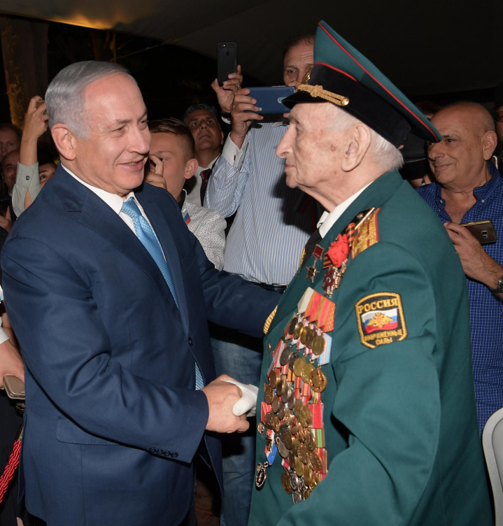
Russian-Israeli Celebration in Jerusalem
“This is a holiday for Russia, and it’s a celebratory day that was initiated and takes place in Jerusalem, and I assume that there will be many more days like this one in Jerusalem,” Prime Minister Benjamin Netanyahu said at the event. “I know that we’re going to celebrate many, many years of cooperation between Israel and Russia in Moscow and also next year in Jerusalem.”
Times of Israel , June 14, 2018

Slide 48
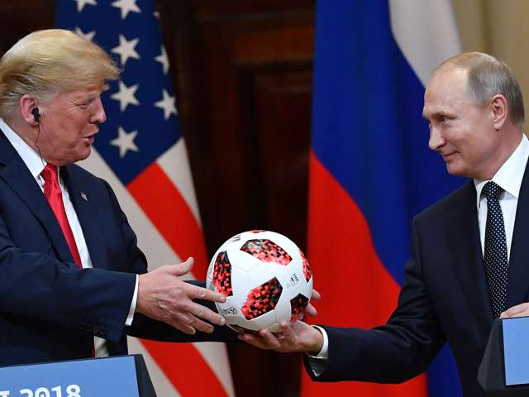
The soccer ball that Putin gave to Trump had a chip inside that could transmit to phones
Russia’s President Vladimir Putin (R) offers a ball of the 2018 football World Cup to US President Donald Trump during a joint press conference after a meeting at the Presidential Palace in Helsinki, on July 16, 2018. YURI KADOBNOV/AFP/Getty Images

Slide 49
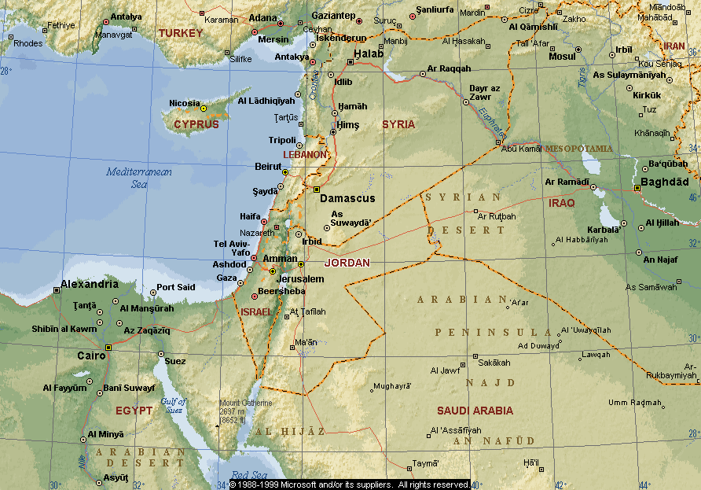
THE LAND OF PROMISE
Genesis 15:18 KJV
“In the same day the LORD made a covenant with Abram, saying, Unto thy seed have I given this land, from the river of Egypt unto the great river, the river Euphrates:”
Russia’s Military is already in the Land of Promise!
LAND PROMISED TO ABRAHAM FOREVER – Genesis 17:8
Notes:
The Land of Promise
Russia now has a military base within the borders of God’s land
Note the countries that God’s boundaries will affect.
We are very close to the end.

Slide 50
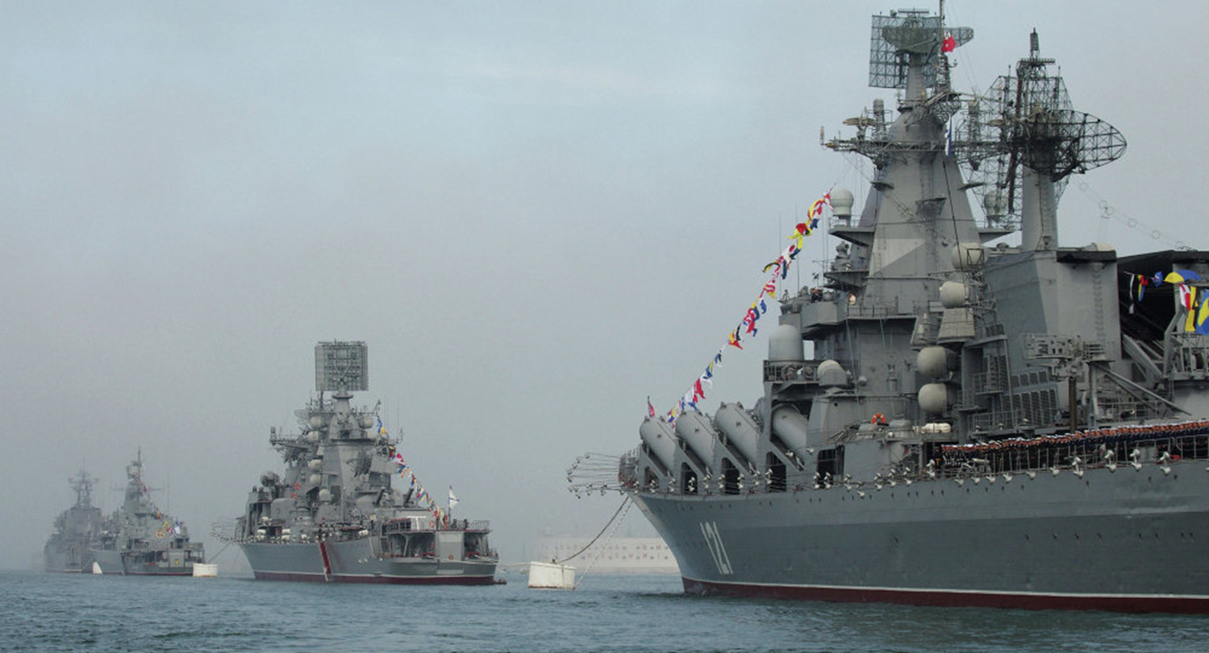
The Russian Presence in the Mediterranean

Slide 51
The Russian-Led Forces will be Destroyed by God, in Israel!
Ezekiel 38:21-23 KJV
21 And I will call for a sword against him throughout all my mountains, saith the Lord GOD: every man's sword shall be against his brother.
22 And I will plead against him with pestilence and with blood; and I will rain upon him, and upon his bands, and upon the many people that are with him, an overflowing rain, and great hailstones, fire, and brimstone.
23 Thus will I magnify myself, and sanctify myself; and I will be known in the eyes of many nations, and they shall know that I am the LORD.
Notes:
At the same time when Gog comes against the land of Israel.
Suddenly God will break forth on His enemies.

Slide 52
The Russian-Led Forces will be Disarmed by God, in Israel!
Ezekiel 39:1-3 RV
1 And thou, son of man, prophesy against Gog, and say, Thus saith the Lord GOD: Behold, I am against thee, O Gog, prince of Rosh, Meshech, and Tubal:
2 and I will turn thee about, and will lead thee on, and will cause thee to come up from the uttermost parts of the north; and I will bring thee upon the mountains of Israel:
3 and I will smite thy bow out of thy left hand, and will cause thine arrows to fall out of thy right hand.
Notes:
At the same time when Gog comes against the land of Israel.
Suddenly God will break forth on His enemies.

Slide 53
Summary
Russia is identified in Bible Prophecy.
Russia’s work is to group nations together to fulfill the prophecy of Daniel chapter 2.
Russia is being moved by God to humble Israel and the time to do so is nigh at hand.
Russia will find holes in the defenses of the Western Nations to work out its agenda.
But in the end the Russian army will stand up against the LORD and meet its demise on the mountains of Israel.
Notes:
Read the summary.

Slide 54
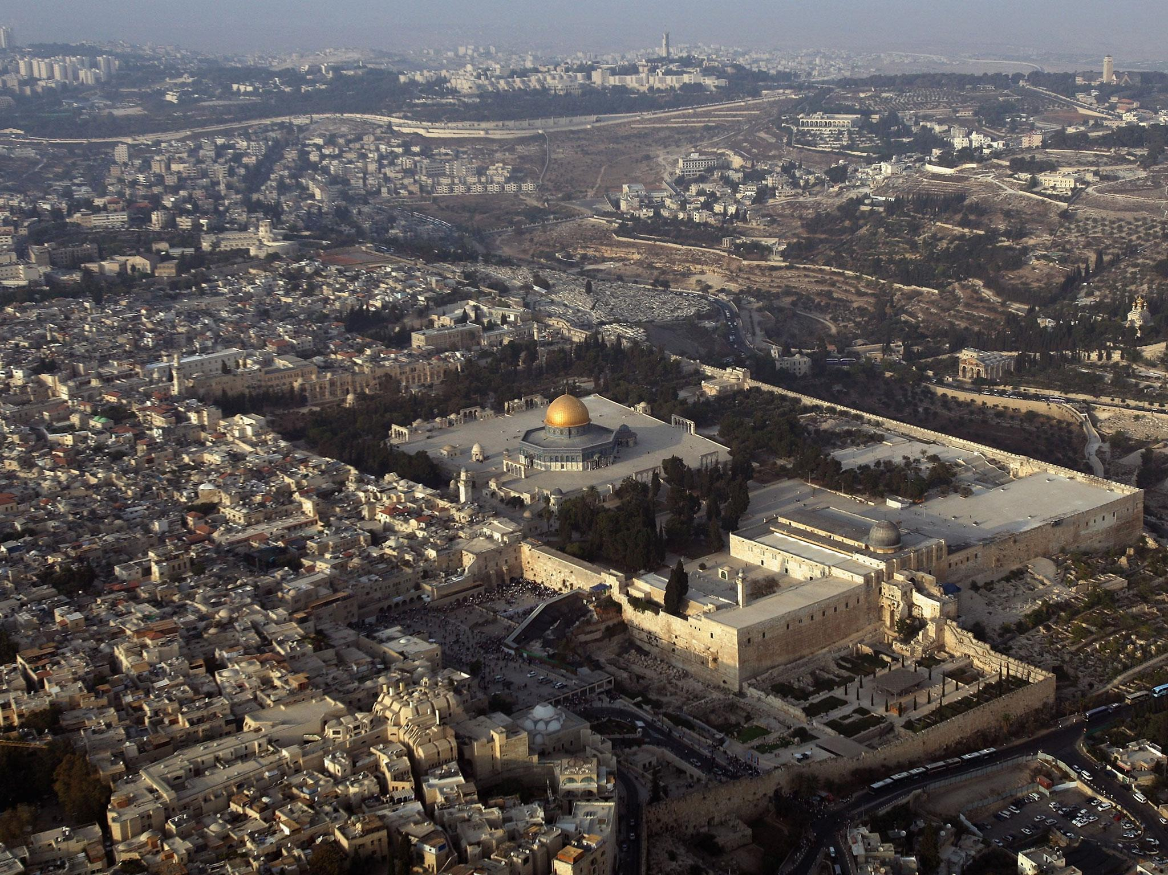
Psalms 122:6 KJV
“Pray for the peace of Jerusalem: they shall prosper that love thee”

