Slide 1
Malachi 3
“But who may abide the day of his coming?”

Slide 2



My messenger
Mal 3:1 Behold, I will send my messenger, and he shall prepare the way before me:
Isa 40:3 The voice of him that crieth in the wilderness, Prepare ye the way of the LORD…
Mat 11:10 For this is he, of whom it is written, Behold, I send my messenger before thy face, which shall prepare thy way before thee. 11 …there hath not risen a greater than John the Baptist…
Mar 1:2 As it is written in the prophets, Behold, I send my messenger before thy face, which shall prepare thy way before thee. 3 The voice of one crying in the wilderness, Prepare ye the way of the Lord…

Slide 3
My messenger
Mal 3:1 Behold, I will send my messenger, and he shall prepare the way before me:
Isa 40:3 The voice of him that crieth in the wilderness, Prepare ye the way of the LORD…
Lk 1:17 And he shall go before him in the spirit and power of Elias, to turn the hearts of the fathers to the children, and the disobedient to the wisdom of the just; to make ready a people prepared for the Lord.
Lk 1:76 And thou, child, shalt be called the prophet of the Highest: for thou shalt go before the face of the Lord to prepare his ways; 77 To give knowledge of salvation unto his people by the remission of their sins…

Slide 4
My messenger
Mal 3:1 Behold, I will send my messenger, and he shall prepare the way before me:
Isa 40:3 The voice of him that crieth in the wilderness, Prepare ye the way of the LORD…
Lk 3:4 As it is written in the book of the words of Esaias the prophet, saying, The voice of one crying in the wilderness, Prepare ye the way of the Lord, make his paths straight.

Slide 5
My messenger
Mal 3:1 Behold, I will send my messenger, and he shall prepare the way before me:
Isa 40:3 The voice of him that crieth in the wilderness, Prepare ye the way of the LORD…
John 1:6 There was a man sent from God, whose name was John… 23 He said, I am the voice of one crying in the wilderness, Make straight the way of the Lord, as said the prophet Esaias.
John 1:29 The next day John seeth Jesus coming unto him, and saith, Behold the Lamb of God, which taketh away the sin of the world.

Slide 6


Yahweh’s messengers
Isaiah 42:19 Who is blind, but my servant? or deaf, as my messenger that I sent? who is blind as he that is perfect, and blind as the LORD'S servant?
Isaiah 42:6 I the Lord have called thee in righteousness, and will hold thine hand, and will keep thee, and give thee for a covenant of the people, for a light of the Gentiles…

Slide 7
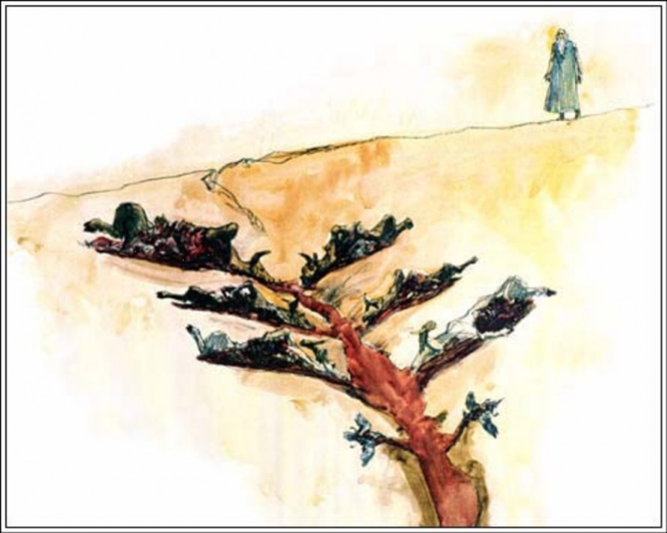

Slide 8
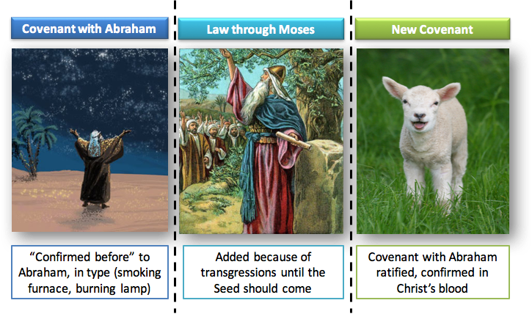

Slide 9

Yahweh’s messengers
2 Chronicles 36:15 And the LORD God of their fathers sent to them by his messengers, rising up betimes, and sending; because he had compassion on his people, and on his dwelling place…
Luke 1:19 I am Gabriel… and am sent to speak unto thee, and to shew thee these glad tidings.
Luke 1:26 …the angel Gabriel was sent from God unto a city of Galilee…

Slide 10



The message sent by the Father
Jesus sent by God
John 3:34 For he whom God hath sent speaketh the words of God.
Revelation sent by Jesus
Rev 1:1 The Revelation of Jesus Christ… and he sent and signified it by his angel unto his servant John:
The message sent to Gentiles
Acts 28:28 Be it known therefore unto you, that the salvation of God is sent unto the Gentiles, and that they will hear it.
Rev 22:17 And the Spirit and the bride say, Come. And let him that heareth say, Come. And let him that is athirst come.

Slide 11




Seeking Jesus in John 7
7:1 Jews sought to kill
7:4 Man seeks to be known
7:11 Jews sought him
7:18 Seeks God’s glory
7:30 They sought to take him
7:20 Who seeks to kill you?
7:19 Why seek to kill me?
7:34 Ye shall seek me and not find
7:25 Is not this they seek to kill?
7:36 What manner of saying…?

Slide 12



Seeking and finding Jesus
To the Jews
To disciples
To Peter
7:34 Ye shall seek me, and shall not find me: and where I am, thither ye cannot come.
8:21 Then said Jesus again unto them, I go my way, and ye shall seek me, and shall die in your sins: whither I go, ye cannot come.
13:33 Ye shall seek me: and as I said unto the Jews, Whither I go, ye cannot come; so now I say to you.
13:36 Whither I go, thou canst not follow me now; but thou shalt follow me afterwards.

Slide 13
Jesus in the Temple
John 2
Cleansed the Temple: “my Father’s House”
  Matthew 23:38
  Your house is left unto you desolate

Slide 14

Mal 3:2 The day of his coming
Joel 2:11 And the LORD shall utter his voice before his army: for his camp is very great: for he is strong that executeth his word: for the day of the LORD is great and very terrible; and who can abide it?
Amos 5:18 Woe unto you that desire the day of the LORD! to what end is it for you? the day of the LORD is darkness, and not light.

Slide 15

Mal 3:2,3
Refiner’s fire
3:3 Refiner and purifier of silver and gold

Slide 16
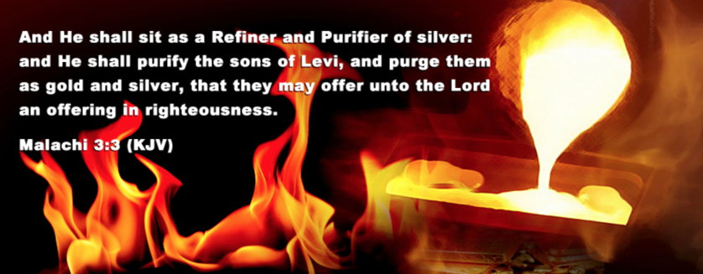
1Pe 4:12 Beloved, think it not strange concerning the fiery trial* which is to try you…
Prov 17:3 The fining pot is for silver, and the furnace for gold: but the LORD trieth the hearts.
1Pe 1:7 the trial of your faith… more precious than of gold that perisheth, though it be tried with fire…
Job 23:10
When he hath tried me, I shall come forth as gold.
* the burning by which metals are roasted and reduced

Slide 17
Mal 3:2,3
Refiner’s fire
3:3 Refiner and purifier of silver and gold
Silver of redemption
(Exodus 30:14)
Gold of tried faith (1 Peter 1:7)
Removal of dross

Slide 18

Mal 3:2,3
Refiner’s fire
Fuller’s soap
3:3 Refiner and purifier of silver and gold
3:2 Fuller: to wash, to trample
Silver of redemption
(Exodus 30:14)
Gold of tried faith (1 Peter 1:7)
Removal of dross

Slide 19
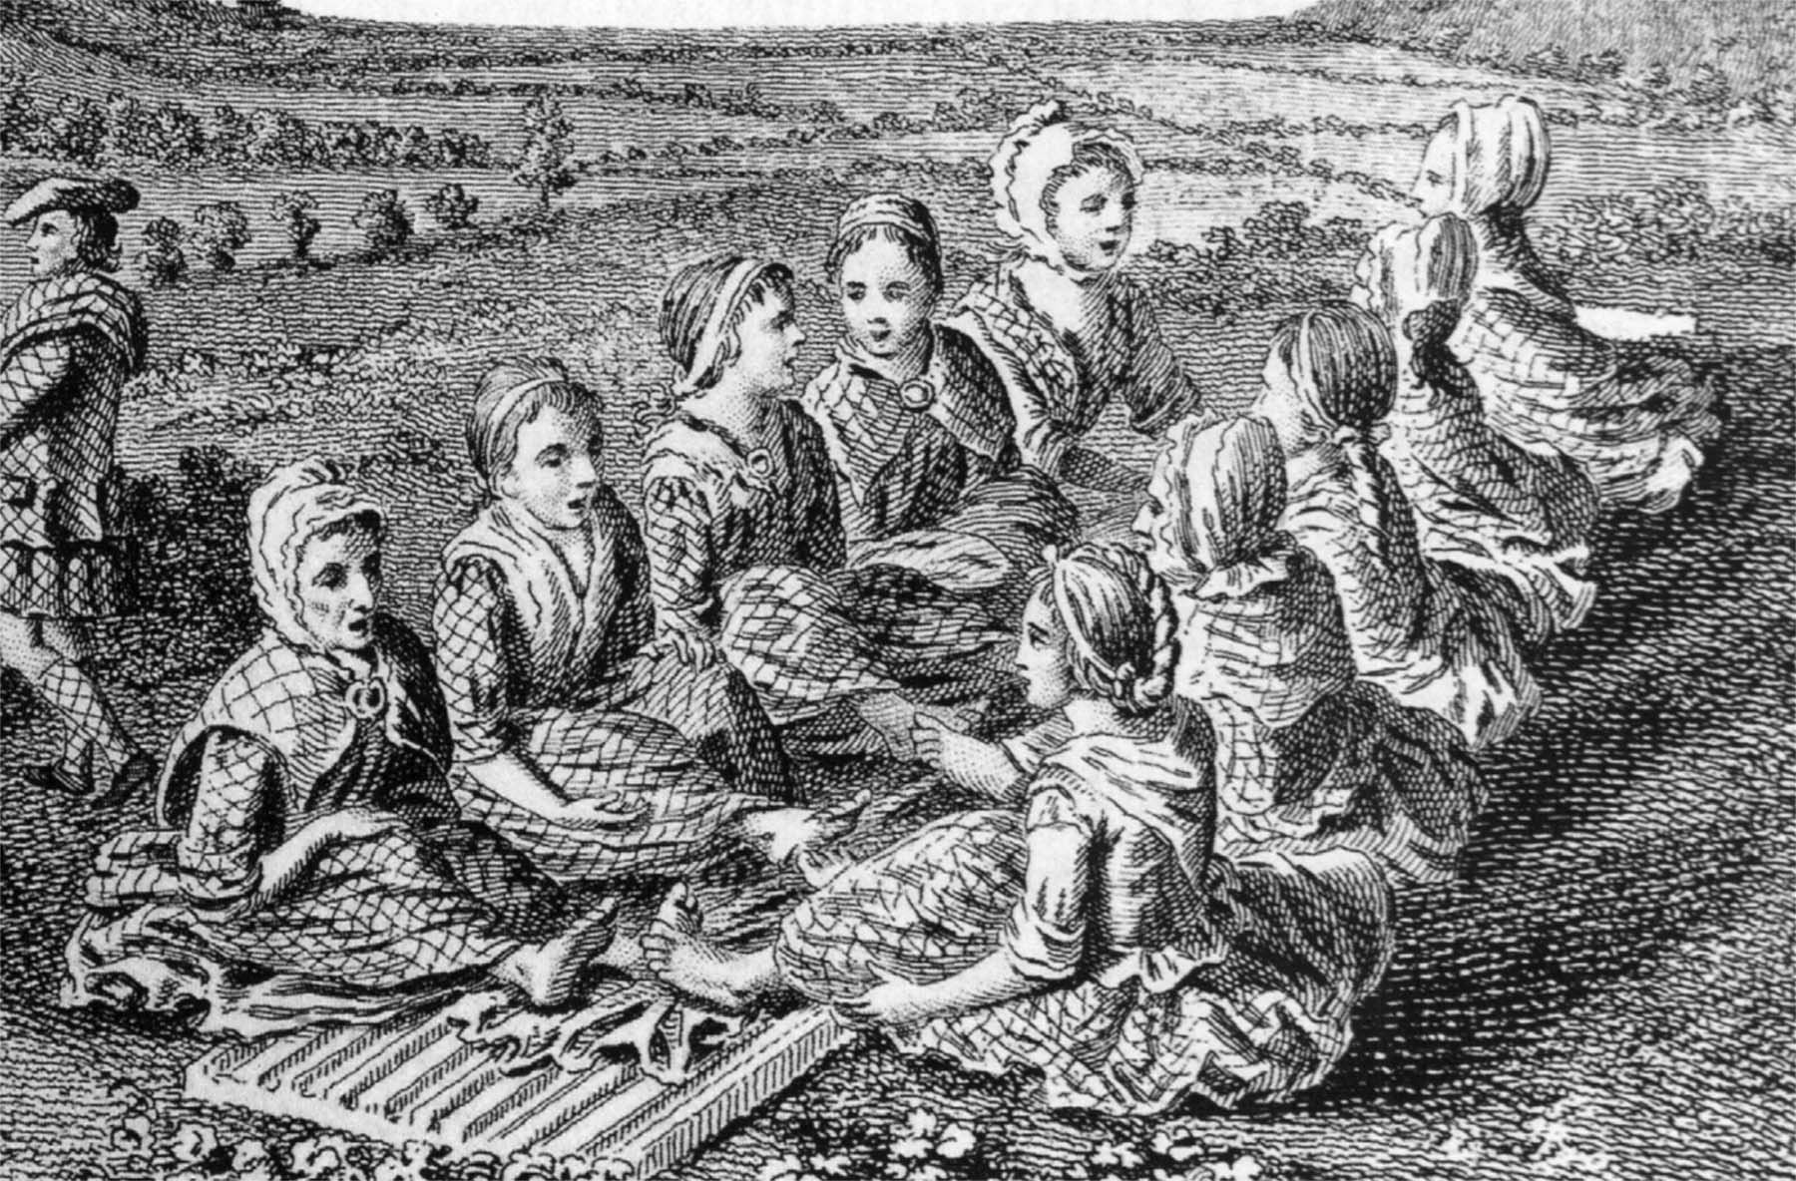
Engraving of Scotswomen singing a waulking song while walking or fulling cloth, c. 1770.
  Mk 9:3 And his raiment became shining, exceeding white as snow; so as no fuller on earth can white them.
  Rev 7:14
  they which came out of great tribulation, and have washed their robes, and made them white in the blood of the Lamb.
  Rev 19:8
  And to her was granted that she should be arrayed in fine linen, clean and white: for the fine linen is the righteousness of saints.
Notes:
Fulling, also known as tucking or walking (spelt waulking in Scotland), is a step in woollen clothmaking which involves the cleansing of cloth (particularly wool) to eliminate oils, dirt, and other impurities, and making it thicker. The worker who does the job is a fuller, tucker, or walker,[1] all of which have become common surnames. The Welsh word for a fulling mill is pandy, which appears in many place-names, for example Tonypandy ("fulling mill lea").
Fulling involves two processes, scouring and milling (thickening). Originally, fulling was carried out by pounding the woollen cloth with the fuller's feet, or hands, or a club. In Scottish Gaelic tradition, this process was accompanied by waulking songs, which women sang to set the pace. From the medieval period, however, fulling was often carried out in a water mill.
These processes are followed by stretching the cloth on great frames known as tenters, to which it is attached by tenterhooks. It is from this process that the phrase being on tenterhooks is derived, as meaning to be held in suspense. The area where the tenters were erected was known as a tenterground.
Scouring[edit]
In Roman times, fulling was conducted by slaves working the cloth while ankle deep in tubs of human urine. Urine was so important to the fulling business that it was taxed. Stale urine, known as wash, was a source of ammonium salts and assisted in cleansing and whitening the cloth.
By the medieval period, fuller's earth had been introduced for use in the process. This is a soft clay-like material occurring naturally as an impure hydrous aluminium silicate. It was used in conjunction with wash. More recently, soap has been used.
Thickening[edit]
The second function of fulling was to thicken cloth by matting the fibres together to give it strength and increase waterproofing (felting). This was vital in the case of woollens, made from carding wool, but not for worsted materials made from combing wool. After this stage, water was used to rinse out the foul-smelling liquor used during cleansing.
Felting of wool occurs upon hammering or other mechanical agitation because the microscopic barbs on the surface of wool fibres hook together, somewhat like Velcro.
https://en.wikipedia.org/wiki/Fulling

Slide 20
Mal 3:2,3
Refiner’s fire
Fuller’s soap
3:3 Refiner and purifier of silver and gold
3:2 Fuller: to wash, to trample
Jer 2:22 For though thou wash thee with nitre, and take thee much soap, yet thine iniquity is marked before me
Silver of redemption
(Exodus 30:14)
Gold of tried faith (1 Peter 1:7)
Removal of dross
Cleansing from defilement

Slide 21
Mal 3:5
1 | Sorcerers, witchcraft | Exod. 22:18 - religious deception
2 | Adulterers | Exod. 20:14 - moral weakness
3 | False swearers | Exod. 20:16 - ‘sweareth to his hurt and changeth not’ (Ps 15:4)
4 | Affliction of widows and fatherless | Exod. 22:22 - specially observed by God
5 | Denying the stranger his right | Exod. 22:21 - anyone who takes advantage of those who cannot help themselves
6 | Oppressors of hirelings | Deut. 24:14 - selfishness and meanness
7 | Fear not Yahweh | the foundation sin behind all the others

Slide 22

Mal 3:9
Deut 27:26 Cursed be he that confirmeth not all the words of this law to do them. And all the people shall say, Amen.

Slide 23
Mal 3:10
Deut 27:26 Cursed be he that confirmeth not all the words of this law to do them. And all the people shall say, Amen.
Deut 28:8 The Lord shall command the blessing upon thee in thy storehouses, and in all that thou settest thine hand unto; and he shall bless thee in the land which the Lord thy God giveth thee.

Slide 24

Mal 3:11
Deut 28:38 Thou shalt carry much seed out into the field, and shalt gather but little in; for the locust shall consume it.
Deut 28:18 Cursed shall be the fruit of thy body, and the fruit of thy land, the increase of thy kine, and the flocks of thy sheep.
Lev 26:20 And your strength shall be spent in vain: for your land shall not yield her increase, neither shall the trees of the land yield their fruits.

Slide 25

Mal 3:12
Isaiah 61:9 And their seed shall be known among the Gentiles, and their offspring among the people: all that see them shall acknowledge them, that they are the seed which the LORD hath blessed.
Is 62:4 Thou shalt no more be termed Forsaken; neither shall thy land any more be termed Desolate: but thou shalt be called Hephzibah, and thy land Beulah: for the LORD delighteth in thee, and thy land shall be married.

Slide 26

Mal 3:14
Deut 28:47,48 Because thou servedst not the LORD thy God with joyfulness, and with gladness of heart, for the abundance of all things;
Therefore shalt thou serve thine enemies which the LORD shall send against thee…
Ex 25:2 Speak unto the children of Israel, that they bring me an offering: of every man that giveth it willingly with his heart ye shall take my offering.
2 Cor 9:7 Every man according as he purposeth in his heart, so let him give; not grudgingly, or of necessity: for God loveth a cheerful giver.

Slide 27

Mal 3:15
J P Green Literal version:
And now we are calling the arrogant blessed. Not only are the doers of wickedness built up, they also test God, and escape.

Slide 28
Mal 3:16
What the faithful did | What the faithless did
They feared Yahweh | 3:5 Did not fear God
They spoke of His gracious character and ways | 3:13 Spoke bold words against Him
They thought upon - esteemed His Name | 1:6 despised his Name
Notes:
spake: cp Anna: spake of him to all who looked for redemption

Slide 29
Fear and reverence in Malachi
1:6 A son honoureth his father, and a servant his master: if then I be a father, where is mine honour? and if I be a master, where is my fear?
1:14 My name is dreadful [feared, held in reverence] among the heathen.
2:5 My covenant was with him of life and peace… for the fear wherewith he feared me, and was afraid before my name.
3:5 And I will come near to you to judgment…[you] fear not me…
4:5 I will send you Elijah the prophet before the coming of the great and dreadful day of the LORD.
4:2 But unto you that fear my name shall the Sun of righteousness arise…

Slide 30
Ten refs to ‘The Name’ in Malachi
1:6 Priests despise the Name
1:6 Wherein have we despised thy Name?
1:11 My Name shall be great among the Gentiles
1:11 In every place incense shall be offered unto my Name
1:11 My Name shall be great among the heathen
1:14 My Name is dreadful [feared] among the heathen
2:2 Give glory unto my Name
2:5 [Levi] was afraid before my Name
3:15 A book of remembrance was written before him for them that... thought upon his Name
4:2 But unto you that fear my Name shall the Sun of righteousness arise

Slide 31

The book of life
Dan 12:1 And at that time shall Michael stand up… and at that time thy people shall be delivered, every one that shall be found written in the book.
Rev 20:12 And I saw the dead, small and great, stand before God; and the books were opened: and another book was opened, which is the book of life: and the dead were judged out of those things which were written in the books, according to their works.

Slide 32
A scroll of the Life
The scroll of the Life
“Day Book”
“Final Ledger”

Slide 33

Thought upon His Name
Exodus 26:1 Moreover thou shalt make the tabernacle with ten curtains of fine twined linen, and blue, and purple, and scarlet: with cherubims of cunning work shalt thou make them.
Psa 45:13 The king's daughter is all glorious within: her clothing is of wrought gold. 14 She shall be brought unto the king in raiment of needlework [embroidery]: the virgins her companions that follow her shall be brought unto thee.

Slide 34

Mal 3:17
Exodus 19:5 Now therefore, if ye will obey my voice indeed, and keep my covenant, then ye shall be a peculiar treasure unto me above all people: for all the earth is mine:
Deut 7:6 For thou art an holy people unto the LORD thy God: the LORD thy God hath chosen thee to be a special people unto himself, above all people that are upon the face of the earth.

Slide 36
Jesus in the Temple
John 2
Cleansed the Temple: “my Father’s House”
John 5
Healed the impotent man, discussed work as judge
  John 7:14,16 Went to Temple and taught
John 7:28 Proclaimed he came from God
  John 8
  Woman in adultery, light of the world
  Matthew 23:38
  Your house is left unto you desolate

Slide 37
The Jews seeking Jesus
Mar 8:11
Seeking a sign from heaven, tempting him
  Mar 12:12
They sought to lay hold on him, but feared the people
  Mar 14:1 The scribes sought how they might take him by craft, and put him to death
Luke 11:54
seeking to catch something out of his mouth, that they might accuse him
John 5:18 The Jews sought the more to kill him, because he… said also that God was his Father
  Mar 14:55
All the council sought for witness against Jesus to put him to death; and found none

Slide 38
The word of salvation sent
Acts 13:26 Men and brethren, children of the stock of Abraham, and whosoever among you feareth God, to you is the word of this salvation sent.
Acts 28:28 Be it known therefore unto you, that the salvation of God is sent unto the Gentiles, and that they will hear it.
Rev 1:1 The Revelation of Jesus Christ, which God gave unto him… and he sent and signified it by his angel unto his servant John…
Rev 22:6 And he said unto me, These sayings are faithful and true: and the Lord God of the holy prophets sent his angel to shew unto his servants the things which must shortly be done.

Slide 39
Jesus was sent by his Father
Luke 4:43 I must preach… for therefore am I sent.
John 3:17 God sent not his Son into the world to condemn the world
John 3:34 For he whom God hath sent speaketh the words of God
John 6:29 …believe on him whom [God] hath sent.
John 8:42 I proceeded forth and came from God… he sent me.
John 10:36 …[him] the Father … sent into the world
John 17:3 …Jesus Christ, whom thou hast sent
Acts 3:26 God… sent him to bless you

