Slide 1
PROPHECY OF OBADIAH
PIONEER CENTRE BIBLE SCHOOL:
30th NOVEMBER 2018

Slide 2
OBADIAH means
‘SERVANT OF YAHWEH’
TWO SUGGESTED MAIN OPTIONS
FOR DATE OF PROPHECY:
Obadiah prophesied either
Circa 586 BC
(following invasion by Babylon
- II Kings 24 & 25), or
Circa 848 BC) (during
King Jehoram’s reign – II Chron 21:8-10)
Notes:
In 848 BC Edom revolted against rulership by Judah and were defeated in battle

Slide 3
SUGGESTION: Both fit
Either date option ties in with
Jeremiah 49:7-22
(note vs 7,8, 17 & 22)
[EDOM was in fact removed from its land in the 5th Century BC initially by the Nabataeans following the Babylonian invasion – so that eventually no survivors remained [cp Obadiah 18]
Notes:
Ezra: Edom not included in list of 8 nations (Canaanites etc) from whom they should have separated themselves - because Edom no longer there.

Slide 4
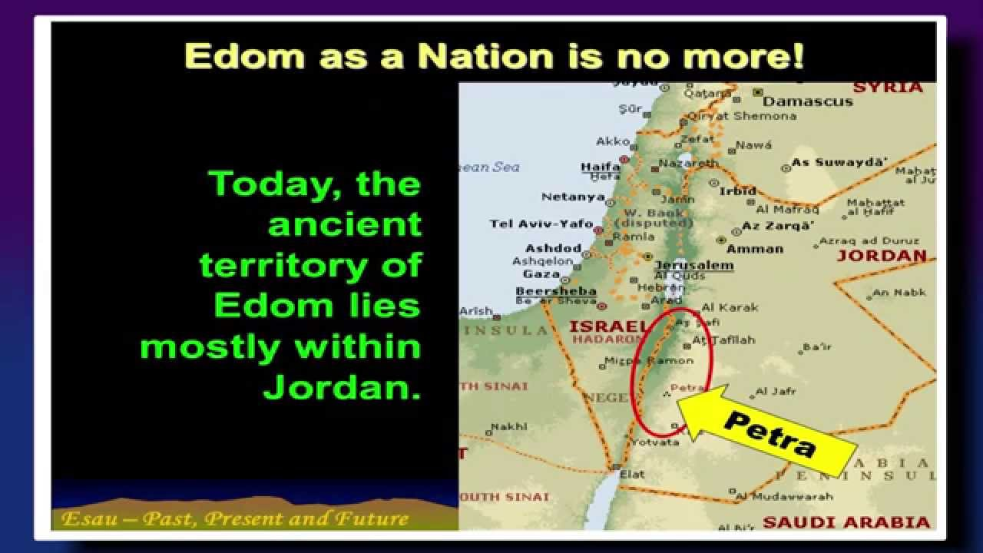

Slide 5
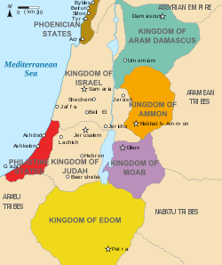
LARGEST
EXTENT
OF
EDOM
WAS
CIRCA
800 BC

Slide 6
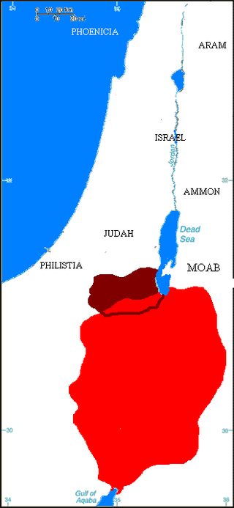
EDOM (in red) DESTROYED IN 5th CENTURY BC
--------------------
[Part of territory later known as IDUMEA shown in dark red]

Slide 7
EDOM:
(identical to Heb: ‘Adam’ – ‘Red’) connected with ESAU
cp Genesis 36:1,8,9,19 & 43
and MOUNT OF ESAU
(Obadiah 8,9,19 & 21)
and MOUNT SEIR
[Ezekiel 35:1-3 + 7 & 15] &
IDUMEA [Isaiah 34:5-6]
Notes:
Refer to Ezekiel later; Isaiah: ”My sword shall come down upon Idumea; it is filled with blood”.

Slide 8
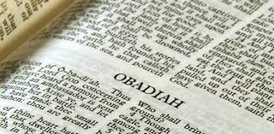
CONTRAST ESAU (v6) WITH (“THY
BROTHER”) JACOB (Obadiah 10 & 12):
GENESIS 26:34-35 & 27:41
NUMBERS 20:18-21 & 21:4
MALACHI 1:1-4
HEBREWS 12:16-17
Notes:
Moses: leading Israel through wilderness requested passage through Edom who violently refused; Israel much discouraged; Lamentations: ‘Sins’

Slide 9
EDOM:
Implacably opposed to ISRAEL
cp [Psalm 137:7]
Ezekiel 25:12-13 [& ch 35]
[Joel 3:19 & Amos 1:11-12]
contrasted with JACOB & JOSEPH
(Obad 17-18)
and MOUNT ZION (Obad 17 & 21)
Notes:
Psalm: Edom rejoicing in Jerusalem’s destruction; Joel: Edom to be desolate “”for violence”; Amos: Edom “pursued his brother with the sword”.

Slide 10
JOSEPHUS (JEWISH HISTORIAN)
REPORTED THAT EDOMITES WERE:
TURBULENT
AN UNRULY RACE
REBELLIOUS
EASILY ROUSED TO ARMS
FRACTIOUS
CHANGEABLE
WARMONGERS

Slide 11
Comparing Ezekiel 35 and Obadiah
V 5 perpetual hatred of
Israel;
10 Anti-Semitic;
11 Reveals anger and
envy;
12 Utters blasphemies;
13 Boasts against
Yahweh;
15 Rejoices at Israel’s
desolation;
V 3 Pride of heart;
8-9 Every one of Edom
to be cut off;
10 Violence against
“thy brother Jacob”;
11-12 Rejoiced over
Judah’s destruction;
13 “Entered into the
gate of my people”;
14 Cut off Judah’s
escape;

Slide 12
EDOM – REPRESENTATIVE OF HEATHEN(ANTI-SEMITIC) NATIONS:
OBADIAH 15 & 16
PSALM 108:5-11
&
[ISAIAH 34:1-2 & 5-9]
Notes:
Isaiah: “Indignation of Yahweh is upon all nations”; “a great slaughter in the land of Idumea”.

Slide 13
“DELIVERANCE” (V17) AND “SAVIOURS” (V21) UPON
MOUNT ZION MUST BE IN THE FUTURE
[Is 46:13] &
Numb 24:17-19
Compare:
AMOS 9:8-12
(future) with
ACTS 15:14-17
(‘remnant of Edom’ becomes ‘residue of men’ )
Notes:
Isaiah: “Salvation in Zion for Israel my glory”. Acts: ‘heathen’ becomes ‘Gentiles’.

Slide 14

V18
“house of Jacob” (natural Israel –
Luke 1:33) ‘which possesses’ (Obad 17),
and “house of Joseph”
(spiritual Israel [?] - Deut 33:16-17) -
“a flame” (Obad 18) - synonomous with
the saints or mighty angels –
II Thessalonians 1:7-10 & Revelation 14:1
Notes:
Deut: blessing and glory upon the head of Joseph; Revelation 14: Lamb upon Mount Zion with 144,000 redeemed.

Slide 15
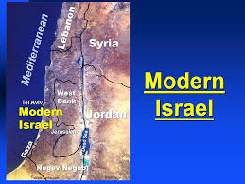
Verse 19
“they of the south” (Sinai connection)
Heb “negeb”- i.e: the saints [Hab 3:3-6]
Esau/Edom now Jordan;
the Philistines (Palestinians) now Gaza;
Ephraim and Samaria now West Bank;
Gilead (of Gad) now Jordan;

Slide 16
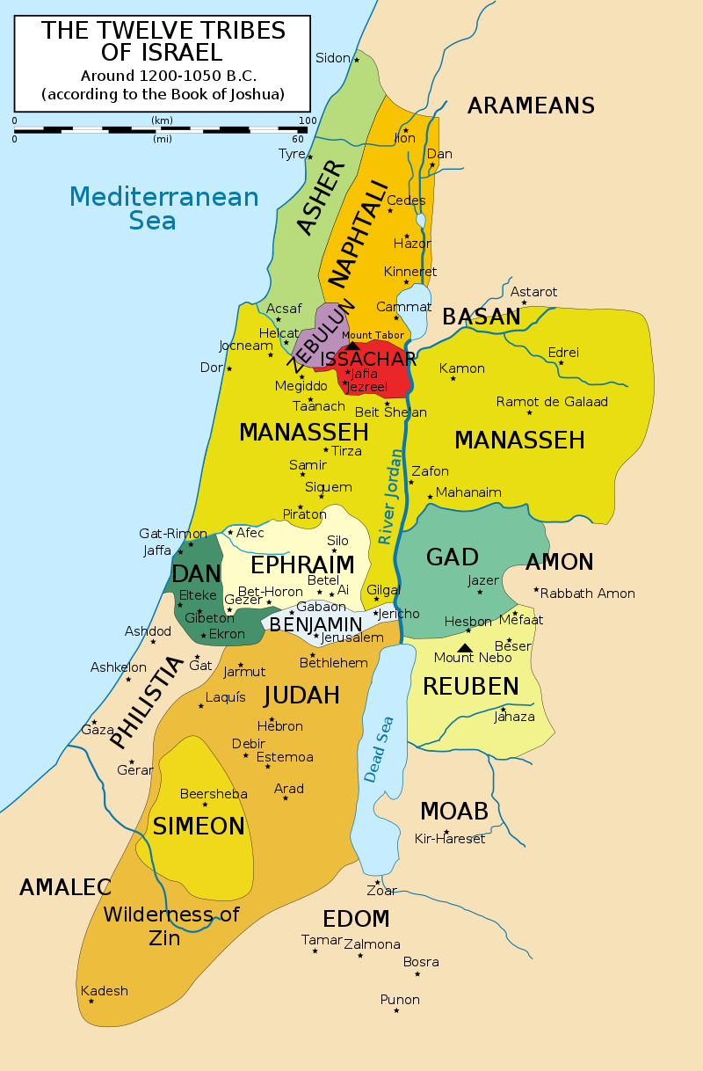
ZAREPHETH

Slide 17
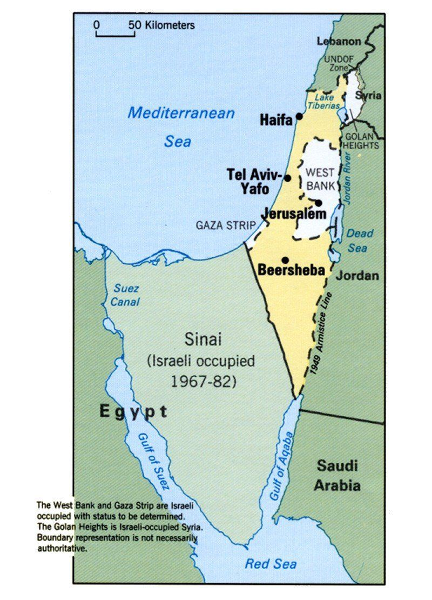
GOLAN HEIGHTS
WAS
WITHIN
THE
TERRITORY
OF MANASSEH

Slide 18
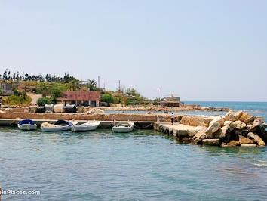
Verse 20
ZAREPHATH
means “Refinement ”
Now in Lebanon!
Connected with Elijah
(I Kings 17:9)
Also in the area of the
Zidonians where Jezebel,
daughter of Ethbaal the king, was born (I Kings 16:31)
Notes:
Elijah: renewed widow’s cruse of oil & barrel of meal, later raising her son; Jezebel: evil Ahab’s wicked wife; spiritual seductress Rev 2:20

Slide 19
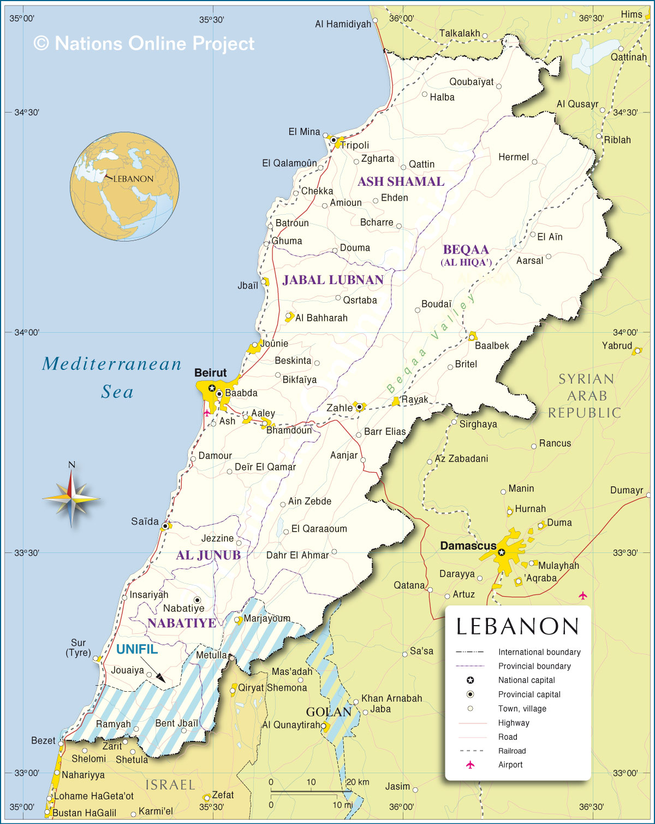
ZAREPHATH

Slide 20
ZAREPHATH

Slide 21
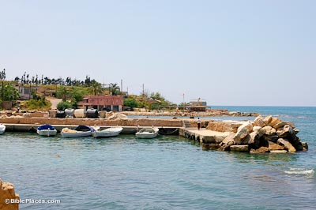
ZAREPHATH
(in Lebanon)
cp ZECHARIAH 10:10

Slide 22
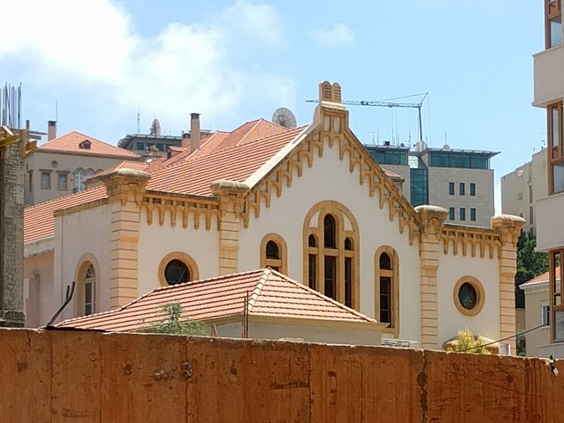
RE-BUILT SYNAGOGUE IN LEBANON (Beirut)

Slide 23
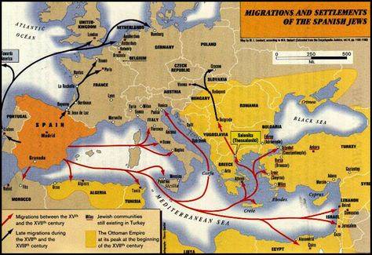
VERSE 20 – SEPHARAD
“Of unknown derivation”;
Possibly referring to the Sephardic Jews who migrated to the Iberian Peninsula; or to the ‘distant ’ north: Assyria/Babylon?

Slide 24
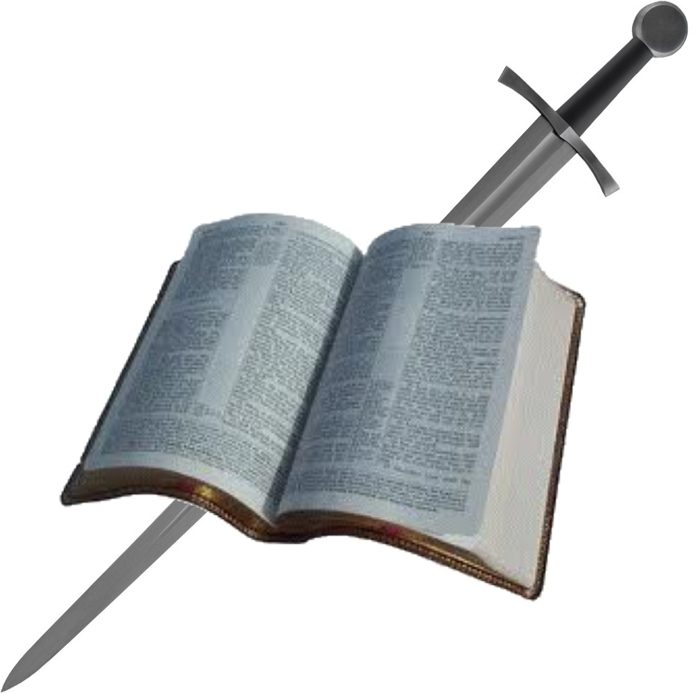
V21
‘SAVIOURS’ (‘DELIVERERS’ cp V17)
“ON MOUNT ZION
TO JUDGE ”
cp
I CORINTHIANS 6:2-3
& PSALM 149:5-9

Slide 25
Notes:
Lessons for ecclesia: Israel must be repentant; Yahweh is faithful; Judgment is coming; saints preserved and will be co-rulers with Christ.

