Slide 1
PROPHECY OF ZEPHANIAH
PIONEER CENTRE BIBLE SCHOOL:
1ST DECEMBER 2018

Slide 2
ZEPHANIAH means
‘YAH HAS HIDDEN’
He prophesied “in the days of Josiah”
(ch 1:1) whose kingship was :
between 639 – 609 BC
His great-great-grandfather appears to have been Hezekiah so he was in the line of David (as was Josiah).
V 8 seems to suggest that Josiah’s sons were grown to maturity which indicates an actual date of writing:
Circa 606 BC [Jerusalem’s demise in 586]

Slide 3
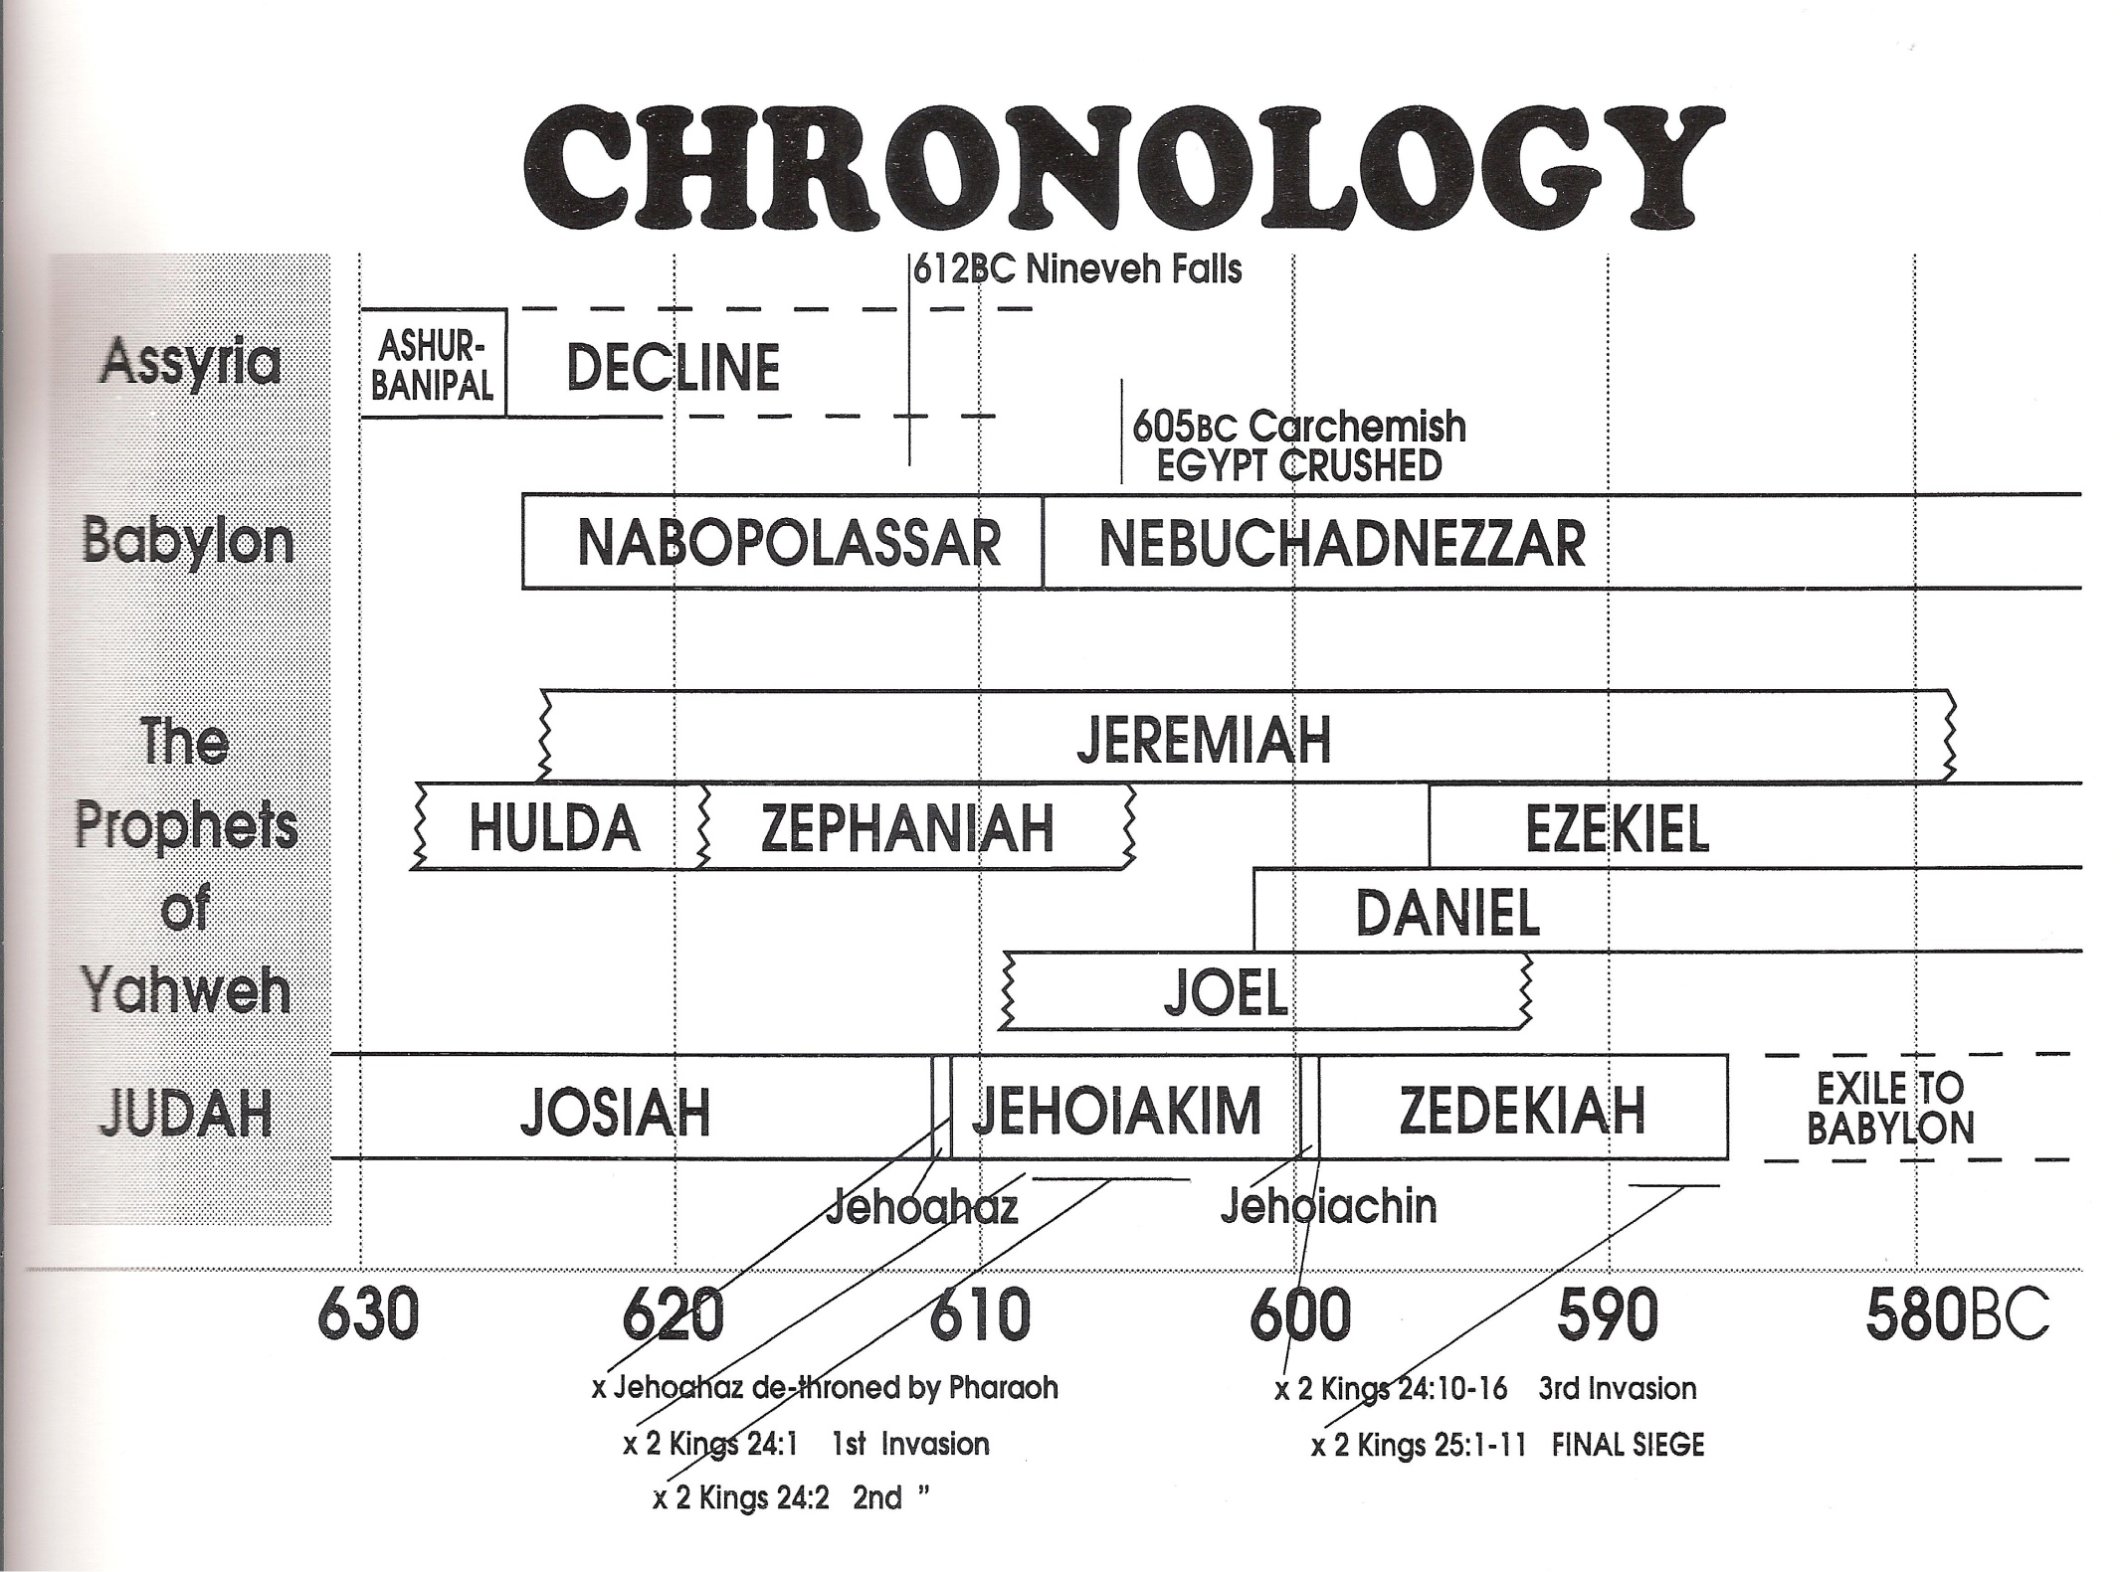

Slide 4
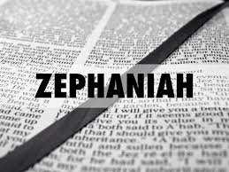
Theme of the book:
THE DAY OF YAHWEH IS AT HAND - Chapter 1:7
[Strong connections with Prophecy of Joel]

Slide 5
BACKGROUND CHAPTERS:
II CHRONICLES 34
Verses 1-7 Removing altars etc
V8 Repairing the house of Yahweh
V14-19 Reading the book of the law & V20-28 Prophecy of HULDAH
II CHRONICLES 35
V16-19 Josiah’s Great Passover
[cp also Jeremiah 3:6 & 10]

Slide 6
PUNISHMENT UPON JUDAH
(Zephaniah ch 1):
VERSES 2-6 “I WILL CONSUME”
VERSES 7-13 THE DAY OF YAHWEH
VERSES 14-21 THE GREAT DAY IS NEAR
Note ‘CHEMARIMS’ – v 4 (cp V 8)
& ‘MALCHAM’ – V5
& ‘SEARCH JERUSALEM’ – V 11

Slide 7
CHAPTER 2
COMMENCES WITH REFERENCE TO YAHWEH’S JUDGMENT ON JUDAH BEING TEMPERED WITH MERCY - VERSES 1-3
REVEALING HIS GOODNESS AND SEVERITY: ROMANS 11:22

Slide 8
CHAPTER 2
WARNING OF IMPENDING JUDGMENT IS PRECEDED BY A 3-FOLD WARNING:
“BEFORE” IN VERSE 2, AND
A 3-FOLD APPEAL: “SEEK” IN VERSE 3

Slide 9
CHAPTER 2:3-15
THIS JUDGMENT WAS EXECUTED BY THE SCYTHIANS DESCRIBED BY THE GREEK HISTORIAN HERODOTUS AS SAVAGE AND BLOODTHIRSTY WARRIORS - WHO ORIGINALLY EMANATED FROM THE PERSIAN REGION BUT TRANSMIGRATED TO SOUTHERN RUSSIA AND CAME DOWN FROM THE NORTH SYSTEMATICALLY DESTROYING (1) WEST
(2) EAST, (3) SOUTH & (4) NORTH

Slide 10
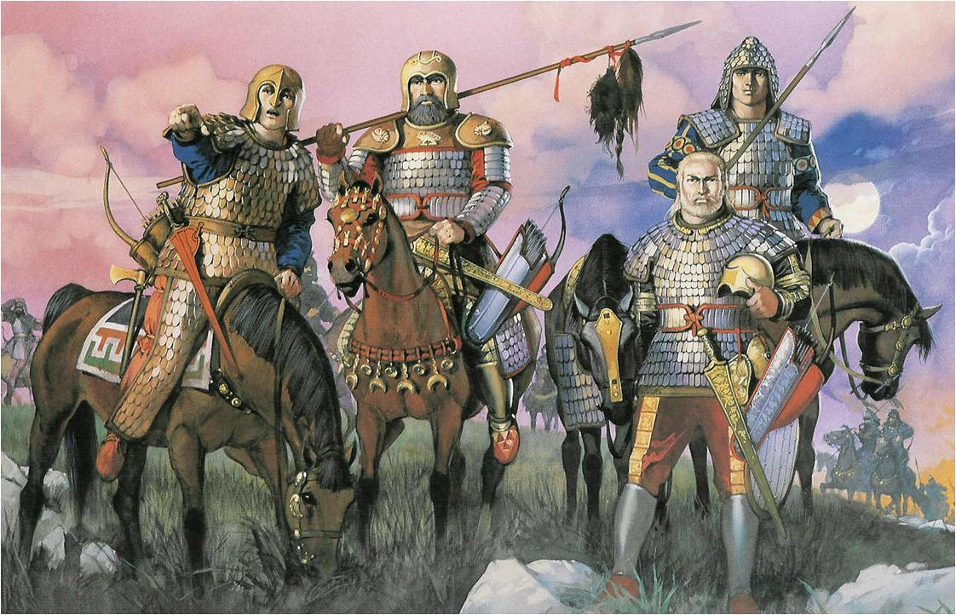

Slide 11
CH 2 – JUDGMENT AGAINST:
THE WEST Verses 4-7
PHILISTIA etc
THE EAST Verses 8-11
MOAB etc
THE SOUTH Verse 12
ETHIORIANS
THE NORTH Verse 13-15
ASSYRIA

Slide 12
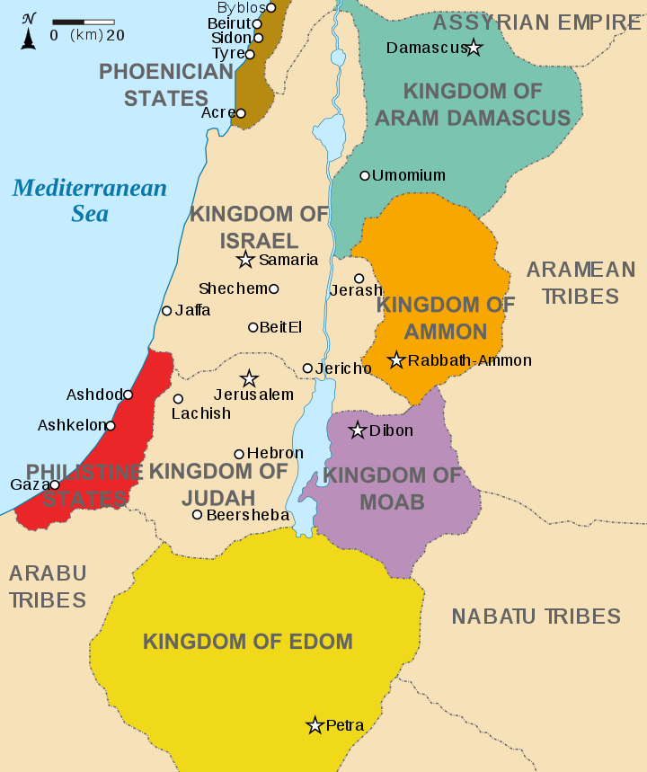

Slide 13
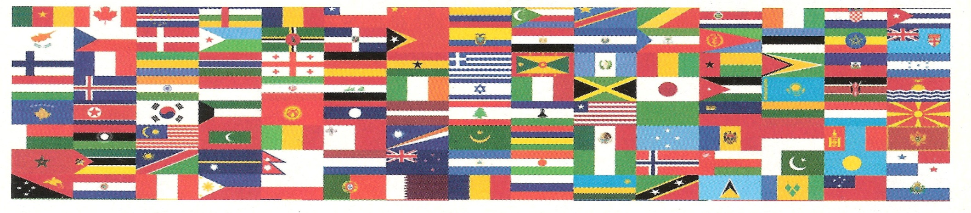
CHAPTER 2:
IS THUS A TYPE OF THE FINAL JUDGMENT
FROM THE NORTH ON THE NATIONS.
THE FAITHFUL BEING ‘ HID ’ - VERSE 3.
N.B. ‘ DAN ’ – THE NORTHERN TRIBE
- MEANS ‘ JUDGE ’

Slide 14

WHEN JUDGMENTS COME UPON THE NATIONS (Ch 3:8) THE FAITHFUL
WILL BE “HID” WITH YAHWEH
– Ch 2:3 & 3:12-13
cp ISAIAH 11:11-12
& 26:19-20

Slide 15
CHAPTER 3:
VERSES 1-7
REASONS FOR JERUSALEM’S PUNISHMENT;
Note Verse2 - OBEYED NOT
RECEIVED NOT
TRUSTED NOT
DREW NOT
[AFTER JOSIAH’S DEMISE JUDAH
HAD NO EFFECTIVE KING]
cp REVELATION 3:13-18

Slide 16
CHAPTER 3:8-10:
PURGING & CONVERTING THE PEOPLE
NOTE V9: ‘A PURE LANGUAGE:
- UNDOUBTEDLY HEBREW
- THE LANGUAGE OF SCRIPTURE
- ASSOCIATED WITH THE DIVINE NAME
CONTAINS ALL 22 LETTERS OF THE HEBREW ALPHABET -
POINTING TO ALL NATIONS SPEAKING THE PURE LANGUAGE OF HEBREW

Slide 17
CHAPTER 3:11-13
ISRAEL SANCTIFIED
NO MORE SHAME (V11)
TRUST (V12)
cp ROMANS 11:23
CONTRAST V13 WITH V9

Slide 18
THE SAINTS REJOICE (V14) cp
ZECHARIAH
2:10-11
NOTE:
‘DAUGHTER OF ZION’
(NATURAL ISRAEL)
‘ISRAEL’
(THE 12 TRIBES) &
‘DAUGHTER OF
JERUSALEM’
(INDIVIDUAL SAINTS)

Slide 19
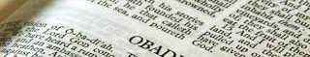
VERSES 14-20 – A SUMMARY
1) APOCALYPSE OF ISRAEL’S KING
2) JERUSALEM’S JUDGMENTS
REMOVED
3) PURIFICATION OF REMNANT
4) EXALTATION OF ISRAEL
5) RESTORATION OF HOLY LAND
6) ABOLITION OF APOSTACY
7) ESTABLISHMENT OF DIVINE
RULERSHIP

