Slide 1
When the Master returns
Behold, I come as a thief
Study No. 1
Reading: 1 Thessalonians 5:1-11
Notes:
Our study, of necessity, must be selective
Time does not permit to examine all the details of the return of Christ
One thing is for sure, we are living in a critical period of human history
Jesus Christ is about to return – need to ask ourselves, are we really ready?
NEXT SLIDE

Slide 2
châzôn (H2377); a sight, from H2372: to gaze at; mentally to perceive, contemplate.
Proverbs 29:18
Where there is no vision, the people perish: but he that keepeth the law, happy is he
pâra‛ (H6544): A primitive root; to loosen of restraint; to expose, dismiss.
“The people cast off restraint” (ESV)
“is made naked” (AV marg)
“a people is let loose” (Roth)
Notes:
Proverbs 29:18 puts the subject into perspective READ
ENTER
The Heb word for “vision” something in our sights.
Something to focus on – to mull over in our minds
More than ever before, we need to focus our attention upon God’s promises
ENTER
If we don’t we will “perish”. Heb signifies ‘to have no restraint’
When the future is empty, nothing to look forward to, there’s no incentive, no restraint
Look at the way others translate the phrase.
NEXT SLIDE

Slide 3
bebaios (G949); stable : - firm, of force, stedfast, sure. From the base of G939 ‘basis’, feet (Acts 3:7)
2 Peter 1:19
We have also a more sure word of prophecy; whereunto ye do well that ye take heed, as unto a light that shineth in a dark place, until the day dawn, and the day star arise in your hearts
Bible prophecy
Something to take seriously
Illuminates the way ahead
Notes:
2 Peter 1:19 – describes the importance of Bible prophecy
READ
ENTER
“made sure” = something ‘firm’, something ‘solid’
From root ‘basis’ occurs 1x – Acts 3:7, translated “feet”
The man couldn’t stand on his feet until Peter healed him, they became firm, secure.
ENTER
Bible prophecy needs to be taken seriously
Over 70% of scripture is prophecy
It illuminates the darkness – we can see where we are going.
NEXT SLIDE

Slide 4
God’s 7000 year plan
0
2344BC
1487BC
AD 70
20??
30??
Antediluvian
age
Patriarchal
age
Jewish
age
Times of the Gentiles
Millennial
age
Jerusalem overthrown
Creation
The Flood
The Exodus
Christ’s return
God all in all
HOW LONG?
“The vision is for an appointed time” (Hab. 2:3-4)
    “God has appointed a day” (Acts 17:31)
  “A set time to favour Zion” (Psa.103:13 RV)
  “Until the times of the Gentiles be fulfilled” (Lk.21:24)
Gk. Karios = opportunity, Eph.5:16; Col.4:5
Notes:
God’s purpose has been at work for the past 6000 years.
The cry of the faithful throughout this entire period has been “How Long?” (Psa.13:1; 94:3; Dan.8:13; 12:6; Hab.1:2; Zech.1;12; Rev.6:10).
Habakkuk 2:3-4: “The vision is for an appointed time” – the day has been set.
Acts 17:31 – “God has appointed a day”
Psa.103:13 – “A set time to favour Zion” (Revised Version).
Past 2000 years living in the “times of the Gentiles” (Luke 21:24). “times” = ‘karios’ (2540) – opportunity (Eph.5:16; Col.4:5 – redeeming the time)
Jesus Christ says – there will be “time no longer” (Rev.10:6)
Important to recognize that when this event occurs everything will change. Life as we know it will end forever. Our life style, our environment, our relationships – all will change.
NEXT SLIDE

Slide 5
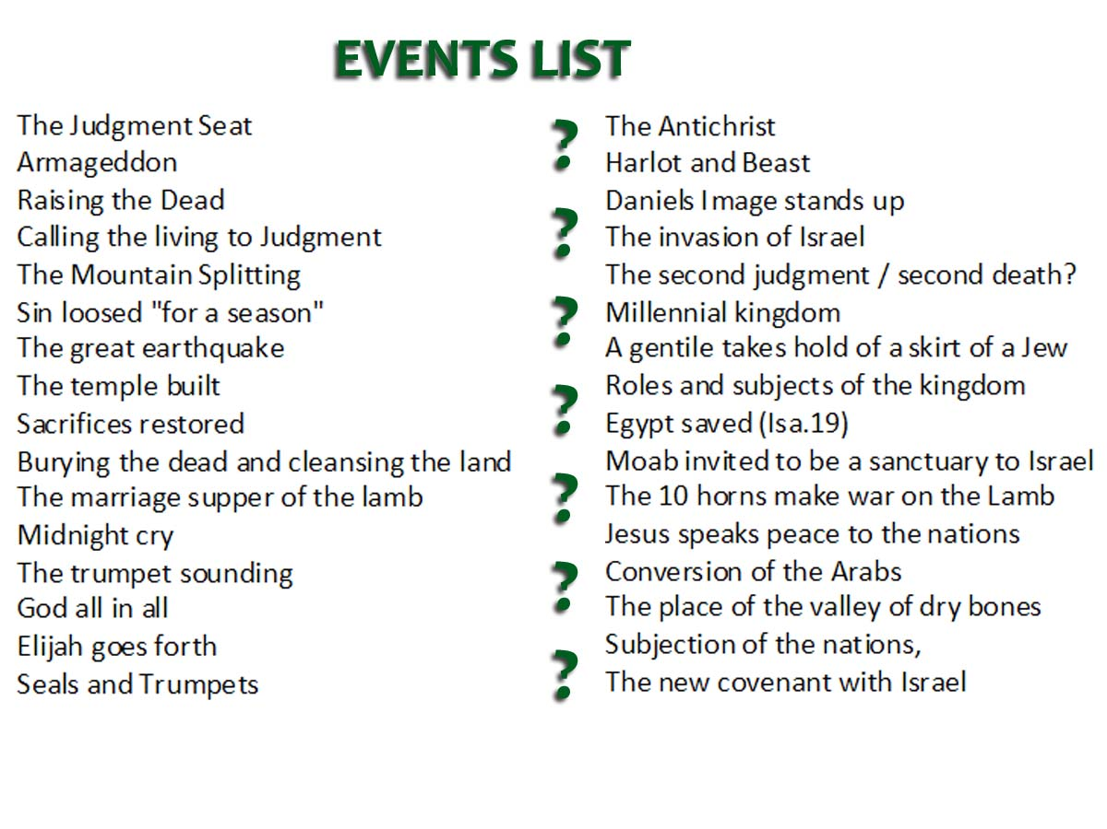
The return of Jesus
Resurrection & Judgment
Gog invades Israel
Israel decimated
Elijah begins his work
Armageddon
Judah saved first
Nations invited to submit to Christ
Roman beast destroyed
The Temple built
Millennial Kingdom
Notes:
This slide provides a list of some of the events that will occur when Jesus returns
By no means exhaustive
Mustn’t become overwhelmed
There are certain key events that we can identify
ENTER
There are certain events to take place between Christ’s return and Armageddon
There are other events that must occur after Armageddon and before the kingdom actually begins.

Slide 6
Events subsequent to Christ’s return
Marriage of Lamb
Marriage Supper of the Lamb
Gog invades
The work of Elijah
In the land The dispersed of Israel
Resurrection & Judgment
The Return of Jesus Christ
Judah saved first
Second Exodus for those dispersed
The millennium begins
Armageddon
Nations invited to submission
Building the Temple
Ships of Tarshish bring Israel home
Catholic Rome destroyed
1Peter 4:17
For the time is come that judgment must begin at the house of God: and if it first begin at us, what shall the end be of them that obey not the gospel of God?
Notes:
Peter reminds us that Judgment will begin with the household of faith
This will be the first thing Jesus does
In this slide review the various events
NEXT SLIDE

Slide 7
1 Thessalonians 4:15-17
“For this we say unto you by the word of the Lord, that we which are alive and remain unto the coming of the Lord shall not prevent them which are asleep. For the Lord himself shall descend from heaven with a shout, with the voice of the archangel, and with the trump of God: and the dead in Christ shall rise first”
The Lord himself: ‘autos’ (846), himself, he, the same. Jesus himself will be personally involved. He will descend with the voice and authority as Michael in the Old Testament
Shout: ‘keleuma’ (2752), a call or summons. Inaudible to the world, John 5:25,28
Voice of archangel: ref. to Michael, Jude 9; Dan.12:1. Michael means “who is like God”, also a ref. to Christ. (Exod.23:20-22)
Trump of God: Echo of Num.10:3 – to call an assembly (1Cor.15:52)
Notes:
1Thess.4:15-17 – Highlights a number of importance details
“we which are alive”: The language indicates Paul expected Christ in his day
This a position we all should be in – expecting Christ at all times.
Jesus himself will be personally involved in the resurrection. He will act in similar manner to Michael of OT.
Shout: not everyone will hear the call – John 5:25, 28
All who are responsible will be summoned to judgment
Voice of Archangel: Michael was the angel identified with Israel in the OT
Trump of God: Num.10:3 describes the silver trumpets used to call an assembly
Jesus will assemble the dead and then the living

Slide 8
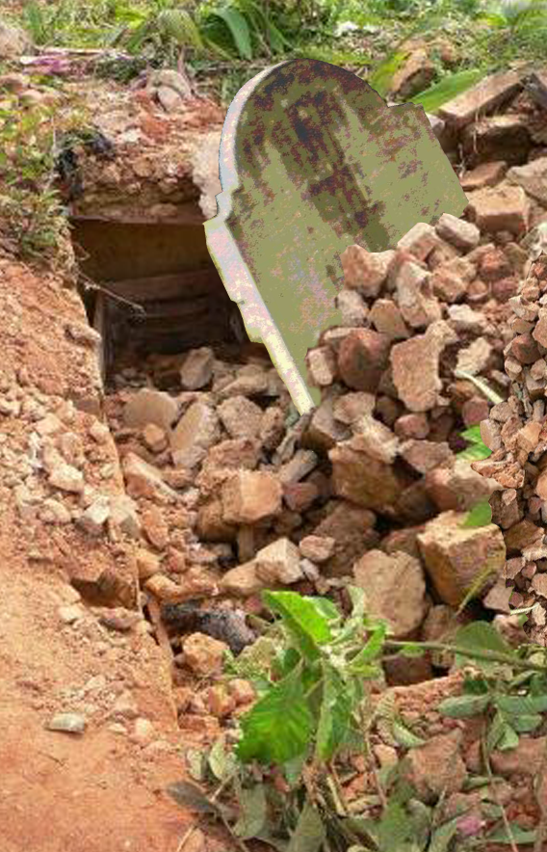
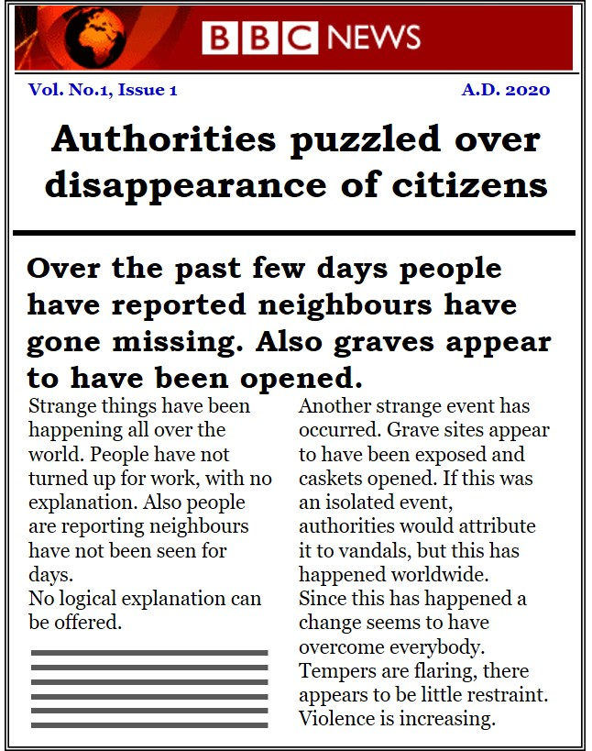
Tomorrow’s Headlines
“For the Lord himself shall descend from heaven with a shout, with the voice of the archangel, and with the trump of God: and the dead in Christ shall rise first”

Slide 9
1 Thessalonians 4:15-17
“The Lord shall descend” – verse 16
“The voice of the archangel” – verse 16
“With the trump of God” – verse 16
“With them in clouds” – verse 17
“meet the Lord” – verse 17
“Yahweh descended upon it” – Exodus 19:18
“The voice…” – Exodus 19:16
“…of the trumpet” – Exodus 19:16
“A thick cloud” – Exodus 19:16
“to meet with God” – Exodus 19:17,20
Notes:
Significant overtones of Sinai in the language used by Paul.
“The Lord shall descend” – Exodus 19:18
“The voice of the archangel” – Exodus 19:16
“With the trump of God” – Exodus 19:16
“With them in clouds” – Exodus 19:16
“meet the Lord” – Exodus 19:17,20
Can’t be certain as to the location, yet the evidence points towards Sinai.

Slide 10
Gather my saints together
Deut.33:2; Psa.68:17(RSV); Isa.63:1; Hab.3:3; Song 3:6
Resurrection/Judgment
Resurrection – similarities to Exodus (1Thess.4:15-18)
Movement from the south
Historically
Typically
Revival of God’s work
Deut.33/Psa.77
At the time of the Exodus Israel did not enter into God’s rest (Hebrews 3:19, 4:8)
Mini Revival
Judges 5
Habakkuk 3
Typical Revival
Psalm 68
Notes:
This slide illustrates three areas of evidence – (i) Historical, (ii) Typical, (iii) Latter day prophecies.
Historically Israel left Egypt to enter God’s rest and establish the kingdom. Israel did not enter in because of the unfaithfulness; God’s work is interrupted.
Typically there have been periods in Israel’s history which have served as a continuation of God’s work – but limited in scope.
The time of the end is a revival of God’s work (Hab.3:2).
When Jesus manifests himself to the world, he will not be alone. Daniel 7:22; Zech.14:5; Joel 3:11.
This implies that the land is invaded at some point during the judgment.

Slide 11
Appear: “phaneroo’ (5319) to render apparent, to manifest (v.11; 1Cor.4:5), see Rom.2:16
Done in his body: Literally Diaglott: “receive the things through the body”
Coverdale: “receive in his body”
Roth: “done by means of the body”
Faithful = immortal body
Sinner = mortal body
2Corinthians 5:10
For we must all appear before the judgment seat of Christ; that every one may receive the things done in his body, according to that he hath done, whether it be good or bad.
Notes:
An important statement in 2Cor.5:10
Paul not simply saying we all must be present, even though that is true
ENTER
Appear: to render apparent
i.e. Jesus is going to reveal what we are really like
The hidden things we have concealed to be laid bare – 1Cor.4:5
Our secrets – Rom.2:16
ENTER
Done in his body: words darkened not in the Greek – thus reads “receive the things in body”
Roth: For, we all, must needs be made manifest before the judgment seat of the Christ, that each one may get back the things done by means of the body, according to the things which he practised, whether good or corrupt
In other words, we will receive in body the reward due
ENTER
Faithful = immortal body; sinner = mortal body

Slide 12
“But ye, brethren, are not in darkness, that that day should overtake you as a thief,” verse 4
“but let us watch and be sober,” verse 6
Marriage of Lamb
Marriage Supper of the Lamb
Gog invades
The work of Elijah
In the land The dispersed of Israel
Resurrection & Judgment
Jesus comes as a thief
Judah saved first
Second Exodus for those dispersed
The Return of Jesus Christ
The millennium begins
Armageddon
Nations invited to submission
Building the Temple
Ships of Tarshish bring Israel home
Catholic Rome destroyed
1 Thessalonians 5:1-2
“But of the times and the seasons, brethren, ye have no need that I write unto you. For yourselves know perfectly that the day of the Lord so cometh as a thief in the night. For when they shall say, Peace and safety; then sudden destruction cometh on them”
Notes:
Paul comments about that time 1Thess.5:1-2
we should be aware of this thief like coming
ENTER
The world will be totally ignorant of Christ’s presence
ENTER
But this should not be the case for ourselves
Need to be watching
Need to have our minds alert

Slide 13
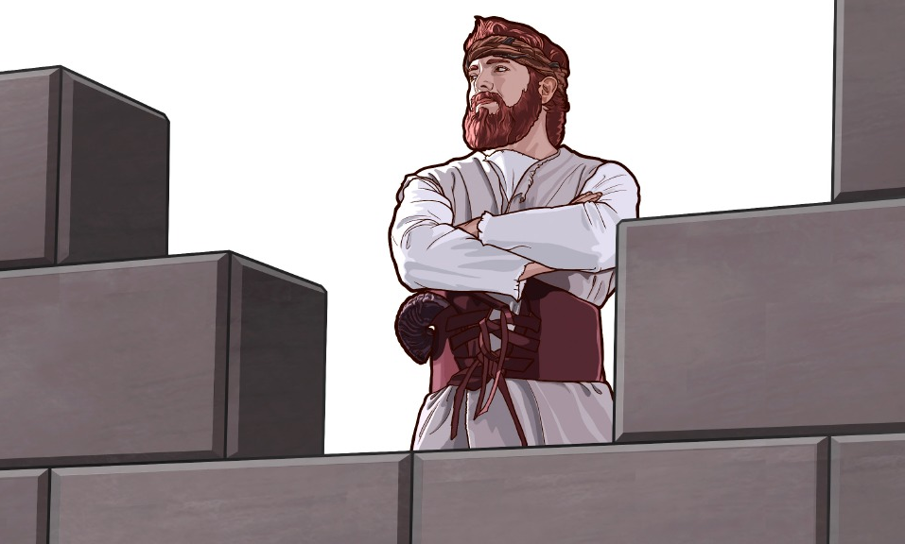
Coming as a thief
Jesus’ return will be thief-like
Exhortation to watch
Failure results in loosing our identity with Christ
Exposes our true self
Visible to all at the judgment
Behold, I come as a thief. Blessed is he that watcheth, and keepeth his garments, lest he walk naked, and they see his shame.
Revelation 16:15
Notes:
Jesus comments upon this in Rev.16:15
But in this case he directs his warning to US.
It is possible for us to be taken off guard
ENTER
If we don’t watch
Loose our identity with Christ – Matt.10:33 “deny us” (Matt.25:41).
Our true self will be fully exposed
Everybody will witness it – visible to all: the angels Luke 12:8-9
Those at the judgment seat (stand with hypocrites, Matt.24:47; 8:12)

Slide 14
The progression of sin – Exodus 32
The people were restless and impatient (v.1)
  Moses delayed to come down, Deut.9:11; 2Pet.3:3-4
  People of faith not short-sighted, Heb.11:13; 2Pet.3:9
Israel’s heart was not converted (v.4)
  Egypt still prominent in Israel’s mind, Acts 7:39-40
  Their mind had been corrupted, v.7; Gen.6:11-17
Israel was compromised in their worship (v.5,6)
  Gave lip service to Yahweh, Psa.78:36-37
  They mocked the principle of dedication and fellowship, verse 6; (1Cor.10:21)
  Guilty of divided loyalty, Matt.6:24
Israel lacked a conscience before God (v.25)
  Nakedness, a symbol of sin, Gen.2:25; 3:7-10; Rev.3:17 (Exod.20:26; 28:42)
  People had no vision, Prov.29:18 [perish = Hb. ‘para’, naked (Exod.32:25)]. Rev.16:15
Notes:
The idea of being ignorant of Christ’s return has its counterpart in Exod.32

Slide 15
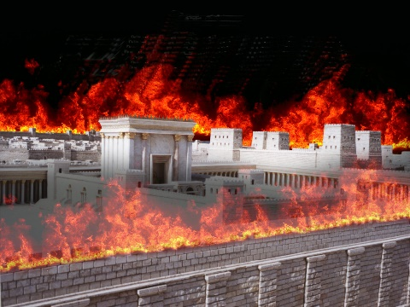
The signs of the times
“The Pharisees also with the Sadducees came, and tempting desired him that he would shew them a sign from heaven. He answered and said unto them, When it is evening, ye say, It will be fair weather: for the sky is red. And in the morning, It will be foul weather to day: for the sky is red and lowring. O ye hypocrites, ye can discern the face of the sky; but can ye not discern the signs of the times?”
Matthew 16:1-3
“For the days shall come upon thee, that thine enemies shall cast a trench about thee, and compass thee round, and keep thee in on every side, And shall lay thee even with the ground, and thy children within thee; and they shall not leave in thee one stone upon another; because thou knewest not the time of thy visitation.”
Luke 19:43-44
Notes:
Another example in Matt.16:1-3
ENTER
Despite the numerous warnings in Scripture, they were ignorant, “they knew not”

Slide 16
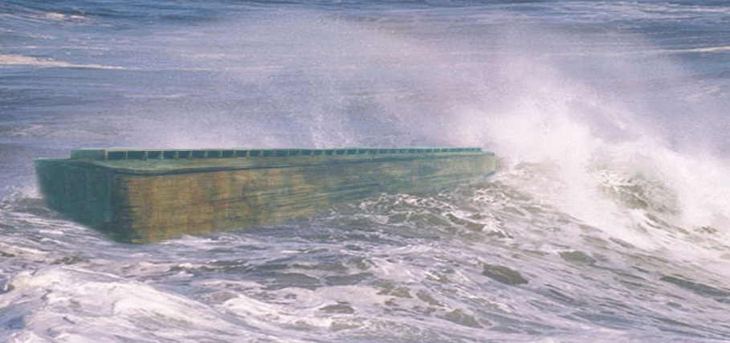
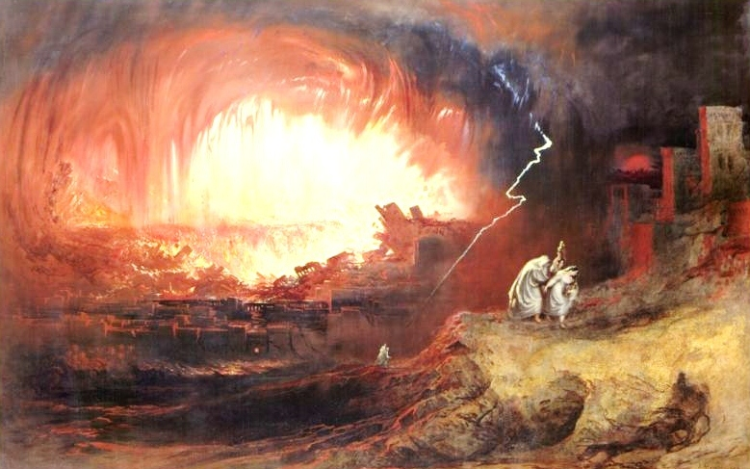
The coming of the Son of man
And as it was in the days of Noe, so shall it be also in the days of the Son of man. They did eat, they drank, they married wives, they were given in marriage, until the day that Noe entered into the ark, and the flood came, and destroyed them all.
Luke 17:26-27
Likewise also as it was in the days of Lot; they did eat, they drank, they bought, they sold, they planted, they builded; But the same day that Lot went out of Sodom it rained fire and brimstone from heaven, and destroyed them all.
Luke 17:28-29
Notes:
Jesus likens his coming to the days of Noah and Lot
This helps to appreciate how we can be taken unawares
Luke 17:26-27
ENTER
Luke 17:28-29
Consider, no reference to the violence of Noah’s day, or the immorality of Lot’s day
Jesus lists everyday living WITHOUT GOD

Slide 17
Prosperity at return of Christ!
Eating and drinking – gluttony and excessive drinking – culture of enjoyment and revelry.
Marrying and being given in marriage – implies multiple marriages – culture of pleasure.
Buying and selling – pre-occupation with acquisition – never satisfied = materialism.
Planting – business pursuits - culture of increase and gain.
Building – continual upgrading to improve status – culture of luxury and comfort.

Slide 18
Matthew 24:36-39, 43
But of that day and hour knoweth no man, no, not the angels of heaven, but my Father only. But as the days of Noe were, so shall also the coming of the Son of man be. For as in the days that were before the flood they were eating and drinking, marrying and giving in marriage, until the day that Noe entered into the ark, And knew not until the flood came, and took them all away; so shall also the coming of the Son of man be…
… But know this, that if the good man of the house had known in what watch the thief would come, he would have watched, and would not have suffered his house to be broken up
Notes:
Jesus adds a further comment in Matt. 24:36-43
The hour of his coming not known
Because they were so preoccupied “they knew not” until it happened
If only they had watched

Slide 19
Evil Servant
Reveals the content of his heart
Becomes an oppressor, not a nourisher
Feeds himself and not the household
Denies the nearness of Jesus return
Isn’t looking for Jesus
Indulges in the pleasures of life
Faithful and Wise Servant
Mat 24:45-47
Who then is a faithful and wise servant, whom his lord hath made ruler over his household, to give them meat in due season? Blessed is that servant, whom his lord when he cometh shall find so doing. Verily I say unto you, That he shall make him ruler over all his goods.
Evil Servant
Mat 24:48-51
But and if that evil servant shall say in his heart, My lord delayeth his coming; And shall begin to smite his fellowservants, and to eat and drink with the drunken; The lord of that servant shall come in a day when he looketh not for him, and in an hour that he is not aware of, and shall cut him asunder, and appoint him his portion with the hypocrites: there shall be weeping and gnashing of teeth.
Notes:
In vv.45-51 Jesus contrast two servants – both in the Truth
The faithful servant was preoccupied with serving God
The evil servant was preoccupied with serving self
He was too busy to watch
He wasn’t looking for him
ENTER
Consider the evil servant
The faithful entered the kingdom of God
The unfaithful returned to the darkness of this world

Slide 20
Faithful and Wise Servant
Mat 24:45-47
Verily I say unto you, That he shall make him ruler over all his goods.
A king/priest with Jesus – Rev.5:10
Evil Servant
Mat 24:48-51
and shall cut him asunder, and appoint him his portion with the hypocrites: there shall be weeping and gnashing of teeth.
Cast out into “outer darkness” – Matt.8:12
A symbol of the world without God – John 3:19; Isa. 8:22
Prospect of being judged with the world
Notes:
The faithful entered the kingdom of God
The unfaithful returned to the darkness of this world

Slide 21
The fate of the wicked
Nazareth Revisited – page 394
The sentence of expulsion consigns its unhappy objects to participation in “the judgment and fiery indignation which shall devour the adversaries” (Heb. x. 27). Their fate is to “depart from me, ye cursed, into the aionian fire, prepared for the devil and his angels.” Into the countries of the condemned, the whole multitude of the rejected will be driven to shift for themselves among a cruel population for whom judgment waits. Mortal as they are, it is no stretch of the imagination to realise the suffering of body, the anguish of mind incidental to such a fearful situation—without home or friends or acquaintances or means of living, wandering as vagabonds like Cain till the maturing judgment of God culminates in the terrible outbreak of destruction and desolation long foretold. This “hour of judgment” will take time to run.

Slide 22
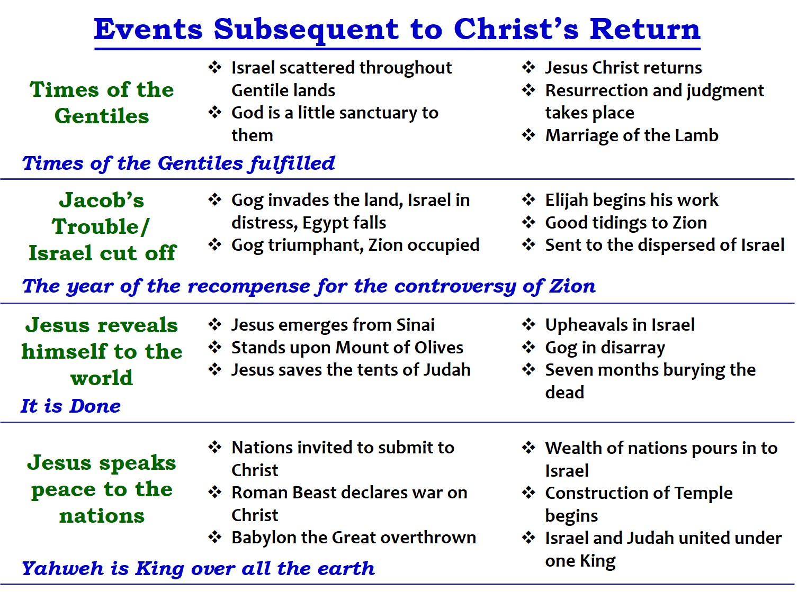
Prophetic Patterns
(1) Abraham and Melchizedek – Genesis 14
(2) Samson’s exploits – Judges 15
(3) David & Solomon - 2Sam.5-8 and 1Kings 1-6
(4) The Babylonian Invasion
(5) The Feasts of Yahweh – Lev.23

Slide 23
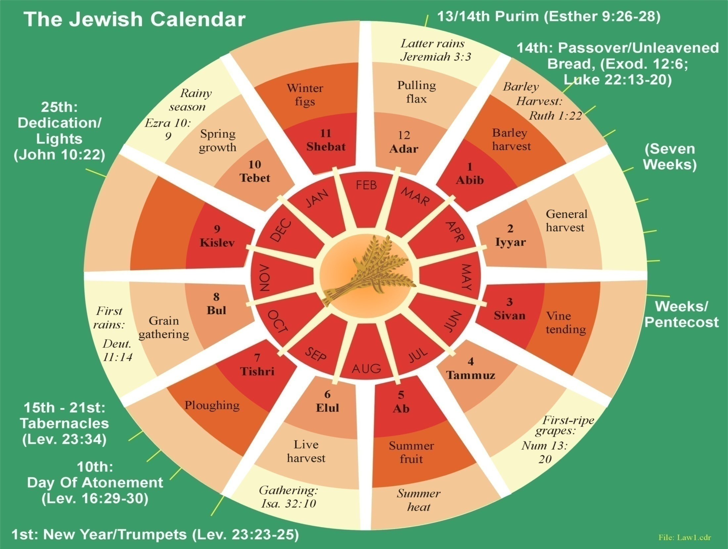
A set time to favour Zion
Passover
Pentecost
Trumpets
Atonement
Tabernacles
Notes:
Leviticus 23
Verse 2,4 note reference to “set feasts” (RV) same as Psalm 102:13.
Feasts have prophetic significance – Passover and Pentecost fulfilled in 1st century.
Tabernacles is the feast of the kingdom – Zech.14:16 – yet future.
Consider the events surrounding the 7th month (Lev.23:34-44).

Slide 24
The Jewish Calendar – Leviticus 23
The Passover (vv.4-14)
Feast of Weeks (vv.15-21)
Law of gleanings in the fields of Israel (v.22)
Feast of Trumpets (vv.23-25)
The Day of Atonement (vv.26-32)
Feast of Tabernacles (vv.33-44)
Christ our Passover (1Cor.5:7)
Pentecost (Acts 2)
Times of the Gentiles (Luke 21:24)
Resurrection and judgment (1Thess.4:16)
Israel’s day of forgiveness (Isa.59:9-14)
Nations travel to Jerusalem (Zech.14:16)

Slide 25
The return of Jesus
1Peter 4:17
For the time is come that judgment must begin at the house of God: and if it first begin at us, what shall the end be of them that obey not the gospel of God?
Resurrection & Judgment
Invasion of Israel
Israel decimated
Zechariah 14:1-5
Behold, the day of the LORD cometh…For I will gather all nations against Jerusalem to battle…and the LORD my God shall come, and all the saints with thee.
Gog triumphant
Armageddon
Gog destroyed, the land cleansed
Nations invited to submit to Christ
The Temple built
Roman beast destroyed
Kingdom begins

Slide 26
Armageddon
Nations invited to submit to Christ
The return of Jesus
Roman beast destroyed
Millennial Kingdom
The Temple built
Invasion of Israel;
Israel decimated
Resurrection & Judgment

Slide 27
Yahweh’s set time
Jewish Calendar of the Law
Events at the time of the end
7th Month
1
Feasts of Trumpets Lev.23:24
Israel
The Saints
2
Resurrection & Judgment
3
Jesus comes as a thief
4
1 Thess.4:16
1 Cor.15:52
Rosh Hashanah – A period of reflection
5
6
7
8
9
10
Day of Atonement Lev.23:27; 25:9
Israel forgiven & restored to the land
1 Thessalonians 5:1-2
“But of the times and the seasons, brethren, ye have no need that I write unto you. For yourselves know perfectly that the day of the Lord so cometh as a thief in the night. For when they shall say, Peace and safety; then sudden destruction cometh on them”
11
12
Jubilee Trumpet
Liberty proclaimed
Time of restitution
Isaiah 58:1
Isaiah 18:3,7
Isaiah 27:12,13
13
14
15
Feasts of Tabernacles
The time of the kingdom
Notes:
The three main events: Trumpets, Atonement, Tabernacles
Between Trumpets and Atonement a period of 10 days. Edersheim comments: "One of its (trumpets) main purposes was to arouse men to repentance..."
Additional trumpet blown in jubilee year (Lev.25:9-10), linked with Atonement. Proclaim liberty and receive restitution of land.
A parallel with latter day: Isa.58:1; 18:3,7; 27:12,13.
What causes Israel to reflect? Invasion of the land!!!
Another trumpet blown earlier – Feast of Trumpets – Significance? The resurrection and judgment. 1 Cor.15:52; 1 Thess.4:16
The trumpet blowing initiates the thief like advent of Jesus Christ.

