Slide 1
When the Master Returns
The Time of Jacob’s Trouble
Study No.2
Reading: Ezekiel 38

Slide 2
Marriage of Lamb
World Conditions
Final gathering of the nations (Joel 3:11)
Nations will be unrestrained and angry (Rev.11:18)
Gross darkness will cover the earth (Isa.60:2)
Men’s hearts will fail them (Luke 21:26)
Israel to be the focus of international opposition (Zech.14:2)
Marriage Supper of the Lamb
Gog invades
The work of Elijah
In the land The dispersed of Israel
Resurrection & Judgment
The Return of Jesus Christ
Judah saved first
Second Exodus for those dispersed
The millennium begins
Armageddon
Nations invited to submission
Building the Temple
}
Ships of Tarshish bring Israel home
Catholic Rome destroyed
Daniel 12:1
…and there shall be a time of trouble, such as never was since there was a nation even to that same time…

Slide 3
Where does Ezekiel 38 fit into the scheme of prophecy?
No hint of Jesus sitting on the throne of Israel
Purpose of invasion - “to take a spoil”, vv. 11,12
Only objection comes from the nations, v.13
Israel is “spoiled”, suggesting a successful invasion, 39:10
God’s Name made known to Israel, 39:7
The event has been described by other prophets
Ezekiel 38:17
Thus saith the Lord GOD; Art thou he of whom I have spoken in old time by my servants the prophets of Israel, which prophesied in those days many years that I would bring thee against them?
Notes:
The main support for the chapters being in sequence is Ezekiel 37:22-24 where we read of Jesus sitting upon his throne. The following chapter describes Israel “dwelling safely” (suggesting a kingdom scene) – deal with this in a moment!!
READ SLIDE
None of this makes sense if Jesus is sitting on his throne.
ENTER
Ezekiel 38 is an event mentioned by all the prophets
ENTER
Note verse 17
NEXT SLIDE

Slide 4
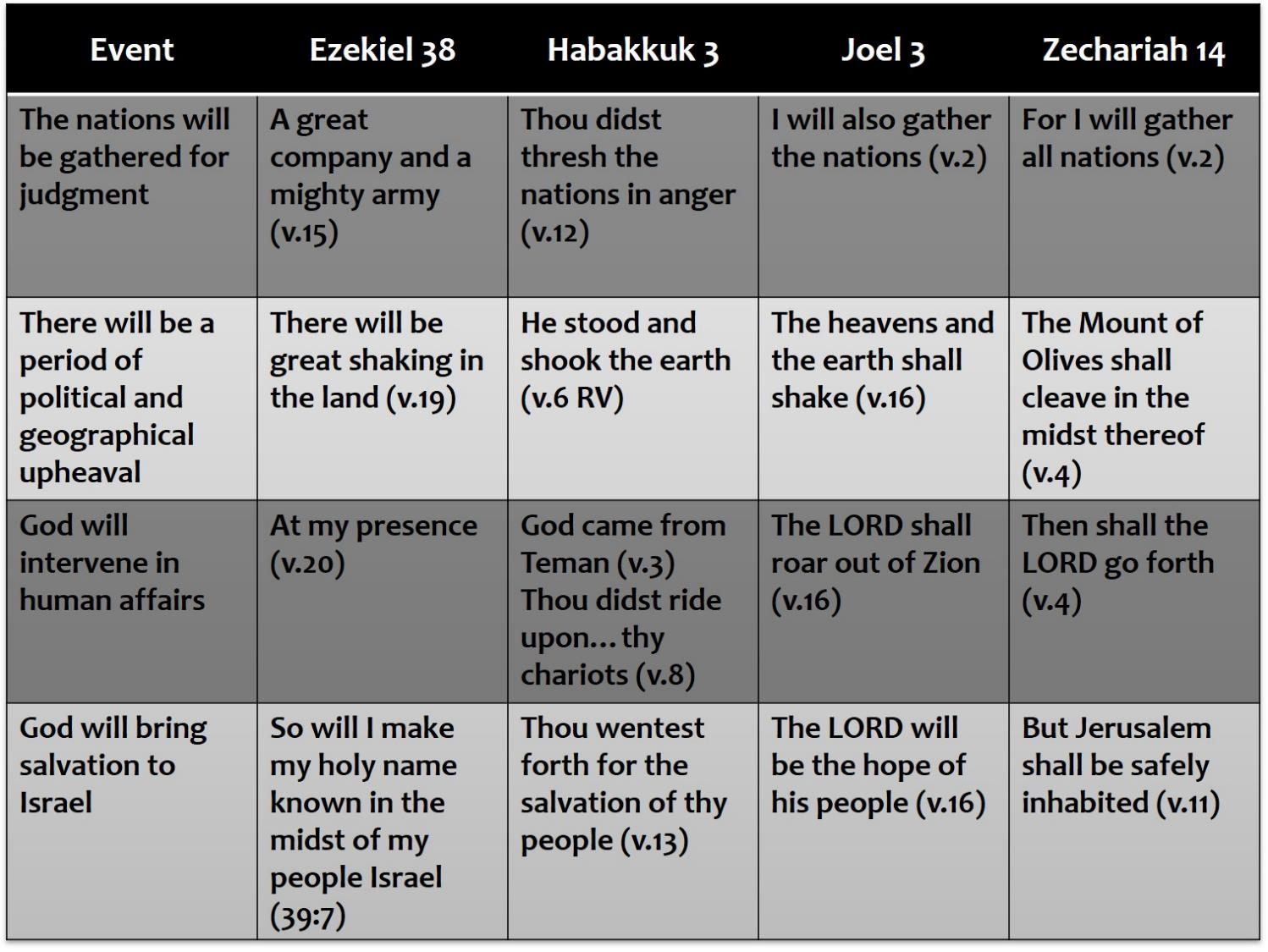
Notes:
Ezekiel’s role in latter day events is found elsewhere:
Chart (above) illustrates the core prophecies which compliment Ezekiel
One comment suggesting that Ezekiel 38 is based on the view that the latter day section from Ezekiel 34-39 is in sequential order - Is this the case?
NEXT SLIDE

Slide 5
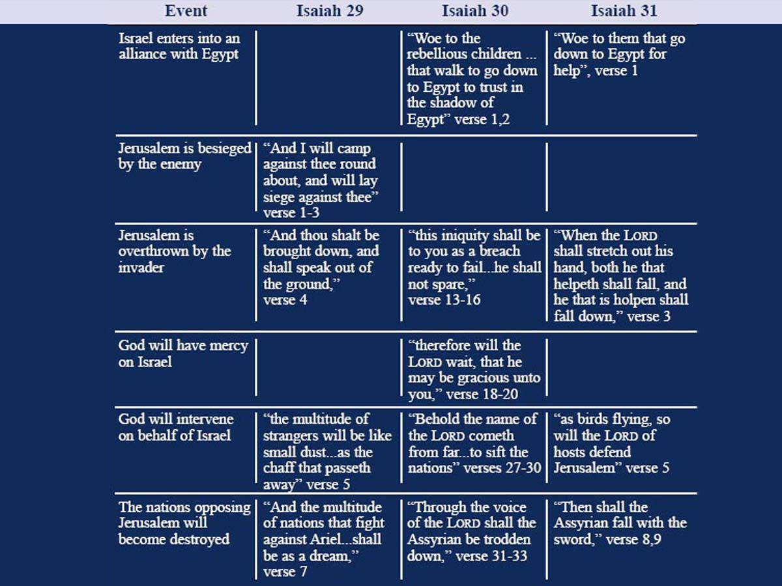
Notes:
Isaiah prophesied about 120 years before Babylon, yet the prophecies about Assyria fit the latter day pattern.
Example of Isaiah 14 – proverb against the king of Babylon, yet described as the Assyrian in verse 25.
Isaiah 10 describes the invasion of Sennacherib with latter day overtones – note verse 6, “to take a spoil and prey”
READ SLIDE – Isaiah 29-31 describe the historical events in Hezekiah’s day – yet prophetical, see Isa.30:8.
Isaiah and Ezekiel both describe the Image power of Daniel.

Slide 6
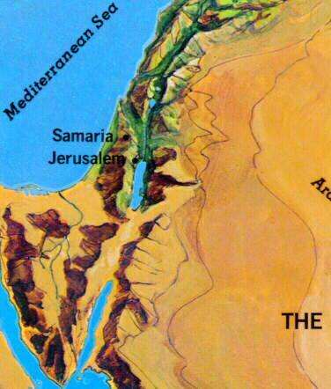


The Time of the End
Events
Ezek. 38
Dan. 11
Takes place in the latter days
verse 8
verse 40
Invades from the north
verse15
verse 40
Ascends like a storm/whirlwind
verse 9
verse 40
Against the land of Israel
verse 8
verse 41
To take a spoil
verse 12
verse 43
Ethiopia and Libya confederate
verse 5
verse 43
Israel is overthrown
ch. 39:10
verse 45
Divine intervention for Israel
verse 20
ch. 12:1
Notes:
Daniel 11:40-45 provides the clearest comparison to Ezekiel 38
This chart illustrates the similarities between Ezekiel 38 and Daniel 11 – the language is unmistakably the same.

Slide 7
Ezekiel 38 in Context
Description
Israel made desolate
Israel bears her shame
Israel regathered
Great shaking
Heathen bear their shame
Israel given a new heart
Ezekiel 34
vv. 22, 28
v. 29
v. 13
v. 25
v. 25
Ezekiel 36
vv. 3, 4
v. 6
v. 8, 10
v. 7
v. 26, 27
Ezekiel 37
vv. 11
v. 13
v. 12, 21
v. 7
v. 14
Ezek.38/39
38:9
39:10
39:26
39:25
38:18, 19
38:16, 23
39:29
Notes:
This slide demonstrates that the chapters are complete in themselves
Each chapter provides a picture of the same time period from a different perspective
REVIEW SLIDE

Slide 8
Peace in Israel?
Describing a rural way of life – Lev.25:31 (contrast “walled cities”). Hebrew ‘perazah’ (6519): Open region or country
Ezekiel 38:11
And thou shalt say, I will go up to the land of unwalled villages; I will go to them that are at rest, that dwell safely, all of them dwelling without walls, and having neither bars nor gates
Safely: Ezekiel 28:26; 39:26 Carelessly: Ezek.39:6; Zeph.2:15
Boldly: Genesis 34:25
Securely: Micah 2:8
Hebrew ‘batach’ (983)
Young’s = Confidence, trust
Strong’s = A place of refuge
Notes:
Ezekiel describes Israel’s circumstances when the invasion occurs – verse 11
ENTER
The term “unwalled villages” is applied to rural living in Lev.25:31
ENTER
“dwell safely” – Hebrew word ‘batach’
ENTER
Used in a variety of ways
NEXT SLIDE

Slide 9
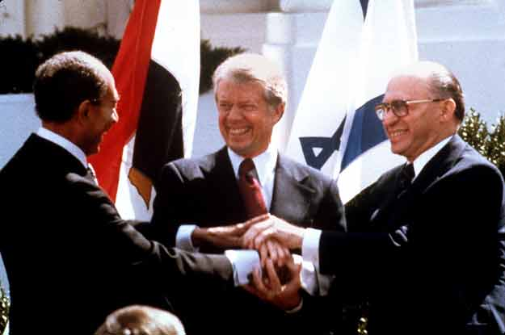
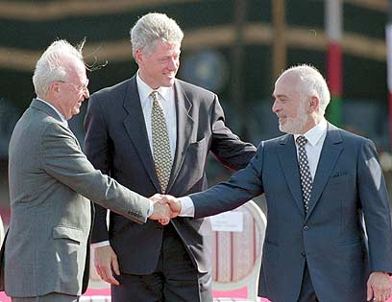
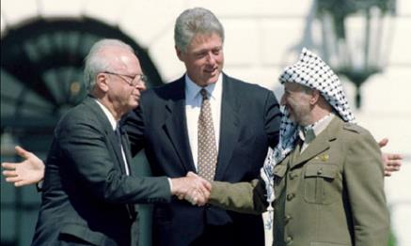
Composition of Gog’s Army
Japheth
  Rosh
  Meshech
  Tubal
  Magog
  Gomer
  Togarmah
  Persia
Ham
  Ethiopia
  Lybia
Daniel 11:41-42
“These shall escape out of his hand Edom, and Moab, and the chief of the children of Ammon …The land of Egypt shall not escape”
Shem
Absent:
Egypt; Philistines; Tyre; Edom; Moab; Ammon (surrounding nations)
Notes:
Another observation is the players involved
Who is absent from the list?
ENTER – The surrounding Arab nations
Suggestions as to why this is so!!
ENTER
Peace treaties have been entered into – Egypt 1979; Jordan 1994; Palestinians 1993
hence Daniel 11:41-42
Egypt’s relationship to Israel causes her problems - Isa.30:2; 31:1; 36:6
The present relationship, yet to develop further
Jordan is not to be trusted – last November cancelled parts of the treaty.
The greatest present threat is Gaza and Southern Lebanon
Hamas and Hezbollah
NEXT SLIDE

Slide 10
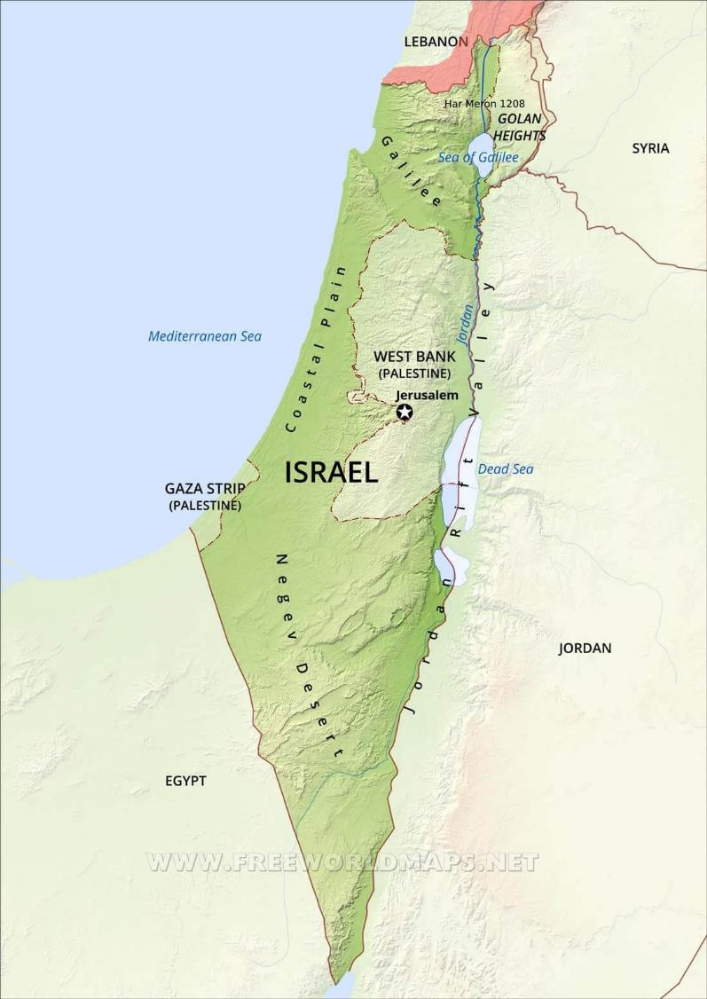
Psalm 83:5-8
TYRE
Hezbollah
For they have consulted together with one consent: they are confederate against thee: The tabernacles of Edom, and the Ishmaelites; of Moab, and the Hagarenes; Gebal, and Ammon, and Amalek; the Philistines with the inhabitants of Tyre; Assur also is joined with them: they have holpen the children of Lot. Selah.
Fatah
AMMON
Hamas
MOAB
HAGARENES
PHILISTINES
AMALEK
EDOM
GEBAL
Notes:
Psa.83:5-8 describes the hostile attitude of the nations around Israel
Edom, Moab, children of Ammon – Territory of Jordan.
Jordan presently has a peace agreement with Israel
Note verse 7 “Philistines WITH…inhabitants of Tyre”
The two main antagonists are Hamas and Hezollah
Peace has to be achieved – How? Not revealed
NEXT SLIDE

Slide 11
Notes:
The map identifies the location of the various players in Ezekiel 38
Major changes in the political alignment are necessary before the invasion
NATO must disappear; Europe must change its allegiance
Cracks are already showing in the EU and France and Germany are drawing closer.
When we look at a map and realize the size of Gog’s confederacy, we can appreciate the language of Ezekiel
NEXT SLIDE

Slide 12

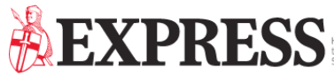
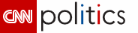
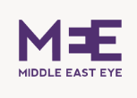
    Macron warns of European 'civil war' over growing East-West divide (April 2018)
France and Germany to seal new deal as Brexit looms (21 January 2019)
'We MUST have a European Army!' Macron unveils plans to build new 'SOVEREIGN' force for EU
Trump plunges West into crisis over summit spat
Vladimir Putin's plan to 'DESTABILIZE' EU with covert support for populist parties
Why Jordan cancelled part of its peace treaty with Israel

Slide 13
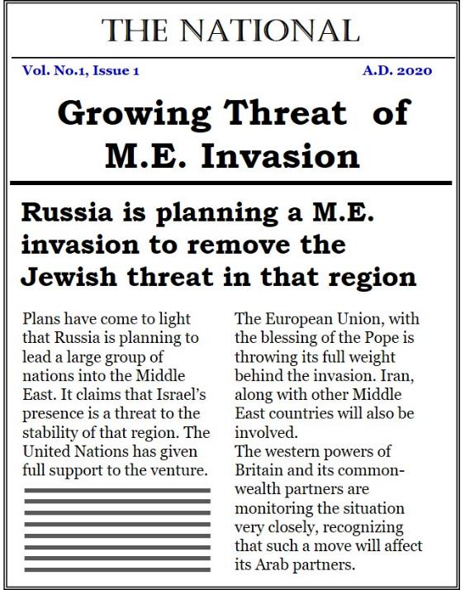
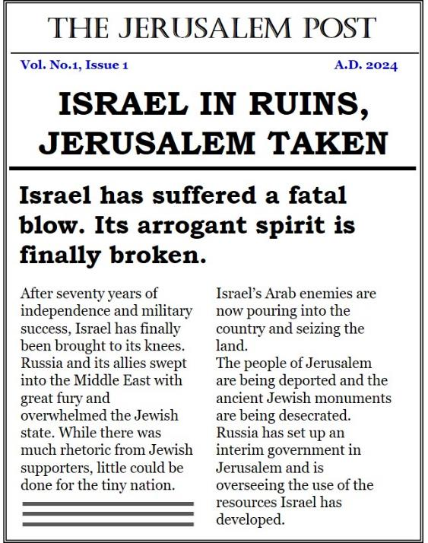
Tomorrow’s Headlines
Divine restraints will be removed following the saints being called to judgment
Preparations for war will escalate and Israel will become a target for international aggression
Gog will be drawn into the Middle East to take a spoil and a prey,
Israel will fall.

Slide 14
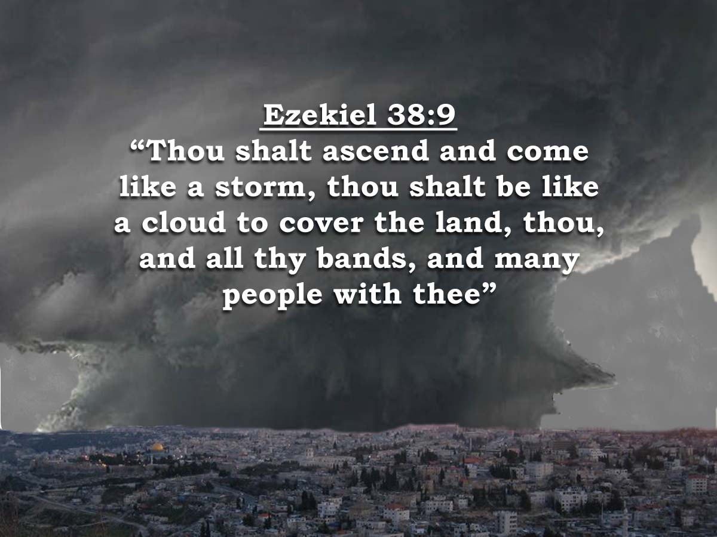
Like a storm
Notes:
Ezekiel 38:9
Again the picture provides an unprecedented invasion
Like a storm – “thou shalt be like a cloud to cover the land.
A reminder of the crucifixion when the sky over them went black and “covered the land” (Matthew 27:45).
At the exodus Egypt experienced a darkness that could be felt (Exod.10:21)
In the garden Jesus said, “this is your hour and the power of darkness” (Luke 22:53).
Other details are filled out by other prophecies.
NEXT SLIDE

Slide 15
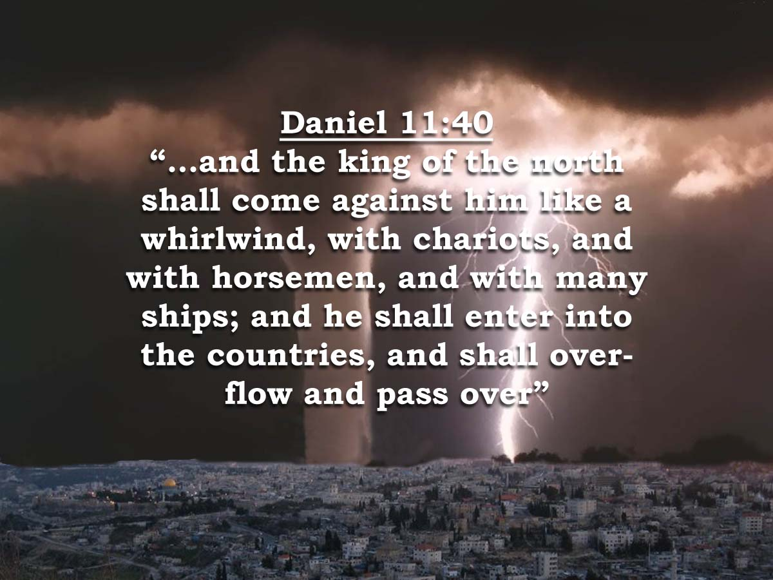
Like a whirlwind
Notes:
Daniel 11:40 describes the invasion as proceeding like a whirlwind.
Whirlwinds move with speed, some are accompanied by lightning.
The Israelis are known for their lightning attacks – the element of surprise has allowed them to resist the aggressor. Now the tables are to be turned; without much warning the forces of Gog will ascend over the land.
The language also suggests a tsunami like invasion – they “shall overflow…”
The invasion shall involve land and naval forces.
Ezekiel adds further detail
NEXT SLIDE

Slide 16
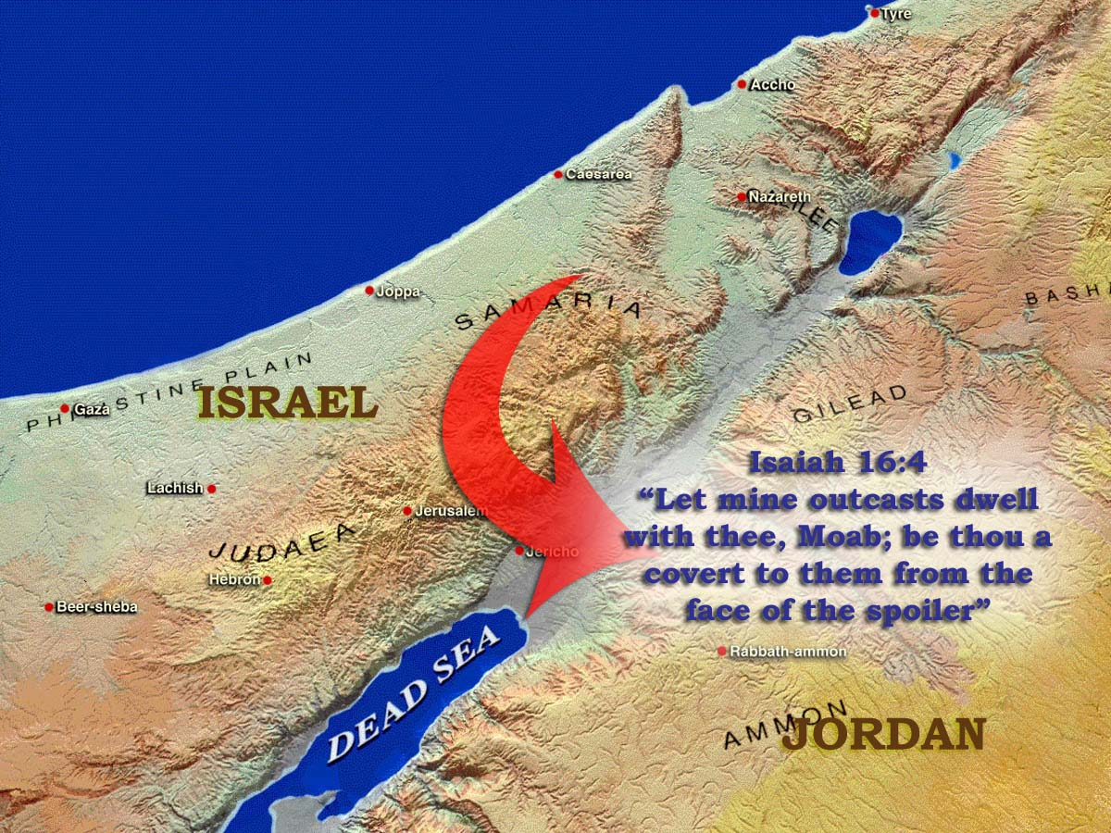
Notes:
Isaiah 16 – A prophecy about Moab. All indication is that Israel seeks refuge in Moab (modern Jordan) in order to escape the northern invader.
Daniel 11 supports this by informing us that Edom, Moab and the children of Ammon escape the invasion.
@

Slide 17
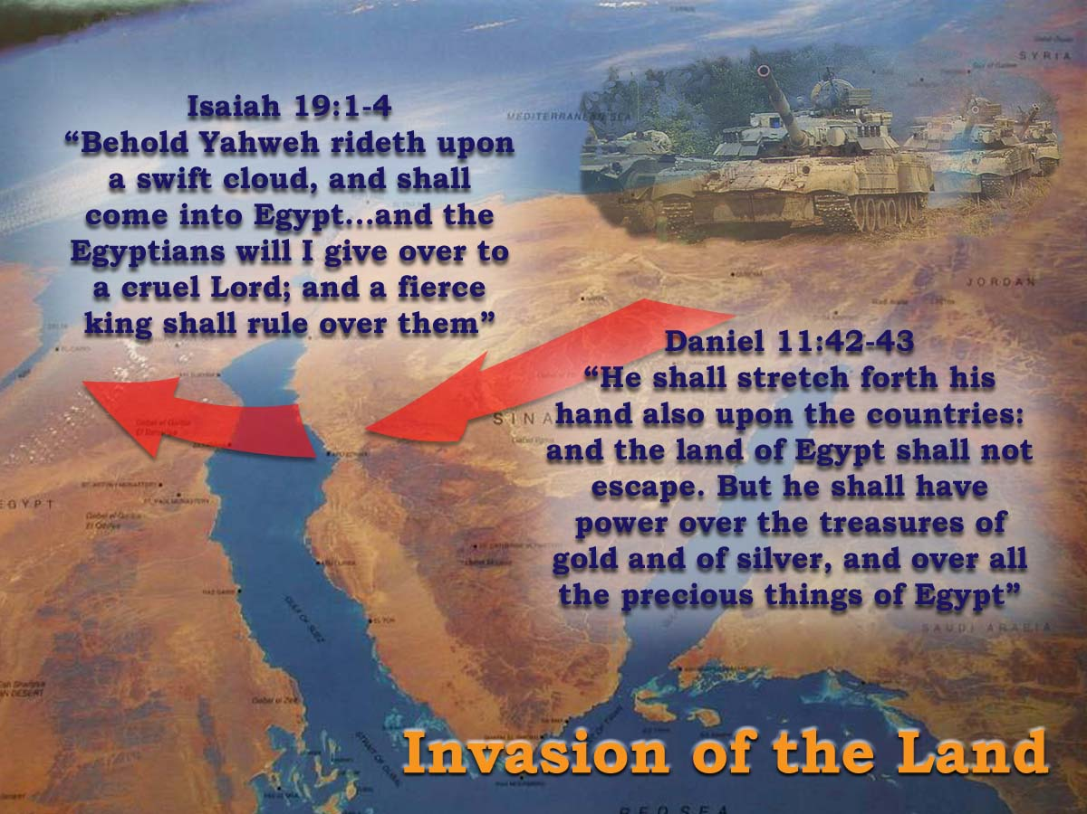
Notes:
Two scriptures add more detail to the picture: Daniel 11:42-43 and Isaiah 19:1-4. These show that Egypt also becomes a victim of the invasion.
Egypt was the first to establish ties with Israel – March 26, 1979, the first between Israel and any of its Arab neighbors; in recent times has been involved in attempting to broker peace with the Palestinians.

Slide 18
Gog’s military strength
Gog’s confederacy
  Russia
  Turkey
  Germany
  France
  Iran
  Ethiopia
  Libya
Fit for Service
  47,000,000
  35,010,000
  29,540,000
  23,750,000
  39,570,000
  13,320,000
  3,000,000
  191,190,000
Total Military
  3,586,128
  710,565
  208,641
  388,635
  934,000
  282,150
  100,000
  6,210,119
Active Military
  1,013,628
  350,000
  178,641
  205,000
  534,000
  177,150
  35,000
  2,493,419
Notes:
The shear size of the confederacy is frightening
The slide shows the modern names of the countries involved + their military capability.

Slide 19
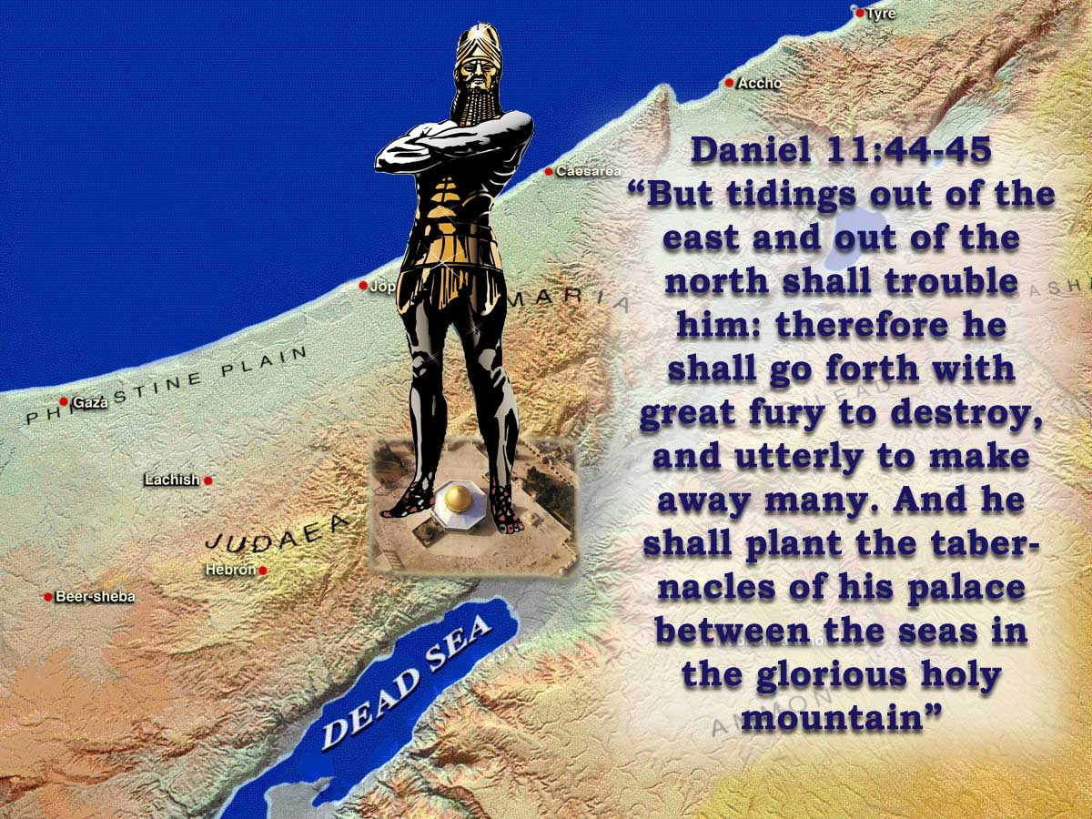
RUSSIA
TRIUMPHANT
Notes:
The Northern invader will establish his authority by taking Jerusalem – Daniel 11:44-45
The record says “he shall plant his tabernacles in the glorious holy mountain” – This is God’s mountain – where He intends to dwell.
Note Isaiah 14:13-15 – the arrogance of human pride.

Slide 20
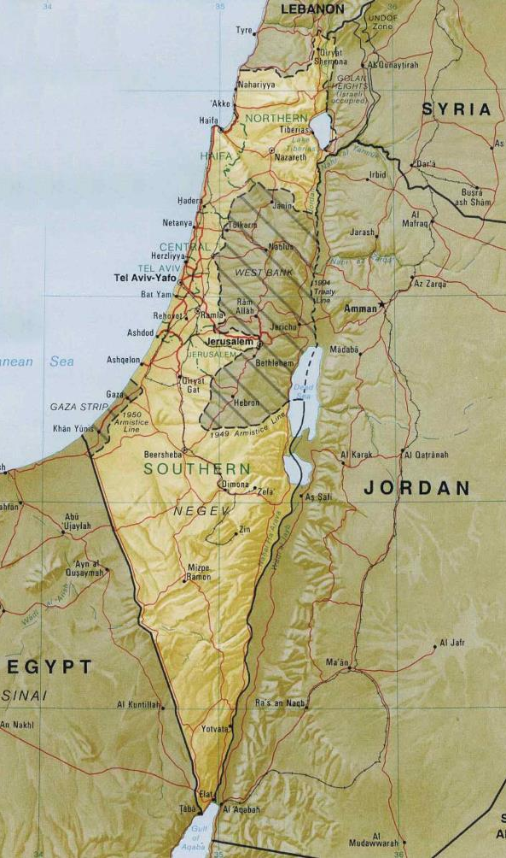
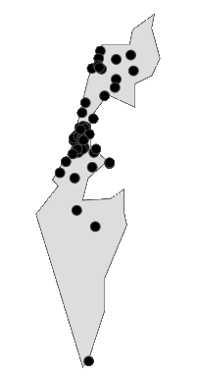
Israel bears her shame
Zechariah 13:8
“And it shall come to pass, that in all the land, saith the LORD, two parts therein shall be cut off and die; but the third shall be left therein”
Current population of Israel = 8,529,815
73% are Israeli = 6,226,765
20% are Arab = 1,705,963
Others = 597,087
Tel Aviv
The mountains of Israel
Jerusalem
Areas of population density
Total | Jews only
5,686,543 | 4,151,177
2,843,272 | 2,075,588
Notes:
Zechariah provides a graphic picture of the desolation – 13:8
The most concentration of population is around Tel Aviv.
2/3 will perish – equivalent to the holocaust.
This region is perhaps the most secular.

Slide 21
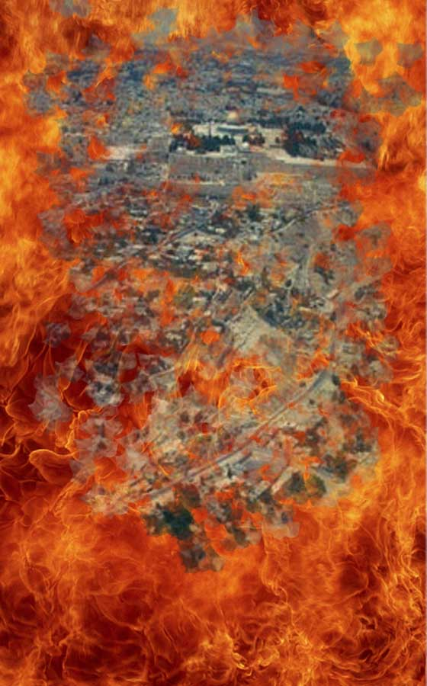
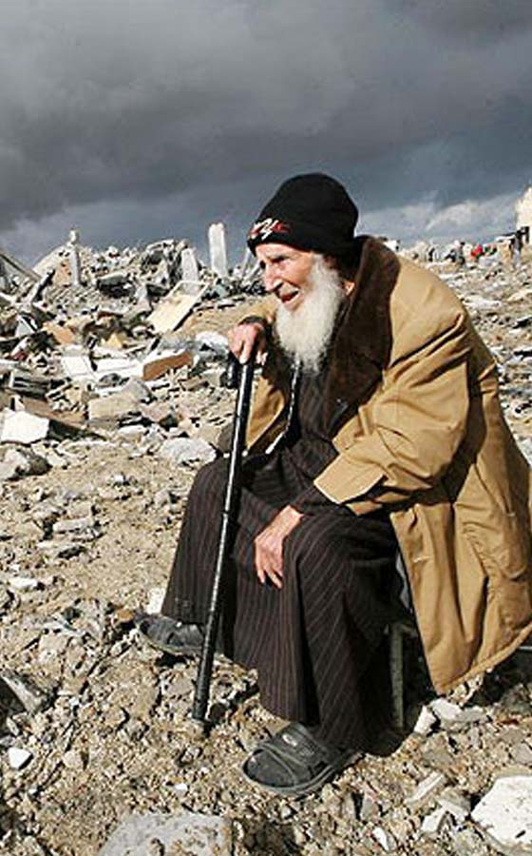
Daniel 11:45
The Time of Jacob’s Trouble
Israel humiliated – Jer.30:4-7
Jerusalem humiliated – Zech.14:1-2
Jewish casualties high – Zech.13:8-9
Arab nations seize the land – Ezek.36:2-3
Israel is in despair – Ezek.37:11; Isa.49:14; Psa.102:8-11
Notes:
Zechariah provides a graphic picture of the terrible devastation.
Jerusalem Humiliated: Zech.14:1-2: Man’s basest instincts will rise to the surface.
It is possible that when the saints are taken away for judgment all restraint will be removed. Humanity will be plunged into the depths of degradation.
Ezekiel informs us that the surrounding Arab nations will be quick to seize the land – Ezekiel 36:2-3. It happened in the days of Zerubbabel when Israel returned to the land; the Samaritans where in occupation – they had taken over after the Babylonians invaded the land.
We have a picture of utter devastation.
NEXT SLIDE

Slide 22
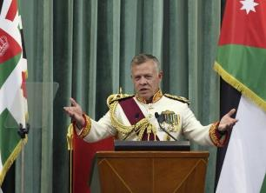

Why Jordan cancelled part of its peace treaty with Israel
4 November 2018
The move comes as Jordan has been repeatedly sidelined on US-Israeli decisions concerning Jerusalem and Palestinian refugees.
Jordan has announced the cancellation of clauses in its 1994 peace treaty with Israel that had allowed Israel to use two agricultural areas along the border, al-Baqura and al-Ghamr. The clauses had been harshly criticized inside Jordan as being unfair and biased towards Israel.
The deal had allowed Israel to essentially “lease” these areas from Jordan for renewable 25-year periods, unless either party opted to cancel the deal. The Jordanian decision not to renew came as a surprise, both domestically and within Israel.
Over the past quarter century, Jordan has reiterated that peace is the country's "strategic choice", and previous attempts to force the government to exit the treaty with Israel have failed. Last December, parliamentarians opted to re-examine the treaty in response to the US recognition of Jerusalem as the capital of Israel.

