Slide 1
When the Master Returns
The supper of the great God
Study No. 3
Reading: Psalm 2

Slide 2
Marriage of Lamb
Marriage Supper of the Lamb
Gog invades
The work of Elijah
In the land The dispersed of Israel
Resurrection & Judgment
The Return of Jesus Christ
Judah saved first
Second Exodus for those dispersed
The millennium begins
Armageddon
Nations invited to submission
Building the Temple
Ships of Tarshish bring Israel home
Catholic Rome destroyed
Revelation 19:7-8
Let us be glad and rejoice, and give honour to him: for the marriage of the Lamb is come, and his wife hath made herself ready. And to her was granted that she should be arrayed in fine linen, clean and white: for the fine linen is the righteousness of saints.
Notes:
We left Gog triumphant in the land,
Israel decimated, Egypt crushed
During all this time another event has been taking place
Judgment over, rejected dismissed
Marriage of the Lamb takes place – Rev.19:6-9
The marriage and the supper are two separate events
One takes place before Armageddon, the other after
NEXT SLIDE

Slide 3
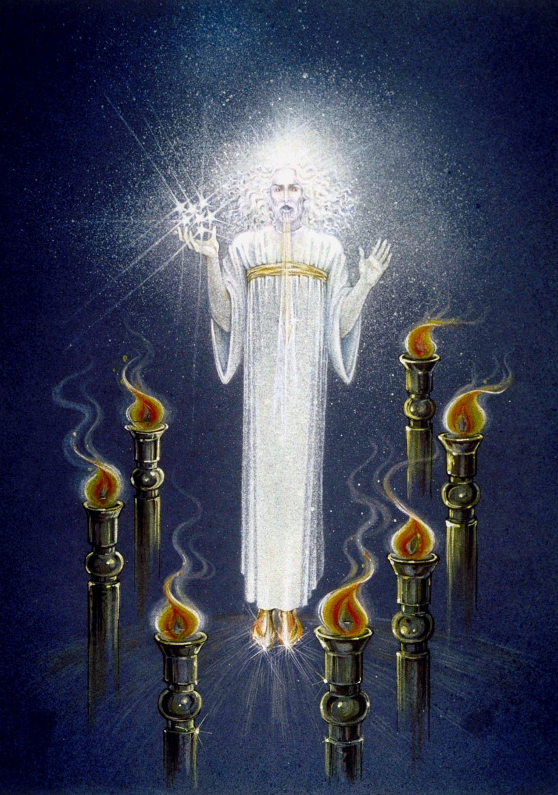
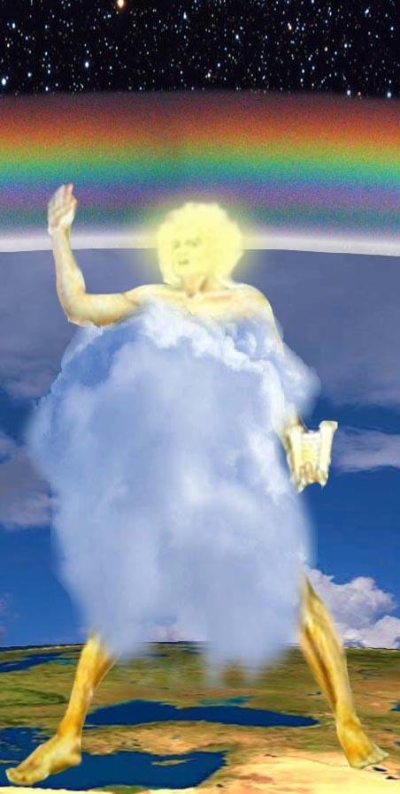
The Glorified Bride
Marriage of the Lamb: Rev.19:7
The bride becomes a warrior: Rev.1:12-16
Preparation for war: Psa.149
One like the Son of man
God gathers His “mighty ones”: Joel 3:11
God’s fury rises against Gog: Ezek.38:18, 21
Christ and the saints revealed: Zech.14:5; Rev.1:7; Rev.10:1
The Rainbow angel
His countenance as the sun
Notes:
The Bride becomes a warrior – Rev.1:12-16, Melchizedek king/priests
Takes place “on the Lord’s day” – v.10
Signalled by “the great voice as of a trumpet”
The one body of Christ – “voice of a multitude” – v.15
Glorified saints prepare for war – Psa.149; (Joel 3:11)
God is gathering His mighty ones – Joel 3:11
When Christ manifests himself, the saints will be in attendance – Zech.14:5

Slide 4
Marriage of Lamb
Marriage Supper of the Lamb
Gog invades
The work of Elijah
In the land The dispersed of Israel
Resurrection & Judgment
The Return of Jesus Christ
Judah saved first
Second Exodus for those dispersed
The millennium begins
Armageddon
Nations invited to submission
Building the Temple
Ships of Tarshish bring Israel home
Catholic Rome destroyed
Malachi 4:5-6
Behold, I will send you Elijah the prophet before the coming of the great and dreadful day of the LORD: And he shall turn the heart of the fathers to the children, and the heart of the children to their fathers, lest I come and smite the earth with a curse
Notes:
Before examining the position of Babylon the great

Slide 5
Yahweh’s set time
Jewish Calendar of the Law
Events at the time of the end
7th Month
1
Feast of Trumpets Lev.23:24
Israel
The Saints
2
Gog/king of the North invades the land of Israel
Resurrection & Judgment
3
4
1 Thess.4:16
1 Cor.15:52
5
Rosh Hashanah – A period of reflection
Israel’s period of reflection
6
7
Ezekiel 37:11
Isaiah 49:14
Yahweh marches for His people
8
9
Ezekiel 38:18
Zechariah 14:3,5
Joel 3:11
10
Day of Atonement Lev.23:27; 25:9
Israel forgiven & restored to the land
11
12
Jubilee Trumpet
Liberty proclaimed
Time of restitution
Isaiah 58:1
Isaiah 18:3,7
Isaiah 27:12,13
13
14
15
Feasts of Tabernacles
The time of the kingdom
Notes:
The general sequence historically accepted still holds true. Must not be dogmatic about the order of events within this scheme.
There is a large amount of details given about the time of the end; what we need to do first of all is establish the prophetic references which are most influential.
Three points need emphasizing:
Ezekiel 38 is not an isolated prophecy – part of the same period of other records
The Assyrian prophecies of Isaiah describe the same events
Ezekiel 38 and Daniel 11:40-45 describe the same event.

Slide 6
Israel – tried as gold
Divine Favour is Conditional
  Israel must confess her sins THEN God will remember His covenant – Leviticus 26:38-42; Deuteronomy 30:1-3
Jesus’ manifestation to Israel is in response to Israel’s confession – Acts 3:19-21 RV; Rom.11:23-27
Lev/Deut
Israel distressed thru disobedience
“If they confess their iniquity”
God “will return and gather you”
Acts 3
Israel disobedient – “denied the Holy One”
“Repent ye therefore and be converted”
“That he may send Jesus”
Romans 11
Israel cast off
“All Israel shall be saved”
“There shall come…the deliverer”

Slide 7
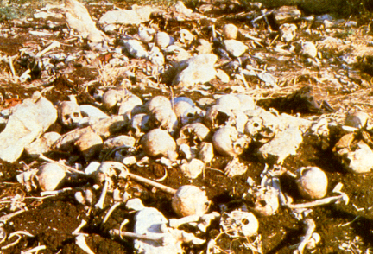

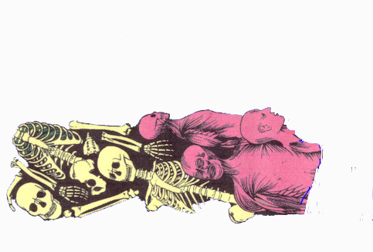
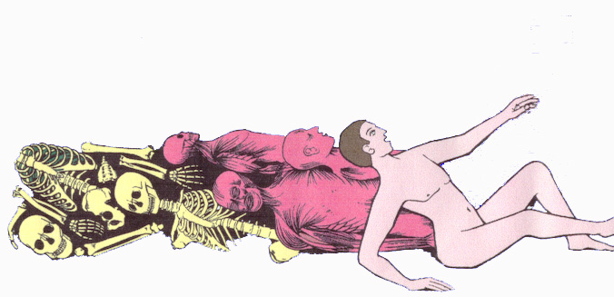
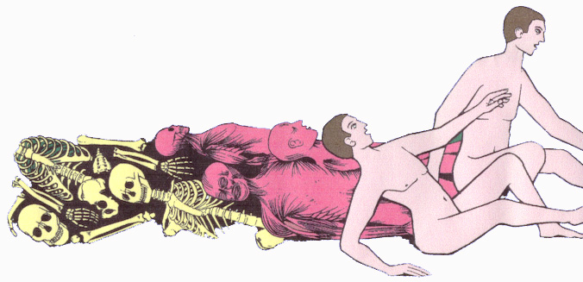
Ezekiel 37
The whole house of Israel – verse 11
The forming of a new “man”
Skin covers them
Bones come together
Flesh comes upon them
Breath (spirit) enters into them and they live
They stand upon their feet, as an exceeding great army
Notes:
Israel experiences a re creation – the creation of a new man
A resurrection takes place.
Hence the sequence described by Ezekiel
ENTER

Slide 8
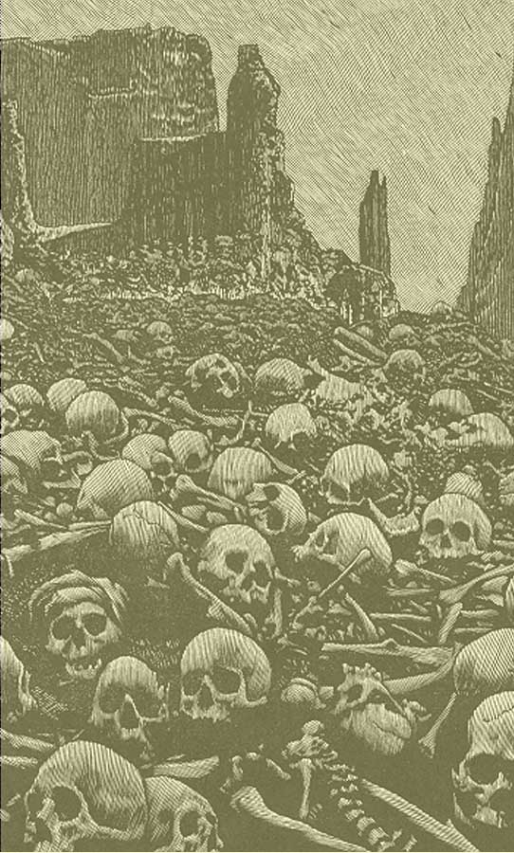
Valley of dry bones
Ezekiel 37
“Set me down in the midst of a valley which was full of bones”
Old Testament language
  Deut.28:25-26
  Jer.7:33-34
  Ezekiel 6:5-7
A broken people
  Ezekiel 37:4,11
Bones represent “the whole house of Israel”
  Ezekiel 37:11
Notes:
Ezekiel 37 – Vision of a Valley of dry bones – verse 1.
The language is common in the Old Testament, signifying the manner in which Israel has become a prey to the Gentile nations – the feeding frenzy of wild beasts and birds of prey.
Deuteronomy 28:25-26 warned of these conditions if unfaithful.
Repeated in Jeremiah in the days of Babylon – Jer.7:33-34.
Ezekiel 6 – a prophecy against the mountains of Israel (those of Ezekiel 38:8). Note verse 5-7 Israel’s bones scattered; the slain fall in the midst. Similar language to Ezekiel 37:1, 9.
Ezekiel 37:4 – the bones are dry – picked bare and bleached by the scorching heat of judgment.
Israel is in total despair – Ezekiel 37:11 – “our hope is lost: we are cut off for our parts”
Important to recognize, this is not describing a portion of Israel, rather “the whole house of Israel”. Not only the condition of Israel in the land - but entire Jewry.
Anti-Semitism is on the rise – When all nations gather against Jerusalem it will be full blown.
Isaiah 49:14 – Israel concludes that God has altogether forsaken them.
Ezekiel is asked, “Son of man can these bones live?” (Ezekiel 37:3) – “Thou knowest”.

Slide 9
Revival of the bones
  Noise of a trumpet Exod.20:18
  Voice of a trumpet Isa.58:1
  Trumpet identified with Israel’s restoration, Lev. 25:9,10; Isa. 18:3,7; 27:13
Shaking equates with Ezek.38:19; Zech.14:5
Work of Elijah
“The voice of him that crieth...good tidings to Zion”
Isaiah 40:3,9; Jer. 3:15; 23:4; Isa. 30:21; 32:1
noise: Heb. Qool (6963) to call aloud, voice or sound
Ezekiel 37:7
So I prophesied as I was commanded: and as I prophesied, there was a noise, and behold a shaking, and the bones came together, bone to his bone.
shaking: Heb. raash (7494) commotion, confused noise, earthquake
Notes:
A Noise

Slide 10
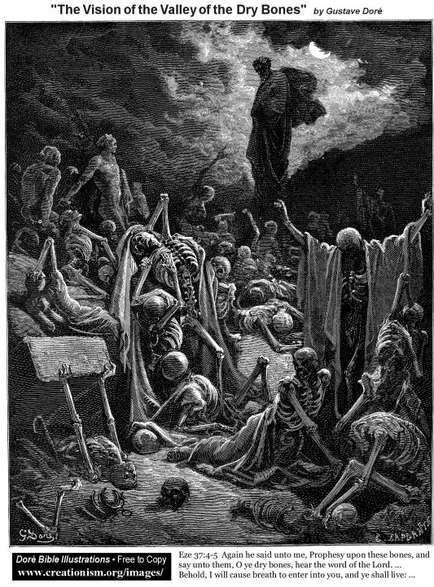
Ezekiel 37 – breath into them
Valley of dry bones
“Behold I will cause breath to enter into you, and ye shall live”
Breath or “spirit” identified with the spirit of truth
  1 John 5:6 RV
  John 3:5, 8
  John 6:63
Israel enters the new covenant
  Ezekiel 11:7-9
  Jer.31:31-33
  Jer.32:38-41
Notes:
“Behold I will cause breath to enter into you, and ye shall live”
Breath or “spirit” identified with the spirit of truth: 1 John 5:6 RV; John 3:5, 8; John 6:63
Israel enters the new covenant: Ezekiel 11:7-9; Jer.31:31-33; Jer.32:38-41
The outcome – verse 13, “they shall know that I am Yahweh”
Question: When does this take place? Who breathes into Israel the knowledge of the truth?
@

Slide 11
Summary of Events
Ezekiel 39:25-29
25 Therefore thus saith the Lord GOD; Now will I bring again the captivity of Jacob, and have mercy upon the whole house of Israel, and will be jealous for my holy name;
26 After that they have borne their shame, and all their trespasses whereby they have trespassed against me, when they dwelt safely in their land, and none made them afraid.
27 When I have brought them again from the people, and gathered them out of their enemies' lands, and am sanctified in them in the sight of many nations;
28 Then shall they know that I am the LORD their God, which caused them to be led into captivity among the heathen: but I have gathered them unto their own land, and have left none of them any more there.
29 Neither will I hide my face any more from them: for I have poured out my spirit upon the house of Israel, saith the Lord GOD.
Speaking of the Whole House of Israel - Ezek. 37:11; 36:10. Refers to total restoration (see v.28)
Occurs after Israel’s humiliation - Ezek.38:18; 34:29; 36:6; 37:13
Their humiliation takes place when they dwell safely - Ezek. 38:11
Israel receives knowledge of the Truth after restoration - Ezek. 28:26; 39:22; 34:30
Divine favour returns -Ezek. 34:25; 36:26-27; 37:14
Notes:
Ezekiel 39 summarizes the events of chapt 38 and in addition places chapt. 37 in context.
Speaking of the Whole House of Israel – Ezek. 37:11; 36:10. Refers to total restoration (see v.28)
Occurs after Israel’s humiliation – Ezek.38:18; 34:29; 36:6; 37:13
Their humiliation takes place when they dwell safely – Ezek. 38:11
Israel receive knowledge of the Truth after restoration – Ezek. 28:26; 39:22; 34:30
Divine favour returns – Ezek. 34:25; 36:26-27; 37:14

Slide 12
Ezekiel and the 6th/7th vial
Ezekiel 38 & 39
Revelation 16
“I will put hooks into thy jaws, and I will bring thee forth...
“I will bring thee against my land...
“It is done (39:8)
“In that day there shall be a great shaking in the land
“Fire on Magog and on them that dwell...in the isles
“...to gather them to the battle of the great day of God Almighty
“He gathered them to a place called in the Hebrew tongue Armageddon”
“It is done (16:17)
“There was a great earthquake
“The cities of the nations fell
Notes:
Ezekiel 38/39 corresponds to revelation 16:15-17
The key word is “it is done”
When the 7th vial is poured out Armageddon is complete
An earthquake is mentioned in both cases – one literal, one political
Then reference is made to “the cities of the nations”
This seems to corresponds to “fire on Magog and the isles”
WANT NOW TO CONSIDER EVENTS IN THE NATIONS AFTER ARMAGEDDON
NEXT SLIDE

Slide 13
Jeremiah 25:31-33
A noise shall come even to the ends of the earth; for the LORD hath a controversy with the nations, he will plead with all flesh; he will give them that are wicked to the sword, saith the LORD. Thus saith the LORD of hosts, Behold, evil shall go forth from nation to nation, and a great whirlwind shall be raised up from the coasts of the earth. And the slain of the LORD shall be at that day from one end of the earth even unto the other end of the earth: they shall not be lamented, neither gathered, nor buried; they shall be dung upon the ground.
Notes:
Reading this verse highlights the fact that the destruction of Gog is only the beginning
READ SLIDE – highlight words in colour
God’s judgements are to progressively spread worldwide
The impact of Gog’s destruction will resonate throughout the earth
Jeremiah 25: this sheds some light on the transpiring events.
Jeremiah shows that God’s judgments expand beyond Israel – Nations to be drunk with wine of God’s fury.
from Jerusalem and Judah (v.17-18); Egypt (v.19); Surrounding nations (vv.20-24); all nations (vv.25-26). Note verse 26, “Sheshach shall drink after them…”
Who is Sheshach? RV says it is a cipher for Babel or Babylon (see Jer.51:41).
Babylon is the last power to be destroyed.

Slide 14
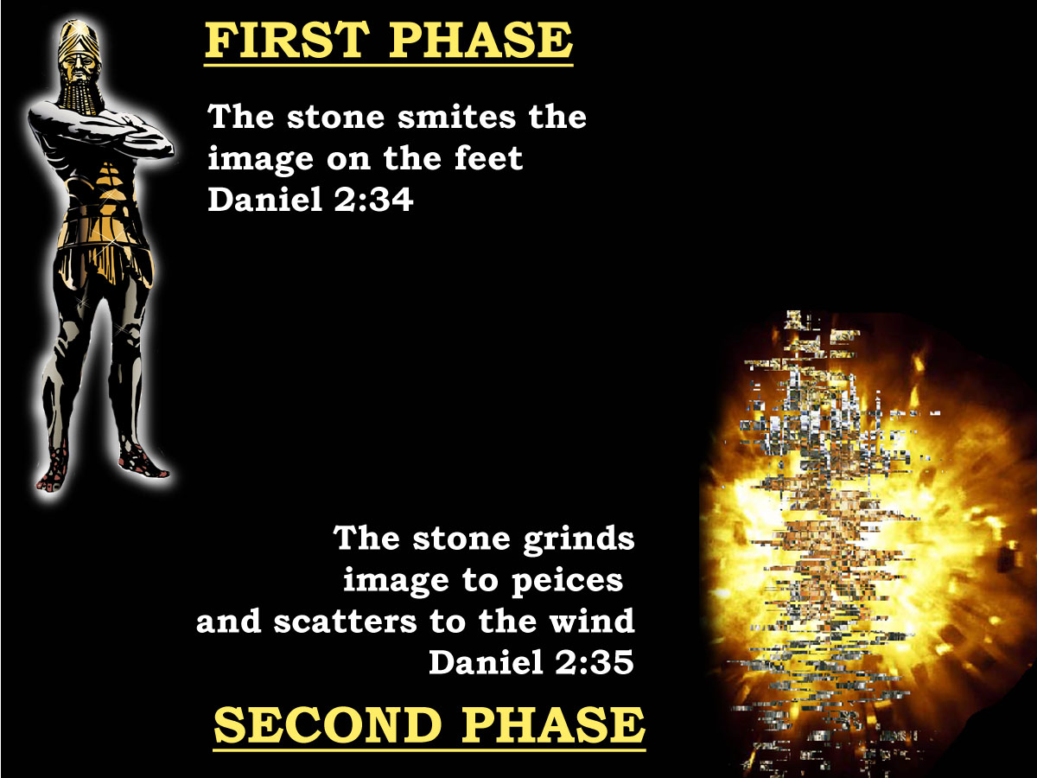
The image falls
Notes:
Daniel 2:34-35 indicates that there will be a two phase process in putting down sin.
1st – the smiting of the image on the feet – verse 34
2nd – the grinding to powder of the image (echo of Israel, Isa.41:15)
Not only must the aggression be challenged and overthrown – but before the kingdom can begin proper the mindset of the flesh must be dealt with.

Slide 15
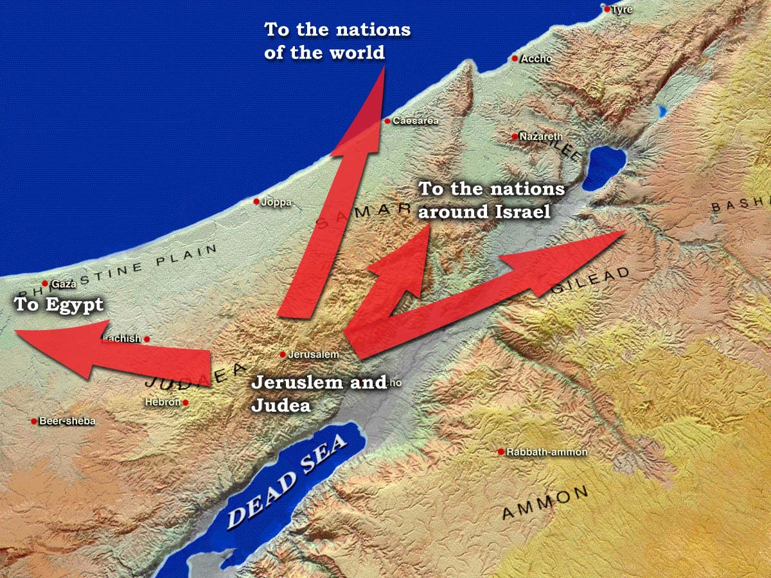
A Controversy with the Nations
A proclamation is issued from Zion - Zech.9:10; Rev.14:6
Certain nations are hostile to Jesus’ authority - Psa.2:1-6; Psa.110:2,3
Babylon comes into remembrance before God - Rev.14:8; Rev.16:19
Notes:
Christ’s first work is to invite the nations to submit to his authority
He issues an invitation of Peace
There is a mixed reaction amongst the nations

Slide 16
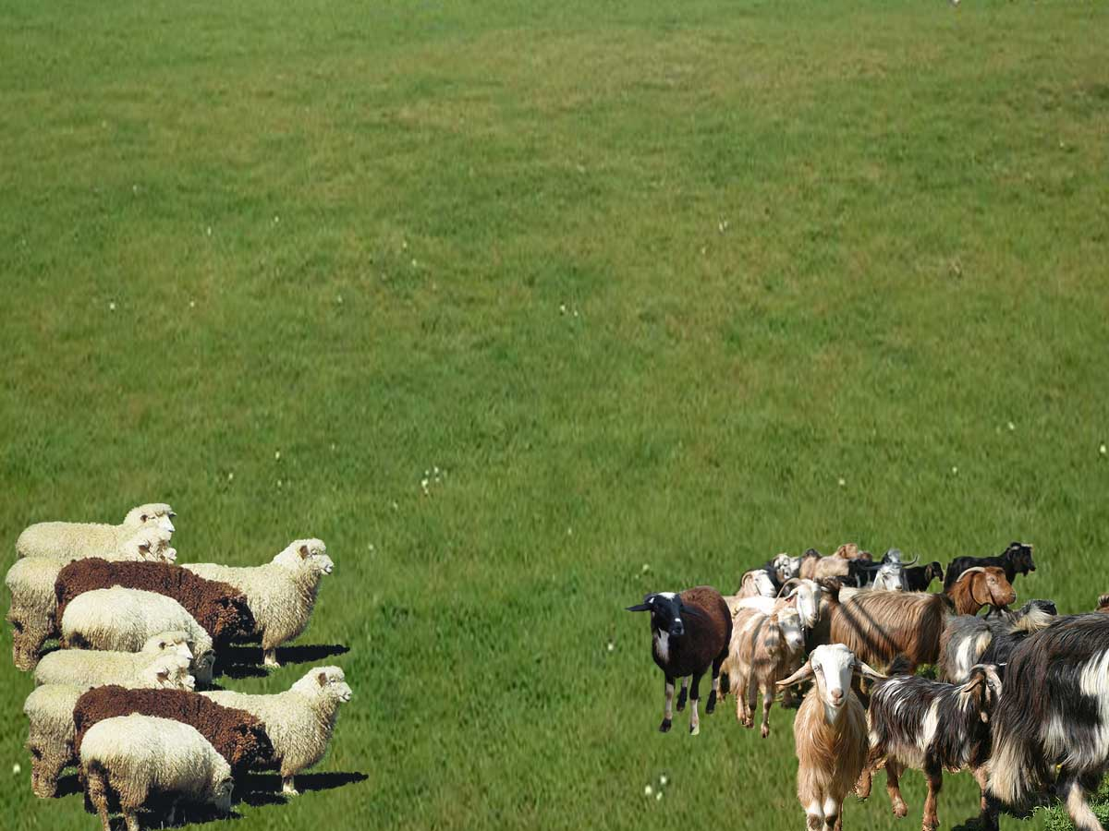
The sheep and the goats
Jesus is sitting on his throne: Luke 1:32; Matt.19:28; Jer.3:17
All nations are gathered for judgment: Joel 3:12; Zech.14:16; Rev.14:6
Nations which are blessed inherit the kingdom: Isaiah 2:2; Psa.72:11; Zech.14:16
Notes:
The Parable of the sheep and goats. Need to examine some of the details:
Jesus is sitting on David’s throne, verse 31
All nations are gathered before him, verse 32
Nations invited to inherit the kingdom, verse 34
Nations are judged on how they have dealt with Jesus brethren, verse 40

Slide 17
The sheep and the goats
Who are his brethren (v.40)
  The Saints – Matt.12:49; 1Cor.8:12
  Israel – Deut.28:48
How do the nations inherit the kingdom (v.34)?
  Micah 4:8; Psalm 2:10-12; Mal.1:11; Zeph.2:11
How do the nations inherit life eternal (v.46)?
  ζωή αἰώνιος – life age- lasting, Rotherham = “age-abiding life”
  Daniel 7:12
Strong’s: (2816), klēronomeō
to be an heir to (literally or figuratively): - be heir, (obtain by) inherit (-ance).
Thayer: to receive a lot, receive by lot
LXX: Num.33:54; translated “possess”, Deut.4:5; Josh.24:4
Notes:
Who are Christ’s brethren?
The saints – Matt.12:49; 1Cor.8:12
Note vv.35-36 – Bible echo, Deut.28:48. Answer Israel – Jesus has come to save His brethren.
How can the nations inherit the kingdom? Again note Daniel 7:12
@ - Strong’s definition.
@ Nations in the kingdom – Mic.4:8; Psa.2:10-12; Mal.1:11; Zeph.2:11
What is meant by “life eternal” (v.46) – the life of the age, Rotherham, “age abiding life”
Our interest lies in verse 41 – who does this refer to?

Slide 18
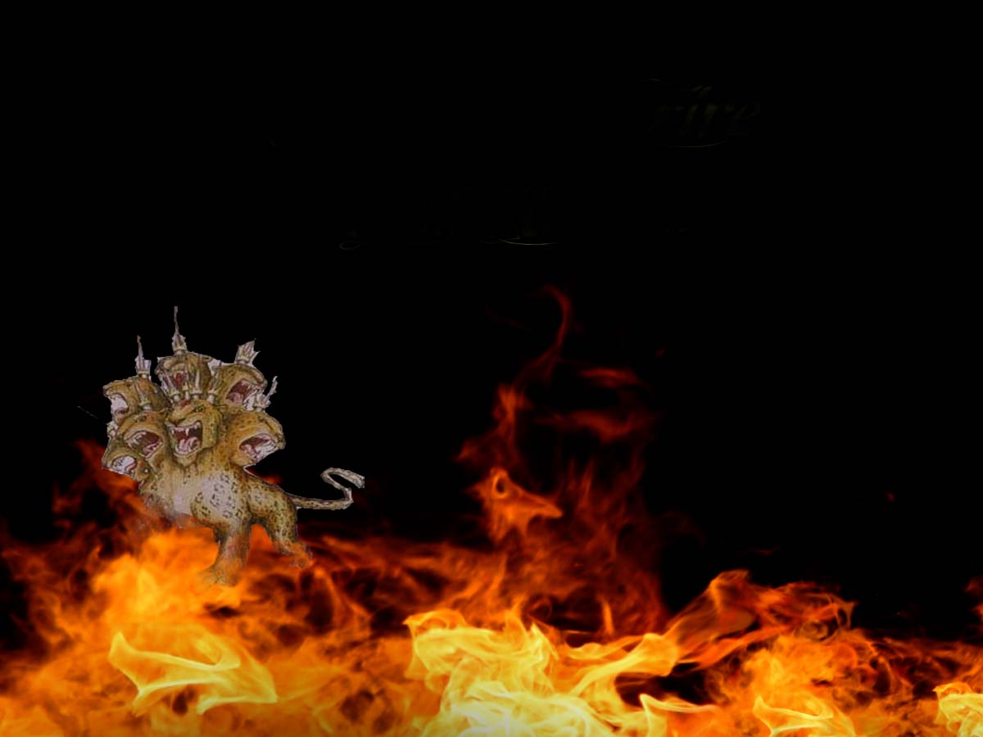
The devil and his angels
Disobedient nations to suffer the same fate as “the devil”
Bible echo
  A political power, Rev.12:7-9
  The fate of the beast, Dan.7:11-12; Rev.19:20
Notes:
READ SLIDE

Slide 19
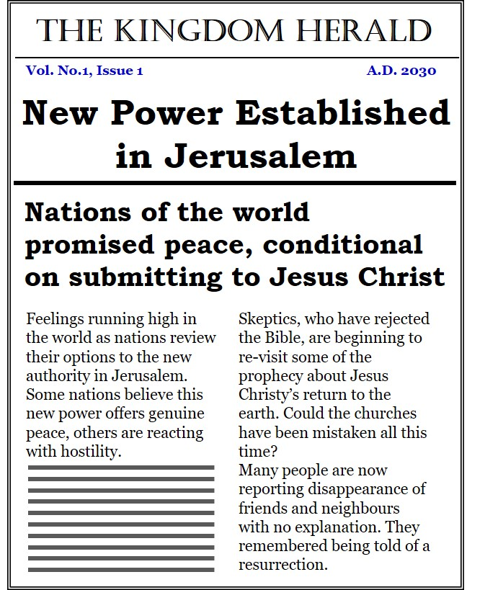
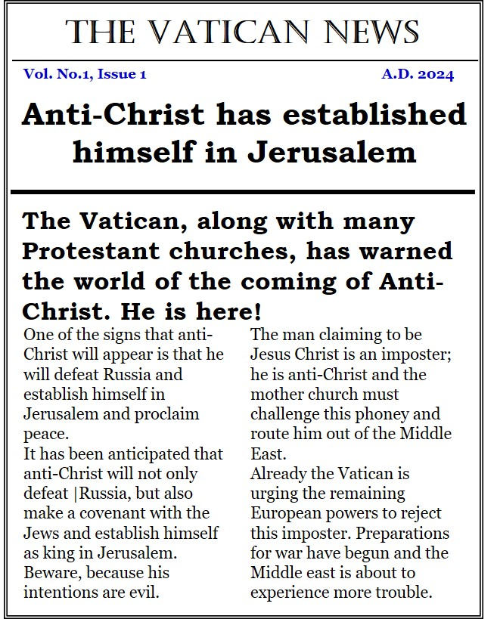
Tomorrows News
Notes:
We need to appreciate the reaction of the nations at this point
Not all will be happy with Jesus return
In fact for years the Vatican and many Evangelicals have been promoting the appearance of Anti-Christ.
Everything that Jesus does is anticipated as the actions of anti-Christ.

Slide 20
Ezekiel 38 & 39
I will put hooks in thy jaws, and will bring thee forth…
I will bring thee against my land…
It is done (39:8)
In that day there shall be a great shaking in the land of Israel
Gather yourselves on every side to my sacrifice
Revelation 16
He gathered them to the battle of the great day of God Almighty…
Behold I come as a thief
He gathered them to a place called, in the Hebrew tongue, “Armageddon”
It is done (16:17)
There was a great earthquake
…and great Babylon came into remembrance before God
Notes:
Returning to our comparison chart, the 7th vial introduces Babylon the great

Slide 21
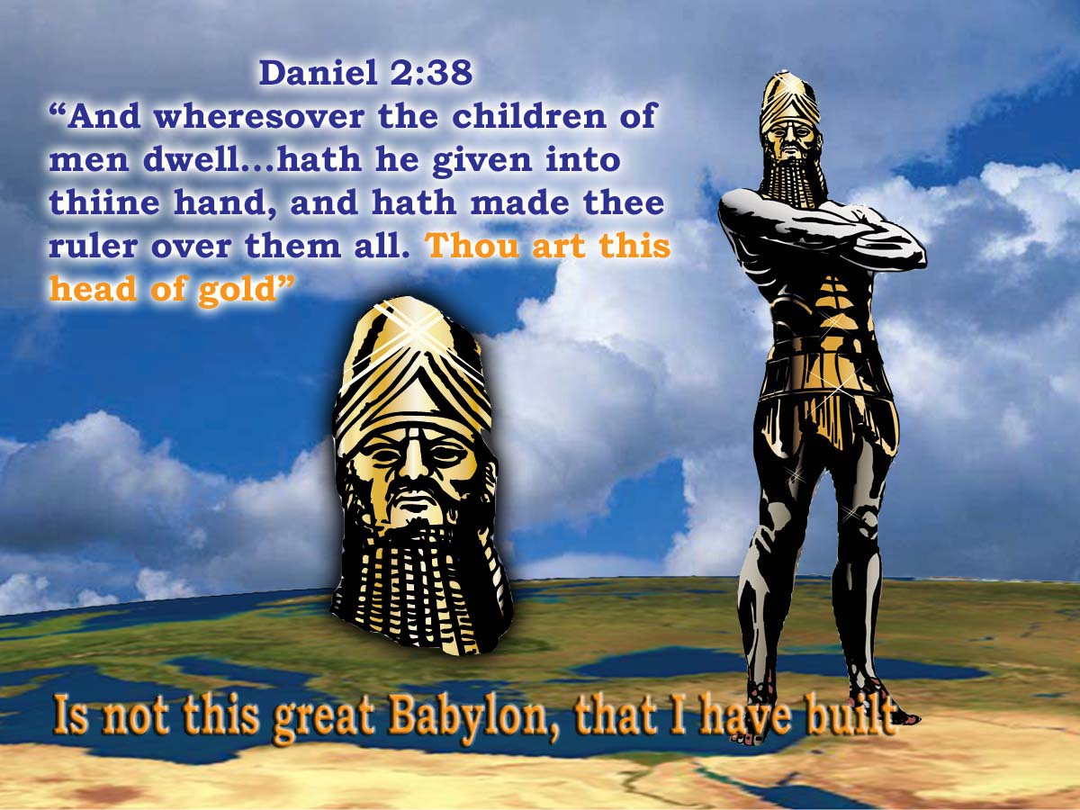
The Head of Gold
Notes:
Daniel chapter 2 is the foundation chapter this this session
Nebuchadnezzar’s Image covers a vast region of powers – Babylon, Medo-Persia, Greece, Rome.
But the master mind behind this vast kingdom of men is the Head of Gold – verse 38
Babylon, “thou art this head of gold”
Two mindsets exist in the Scriptures
One influenced by the Word, the other by the flesh
NEXT SLIDE

Slide 22
Revelation 17:12-14
And the ten horns which thou sawest are ten kings, which have received no kingdom as yet; but receive power as kings one hour with the beast. These have one mind, and shall give their power and strength unto the beast. These shall make war with the Lamb, and the Lamb shall overcome them: for he is Lord of lords, and King of kings and they that are with him are called, and chosen, and faithful.
Revelation 19:19
And I saw the beast, and the kings of the earth, and their armies, gathered together to make war against him that sat on the horse, and against his army
Notes:
Revelation 17 describes the hostility
Babylon is one power that identifies with those who have persecuted Christ’s brethren (17:6; 18:13)
Notice how this corresponds to Rev.19

Slide 23
A great sacrifice
Revelation 19
Ezekiel 39
I saw an angel standing in the sun…saying, to all the fowls that fly in the midst of heaven...
Come and gather yourselves together unto the supper of the great God
That ye may eat the flesh of kings, and the flesh of captains, and the flesh of mighty men...
And the flesh of horses, and of them that sit on them, and the flesh of all men, both free and bond, both small and great
Speak unto every feathered fowl, and unto every beast of the field...
Assemble yourselves, and come; gather yourselves together ... to my sacrifice that I do sacrifice...
Ye shall eat the flesh of the mighty, and drink the blood of the princes of the earth...
Thus shall ye be filled at my table with horses and chariots, with mighty men, and with all the men of war, saith the Lord GOD
Notes:
Two details indicate that both scriptures speak of the same event
Both fall into the same time period
Both use identical language.
Who do these fowls and breasts refer to?

Slide 24
Ezekiel 39:4
Thou shalt fall upon the mountains of Israel, thou, and all thy bands, and the people that is with thee: I will give thee unto the ravenous birds of every sort, and to the beasts of the field to be devoured.
Israel historically has fallen prey to Gentile predators - Deut.28:26; Jer.7:33; 1Sam.17:44
God’s covenanted people to reverse these conditions - Num.23:24; 24:8,9; Jer.51:20; Isa.14:2
The armies of Christ (saints & Israel) will attend God’s supper - Rev.19:17; Acts 10:12
Ravenous birds: Echo of Cyrus, Isa.46:11 – type of Christ (Isa.41:2)
Birds and Beasts: ref. to Gentile powers, Lev.11:13-19; Acts 10:12. Cleansed by God, Acts 10:15

Slide 25
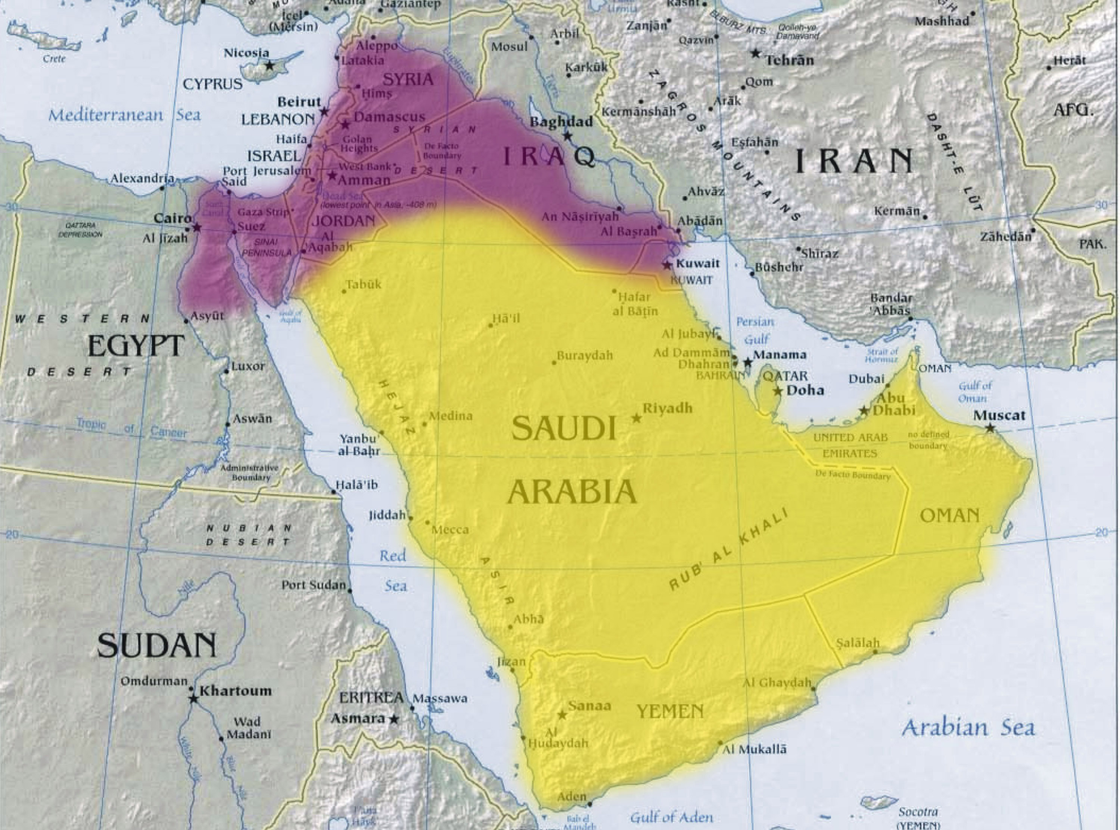
Subduing the nations
The land is cleansed of all false religions – Zech.13:2
Israel’s neighbours learn the ways of Israel – Jer.12:14-17
Arab nations that submit will dwell alongside Israel (Nebaioth, Kedar and Tema) – Isaiah 60:6,7; Psa.72:10
Certain Gentile nations will comply (Tarshish) – Psa.72:10; Isa.60:9
Gentile nations will learn God’s ways – Isa.2:1-4
ISRAEL
Nebaioth
Kedar
Dedan
ISHMAEL
Tema
Sheba
Notes:
The influence of Babylon will be dealt with decisively
The nations will be invited to submit to Christ
Cleanse Jerusalem, remove all evidence of false worship
Babylon will respond by rejecting Christ

Slide 26
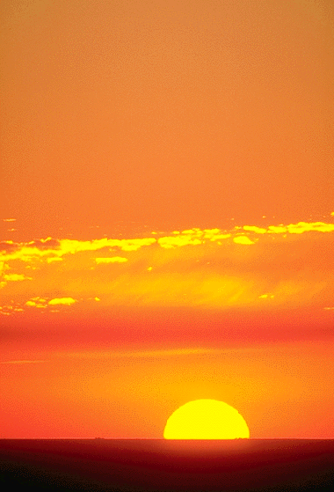
And the LORD shall be King
“Blessed be the LORD God, the God of Israel, who only doeth wondrous things. And blessed be his glorious name for ever: and let the whole earth be filled with His glory; Amen, and Amen”
Isaiah 26:9
Isaiah 32:17
Psalm 72:7
Isaiah 53:11
“Behold I come quickly and my reward is with me”
“Blessed is he that watcheth”

Slide 27
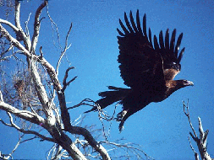
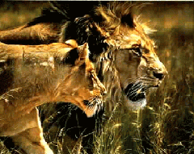
Gather yourself to my sacrifice
Israel historically has fallen prey to Gentile predators - Deut.28:26; Jer.7:33; 1 Sam.17:44
God’s covenanted people to reverse these conditions - Num.23:24; 24:8,9
The armies of Christ (the saints) will attend God’s supper - Rev.19:17; Acts 10:12 [Lev.11:13-19; 20:23-26]
“Thou art my battle axe and weapons of war: for with thee will I break in pieces the nations...” Jer.51:20

Slide 28
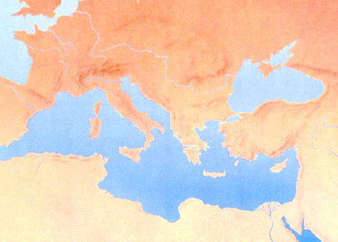
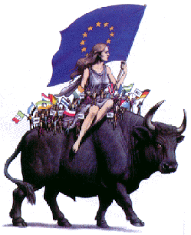

The banner of the beast
European Beast
These shall make war
on the Lamb
NEXT TWO SLIDES NEED SOME SERIOUS WORK
“Ye shall eat the flesh of the mighty, and drink the blood of the princes of the earth, of rams, of lambs, and of goats, of bullocks, all of them fatlings of Bashan” Ezek.39:18

Slide 29
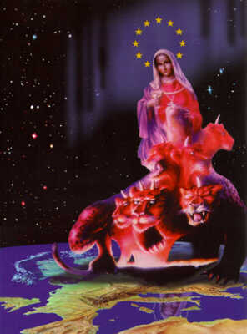
A great sacrifice
“And the beast was taken, and with him the false prophet…these both were cast into the lake of fire…and all the fowls were filled with their flesh” (Revelation 19:20,21)
2000 years of oppression for God’s people will come to an end on the mountains of Israel

Slide 30
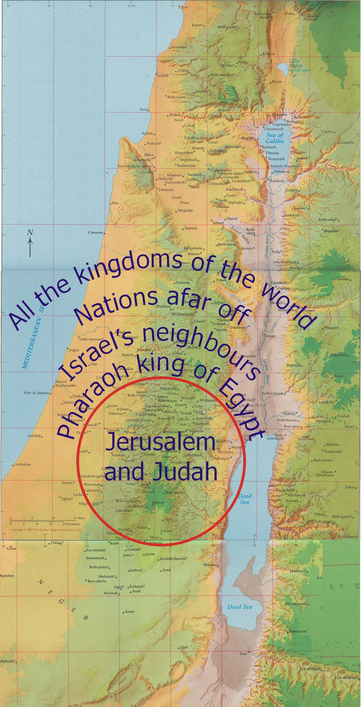
A controversy with the nations
Jeremiah 25
The nations drink of the wine of God’s fury
“The slain of Yahweh shall be from one end of the earth to the other…”
“And the king of Sheshach shall drink after them…”
  Symbolic name for Babylon (Jer. 51:41)
Notes:
The principle that judgment begins at the house of God is drawn from Jeremiah 25
Jeremiah shows judgment beginning with Judah and ending with Babylon

Slide 31
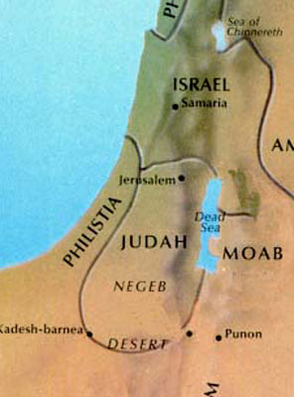
Speaking peace to the nations
A proclamation is issued from Zion - Zech.9:10; Rev.14:6
Certain nations are hostile to Jesus’ authority - Psa.2:1-6; Psa.110:2,3
Babylon comes into remembrance before God - Rev.14:8; Rev.16:19

Slide 32
Habakkuk 3:2-6
O LORD, I have heard thy speech, and was afraid: O LORD, revive thy work in the midst of the years, in the midst of the years make known; in wrath remember mercy. God came from Teman, and the Holy One from mount Paran. Selah. His glory covered the heavens, and the earth was full of his praise. And his brightness was as the light; he had horns coming out of his hand: and there was the hiding of his power. Before him went the pestilence, and burning coals went forth at his feet. He stood, and measured the earth: he beheld, and drove asunder the nations
God revives the work of the exodus – v.2
Christ and the saints emerge from the south – v.3
The new heavens and new earth is established – v.3
God rides upon His chariots of salvation – v.12
His purpose is to thresh the nations – v.12
God proceeds to deliver His people – v.13

Slide 33
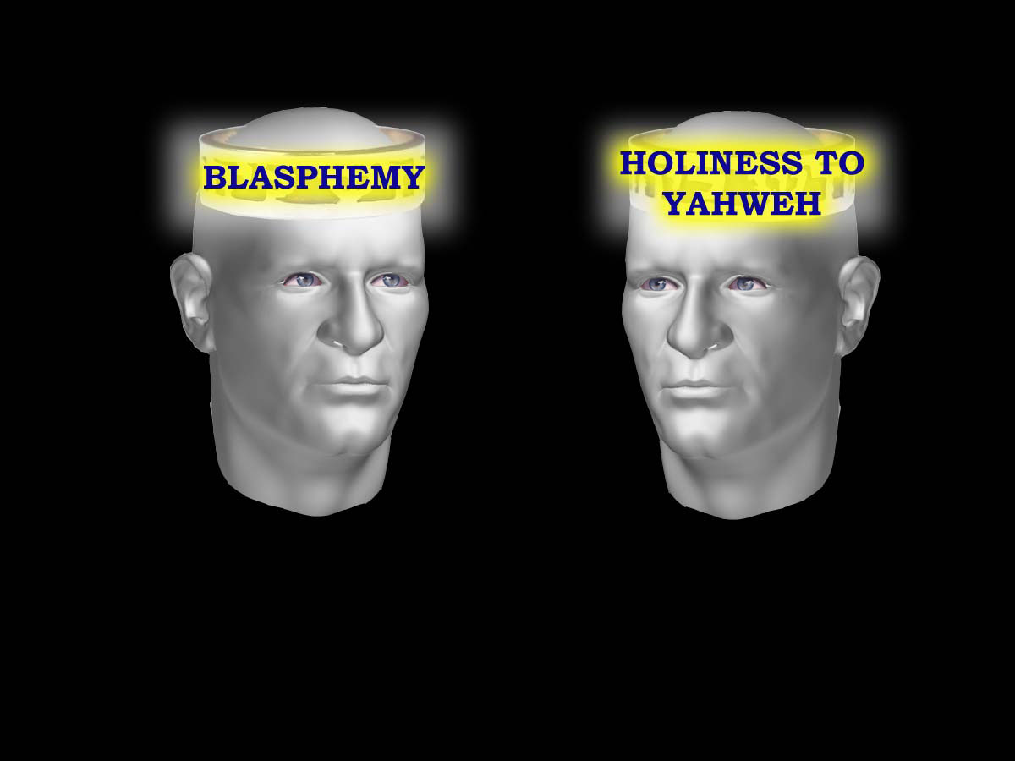
Babylon Mindset
BABYLON
CHRIST
Mouth speaking blasphemy: Rev.13:5-6
A name of Mystery: Rev.17:5
The name of Blasphemy: Rev.13:1
Mouth with no guile: Rev.14:5
A name: The Word of God: Rev.19:13
The name of my God: Rev.3:12
Notes:
Revelation 14 – here the thinking of the flesh is contrasted with the mind of the spirit. READ SLIDE
The spirit of Babylon began in Eden – thinking in opposition to God (enmity, Gen.3:15)
Manifested again in Jesus’ day – the seed of the serpent in religious leaders (John 8:44-45)
This mindset “deceives all nations” (Rev.18:23).
Note that Babylon falls before the redeemed of God – 14:8-9
Note the fate of Babylon – Rev.14:10 “fire and brimstone”

Slide 34
There was a noise… - v.7
Noise: Heb. Qool (stg# 6963) - “to call aloud”
  Noise of a trumpet Exod. 20:18
  Voice of a trumpet Isa. 58:1
Trumpet identified with Israel’s restoration
  Lev. 25:9,10; Isa. 18:3,7; 27:13
“The voice of him that crieth...good tidings to Zion”
  Isaiah 40:3,9; Jer. 3:15; 23:4; Isa. 30:21; 32:1
The prophet Isaiah
Trumpet sound declares Israel’s sins (58:1)
Day of Atonement (58:5)
Israel’s sins revealed (59:2,3)
Israel acknowledges her sins (59:9-13)
The Redeemer comes to Zion (59:20)
Notes:
A Noise

