Slide 1
Jesus relationship to God and man
Class 4 (SS)
North Battleford
March 10, 2019

Slide 2
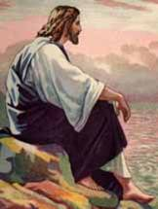
Thoughts to consider
Jesus, the Son of God – how it affected him
Jesus, the seed of the woman – how it affected him
Could Jesus be tempted or tried?
Is temptation sin?
Did Jesus have an independent will?

Slide 3
Jesus – Son of God
God was the prime mover in the process of reconciliation – Gen.3:15; 2Sam.7:14; Isa.59:16
God was involved in the process of reconciliation – Rom.3:25; 2Cor.5:19; 1John 4:1; John 3:16
Jesus’ birth was unique, God was his Father by His spirit – Matt.1:20; Luke 1:35
Jesus was made strong for God – Psa.80:17
Jesus was God manifest in the flesh – John 1:14
“His being God manifest in the flesh led to his powerful proneness in a spiritual direction, and to the fruitfulness of his application to this direction” Robert Roberts 1879
Notes:
“Made strong” – what does this mean? Did Jesus have an advantage over others?
YES, he did. Unlike other humans, he inherited his Father’s characteristics
He was God manifest in the flesh – John 1:14.
People saw what God was really like.

Slide 4
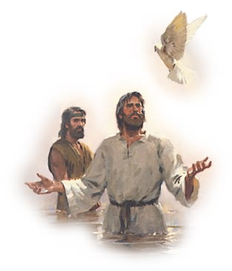
Jesus – Son of God
Jesus’ character was developed, not given to him – “waxed strong” Luke 2:40, “increased in wisdom” verse 52
Jesus was attentive to the Scriptures – Isa.50:4-5; Luke 2:46-47; Luke 4:16; (Psa.119:11, 97)
Jesus was a living Bible – “the word made flesh” John 1:14
Notes:
Jesus character was developed, not given to him

Slide 5
The Spirit of Yahweh is upon me
The spirit of Yahweh rest upon him – Isa.11:2; 60:1
Not unique to Jesus – Judg.3:10; 6:34; 11:29; 13:25; 1Sam.16:13
Wisdom, understanding – Bezaleel, Exod.31:3; Solomon, 1Kings 3:12
Spirit refers to his power received at baptism – Matt.3:16; John 1:32
Spirit given without measure – John 3:34
Spirit given for the purpose of preaching – Isa.61:1; Acts 10:38; Matt.4:23; Matt.11:20
Jesus never used his power for personal benefit – Matt.4:3-11, the temptations
Notes:
Isa.11:2 – the spirit of Yahweh shall rest upon him.
Did this provide Jesus with an unfair advantage?
This was not unique to Christ

Slide 6
The Seed of the Woman
Jesus was born of a woman – Galatians 4:4; Rom.1:3; Luke 1:31
Jesus shared our human nature – Heb.2:14; Rom.8:3
Jesus was made like his brethren – Heb.2:17; Rom.1:3
Like all those in Adam, Jesus needed saving – Heb.5:7; Psa.89:26; Psa.86:16
Jesus was tempted like every other human being – Heb.2:18; Heb.4:15; 1 Pet.2:22; 2 Cor.5:21
Notes:
Consider the first of these requirements
Could it be said that Jesus was subject to the influences of sin?
ENTER
READ SLIDE

Slide 7
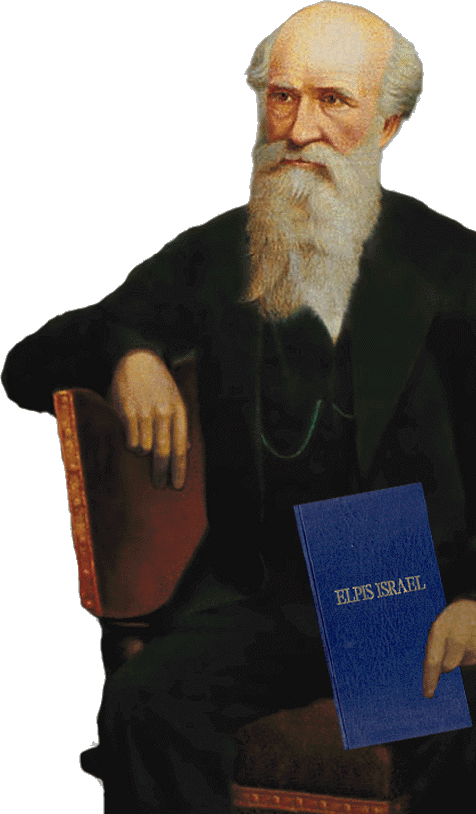
The usage of the word SIN in scripture
The word sin is used in two principal acceptations in the scripture. It signifies in the first place, “the transgression of law; ” and in the next, it represents that physical principle of the animal nature, which is the cause of all its diseases, death, and resolution into dust. It is that in the flesh “which has the power of death;” and it is called sin, because the development, or fixation, of this evil in the flesh, was the result of transgression. Inasmuch as this evil principle pervades every part of the flesh, the animal nature is styled “sinful flesh,” that is, flesh full of sin; so that sin, in the sacred style, came to stand for the substance called man.
Elpis Israel, page 126
Notes:
Important to appreciate the scriptural use of SIN. Bro. Thomas quote – this quote grossly misunderstood – Claimed that he is saying that Adam’s descendents (including Christ) were sinners by birth, and thus were/are alienated by birth.
They overlook Bro. Thomas comment – “it is our misfortune, not our crime” (p.129, Elpis Israel)

Slide 8
Definition of the word Sin
Sin used to describe sins committed.
  1John 3:4; 5:17; Romans 2:12; 3:23
Sin used to describe human nature by the language of personification
  Common in scripture: Proverbs 8:1-3; Matthew 6:24
  Sin is depicted as a ruler or a king: Romans 6:12; John 12:31; Ephesians 2:2
The language of Romans
“We are all under sin” 3:9
“sin hath reigned” 5:21
“should not serve sin” 6:6
“I am sold under sin” 7:14
“sin that dwelleth in me” 7:20
Robert Roberts (1874)
“A disregard for metonymy and ellipsis in such statements, has led to most of the errors of the apostasy; and is leading some back to them who had escaped”
Figure of speech used in scripture called metonymy, where one word or expression is substituted for another
Notes:
The first instance it describes sins committed: 1John 3:4; 5:17; Romans 2:12; 3:23.
The second instance describes our human nature by the language of personification; sin is presented as a ruler or king (Romans 6:12; John 12:31; Ephesians 2:2). The language is used especially in Romans as an oppressor: (Romans 3:9; 5:21; 6:6; 7:14; 7:20).

Slide 9
Bible Terminology
We live under the constitution of sin, i.e. under sin’s dominion; this is our natural environment. This is the environment in which sin rules and is described in scripture as “sinful flesh” or the flesh of sin
The constitution of sin
sinful flesh
body of sin
body of this death
Notes:
Other terms are used also: body of sin, sinful flesh, vanity, body of this death.
Brother Thomas described this as the Constitution of sin.

Slide 10
The law of sin and death
Paul said “in me dwelleth no good thing” (verse 18)
What was it that dwelt in Paul?
How did sin dwell in Paul?
What did that law produce?
“sin that dwelleth in me” (verse 17, 20)
“the law of sin in my members” (verse 23)
“the law of sin and death” (Romans 8:2)
Mankind has moved from being “very good” to “no good thing”
Notes:
Adam moved from a “very good”, “upright” state to “no good thing” (Rom.7:18).

Slide 11

The flesh and sin
Paul does not say “my flesh is no good thing”
Rather “in my flesh dwelleth no good thing” (Romans 7:18)
Neither would we suggest that the body thinks for itself.
It is the carnal mind – the imagination of men’s heart: Romans 8:5-8
MORTAL
CORRUPTIBLE
VILE BODY
UNCLEAN
Notes:
Paul does not say “my flesh is no good thing”, rather “in my flesh dwelleth no good thing” (Romans 7:18). Wrong to conclude that the body is itself sinful, rather it is the product of sin. We would never suggest that the body is capable of thinking for itself – it is driven by the carnal mind, the imagination of the heart; Romans 8:5-8.

Slide 12
Restoration to favour
“For God so loved the world, that He gave His only begotten Son, that whosoever believeth on him should not perish, but have everlasting life” (John 3:16)
God – the Father
2Samuel 7:14
Isaiah 7:14
Isaiah 9:6-7
  Echo of John 3:16
2Corinthians 5:18-19
Galatians 1:4
Jesus – born of a woman
Genesis 3:15
Matt.1:1; Luke 1:30-32
Galatians 4:4
Romans 8:3
Hebrews 2:14
Ephesians 2:14-16
*
*
*
*
Notes:
Restoration to favour
Required the putting to death of man’s condemned and evil nature in a representative of spotless character – hence John 3:16. Emphasize God as the prime mover: 2Samuel 7:12-14; Psalm 80:17; Isaiah 7:14; Isaiah 9:6-7. The last reference highlights two sides to God’s redeemer – (i) a child is born, (ii) a son is given” (echo of John 3:16).
Jesus shared our condemned nature: Matthew 1:1; Luke 1:30-32; Galatians 4:4; Romans 8:3; Hebrews 2:14; Ephesians 2:14-16.

Slide 13
“I will put enmity between thee and the woman, between thy seed and her seed; it shall bruise thy head, and thou shalt bruise his heel” (Genesis 3:15)
Genesis 3:15 | The seed of the woman | Shall bruise | The serpent in the head
Hebrews 2:14 | He partook of flesh and blood | That through death he might destroy | The devil
Romans 8:3 | In the likeness of sinful flesh | For sin (sacrifice for sin), condemned | sin in the flesh
Eph. 2:14-16 | Abolished in his flesh | By the cross | The enmity
“Sin in the flesh”
Jesus condemned sin
Where?
in the flesh
Notes:
This chart is based upon Genesis 3:15
Note the consistency of thought throughout scripture

Slide 14
“For he hath made him to be sin for us, who knew no sin; that we might be made the righteousness of God in him” 2 Cor.5:21
He was made sin in that he was “made of a woman” – he came under the constitution of sin
He was made sin in same way that he was “made a curse for us” (Gal.3:13) – he came under the influence of the law (of sin or Moses)
    By his personal knowledge of sin (Isa.53:11)
    As a sin bearer (Isa.53:6).
    He was “made like his brethren” (Heb.2:17).
2 Corinthians 5:21 | 1 Peter 2:24
For he hath made him to be sin for us, who knew no sin | Who his own self bare our sins in his own body on the tree
that we might be made the righteousness of God in him | that we, being dead to sins, should live unto righteousness: by whose stripes ye were healed
2 Corinthians 5:21 | 1 Peter 2:24
For he hath made him to be sin for us, who knew no sin | Who his own self bare our sins in his own body on the tree
that we might be made the righteousness of God in him | that we, being dead to sins, should live unto righteousness: by whose stripes ye were healed
Notes:
When therefore Paul says Jesus was “made sin for us, who knew no sin” (2Cor.5:21), we can understand what is meant.
He was made sin in that he was “made of a woman” – he came under the constitution of sin
He was made sin in same way that he was “made a curse for us” (Gal.3:13) – he came under the influence of the law (of sin or Moses)
When Peter says, he “bore our sins in his own body” (1Pet.2:24), what did he mean? How could our sins be in his body – by his personal knowledge of sin – “the LORD hath laid on him the iniquity of us all” (Isa.53:6). In other words, he was “made like his brethren” (Heb.2:17).

Slide 15
Is the thought sin?
Proverbs 24:9
The thought of foolishness is sin: and the scorner is an abomination to men.
Rotherham: The purpose of folly, is sin
ESV: The devising of folly is sin
ISV: To devise folly is sin
HRB: The plot of foolishness is sin
Jer. B: The foolish scheme nothing but sin
NIV: The schemes of folly are sin
Thought: Heb. ‘zimmah’ (H2154) plan, device, wickedness, evil plan, mischievous purpose.
Occurs 29x, only 1x thought
Heinous crime – 1. Lewdness – 17
Mischief – 3. Purpose – 1
Wicked - 6
Notes:
Suggested, the thought, in itself, is a sin
Prov.24:9 provided as evidence
ENTER
Hebrew suggests more than a thought
To plan to do wrong, devise evil
ENTER
Scripture usage – only once transl. “thought”
ENTER
Other translations give the sense
Implication of this suggestion:
Every time we think certain thoughts, we sin
Jesus could not consider anything that would be wrong
NEXT SLIDE

Slide 16
The process of temptation
James 1:13-15
.(12) Blessed is the man that endureth temptation ^{G3986}: for when he is tried, he shall receive the crown of life, which the Lord hath promised to them that love him.
(13) Let no man say when he is tempted ^{G3985}, I am tempted ^{G3985} of God: for God cannot be tempted^{G2076 G551} with evil, neither tempteth ^{G3985} he any man:
(14) But every man is tempted ^{G3985}, when he is drawn away of his own lust, and enticed.
(15) Then when lust hath conceived, it bringeth forth sin: and sin, when it is finished, bringeth forth death.
Temptation: peirasmos (3986), endeavor, scrutinize, entice, discipline
Temptation is something to be endured (v.12)
When we fail to endure, we can’t blame God (v.13, see Prov.19:3)
God does not cause people to sin (v.13)
  God tests (tempts) people (Gen.22:1)
  God tempts us according to our ability 1Cor.10:13
Where does the fault lie?
  when we pursue our lustful desire (v.14)
  When conception occurs, sin is born (v.15)

Slide 17
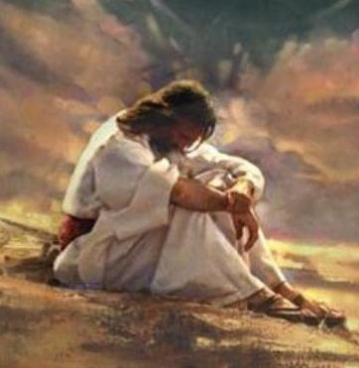
Could Jesus be tempted or tried?
Jesus was tempted in all points as ourselves – Heb.4:15
Jesus was tempted in the wilderness – Matt.4:1; Luke 4:2
Jesus’ life was a daily trial – Luke 22:28; Heb.2:18; Heb.5:7
  Examples: Luke 4:13; John 6:15; Luke 22:44; Matt.26:53; Luke 22:44

Slide 18
Did Jesus have an independent will?
“Not as I will, but as thou wilt”, Matt.26:39, 42; John 5:30; 6:38
“He learned obedience” Heb.5:8
“Became obedient unto death”, Phil.2:8
“Lo, I come…to do thy will, O God”, Heb.10:5-7; Psa.40:8
“Thus it becometh us to fulfill all righteousness” Matt.3:15; Rom.3:26
Obedience is born of an independent will
Jesus, though born God’s son, had to choose to bear that responsibility
Jesus couldn't declare God’s righteousness without an independent will
Jesus’ death necessitated it being voluntary.
To remove Christ’s independent will is to nullify his life’s work recorded in the Gospels

Slide 19
Summary
Sin could only be effectively challenged by someone totally subject to its influence.
Sin could only be effectively challenged by someone with the strength of character to resist it.
Although sin took hold of the nature of Jesus, it did not take hold of his character.
When Jesus died on the cross, a unique situation existed – a man had died that had never sinned.
The result, God raised him from the grave
Through Christ, God’s righteousness was declared and God’s work brought justification for a believer

Slide 20
Summary of the Atonement
God's work of redemption necessitated the upholding of His righteousness, which required the destruction of the flesh. Notwithstanding, for mortal man to experience the mercy of God, He raised up one who never succumbed to its influence. Thus, God was not only just, but the justifier of the unjust (Rom.3:23-26).
God was the prime mover in this work by raising up "a man made strong for (himself)" (Psa.80:17). Such a man would be the seed of the woman, the seed of Abraham, the seed of David, but in addition he would be the Son of God (Gen.3:15; Gen.12:1-7; 2Sam.7:12-16).
Jesus Christ was born of such circumstances (Luke 1:31-33; Luke 1:69; Acts 13:22-23; Gal.4:4). As a member of Adam's race, Jesus came under the constitution of sin, was made in the likeness of sinful flesh (Rom.8:3; Heb.2:14), and subject to the same influences of sin as the rest of mankind, yet without sin (Heb.2:17; 4:14; Phil.2:7).
The redemptive work of God necessitated the condemnation of sin in a representative man, one who was "made sin", or "made of a woman" in the sense that "he also himself likewise partook of the same" sinful nature (2Cor.5:21; Gal.4:4; Heb.2:14). Thus, when Jesus died on the cross the righteousness of God was declared (Rom.3:25-26); sin was destroyed by means of an individual who controlled its influence by the strength and power of God (Heb.9:26; Isa.11:2-3; John 1:14).

