Slide 1
When the Master Returns
Worship in the age to come
Study No.6
Reading: Micah 4
Notes:
The study of Bible prophecy has declined over the past 30 years

Slide 2
Marriage of Lamb
Marriage Supper of the Lamb
Gog invades
The work of Elijah
In the land The dispersed of Israel
Resurrection & Judgment
The Return of Jesus Christ
Judah saved first
Second Exodus for those dispersed
The millennium begins
Armageddon
Nations invited to submission
Building the Temple
Ships of Tarshish bring Israel home
Catholic Rome destroyed
Zechariah 14:16
And it shall come to pass, that every one that is left of all the nations which came against Jerusalem shall even go up from year to year to worship the King, the LORD of hosts, and to keep the feast of tabernacles
Notes:
The subjugation of the nations, we have seen, will not be an overnight event.
That will also be true once Christ begins to rule from Jerusalem
The godly conditions to be developed in the Millennium age will take time
The entire structure of human government and life has to change
Zechariah tells us that eventually all nations will learn God’s ways
Jerusalem will be the focus of God’s education.
NEXT SLIDE

Slide 3
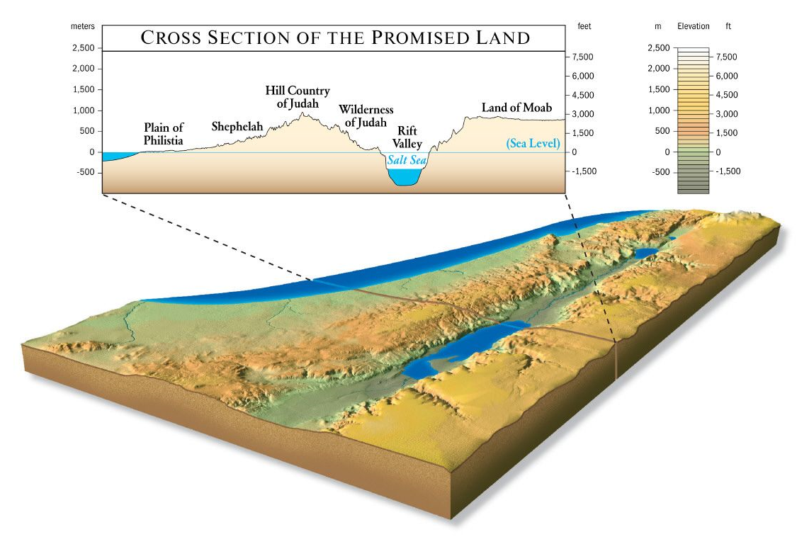
Changes coming to the land
Zechariah 14:8
And it shall be in that day, that living waters shall go out from Jerusalem; half of them toward the former sea, and half of them toward the hinder sea: in summer and in winter shall it be.
The Dead Sea is 1300 feet below sea level; there is no life in it.
The former sea is the eastern or Great Sea (Mediterranean).
The hinder sea is the western or Dead Sea.
Major topographic changes are required.
Notes:
Zech.14:8 describes Jerusalem once the Temple is built
These conditions don’t presently exist
Presently the waters of the Dead Sea cannot be described as living
Chart shows a cross section of that area
Dead Sea about 1300 feet (413 m) below sea level
ENTER
The entire topography must change
NEXT SLIDE

Slide 4
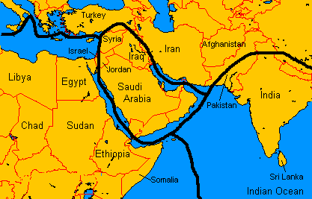
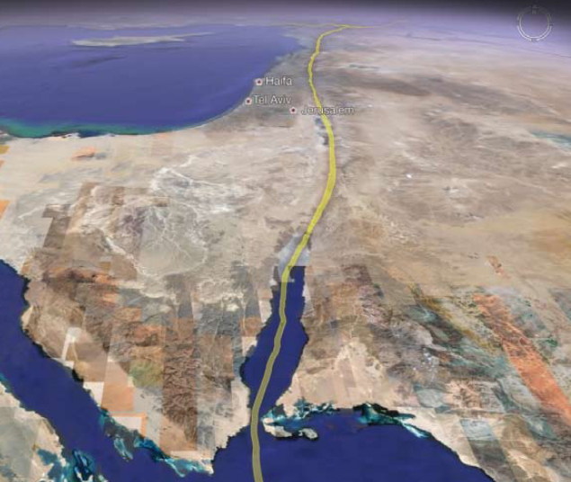
Changes coming to the land
Notes:
14,568 earthquakes, over a magnitude of 4, occurred in 2018
134 earthquakes over 6.0 mag in 2018
Earthquakes are caused when tectonic plates of the Earth's crust move against each other causing a disturbance.
Top left map shows the fault-lines in the Middle East
Satellite image on left shows a fault-line running through Israel into the Red Sea
Close up of Israel identifies numerous fault-lines
NEXT SLIDE

Slide 5
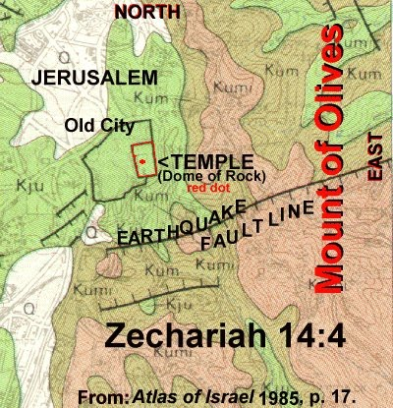

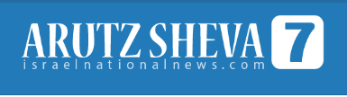
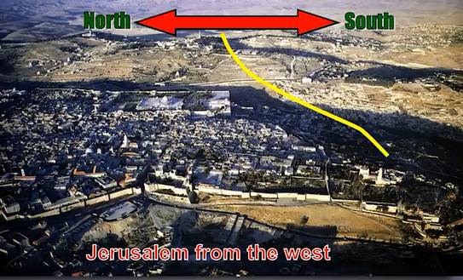
Earthquake fault-line
A fault-line runs from west to east through the Mount of Olives on a line south of the Temple Mount
July, 2018
After tremors, experts warn a huge quake is the greatest threat facing Israel
“The threat of an earthquake, is in my eyes, the greatest threat facing the state of Israel,” geologist Ariel Heimann told Hadashot news on Friday. “It is definitely a greater threat than the Qassam [rockets] fired from Gaza, and it is a far greater danger than the Iranian threat.”
The Fault Line in Jerusalem rivals that of the more well known San Andreas Fault in the West Coast of the United States…As it turns out the worst hit area when an Earthquake occurs will be the Temple Mount. Earthquakes have already occurred in Jerusalem. Zechariah mentions the Earthquake that occurred in the days of King Uzziah of Judah. Scientists estimate that this Earthquake was 7.8 to 8.2 on the Richter Scale. An Earthquake in Jerusalem on January 15th, 1546 was 6.7 on the Richter Scale. The last Earthquake was in 1927 and caused the Allenby Bridge to collapse.
Zechariah 14:4
And his feet shall stand in that day upon the mount of Olives, which is before Jerusalem on the east, and the mount of Olives shall cleave in the midst thereof toward the east and toward the west, and there shall be a very great valley; and half of the mountain shall remove toward the north, and half of it toward the south.
Notes:
The region around Jerusalem is especially vulnerable
Fault-line runs horizontally just south of Jerusalem
ENTER
Zech.14:4 describes the earthquake at Christ’s return
ENTER
Arutz Sheva reported (2014) that the Jerusalem fault-line rivalled the San Andres fault
ENTER
Geologist reported in 2018, an earthquake is Israel’s greatest threat

Slide 6
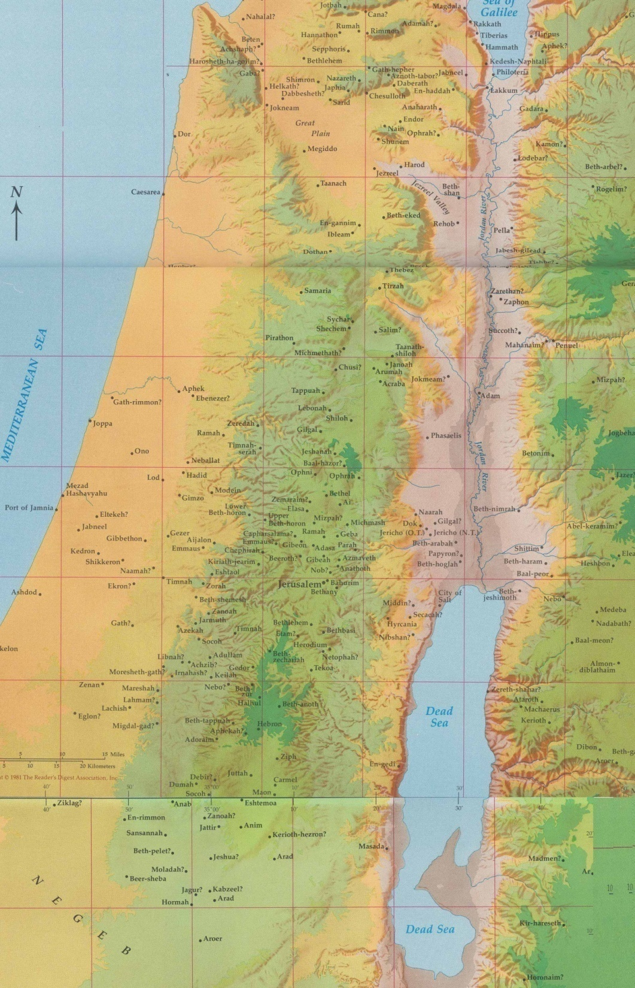
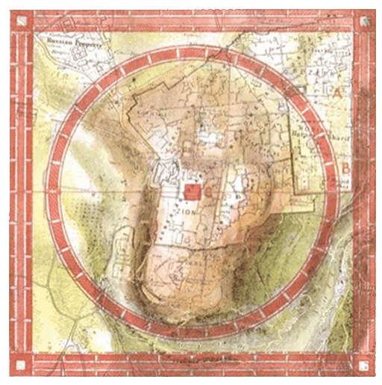
Preparation for the Kingdom
Zechariah 14
A plain will be created from Geba to Rimmon – 40 miles (v.10)
Living waters to proceed from Zion and revitalize the region (v.8)
Jerusalem will be elevated (v.10; Psa.48:2)
“Men shall dwell in it, and there shall be no more utter destruction” (v.11)
Geba
Rimmon
Notes:
Zechariah 14 offers a description of the changes required in preparation for the Kingdom of God. Emphasis upon the land.
The earthquake will divide the mount of Olives (v.4)
Verse 10: Indicates the extent of the changes – from Geba to Rimmon – a distance of approx 40 miles (north to south).
This area is now part of the hills of Judah; in fact is quite mountainous.
Living waters to proceed from Zion and revitalize the region (v.8)
Jerusalem will be elevated (v.10; Psa.48:2)
“Men shall dwell in it, and there shall be no more utter destruction” (v.11)
NEXT SLIDE

Slide 7
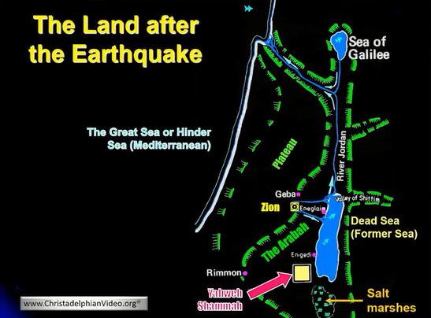
Preparations for the Temple
Ezekiel 47:9
And it shall come to pass, that every thing that liveth, which moveth, whithersoever the rivers shall come, shall live: and there shall be a very great multitude of fish, because these waters shall come thither: for they shall be healed; and every thing shall live whither the river cometh.
Notes:
Here is a view of the mountains of Judea & Samaria
The dead sea is 1,292 ft. below that of the Mediterranean.
This region must change in preparation for the Temple
Ezekiel 47:9 describes the changes
NEXT SLIDE

Slide 8
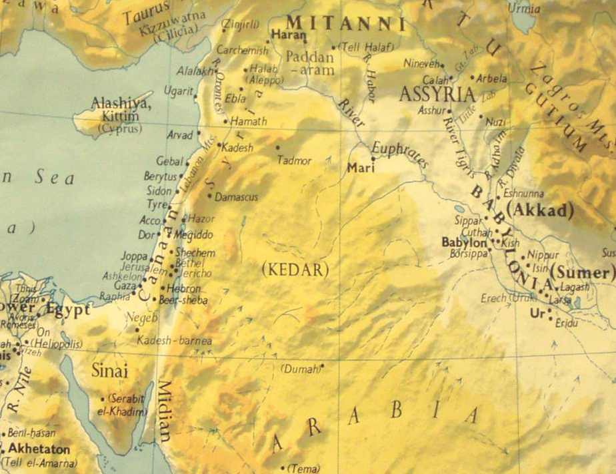
Genesis 15:18
In the same day the LORD made a covenant with Abram, saying, Unto thy seed have I given this land, from the river of Egypt unto the great river, the river Euphrates:
Notes:
Other changes will occur
Israel’s territory will expand, according to God’s covenant
ENTER
Presently Israel occupies a tiny strip of land – 100m x 35m
ENTER
God’s promise to Abraham (Gen.15:8), will extend the land from the Nile to Euphrates
ENTER
NEXT SLIDE

Slide 9
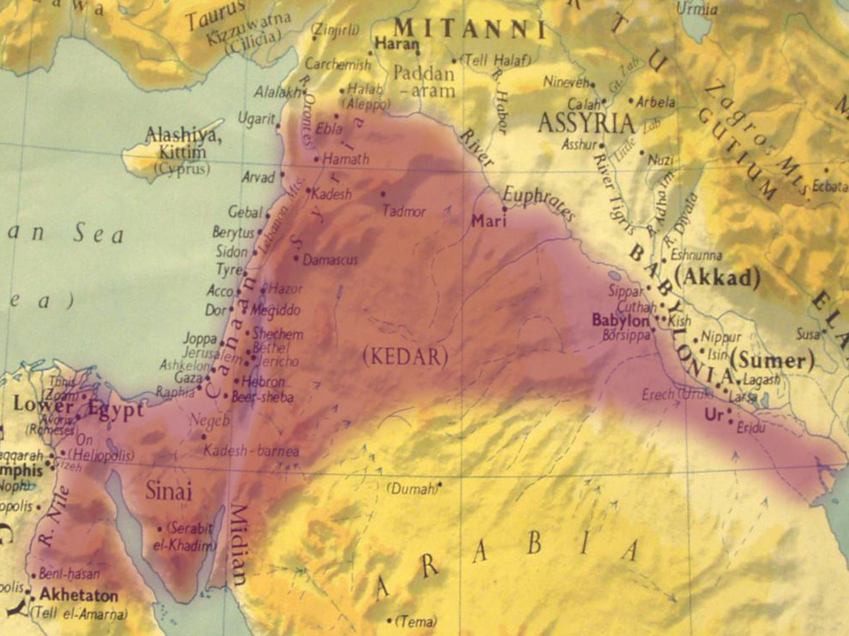
ISRAEL
The boundaries of the promise land
Notes:
This shows the extent of Israel’s territory

Slide 10
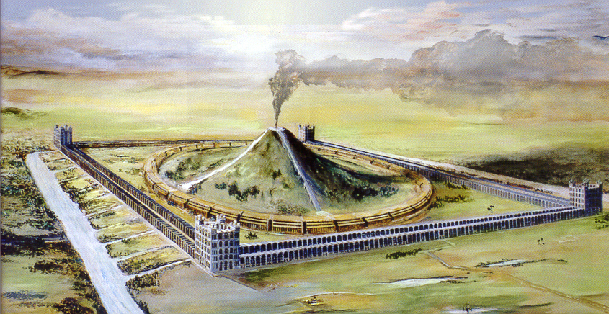
The wealth of the nations
Egyptians spoiled at the Exodus – Exod. 3:22; 12:36
  Used for building the Tabernacle – Exod. 25:1-8
Wealth of nations taken by David – 2Sam. 8:1-10
  Used for building the Temple – 2Sam. 8:11
Israel will spoil Gog’s army – Ezek. 39:10
The nations that submit to Christ offer gifts – Psa.72:10; Isa.60:5-6, 9; Zech.14:14
  Use for building the Temple – Psa. 68:29
Zion, the place of God’s rest – Deut.12:5, 9; Psa.132:13-4
House of prayer for nations – Isa.56:7; Isa.60:13; Ezek.43:7
Notes:
The wealth of the nations will pour into Israel
History repeating itself Exod.12:36; 2Sam.8:1-10
ENTER
Jerusalem to become the focal point in the world (God has set her in the midst of the nations – Ezek.5:5)
NEXT SLIDE

Slide 11
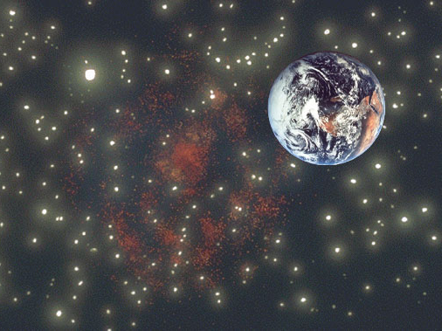
The new heavens and new earth
God promises a new Heaven and new Earth - 2Peter 3:13
This is Biblical language for the New Jerusalem - Isa.65:17,18
The rudiments of the Kingdom
  The heavens (immortal saints) – Ephesian 2:6
  The earth (mortal Israel) – Micah 4:8
Notes:
A new heavens and new earth will be established
A new world order

Slide 12
The Kingdom Pyramid
The government shall be upon his shoulder, Isaiah 9:6
Jesus
Christ
Princes shall rule in judgment, Isaiah 32:1
The Saints
Immortal rulers
Gentiles shall come to thy light, Isaiah 60:3
Mortal Israel
First dominion
Mortal Nations
Being taught the ways of God
To be taught of God and walk in His ways, Micah 4:2
Notes:
The kingdom will be structured upon Divine principles
ENTER

Slide 13
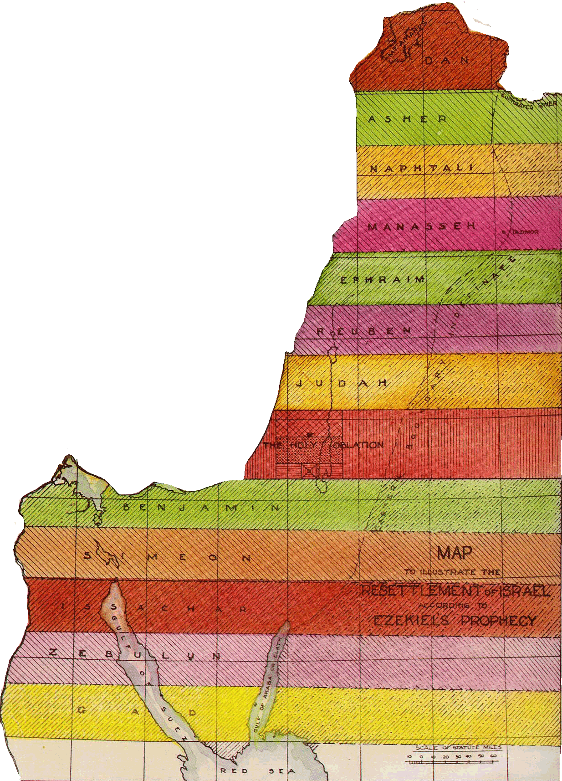
Israel’s role in the kingdom
Israel chosen to be a light to the nations – Deut.4:5-8
A restored role in the kingdom – Isa.60:3; Zech.8:23; Isa.27:6
As part of the new heavens and earth:
Israel will assist in subduing the enemy – Isa. 41:14-16; Jer.51:20; Zech.10:3; Numb.23:24; 24:8-9
Israel’s role will be focused in the land – Ezek.36:24-28, 34-35; Ezek.37:25; Joel 3:18; Amos 9:13-15
Israel will perform a priestly work – Ezek.44:10-11; Isa.61:6; 66:21

Slide 14
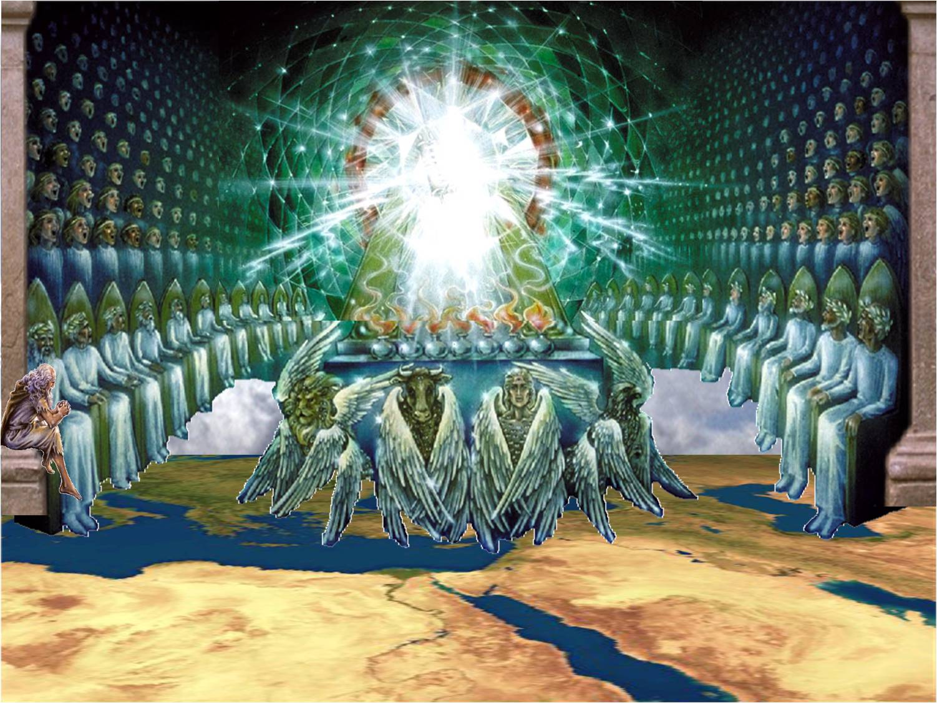
The role of the saints
They are given the kingdom – Luke 12:32
They are made kings and priests – Rev. 1:6; 5:10
Joint-heirs with Christ – Rom.8:17
They sit down on Christ’s throne – Rev.3:21; 2Tim.2:12
They rule over all Christ’s goods – Matt.24:47
The immortal “sons of Zadok” will officiate in the Temple – Ezek.44:15-16
1 Peter 2:9
But ye are a chosen generation, a royal priesthood, an holy nation, a peculiar people; that ye should shew forth the praises of him who hath called you out of darkness into his marvellous light

Slide 15

Life in the Kingdom
CHRIST’S MANIFESTO
Governments replaced
Justice System abolished
True worship reintroduced
Health system scrapped
Education system overhauled
Employment reorganized
Industrial Revolution
Make Jerusalem the Capital
Replace human officials
Make the Saints kings
Enforce Christ’s laws
Eradicate Anti-Semitism
Prevent Oppression
Destroy Monopolies
Notes:
Life in the kingdom of God will change radically
Here is a brief list of some of the key changes
Human nature has to change – it has to submit to God’s way
The saints will play a direct role in these changes
Briefly let’s examine some of the changes
ENTER

Slide 16
Life in the Kingdom
CHRIST’S MANIFESTO
Governments replaced
Justice System abolished
True worship reintroduced
Health system scrapped
Education system overhauled
Employment reorganized
Industrial Revolution
Introduced Perfect Laws
Penetrate Men’s Hearts
Abolish the Police Forces
Judge without Juries
No Partiality
Ensure Crime doesn’t Pay
Make immorality a Crime

Slide 17
Life in the Kingdom
CHRIST’S MANIFESTO
Governments replaced
Justice System abolished
True worship reintroduced
Health system scrapped
Education system overhauled
Employment reorganized
Industrial Revolution
Build the Temple in Jerusalem
Destroy all Churches/Mosques
Abolish the Clergy
Society introduce to Ecclesias
Establish new Priesthood
Reintroduce Sacrifice
Organize travel to Zion
Provide spiritual Education

Slide 18
Life in the Kingdom
CHRIST’S MANIFESTO
Governments replaced
Justice System abolished
True worship reintroduced
Health system scrapped
Education system overhauled
Employment reorganized
Industrial Revolution
Eliminate out dated Health systems
Abolish Ill-Health
Introduce Pure Food and Air
Lengthen Life
Eliminate Anxiety in Life
Ban Drugs

Slide 19
Life in the Kingdom
CHRIST’S MANIFESTO
Governments replaced
Justice System abolished
True worship reintroduced
Health system scrapped
Education system overhauled
Employment reorganized
Industrial Revolution
Place God at the Centre
Restore Parental Influence
Use the Bible as Textbook
Emphasize Behaviour, respect
Give society real Pastors
Teach Meditation
Reverse the chaos of Babel

Slide 20
Life in the Kingdom
CHRIST’S MANIFESTO
Governments replaced
Justice System abolished
True worship reintroduced
Health system scrapped
Education system overhauled
Employment reorganized
Industrial Revolution
Give Land to every Family
Teach Agriculture
Make the Desert Blossom
Grow Corn on Mountain tops
Stress Quality not Quantity
Divinely Ordered Weather

Slide 21
Life in the Kingdom
CHRIST’S MANIFESTO
Governments replaced
Justice System abolished
True worship reintroduced
Health system scrapped
Education system overhauled
Employment reorganized
Industrial Revolution
Abolish Modern Cities
Eliminate Industrial Pollution
Abolish Mass Production
Restore a Common Standard of Living for All
Working Hours centred around Godly Living
Notes:
David sums up our study as we conclude on this note
Psalm 72:17-20 – NEXT SLIDE

Slide 22
Psalm 72:17-20
Fulfilled:
The promises to Abraham – Gen.12:3
The promise revealed in God’s Name – Exod.3:15
The promise declared at the edge of the land – Num. 14:21
God’s promise at the bush, was to reveal Himself in a special generation of mighty ones – “a generation of the race” (Bro. Thomas): “Blessed be He who shall be mighty ones, the mighty ones of Israel” – Exod.3:15 (Psalm 22:30-31)
His name shall endure for ever: his name shall be continued as long as the sun: and men shall be blessed in him: all nations shall call him blessed. Blessed be the LORD God, the God of Israel, who only doeth wondrous things. And blessed be his glorious name for ever: and let the whole earth be filled with his glory; Amen, and Amen. The prayers of David the son of Jesse are ended.
Notes:
Concluding verse – Psa.22:30-31, is speaking about you and I
We are that generation being prepared for the work of the kingdom
Let us, as part of the bride, make ourselves ready.

Slide 23
Psalm 145:1-11
I will extol thee, my God, O king; and I will bless thy name for ever and ever. Every day will I bless thee; and I will praise thy name for ever and ever. Great is the LORD, and greatly to be praised; and his greatness is unsearchable. One generation shall praise thy works to another, and shall declare thy mighty acts. I will speak of the glorious honour of thy majesty, and of thy wondrous works. And men shall speak of the might of thy terrible acts: and I will declare thy greatness. They shall abundantly utter the memory of thy great goodness, and shall sing of thy righteousness. The LORD is gracious, and full of compassion; slow to anger, and of great mercy. The LORD is good to all: and his tender mercies are over all his works. All thy works shall praise thee, O LORD; and thy saints shall bless thee. They shall speak of the glory of thy kingdom, and talk of thy power…

Slide 24
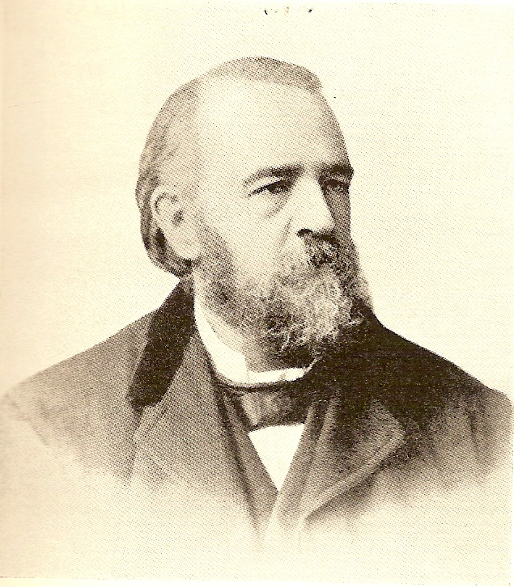
The Temple
The General Truth.—That Christ will build the temple of the future age as a house of prayer for all people.
Uncertain Detail.—What will be the size of it? What will be the shape of it? There are no grounds for absolute certainty. There are strong grounds for the view presented by brother Sulley in his temple book: but we should not be justified in making the reception of this view a condition of fellowship. It is sufficient that the general truth is received. Any view that may be entertained as to details is not inconsistent with the general truth.
True Principles and Uncertain Details, Robert Roberts
Notes:
A great deal of discussion has been generated about whether the temple is large or small. Want to quote from Brother Roberts, who puts the argument into perspective.
What is really important is whether there will be a temple in the kingdom or not! Its size will be revealed at the time of the kingdom.

