Slide 1
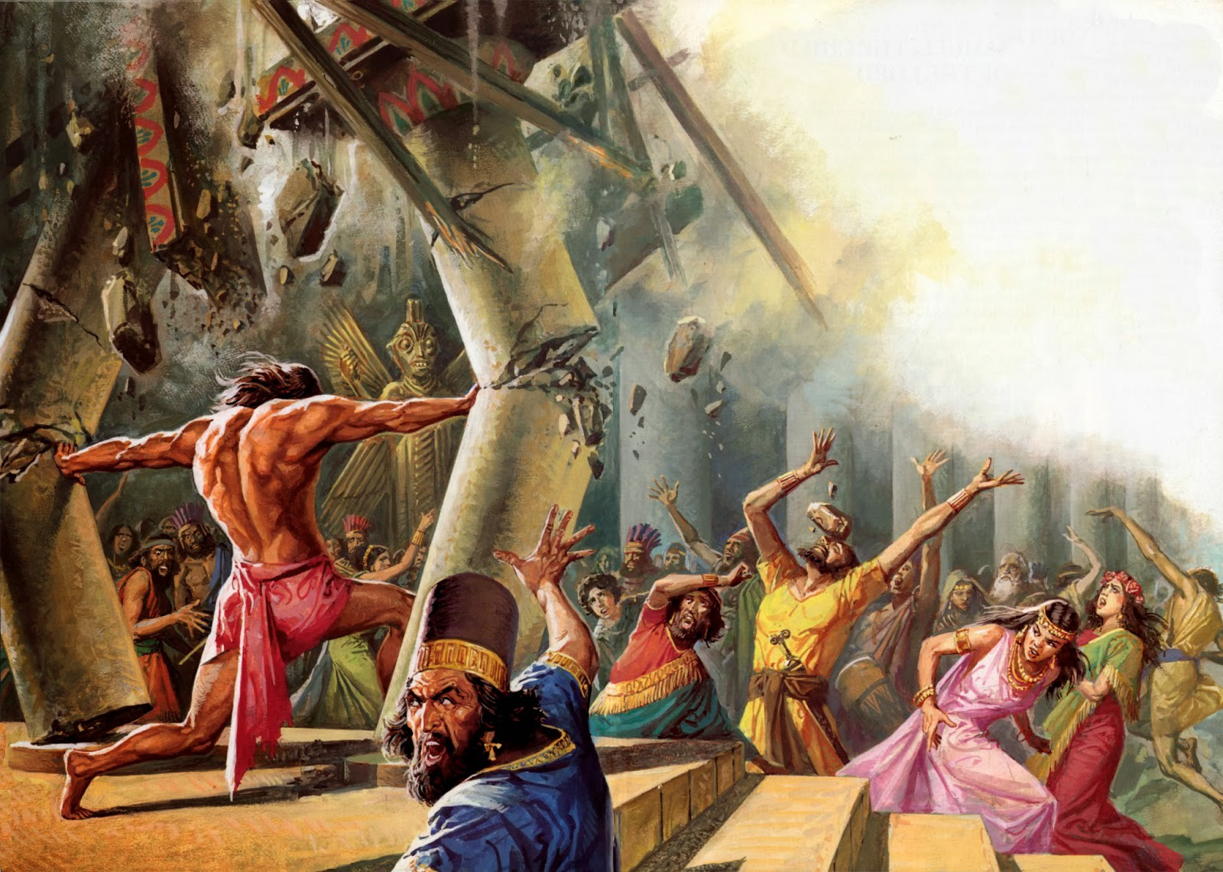
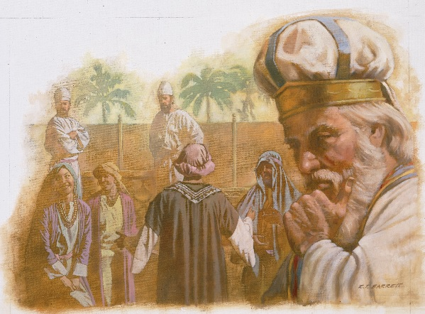
Study 1 – Samuel and Samson
Samuel – Israel’s greatest reformer

Slide 2
Samuel’s Legacies
Psalm 99v6
Jeremiah 15v1
Acts 3v24
Acts 13v20
Hebrews 11v32

Slide 3
Samuel’s Responsibilities
Prophet 1Sam 3v20
Priest 1Sam 9v12-13
Judge 1Sam 7v15
Teacher 1Sam 8v9-11
Scribe - The constitution 1Sam 10v25
- A history of David 1Chron 29v29
Mediator 1Sam7v9
Visionary - School of the prophets 1Sam 19v20
- Organise temple worship 1Chron 9v22
Kingmaker - Saul 1Sam 10v1
- David 1Sam 16v13
Mentor - Saul 1Sam 9v25
- David 1Sam 19v18

Slide 4
Hophni and Phinehas
Hophni = Pugilist
The skill or practice of fighting with fists
i.e. a professional boxer
From the Hebrew word ‘Chophen’ = two fists or two hands

Slide 5
Hophni and Phinehas
Phinehas = from 2 two words
1. ‘peh’ = mouth
2. ‘nachash’ = serpent
hence – mouth of the serpent

Slide 6
Hophni and Phinehas…and Samuel
(v11) Samuel – ministered unto Yahweh
(v18) Samuel – ministered before Yahweh
(v21) Samuel – grew before Yahweh
(v26) Samuel – grew on and in favour with Yahweh

Slide 7
Hophni and Phinehas…and Samuel
(v11) Samuel – ministered unto Yahweh
(v12) Hophni and Phinehas – Sons of Belial
(v17) Hophni and Phinehas – very great sinners
(18) Samuel – ministered before Yahweh
(v21) Samuel – grew before Yahweh
(v22) Hophni and Phinehas – did to ALL Israel
(v25) Hophni and Phinehas – disobedient to parent (Eli)
(v26) Samuel – grew on and in favour with Yahweh

Slide 8
Hophni and Phinehas…and Samuel
(v11) Samuel – ministered unto Yahweh
(v12) Hophni and Phinehas – Sons of Belial
Abusing the sacrifices, abusing the offerers
(v17) Hophni and Phinehas – very great sinners
(18) Samuel – ministered before Yahweh
(v21) Samuel – grew before Yahweh
(v22) Hophni and Phinehas – did to ALL Israel
Abusing the women, abusing their father
(v25) Hophni and Phinehas – disobedient to parent (Eli)
(v26) Samuel – grew on and in favour with Yahweh

Slide 9
The Tabernacle Women
V22 ‘assembled’ - Heb ‘Tsaba’
= to wage war, to serve
Used to describe the service of the Levites in Num 4v3,23,30
Specifically used of the women who served in Exod 38v8

Slide 10
To be a Phinehas?
First Phinehas
(sought to destroy the doctrine of Balaam)
Kept a javelin in his hand – aggressive in fighting for Yahweh
Kills the Midianitish woman
Promised an everlasting priesthood
Second Phinehas
(sought to uphold the doctrine of Balaam)
Kept a flesh hook of 3 teeth in his hand – aggressive in fighting for selfish lusts
Lays with the women
Promised a permantly terminated priesthood

Slide 11
Samson
40 Years of the Philistines
Began in Judges 13
Ended in 1Sam 7

Slide 12
Samson
40 Years of the Philistines
Began in Judges 13
Ended in 1Sam 7
Samsons 20 years as Judge
Samson born
“He will begin to destroy the Philistines”
Samuel begins as Judge. “Philistines came no more”

Slide 13
Three Nazarites From Birth
Samson Lifelong mimic of the High priest
Samuel A Levite who is a lifelong mimic of the High Priest
John the Baptist A Levite and of the priestly line who is a lifelong mimic of the High Priest.

Slide 14
Three Nazarites From Birth
Samson Lifelong mimic of the High priest
Samuel A Levite who is a lifelong mimic of the High Priest
John the Baptist A Levite and of the priestly line who is a lifelong mimic of the High Priest.
Jesus The one who ends up being the ACTUAL High Priest
- Yet not in priestly line
- Not even a Levite
- Not even described as a Nazarite (touches the dead, drinks wine)

Slide 15
Three Nazarites From Birth
Samson
At birth
Manoah’s wife was barren
Manoah became afraid
The child to be a Nazarite
Asked for reassurance
“The child grew and Yahweh blessed him” How? “The Spirit of Yahweh came mightily upon him”
John Baptist
At birth
Elisabeth was barren
Zechariah was afraid
The child to be a Nazarite
Asked for reassurance
“The child grew and waxed strong in spirit”

Slide 16
Three Nazarites From Birth
Samson
At death
Languished in prison
Betrayed by Delilah
Celebrating a banquet – Dagon’s feast
Called for Samson to mock
Died in Dagon’s temple
“Then his brethren and all the house of his father came and took him and buried him”
John Baptist
At death
Languished in prison
Betrayed by Herodias
Celebrating a banquet – Herod’s birthday
Called for John’s head
Died in Herod’s palace
“His disciples came and took up his body and buried it”

Slide 17
Three Nazarites From Birth
Samuel
Hannah was barren
Family went every year to Shiloh
Hannah’s song
Eli blesses Elkanah and Hannah in the Temple
Raised by a ‘father’ not related to him (Eli)
“The child Samuel grew on and was in favour both with Yahweh and also men
Jesus
Mary was a virgin
Family went every year to Jerusalem
Mary’s song
Simeon blesses Joseph and Mary in the Temple
Raised by a ‘father’ not related to him (Joseph)
“Jesus increased in wisdom and stature and in favour with God and man”

Slide 18
Three Nazarites From Birth
Samuel
Aged 12? Yahweh speaks to him in the Temple
“Samuel grew and Yahweh was with him”
God spoke in his ear
A time when the priesthood was corrupt – Hophni and Phinehas
A priest but not of Aaron
Filled role of High Priest after death of Eli
Jesus
Aged 12 says “I must be about my Father’s business”
“The child grew and waxed strong in spirit…and the grace of God was upon him”
God spoke in his ear
A time when priesthood was corrupt – Annas and Caiaphas
A priest but not of Aaron
Filled role of High Priest after his death/resurrection

Slide 19
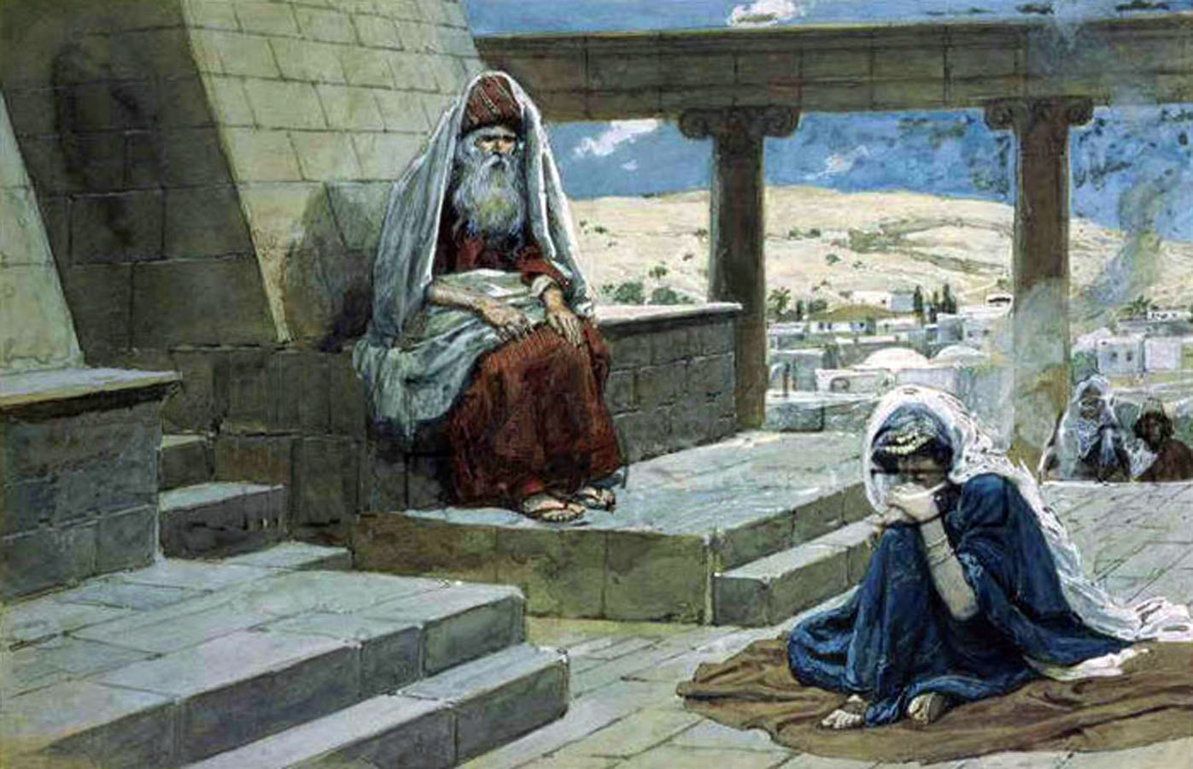
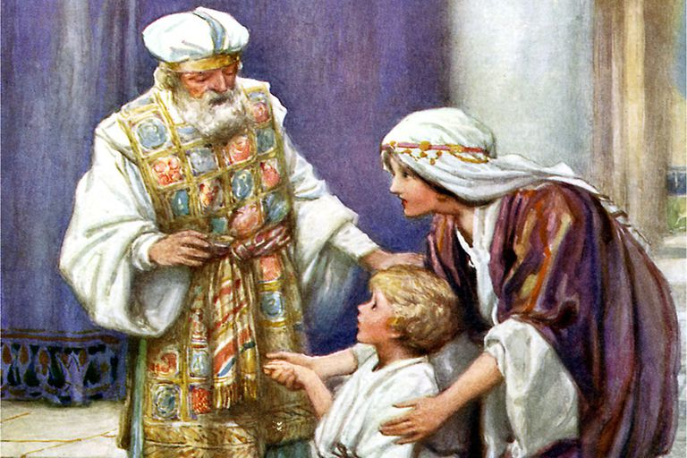
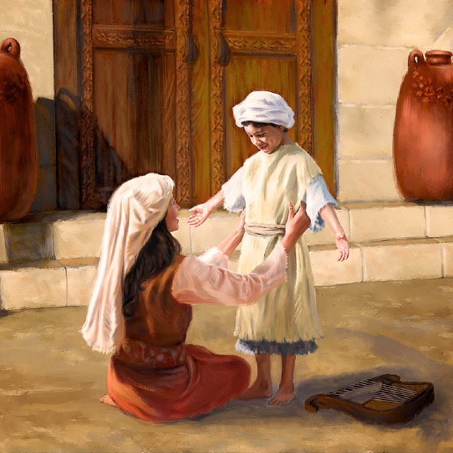
Study 2 – Samuel and Hannah
Samuel – Israel’s greatest reformer

Slide 20
Ramathaim-zophim
1Sam 1v1
Ramathaim – (plural) = the heights
Possibly situated between two hills
Zophim = to watch
Hence to watch from the heights

Slide 21
Ramathaim-zophim
Mostly called just Ramah
Influential in Samuels life
His birthplace – 1v19
His primary residence – 7v17
His burial place – 25v1

Slide 22
Two Wives
Hannah = Grace or favour
Peninnah = Pearl

Slide 23
To Worship in Shiloh
1Sam 1v3
Sacrifice Heb – ‘Zobach’
From ‘zebech’
Used predominantly for those sacrifices that the offerer could partake of
The peace offering
Thanksgiving, vow and voluntary
Lev ch3 and ch7v11-21

Slide 24
Worship in Shiloh
1Sam 1v3
Shiloh From ‘shalah’
= to be tranquil, to be at ease, at rest

Slide 25
Hannah’s Distress
1Sam 1v6
‘Adversary’ Heb – ‘Tsarah’
= distress or straits
Translated elsewhere
trouble, anguish, tribulation

Slide 26
Hannah’s Distress
1Sam 1v6
‘Provoked’ Heb – ‘Kaas’
= to be angry
‘Sore’ Of the same root word
‘Kaac’ = hence to be angry

Slide 27
Hannah’s Distress
1Sam 1v6
‘fret’ Heb – ‘Raan’
= to thunder or roar
from a root word which means to tumble (i.e. be agitated)

Slide 28
Two Parents
Hannah
(The devoted mother)
Because she was distressed…
She stood
Did not eat
Gave up her son to Yahweh
Sacrificed herself for the benefit of her son
Eli
(The defective father)
Although he was distressed…
He continued to sit
He continued to eat
Gave up on his sons regarding Yahweh
Sacrificed his sons for the benefit of himself

Slide 29
Theme of Reversal
1 Samuel Ch1v1-20 – Hannah’s distress at the current corrupt priesthood
A (v1-3) Elkanah goes to Shiloh yearly to worship
B (v4-8) Hannah comes but is distressed – Elkanah says something unhelpful
C (v9-18) Hannah stands near Eli to silently pray for a child to give to Yahweh
D (v19-20) They worship Yahweh – Hannah conceives and bears a son

Slide 30
Theme of Reversal
1 Samuel Ch1v21-28 – Hannah’s joy at the prospect of a ‘new priesthood’
A (v21) Elkanah goes to Shiloh yearly to worship and pay his vow
B (v22-23) Hannah doesn’t come at first, to look after Samuel – Elkanah says something helpful
C (v24-28) Hannah finally comes and stands before Eli to give her child to Yahweh
D (v28-2v1) They worship Yahweh – Hannah prays in thankfulness for her son

Slide 31
Two Vows
Jepthah’s vow
Rash and unthoughtful
But his daughter had considered it
Involved dedicating his daughter
His daughter would never have children
Hannah’s vow
Seemed rash and unthoughtful to everyone else
But she had diligently considered it
Involved dedicating her son
She would never have children again if necessary

Slide 32
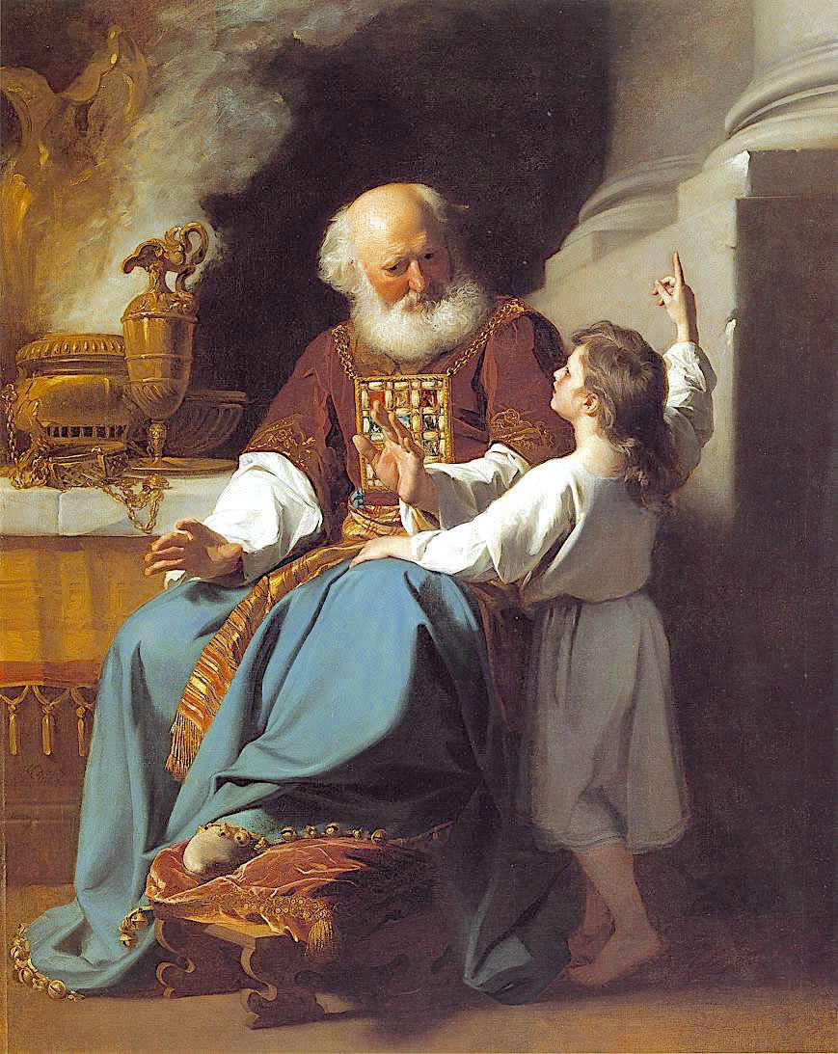

Study 3 – Samuel and Eli
Samuel – Israel’s greatest reformer

Slide 33
Hannah’s Song
Quoted from in large parts in
Psalm 75
Psalm 113
Luke 1v46-55
(Mary’s song)

Slide 34
Hannah’s Song
Her understanding of her God
He’s a God that can save “I rejoice in thy salvation” (v1)
He’s an holy God (v2)
He’s the only one “none beside thee” (v2)
He’s a Rock (v2)
He’s a God of Knowledge (v3)
He’s a just God “by him actions are weighed” (v3)

Slide 35
Two Songs
Song of Hannah (1Sam2)
Rejoice in thy salvation (v1) …neither any rock like our rock (v2)
A God of knowledge (v3)
By Him actions…weighed(v3)
Yahweh killeth and maketh alive (v6)
Keep…feet of His saints (v9)
Provoked her sore (to anger) (1v6)
Song of Moses (Deut 32)
Lightly esteemed the rock of our salvation (v15)
A God of truth (v4)
Just and right is He (v4)
I kill, & I make alive (v39)
Merciful to His land & to his people (v43)
Provoke Him to anger (v16, 21)

Slide 36
Provoked to Anger
Deut 32
V16 – “They provoked Him to anger”
No occurrence of this phrase until the book of Deuteronomy.
Three times elsewhere in the book 4v25, 9v18, 31v29
Three times in ch32, once in v16 and twice in v22
Then once in Judges 2v12
Then used by Hannah in 1Sam 1v6,7

Slide 37
Hearer But Not A Doer
1Sam 2v22-24
Eli - “heard all that all that his sons did” (v22)
“I hear of your evil doings”(v23)
“It is no good report that I hear” (v24)
Eli was a hearer only and not a doer of the word
James 1v22

Slide 38
Theme of Reversal
Bows of mighty are broken
Full have hired out for bread
She with many waxed feeble
Yahweh killeth
He bringeth down to the grave
Yahweh maketh poor
He lifteth up
Stumbled girded with strength
Hungry ceased
Barren born seven
Maketh alive
Bringeth up
Maketh rich
Lifteth up

Slide 39
Theme of Reversal
Bows of mighty are broken
Full have hired out for bread
She with many waxed feeble
Yahweh killeth
He bringeth down to the grave
Yahweh maketh poor
He lifteth up
Stumbled girded with strength
Hungry ceased
Barren born seven
Maketh alive (Deut 32v39)
Bringeth up
Maketh rich
Lifteth up

Slide 40
The Messiah
1Sam2v10
“And he shall give strength unto his king and exalt the horn of his anointed”
First mention in the Bible of the Yahweh’s ANOINTED
Hannah pulls together
Genesis 14 – Melchizedek, faithful king/priest
Genesis 49v10 – “sceptre shall not depart from Judah”
Num 24v17-19 – “sceptre out of Israel”
Deut 17v14-20 – “When thou shalt say I will set a king over me”

Slide 41
Two Prophetical Messages
Steeped in Deut 32
Yahweh CAN reverse situations, local or global
Yahweh kills and makes alive, he brings down and brings up
The full would need to go begging for bread
1st mention of ‘Anointed’ ever in scripture
Steeped in Deut 32
Yahweh WILL reverse the situation with his priesthood
Yahweh kills Hophni and Phinehas, raises up a faithful priest
Eli’s house would come to Samuel to ask for bread
2nd mention of ‘Anointed’ ever in scripture

Slide 42
The Word of God was Rare
1Sam 3v1
Precious Heb – yaqar = rare
hence valuable or priceless
Open Heb – parats = to break through
or spread abroad

Slide 43
Accursed
1Sam 3v14
Vile Heb – qalal = to bring a curse on oneself
“to be light” i.e. to count something as trifle or contemptible
Same as “lightly esteemed” in 2v30
i.e. to treat with contempt

Slide 44
Unrestrained
1Sam 3v14
Restrained not Heb – kahah
= to be dim, feeble, faint, darkened
same word as Eli’s eyes waxing “dim”
i.e. He failed to dim his sons but let their light continue to shine

Slide 45
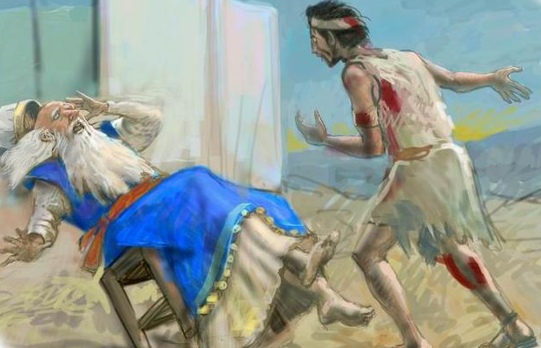
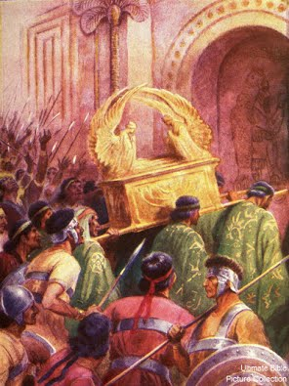
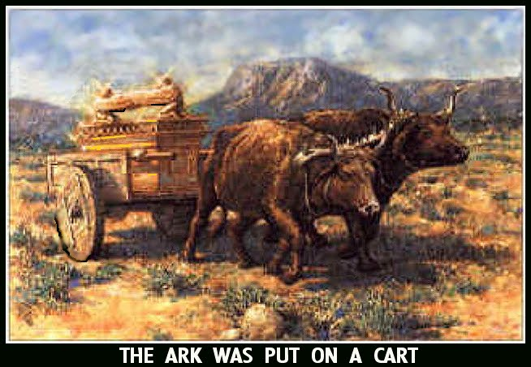
Study 4 – Samuel and the Philistines
Samuel – Israel’s greatest reformer

Slide 46
Theme of Reversal
1 Samuel Ch1v1-20 – Hannah’s distress at the current corrupt priesthood
A (v1-3) Elkanah goes to Shiloh yearly to worship
B (v4-8) Hannah comes but is distressed – Elkanah says something unhelpful
C (v9-18) Hannah stands near Eli to silently pray for a child to give to Yahweh
D (v19-20) They worship Yahweh – Hannah conceives and bears a son

Slide 47
Theme of Reversal
1 Samuel Ch1v21-28 – Hannah’s joy at the prospect of a ‘new priesthood’
A (v21) Elkanah goes to Shiloh yearly to worship and pay his vow
B (v22-23) Hannah doesn’t come at first, to look after Samuel – Elkanah says something helpful
C (v24-28) Hannah finally comes and stands before Eli to give her child to Yahweh
D (v28-2v1) They worship Yahweh – Hannah prays in thankfulness for her son

Slide 48
Theme of Reversal
1Samuel ch2 – Samuel to replace Hophni and Phinehas
A (v1-11) Hannah’s prophetical song
B (v11) Samuel
C (v12-17) Sin of Hophni and Phinehas – Disregard for God’s sacrifices and people
D (18) Samuel
E (v19-21) Hannah
D (21) Samuel
C (v22-25) Sin of Hophni and Phinehas – Disregard for Eli their father and High Priest
B (v26) Samuel
A (v27-36) The man of God’s prophetical message

Slide 49
Theme of Reversal
1Samuel ch2 – Samuel to replace Hophni and Phinehas
A (v1-11) Hannah’s prophetical song
B (v11) Samuel
C (v12-17) Sin of Hophni and Phinehas – Disregard for God’s sacrifices and people
D (18) Samuel
E (v19-21) Hannah
D (21) Samuel
C (v22-25) Sin of Hophni and Phinehas – Disregard for Eli their father and High Priest
B (v26) Samuel
A (v27-36) The man of God’s prophetical message

Slide 50
Theme of Reversal
1Samuel ch2 – Samuel to replace Hophni and Phinehas
A (v1-11) Hannah’s prophetical song
B (v11) Samuel
C (v12-17) Sin of Hophni and Phinehas – Disregard for God’s sacrifices and people
D (18) Samuel
E (v19-21) Hannah
D (21) Samuel
C (v22-25) Sin of Hophni and Phinehas – Disregard for Eli their father and High Priest
B (v26) Samuel
A (v27-36) The man of God’s prophetical message

Slide 51
Theme of Reversal
1Samuel ch2 – Samuel to replace Hophni and Phinehas
A (v1-11) Hannah’s prophetical song
B (v11) Samuel
C (v12-17) Sin of Hophni and Phinehas – Disregard for God’s sacrifices and people
D (18) Samuel
E (v19-21) Hannah
D (21) Samuel
C (v22-25) Sin of Hophni and Phinehas – Disregard for Eli their father and High Priest
B (v26) Samuel
A (v27-36) The man of God’s prophetical message

Slide 52
Theme of Reversal
1Samuel ch2 – Samuel to replace Hophni and Phinehas
A (v1-11) Hannah’s prophetical song
B (v11) Samuel
C (v12-17) Sin of Hophni and Phinehas – Disregard for God’s sacrifices and people
D (18) Samuel
E (v19-21) Hannah
D (21) Samuel
C (v22-25) Sin of Hophni and Phinehas – Disregard for Eli their father and High Priest
B (v26) Samuel
A (v27-36) The man of God’s prophetical message

Slide 53
Theme of Reversal
1Samuel ch3 – Samuel to replace Eli
A (v1) The word of God was precious (rare)
B (v2) Eli’s decline – physical but also spiritual
C (v3-10) Samuel lays down to sleep – Yahweh calls Samuel who answers ‘Here am I’
D (v11-14) Yahweh reveals his judgements on Eli’s house
C (v15-18) Samuel lays till morning – Eli calls Samuel who answers ‘Here am I’
B (v19-20) Samuel’s growth – physical but also spiritual
A (v21-4v1) The word of God comes to all Israel through Samuel

Slide 54
Theme of Reversal
1Samuel ch2 – Samuel to replace Hophni and Phinehas
A (v1-11) Hannah’s prophetical song
B (v11) Samuel
C (v12-17) Sin of Hophni and Phinehas – Disregard for God’s sacrifices and people
D (18) Samuel
E (v19-21) Hannah “SEED OF THE WOMAN”
D (21) Samuel
C (v22-25) Sin of Hophni and Phinehas – Disregard for Eli their father and High Priest
B (v26) Samuel
A (v27-36) The man of God’s prophetical message

Slide 55
Theme of Reversal
1Samuel ch3 – Samuel to replace Eli
A (v1) The word of God was precious (rare)
B (v2) Eli’s decline – physical but also spiritual
C (v3-10) Samuel lays down to sleep – Yahweh calls Samuel who answers ‘Here am I’
D (v11-14) Yahweh reveals his judgements on Eli’s house “REMOVE THE CURSE”
C (v15-18) Samuel lays till morning – Eli calls Samuel who answers ‘Here am I’
B (v19-20) Samuel’s growth – physical but also spiritual
A (v21-4v1) The word of God comes to all Israel through Samuel

Slide 56
Theme of Reversal
1 Samuel Ch4v1-11 – Hopni and Phinehas die
A (v1-5) Word is sent from the army to Shiloh to bring the ark.
B (v6-9) News of the ark causes the Philistines to ‘Be strong’.
C (v10-11) The ark is captured and Hophni and Phinehas are slain.

Slide 57
Theme of Reversal
1 Samuel Ch4v12-22 – Eli and Phinehas’ wife die
A (v12) A man runs from the army to Shiloh to bring news of the ark.
B (v13-18) News of the ark causes Eli to fall back and break his neck.
C (v19-22) ‘The glory is departed’ says Phinehas’ wife about the ark’s capture as she dies in childbirth.

Slide 58
The Uncircumcised
Judges 14v3 Manoah calls them this
Judges 15v18 Even Samson calls them this
1Sam 14v6 Jonathan calls them this too
1Sam 17v26,36 As does David
1Sam 31v4 Finally even Saul does too

Slide 59
Battle of Aphek
Ebenezer = stone of help

Slide 60
Battle of Aphek
Ebenezer = stone of help
Aphek = fortress
from a root = be strong

Slide 61
Israel’s Religion
Completely surprised at the defeat
Their relationship with God was self centred…”us, us, us”
Revered the symbol more than what the symbol represented
Brought God to them
This form of religion was apostate
Focus is on rituals, legalism and self centredness

Slide 62
Corinthians Religion
1Cor 14v20
“Be not children in understanding, howbeit in malice be ye children”
Malice – Gk kakos = things that are worthless
“but in understanding be men”
Men – Gk telious = to be mature or grown up

Slide 63
Unredeemable Donkey
Exod 13v13, 34v20
An unclean ass could be redeemed by a blood sacrifice
OR
Killed by a bloodless death (breaking the neck)

Slide 64
Weight Of Glory
1Sam 4v18
“Very heavy” Heb – kabod
= to have weight
related to kabed = glory
Compare 2Cor 4v15-18
“Exceeding eternal weight of glory”
Eli had a temporary weight of ‘flesh’

Slide 65
Exhort – Samuel and all Israel
Samuel – Israel’s greatest reformer

Slide 66
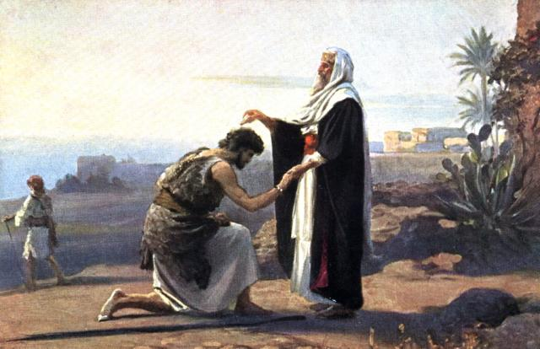
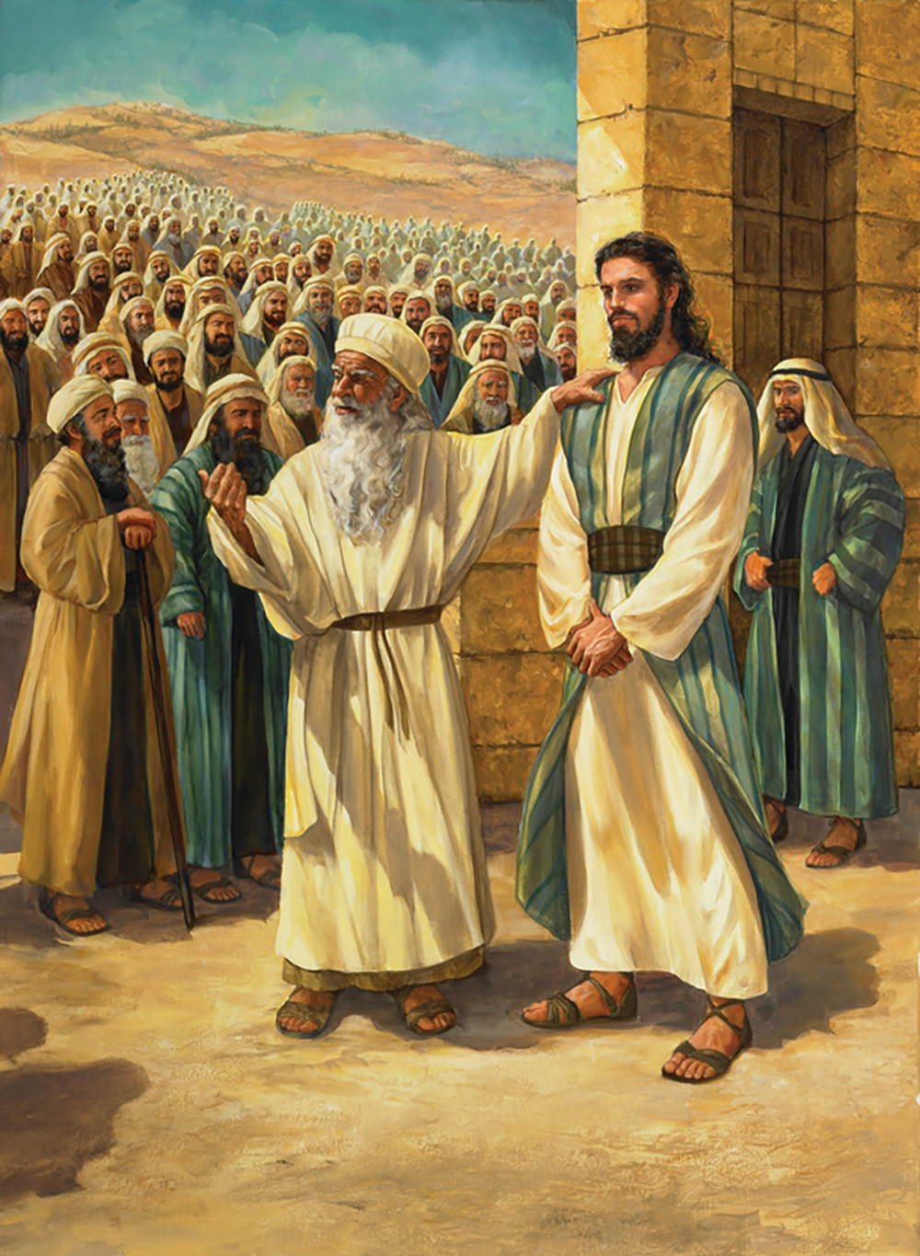
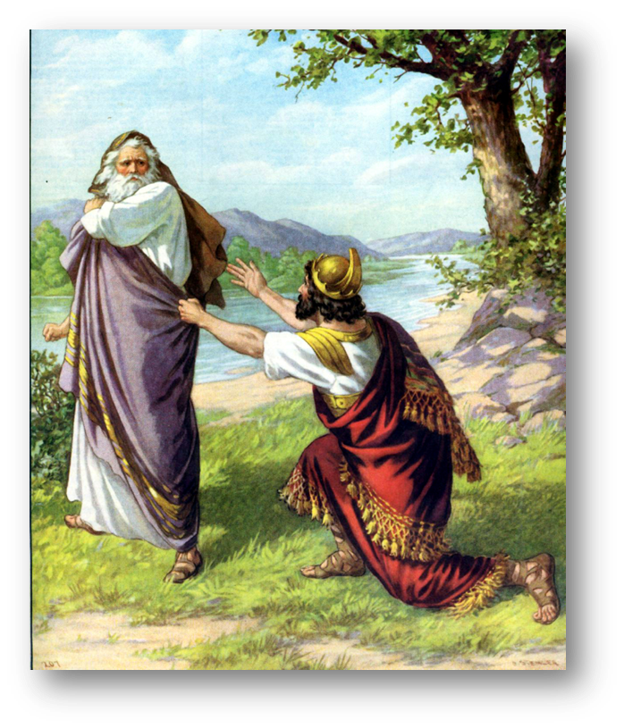
Study 5 – Samuel and Saul
Samuel – Israel’s greatest reformer

Slide 67
Circuit Judge
1Sam 7v15-17
1. Judging was a lifetime work
“Judged Israel all his life”
2. Judging was associated with worship
“He built an altar unto Yahweh”
3. Judging was not separated from his home life
“Where his house was”

Slide 68
The Warning of a King
1Sam 8v10-18
Military conscription plus court servants v11
Forced labour on the royal estates v12a
Labour for the manufacture of munitions v12b
Conscription of girls as perfume makers or cooks and bakers in the royal kitchens v13
Requisitioning of land for personal royal use v14
Taxation on all produce v15-17

Slide 69
Samuel and Saul
1Sam 9v1-2
A Benjamite, a mighty man of power
A choice young man, and a goodly
Not among the children of Israel a goodlier person
From his shoulders and upwards he was higher than any

Slide 70
Saul’s Qualities
Cares for his father – 9v5
Listens to his servant – 9v10
Feels insignificant – 9v21
Enjoys being among the prophets – 10v9-10
Listens to Samuel – 10v16
Still feels insignificant – 10v22-23
Patient and gentle – 10v27
Reticence to grab power – 11v5
Displays righteous anger – 11v6
Looked to Samuel for guidance – 11v7
Merciful – 11v12-13

Slide 71
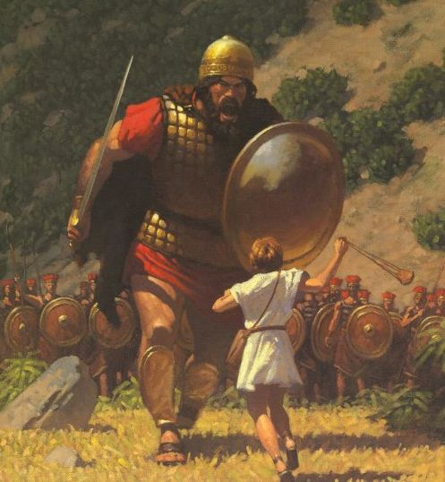
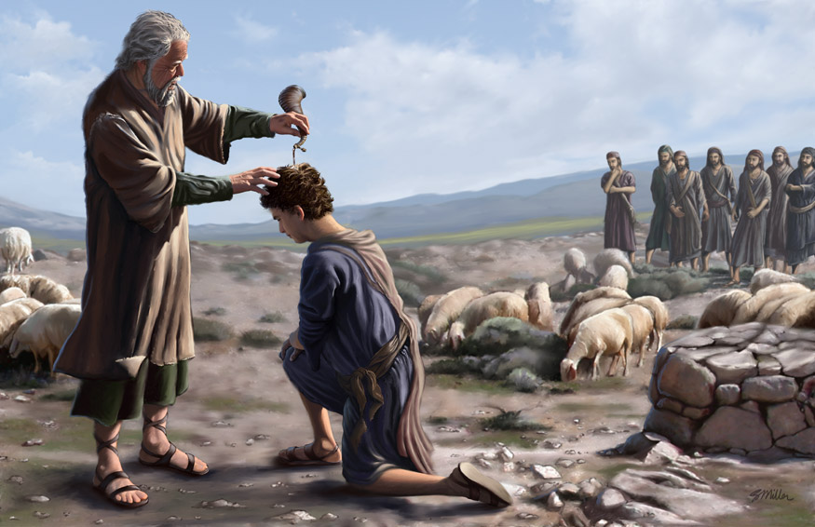
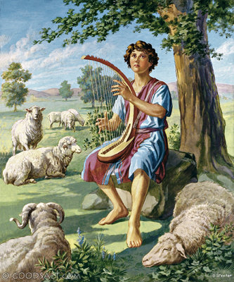
Study 6 – Samuel and David
Samuel – Israel’s greatest reformer

Slide 72
Saul’s Spiritual State
Doesn’t know where the prophet lives but knows he should bring a gift – 9v6
Doesn’t know who Samuel is – the most recognisable man in all Israel with mantle and long hair – 9v18-19
Never been to a school of the prophets – 10v11
Doesn’t read the constitution – 10v25, or write out a copy of the law – Deut 17v18

Slide 73
Saul - A Potential Type of Christ
1Sam 10v11
Is Saul among the prophets Matt 13v54-55
1Sam 10v27
He held his peace Matt 26v63, 27v12,14
1Sam 11v12
Bring the men hither that we may put them to death
Luke 19v27

Slide 74
Samuel Mentoring Saul
Reassured him about the assess
Gave him the chiefest place at the meal
Stayed to talk to him all night
Kissed him
Reassured him with 3 signs
Renewed the kingdom with him in Gilgal

Slide 75
Saul – the Man with Potential
1Samuel ch8-12 – Saul elected as king
A (ch8) The people ask for a king and Samuel is displeased. Samuel’s first speech – describes what a king would do. He then prays to Yahweh
B (ch9) Saul is looking for asses. Given a message from Samuel that he will be the new king
C (ch10) Spirit of God comes on Saul, he’s turned into another man. Then presented as the new king
B (ch11) Saul is in the fields. Responds to the message of Jabesh Gilead by stepping up as the new king
A (ch12) Samuel’s second speech – you have sinned in asking for a king. Describes what God has done but what He would now do. He would not cease to pray to God

Slide 76
Saul – the Man with Potential
1Samuel ch8-12 – Saul elected as king
A (ch8) The people ask for a king and Samuel is displeased. Samuel’s first speech – describes what a king would do. He then prays to Yahweh
B (ch9) Saul is looking for asses. Given a message from Samuel that he will be the new king
C (ch10) Spirit of God comes on Saul, he’s turned into another man. Then presented as the new king
B (ch11) Saul is in the fields. Responds to the message of Jabesh Gilead by stepping up as the new king
A (ch12) Samuel’s second speech – you have sinned in asking for a king. Describes what God has done but what He would now do. He would not cease to pray to God

Slide 77
Saul – the Man with Ambition
1Samuel ch13-15 – Saul rejected as king
A (ch13) Saul commanded to wait in Gilgal for 7 days. He disobeys and sacrifices before Samuel arrives – Samuel gives him his first rejection
B (ch14) Jonathan excels above Saul. Saul is jealous and seeks to have Jonathan killed. The people save Jonathan
A (ch15) Saul commanded to slay all the Amalekites. He disobeys and saves the animals for sacrifices and Agag alive– Samuel gives him his second rejection

Slide 78
Saul – the Man with Ambition
1Samuel ch13-15 – Saul rejected as king
A (ch13) Saul commanded to wait in Gilgal for 7 days. He disobeys and sacrifices before Samuel arrives – Samuel gives him his first rejection
B (ch14) Jonathan excels above Saul. Saul is jealous and seeks to have Jonathan killed (kill his own son????). The people save Jonathan
A (ch15) Saul commanded to slay all the Amalekites. He disobeys and saves the animals for sacrifices and Agag alive– Samuel gives him his second rejection

Slide 79
Saul and Christ
Saul the rebellious son
1Sam 15v22-23
“To obey is better than sacrifice and to hearken than the fat of rams. For rebellion is as witchcraft and stubbornness as idolatry”.
Deut 21v18-21
“If any man hath a stubborn and rebellious son…that will not obey…neither hearken…he shall be stoned”.

Slide 80
Saul and Christ
Christ the obedient son
Isa 50v5
“The lord Yahweh hath opened mine ear and I was not rebellious”.
Heb 5v8
“Though he were a Son, yet learned he obedience”.
Phil 2v8
“He became obedient unto death, even the death of the cross”

Slide 81
Samuel, Saul and David
SAUL
Reassured him about the assess
Gave him the chiefest place at the meal
Stayed to talk to him all night
Kissed him
Reassured him with 3 signs
Renewed the kingdom with him in Gilgal
DAVID
Doesn’t want to go to Bethlehem – gives excuse
Thinks it’s Eliab-tall, handsome
Doesn’t know anything about David – “any more sons?”
Doesn’t want to stay
Leaves immediately after
For Samuel it feels like de-ja-vue and he’d rather not be involved. He feels despondent

Slide 82
Samuel and the Schools
1 Samuel 10v 25
First known school (or band) is mention here. Samuel directs Saul to meet these prophets. Samuel knows an awful lot about them too – where they are, the times they’ll come and go etc.
1 Samuel 19 v20
Samuel was standing as appointed over the prophets as they prophesied
Appointed = a president or headmaster

Slide 83
Samuel and the Schools
The work of Samuel was the starting point of a better time (for the Levites). Himself a Levite, and though not a priest, belonging to that section of the Levites which was nearest the priesthood (1 Chron 6v28), adopted as it were, by a special dedication into the priestly line and trained for its offices (1 Sam 2v 18), he appears as infusing fresh life, the author of a new organisation
Smith’s Bible Dictionary

Slide 84
Samuel the Reformer
There is no reason to think, indeed, that the company or schools of the sons of the prophets, which appear in his time (1 Sam 10 v5) and are traditionally said to be founded by him, consisted exclusively of Levites; but there are many signs that the members of that tribe formed a large element in the new order and received new strength from it. It exhibited indeed the ideal of the Levite life as one of praise devotion and teaching.
Smith’s Bible Dictionary

Slide 85
A Psalm of Asaph
1 Samuel 9v 9
Samuel is called a Seer (He could see clearly)
So also were
Asaph Heman Ethan
2 Chr 29v 30 1 Chr 25v 5 also called Jeduthun
2 Chr 35v 15
(Samuel’s grandson)
Of Gershon Of Kohath Of Merari
Psa 50, 73-83 Psa 88 Psa 89
(cp 1 Kg 4v 31)

Slide 86
A Psalm of Asaph
Psalm 50
V7- 13 Yahweh doesn’t need animal sacrifices. It was never about the animal, sacrifices are about the offerer.

Slide 87
A Psalm of Asaph
Psalm 50
V14-15 Yahweh would rather:
1. Thanksgiving – i.e. a recognition He provides everything
2. Pay your vow – i.e. Keep your promises to Him
3. Call upon me in the day of trouble – i.e. accept Him as your Saviour
V16 The wicked hate instruction – therefore they have no right to comment on my laws

Slide 88
Legacy of Samuel
1 Chronicles 23v 1-6
The number of Levites was 38,000
24,000 – to do the servile work
6,000 – to be officers and judges, sent throughout the land
4,000 – to be porters (= a gatekeeper), 1000 per gate
4,000 – to be singers and musicians

Slide 89
Legacy of Samuel
1 Chronicles 9
The Return
V3-9 Children of Israel
V10-13 Priests
V14-34 Levites
V17-30 The Porters
V31-32 Other work
V33 The Singers

Slide 90
Legacy of Samuel
1 Chronicles 9
V22 ‘did ordain in their set office’
“Ordain” = to appoint
“Set office” = to be trustworthy, dependable, faithful
Hence – appointed because they could be trusted
Samuel found them and then passed them on to David

Slide 91
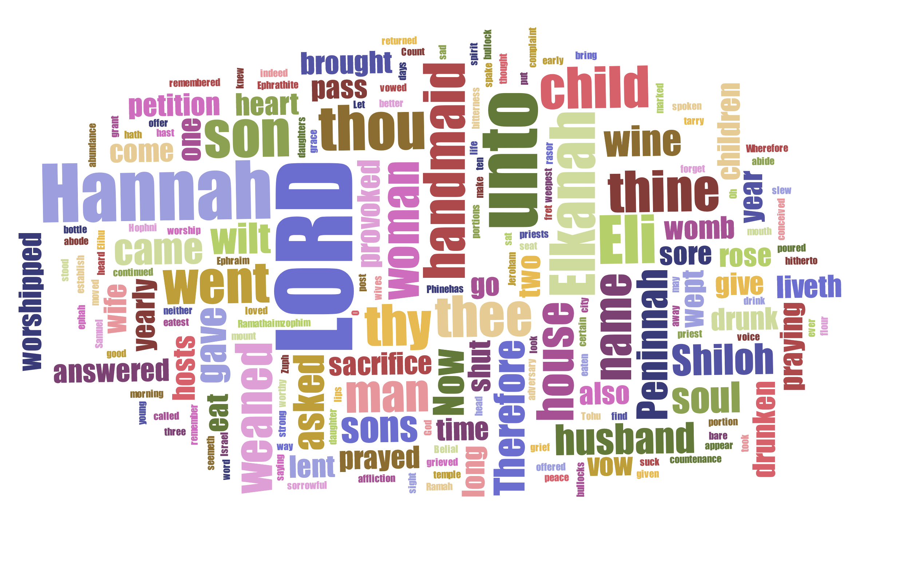
Samuel and Hannah

