Slide 1
“Risen with him – From our baptism to the Resurrection”
Study 4 – “How are the dead raised up?”

Slide 2
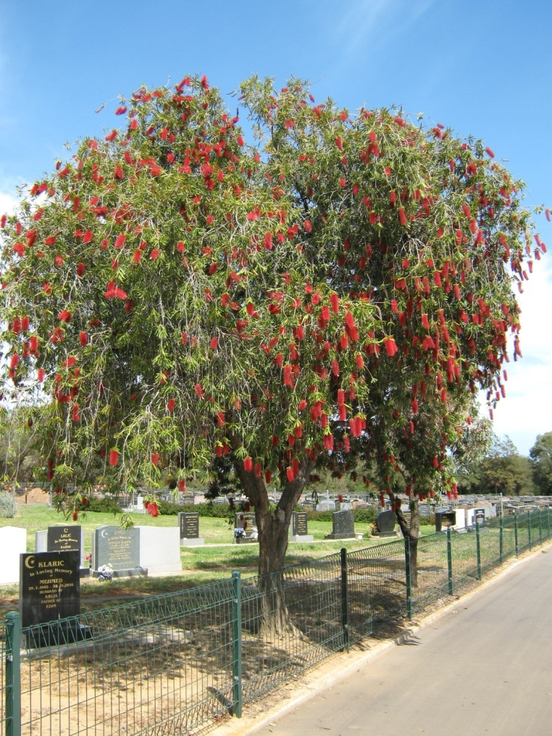
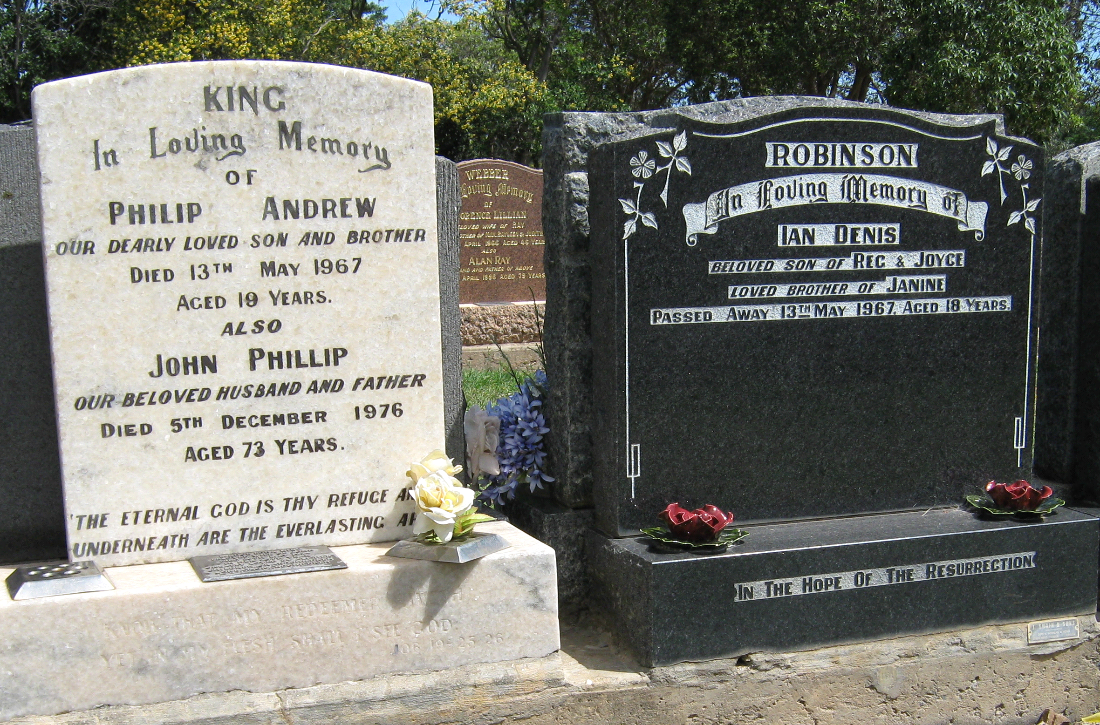
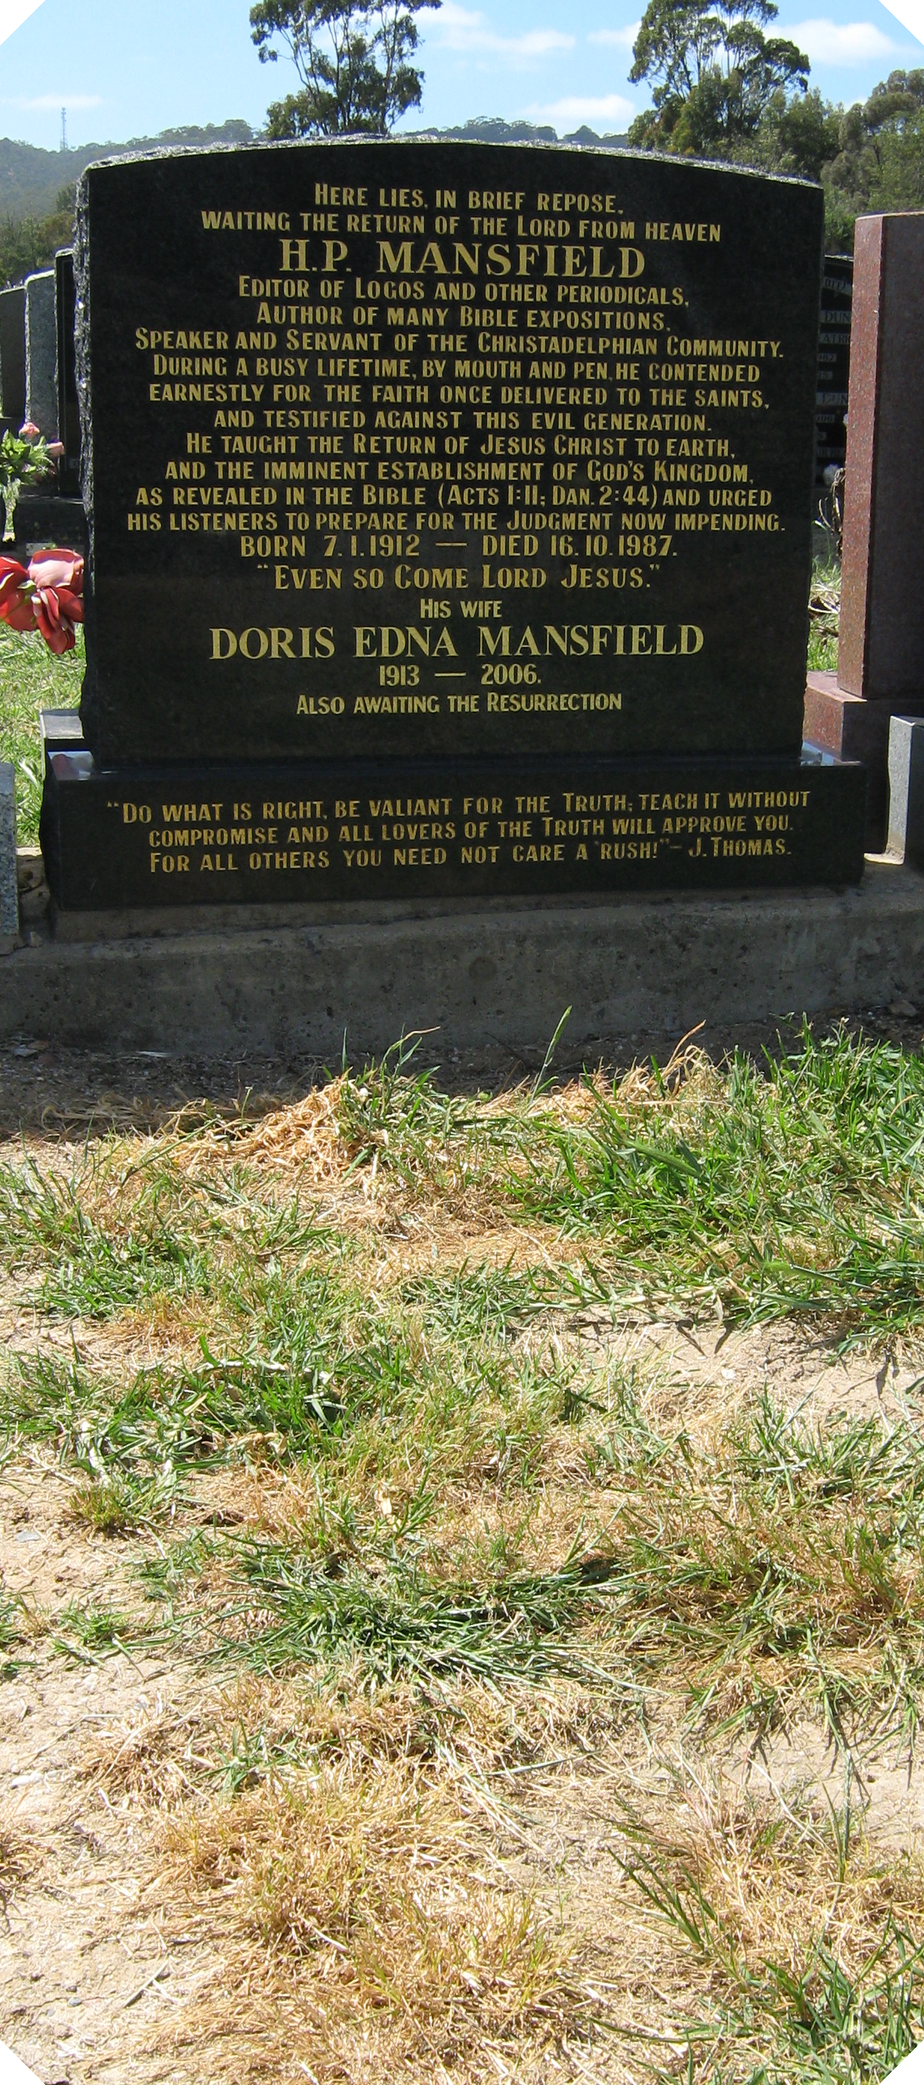
“…the hour is coming, in the which all that are in the graves shall hear his voice, and shall come forth…” – John 5:28-29
Centenial Park Cemetry in Adelaide, S.A.
Bre. Phil King and Ian Robinson – killed in a road accident 13 May 1967 on the way to Bible School

Slide 3
What is Anastasis?
A rising up, a standing up (from the root ANISTEMI, to stand up, to cause to rise) is used 42 times in the N.T. and is translated 39 times ‘resurrection’, once ‘rising again’, once ‘raised to life again’, and once ‘that should rise’.
Resurrection is therefore the standing up of dead ones. The resurrection will be a virtual recreation of former beings into exactly the same mental, moral and physical state that they possessed prior to their death – 1 Pet. 4:19.
Risen with him – Baptism to Resurrection

Slide 4
3 views on “sown” in 1 Cor. 15
That we are sown:
When we are born into a state and an environment related to corruption, dishonour, weakness, and to things natural.
When the dead body is buried in the ground.
When we are called forth from the grave at the resurrection.
Which of these views is Scripturally correct?
Answer – Views 2 and 3 are both correct in context!
Risen with him – Baptism to Resurrection

Slide 5
“Sowest” in 1 Cor. 15:35-38
Gr. egeiro – to rebuild, cause to exist
Bro. Thomas trans-
lates, “for what body”.
35 But some man will say, How are the dead raised up? and with what body do they come?
36 Thou fool, that which thou sowest is not quickened, except it die: – John 12:24
Gr. speiro (Active voice) – to scatter seed, sow
37 And that which thou sowest, thou sowest not that body that shall be, but bare grain, it may chance of wheat, or of some other grain:
38 But God giveth it a body as it hath pleased him, and to every seed his own body.
Ygs. Lit. – “according as He willed.”
Egyptian wheat 3 millennia old sown springs forth in life
Gen. 1:11-12 – Inflexibe law of creation

Slide 6
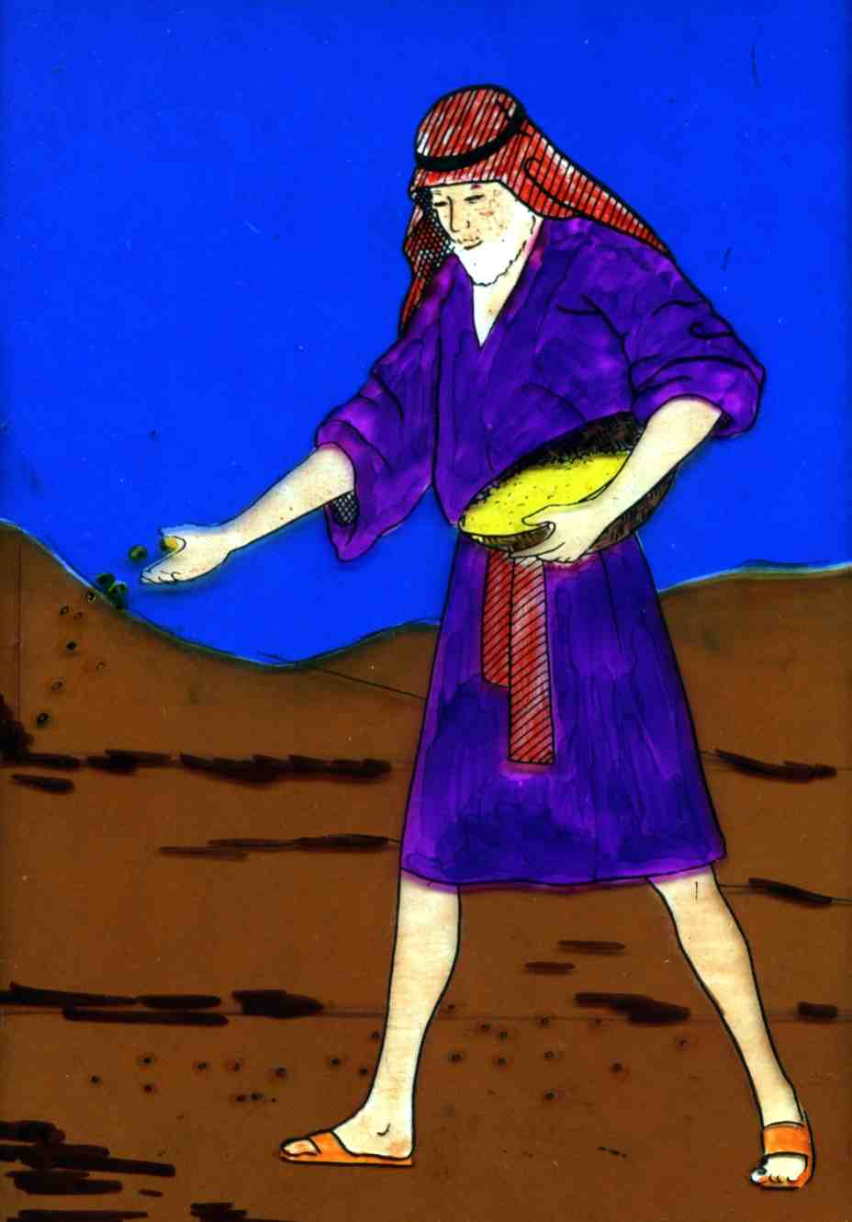
“Sown” in 1 Cor. 15:36-37
The Greek word speiro occurs 3 times in Vv.36 and 37, all in the Active voice.
SPEIRO (Active voice) – to scatter seed, to sow seed (Liddell and Scott Greek Lexicon)
Represents the burial of the dead body
Risen with him – Baptism to Resurrection

Slide 7
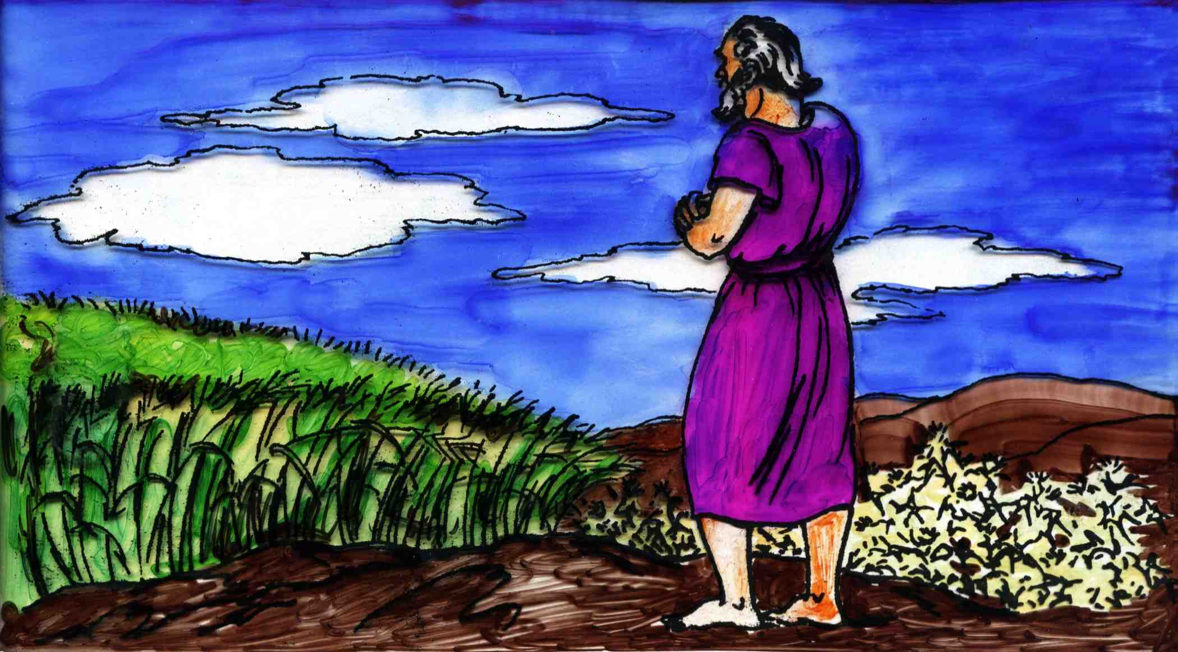
“Sown” in 1 Cor. 15:42-44
The word speiro occurs 4 times in Vv.42-44 but is in the passive voice where it speaks of the results of sowing.
The word in the Greek is SPEIRETIA (Passive Voice) – to spring or be born (Liddell and Scott Greek Lexicon).
The resurrection of the body
Risen with him – Baptism to Resurrection

Slide 8
1 Cor. 15:42-45
Bro. Thomas – “It is sprouted”
anastasis – standing up
42 So also is the resurrection of the dead. It is sown in corruption; it is raised in incorruption:
43 It is sown in dishonour; it is raised in glory: it is sown in weakness; it is raised in power:
44 It is sown a natural body; it is raised a spiritual body. There is a natural body, and there is a spiritual body.
45 And so it is written, The first man Adam was made a living soul; the last Adam was made a quickening spirit.
egerthesontai – to raise up, rebuild, cause to exist
speiretai (Passive Voice) – to spring or be born

Slide 9
The pattern of contrasts in Vv.42-44
“sown” | “raised”
“it springs forth in…” | “it is caused to exist in…”
Corruption | Incorruption
Dishonour | Glory
Weakness | Power
Natural Body | Spiritual Body
Risen with him – Baptism to Resurrection

Slide 10
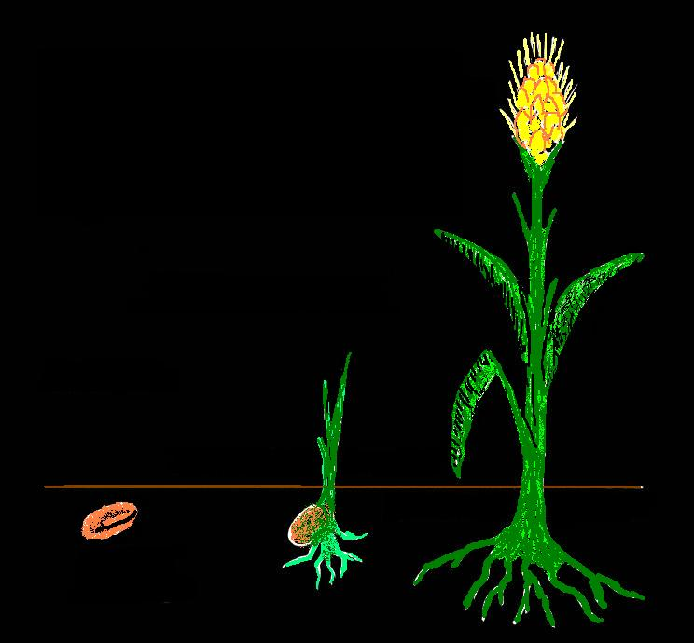
Three stages of resurrection
1 Cor. 15:35-45
3. Glorification
Corruption
Dishonour
Weakness
Natural
Judgement
2. Resurrection
“Gather my saints unto me…”
1.Death
Raised Body
1.
Seed
Body
Sprout
Body
3.
2.
“naked kernel”

Slide 11
Raised incorruptible
1 Cor. 15:52 – Two very diverse interpretations have been placed upon this phrase. They are:
That the dead are resurrected with incorruptible bodies, i.e. they come forth from the grave immortal. This doctrine is commonly known as ‘immortal emergence’.
That the dead are ‘raised’, ‘reared up’, ‘rebuilt’, and ‘caused to exist’ by a process in stages, including judgement, to ultimate incorruptibility.

Slide 12
Examination of these views
Interpretation 1 – This doctrine does away with the judgement of the “just and unjust” before the tribunal of Christ.
It leaves responsible but unworthy saints and accountable sinners in the grave, and does similar violence to many other doctrines of the “one faith”.
The apostle does not say, “The dead are resurrected incorruptible”, but “the dead are raised incorruptible”. Everything hinges on the word ‘raised’ and investigation shows that it must not be confused with anastasis or “standing up” of dead ones.

Slide 13
What ‘raised incorruptible’ means
Interpretation 2 – The Greek word translated ‘raised’ is egeiro – to awaken, wake up, arouse, cause to rise up, etc. In 1 Cor. 15:52 it is in the Passive Voice.
(The word has wide usage in the N.T. and relates to rising from sickness, sitting or lying; to appearing or raising up so as to occupy a place in the midst of people; to the raising of buildings; to rising up against, as well as to the rising of the dead.)
For the phrase “shall be raised” – egerthesontai – Bro. Thomas gives the meaning “to raise up, or again, to rebuild, to cause to exist” and adds that “it includes the whole process of rebuilding from the awakening to the quickening” into immortality.

Slide 14
Immortality, eternal life – Rom. 2:7
1 Cor. 15:53 – “For this corruptible must put on incorruption, and this mortal must put on immortality.”
“corruptible” – phthartos – corruptible, perishing.
“incorruption” – aphtharsia – incorruption, perpetuity.
“mortal” – thnētos – liable to death, mortal.
“immortality” – athanasia – undying, immortality, everlasting.
Eternal life relates to time/duration – perpetuity
Immortality is a condition of nature

Slide 15
Bro. Thomas in Anastasis
In “Anastasis” Bro. Thomas states on a number of occasions that the resurrected body will be in condition and nature like the body of Adam before he transgressed and was made subject to death. The following quotations reveal his mind on this point in 1866 (refer also Eureka vol. 1, pg. 63).
“This is our present life, intermitted at death, and restored when we awake from our sleep in the dust of sheol. We are then as Adam was when he came from the Creator’s hand. The life is organic and terminable; and liable to disturbance from any cause operating judicially.”

Slide 16
Bro. Thomas in ‘Anastasis’ on the condition or nature of the resurrected body
“......so that far as body is concerned in the matter, the one character on record in the Lamb's Book of Life, when glorified, will have been related to three bodies, more or less intimately connected – the first, the body of sin; the second, a body like Adam's before he sinned: the third.......”

Slide 17
Bro. Thomas in ‘Anastasis’ on the condition or nature of the resurrected body
“The crowd before him in this stage of resurrection, which is simply ANASTASIS, or standing up, are in corruption, dishonour, weakness, and naturality; for those physical qualities are constituents of all bodies begotten or conceived in dust – “Dust of the earth, earthy”; yet ‘very good’ bodies, in the sense that the first Adam's was ‘very good’ before he sinned.”

Slide 18
Bro. Thomas in Eureka Volume 3
“This would not have been affirmed of him (Christ) while dead. But the dead body was made to live again. It was thus restored to its former life; brought back to what is was before; ...the risen Jesus waited to be changed, or transformed, into what he was not on emerging from the tomb. The true believers who hope not to die, knowing that flesh and blood cannot inherit the kingdom, are also waiting to be changed or transformed into what they are not. The position of Jesus and this remnant is identical” (page 383).

Slide 19
Bro. Thomas in Eureka Volume 3
“This coming forth of the future constituents of the perfect man from the graves, restores them to an equality with the few among the living, who may attain perfection with them. In this co-equality they are intellectually, morally, and materially alike” (page 586).
“But, passing through the grave cleanses no one. They who emerge thence, ‘Come forth’ with the same nature they carried into it; and therefore their coming forth is resurrection. If the same kind of body did not come forth that was buried, it would not be resurrection, but only surrection, as in the case of the first man........He (Jesus) rose again the same Jesus that was buried, only that instead of being dead, he was alive again.” (page 587).

Slide 20
Bro. Thomas in Eureka Volume 3
“All that comes out of the ground is cursed, and unclean; so that even the body of Jesus, and the bodies of the approved saints in resurrection, require to be justified, rectified, purged or perfected, by all-absorbing spirit: which makes every atom of their substance instinct with incorruption, and life; in other words, transforms it into spirit” (page 705).
Bro. Thomas had clearly revised his thinking on the matter of the state of the resurrected body.

Slide 21
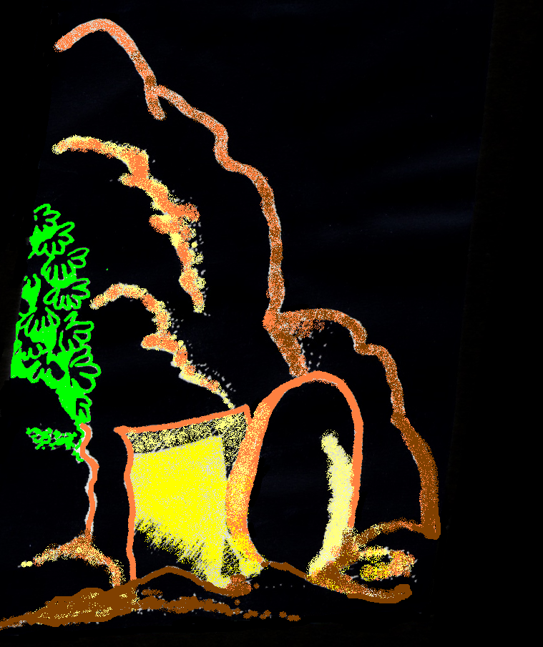
The certainty of the Resurrection
Acts 24:15 – And have hope toward God, which they themselves also allow, that there shall be a resurrection of the dead, both of the just and unjust.
John 5:28-29 – Marvel not at this: for the hour is coming, in the which all that are in the graves shall hear his voice,
And shall come forth; they that have done good, unto the resurrection of life; and they that have done evil, unto the resurrection of damnation.
Risen with him – Baptism to Resurrection

Slide 22
“Risen with him – From our baptism to the Resurrection”
Next Study (God willing)
Study 5
“O man greatly beloved, fear not: peace be unto thee, be strong, yea, be strong”

Slide 23
…
...

