Slide 1
Wicked Spirits
7
The Parable of the

Slide 2
“When the unclean spirit is gone out of a man,”
  The unclean spirit, the idolatry of Israel, is exorcised when Nebuchadnezzer destroys the temple and carries away the captives.
“he walketh through dry places, seeking rest, and findeth none.”
  The exile in Babylon lasted 70 years. During this time there were some righteous men yet among the majority there was a prevailing spirit to worship heathen gods (Ezek. 36:20, 23).
“Then he saith, I will return into my house from whence I came out;
and when he is come, he findeth it empty, swept, and garnished.”
  The return of the exiles sees a national rejuvenation under Ezra and Nehemiah where the temple is built and rededicated (emptied, swept and garnished).
“Then goeth he, and taketh with himself seven other spirits more wicked than
himself, and they enter in and dwell there:”
  The reforms of Ezra and Nehemiah did not last long before heathen influences encroached on the Jewish beliefs. Chief among these was the Persian ideas of Zoroastrianism which incorporated seven evil spirits.

Slide 3
“During the Exile many Jews became confused and skeptical. The Hebrew language was dying off, and with it those who cared for the Torah. The temple had been destroyed and animal sacrifices stopped. No longer was it clear what God required of His people.
Elements of pagan religion began to fill the voids created by skepticism and doubt. Some Jews ‘hedged’ their faith by dabbling in astrology and the occult. They moved into these areas very slowly, and Jewish leaders did not realize at first what was happening, but Jewish mystics began to reinterpret the traditional Jewish teachings in light of the pagan beliefs they had accepted.”
James Packer, Merrill Tenney, William White, Jr., Editors,
The Bible Almanac, (Thomas Nelson, Nashville, 1980), pp. 500-1.

Slide 4
“For example, Jews of the Diaspora became fascinated with demons and angels. They qualified the Biblical belief in a Creator who has sovereign control of His creation, by adopting a Persian view of the universe with an elaborate spirit world and an ongoing war between the forces of light and of darkness.
James Packer, Merrill Tenney, William White, Jr., Editors,
The Bible Almanac, (Thomas Nelson, Nashville, 1980), pp. 500-1.

Slide 5
“Jewish mystics compiled these beliefs in a group of religious writings known as the deuterocanon and pseudepigrapha. Some deuterocanonical books, such as the Book of Tobit, promoted astrology and the teachings of Zoroastrianism, which came from Persia. The story of Tobit asserts the victory of God over pagan demons---but in the process it acknowledges the power of pagan demons. Moreover, it portrays God as a great force behind the events of life, rather that a personal presence in the midst of His people. This erosion of the Jewish faith made it more difficult for the Jews to believe that Jesus was "Immanuel . . . God with us" (cf. Matt. 1:23). Many Jews still held to the pagan belief that God had removed himself from man's everyday life.”
James Packer, Merrill Tenney, William White, Jr., Editors,
The Bible Almanac, (Thomas Nelson, Nashville, 1980), pp. 500-1.

Slide 6
“Without here entering on a discussion of the doctrine of Angels and devils as presented in Holy Scripture, the Apocrypha, and the Pseudepigrapha, it will be admitted that considerable progression may be marked as we advance from even the latest Canonical to Aprocryphal, and again from these to the Pseudepigraphic Writings. The same remark applies even more strongly to a comparison of the latter with Rabbinic literature. There we have comparatively little of the Biblical in its purity. But, added to it, we now find much that is the outcome of Eastern or of prurient imagination, of national conceit, of ignorant superstition, and of foreign, especially Persian, elements. In this latter respect it is true---not, indeed, as regards the doctrine of good and evil Angels, but much of it Rabbinic elaboration---that 'the names of the Angels (and of the months) were brought from Babylon' (Jer. Rosh. haSh. 56 d; Ber. R. 48), and with the 'names,' not a few of the notions regarding them.”
Alfred Edersheim, The Life and Time of Jesus the Messiah, (Eerdmans, 1977), Ap. XIII, p. 748.

Slide 7
“Seven chief demons, seven archfiends, aid Ahriman in his struggle against the forces of light. The seven archfiends, led by Aeshma (wrath), are Wrongmindedness, Heresy or Apostasy, Anarchy or Misgovernment, Discord, Presumption, Hunger, and Thirst. Under the command of these archdemons are hosts of other evil spirit, some of whom figure prominently in the development of the concept of the Devil. . . The demons lived in the unclean creatures, or they roamed through the air, and they could enter into the bodies of human beings, possessing them and causing disease, insanity, or death.”
Jeffrey Burton Russell, The Devil: Perceptions of Evil from Antiquity to Primitive Christianity, (Cornell University Press, Ithaca, 1977), p. 115, 116.

Slide 8
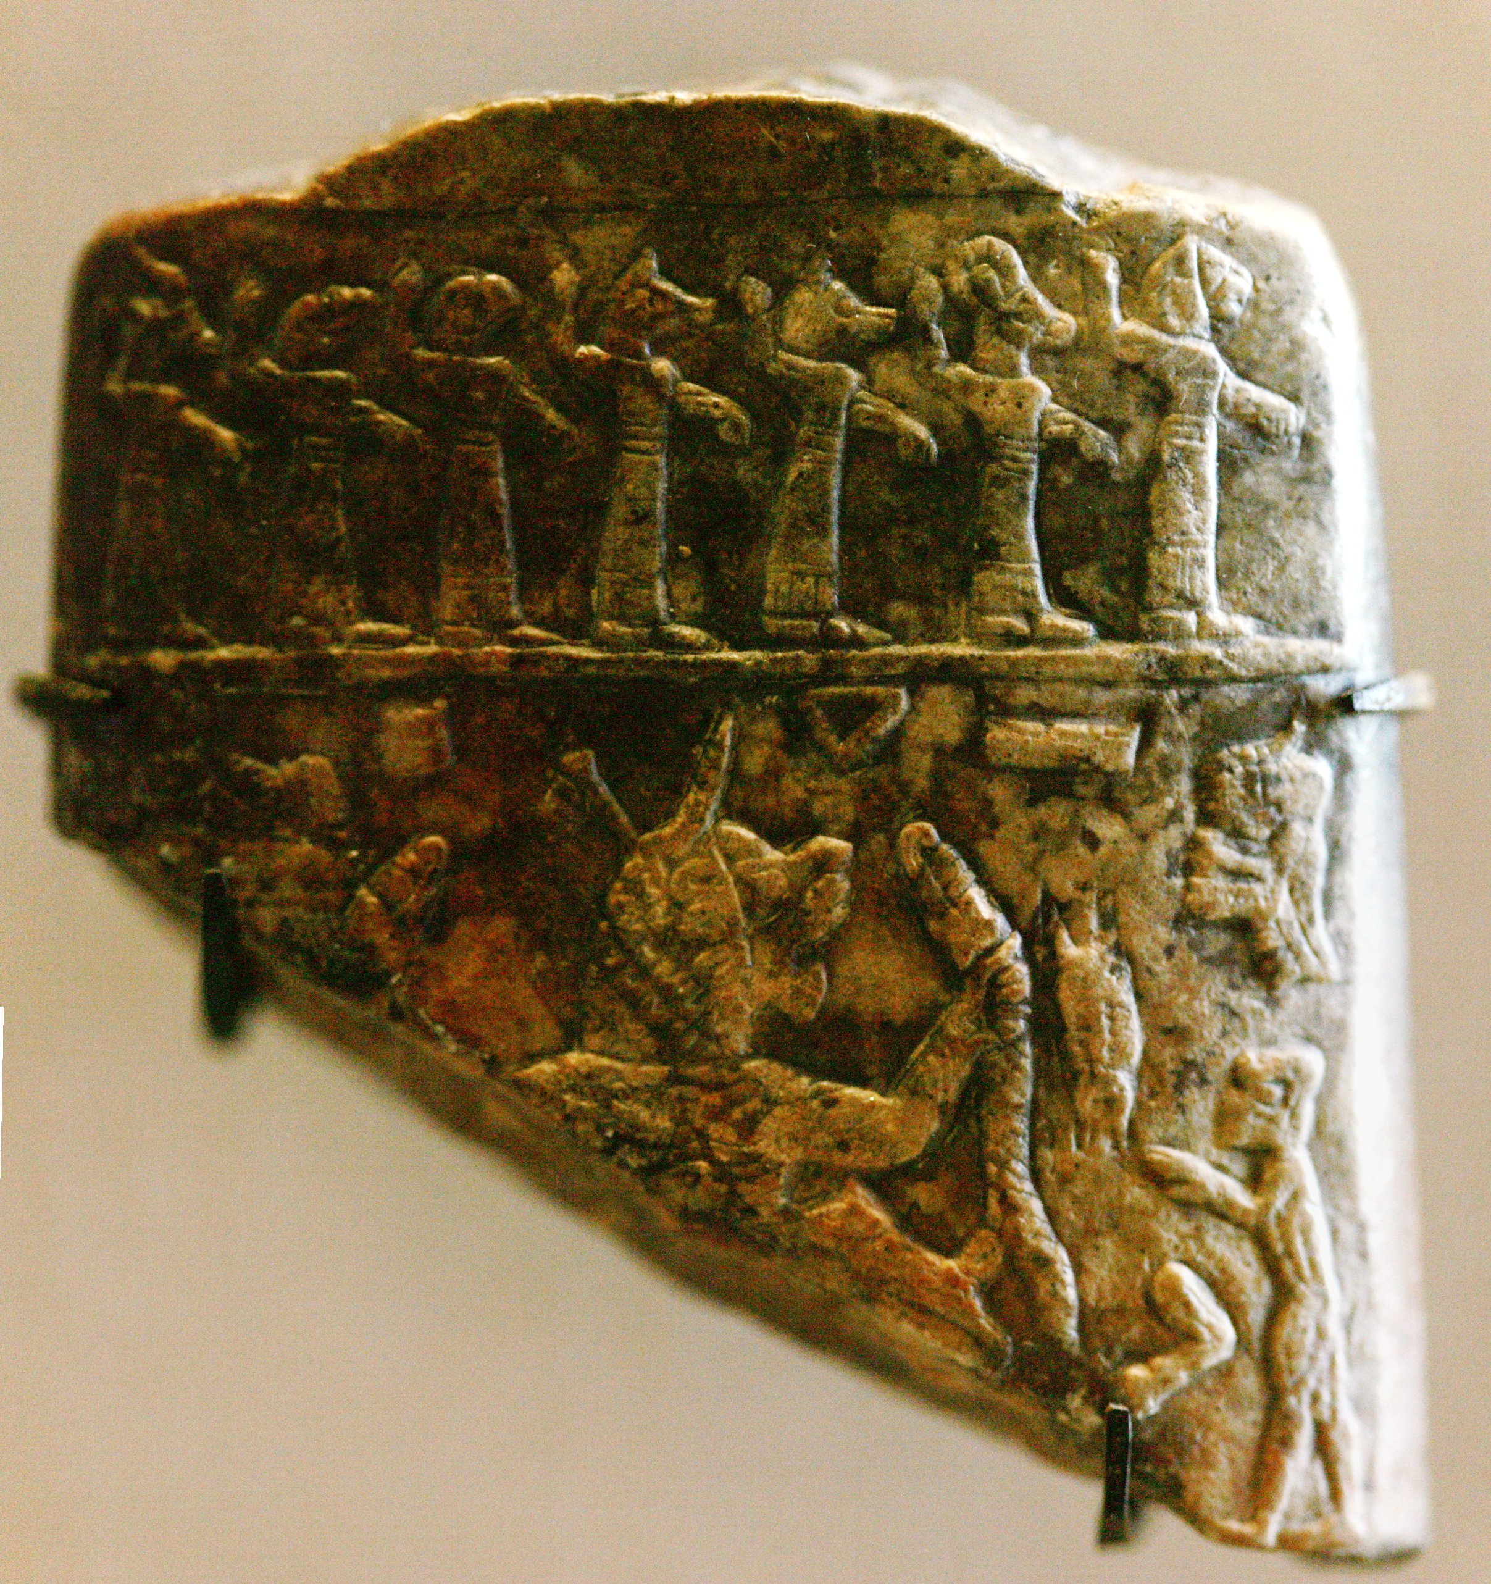
Babylonian plaque showing seven demons and Lamashtu, a feared female demon.

Slide 9
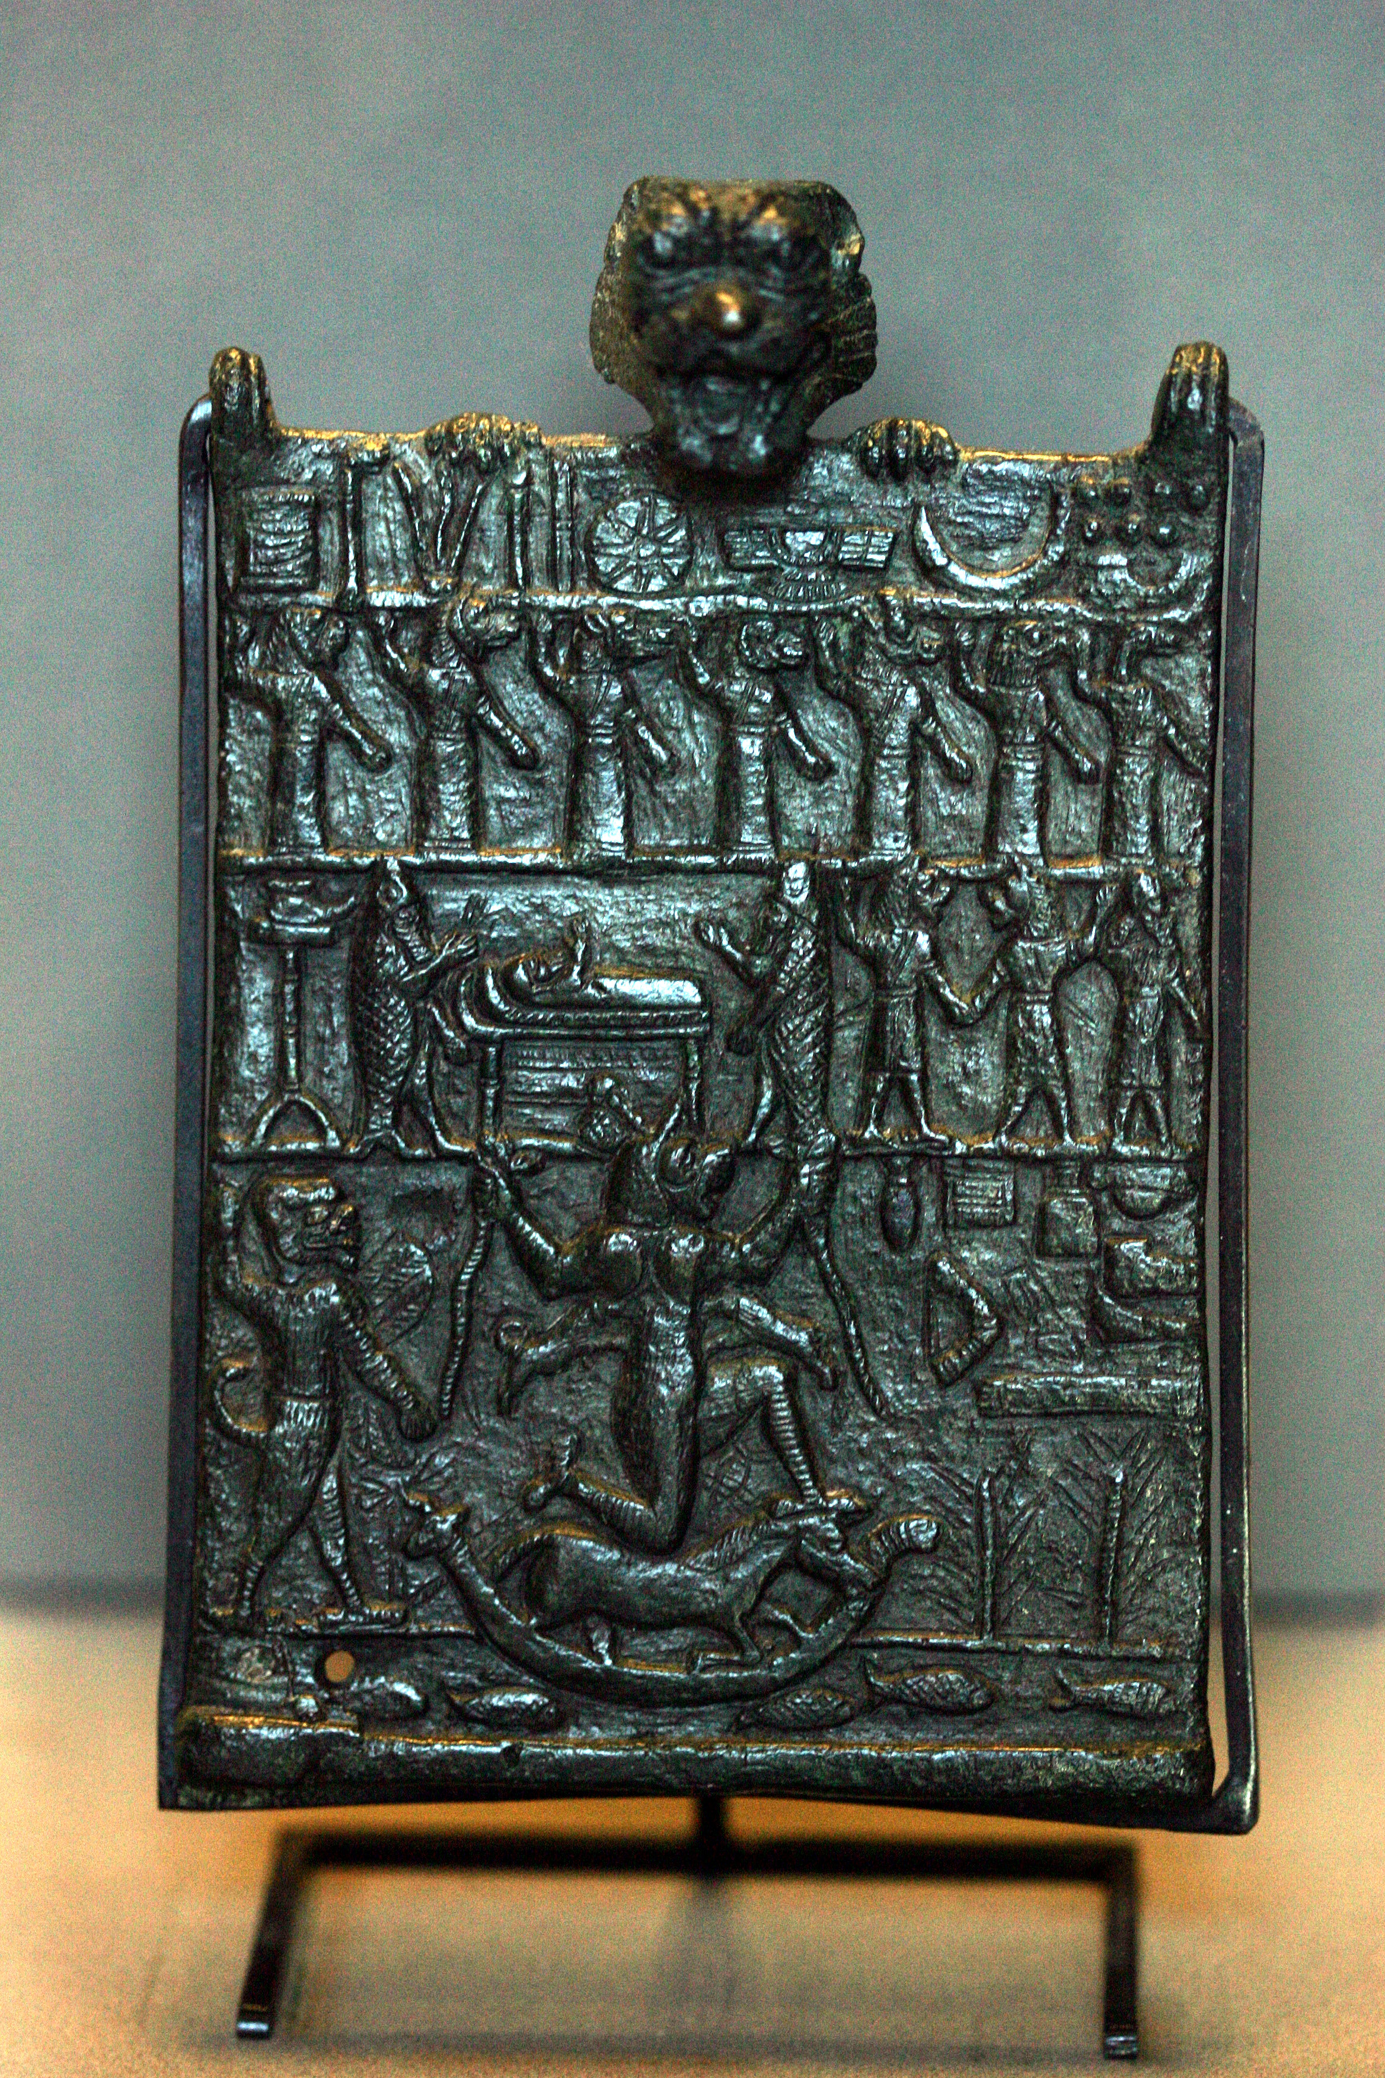
Plaque for protection against the female demon Lamashtu
Notes:
Characters in an exorcism ceremony
The exorcism scene is divided into registers. In the upper register, symbols represent the great cosmic gods that are invoked to heal the sick person: the sun of Shamash, the crescent moon of Sin, the lightning bolt of the storm god Adad, and the winged disc of Ashur, the supreme god of the Assyrian Empire. The seven spirits in the second register, each with a different animal's head, probably have a beneficial function: they seem to be symbolically guarding the door of the patient's bedchamber. The patient is in the third register, lying on a high bed surrounded by two figures dressed in fish skins like the spirits associated with Ea, god of the depths and wisdom. They are probably the priestly exorcists who are conducting the ritual, with the help of three animal-headed spirits.
Driving out evil spirits
The causes of the illness appear in the lower register. Lamashtu, sitting on a donkey in a boat, is twice as big as all the other characters. She is presented as physically fearsome, with a hairy body, lion's head, and talons. She is holding snakes and suckling two lion cubs. An inscription describes her as "furious and cruel, a dazzling goddess; she is a she-wolf; she snatches the young man on the path, the girl at play, the child from the arms of his nurse." The boat is sailing along a river full of fish, which symbolizes the world of Apsu - the underworld that is home to demons. The gifts and provisions at the side of the scene are meant to encourage her to set off on her journey back to the underworld. Pazuzu is standing behind Lamashtu, with one arm raised. Even though his gesture may seem threatening and, with his scaly winged body, dragon's head, scorpion's tail, and talons, he is physically as fearsome as his spouse, he is nonetheless there to protect the patient by coaxing his wife to retreat. Pazuzu is again seen looming up above the scene clinging on to the back of the plaque. Documents and objects that give protection from Lamashtu's evil doings were widespread in the 1st millennium in Mesopotamia, a period in which this type of belief seems to have flourished.

Slide 10
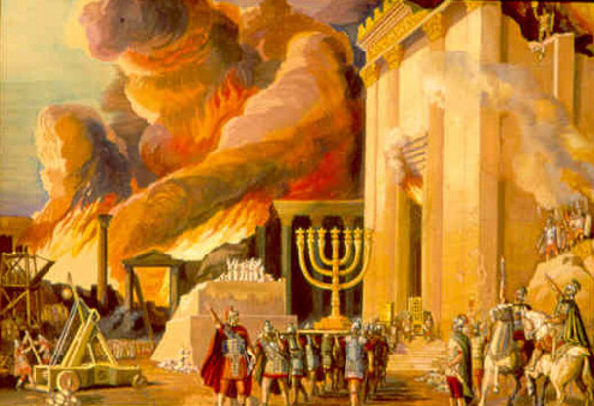
“and the last state of that man is worse than the first.”
Certainly the destruction of the temple (the house) in A.D. 70 was worse then the destruction by the Babylonians. The account given by Josephus gives a picture of shear madness behind the actions of the Jews as the Romans besieged the city.
“Even so shall it be also unto this wicked generation.”

Slide 11
Evil Spirits | Good Spirits
A Spirit of Bondage - Rom. 8:15 | A Spirit of Meekness - 1 Cor. 4:21; Gal. 6:1
A Spirit of Fear - 2 Tim. 1:7 | A Spirit of Wisdom - Eph. 1:17
An Erring Spirit - Isa. 29:24 | A Spirit of Understanding - Isa. 11:2
A Haughty Spirit - Pro. 16:18 | A Spirit of Counsel - Isa. 11:2
A Spirit of Jealousy - Num. 5:14 | A Spirit of Knowledge - Isa. 11:2
A Spirit of Infirmity - Luke 13:11,12 | A Spirit of Power - 2 Tim. 1:7
A Spirit of Filthiness - 2 Cor. 7:1 | A Spirit of Love - 2 Tim. 1:7
A Sorrowful Spirit - 1 Sam. 1:15 | A Spirit of a Sound Mind - 2 Tim. 1:7
A Sad Spirit - 1 Kings 21:5 | A Quiet Spirit - 1 Peter 3:4
A Spirit of Anguish - Job 7:11 | A Fervent Spirit - Rom. 12:11
A Spirit of Slumber - Rom. 11:8 | A Renewed Spirit (of Your Mind) - Eph. 4:23

Slide 12
“A wicked (poneros) and adulterous generation seeketh after a sign; and there shall no sign be given unto it, but the sign of the prophet Jonas. And he left them, and departed.” (Mat. 16:4)
“Then Jesus answered and said, O faithless and perverse generation, how long shall I be with you? how long shall I suffer you? bring him hither to me.” (Mat. 17:17)
“Whosoever therefore shall be ashamed of me and of my words in this adulterous and sinful generation; of him also shall the Son of man be ashamed, when he cometh in the glory of his Father with the holy angels.” (Mark 8:38)

Slide 13
“But draw near hither, ye sons of the sorceress, the seed of the adulterer and the whore. . . Enflaming yourselves with idols under every green tree, slaying the children in the valleys under the clifts of the rocks?” (Isa. 57:3, 5)
“And it came to pass through the lightness of her whoredom, that she defiled the land, and committed adultery with stones and with stocks.” (Jer. 3:9)
“I have seen thine adulteries, and thy neighings, the lewdness of thy whoredom, and thine abominations on the hills in the fields. Woe unto thee, O Jerusalem! wilt thou not be made clean? when shall it once be?” (Jer. 13:27)
“That they have committed adultery, and blood is in their hands, and with their idols have they committed adultery, and have also caused their sons, whom they bare unto me, to pass for them through the fire, to devour them." (Ezek. 23:37)

