Slide 1
“A
divided
against a
house
falleth.”

Slide 2
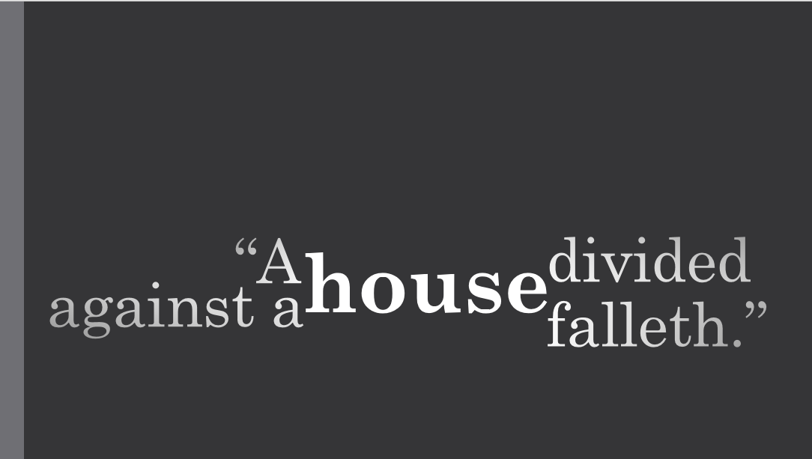

Slide 3
"But when the Pharisees heard it, they said..." Matthew 12:24
"the scribes which came down from Jerusalem said..." Mark 3:22
"the people wondered. But some of them said..." Luke 11:14-15

Slide 4
1 Kings 1:2
"Now it happend that Ahaziah, as he was coming down from the top of his house, fell down from it and in his sickness sent to the Fly, which was the god of Ekron."
Josephus, trans. Whiston, Antiquites of the Jews (9.2.1)

Slide 5
Matthew 10:24-25
“The disciple is not above his master, nor the servant above his lord. (25) It is enough for the disciple that he be as his master, and the servant as his lord. If they have called the master of the house Beelzebub, how much more shall they call them of his household?”

Slide 6
Luke 6:39-40
Mark 3:23-24
And he called them unto him, and said unto them in parables, How can Satan cast out Satan?
(24) And if a kingdom be divided against itself, that kingdom cannot stand.
“And he spake a parable unto them, Can the blind lead the blind? shall they not both fall into the ditch?
(40) The disciple is not above his master: but every one that is perfect shall be as his master.”

Slide 7
Luke 11:20
Matthew 12:28
“But if I cast out devils by the Spirit of God, then the kingdom of God is come unto you.”
“But if I with the finger of God cast out devils, no doubt the kingdom of God is come upon you.”

