Slide 1
the
Binding
Strong
Man

Slide 2


Slide 3
Luke 11:21-22
Mark 3:27
When a strong man armed keepeth his palace, his goods are in peace:
But when a stronger than he shall come upon him, and overcome him, he taketh from him all his armour wherein he trusted, and divideth his spoils.
No man can enter into a strong man's house, and spoil his goods, except he will first bind the strong man; and then he will spoil his house.

Slide 4
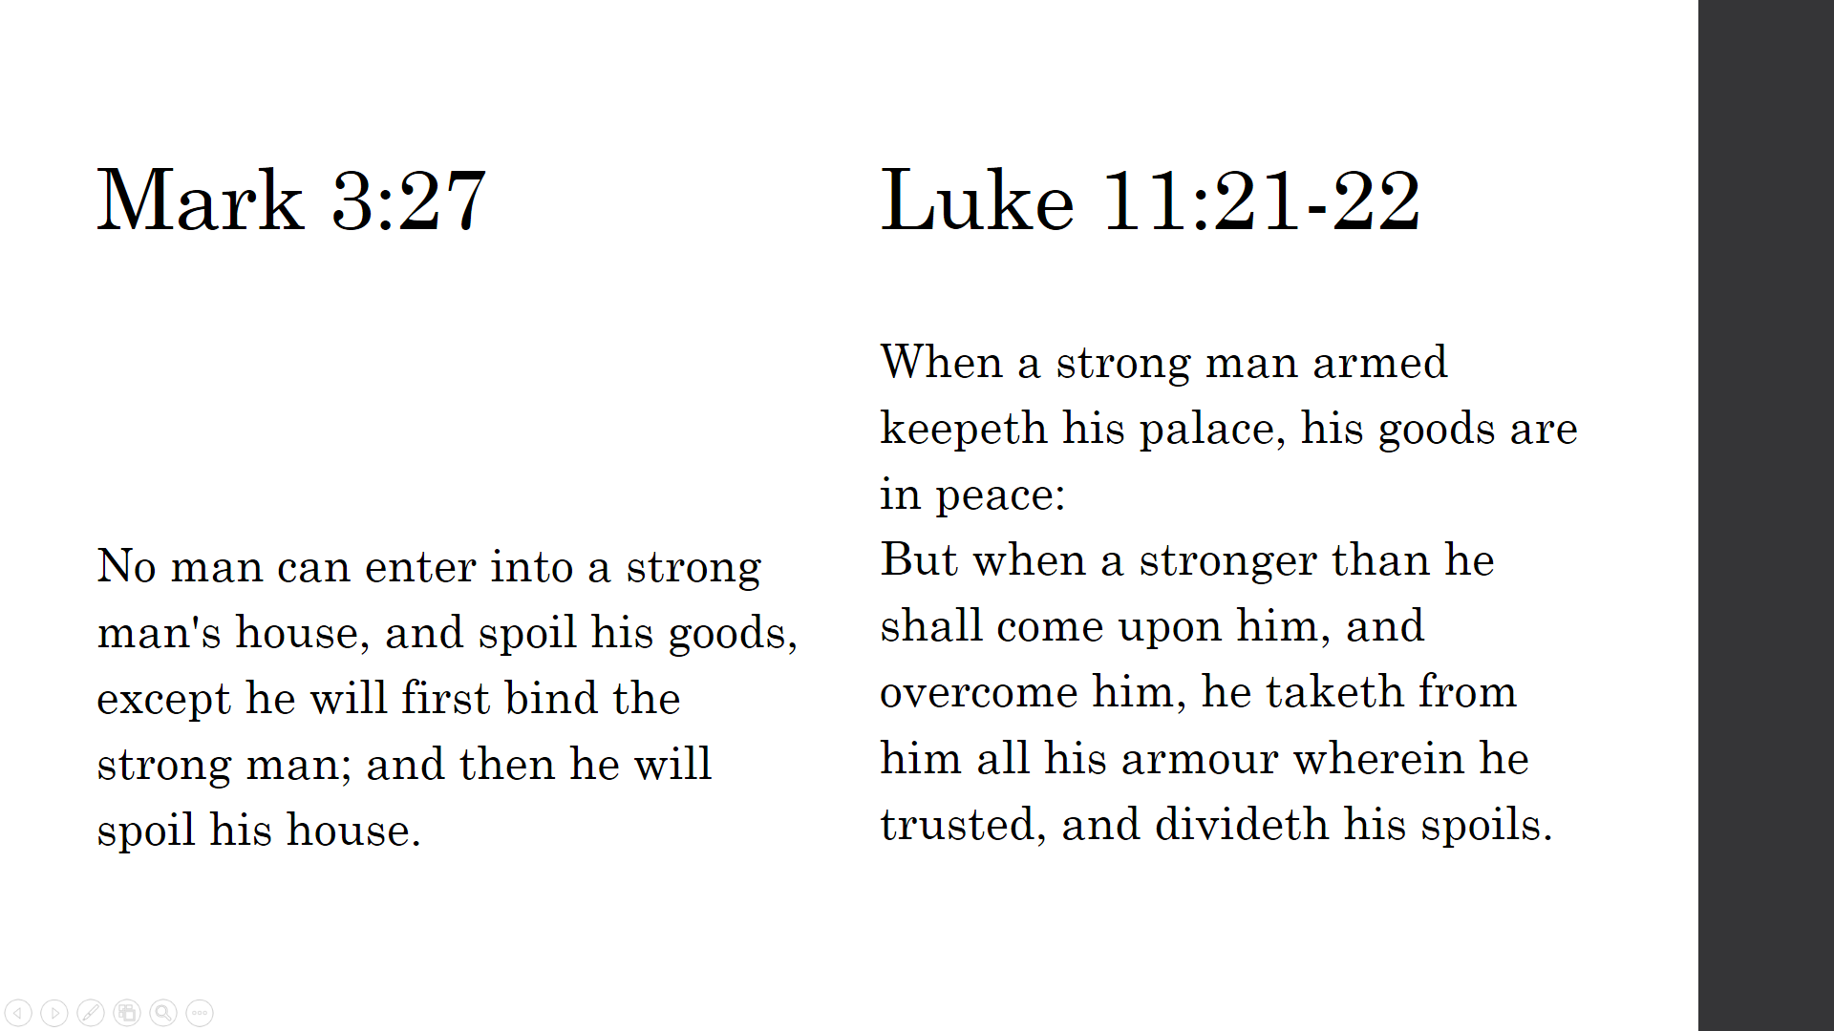

Slide 5
 | Matthew 3 | Matthew 12
“O generation of vipers” | 3:7 | 12:34
Trees with bad fruit | 3:10 | 12:33
Mightier = stronger | 3:11 | 12:29
Holy Spirit | 3:11 | 12:31-32
Gathering | 3:12 | 12:30

Slide 6
Proverbs 24:1-6
"Be not envious of evil men, nor desire to be with them; {2} for their minds devise violence, and their lips talk of mischief. {3} By wisdom a house is built, and by understanding it is established; {4} by knowledge the rooms are filled with all precious and pleasant riches. {5} A wise man is mightier than a strong man, and a man of knowledge than he who has strength; {6} for by wise guidance you can wage your war, and in abundance of counselors there is victory."

Slide 7
Psalm 35:10
“All my bones shall say, LORD, who is like unto thee, which deliverest the poor from him that is too strong for him, yea, the poor and the needy from him that spoileth him?”

Slide 8
Luke 11:21-22
Mark 3:27
When a strong man armed keepeth his palace, his goods are in peace:
But when a stronger than he shall come upon him, and overcome him, he taketh from him all his armour wherein he trusted, and divideth his spoils.
No man can enter into a strong man's house, and spoil his goods, except he will first bind the strong man; and then he will spoil his house.

Slide 10
Isaiah 53:12
"Therefore will I give him a portion in the great, And the strong shall he apportion as spoil" (Rotherham's)
"therefore he shall inherit much and divide the spoils of the strong." (LXX)

