Slide 1

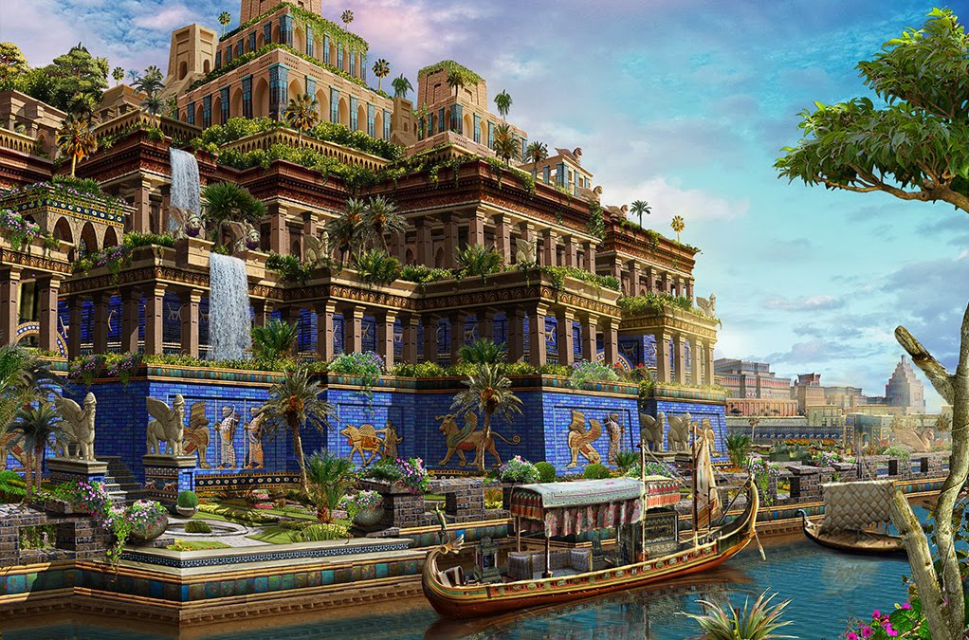
Outliving Babylon

Slide 2
Grew into 2 rival systems
Murderer & Liar
Babylon
- Shinar -
Genesis 10 - NIMROD
City & Temple
King & Priest
Civil & Religious
ENMITY
Genesis 14 - MELCHIZEDEC
Jerusalem

Slide 3
The ancient rivalry continued in Daniel
(Dan 1:1-2) - In the third year of the reign of Jehoiakim king of Judah, Nebuchadnezzar king of BABYLON came to JERUSALEM and besieged it. And the Lord gave Jehoiakim king of Judah into his hand, with some of the vessels of the house of God. And he brought them to the land of shinar, to the house of his god, and placed the vessels in the treasury of his god.

Slide 4
Nebuchadnezzar
His god was probably Marduk or Bel Jer 50:2; 51:44.
Less likely to be Nabu as that was his father’s god and most of Nebchadnezzar’s inscriptions refer to Marduk, though his father named him NEBUchadnezar.
In an inscription he does style himself as Nabu’s beloved and favourite.

Slide 5
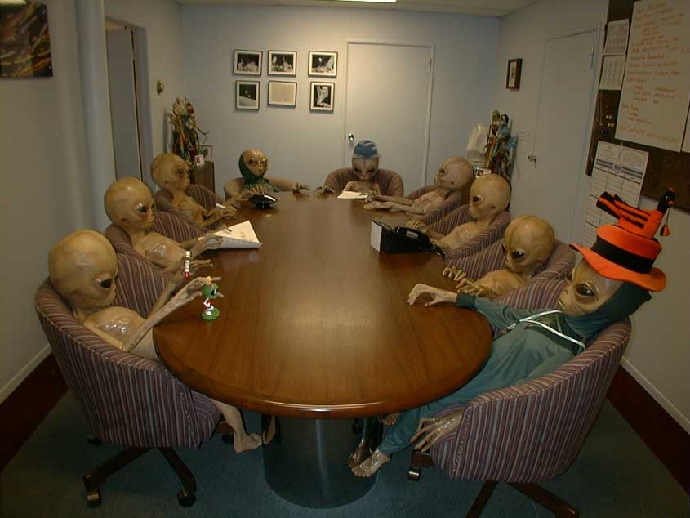

Slide 6
Word for the day
ENCULTURATION
the process by which an individual learns the traditional content of a culture and assimilates its practices and values, to socialise…here in Babylon it is forced enculturation.

Slide 7
Operation Babylon
Forced to a foreign land
In the charge of a foreign official with a foreign name.
Called by foreign titles
Ordered into a foreign education.
Fed a foreign diet.
Assigned foreign names.
To prepare them to serve in a foreign court.

Slide 8
Same meaning in Daniel…
Same meaning in Daniel…
1. The need to do normal faithful things.
2. Cooperate with those in authority without breaking God’s laws.
3. Obeying God in spite of opposition.
4. Doing regular habits of service including prayer and bible study/educate yourself on God.
5. Maintain a separation…BE DIFFERENT.

Slide 9
Daniel & Joseph
Both were exiles
Both showed amazing loyalty and allegiance to God's law
Both were publicly humiliated by false accusation and ultimately vindicated
Both were renowned for interpreting dreams that others were unable to.
Both were elevated to 2nd in charge (2IC) of the kingdom in around their 2nd to 3rd year.
Both were recognised as possessing gifts from God.
Both were wisest of the wise men.
Both were saviours of their people.

Slide 10
Babylonian Morphing
Made them - Eunuchs
Took them – from the other captives.
Taught them – for 3 years the literature and language of the Chaldeans.
Allocated them – a daily portion of the king’s food and wine.
Trained them – how to conduct themselves before the king.
Named them – Belteshazzar, Shadrach, Meshach and Abednego.

Slide 11
Babylon’s wine is a metaphor for sin
Rev 14:8; 17:6; 18:3-4,23; 19:2
Persecution (Murder)
Anything that corrupts or blasphemes
Wrong doctrine (lies)
Immorality
Contrast to Christ, which we accept and agree with.

Slide 12
Babylon’s wine is a metaphor for sin
Personally – sin challenges us everyday to drink its wine
An individual or group that seeks to lead you from God – challenge your faith.
Nation or government requires you to break your faith and values to show allegiance to them. Eg a pinch of salt.

Slide 13
Two Kings two eras
Nebuchadnezzar
Invasion,
Siege
Defeat
Plundering
Exile
Cyrus
Deliverance
Freedom
Restoration
Rebuilding,
Joy of going home.

