Slide 1
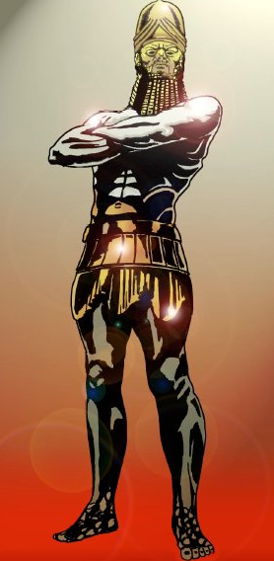
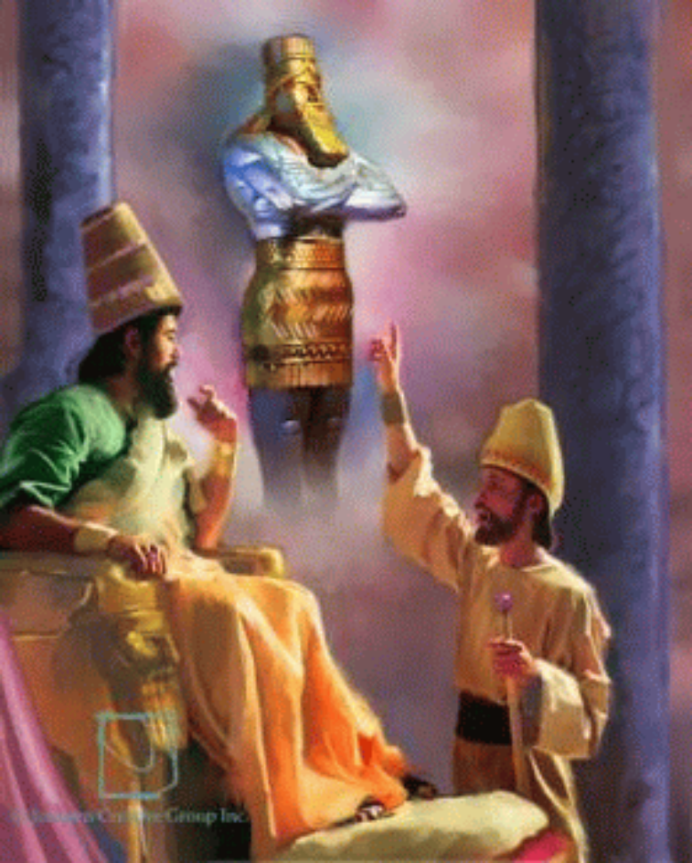
Daniel rises to the call
Notes:
Not a detailed study of Daniel 2 – I am assuming a lot of background knowledge!

Slide 2
Summary of chapter 2
v1-9 The King’s dream and decree.
v10-13 Failure of Babylon’s clever people.
v14-18 Daniel’s request and prayer to God.
v19-23 Daniel’s thankfulness to God.
v24-30 Daniel before Nebuchadnezzar.
v31-45 Daniel reveals the dream and gives the interpretation.
v46-49 Nebuchadnezzar honours God.
Notes:
Sun set on Israel’s glory, land ravaged, people bewildered!

Slide 3
The Exchange
The King
The Wise Men
V3 – “I had a dream and need to know”.
V5-6 – “My command is, details + dream or else”.
V8 – “You’re stalling because you don’t know what you’re talking about”.
V12 – “Don’t say I didn’t warn you”.
V3 – “Reveal the dream and we’ll give the meaning”.
V7 – “Please reveal the dream and we’ll give the meaning”.
V10 – “You're not playing fair”.

Slide 4
God does dwell with flesh
(Jhn 1:14) the word was made flesh.
(Rom 1:3) – God…his son…descended from David according to the flesh.
(Rom 8:3) – God sent his own son in the likeness of sinful flesh.
(Eph 2:18-21) – in him you also…a dwelling place for God.
(Eph 3:17) – Christ dwells in our hearts by faith.

Slide 5
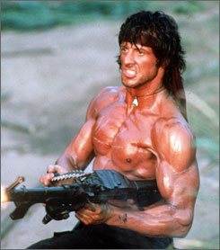
KING MAD

Slide 6
Joseph and Daniel
* After two years (Gen 41:1; Dan 2:1)
* Ruler’s spirit troubled them (Gen 41:8; Dan 2:1)
* Wise men unable to interpret (Gen 41:8; Dan 2:2)
* Both brought before the King (Gen 41:14; Dan 2:25)
* God acknowledged as source of interpretation (Gen 41:16; Dan 2:30)
* God reveals future to kings (Gen 41:25; Dan 2:45)
* Joseph and Daniel given wisdom from God (Gen 41:33,38; Dan 1:17; 2:23; 4:8; 5:11,14; 6:3)
* Elevation (Gen 41:41; Dan 2:48-49)

Slide 7
Joseph’s Purpose
Zaphenathpaneah (Gen 41:45)
Possibly = The saviour of the world
(Gen 50:19-20) I am in the place of God…
”to save much people alive”.
Daniel understands his chief purpose in Babylon is… to save his people
…everything about Daniel is Christ.
# Jesus called the same when he declared unrevealed details (Jhn 4:39-42).

Slide 8
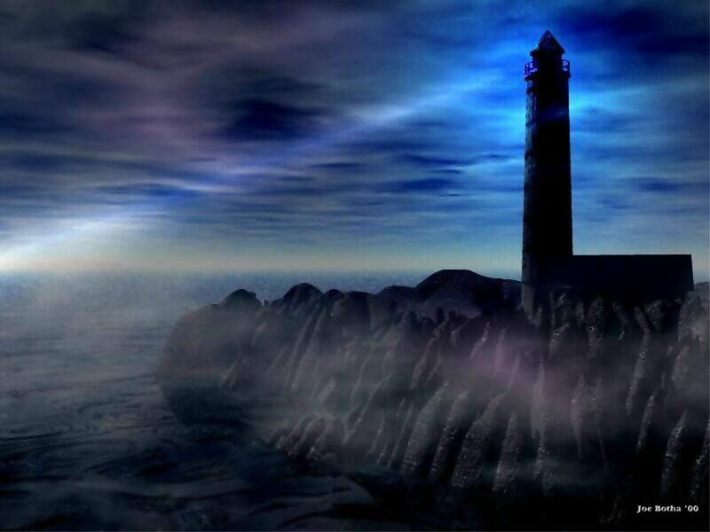
Prophecy is a Light
We have also a more sure word of prophecy; whereunto ye do well that ye take heed [as unto a light that shineth in a dark place, until the day dawn, and the day star arise] in your hearts:
2 Peter 1:19
Section 7
Notes:
An incorrect view of God’s prophetic word can cause us to stumble in darkness!

Slide 9
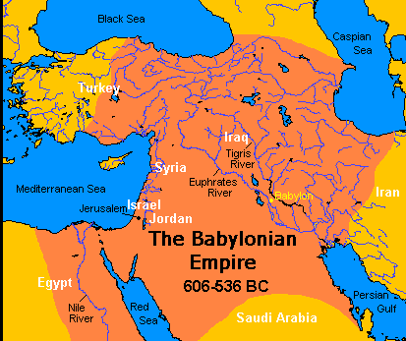
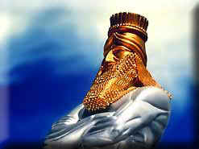
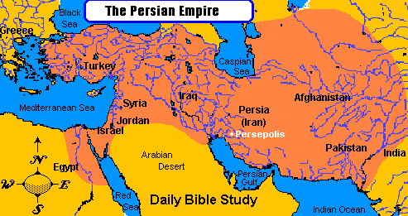
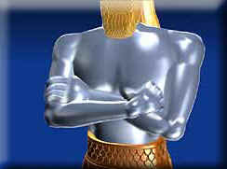
Daniel 2 Reveals World History
Head of Gold
Babylon (605-539 BC)
Breast & Arms of Silver
Medo-Persia (539-331 BC)
Notes:
"clay" - literally 'burnt clay' - hardened and brittle
Represents MAN Job 10:9; 33:6; Isa 64:8
- especially unbelieving men! Isa. 29:16; 45:9
A form of rulership that elevates the flesh!
- power of the common man (ie democracy, people power,...)
cp. Luke 21:25-26 with Psa 65:7
"sea and waves roaring" = "tumult of the people"
- demanding rights, protests, "social democracy" - revolution!
Note: atheism predates evolution!

Slide 10
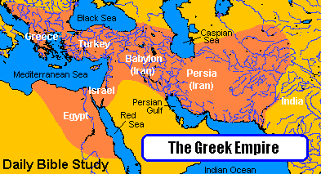
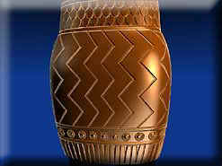
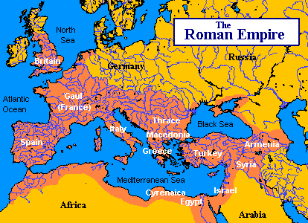
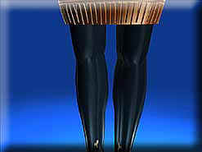
History Continued…
Belly & Thighs of Brass
Greece (331-168 BC)
Rome (168 BC - AD 476)
Legs of Iron

Slide 11
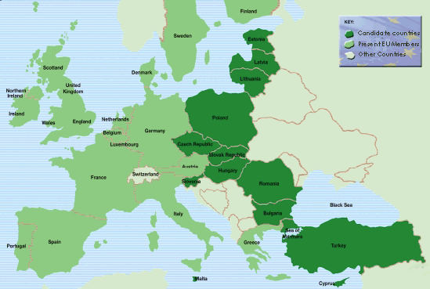
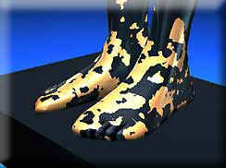

History Continued…
Feet and Toes of Iron & Clay
“United” Europe (EU)
(AD 476 - present)
And the Future!
God’s Kingdom on Earth
Notes:
Clay = democracy – people power!
We used to say “Divided Europe” – but now its United!

Slide 12
Daniel 2
Date AD
Name
Head
Chest
Belly &
Thighs
Legs
Feet and Toes
Stone/Mountain
1st
century
Johanan Ben
Zakkai
Babylon
Medo-Persia
Greece
Rome
Not available
Not available
1st
century
Josephus
Babylon
Medo-Persia
Greece
Rome
Not available
Messiah
150
Akiba Ben Joseph
Babylon
Medo-Persia
Greece
Rome
Not available
Not available
185
Irenaeus
Babylon
Medo-Persia
Greece
Rome
Rome divided
Christ
190
Tertullian
Babylon
Medo-Persia
Greece
Rome
Rome divided
Christ
194
Clement
Babylon
Medo-Persia
Greece
Rome
Rome divided
Christ
235
Hippolytus
Babylon
Medo-Persia
Greece
Rome
Rome divided
Christ
230
Origen
Babylon
Medo-Persia
Greece
Rome
Rome divided
Christ
280
Methodius
Babylon
Medo-Persia
Greece
Rome
Rome divided
Christ
300
Victorinus
Babylon
Medo-Persia
Greece
Rome
Rome divided
Christ
306
Lactantius
Babylon
Medo-Persia
Greece
Rome
Rome divided
Christ
330
Eusebius
Babylon
Medo-Persia
Greece
Rome
Rome divided
Christ
347
Cyril
Babylon
Medo-Persia
Greece
Rome
Rome divided
Christ
350
Aphrahat
Babylon
Medo-Persia
Greece
Rome
Rome divided
Not available
401
Severus
Babylon
Medo-Persia
Greece
Rome
Rome divided
Christ
407
John Chrysostom
Babylon
Medo-Persia
Greece
Rome
Rome divided
Not available
340-420
Jerome
Babylon
Medo-Persia
Greece
Rome
Rome divided
Christ
450
Theodoret
Babylon
Medo-Persia
Greece
Rome
Rome divided
Christ
354-430
Augustine
Babylon
Medo-Persia
Greece
Rome
Rome divided
Christ

Slide 13
What they understood
Daniel 2 represented the four empires Babylon, Medo-Persia, Greece and Rome, and that the feet and toes of iron and clay showed that the Roman kingdom would eventually fragment and divide…Most of them also understood that these fragments would ever attempt to recombine to reform the old empire, without success, until the return of Christ.

Slide 14
What they understood
The fourth beast of Daniel 7 is Rome, and its ten horns are the divisions into which the Roman Empire would be fragmented. These would continue to attempt to recombine into a restored empire such as that from which they had come.

Slide 15
Daniel 7
Date (AD)
Name
1st Beast
2nd Beast
3rd Beast
4th Beast
1st century
Josephus
Not available
Rome
1st century
Rabbi Joseph
Not
available
Medo-Persia
Not
available
Not available
80-160
Epistle of Barnabas
Babylon
Medo-Persia
Greece
Rome
110-165
Justin Martyr
Babylon
Medo-Persia
Greece
Rome
185
Irenaeus
Babylon
Medo-Persia
Greece
Rome
190
Tertullian
Babylon
Medo-Persia
Greece
Rome
200
Hippolytus
Babylon
Medo-Persia
Greece
Rome
300
Victorinus
Babylon
Medo-Persia
Greece
Rome
306
Lactantius
Babylon
Medo-Persia
Greece
Rome
330
Eusebius
Babylon
Medo-Persia
Greece
Rome
347
Cyril
Babylon
Medo-Persia
Greece
Rome
350
Aphrahat
Babylon
Medo-Persia
Greece
Rome
389
Chrysostom
Babylon
Medo-Persia
Greece
Rome
401
Sulpicius Severus
Not available
Rome
340-420
Jerome
Babylon
Medo-Persia
Greece
Rome
354-430
Augustine
Babylon
Medo-Persia
Greece
Rome
393-457
Theodoretus
Babylon
Medo-Persia
Greece
Rome
400’s
Paulus Orosius
Not available
Rome
450
Isidore of Pelusium
Babylon
Medo-Persia
Greece
Rome

Slide 16
Structure of Daniel
Order of chapters
1 – intro
2 – Image = man’s view
3 – idolatry
4 – pride
5 – contempt/rebellion
6 – envy
7 – beasts = God’s view
8 – ram/goat
9 – prayer
10 – Man of one
11 – history
12 - conclusion
Chronology of chapters
1 - intro
2 – Image = man’s view
3 – idolatry
4 – pride
7 – beasts = God’s view
8 – ram/goat
5 – contempt/rebellion
9 – prayer
6 – envy
10 – Man of one
11 – history
12 - conclusion
Chapters of man’s dominion and pride that justify God’s conclusion in chapter 7 that men and their kingdoms are only beasts that persecute and rebel, ignorant of God and incapable of worship and cooperation. This is one reason why the book is out of chronological order.

Slide 17
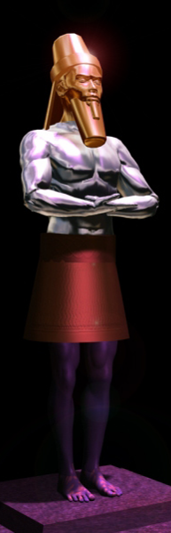
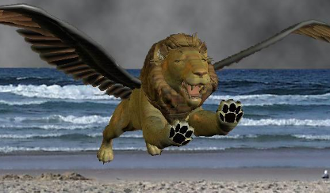
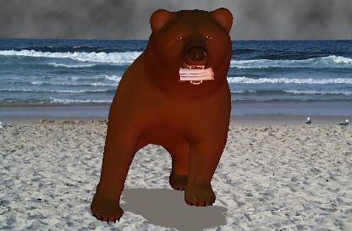
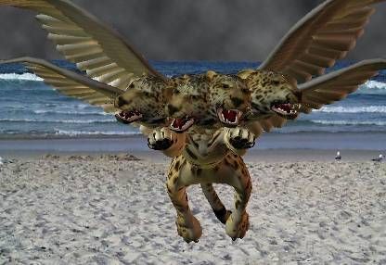
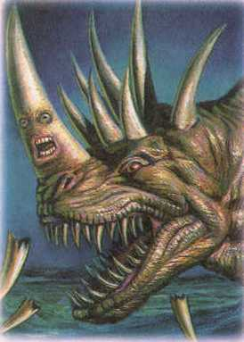
Ch. 2
Ch. 7
Babylon
626 – 539 BC
Medo-Persia
539 – 330 BC
Greece
330 – 63 BC
Identified – 8:21
Rome –
10 Horns -
63 BC
AD 470
DANIEL’S IMAGE
Little Horn
800 AD – 2060 ?!

Slide 18
What they understood
The fourth empire of Daniel 2 was represented as the fourth beast in Daniel 7, was the same beast as the beast of the sea in Revelation 13.
The combination of the descriptions of the beasts of Daniel 7 and Revelation 13 (together with Revelation 16 and 17), were understood to be a prophecy of this reconstitution of a new Roman empire comprising Western European nations, with the antichrist (papal) system as the combining and dominant element.

Slide 19
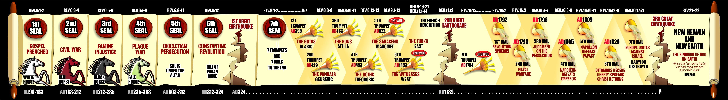
The Seven Seals of the Revelation:

Slide 20
The Story
the dream,
the puzzled king,
the unskillful experts,
the angry tyrant,
the hero in danger,
the victorious hero appearing last,
the king open to insight and change,
the hero rewarded
Notes:
Why the dream?...=v29
Found himself at the head of world power, bereft of Dad, sole ruler,
Most businesses go broke within the first 2 years & this is within 2 yrs of Carchemish where Neb had done the impossible…the giant slayer

