Slide 1
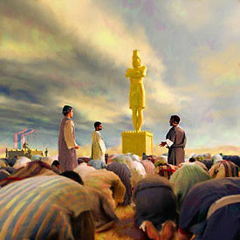
The Living God

Slide 2
What was the image?
What was the image?
Nebuchadnezzar? (a big selfie)
A Babylonian god?
The spirit of Babylonia?
Generic?
The image was a cunning stroke of genius

Slide 3
The God Test is…
Who can predict the future?
Yahweh predicts that he will navigate safe passage for Israel.
To prove that he is God he says “Israel will be safe”.
(Isa 43:1-13)
Babylon predicts that they will destroy Israel.
To prove that Babylon is god they say “We will destroy Israel”.
(Isa 44:7; 47:6-7)

Slide 4
Babel ever seeks to recombine
Most impressive statue that dispersion Jews had ever seen.
Largest crowd of dignitaries ever witnessed.
Representing as many nations imaginable.
United around a single unifying project/religion.
A furnace for firing new bricks?? (Gen 11:3)
Like the European project today.

Slide 5
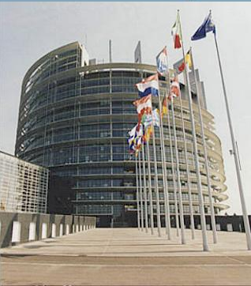
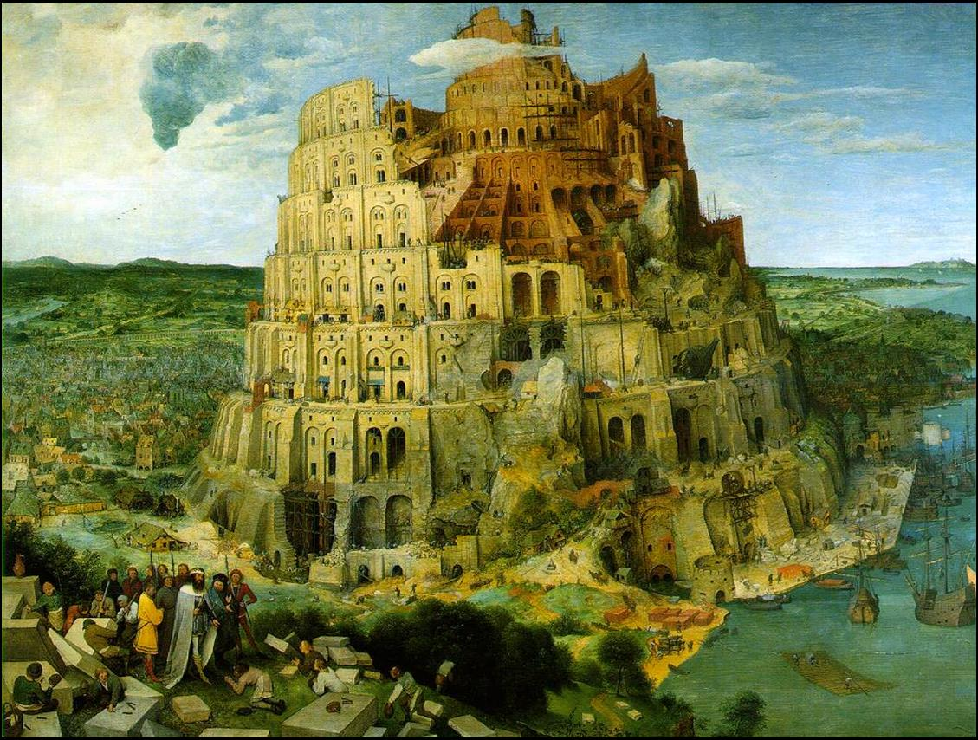
Modern Babylon

Slide 6
Man v God (Isa 46)
Must be chosen
Must be made
Must be set up
Can’t “go” from A to B
Must be carried
Can’t impart power to the weary beasts
Can’t answer
Can’t save
Chooses us
Makes us
Is powerful
Tells the future
Carries us from birth
Strengthens us
Saves us

Slide 7
Nebucadnezzar’s commands
(4) – you are commanded
(10) - “didn’t you make a command”?
(13) – angry “bring them here”
(19) – berserk “heat it up,…keep going” xs7
(v22) – too urgent it killed the innocent
(v26) – exasperated “come out, get out”
(v28) – admits its not his day
(v29) – attempts to save face “don’t blaspheme that God” = only command upheld that day!

Slide 8
The Charge v12
They are Jews.
You gave them jobs
They are leaders of Babylon
Disrespecting you
Refuse to serve Babylonian gods
Refuse to worship the image
You made the image

Slide 9
V17 - How?
God can save us from the furnace
He will save us from you.
How??
If saved from the furnace they are also saved from Nebuchadnezzar.
If they die, they are also saved from Nebuchadnezzar.

Slide 10
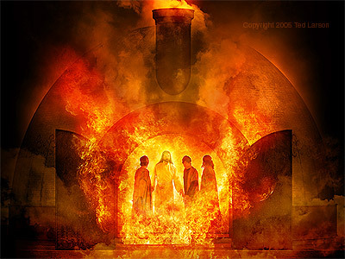
I see four men…

Slide 11
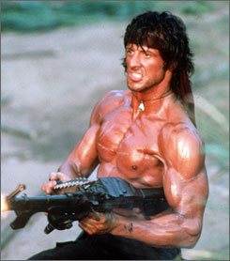

Slide 12
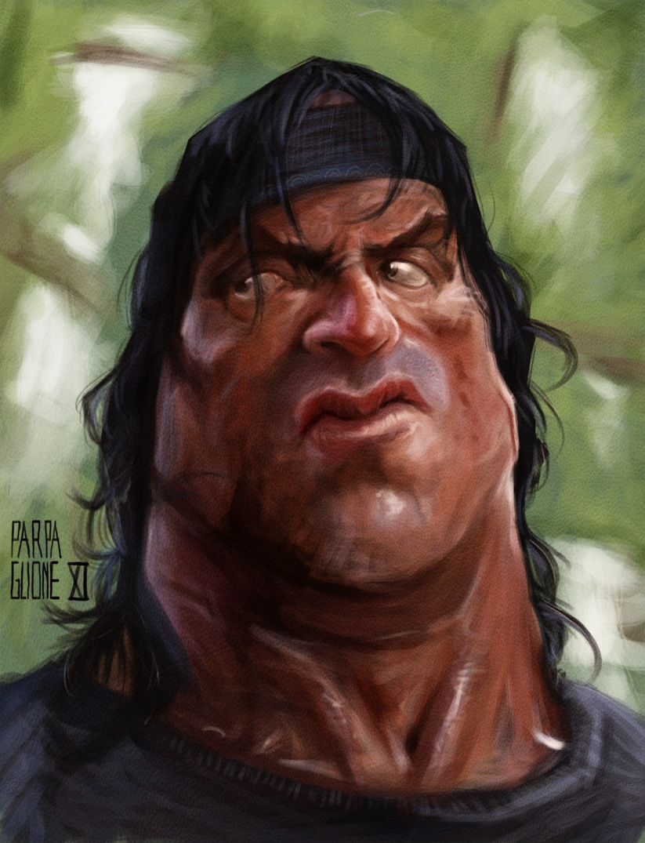

Slide 13
Chilling Comparison
God is acknowledged not because he is God, but because this helps to undergird the state. Herr Baldur von Schirach declared in 1936,
“﻿One cannot be a good German and at the same time deny God, but an arousal of faith in the eternal German is at the same time an arousal of faith in the eternal God. If we act as true Germans we act according to the laws of God. Whoever serves Adolf Hitler, the Führer, serves Germany, and whoever serves Germany serves God﻿”

