Slide 1
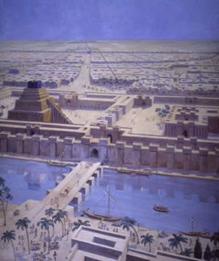
The
Last Supper

Slide 2
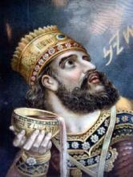
Context of Chp 5
539 BC
Daniel 84yrs
Nebuchadnezzar dead for 23 yrs
Belshazzar ruling for 14 yrs
Chp 4 around 40 yrs ago

Slide 3
Kings of Babylon
Nebuchadnezzar – 605-562
Evil-Merodach – 562-560
Nergalsarezer – 562-556
Labashi-Marduk – 556 (9 months)
Nabonidus – 556-539
Belshazzar – coregent 553-539

Slide 4
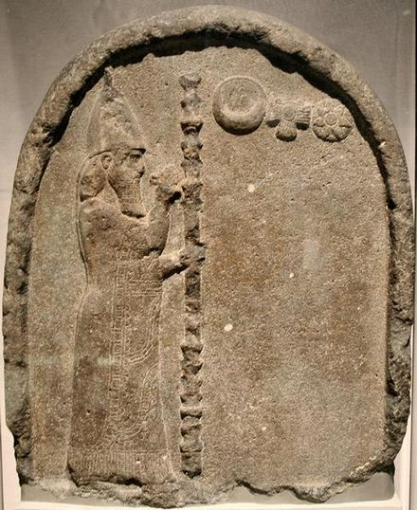
Nabonidus in relief showing him praying to the moon, sun and Venus

Slide 5
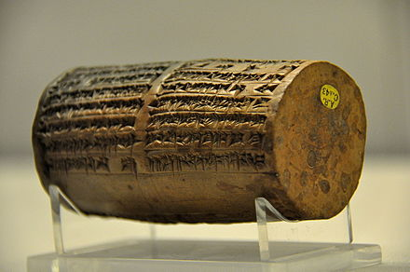
The Nabonidus Cylinder of Sippar on display in the British Museum
“… and as for Belshazzar, the eldest son my offspring instill reverence for your great godhead in his heart and may he not commit any cultic mistake, may he be sated with a life of plenitude."…

Slide 6
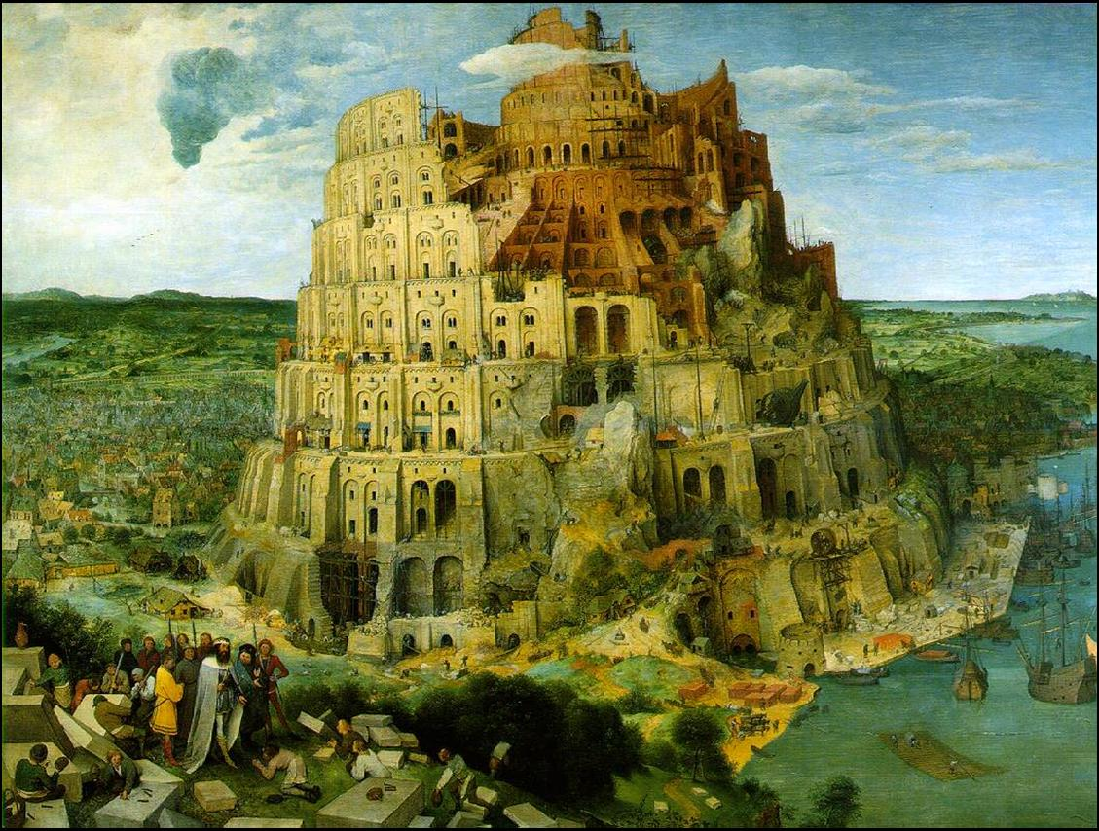
Man's
awesome
Kingdom

Slide 7
Babylonian wine in Israeli cups
Mission = To turn Jews into Babylonians.
Filling the vessels with wine reveals their plan that Jews, full of Babylonian culture would forget their own Jewish culture and…
Praise, serve, honour, sacrifice to and glorify the Babylonian gods.
Vessels are people - II Cor 4:7; I Pet 3:7; II Tim 2:20-23; Jer 27:19; Rev 2:27

Slide 8
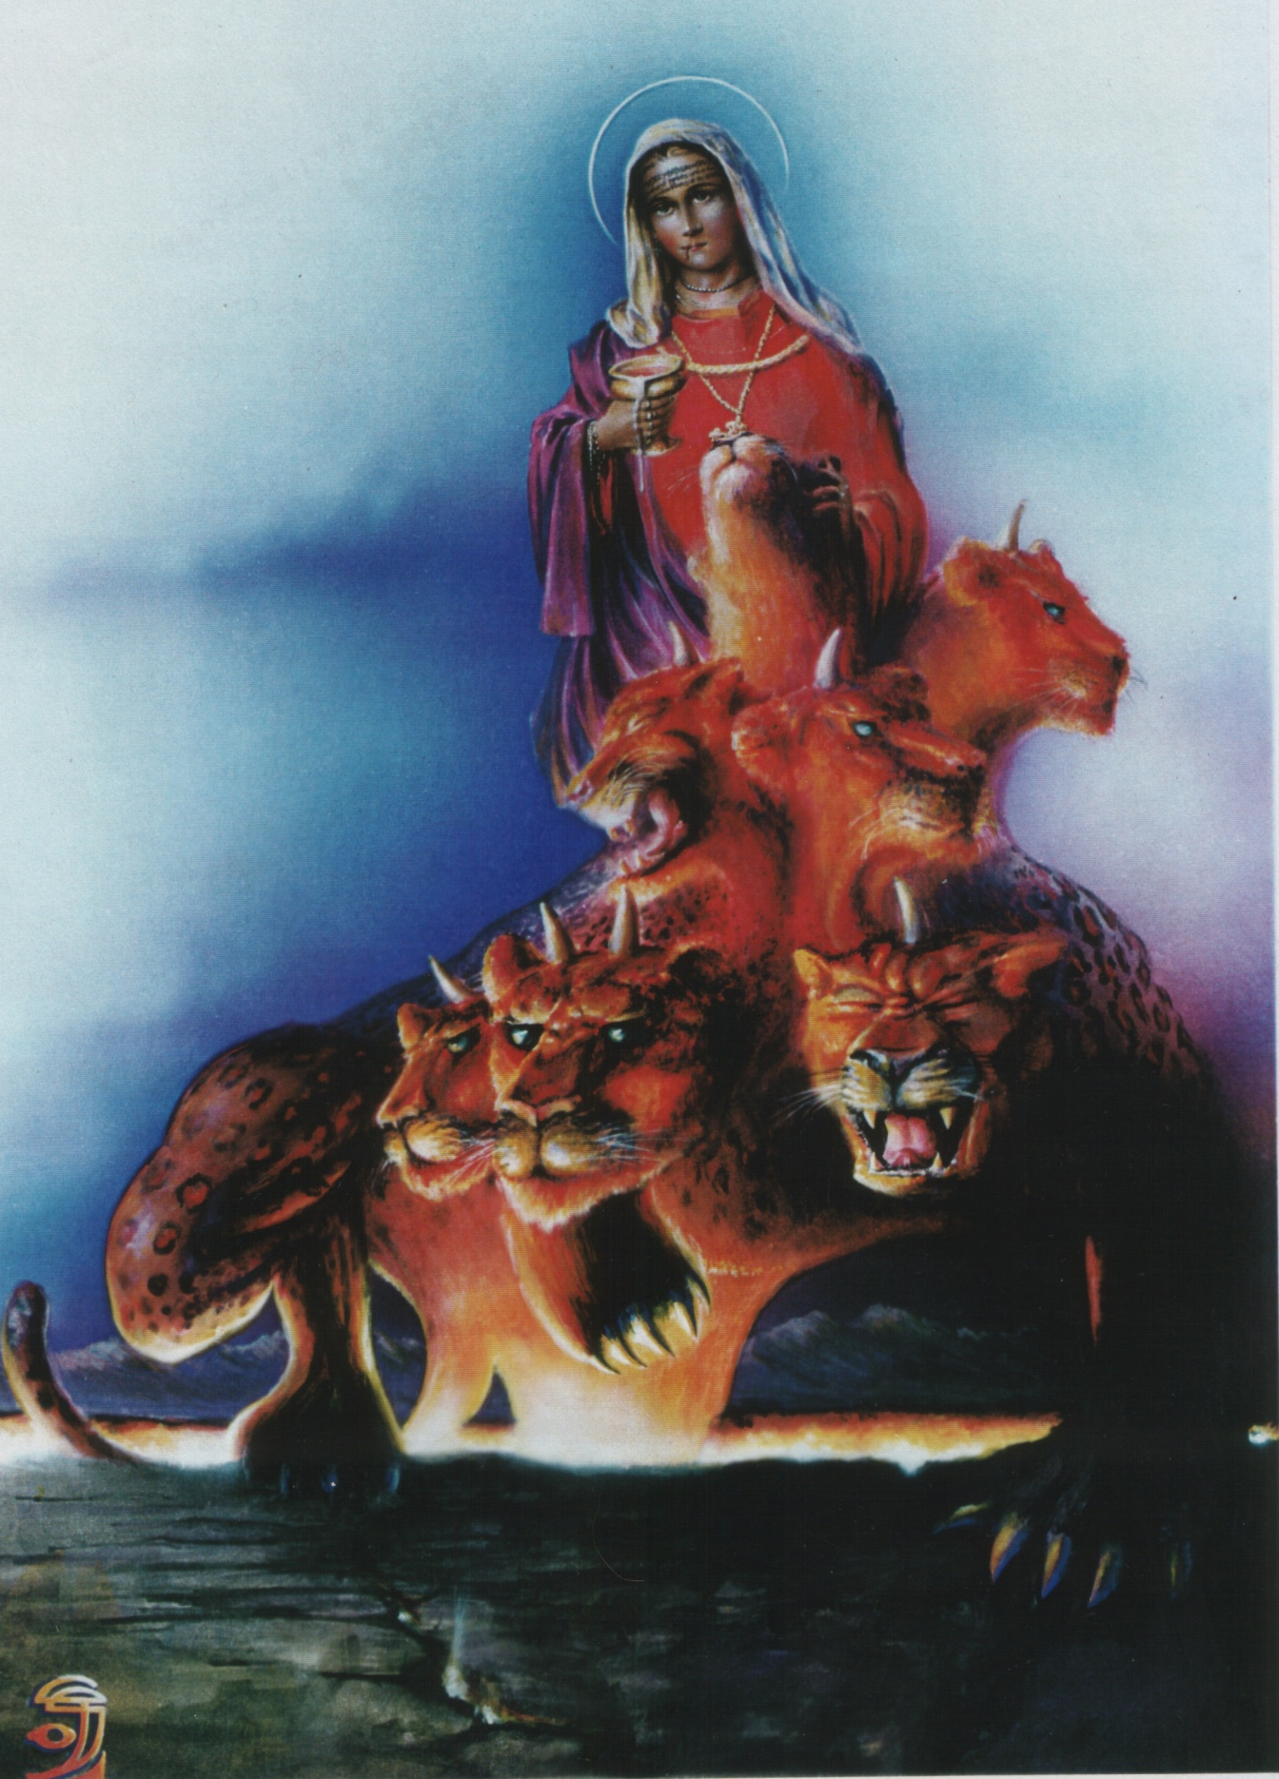
God's
Perspective

Slide 9
MOUTH *6310
Hole in the high priest’s blue robe
28:32; 39:23 “hole”
To THINK or MEDITATE *2803
The skilful work of the mishkan 26:1 “cunning”

FACE *6440
Used for various parts
25:30; 26:9; 28:27; 28:37; 30:6
LIPS *8193
The binding around the hole in the HP’s blue robe
28:32 “binding” 39:23 “band”
Border of the breastplate 28:26; 39:19 “border”
Edge of curtain 36:11 “edge”
Edge of outer coverings 36:17 “edge”
SHOULDERS *3802
27:14-15; 38:14-15 “side”
Two short curtain sections either side of outer court entrance
RIB *6763
sides of the :- Ark 25:12,14; 37:5 “Side”
The Tabernacle 26:20,26,27,35; 36:25,31,32
Altar 27:7; 38:7
AOI 30:4; 37:27 “corners”
HAND *3027
26:17,19; 36:22,24 “tenons”
HOLLOW of the hand & the SOLE of the foot *3709
25:29; 37:16 “spoons”
LOINS *3409
The stem of the lampstand
25:31; 37:17 “shaft”
Nth & sth side of tabernacle
40:22, 24 “side”
FEET *7272
25:26 TOS

Slide 10

BROTHER *413 *251
The two cherubim over the mercy seat.
Lit – “man to his brother”
25:20; 37:9 “one to another”
SISTER *802 *269
The curtains for the mishkan
Lit – “woman to her sister”
26:3 “one to another”

Slide 11
Daniel 5 | The upper room
Daniel the traitor is a righteous man | Judas the betrayer is an evil man
Babylon is a destroyer | Christ is a saviour
Drinking from the cup praised the gods of gold and silver | He took the cup and praised God
Babylon was destroyed but later resurrected in Revelation | Christ was killed but resurrected
Before his lords | Before his disciples
Proud | Humble
Drunken | Sober
Everything represented by Christ - Belshazzar mocked | Everything represented by Babylon Christ condemned
In that night Belshazzar was slain | In that night Christ was betrayed
Belshazzar lived his final moments to himself and would not sacrifice himself for any | Christ lived his whole life to save others and in his final hours gave all he had to save

Slide 12
“Because” NOT “though”
(2:8) The liars were trying to gain time BECAUSE they saw the word of the king was firm.
(3:29) not blaspheme against God BECAUSE there is no God who can deliver like that.
(4:18) Daniel was to tell the dream to Nebuchadnezzar BECAUSE the Babylonians were unable to. (5:12)
(6:22) shut the lions mouths BECAUSE he was innocent.

Slide 13
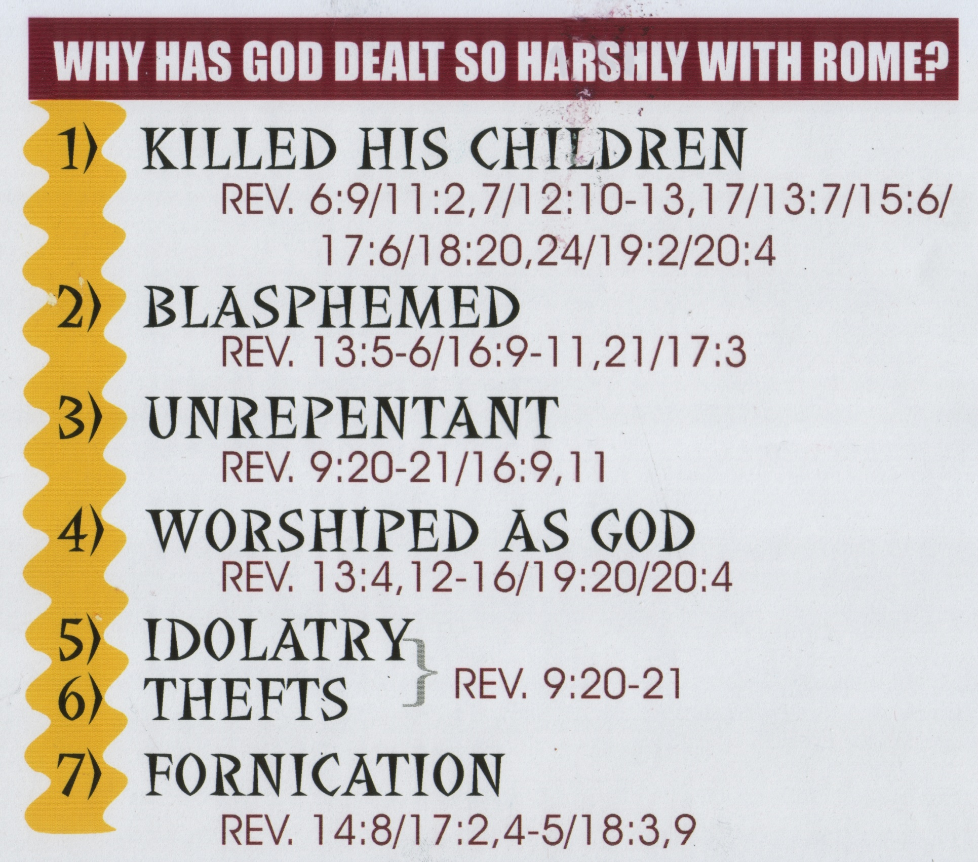

Slide 14
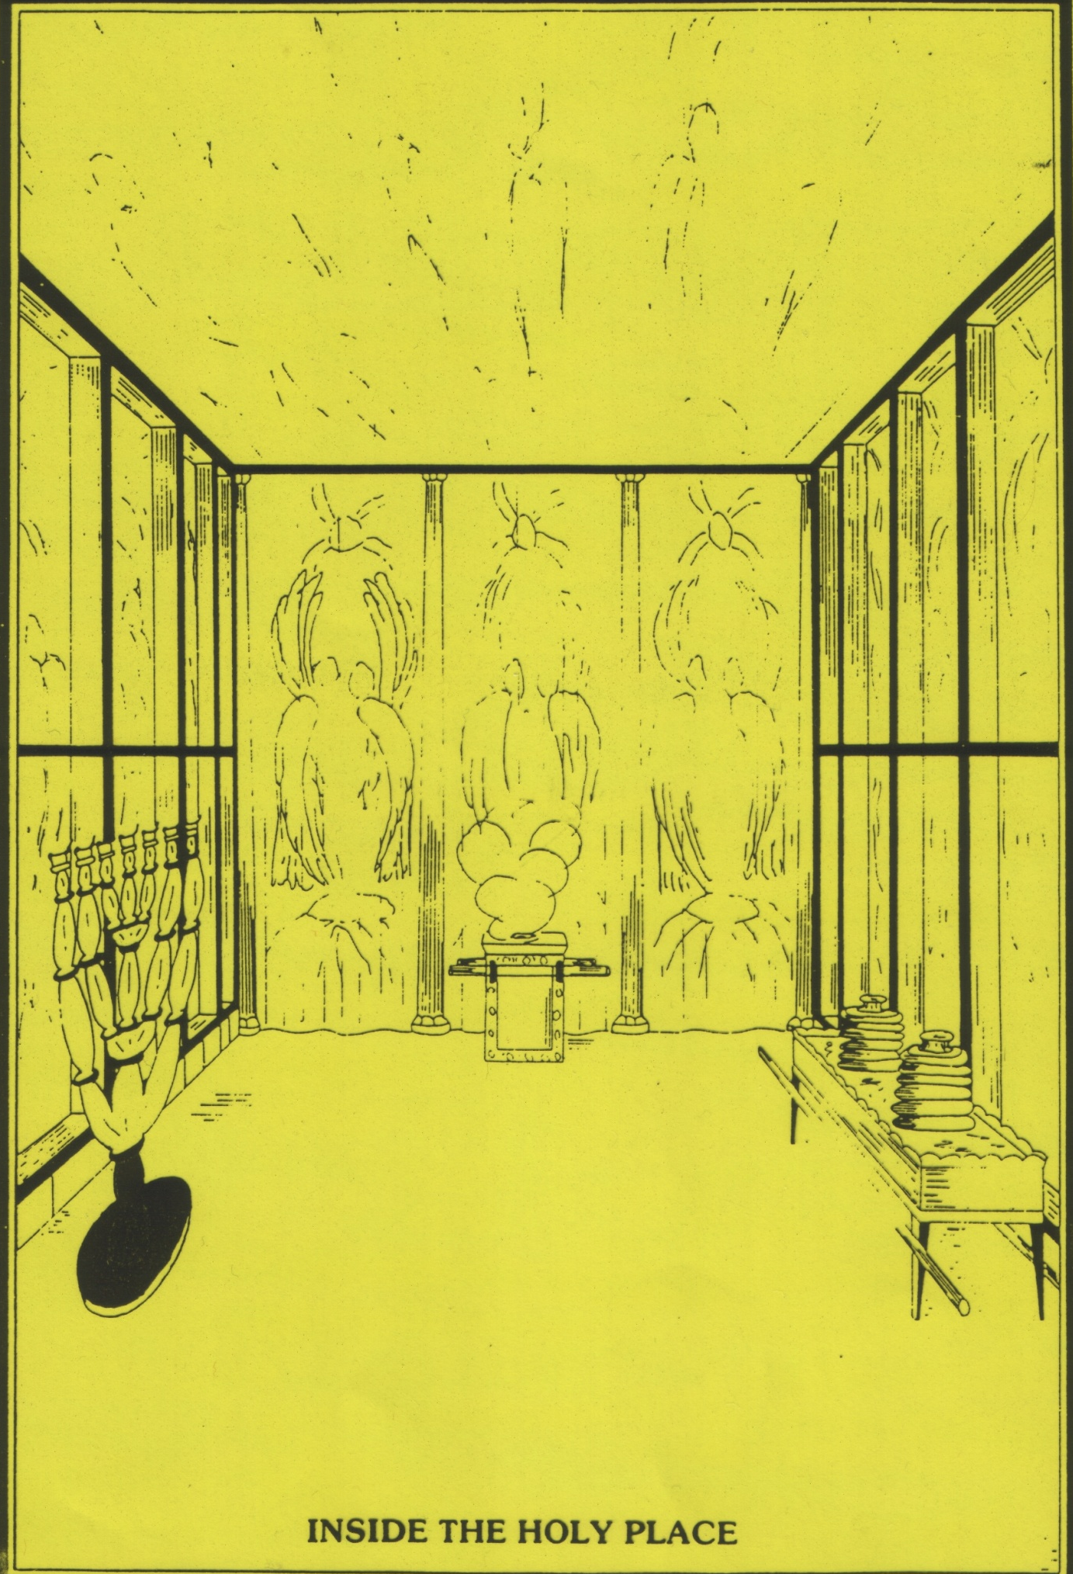

Slide 15
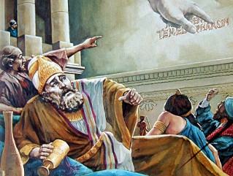
Daniel’s Hand in Babylon

Slide 16
Daniel’s Hand in Babylon
Dan 5:6 KJV - Then the king's countenance was changed, and his thoughts troubled him, so that the joints (7001) of his loins were loosed (8271), and his knees smote one against another.
Dan 5:12 Forasmuch as an excellent spirit, and knowledge, and understanding, interpreting of dreams, and shewing of hard sentences, and dissolving (8271) of doubts (7001), were found in the same Daniel, whom the king named Belteshazzar: now let Daniel be called, and he will shew the interpretation.

Slide 17
The Servant knows
MEANING
Mene - to count/number
Tekel - to weigh
Parsin - divided ie, two minas…
INTERPRETATION
God has counted your days & numbered them
God has weighed you & found you insufficient eg, morally.
Your kgd divided & (like word for Persian therefore) given to them.

Slide 18
The Writing

Slide 19
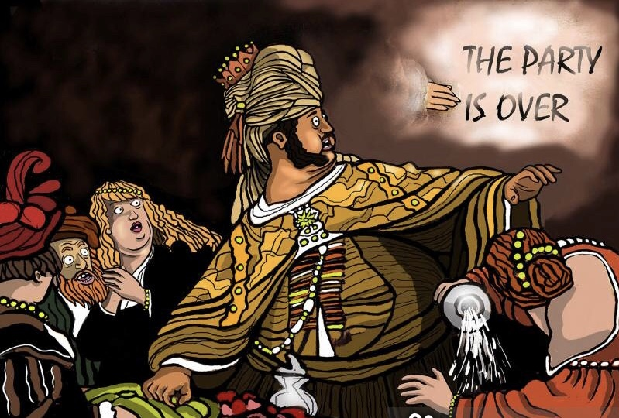
The Translation

Slide 20
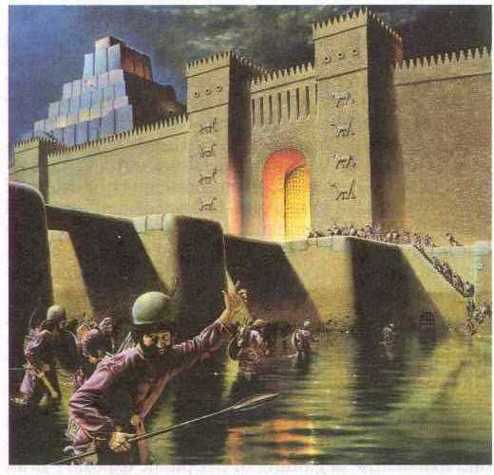
Babylon is
Fallen !!

Slide 21
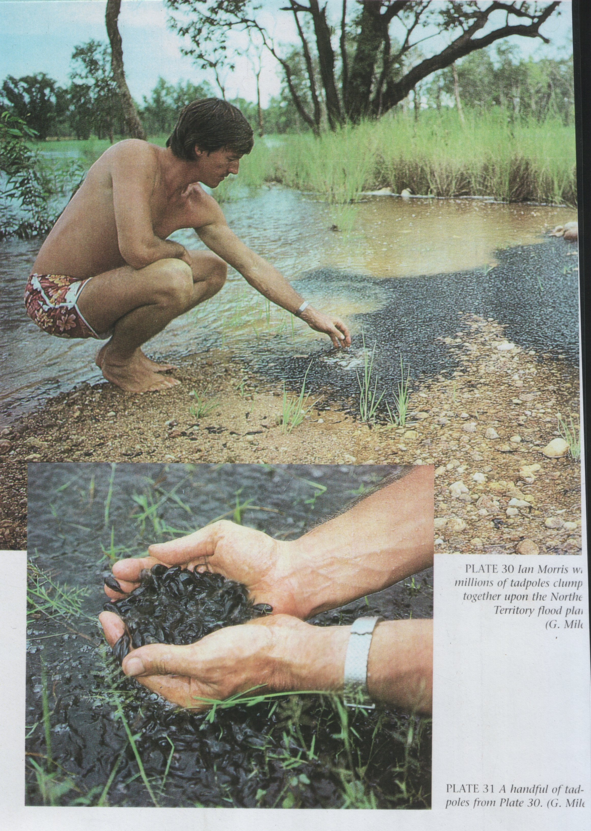

Slide 23
Weighed and found wanting
Do a slide of balancing scales with dan 4 and dan 5 on either side…representing belshazzer compared to the likes of neb.

