Slide 1
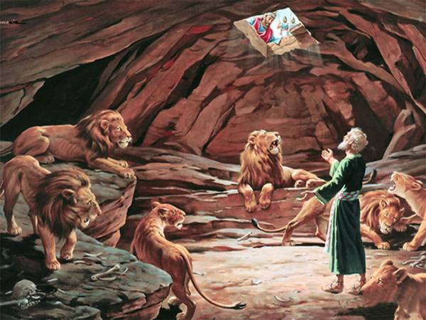
Delivered for envy

Slide 2
Time frame
539 BC.
24yrs after Nebuchadnezzar’s death.
0-2yrs before Cyrus’ decree.
68yrs in Babylon for Daniel
85yrs old (approx).

Slide 3
Kings of Babylon
Nebuchadnezzar – 605-562
Evil-Merodach – 562-560
Nergalsarezer – 562-556
Labashi-Marduk – 556 (9 months)
Nabonidus – 556-539
Belshazzar – coregent 553-539

Slide 4
Daniel’s Life
Chapter | Vision/visitation | Age
1 | None | 17
2 | Dream revealed in vision | 20
3 | Not his | 38?
4 | Not his | 40?
7 | 4 beasts | 70
8 | Ram & He-goat (Gabriel) | 72
5 | Not his | 83
9 | Gabriel visits | 85
6 | Angelic deliverance | 85
10-12 | One single visitation consisting of the man of the one, kings of north and south, the time of the end (Gabriel) | 86

Slide 5
Daniel’s experience
Envy
Faithfulness
Betrayal
Concocted charges
Confused and proud rulers
A stone with a seal
Unexpected salvation

Slide 6
Why did they object to Daniel?
Racism (v13).
Envied his success (Ecc 4:4).
Own ambitions.
Honest - Chance for corrupt gain was nullified
Because he was good.

Slide 7
Came by agreement
AV = “assembled” H7284רגשׁ (Aramaic)
to be in tumult
to gather in a tumultuous throng, show tumultuousness, come thronging
Part of Speech: verb
Same word (v7,11,15)

Slide 8
Apostolic Pattern
3rd Hour (9am) - (Act 2:15)
6th Hour (12pm) – (Act 10:9)
9th Hour (3pm) - (3:1)
morning, noon and evening.

Slide 9
Why Pray?
Example
Habit
Safest option
Honoured God

Slide 10
Why stand firm?
All four stood firm in Chapter 1 and set the basis for all acts of national faithfulness (1:20)
Daniel boldly and wisely interpreted Nebuchadnezzar's dream and the king honored Daniel and his God (2:46-47)
Shadrach, Meshach, and Abed-Nego stood firm and Nebuchadnezzar gave glory to God (3:28-30)
Daniel faithfully told Nebuchadnezzar the truth and the king humbled himself and gave glory to God (4:34-37)
Daniel stood firm and defiantly told Belshazzar the truth and the king honoured Daniel (Daniel 5:29)
WHY?...So God can ultimately be honoured.

Slide 11
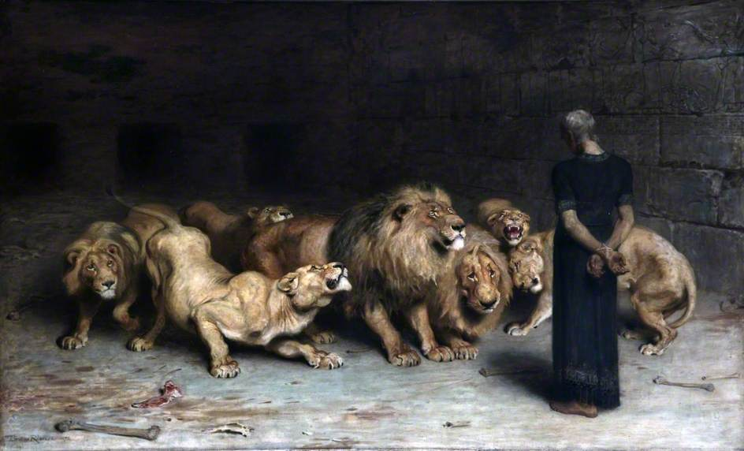
Stopped the lion’s mouths

Slide 12
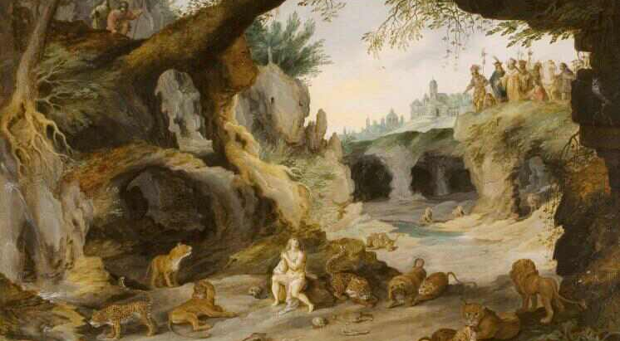
Vast Den

Slide 13
3 and 6
Jews put in vulnerable position because of royal edict.
Indicted by jealous colleagues.
Accused of slighting kings authority.
Capital punishment called for by law.
Mention of possibility that God can deliver.
Servants unharmed.
Mode of death represents source of persecution
            Nebucadnezzar = Fiery furnace
            Accusers = Lions
Declaration by king that all people recognise their God.
Hebrews links both chapters (Heb 11:33-34).

Slide 14
The Symbols from Daniel are transferable to our lives
Not lions but those who devour our faith
Not furnace but trials and hatred as hot
Not wine but immoral world seducing us
Not vessels but us abused by sin as we try to serve God
Not beasts but nations who lie and murder
The book of Daniel is in every way relevant to us.

Slide 15
Lollapalooza
An extraordinary or unusual thing or event; an exceptional example or instance.
An amazing remarkable thing.
Bigger than Ben Hur

Slide 16
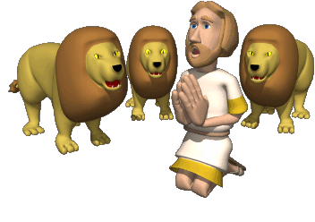
Preschool

