Slide 1
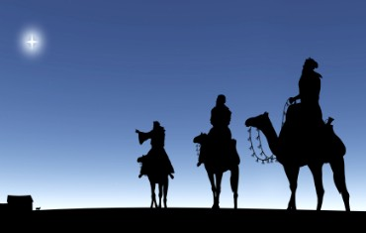
The Wise Men

Slide 2
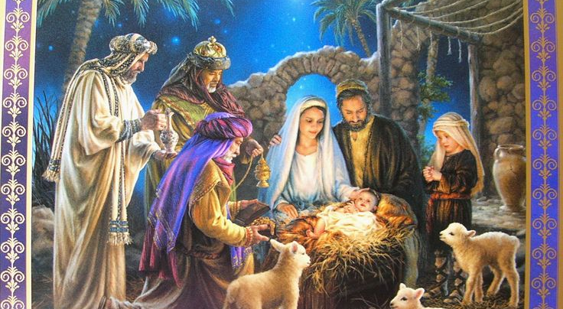
Nativity Scenes

Slide 3
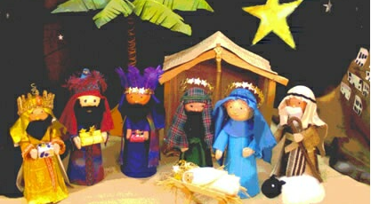
Nativity Scenes

Slide 4
Magi
(1) members of a Persian priestly class
(2) possessors of supernatural knowledge and power
(3) magician
(4) deceiver or seducer.

Slide 5
Herod the Great
Edomite
A terrible person
A psychopath
10 wives
Paranoid - Killed his own son and some of his relatives
“better to be his pig than his son”
Died of a disease… commanded the priests of Jerusalem to be executed the moment of his death so that the city would be in mourning instead of celebration.

Slide 6
Chronology
Born (Lke 2:7)
Shepherds, manger, Bethlehem (Lke 2:1-20).
8th day Circumcision probably in Beth (v21).
40 days later Jerus (v22)…resides in area of Bethlehem or Hebron Eliz’s house?!
Where wise men visit up to two yrs old (Mat 2:11, 16)
Flees to Egypt (Matt 2:13-15)
Babies killed (Matt 2:16)
Nazareth (Matt 2:23) cp.Luke 2:39.

Slide 7
Similarities with Num 22-24
The wicked, threatened king
The strange non-Israelite “medium”
Who comes from the east
The talk of a coming king
The star symbolism.

