Slide 1
Point of the chapter
v3 ‘Works of God made manifest’
5319 – ‘to render apparent’
So they could be seen!!!

Slide 2
Syllogism of Job
Sinners suffer
Job suffered
Job was therefore
a sinner

Slide 3
What does ‘spittle’ represent ??
Num 12:14 Miriam
Lev 15:8 Unclean would affect others
Deut 25:9 Not provide family for Brother
Job 30:10 an abhorrent person
Mat 26:67 For blasphemy
Mat 27:30 When mocking

Slide 4
Spit is reserved for…
Mockers, blasphemers, abhorrent people, rebellion, everything that offends & causes repulsion & disgust.

Slide 5
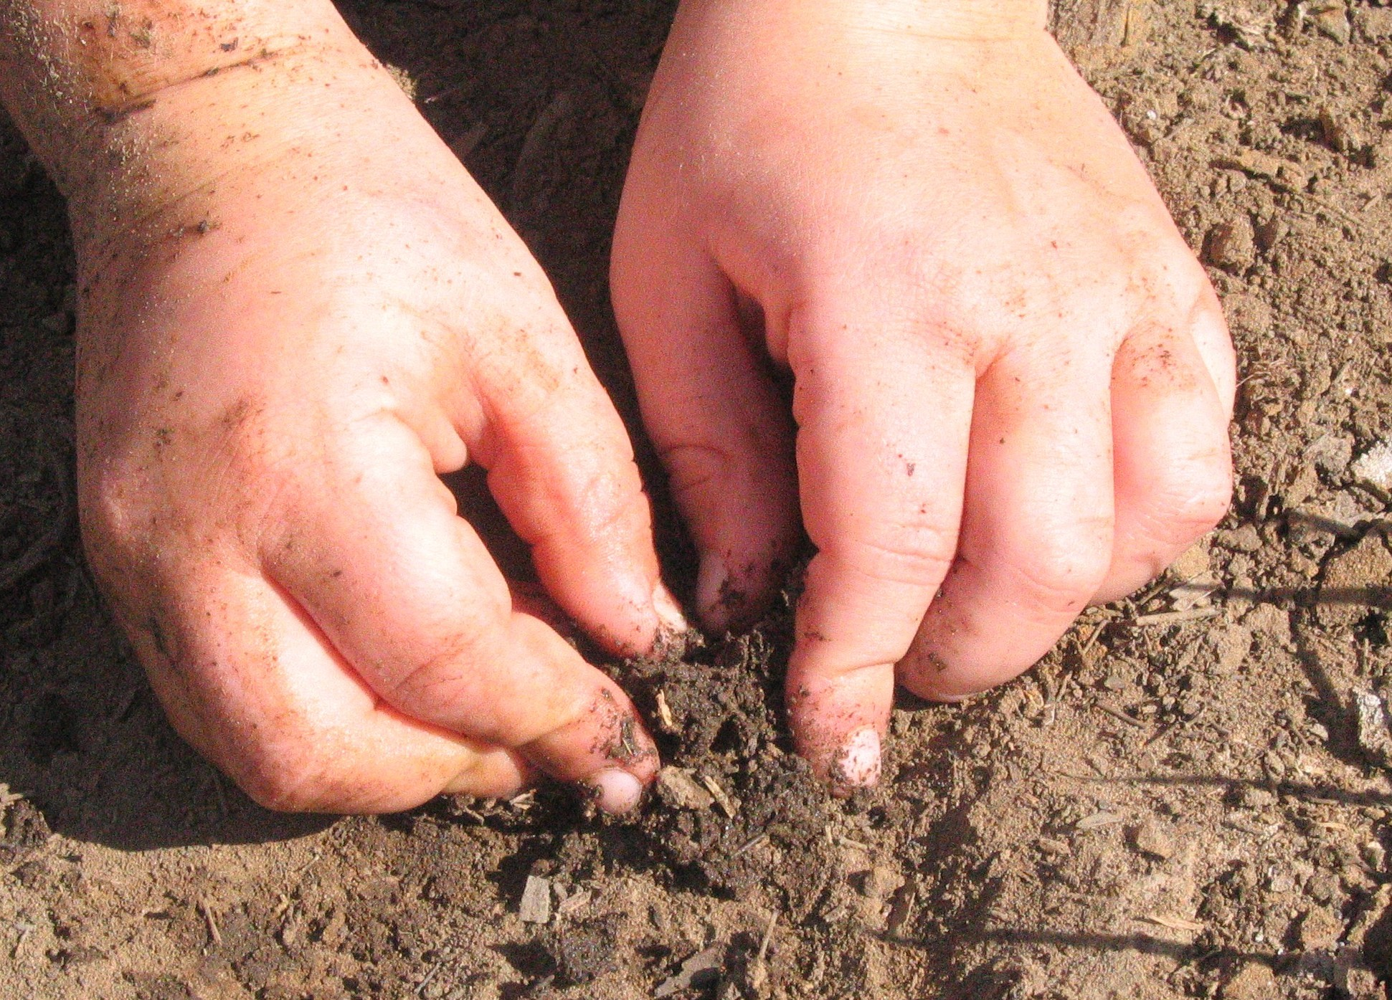

Slide 6
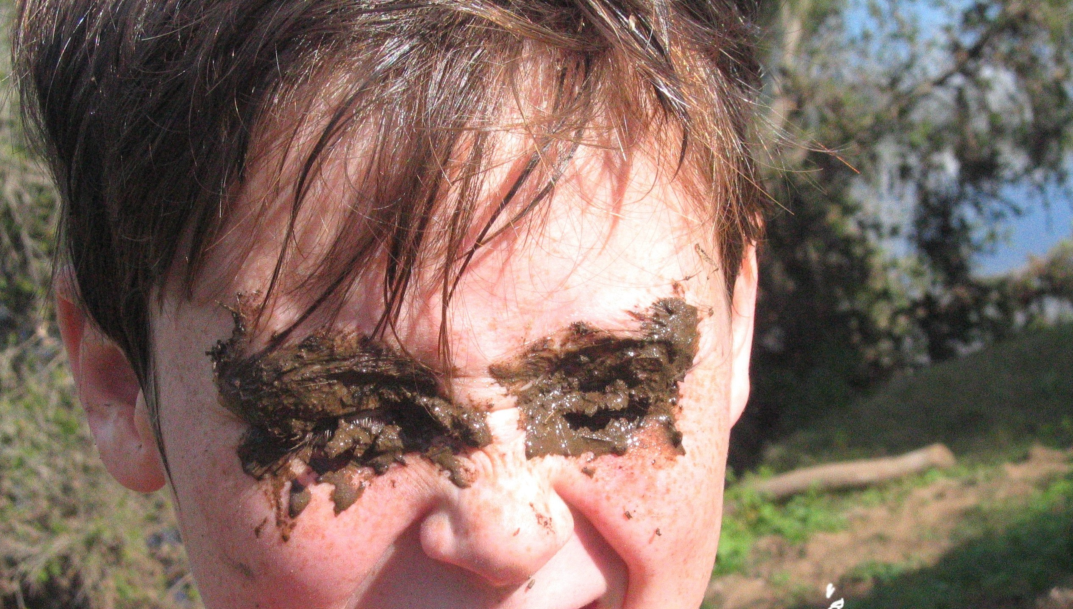

Slide 7
Isa 44:17-18
‘Shut’
H2902 טוּח
ṭûach
too'-akh
A primitive root; to smear, especially with lime: - daub, overlay, plaister.

Slide 8
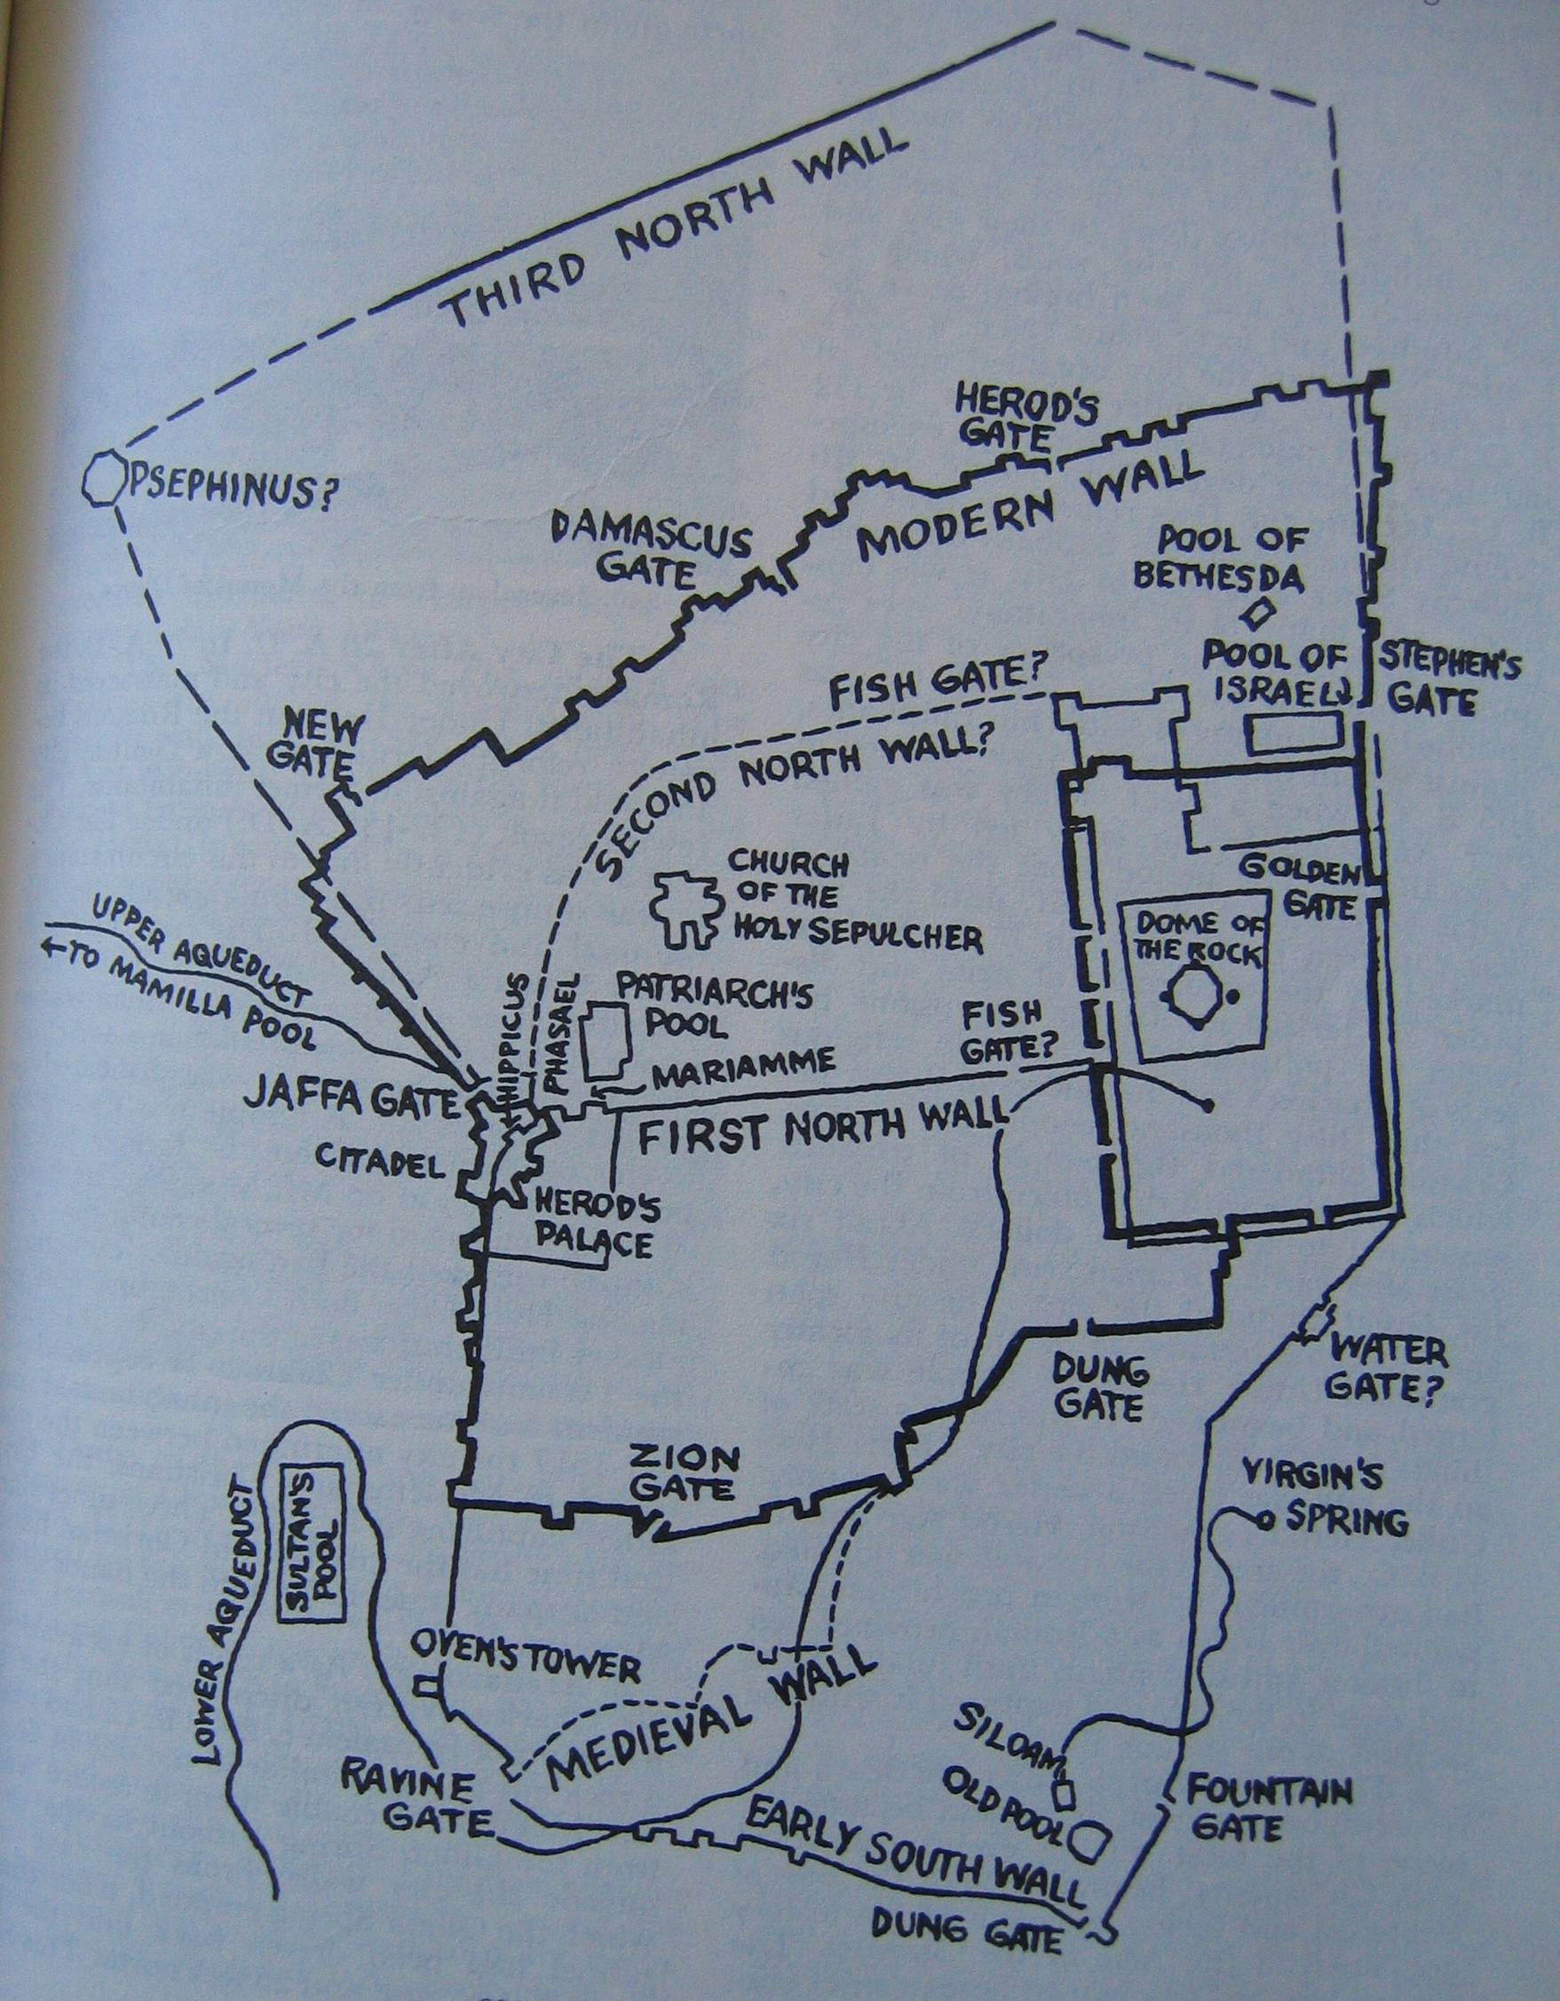

Slide 9
Melva Purkis, p.238
“In a breathless
moment he looked out upon a world of movement & colour.
The sounds & sensations
of a lifetime took
form & beauty.”

Slide 10
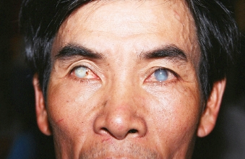

Slide 11
Excommunication
For lighter offences (24 causes) 30 day exclusion from synagogue & 4 cubits from anyone including wife & children.
30 more days.
Utter exclusion forever from worship & contact with other people who were ordered to refuse to sell them anything…treated as one dead.

Slide 12
Questions to the man ????
v10 How were thine eyes opened?
v12 Where is he?
v15 How did you receive your sight?
v17 What sayest thou of him?
v26 What did he to thee?...
How did he open thine eyes?
v34 You were born in sins &
do you teach us?

Slide 13
Other Questions ???
v2 Who sinned…him or parents?
v8 Is that him that begged?
v16 How can a sinner do such miracles?
v19 Is this your son,…born blind?...
how come he can see?
v27 Will you hear again?
Will you be his disciples?

Slide 14
Logic
Amazing thing
You don’t know where he comes from
Opened my eyes
God doesn’t listen to sinners
God listens to worshippers
No one born blind ever been healed
He is from God or else he would be powerless

Slide 15
The question that matters is…
 “Dost thou believe on the son of God?”
“I Believe”

Slide 16
Stages of Spiritual perception
v11 ‘a man called Jesus’
v17 ‘a prophet’
v27 desire to be his disciple.
v33 ‘man…of God’
v38 belief in the son of God.
Have we reached that stage?

Slide 17
4352 Thayer Definition
1) to kiss the hand to (towards) one, in token of reverence
2) among the Orientals, especially the Persians, to fall upon the knees and touch the ground with the forehead as an expression of profound reverence
3) in the NT by kneeling or prostration to do homage (to one) or make obeisance, whether in order to express respect or to make supplication
Strong’s like a dog licking his master’s hand

Slide 18
Christ worshipped?!
Matt 2:2,11 Wise men;
8:2 Leper
9:18 Ruler;
14:33 Disciples
15:25 Woman of Canaan
20:20 James, John & Mum
Mrk 5:6 Legion
28:17 Disciples after resurrection
Lke 24:52 Large group at ascension

Slide 19
Nazerath Revisited p.219.
Yes, why not?
It is written,
‘Let all the angels of God
Worship him’
Shall we…refuse to bend the knee…
‘To Him every knee shall bow…’
Christ accepted the worship

