Slide 1
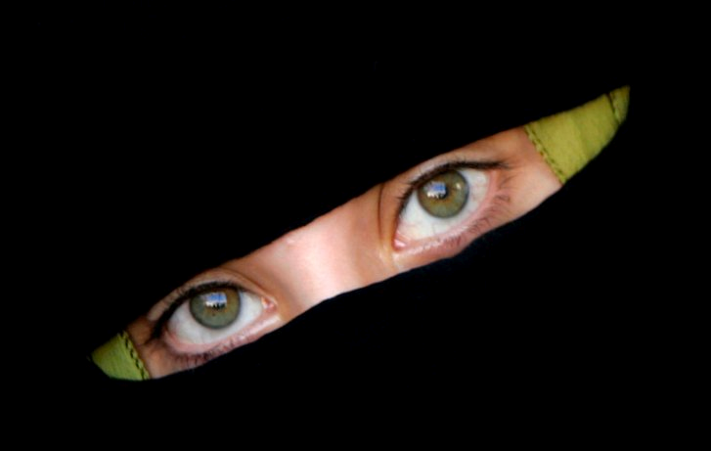
ESTHER
QUEEN OF DESTINY

Slide 2
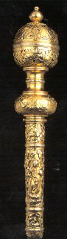
THE SCEPTRE
THE RISE OF AHASUERUS
Esther 5v1 – 6v11

Slide 3
“Sceptre of righteousness”
Symbol of Kingship and Rulership Gen 49v10
Symbol of Power and Justice Num24v17
Symbol of Righteousness and Permanence
Psalm 45v6, Hebrews 1v8
An extension of God’s “stretched out arm”…
Deut 4v34, 5v15, 7v19, 11v2, I Kings 8v42, II Chron 6v32, Psalm 136v12, Jer 32v21, Ezek 20v33-34

Slide 4
The Hallmarks of Pride
(1) Pride is absolutely selfish...v11
(2) Pride rejoices not so much in the inclusion of self, but the exclusion of others…v12
(3) Pride can never make you happy…v13
(4) Pride inevitably ends in hate v14

Slide 5
God’s View of Pride
Proverbs 6v16-17 – “These six things doth Yahweh hate: yea, seven are an abomination unto him: A proud look, a lying tongue”…
Proverbs 11v2 – “When pride cometh, then cometh shame”…
Proverbs 16v18 – “Pride goeth before destruction, and an haughty spirit before a fall”…(Middle verse of Proverbs!)
Proverbs 29v23 – “A man’s pride shall bring him low”…

Slide 6
The Importance of HUMILITY
Revelation 19v8– “And to her was granted that she should be arrayed in fine linen, clean and white: for the fine linen is the righteousness of saints.”…
I Peter 5v5– “Yea, all of you be subject one to another, and be clothed with humility: for God resisteth the proud, and giveth grace to the humble.”…

Slide 7
ESTHER
QUEEN OF DESTINY

