Slide 1
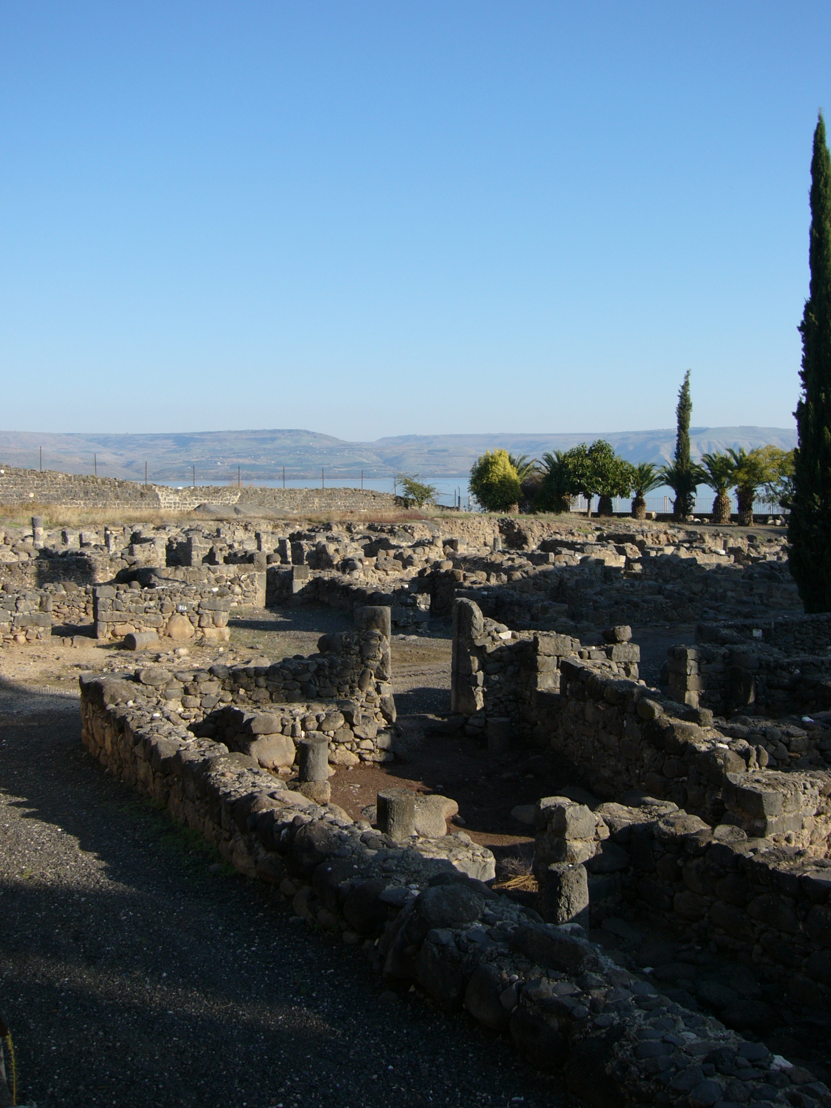
The Trial of our Faith (1 Peter)
1) An apostle of Jesus Christ
Jesus “came down to Capernaum … and entered into Simon’s house” (Luke 4:31,38)

Slide 2
Our introduction to Simon Peter
Simon was the brother of Andrew (John 1:41). Bethsaida (house of fish) in Galilee is given as their place of origin (John 1:44), and during the Lord’s ministry they had a home in Capernaum (Mark 1:21, 29) – which probably means that is where they lived.
“Jesus … said, Thou art Simon the son of Jona: thou shalt be called Cephas, which is by interpretation, A stone” (John 1:42). Simon (or Simeon, ‘hearing’) is named by the Lord Cephas (Aramaic), Petros (Greek), A stone (English).

Slide 3
The call to discipleship
See Matthew 4:18-20: “Follow me (‘Come ye after me’, RV), and I will make you …”
They had to be called and trained in order to continue the work in their Lord’s absence.
The sequence: A relationship to discipleship to apostleship.

Slide 4
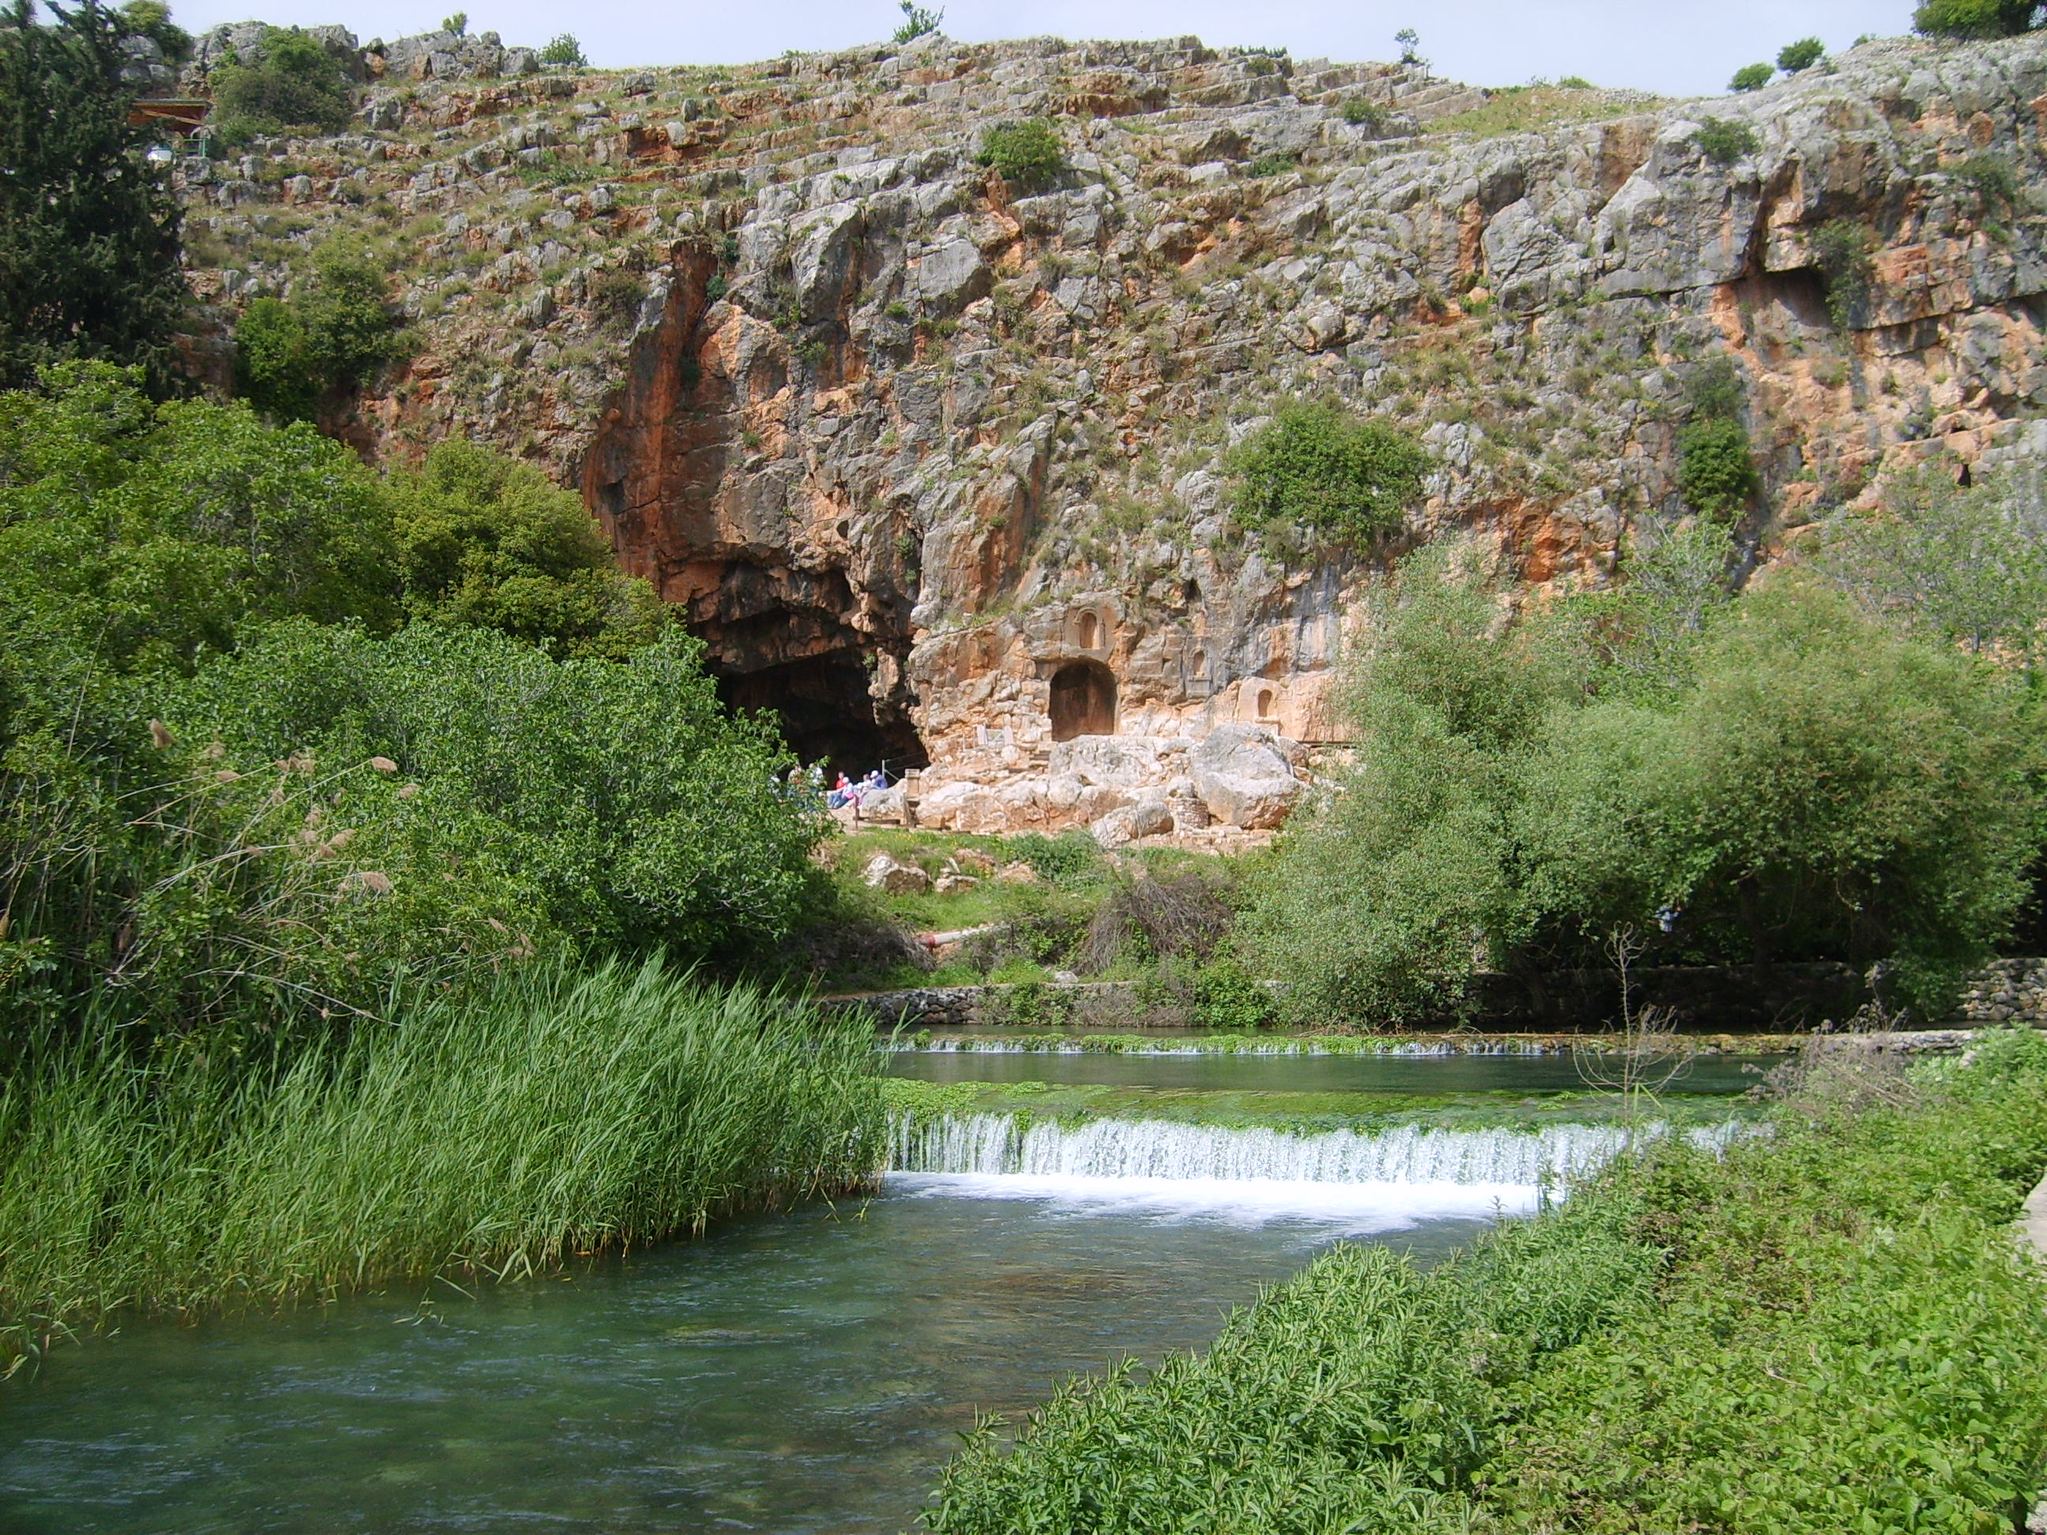
In Caesarea Philippi (Matthew 16)
Called Banias today – one of the tributaries of the River Jordan.
Vs. 13-16: Peter acts as the spokesman of the disciples.
V18: the “rock” is Peter’s confession, “Thou art the Christ” (cp. 1 Cor. 3:11).

Slide 5
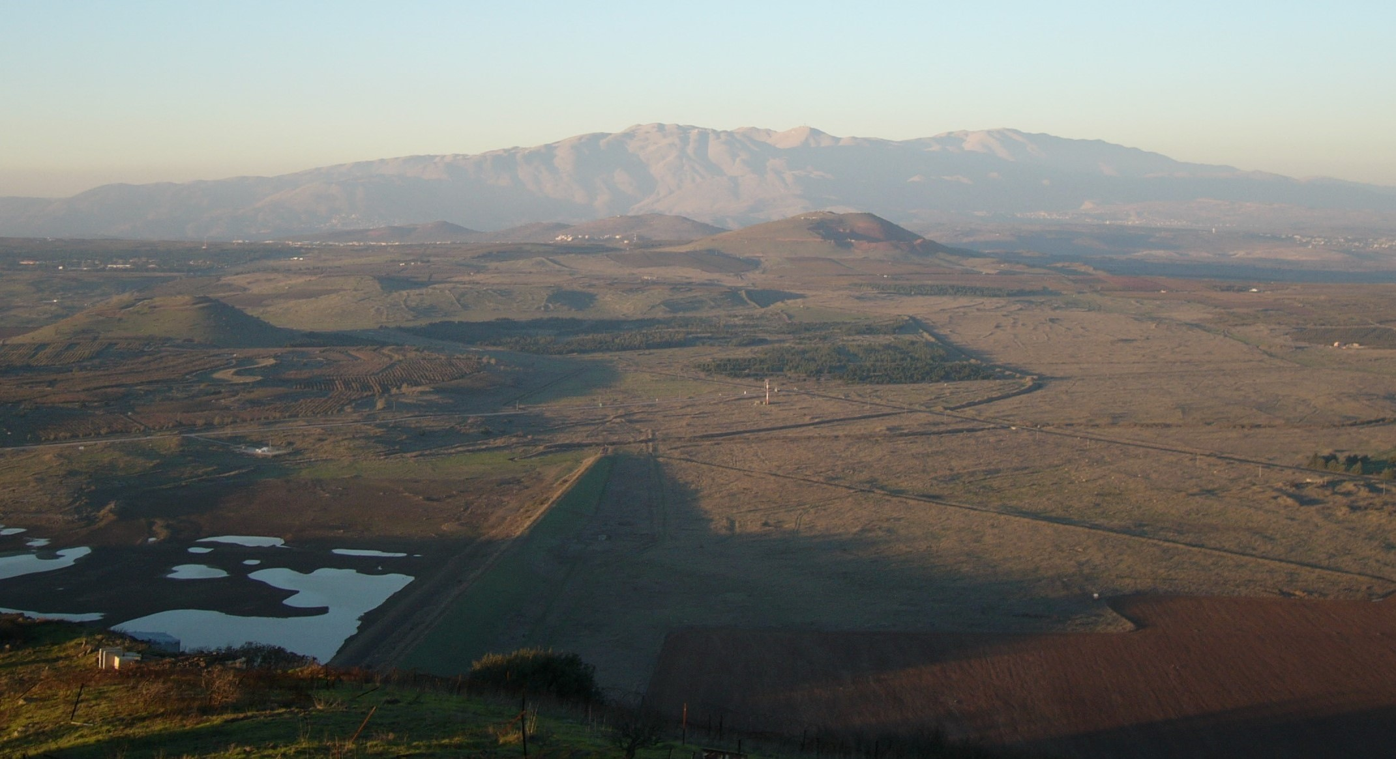
“Jesus … was transfigured before them” (Matt. 17:1-8)

Slide 6
“Satan hath desired to have you”
The Jewish authorities had been watching the disciples, looking for a weak one who might be willing to betray him.
They found the man they were looking for, not in Peter, but in Judas Iscariot. He was a thief (Jn.12:6); they offered him money – and he gave in to the temptation.

Slide 7
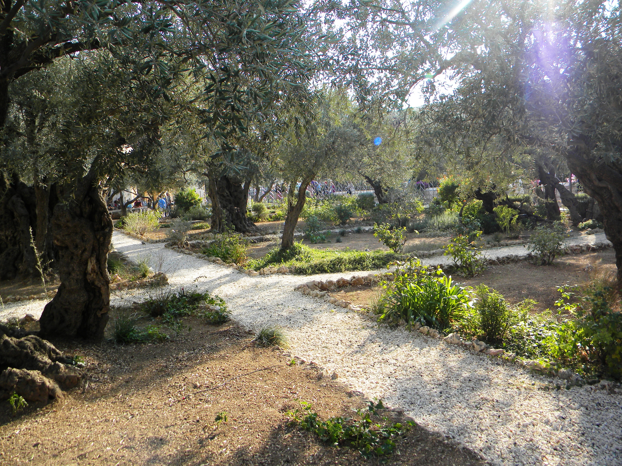
In the Garden of Gethsemane
“Thinkest thou that I cannot now pray to my Father, and he shall presently give me more than twelve legions of angels? But how then shall the scriptures be fulfilled, that thus it must be? … Then all the disciples forsook him, and fled” (Matt. 26:53,54,56).

Slide 8
The message to two disciples
“O fools, and slow of heart to believe all that the prophets have spoken: ought not Christ to have suffered these things, and to enter into his glory?” (Luke 24:25,26).
The Gospel of the kingdom is linked with the fact that Christ has been raised from the dead.

Slide 9
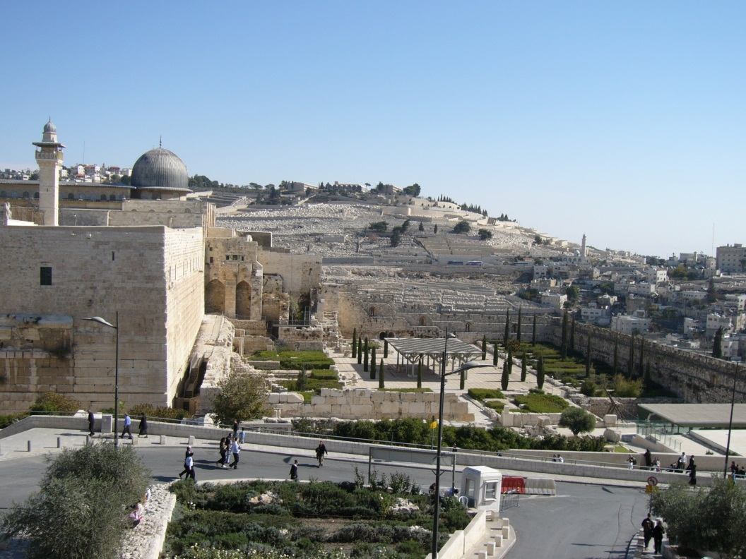
Testimony of angels & apostles
“This same Jesus … shall so come in like manner as ye have seen him go into heaven” (Acts 1:11).
See also Acts 3:19-21; 2 Thessalonians 1:7-10; 2 Timothy 4:8 etc.

Slide 10
Wait and Witness
“Wait for the promise of the Father” (Acts 1:4) – and for the kingdom (verses 6,7).
Witness “in Jerusalem, and in all Judaea, and in Samaria, and unto the uttermost part of the earth” (Acts 1:8).

Slide 11
“Witness” (Acts 1:8)
Jesus had worked out this pattern during the first year of his public ministry:
Jerusalem (John 2:13) … Judaea (3:22) … Samaria (4:4) … Galilee of the Gentiles / nations (4:43; cp. Matthew 4:15; Isaiah 9:1,2).
The Apostles followed the pattern in their own preaching in the Acts record.

Slide 12
The witnessing began
“This Jesus hath God raised up, whereof we all are witnesses” (Acts 2:32).
“Ye … killed the Prince of life, whom God hath raised from the dead; whereof we are witnesses” (Acts 3:14,15).

Slide 13
Repentance or destruction (Acts 3)
Note Acts 3:22,23 (a) cites Deuteronomy 18:15,18,19.
Acts 3:23 (b) picks up the terms of the Covenant with Abraham (note Gen. 17:9,14), spoken of directly in Acts 3:25,26.
A powerful appeal to the evidence of scripture.

