Slide 1
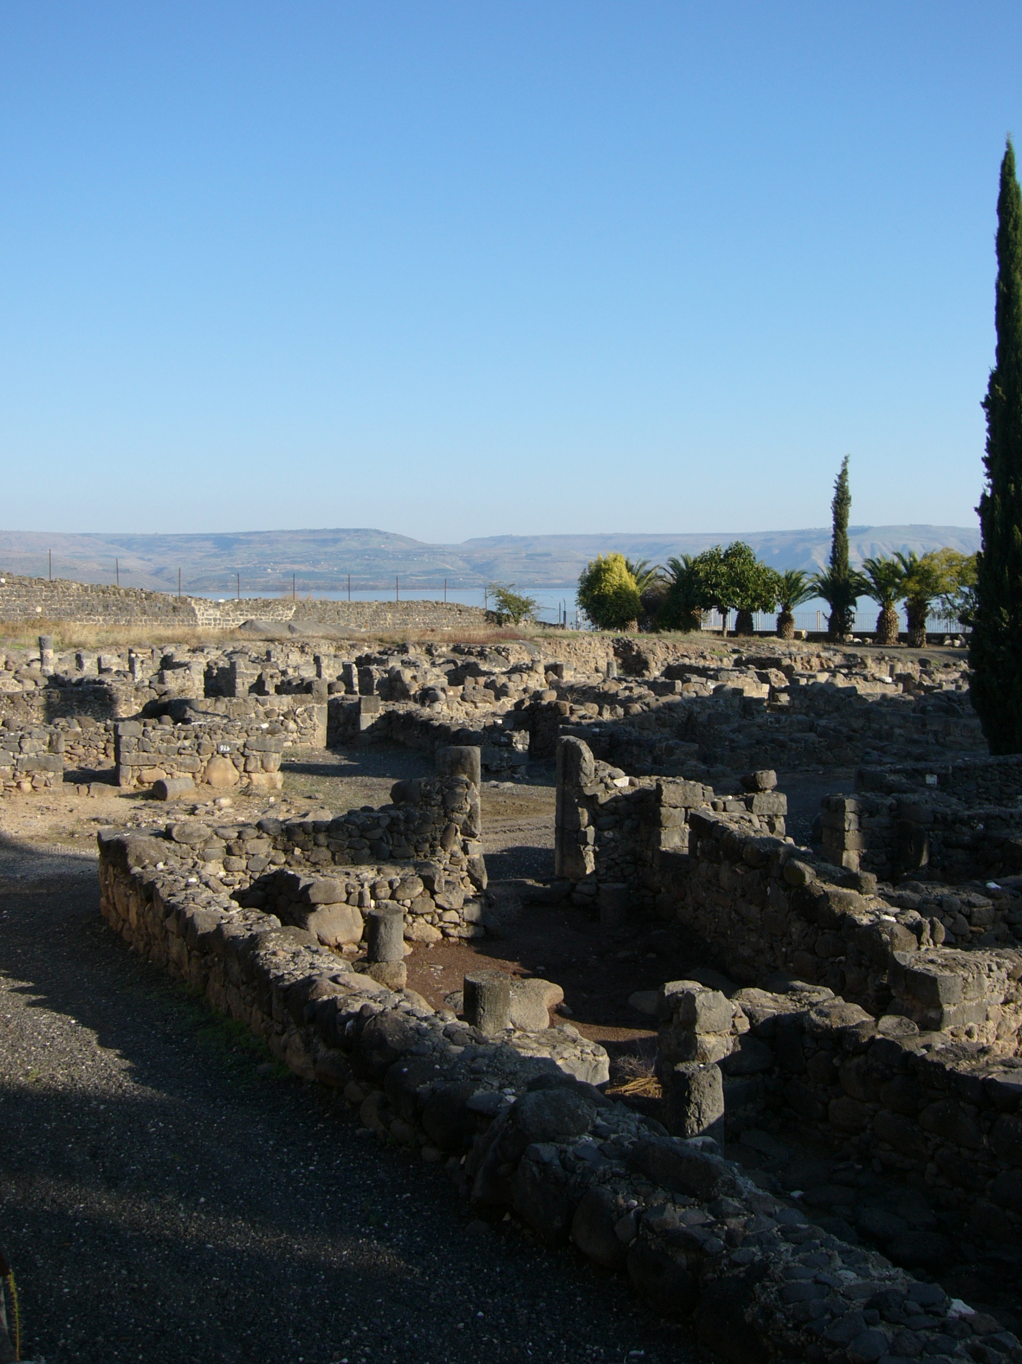
The Trial of our Faith (1 Peter)
2) A living hope
Jesus “came down to Capernaum … and entered into Simon’s house” (Luke 4:31,38)

Slide 2
“The keys of the kingdom”
See Luke 11:52 and Matthew 23:13.
It was keys to knowledge of the kingdom that Jesus gave to Peter, and Peter used them when he preached to the Jews at Pentecost (Acts 2) and later to the Gentile household of Cornelius (Acts 10).
God “had opened the door of faith unto the Gentiles” (Acts 14:27; 15:7).

Slide 3
Binding and loosing
The words of Matthew 16:19 were initially spoken to Peter; later extended to the Lord’s other disciples (Matthew 18:1,18).
Notice the same terms in Luke 13:11,12,16.
Example of ‘binding’, Acts 5:1-11; ‘loosing’, Acts 3:1-10. See also Acts 5:12: “apostles”.
Note Isaiah’s prophecy of Messiah: Isa. 61:1.

Slide 4
Raising the dead
ACTS 9: DORCAS
V39 – weeping
V40 – put people out
V40 – prayed – spoke, she awoke
V41 – gave his hand
MK. 5: JAIRUS’ DAUGHTER
V38 – weeping
V40 – put people out, except Peter, James, John and parents
V41 – gave hand / spoke / she arose

Slide 5
Peter – a man of prayer
“Peter went up upon the housetop to pray about the sixth hour” – noon (Acts 10:9). Cp. Daniel 6:10 & Psa. 55:17.
“Evening, morning and noon”: It seems that the third hour was the hour of the morning sacrifice (see Acts 2:15) and the ninth hour that of the evening sacrifice (Acts 3:1).
It appears that the apostles kept up the pattern of prayer demonstrated in the lives of David and Daniel.

Slide 6
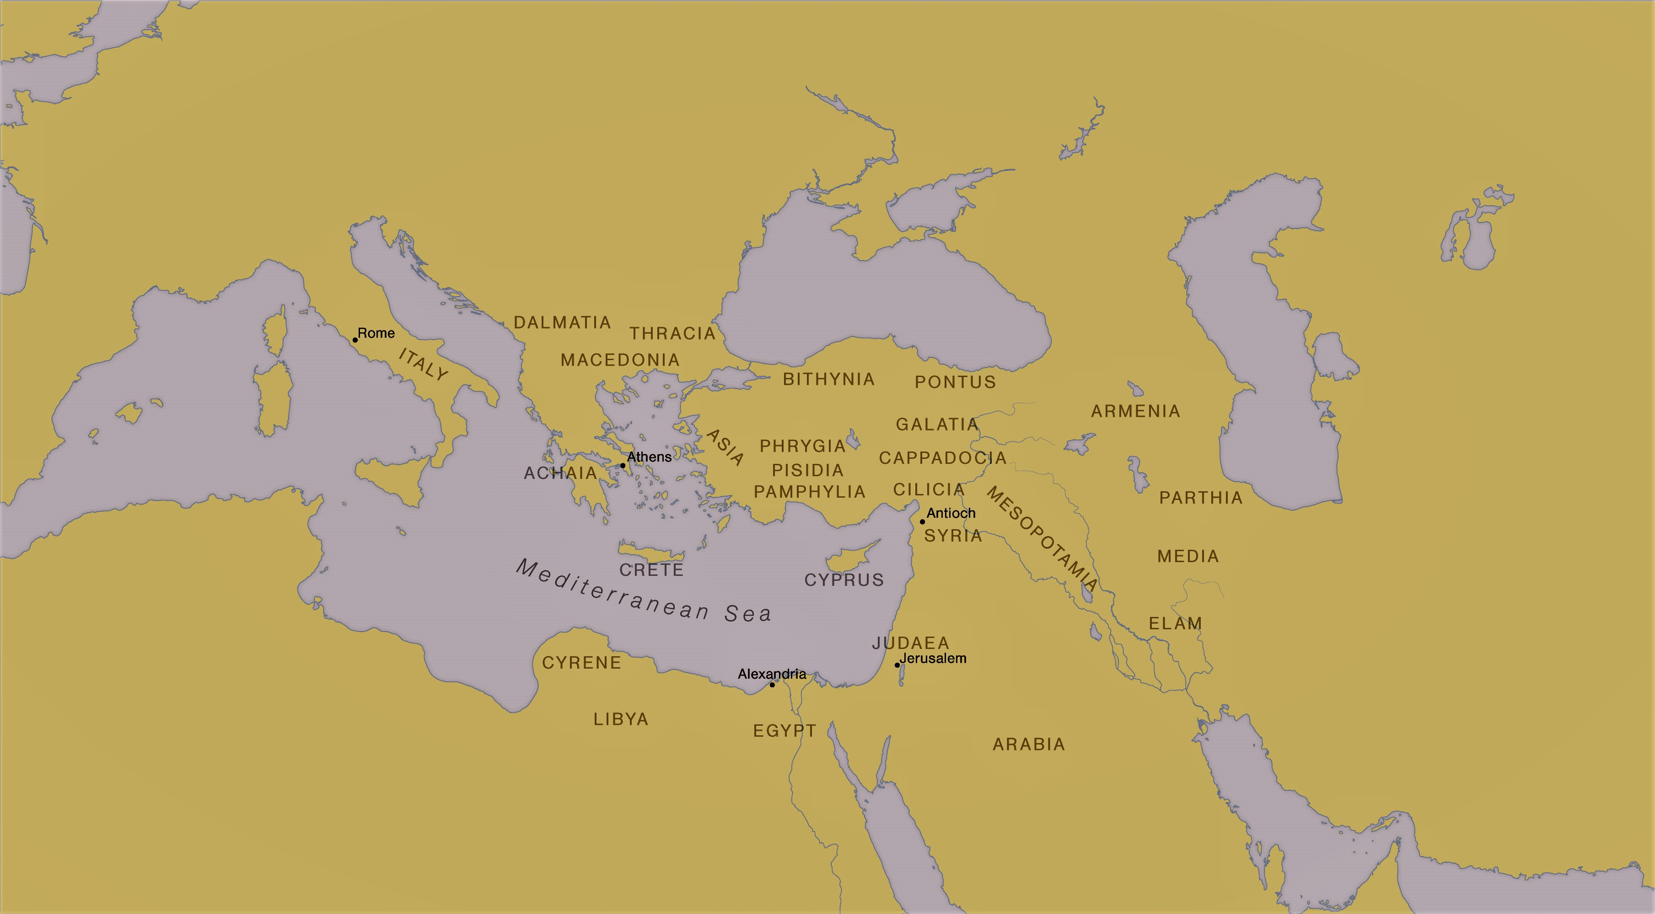
Roman provinces and regions of the ‘diaspora’

Slide 7
“Peter … to the strangers scattered”
Both epistles were written to the same brothers and sisters (cp. 1 Peter 1:1; 2 Peter 3:1).
1 Peter: Trials from Without.
2 Peter: Dangers from Within.

Slide 8
A time of persecution
1 Peter probably written AD 62-64.
References to persecution in every chapter: 1:6,7; 2:12 & 3:16; 3:14; 4:12,19; 5:8-10.
Not yet the systematic persecution following the Fire of Rome (AD 64) when persecution would become the normal experience of ecclesias.

Slide 9
1 Peter: Trials from without
The disciple’s privileges (1:1-2:10) – a living hope (1:3); a living word (1:23); a living stone (2:4).
The disciple’s duties (2:11-4:11).
The disciple’s trials (4:12-5:14).

Slide 10
“Elect …” (1 Peter 1:12)
To be ‘elected’ is to be chosen or selected (note Deut. 7:6; Rom. 11:7).
An Illustration in Elijah and the 7000 who had not bowed to Baal. Note: Elijah made “intercession to God against Israel” (Rom. 11:2), claiming that he alone remained faithful to God.

Slide 11
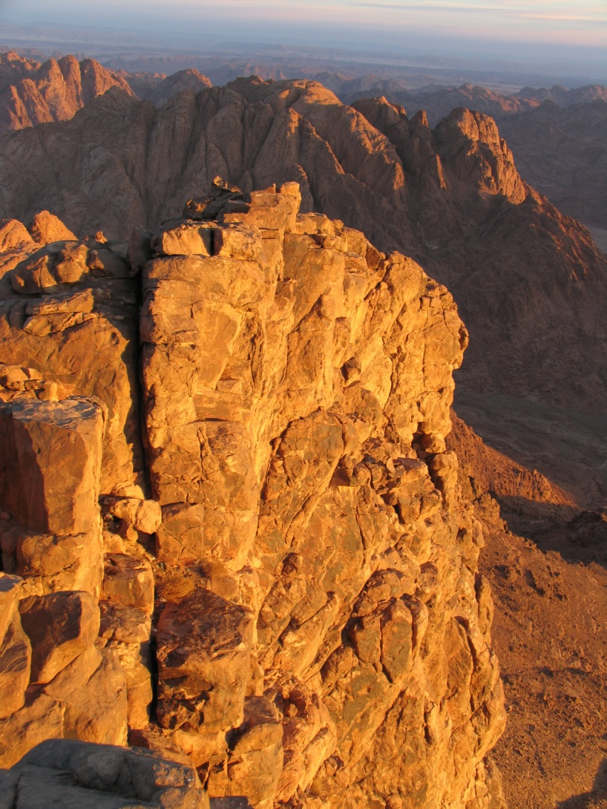
Elijah came to solitude of “Horeb the mount of God”
The place where the Lord had revealed Himself to Moses and given the Law (1 Kings 19:8, Exodus 33,34).
“He came thither unto the cave (Heb. verse 9).

