Slide 1
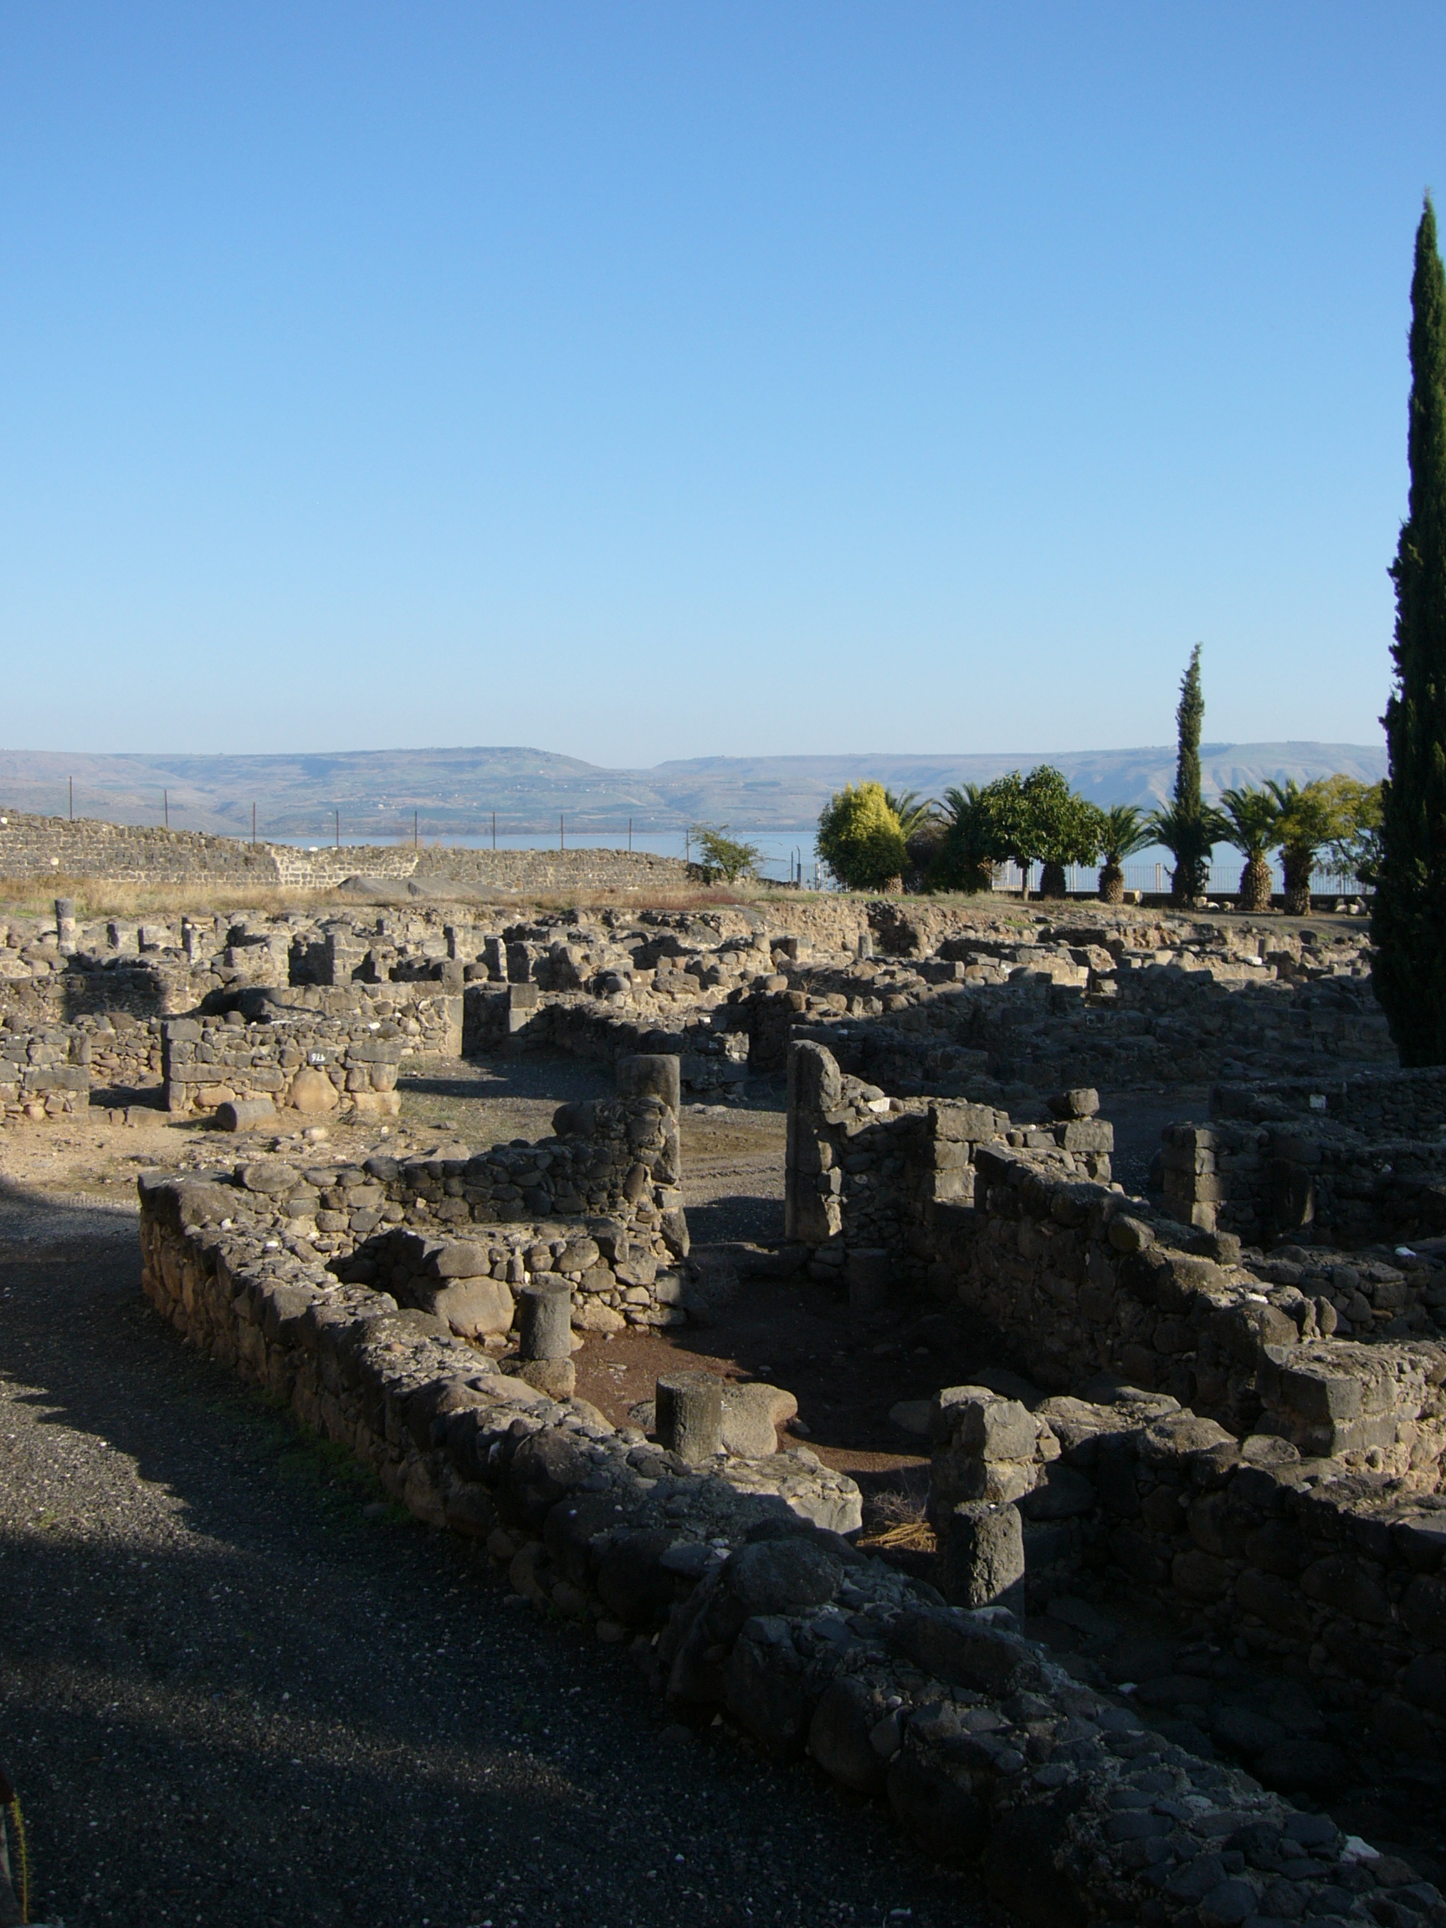
The Trial of our Faith (1 Peter)
3) Strangers and pilgrims
Jesus “came down to Capernaum … and entered into Simon’s house” (Luke 4:31,38)

Slide 2
1 Peter: Trials from without
The disciple’s privileges (1:1-2:10) – a living hope (1:3); a living word (1:23); a living stone (2:4).
The disciple’s duties (2:11-4:11).
The disciple’s trials (4:12-5:14).

Slide 3
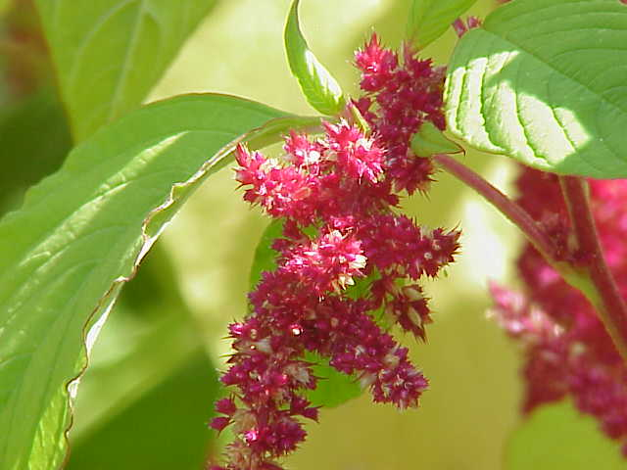
“…that fadeth not away”
The inheritance in Christ (1 Peter 1:4).
The crown to be received at the coming of the Chief Shepherd (1 Peter 5:4).
Gk. term comes from the Amaranth flower which was supposed never to fade.
Author: Kurt Stüber. Source: caliban.mpiz-koeln.mpg.de/mavica/index.html part of www.biolib.de. Wikimedia.org. CC BY-SA 3.0.

Slide 4
1 Peter and Daniel (1)
Peter was writing to “sojourners of the dispersion” (1:1, RV), brothers and sisters living “among the Gentiles” (2:12). They were facing trials / persecution; their faith was being tested.
Note two particular figures of persecution: “fire” (1:7; 4:12) and “a roaring lion” (5:8).

Slide 5
1 Peter and Daniel (2)
At the time of Daniel, the Children of Israel were scattered throughout the provinces of Babylon. Their faith in God was tested – there was persecution. Specifically, the trial of faith for Daniel’s three friends involved fire (Dan. 3), and for Daniel himself it involved lions (Dan. 6). In the Book of Daniel these things were literal, whereas the Spirit in 1 Peter uses them figuratively.
“Who is he that will harm you …?” See Daniel 3:24,25; 6:22,23.

Slide 6
1 Peter and Daniel (3)
Peter’s epistle was written from Babylon (5:13).
“What, or what manner of time” (1 Peter 1:10-12): see Daniel 9:1-3, 25,26; 12:8.
Note Luke 3:15: “The people were in expectation, and all men mused in their hearts of John, whether he were the Christ, or not.”

Slide 7
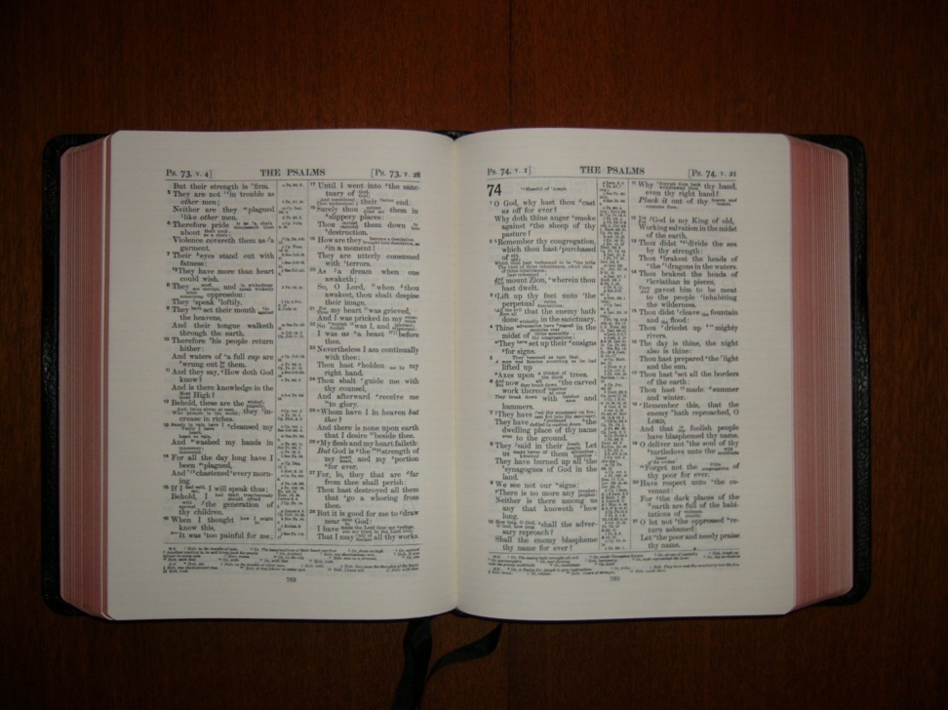
The Living Word (1)
“Being born again, not of corruptible seed, but of incorruptible, by the word of God, which liveth and abideth for ever ... And this is the word which by the gospel is preached unto you” (1 Peter 1:23-25).

Slide 8
The Living Word (2)
“Putting away therefore all … guile … as newborn babes, long for the spiritual milk which is without guile, that ye may grow thereby unto salvation” (1 Peter 2:1,2, RV).

Slide 9
Psalm 34 & 1 Peter
Psalm 34
V8 “taste”
V11 “children”
V13 “tongue from evil”
V13 “guile”
1 Peter 2
V3 “tasted”
V2 “newborn babes”
V1 “evil speakings”
V1 “guile”
V2 “sincere” (Gk. guileless, pure)
Psalm 34:12-16 is then quoted directly in 1 Peter 3:10-12

Slide 10
“The chief corner stone” – 1 Peter 2
Verse 6: the foundation stone (Isa. 28:16)
Verse 7: the headstone (Psalm 118:22)
Verse 8: stone of stumbling (Isa.8:14)
Christ is the foundation, the headstone, and also a stone of stumbling to those who refuse to believe.

Slide 11
Privileges summarised (1 Peter 2:9,10)
V9 – The titles we have were given to Israel (Exod. 19:6; Deut. 7:6), but in the main the Israelites despised them. Peter reminds us of Israel’s failure and God’s purpose to bring in the Gentiles (see Isa. 43:19-22).
V10 – Allusion to Gomer’s children: Lo-ruhamah, “hath not obtained mercy” (Hos. 1:6); Lo-ammi, “not my people” (Hos. 1:9).

