Slide 1
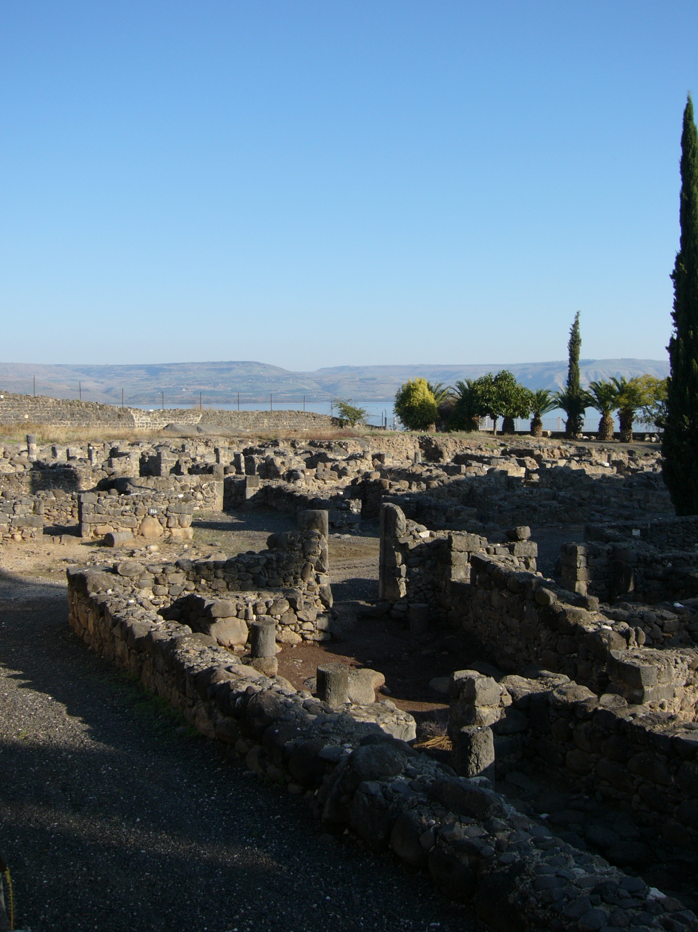
The Trial of our Faith (1 Peter)
4) Spirits in prison
Jesus “came down to Capernaum … and entered into Simon’s house” (Luke 4:31,38)

Slide 2
“Evildoers” (1 Peter)
The term occurs a number of times: 2:12,14; 3:16; 4:15.
Christ was first (falsely) called this: “If he were not a malefactor (an evildoer, RV), we would not have delivered him up unto thee” (John 18:30).

Slide 3
The righteous servant
ISAIAH 53
V9: “No violence, neither was any deceit in his mouth”
V7: “He was oppressed … opened not his mouth”
V12: “He bare the sin of many” [see vs. 4-6,8,10,11]
V5: “And with his stripes we are healed”
V6: “All we like sheep have gone astray”
1 PETER 2
V22: “No sin, neither was guile found in his mouth”
V23: “When he was reviled, reviled not again”
V24: “Who his own self bare our sins …”
V24: By whose stripes ye were healed”
V25: “For ye were as sheep going astray”

Slide 4
“Follow his steps” (1 Peter 2:21)
“Follow” – ‘to follow closely upon’.
The two disciples of John the Baptist “followed” and “abode with him” (John 1:37-39).
Jesus called his disciples to “follow me” (Matthew 4:18-20; “Come ye after me” (Mark 1:17) – come behind.
Jesus said to Peter, “Get thee behind me” – which is where he should have been – and then exhorted his disciples to take up the cross and follow him (Matthew 16:23,24).
In the kingdom: note Revelation 14:4.

Slide 5
Spirits in prison (1)
“Spirits” – used of angels, e.g., Heb. 1:7,14.
These “spirits” were “disobedient” (1 Peter 3:20) – so not angels.
See 1 John 4:1-3 – “spirits” / “false prophets” (note also 1 Timothy 4:1).
1 Peter 3:20: This does not say that Christ personally visited the people of Noah’s day, but that he did so “by the spirit” (or “in spirit”).
It is called “the Spirit of Christ which was in [the prophets]” (1 Peter 1:11). This spirit was in Noah when he preached to the disobedient of his time.

Slide 6
Spirits in prison (2)
In what sense were these people prisoners when preached to? They were prisoners of sin – “dead in trespasses and sins” (Ephesians 2:1), and all men and women are prisoners in this sense until they are made free in Christ.
The idea of liberty from prison can be found elsewhere in connection with the work of Christ: see Isaiah 42:6,7; 49:8,9; 61:1; Zechariah 9:11; John 8:32,36; Ephesians 4:8).

Slide 7
Spirits in prison (3)
Most of those in New Testament days who heard the Gospel message were “disobedient” (1 Peter 3:20); Peter compares the majority who were disobedient in Noah’s day with his own.
“Spirits in prison” is a reference, not just to one group of people at a particular point in time (those of Noah’s day provide a good example), but to a class of people which existed in Noah’s day, in New Testament times, and in our own time – people in bondage to sin and death.

Slide 8
What did Noah preach? (1)
1) JUDGEMENT – Enoch warned the antediluvian world of this (see Jude verses 14,15). In the first instance, his words refer to the judgement of the Flood, which Christ warned was typical of future judgement (see Matthew 24:36-43).
2) RIGHTEOUSNESS – In 2 Peter 2:5 we read that Noah was “A preacher (a herald) of righteousness”. He preached the right ways of God to a wicked world.

Slide 9
What did Noah preach?
3) GOD'S LONGSUFFERING – This is referred to by Peter in 1 Peter 3:20. Longsuffering is part of the character of God that had been revealed to Moses in Exodus 34. In Noah's day, God “waited” (Greek, ‘to await eagerly’); Rotherham says: “God was holding forth a welcome”. God's mercy was shown with an outstretched hand and an offer of grace. See also 2 Peter 3:9,15.
4) REPENTANCE – as in 2 Peter 3:9.
5) He “CONDEMNED THE WORLD” – see Hebrews 11:7.

Slide 10
Size of Noah’s Ark (Gen. 6:15)
In ancient times the length of the cubit could have been anything from about 46 cm to about 52 cm. Assuming the smaller size was used, then the ark measured 150 metres long x 25 metres wide x 15 metres high (450 feet long x 75 feet wide x 45 feet high).
It was not until 1884 that another ship was built having a greater length than the Ark (the Cunard liner Eturia).

Slide 11
Disobedient spirits (1 Peter 3:20)
Disobedient spirits spoke evil of Noah, and suffered the judgment of the Flood. When Christ came and preached, disobedient spirits spoke evil of him also – as they did afterwards of his followers. The generation that rejected and crucified Christ suffered judgment like Noah’s contemporaries – and that is surely why the example of Noah’s day is referred to in 1 Peter 3.
See also Luke 17:26,27 – note Daniel 9:26.

