Slide 1
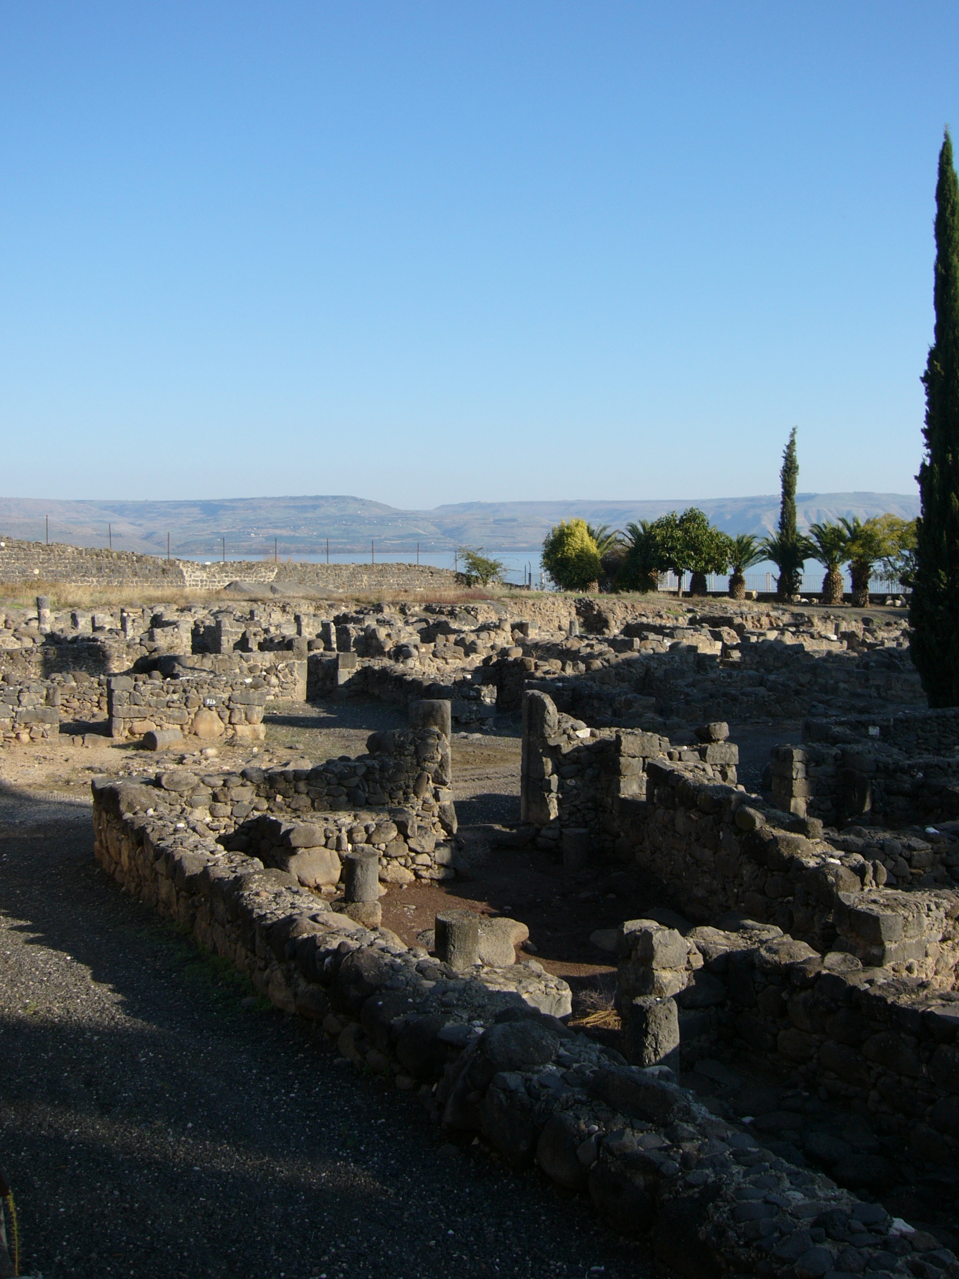
The Trial of our Faith (1 Peter)
5) Partakers of Christ’s sufferings
Jesus “came down to Capernaum … and entered into Simon’s house” (Luke 4:31,38)

Slide 2
Disobedient spirits (1 Peter 3:20)
Disobedient spirits spoke evil of Noah, and suffered the judgment of the Flood. When Christ came and preached, disobedient spirits spoke evil of him also – as they did afterwards of his followers. The generation that rejected and crucified Christ suffered judgment like Noah’s contemporaries – and that is surely why the example of Noah’s day is referred to in 1 Peter 3.
See also Luke 17:26,27 – note Daniel 9:26.

Slide 3
Stephen’s dying vision
“He, being full of the Holy Spirit, looked up stedfastly into heaven, and saw the glory of God, and Jesus standing on the right hand of God, and said, Behold, I see the heavens opened, and the Son of man standing on the right hand of God” (Acts 7:55,56).
An echo of Psalm 110:1 – Was the Lord seen standing by Stephen in preparation for his return?

Slide 4
Watch
“Watch ye therefore: for ye know not when the master of the house cometh … lest coming suddenly he find you sleeping. And what I say unto you I say unto all, Watch” (Mark 13:35-37).

Slide 5
1 Peter and Daniel (4)
“Be ready always to give an answer”: Gk. apologia – a verbal defence (1 Peter 3:15).
“Who is that God that shall deliver you out of my hands?” (Dan. 3:15).
“Shadrach, Meshach, and Abednego, answered …”

Slide 6
Salvation – past, present & future
Past: “[God] hath saved us, and called us with an holy calling, not according to our works, but according to his own purpose and grace” (2 Tim. 1:9).
Present: “Moreover, brethren, I make known unto you the joyful message, which I myself announced to you, which also ye received, in which also ye stand; through which also ye are being saved, – if ye hold fast …” (1 Cor. 15:1,2).
Future: “He that endureth to the end shall be saved” (Matt. 10:22; contrast Mark 4:17).

Slide 7
“If any man suffer as a Christian …”
This name only occurs three times in the New Testament. It seems it was first given by Gentiles (Acts 11:26).
The name was later used by King Agrippa in scorn (Acts 26:28). Peter clearly has the unfriendly use of the name in mind here in 1 Peter 4:16.
Perhaps the apostle is reflecting on his own experience (Matt. 26:74,75).

Slide 8
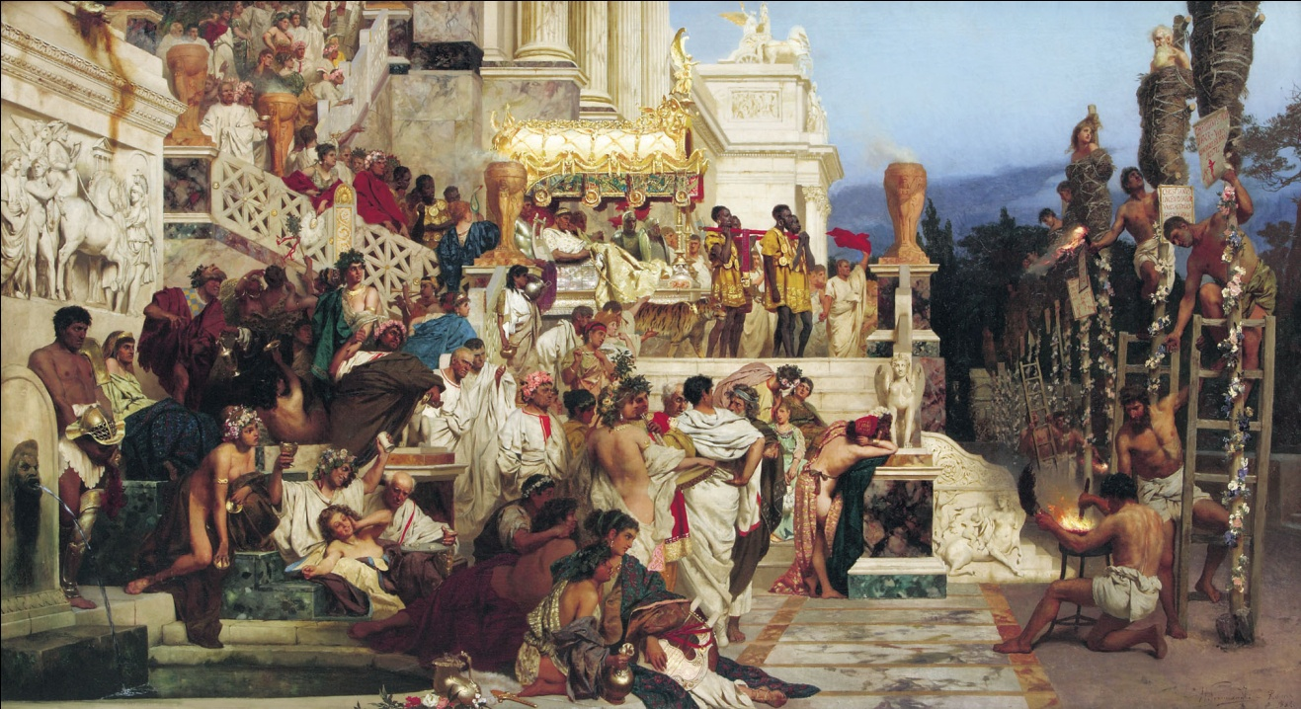
The House of God – 1 Peter 4:17 (1)
“The time is come” – cp. verse 7. The Mosaic age was about to end. Persecution would intensify after AD 64 (the Fire of Rome), being sponsored by the Roman authorities.
The Torches of Nero, by Henryk Siemiradzki

Slide 9
The House of God – 1 Peter 4:17 (2)
“The house of God” – cp. 2:5, “A spiritual house” (note also Num. 12:7; Hos. 8:1; 1Tim. 3:15).
The Greek preposition “at” is far more often translated as “from”.

Slide 10
The House of God – 1 Peter 4:17 (3)
“It is the time of the beginning of the judgment from the house of God.” (Young’s Literal Translation)
“The season is coming for the judgment to begin from the house of God.” (Diaglott)

Slide 11
God’s judgment falls …
First on the Household
Then it spreads to Israel
Finally to the world at large
The prophets suggest this will be the pattern in the age to come.

