Slide 1
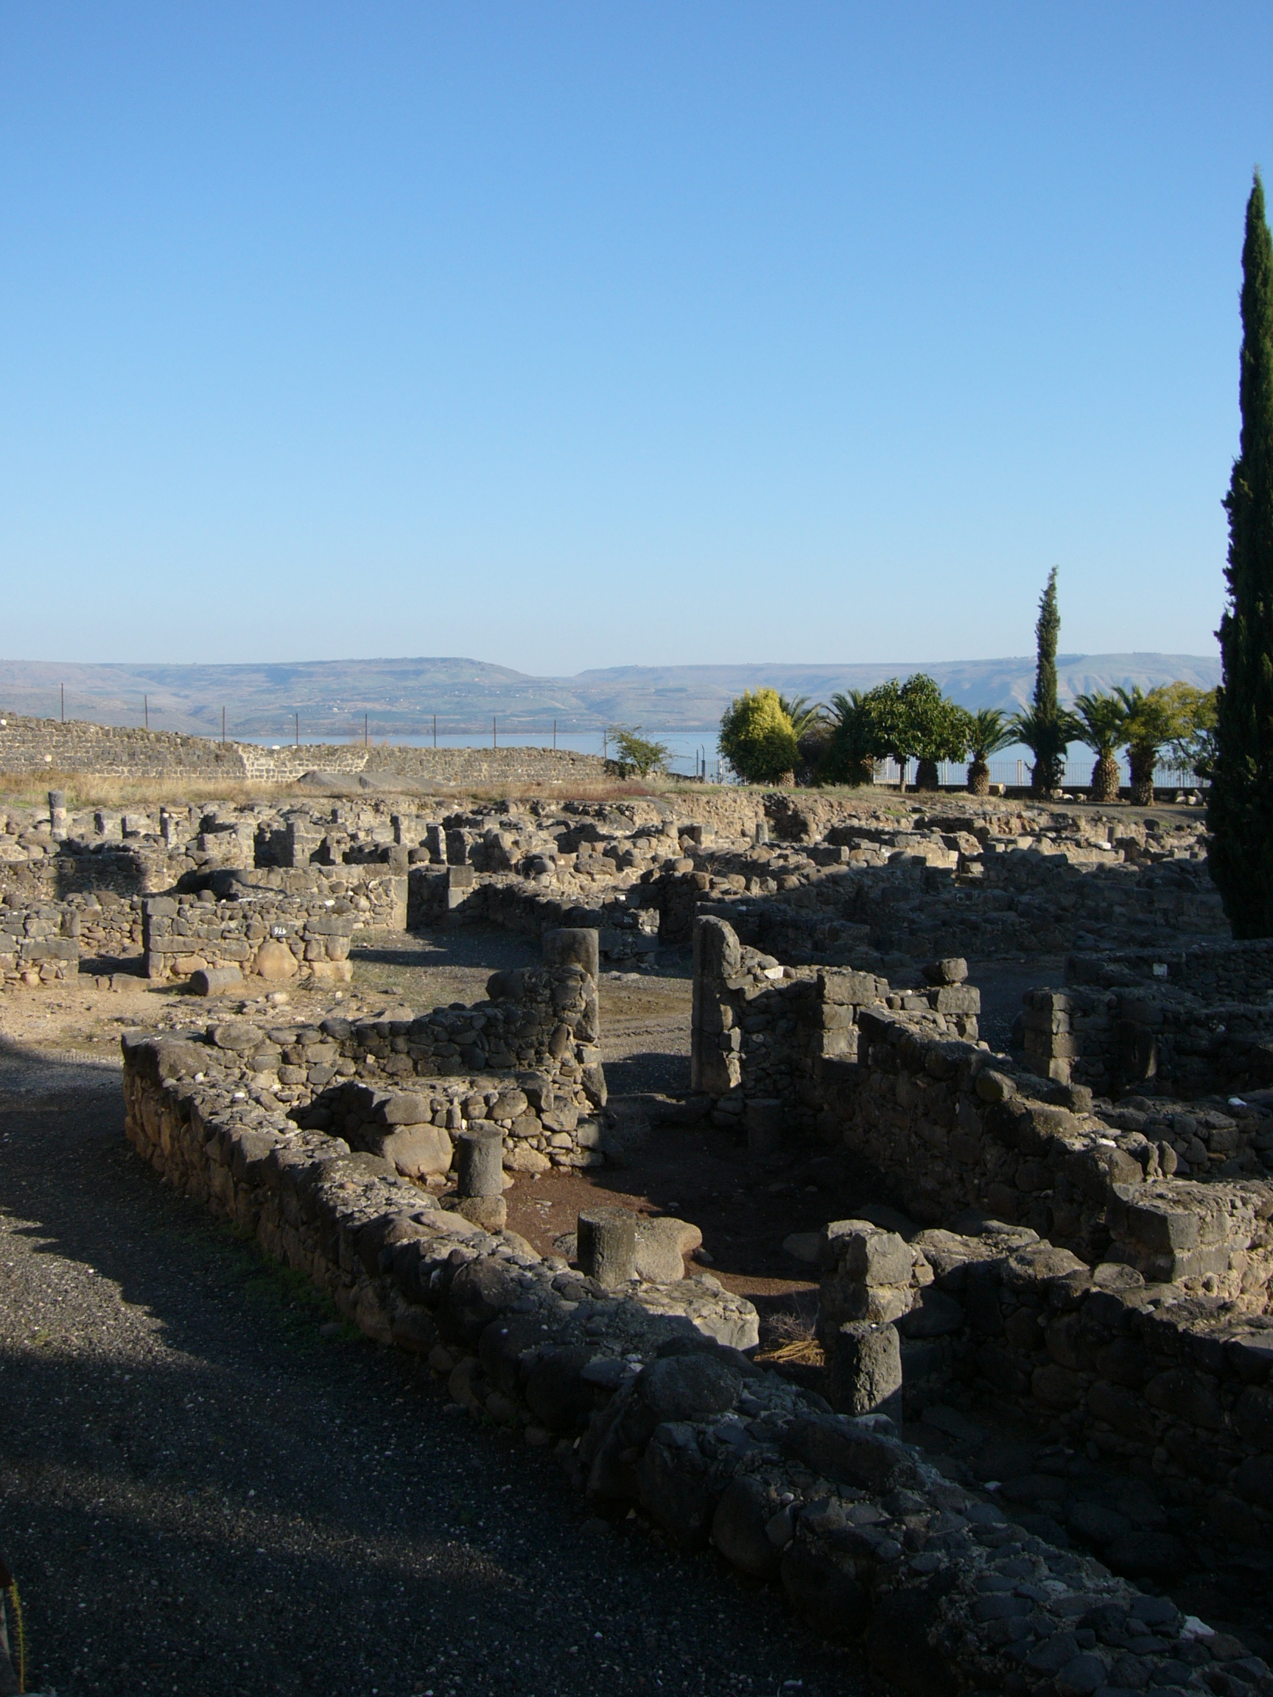
The Trial of our Faith (1 Peter)
6) The flock of God
Jesus “came down to Capernaum … and entered into Simon’s house” (Luke 4:31,38)

Slide 2
God’s judgment falls …
First on the Household
Then it spreads to Israel
Finally to the world at large
The prophets suggest this will be the pattern in the age to come.

Slide 3
Standing before the Judgment Seat
“We shall all stand before the judgment seat of Christ … So then every one of us shall give account of himself to God.” (Romans 14:10,12)
“We must all appear before the judgment seat of Christ …” (2 Corinthians 5:10)

Slide 4
Knowledge brings responsibility
“I will raise them up a Prophet from among their brethren, like unto thee, and will put my words in his mouth; and he shall speak unto them all that I shall command him. And it shall come to pass, that whosoever will not hearken unto my words which he shall speak in my name, I will require it of him.” (Deut. 18:18,19; see Jn. 12:44-48; Matt. 10:33; Mk. 8:38)

Slide 5
“Commit the keeping of their souls …” (1 Pet. 4:19)
“Commit” (Gk. paratithemi), ‘entrust’: a banking word for the giving in trust of valuables as a deposit. Same word as Luke 23:46.
“Unto a faithful Creator” – The transfiguration of Christ left an indelible mark on Peter – see 2 Pet. 1:16-18; 1 Pet. 1:4; 4:19; 5:1,4. He saw that God is able to re-create men out of the dust who have been dead for centuries.

Slide 6
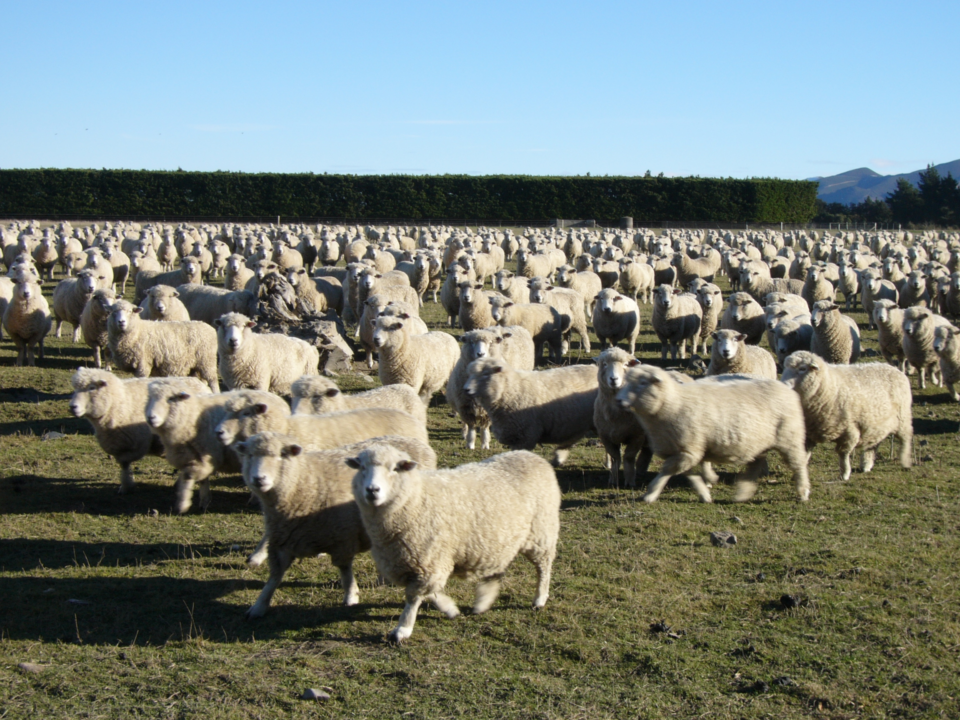
“Feed the flock of God …”
“Feed” (Greek, poimaino, ‘to tend as a shepherd’).

Slide 7
The Shepherd – Old Testament
God is presented as the Great Shepherd of His people, both nationally and individually (e.g., Psa. 80:1; 23:1).
The Son of God, Messiah, is also spoken of prophetically as the Shepherd – e.g., Zech. 13:7, Isaiah 40:11.
Other good shepherds – e.g., Moses (Psa. 77:20; David (2 Sam. 7:8).

Slide 8
The shepherd’s duties (Ezek. 34:2-4)
1) Feeding the flock
2) Strengthening the diseased
3) Healing the sick
4) Binding the broken
5) Bringing back those driven away
6) Seeking out the lost

Slide 9
Beside the Sea of Galilee – Jn. 21
V15 – “Lovest thou me?” (Gk. agapao) / “I love thee” (Gk. phileo) / “Feed my lambs” (Gk. bosko – as Matt. 8:30; Lk. 15:15).
V16 – “Lovest thou me?” (Gk. agapao) / “I love thee” (Gk. phileo) / “Feed” (Gk. poimaino), ‘to tend as a shepherd’.
V17 – “Lovest thou me?” (Gk. phileo) / “Feed” (Gk. bosko).

Slide 10
Tending the ecclesial flock
(1 Pet. 5:2-4)
“Not by constraint but willingly” – work for the right reason, not grudgingly.
“Not for filthy lucre” (“dishonest gain”, NKJV) – work with the right motive, not seeking material gain.
“Neither as being lords …” – work in the right manner, not in a domineering way, but setting an example (note also: Exod. 1:13; Lev. 25:42,43,46; Ezek. 34:4,RV; Lk. 22:25,26).

