Slide 1
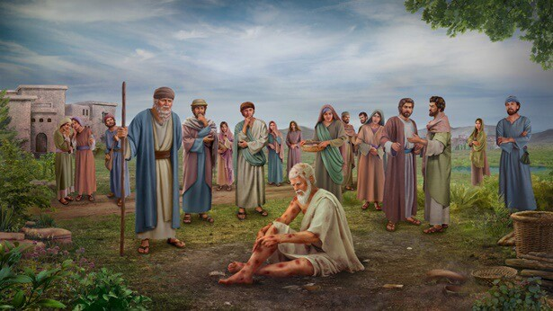
Job: Understanding How God Trains His Children
1) Accepting Good & Bad from God’s Hand

Slide 2
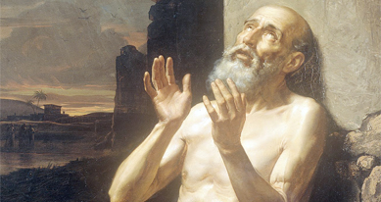
Why Study Job
Help us understand how God works in His family members’ lives so we can be betters parents & effective helpers in our ecclesias
Warns us to be careful about how we view and judge other brothers and sisters or God may have to bring on suffering
Help us understand God - Explains how our wonderful, loving, righteous God uses suffering to perfect all His children
Teaches us how to sincerely pray for others going through rough times without judging them
Helps us to see the big picture of what God is doing, rather than focus on specific events
Helps us realize and accept that we may have to suffer for the sake of others – like Jesus did
Most Sunday School curriculums skip Job, but it is 42 chapters and 3% of the Bible! Must be important!
So we can become more effective comforters

Slide 3


Job Develops
An important life issue that is not in the B.A.S.F.

Slide 4
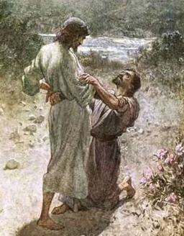
To Understand Job….
Must really feel the agony of our daily struggle with Sin
Must acknowledge that God is the only one who can defeat Sin in us
Must surrender to God’s plan to destroy Sin – it will cost more than we probably knew when we were baptized – Like Jacob holding the angel.
Must admit that any goodness that has developed in us over time is the result of God’s work in our lives – not our own righteousness
Must understand that God sometimes requires the righteous to suffer to prevent them from falling into sin and to win over other people to His family
God will train us for His family if we let Him

Slide 5
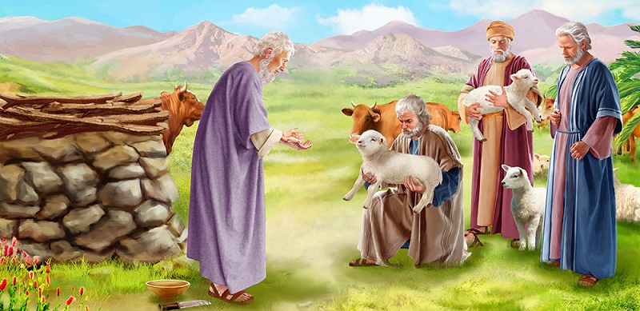
Job is mentioned in the Bible
Ezek 14:14,20 Listed along with Noah & Daniel – men who were known for helping to save others
Jam 5:10-11 Patient endurance through suffering. Note James’ warning about the tongue (Jam 3) and then his exhortation (Jam 5) to pray for others – like Job did
When we think of Job – think about patient endurance through trials and helping to save others

Slide 6

Ezekiel 14:1-3, 12-14, 19-20
Job is known for helping to deliver others
1 Now some of the elders of Israel came to me and sat before me. 2 And the word of the Lord came to me, saying, 3 "Son of man, these men have set up their idols in their hearts, and put before them that which causes them to stumble into iniquity. Should I let Myself be inquired of at all by them?
12 The word of the Lord came again to me, saying: 13 "Son of man, when a land sins against Me by persistent unfaithfulness, I will stretch out My hand against it; I will cut off its supply of bread, send famine on it, and cut off man and beast from it. 14 Even if these three men, Noah, Daniel, and Job, were in it, they would deliver only themselves by their righteousness," says the Lord God.
19 "Or if I send a pestilence into that land and pour out My fury on it in blood, and cut off from it man and beast, 20 even though Noah, Daniel, and Job were in it, as I live," says the Lord God, "they would deliver neither son nor daughter; they would deliver only themselves by their righteousness."
Job is linked with Noah & Daniel

Slide 7
James 5:9-11
The perseverance of Job
9 Do not grumble against one another, brethren, lest you be condemned. Behold, the Judge is standing at the door! 10 My brethren, take the prophets, who spoke in the name of the Lord, as an example of suffering and patience. 11 Indeed we count them blessed who endure. You have heard of the perseverance of Job and seen the end intended by the Lord — that the Lord is very compassionate and merciful.
Result: God is compassionate & merciful

Slide 8
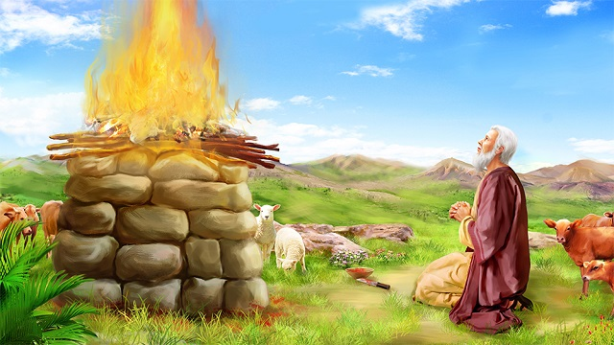
Time Period of Job Probably 5-10 generations after Abraham, but before Joshua
Eliphaz the Temanite: [Near Edom]
Gen 36:10, 11, 15 Teman is son of Eliphaz & Esau’s grandson
Bildad the Shuhite:
Gen 25:2 Abraham & Keturah had son Shuah
Zophar the Naamathite:
In Josh 15:41 Naamah was a city in South of Judah on border with Edom
Elihu the Buzite (32:2):
Gen 22:20-21 Abraham’s brother Nahor & Milcah had Buz
Land of Uz:
Gen 36:28 Esau: Seir → Dishan → Uz
Maybe while Israel was in Egypt or wandering through the desert

Slide 9
Job 1:1-3
Job’s Greatness
There was a man in the land of Uz, whose name was Job; and that man was blameless and upright, and one who feared God and shunned evil. 2 And seven sons and three daughters were born to him. 3 Also, his possessions were seven thousand sheep, three thousand camels, five hundred yoke of oxen, five hundred female donkeys, and a very large household, so that this man was the greatest of all the people of the East.
God used His greatest child of the East to educate all the Family

Slide 10
Job 1:4-5
Tried to cover for others
4 And his sons would go and feast in their houses, each on his appointed day, and would send and invite their three sisters to eat and drink with them. 5 So it was, when the days of feasting had run their course, that Job would send and sanctify them, and he would rise early in the morning and offer burnt offerings according to the number of them all. For Job said, "It may be that my sons have sinned and cursed God in their hearts." Thus Job did regularly.
As priest of his family, Job attempted to sanctify his children and bring them to God

Slide 11
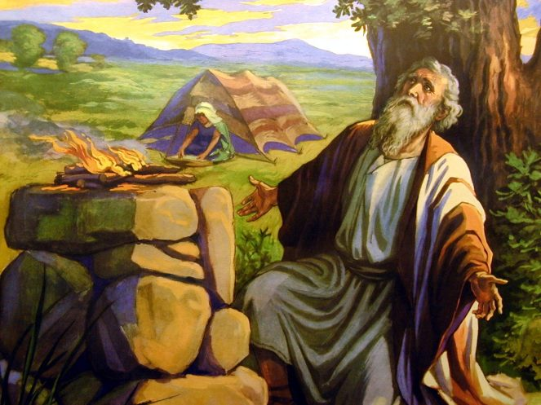
Job is introduced as “blameless”, but he still had a lot to learn about God

Slide 12
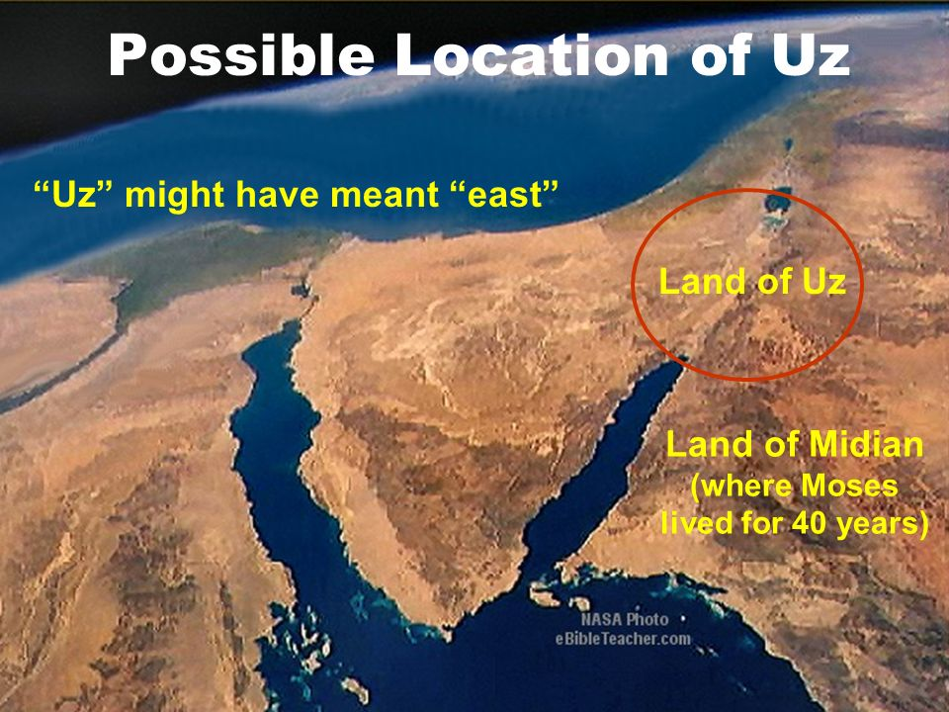

Slide 13
Job 19:-20 (ESV)
Takes place over a few months
13 "He has put my brothers far from me, and those who knew me are wholly estranged from me.
14 My relatives have failed me, my close friends have forgotten me.
15 The guests in my house and my maidservants count me as a stranger; I have become a foreigner in their eyes.
16 I call to my servant, but he gives me no answer; I must plead with him with my mouth for mercy.
17 My breath is strange to my wife, and I am a stench to the children of my own mother.
18 Even young children despise me; when I rise they talk against me.
19 All my intimate friends abhor me, and those whom I loved have turned against me.
20 My bones stick to my skin and to my flesh, and I have escaped by the skin of my teeth.
All of these take time to develop

Slide 14
Job 1:6-12
God’s challenge to Satan
6 Now there was a day when the sons of God came to present themselves before the Lord, and Satan also came among them. 7 And the Lord said to Satan, "From where do you come?"
So Satan answered the Lord and said, "From going to and fro on the earth, and from walking back and forth on it."
8 Then the Lord said to Satan, "Have you considered My servant Job, that there is none like him on the earth, a blameless and upright man, one who fears God and shuns evil?"
9 So Satan answered the Lord and said, "Does Job fear God for nothing? 10 Have You not made a hedge around him, around his household, and around all that he has on every side? You have blessed the work of his hands, and his possessions have increased in the land. 11 But now, stretch out Your hand and touch all that he has, and he will surely curse You to Your face!"
12 And the Lord said to Satan, "Behold, all that he has is in your power; only do not lay a hand on his person.“ So Satan went out from the presence of the Lord.
Remember: this was to help save Satan

Slide 15

Job Himself
A very Godly man
Blessed with family & wealth
Tried to cover for his children
My servant Job —served God in every way.
None like him —his obedience is genuine
Blameless and upright —without reproach [the 3 friends failed to recognize this].
Fears God —has respect and regard for God.
Shuns evil —rejects it, refuses it, turns away
May have been motivated by fear of punishment – not love

Slide 16
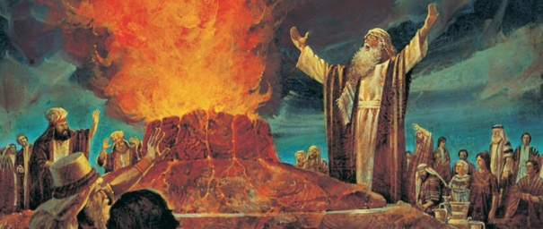
Who Is Satan in the book of Job?
He presents himself before the Lord (1:6)
Like Moses on Mt Sinai (Ex 34:2) and us (Jude 24) – on earth!
He comes from roaming through the earth (1:7)
He is jealous of Job and like Cain, who slew his brother because his works were evil and Abel’s were righteous
He is empowered by God (1:12; 2:6; 42:11)
Not an Angel: He claims God is wrong!
Satan is God’s opponent – Angels do His will (Psa 103)
Angels don’t bring slanderous accusations against God’s righteous children (1:9-11) & are not jealous of humans & would never delight in the downfall of righteous men

Slide 17
Who Is Satan in the book of Job?
God attempts to save Satan & convince him he is wrong
Satan can represent a group of people (Zech 3:1-2; Jude)
Probably not Job’s 3 friends because they would have known why all the calamities came on Job
Job’s 3 friends oppose Job & make false accusations against Job – they certainly become part of Satan as the story progresses
He knows Job well (1:10), so probably a member of Job’s ecclesia
Be careful – you don’t want to be like him

Slide 18
Job’s Satan is Not an Angel
Job’s “Satan” Hebrew: The adversary | Angels Hebrew: One sent, a messenger
Satan answered the Lord, “Does Job fear God for nothing?…stretch out Your hand and touch all that he has, and he will surely curse you to your face!”−Job 1:9 | Take heed that you do not despise one of these little ones, for I say to you that in heaven their angels always see the face of my Father who is in heaven.−Mt 18:10
The Lord said to Satan, “You incited me against him, to destroy him without cause.”−Job 2:3 | The angel of the Lord encamps all around those who fear him, and delivers them.−Ps 34:7
Satan answered the Lord, “Skin for skin! all that a man has he will give for his life…touch his bone and his flesh, he will curse you to your face!”−Job 2:4 | Are they not all ministering spirits sent forth to minister [do service] for those who will inherit salvation?−Heb 1:14

Slide 19
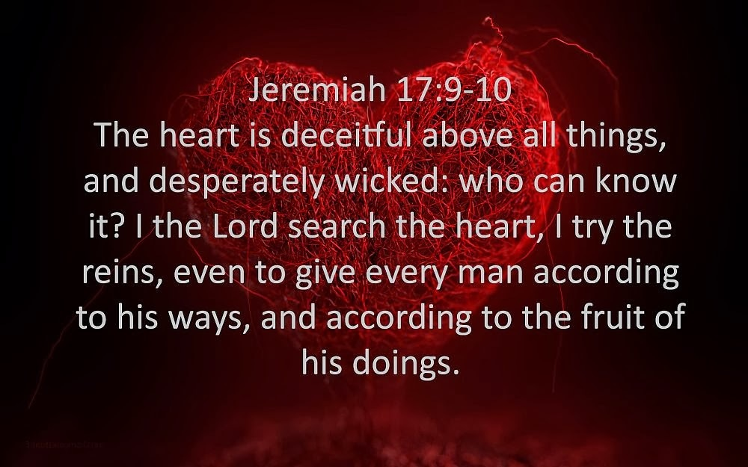
Satan represents all of us who falsely accuse our Brothers & Sisters

Slide 20
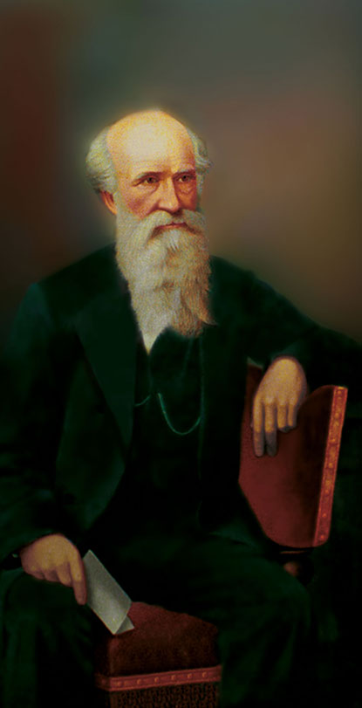
John Thomas’ Explanation of Satan
Job was a man of substance and power, being “the greatest of all the men of the East”. He was one of “the sons of the Deity” belonging to that generation. There was among them also another man of power, who was nominally a coreligionist, but full of envy and unfriendly feeling towards Job. This is not an unusual circumstance, even in societies reputed apostolic. In these, Satans too often abound, and become adversaries of those they cannot imitate. In Job’s day, there were general gatherings of the men of the East, with the sons of the Deity, at the place where the symbol of Yahweh’s presence was established... Here were two classes of worshippers, the nominal and the true; the former constituting the Satan; the latter consisting of the Sons of Deity, of whom Job was most eminent and conspicuous. [Eureka, vol 4, p82, Logos]

Slide 21
Every Character in Job says God (not Satan) brought the trouble on Job
A messenger (1:16) "The fire of God fell from heaven”
Job (1:21)" The LORD gave, and the LORD has taken away.“ Note (1:22) “in all this Job did not sin or charge God with wrong”
(2:10) “Shall we indeed accept good from God, and shall we not accept adversity?" Note: (2:10) “In all this Job did not sin with his lips”
(6:4) the arrows of the Almighty are within me; my spirit drinks in their poison; the terrors of God are arrayed against me.
Satan (1:11) "But now, stretch out Your hand and touch all that he has, and he will surely curse You to Your face!"
God (2:3) “although you incited Me against him, to destroy him without cause”
No one blames a fallen angel Devil

Slide 22
Every Character in Job says God (not Satan) brought the trouble on Job
Eliphaz (5:17-18) "Behold, happy is the man whom God corrects; therefore do not despise the chastening of the Almighty. For He bruises, but He binds up; he wounds, but His hands make whole.
Bildad (8:4) If your (Job’s) sons have sinned against Him (God), he has cast them away for their transgression.
Zophar (11:6) Know therefore that God exacts from you less than your iniquity deserves.
Elihu (33:19, 29) “Man is also chastened with pain on his bed, and with strong pain in many of his bones” …. “Behold, God works all these things, twice, in fact, three times with a man,
Author (42:11) Then all his brothers…sisters…acquaintances, came to him and ate food with him in his house; and they consoled him and comforted him for all the adversity that the LORD had brought upon him.
No one blames a fallen angel Devil

Slide 23
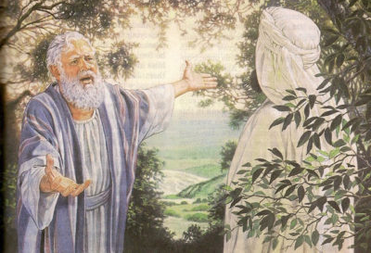
Why does all this happen to Job?
Adversary was envious of Job
Adversary used Job’s prosperity as an excuse as to why he did not serve God like Job
God intended to show the adversary that God’s children live like God because they know it is the right way to live, not because of blessings in this life
God wanted to show the adversary that Job had faith in God’s righteousness & justice in spite of calamities in this life
God was trying to save the Satan

Slide 24
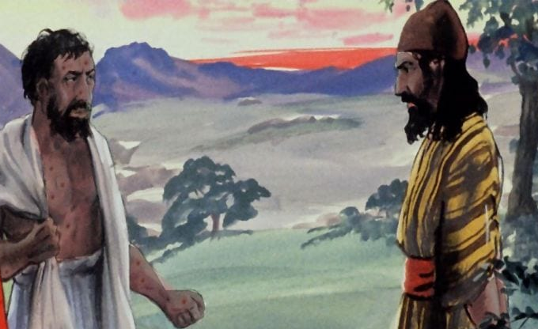
Adversary’s Position
He reasoned that Job served God because God took care of him and make life easy for Job
He thought life was easier for Job because of all the blessings Job received
He believed that if Job lost all his family and material blessings, Job would give up on God
He figured that if Job gave up after losing his blessings, that would justify the adversary’s failure to serve God
Similar to our excuses today: we think if we had all the blessings of others, we would serve God faithfully

Slide 25
Job 1:13-19
Job’s Response
13 Now there was a day when his sons and daughters were eating and drinking wine in their oldest brother's house; 14 and a messenger came to Job and said, "The oxen were plowing and the donkeys feeding beside them, 15 when the Sabeans raided them and took them away — indeed they have killed the servants with the edge of the sword; and I alone have escaped to tell you!"
16 While he was still speaking, another also came and said, "The fire of God fell from heaven and burned up the sheep and the servants, and consumed them; and I alone have escaped to tell you!"
Patient endurance & acceptance

Slide 26
Job 1:13-19
Job’s Response
17 While he was still speaking, another also came and said, "The Chaldeans formed three bands, raided the camels and took them away, yes, and killed the servants with the edge of the sword; and I alone have escaped to tell you!"
18 While he was still speaking, another also came and said, "Your sons and daughters were eating and drinking wine in their oldest brother's house, 19 and suddenly a great wind came from across the wilderness and struck the four corners of the house, and it fell on the young people, and they are dead; and I alone have escaped to tell you!"
Patient endurance & acceptance

Slide 27
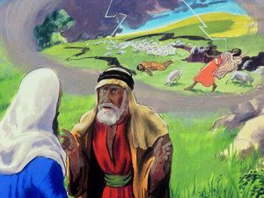
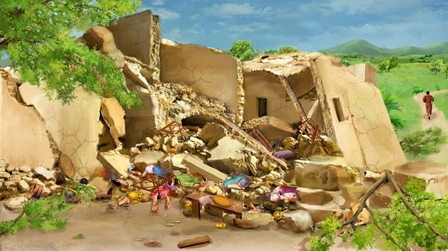
The First wave of Disasters
Sabeans killed oxen & asses and servants
Fire of God (lightening) burned up sheep
Chaldeans killed camels & servants
Wind of God (tornado) killed all of Job’s kids
Note Job’s Response (v.20)

Slide 28
Job 1:20-22
Job’s Response
20 Then Job arose, tore his robe [deeply sorrowful], and shaved his head [repudiate sin & start anew]; and he fell to the ground and worshiped [surrendered to God]. 21 And he said:
"Naked I came from my mother's womb, and naked shall I return there. The Lord gave, and the Lord has taken away; Blessed be the name of the Lord."
22 In all this Job did not sin nor charge God with wrong. [so far, Satan has been shown to be wrong]
Patient endurance & acceptance

Slide 29

Satan will not admit he was wrong
The Adversary should have reconsidered his position
Instead, he pursues further trials of Job
Be careful when we get into debates and arguments when evidence is presented that shows we were wrong – Admit it and move on – Don’t dig the hole deeper!

Slide 30
Job 2:3-6
Round 2 with Satan
3 Then the Lord said to Satan, "Have you considered My servant Job, that there is none like him on the earth, a blameless and upright man, one who fears God and shuns evil? And still he holds fast to his integrity, although you incited Me against him, to destroy him without cause."
4 So Satan answered the Lord and said, "Skin for skin! Yes, all that a man has he will give for his life. 5 But stretch out Your hand now, and touch his bone and his flesh, and he will surely curse You to Your face!"
6 And the Lord said to Satan, "Behold, he is in your hand, but spare his life."
God is still trying to convince Satan

Slide 31

God is unbelievably patient (with an envious believer), shouldn’t we be too?

Slide 32
Job 2:7-10
Envy & Pride drove Satan to torture Job
7 So Satan went out from the presence of the Lord, and struck Job with painful boils [probably leprosy] from the sole of his foot to the crown of his head. 8 And he took for himself a potsherd with which to scrape himself while he sat in the midst of the ashes.
9 Then his wife said to him, "Do you still hold fast to your integrity? Curse God and die!"
10 But he said to her, "You speak as one of the foolish women speaks. Shall we indeed accept good from God, and shall we not accept adversity?" In all this Job did not sin with his lips.
Satan was proved wrong again!

Slide 33

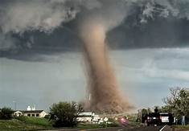
You cannot Build your relationship with God based only on Good Events in our lives
Leads to a prosperity gospel religion
Leads to misjudging why God brings tragic events into the lives of others
Does not prepare us for tragic events that God also brings into our lives
Results in anger against God when tragedies strike
God uses Good and
Calamities to train His children

Slide 34
Ecclesiastes 7:13-14 (NIV)
God brings blessing and calamity
13 Consider what God has done:
Who can straighten what he has made crooked? 14 When times are good, be happy; but when times are bad, consider:
God has made the one as well as the other. Therefore, a man cannot discover anything about his future. [you cannot tell from events of this life whether God will grant you eternal life or not! And you cannot judge others by events of their lives!]
God does not have a prosperity Gospel. He uses good and bad to train us.

Slide 35
Isaiah 45:5-7
God brings good and calamity
5 I am the Lord, and there is no other; There is no God besides Me. I will gird you, though you have not known Me,
6 That they may know from the rising of the sun to its setting that there is none besides Me. I am the Lord, and there is no other;
7 I form the light and create darkness, I make peace and create calamity; I, the Lord, do all these things.'
God uses disasters to accomplish His will

Slide 36
Amos 3:3-6 (ESV)
God brings good and calamity
Cause & Effect Situations
3 "Do two walk together, unless they have agreed to meet?
4 Does a lion roar in the forest, when he has no prey? Does a young lion cry out from his den, if he has taken nothing?
5 Does a bird fall in a snare on the earth, when there is no trap for it? Does a snare spring up from the ground, when it has taken nothing?
6 Is a trumpet blown in a city, and the people are not afraid? Does disaster come to a city, unless the Lord has done it?
God uses disasters to accomplish His will

Slide 37
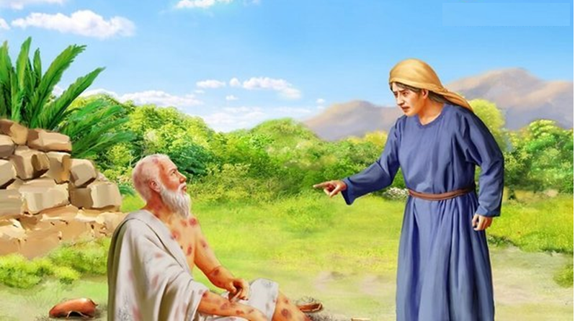
Job’s Wife failed as a Comforter
Do you still hold fast to your integrity? Curse God and Die!

Slide 38

How would you have held up and responded?

Slide 39
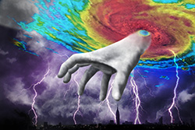
Job & his friends misunderstood how God uses suffering and calamities
They thought all suffering is the punishment of Sin
The degree of suffering is directly related to how terrible a sinner someone is
To relieve suffering, one must confess & repent of their sins
Applying this Understanding to Job:
Job is a great sufferer
Therefore Job must be a great sinner
To help Job, everyone must get Job to confess his sins
Wrong understandings can have drastic effects

Slide 40

Why do People like the idea of Direct Retribution in this life?
Implies that if things are going well, I am doing well in God’s eyes
Many of us believe we are better people than we really are, so we expect good to happen in our lives.
When bad things happen to others it means they are not living by the high standard I maintain – it makes me feel better about myself
It gives us the false feeling that God is pleased with me and will give me eternal life
For most of us it’s a false sense of security

Slide 41
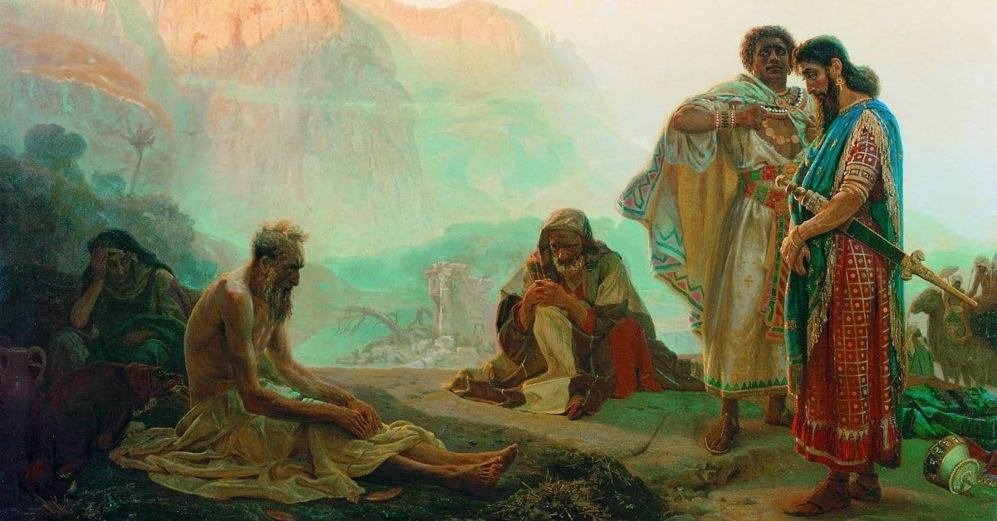
A Warning for us All
Eliphaz, Bildad and Zophar were friends of Job
They came from a distance to comfort him
They sincerely wanted to help Job
They sat in silence with Job for 7 days
And yet they turned out to be miserable comforters!
Think about what we can learn from all this so we can be better comforters

Slide 42
Job 2:11-13
Real friends want to help out
11 Now when Job's three friends heard of all this adversity that had come upon him, each one came from his own place — Eliphaz the Temanite, Bildad the Shuhite, and Zophar the Naamathite. For they had made an appointment together to come and mourn with him, and to comfort him. 12 And when they raised their eyes from afar, and did not recognize him, they lifted their voices and wept; and each one tore his robe and sprinkled dust on his head toward heaven. 13 So they sat down with him on the ground seven days and seven nights, and no one spoke a word to him, for they saw that his grief was very great.
Started out as wonderful comforters

Slide 43

Effective comforters need to first be friends. That means you must get to know others and develop a relationship of trust.

Slide 44
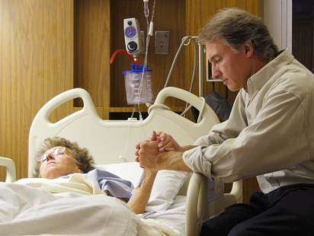
Sometimes you just need to sit quietly to let them know you care
Maybe you can pray together

Slide 45
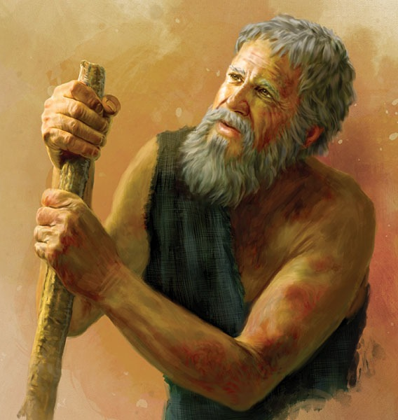
Job’s opening Lament (Job 3)
Wished he had never been conceived (3:2)
Wished he had died at birth (3:11)
Wished he could die now (3:20-21)
Overwhelmed with pain & confusion
Couldn’t see anything positive coming out of all his suffering and did not understand why it happened

Slide 46
Jeremiah 20:14-18
Jeremiah had similar feelings
14 Cursed be the day in which I was born! Let the day not be blessed in which my mother bore me! 15 Let the man be cursed who brought news to my father, saying, "A male child has been born to you!“ Making him very glad.
16 And let that man be like the cities which the Lord overthrew, and did not relent; Let him hear the cry in the morning and the shouting at noon, 17 Because he did not kill me from the womb, that my mother might have been my grave, and her womb always enlarged with me.
18 Why did I come forth from the womb to see labor and sorrow, that my days should be consumed with shame?
They did not understand God’s plan

Slide 47
Job 3:23-26 (ESV)
Job feels God is out to punish him
23 Why is light given to a man whose way is hidden, whom God has hedged in? [Satan claimed God hedged Job in to protect & bless him (1:10)]
24 For my sighing comes instead of my bread, and my groanings are poured out like water.
25 For the thing that I fear comes upon me, and what I dread befalls me.
26 I am not at ease, nor am I quiet; I have no rest, but trouble comes."
Job had lived in fear of God’s punishments

Slide 48
Job & his friends misunderstood how God uses suffering and calamities
They thought all suffering is the punishment of Sin
The degree of suffering is directly related to how terrible a sinner someone is
To relieve suffering, one must confess & repent of their sins
Applying this Understanding to Job:
Job is a great sufferer
Therefore Job must be a great sinner
To help Job, everyone must get Job to confess his sins
Wrong understandings can have drastic effects on our ability to comfort the afflicted

Slide 49
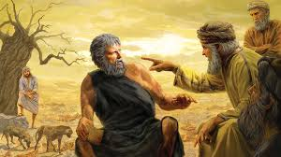
The Strategies of Job’s 3 Friends
Eliphaz: God is so high & pure, everyone is wicked and He doesn’t even trust His angels. Bases his doctrine on inspiration & wisdom of the elders. Round 3 turns to personal accusations!
Bildad: Claims Job and his children must be wicked. Appeals to his interpretation of how God treated the wicked in the past. Job’s present situation proves he is a great sinner. Round 3 – God is so high & righteous he must be right & Job is just a worm in God’s sight
Zophar: Tells Job to quit complaining – God is punishing you less than you deserve! God knows all your faults. God destroys the wicked man & that’s Job! Round 2 – personal accusations. No round 3
Job calls them “miserable comforters” (16:2)

Slide 50

Love is patient, Love is Kind, Love does not envy (1 Cor 13)
Envy destroys relationships and people

