Slide 1
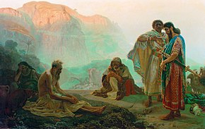
Job: Understanding How God Trains His Children
2) Learning to be Effective Comforters

Slide 2
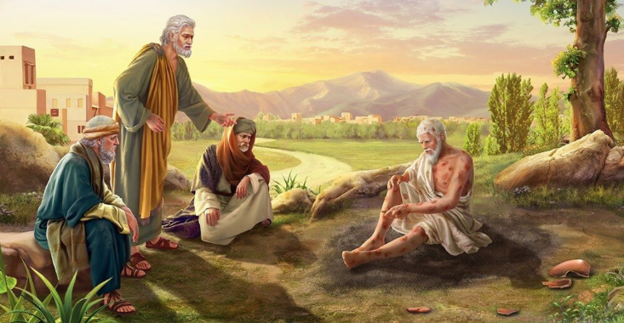
Round 1:
General statements about the Wicked, counselling Job to just repent and God will bless you again

Slide 3

Job 4:1-6 (ESV)
Eliphaz: Now it’s your turn Job
Then Eliphaz the Temanite answered and said:
2 "If one ventures a word with you, will you be impatient? Yet who can keep from speaking? 3 Behold, you have instructed many, and you have strengthened the weak hands. 4 Your words have upheld him who was stumbling, and you have made firm the feeble knees.
5 But now it has come to you, and you are impatient; it touches you, and you are dismayed. 6 Is not your fear of God your confidence, and the integrity of your ways your hope?
Job was used to counselling others

Slide 4
Job 4:7-9 (ESV)
God does destroy the wicked
7 "Remember: who that was innocent ever perished? Or where were the upright cut off? [what about Abel?]
8 As I have seen [through his filter], those who plow iniquity and sow trouble reap the same.
9 By the breath of God they perish, and by the blast of his anger they are consumed.
Sometimes true, but not always!

Slide 5
Job 4:12-16
Eliphaz claims Divine Inspiration
12 "Now a word was secretly brought to me, and my ear received a whisper of it. 13 In disquieting thoughts from the visions of the night, when deep sleep falls on men, 14 Fear came upon me, and trembling, which made all my bones shake.
15 Then a spirit passed before my face; The hair on my body stood up. 16 It stood still, but I could not discern its appearance. A form was before my eyes; There was silence; Then I heard a voice saying:
How can you argue against inspiration?

Slide 6
Job 4:17-19
God is so far beyond all His creations
17 'Can a mortal be more righteous than God? Can a man be more pure than his Maker? 18 If He puts no trust in His [heavenly] servants, if He charges His angels with error, (see 15:15) 19 How much more those who dwell in houses of clay, whose foundation is in the dust, who are crushed like a moth?
Eliphaz’ sees God as so righteous He is far removed from His family

Slide 7
Job 5:1-6
Eliphaz judged people & cursed them
"Call out now; Is there anyone who will answer you? And to which of the holy ones [angels] will you turn? 2 For wrath kills a foolish man, and envy slays a simple one.
3 I have seen the foolish taking root, but suddenly I cursed his dwelling place. 4 His sons are far from safety, they are crushed in the gate, and there is no deliverer. 5 Because the hungry eat up his harvest, taking it even from the thorns, and a snare snatches their substance. 6 For affliction does not come from the dust, nor does trouble spring from the ground; [this is not random, God is punishing you!]
When we become fixed on judging others, it can lead to us cursing those we consider wicked

Slide 8

If we are normally focused on judging others, we will not be effective comforters because we can always find a reason they are experiencing suffering

Slide 9
Job 5:8-9, 17-18
Accept God’s punishment and repent
8 "But as for me, I would seek God, and to God I would commit my cause — [by admitting my sins!] 9 Who does great things, and unsearchable, marvelous things without number.
17 "Behold, happy is the man whom God corrects; Therefore do not despise the chastening of the Almighty. [Prov 3:11; Heb 12:5-6] 18 For He bruises [punishment], but He binds up [when you confess sin]; He wounds, but His hands make whole.
Eliphaz had great sounding words, but applied them incorrectly to Job

Slide 10
Job 5:17-18
Mixture of Truth & Error
17 "Behold, happy is the man whom God corrects; Therefore do not despise the chastening of the Almighty. 18 For He bruises, but He binds up; He wounds, but His hands make whole.
Eliphaz says this from the perspective that God punishes
you with bruises & wounds in proportion to your sins
Hebrews 12:5-6
And you have forgotten the exhortation which speaks to you as to sons: Quotes from Prov 3:11-12 NOT Eliphaz!
"My son, do not despise the chastening of the Lord, nor be discouraged when you are rebuked by Him; For whom the Lord loves He chastens, and scourges every son whom He receives."
That’s what makes it so difficult to sort thru the words of Job’s friends
“they have not spoken of Me what is right” (42:7)

Slide 11
Job 6:1-5, 8-9
Job feels God is punishing him too much!
Then Job answered and said: 2 "Oh, that my grief were fully weighed, and my calamity laid with it on the scales! 3 For then it would be heavier than the sand of the sea — Therefore my words have been rash. 4 For the arrows of the Almighty are within me; My spirit drinks in their poison; The terrors of God are arrayed against me.
5 Does the wild donkey bray when it has grass, or does the ox low over its fodder? [Even animals don’t complain when they are taken care of]
8 "Oh, that I might have my request, that God would grant me the thing that I long for! 9 That it would please God to crush me, that He would loose His hand and cut me off!
With no hope in sight, Job wants to die

Slide 12
Job 6:14-15, 21-23 (NIV)
Three friends have been no help
14 "A despairing man should have the devotion of his friends, even though he forsakes the fear of the Almighty. 15 But my brothers are as undependable as intermittent streams, as the streams that overflow [they are destructive].
21 Now you too have proved to be of no help; you see my calamity and are afraid [maybe afraid to get too close to Job since God was punishing him]. 22 Have I said, 'Make me a gift'? Or, 'From your wealth offer a bribe for me'? 23 Or, 'Deliver me from the adversary's hand'? Or, 'Redeem me from the hand of the ruthless'? [ESV] (extreme tasks to contrast with the little Job was asking of them – help to understand)
Good comforters understand the needs

Slide 13

Effective Comforters
Listen to understand the needs of those suffering
Try to relieve some of the suffering and bring confidence that with God’s help you will get though this
Are not afraid to get involved, even if it will cost them emotionally, financially, ecclesially
Do not think they are better than the one suffering
Don’t use this as a time to preach and correct perceived spiritual weaknesses
It’s easy to stand back and judge, but not effective in helping

Slide 14
Job 6:24-30
Job is searching for understanding
24 "Teach me, and I will hold my tongue; Cause me to understand wherein I have erred. 25 How forceful are right words! But what does your arguing prove? 26 Do you intend to rebuke my words, and the speeches of a desperate one, which are as wind? 27 Yes, you overwhelm the fatherless, and you undermine your friend.
28 Now therefore, be pleased to look at me; For I would never lie to your face. 29 Yield [desist (NASB)], now, let there be no injustice! [false accusations] Yes, concede, my righteousness still stands! [I haven’t done anything to deserve this] 30 Is there injustice on my tongue? Cannot my taste discern the unsavory [sin]?
His friends have no reasonable answer

Slide 15
Job 7:5, 17, 20-21
Job’s desperation & frustration
11 "Therefore I will not restrain my mouth; I will speak in the anguish of my spirit; I will complain in the bitterness of my soul.
16 I loathe my life; I would not live forever. Let me alone, for my days are but a breath. 17 "What is man, that You should exalt him, that You should set Your heart on him, 18 That You should visit him every morning, and test him every moment? 19 How long? Will You not look away from me, and let me alone till I swallow my saliva?
20 Have I sinned? What have I done to You, O watcher of men? Why have You set me as Your target, so that I am a burden to myself? 21 Why then do You not pardon my transgression, and take away my iniquity? For now I will lie down in the dust, and You will seek me diligently, but I will no longer be." [not yet realizing that resurrection is the key]
He never had a loving relationship with God

Slide 16
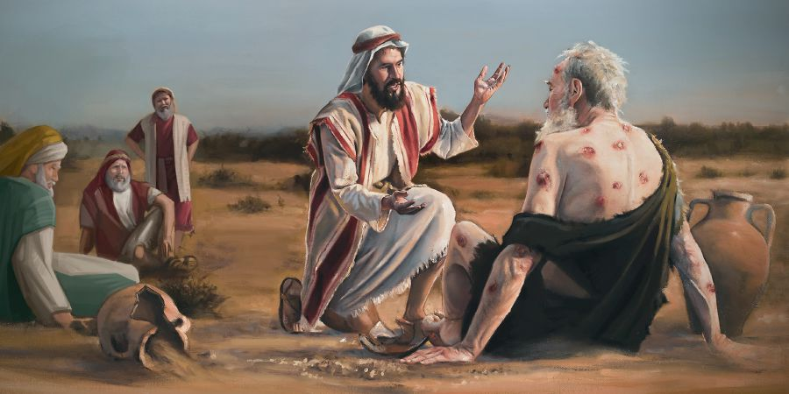
Bildad builds his case on his interpretation of how God treated the wicked in the past
Bildad describes the wicked man
8:3 His strength is starved and destruction is ready at his side
13 It devours patches of his skin; The firstborn of death devours his limbs.
15 Fire resides in his tent; burning sulfur is scattered over his dwelling. (NIV)
19 He has neither son nor posterity among his people, nor any remaining in his dwellings.
Nasty personal accusations against Job, who is a Godly man

Slide 17
Job 8:1-7
Claims Job & kids got what they deserved
Then Bildad the Shuhite answered and said:
2 "How long will you speak these things, and the words of your mouth be like a strong wind?
Does God subvert judgment? Or does the Almighty pervert justice? 4 If your sons have sinned against Him, He has cast them away for their transgression. 5 If you would earnestly seek God and make your supplication to the Almighty, 6 If you were pure and upright, surely now He would awake for you, and prosper your rightful dwelling place. 7 Though your beginning was small, yet your latter end would increase abundantly.
Just repent & change, God will bless you

Slide 18
Job 8:8-13
Look to the past & see how God works
8 "For inquire, please, of the former age, and consider the things discovered by their fathers; 9 For we were born yesterday, and know nothing, because our days on earth are a shadow. 10 Will they not teach you and tell you, and utter words from their heart?
11 "Can the papyrus grow up without a marsh? Can the reeds flourish without water? 12 While it is yet green and not cut down, it withers before any other plant. 13 So are the paths of all who forget God; and the hope of the hypocrite shall perish
Bildad sees the past through his own filter

Slide 19
Job 8:20-22
God only punishes the wicked
20 Behold, God will not cast away the blameless, nor will He uphold the evildoers. 21 He will yet fill your mouth with laughing, and your lips with rejoicing. [once you confess & repent]
22 Those who hate you will be clothed with shame, and the dwelling place of the wicked will come to nothing."
But Job is suffering & he is righteous

Slide 20
Job 9:2-3, 14-20
Job wants to reason with God
2 "Truly I know it is so, but how can a man be righteous before God? 3 If one wished to contend with Him, he could not answer Him one time out of a thousand.
14 "How then can I answer Him, and choose my words to reason with Him? 15 For though I were righteous, I could not answer Him; I would beg mercy of my Judge. [this is the only time Job mentions asking God for mercy, grace, pity & it’s only because he would feel overwhelmed, not sorry] 16 If I called and He answered me, I would not believe that He was listening to my voice. 17 For He crushes me with a tempest, and multiplies my wounds without cause. 18 He will not allow me to catch my breath, but fills me with bitterness. 19 If it is a matter of strength, indeed He is strong; and if of justice, who will appoint my day in court? 20 Though I were righteous, my own mouth would condemn me; Though I were blameless, it would prove me perverse.
Job sees God as way too far off

Slide 21
Job 9:21-24 (NASB)
God destroys the blameless & wicked
21 "I am guiltless; I do not take notice of myself; I despise my life. 22 "It is all one; therefore I say, 'He destroys the guiltless and the wicked.' 23 "If the scourge kills suddenly, He mocks the despair of the innocent. 24 "The earth is given into the hand of the wicked; He covers the faces of its judges. If it is not He, then who is it?
Job is left to conclude God is random and destroys both righteous and wicked

Slide 22
Job 9:32-35
Job’s Friends are not listening, so Job wants to argue his case to God
32 "For He is not a man, as I am, that I may answer Him, and that we should go to court together. 33 Nor is there any mediator between us, who may lay his hand on us both.
34 Let Him take His rod away from me, and do not let dread of Him terrify me. 35 Then I would speak and not fear Him, but it is not so with me.
Job is too afraid of God to challenge Him

Slide 23
Job 10:14-17
Job feels God is out to destroy him
14 If I sin, then You mark me, and will not acquit me of my iniquity. 15 If I am wicked, woe to me; Even if I am righteous, I cannot lift up my head. I am full of disgrace; See my misery!
16 If my head is exalted, you hunt me like a fierce lion, and again You show Yourself awesome against me. 17 You renew Your witnesses against me, and increase Your indignation toward me; changes and war are ever with me.
Job feels God is telling everyone he is a terrible sinner

Slide 24
Job 11:1-6 (ESV)
Zophar: God is punishing you less than you deserve, so quit complaining!
Then Zophar the Naamathite answered and said:
2 "Should a multitude of words go unanswered, and a man full of talk be judged right? 3 Should your babble silence men, and when you mock, shall no one shame you?
4 For you say, 'My doctrine is pure, and I am clean in God's eyes.’ [Elihu tackles this in 33:9]
5 But oh, that God would speak and open his lips to you, 6 and that he would tell you the secrets of wisdom! For he is manifold in understanding. Know then that God exacts of you less than your guilt deserves.
Real effective comforting!

Slide 25
Job 11:13-20
Just confess your great sin!
13 "If you would prepare your heart [confess your great sin!], and stretch out your hands toward Him; 14 If iniquity were in your hand, and you put it far away, and would not let wickedness dwell in your tents; 15 Then surely you could lift up your face without spot; Yes, you could be steadfast, and not fear; 16 Because you would forget your misery, and remember it as waters that have passed away, 17 And your life would be brighter than noonday. Though you were dark, you would be like the morning. 18 And you would be secure, because there is hope; Yes, you would dig around you, and take your rest in safety. 19 You would also lie down, and no one would make you afraid; Yes, many would court your favor. 20 But the eyes of the wicked will fail, and they shall not escape, and their hope — loss of life!"
God will bless you as soon as you confess

Slide 26
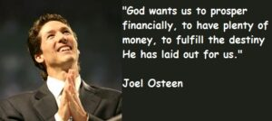
Job & his friends had beliefs very similar to the Prosperity Gospel teachings today
This is similar to works based Judaism

Slide 27

Job’s reply: Open your eyes and see the Truth

Slide 28
Job 12:1-9 (NCV)
Many times the wicked prosper!
Then Job answered: 2 "You really think you are the only wise people and that when you die, wisdom will die with you! 3 But my mind is as good as yours; you are not better than I am. Everyone knows all these things. [God is great & He will punish the wicked]
4 My friends all laugh at me when I call on God and expect him to answer me; they laugh at me even though I am right and innocent! 5 Those who are comfortable don't care that others have trouble; they think it right that those people should have troubles. 6 The tents of robbers are not bothered, and those who make God angry are safe. In what God provides by His hand.
7 "But ask the animals, and they will teach you, or ask the birds of the air, and they will tell you. 8 Speak to the earth, and it will teach you, or let the fish of the sea tell you. 9 Every one of these knows that the hand of the Lord has done this.
God is responsible for the prosperity of the wicked

Slide 29
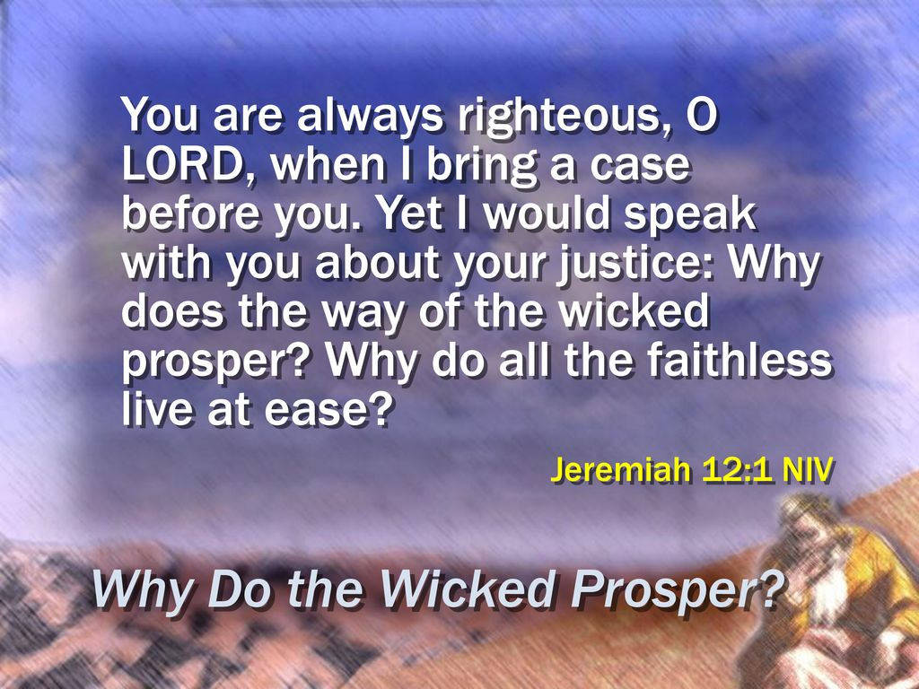

Slide 30
Job 13:1-3
Job wants to present his case to God
"Behold, my eye has seen all this, My ear has heard and understood it. 2 What you know, I also know; I am not inferior to you.
3 But I would speak to the Almighty, and I desire to reason with God.
The 3 friends haven’t presented anything that Job did not already know

Slide 31
Job 13:4-12 (NIV)
Job challenges his friends
4 You, however, smear me with lies; you are worthless physicians, all of you! 5 If only you would be altogether silent! For you, that would be wisdom.
6 Hear now my argument; listen to the plea of my lips. 7 Will you speak wickedly on God's behalf? Will you speak deceitfully for him? 8 Will you show him partiality? [by claiming God considers Job a wicked sinner] Will you argue the case for God? 9 Would it turn out well if he examined you? Could you deceive him as you might deceive men? 10 He would surely rebuke you if you secretly showed partiality. 11 Would not his splendor terrify you? Would not the dread of him fall on you? 12 Your maxims are proverbs of ashes; your defenses are defenses of clay.
Sufferers wish bad comforters would quit

Slide 32
Job 13:13-19
Job’s desire to defend himself to God
13 "Hold your peace with me, and let me speak, then let come on me what may! 14 Why do I take my flesh in my teeth, and put my life in my hands? 15 Though He slay me, yet will I trust Him. Even so, I will defend my own ways before Him. 16 He also shall be my salvation, for a hypocrite could not come before Him. 17 Listen carefully to my speech, and to my declaration with your ears. 18 See now, I have prepared my case, I know that I shall be vindicated. 19 Who is he who will contend with me? If now I hold my tongue, I perish.
Job is confident of his innocence

Slide 33

Job’s desire

Slide 34
Job 13:20-26
Job’s Hopeless prayer to God
20 "Only two things do not do to me, then I will not hide myself from You: 21 1) Withdraw Your hand far from me, and 2) let not the dread of You make me afraid. 22 Then call, and I will answer; or let me speak, then You respond to me. 23 How many are my iniquities and sins? Make me know my transgression and my sin. 24 Why do You hide Your face, and regard me as Your enemy? [when we have a relationship with God based on punishment & fear] 25 Will You frighten a leaf driven to and fro? And will You pursue dry stubble? 26 For You write bitter things against me, and make me inherit the iniquities of my youth. [Job’s only explanation: God must punish us later for sins we committed early in life]
Wrong views of God push us away

Slide 35

If we have a relationship with God build on fear & punishment, when bad things happen we can only understand that an angry God is punishing us

Slide 36
Job 14:13-19
Job’s hope is resurrection & justification
13 "Oh, that You would hide me in the grave, that You would conceal me until Your wrath is past, that You would appoint me a set time, and remember me!
14 If a man dies, shall he live again? All the days of my hard service I will wait, till my change comes. [the patience of Job!] 15 You shall call, and I will answer You; You shall desire the work of Your hands. 16 For now You number my steps, but do not watch over my sin. 17 My transgression is sealed up in a bag, and You cover my iniquity. [God will not tell Job about his sin]
18 "But as a mountain falls and crumbles away [God destroys even strong men], and as a rock is moved from its place; 19 As water wears away stones, and as torrents wash away the soil of the earth; So You destroy the hope of man.
Feels God destroys our hope in this life

Slide 37
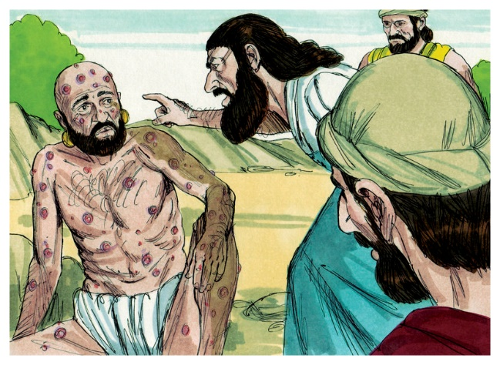
Tragic position of the Friends
Falsely accused Job of terrible sins he did not commit
Said things about God that were not true
claimed God was punishing Job for his great sins
Told Job to just confess & then God would bless him (prosperity gospel)
Did not modify their position even though Job was presenting evidence that something was wrong – all they do is become more intense by increasing their accusations about Job personally and driving Job further into despair
Be Careful that we don’t fall into this same tragic mistake!

Slide 38

Good Godly counsellors are willing to listen, try to understand, and open to modifying their view before suggesting a plan of action

Slide 39
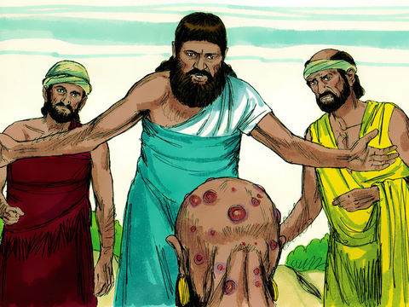
Job is being punished as wicked man, no mention of repent
Round 2

Slide 40
Job 15:1-6 (NASB)
Eliphaz: Job argues with worthless words
Then Eliphaz the Temanite responded,
2 "Should a wise man answer with windy knowledge and fill himself with the east wind? 3 "Should he argue with useless talk, or with words which are not profitable? 4 "Indeed, you do away with reverence and hinder meditation before God. 5 "For your guilt teaches your mouth, and you choose the language of the crafty. 6 "Your own mouth condemns you, and not I; and your own lips testify against you [that you are not wise!].
He thinks Job’s guilt is deceiving him

Slide 41
Job 15:7-13 (NIV)
Eliphaz challenges Job’s wisdom
7 "Are you the first man ever born? Were you brought forth before the hills? 8 Do you listen in on God's council? Do you limit wisdom to yourself? 9 What do you know that we do not know? What insights do you have that we do not have?
10 The gray-haired and the aged are on our side, men even older than your father. 11 Are God's consolations not enough for you, words spoken gently to you [by the 3 friends]? 12 Why has your heart carried you away [with such passion], and why do your eyes flash [with anger], 13 so that you vent your rage against God and pour out such words from your mouth?
The wise old men agree with us Job

Slide 42
Job 15:14-18
Everyone and thing is impure to God
14 "What is man, that he could be pure? And he who is born of a woman, that he could be righteous? 15 If God puts no trust in His saints, and the heavens are not pure in His sight, [from 4:18, then repeated by Bildad in 25:4-5] 16 How much less man, who is abominable and filthy, who drinks iniquity like water!
17 "I will tell you, hear me; a) What I have seen I will declare, 18 b) What wise men have told, not hiding anything received from their fathers, 19 To whom alone the land was given, and c)no alien passed among them: [not contaminated by foreigners]
Leaves you with a God with no trusting relationship with anyone

Slide 43
Job 15:20-26 (NIV)
The wicked live in fear of their punishment
All his days the wicked man suffers torment, the cruel suffer during all the years saved up for them [NCV]. 21 Terrifying sounds fill his ears; when all seems well, marauders attack him. 22 He despairs of escaping the darkness; he is marked for the sword. 23 He wanders about — food for vultures; he knows the day of darkness is at hand. 24 Distress and anguish fill him with terror; they overwhelm him, like a king poised to attack, 25 because he shakes his fist at God and vaunts himself against the Almighty, 26 defiantly charging against him with a thick, strong shield. [like Eliphaz sees Job doing]
There is no peace for the wicked

Slide 44
Job 15:27-35 (NiRV)
God will judge the wicked in this life
27 “Their faces are very fat. Their stomachs hang out. 28 They’ll live in towns that have been destroyed. They’ll live in houses where no one else lives. The houses will crumble to pieces. 29 They won’t be rich anymore. Their wealth won’t last. Their property will no longer spread out over the land. 30 They won’t escape the darkness. A flame will dry up everything they have. The breath of God will blow them away. 31 Don’t let them fool themselves by trusting in what is worthless. They won’t get anything out of it. 32 Even before they die, they’ll be paid back in full. No matter what they do, it won’t succeed. 33 They’ll be like vines that are stripped of their unripe grapes. They’ll be like olive trees that drop their flowers. 34 People who are ungodly won’t have any children. Fire will burn up the tents of people who accept money from those who want special favors. 35 Instead of having children, ungodly people create suffering. All they produce is evil.
This is YOU Job!

Slide 45
Job 16:1-5
Job is getting no comfort, just accusations
Then Job answered and said:
2 "I have heard many such things; Miserable comforters are you all! 3 Shall words of wind have an end? Or what provokes you that you answer?
4 I also could speak as you do, if your soul were in my soul's place. I could heap up words against you, and shake my head at you; 5 But I would strengthen you with my mouth, and the comfort of my lips would relieve your grief.
Job used to comfort sufferers

Slide 46
Job 16:7-10
God has witnessed against me
7 But now He has worn me out; You have made desolate all my company. 8 You have shriveled me up, and it is a witness against me; My leanness rises up against me and bears witness to my face. 9 He tears me in His wrath, and hates me; He gnashes at me with His teeth; My adversary sharpens His gaze on me. 10 They gape at me with their mouth, they strike me reproachfully on the cheek, they gather together against me.
Feels God has turned everyone against Job

Slide 47
Job 16:11-14
God has set out to destroy me
11 God has delivered me to the ungodly, and turned me over to the hands of the wicked. 12 I was at ease, but He has shattered me; He also has taken me by my neck, and shaken me to pieces; He has set me up for His target, 13 His archers surround me. He pierces my heart and does not pity; He pours out my gall on the ground. 14 He breaks me with wound upon wound; He runs at me like a warrior.
Feels God has no compassion or pity

Slide 48
Job 16:18-22 (ESV)
There must be a witness who will justify Job
18 "O earth, cover not my blood, and let my cry find no resting place. 19 Even now, behold, my witness is in heaven, and he who testifies for me is on high.
20 My friends scorn me; my eye pours out tears to God, 21 that he [Job’s witness] would argue the case of a man with God, as a son of man does with his neighbor.
22 For when a few years have come I shall go the way from which I shall not return.
Job wants to be vindicated in this life

Slide 49
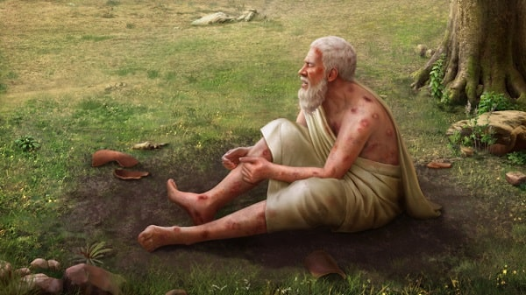
Job’s Concern at this time
Job is convinced that in God’s justice, there must be a time and situation when a witness [Job’s redeemer] will stand up and vindicate Job before God
He wants his witness to convince God that God is wrong and has unjustly held Job guilty
He wants everyone else to know that Job was innocent all the time
Job wants this now before he dies, but is sure it will have to eventually happen

Slide 50
Job 17:1-5 (NASB)
Job wants to be justified to his community
"My spirit is broken, my days are extinguished, the grave is ready for me. 2 "Surely mockers are with me, and my eye gazes on their provocation.
3 "Lay down, now, a pledge for me with Yourself; Who is there that will be my guarantor? 4 "For You have kept their heart from understanding, therefore You will not exalt them.
5 "He who informs against friends for a share of the spoil, the eyes of his children also will languish. [their children will be shamed when they see what their parents did]
Only God can eventually reveal Job’s Truth

Slide 51
Job 17:6-9 (NIV)
God has humiliated & worn out Job
6 "God has made me a byword to everyone, a man in whose face people spit. 7 My eyes have grown dim with grief; my whole frame is but a shadow. 8 Upright men [not 3 friends] are appalled at this; the innocent [like Job] are aroused against the ungodly [questioning why the wicked prosper]. 9 Nevertheless, the righteous will hold to their ways, and those with clean hands will grow stronger.
Upright men are questioning, like Job

Slide 52
Job 17:10-16 (NIV)
Job is consigned to his soon death
10 "But come on, all of you, try again! I will not find a wise man among you. 11 My days have passed, my plans are shattered, and so are the desires of my heart. 12 These men turn night into day; in the face of darkness they say, 'Light is near.‘ [by telling Job to confess & repent & then be restored] 13 If the only home I hope for is the grave, if I spread out my bed in darkness, 14 if I say to corruption, 'You are my father,‘ and to the worm, 'My mother' or 'My sister,‘ 15 where then is my hope? Who can see any hope for me? 16 Will it go down to the gates of death? Will we descend together into the dust?"
So sad he will die & not see his justification

Slide 53
Job 18:1-6
Bildad hadn’t thought about Job’s words at all
Then Bildad the Shuhite answered and said:
2 "How long till you put an end to words? Gain understanding, and afterward we will speak. 3 Why are we counted as beasts, and regarded as stupid in your sight? 4 You who tear yourself in anger, shall the earth be forsaken for you? Or shall the rock be removed from its place?
5 "The light of the wicked indeed goes out, and the flame of his fire does not shine. 6 The light is dark in his tent, and his lamp beside him is put out.
Bildad was convinced he was right in spite of Job’s evidence

Slide 54
Job 18:12-14, 17-19, 21
Job is suffering like wicked men
12 His strength is starved, and destruction is ready at his side. 13 It devours patches of his skin; The firstborn of death devours his limbs. 14 He is uprooted from the shelter of his tent, and they parade him before the king of terrors.
17 The memory of him perishes from the earth, and he has no name among the renowned 18 He is driven from light into darkness, and chased out of the world. 19 He has neither son nor posterity among his people, nor any remaining in his dwellings.
21 Surely such are the dwellings of the wicked, and this is the place of him who does not know God."
Now Bildad makes it personal. Job – You are the wicked man!

Slide 55
Bildad customizes his words to Job’s situation (Job 18)
Bildad describes the wicked man
12 His strength is starved and destruction is ready at his side
13 It devours patches of his skin; The firstborn of death devours his limbs.
15 Fire resides in his tent; burning sulfur is scattered over his dwelling. (NIV)
19 He has neither son nor posterity among his people, Nor any remaining in his dwellings.
Nasty accusations against a Godly man

Slide 56
Job 19:1-6
Job reproaches his friends
Then Job answered and said:
2 "How long will you torment my soul, and break me in pieces with words? 3 These ten times you have reproached me; You are not ashamed that you have wronged me. 4 And if indeed I have erred, my error remains with me.
5 If indeed you exalt yourselves against me, and plead my disgrace against me, 6 Know then that God has wronged me, and has surrounded me with His net.
Job claims God has wronged him by mistake

Slide 57
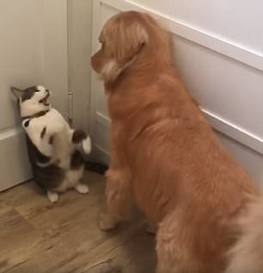
Job gets backed into a corner
Job knows he has not committed sins that are greater than his friends, so according to their views about suffering, God must be wrong. Job does consider other reasons for suffering during the discussions (God is random 9:16,22,23), but always comes back to his defense that God is wrong about him. No one so far is able to give Job another reason for suffering.
Be careful not to back others into corners to defend themselves! We might push them to extremes.

Slide 58
Job 19:7-12
Job feels God has wrongfully destroyed him
7 "If I cry out concerning wrong, I am not heard. If I cry aloud, there is no justice. 8 He has fenced up my way, so that I cannot pass; and He has set darkness in my paths. 9 He has stripped me of my glory, and taken the crown from my head. 10 He breaks me down on every side, and I am gone; My hope He has uprooted like a tree. 11 He has also kindled His wrath against me, and He counts me as one of His enemies. 12 His troops come together and build up their road against me; They encamp all around my tent.
Job blames God for all of this!

Slide 59
Job 19:13-20
Job feels God has wrongfully destroyed him
13 "He has removed my brothers far from me, and my acquaintances are completely estranged from me. 14 My relatives have failed, and my close friends have forgotten me. 15 Those who dwell in my house, and my maidservants, count me as a stranger; I am an alien in their sight. 16 I call my servant, but he gives no answer; I beg him with my mouth. 17 My breath is offensive to my wife, and I am repulsive to the children of my own body. 18 Even young children despise me; I arise, and they speak against me. 19 All my close friends abhor me, and those whom I love have turned against me. 20 My bone clings to my skin and to my flesh, and I have escaped by the skin of my teeth.
Job blames God for all of this!

Slide 60
Job 19:21-22
Job pleads for compassion from his friends
21 "Have pity on me, have pity on me, O you my friends, for the hand of God has struck me!
22 Why do you persecute me as God does, and are not satisfied with my flesh?
He feels that God is mistakenly angry with him and wrongfully persecutes him

Slide 61
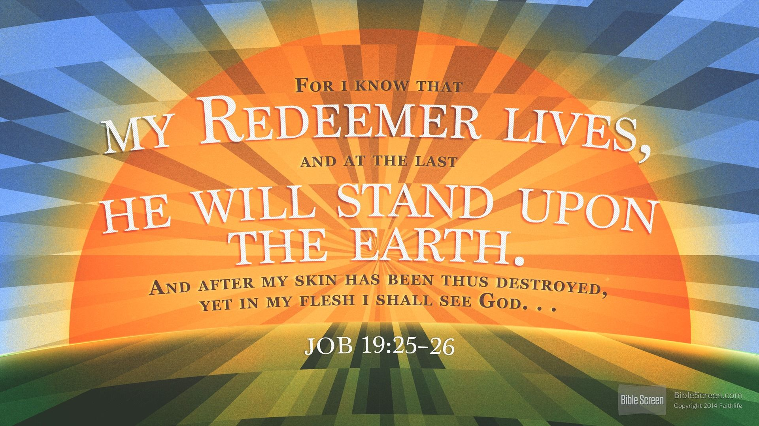
Good Bible exposition is based on Context

Slide 62
Job 19:23-27
Job fully expects his redeemer to justify him and show God to be wrong!
23 "Oh, that my words were written! Oh, that they were inscribed in a book! 24 That they were engraved on a rock with an iron pen and lead, forever!
25 For I know that my Redeemer lives, [Job expects according to God’s justice someone will have to show Job is innocent and God has wronged him (v.6)] and He shall stand at last on the earth; 26 And after my skin is destroyed, this I know, that in my flesh I shall see God, 27 Whom I shall see for myself [“whom I will see on my side” (RSV)], and my eyes shall behold, and not another. How my heart yearns within me!
Job is excited for the day he will be vindicated!

Slide 63
Job 19:28-29 (NIrV)
Job warns his friends
28 “You might say, ‘Let’s keep bothering Job. After all, he’s the cause of all of his suffering.’
29 But you should be afraid when God comes to judge you. He’ll be angry. He’ll punish you with his sword. Then you will know that he is the Judge.”
Job knows God will hold us accountable for false accusations against one another

Slide 64
Job 20:1-5
Zophar hasn’t understood Job at all
Then Zophar the Naamathite answered and said:
2 "Therefore my anxious thoughts make me answer, because of the turmoil within me. 3 I have heard the rebuke that reproaches me [understood that Job reproved him], and the spirit of my understanding causes me to answer.
4 "Do you not know this of old, since man was placed on earth, 5 That the triumphing of the wicked is short, and the joy of the hypocrite is but for a moment?
Right back to “judgment in this life”

Slide 65
Job 20:4-11
The fate of the Wicked Man
4 "Do you not know this of old, since man was placed on earth, 5 That the triumphing of the wicked is short, and the joy of the hypocrite is but for a moment? 6 Though his haughtiness mounts up to the heavens, and his head reaches to the clouds, 7 Yet he will perish forever like his own refuse; Those who have seen him will say, 'Where is he?' 8 He will fly away like a dream, and not be found; Yes, he will be chased away like a vision of the night. 9 The eye that saw him will see him no more, nor will his place behold him anymore. 10 His children will seek the favor of the poor, and his hands will restore his wealth. 11 His bones are full of his youthful vigor, but it will lie down with him in the dust.
Everyone knows the wicked man will die early

Slide 66
Job 20: 12-19
The fate of the Wicked Man
12 "Though evil is sweet in his mouth, and he hides it under his tongue, 13 Though he spares it and does not forsake it, but still keeps it in his mouth, 14 Yet his food in his stomach turns sour; it becomes cobra venom within him. 15 He swallows down riches and vomits them up again; God casts them out of his belly. 16 He will suck the poison of cobras; The viper's tongue will slay him. 17 He will not see the streams, the rivers flowing with honey and cream. 18 He will restore that for which he labored, and will not swallow it down; From the proceeds of business he will get no enjoyment. 19 For he has oppressed and forsaken the poor, he has violently seized a house which he did not build.
God will take away all his stuff

Slide 67
Job 20:20-25
The fate of the Wicked Man
20 "Because he knows no quietness in his heart, he will not save anything he desires. 21 Nothing is left for him to eat; Therefore his well-being will not last. 22 In his self-sufficiency he will be in distress; Every hand of misery will come against him. 23 When he is about to fill his stomach, God will cast on him the fury of His wrath, and will rain it on him while he is eating. 24 He will flee from the iron weapon; A bronze bow will pierce him through. 25 It is drawn, and comes out of the body; Yes, the glittering point comes out of his gall. Terrors come upon him;
God will bring misery on a wicked man – You Job!

Slide 68
Job 20:26-29
The fate of the Wicked Man
26 Total darkness is reserved for his treasures. An unfanned fire will consume him; It shall go ill with him who is left in his tent. 27 The heavens will reveal his iniquity, and the earth will rise up against him. 28 The increase of his house will depart, and his goods will flow away in the day of His wrath. 29 This is the portion from God for a wicked man, the heritage appointed to him by God."
God will bring misery on a wicked man – You Job!

Slide 69
Job 21:1-6 (NCV)
Job pleads with them to listen to him
Then Job answered:
2 "Listen carefully to my words, and let this be the way you comfort me. 3 Be patient while I speak. After I have finished, you may continue to make fun of me.
4 "My complaint is not just against people; I have reason to be impatient. 5 Look at me and be shocked; put your hand over your mouth in shock. 6 When I think about this, I am terribly afraid and my body shakes.
They should have listened and considered Job’s words

Slide 70
Job 21:7-16
Some of the Wicked prosper
7 Why do the wicked live and become old, yes, become mighty in power? 8 Their descendants are established with them in their sight, and their offspring before their eyes. 9 Their houses are safe from fear, neither is the rod of God upon them. 10 Their bull breeds without failure; Their cow calves without miscarriage. 11 They send forth their little ones like a flock, and their children dance. 12 They sing to the tambourine and harp, and rejoice to the sound of the flute. 13 They spend their days in wealth, and in a moment go down to the grave. 14 Yet they say to God, 'Depart from us, for we do not desire the knowledge of Your ways. 15 Who is the Almighty, that we should serve Him? And what profit do we have if we pray to Him?' 16 But their prosperity is not in their own hands, so I stand aloof from the counsel of the wicked (NIV). [Job is not influenced by their reasoning]
They prosper because God allows it

Slide 71
Job 21:17-21 (ESV)
The wicked are rarely destroyed
17 "How often is it that the lamp of the wicked is put out? That their calamity comes upon them? That God distributes pains in his anger? 18 That they are like straw before the wind, and like chaff that the storm carries away? 19 You say, ‘God stores up their iniquity for their children.’ Let Him pay it out to them, that they may know it. 20 Let their own eyes see their destruction, and let them drink of the wrath of the Almighty. 21 For what do they care for their houses after them, when the number of their months is cut off?
Friends believed that if God did not destroy the wicked, He would destroy their kids! (Ezek 18, Jn 9)

Slide 72
Job 21:22-26
Job now thinks God treats wicked men randomly
22 "Can anyone teach God knowledge [about how to judge the wicked], since He judges those on high?
23 One [wicked man] dies in his full strength, being wholly at ease and secure; 24 His pails are full of milk, and the marrow of his bones is moist.
25 Another [wicked] man dies in the bitterness of his soul, never having eaten with pleasure.
26 They lie down alike in the dust, and worms cover them.
The both end up the same!

Slide 73
Job 21:27-34 (ESV)
Many evil men are not punished in this life!
27 "Behold, I know your thoughts and your schemes to wrong me. 28 For you say, 'Where is the house of the prince [maybe implying Job]? Where is the tent in which the wicked lived?‘ [they claimed God always destroyed the wicked]
29 Have you not asked those who travel the roads, and do you not accept their testimony 30 that the evil man is spared in [“reserved from” in some versions] the day of calamity, that he is rescued in [“brought out on” in some versions] the day of wrath? 31 Who declares his way to his face, and who repays him for what he has done? 32 When he is carried to the grave, watch is kept over his tomb. 33 The clods of the valley are sweet to him; all mankind follows after him, and those who go before him are innumerable.
34 How then will you comfort me with empty nothings? There is nothing left of your answers but falsehood."
Their useless words did not fit Job’s experience

Slide 74

Round 3
Nasty, Personal accusations

Slide 75
Job 22:4-11 (NIV)
Eliphaz’ false accusations
4 "Is it for your piety that he rebukes you and brings charges against you? 5 Is not your wickedness great? Are not your sins endless?
6 You demanded security from your brothers for no reason; you stripped men of their clothing, leaving them naked. 7 You gave no water to the weary and you withheld food from the hungry,
8 though you were a powerful man, owning land — an honored man, living on it. 9 And you sent widows away empty-handed and broke the strength of the fatherless. 10 That is why snares are all around you, why sudden peril terrifies you, 11 why it is so dark you cannot see, and why a flood of water covers you.
Terrible false accusations

Slide 76

False accusations destroy friendships and can ruin lives
“‘Do not go around spreading lies among your people.
“‘Love your neighbor as you love yourself Lev 19:16, 18

Slide 77
Job 23:1-7
Job wants his day in court
Then Job answered and said:
2 "Even today my complaint is bitter; My hand is listless because of my groaning. 3 Oh, that I knew where I might find Him, that I might come to His seat! 4 I would present my case before Him, and fill my mouth with arguments. 5 I would know the words which He would answer me, and understand what He would say to me.
6 Would He contend with me in His great power? No! But He would take note of me. 7 There the upright could reason with Him, and I would be delivered forever from my Judge.
Seeking to be delivered from his Judge

Slide 78
Job 23:8-12
I can’t find God, but He finds me
8 "Look, I go forward, but He is not there, and backward, but I cannot perceive Him; 9 When He works on the left hand, I cannot behold Him; When He turns to the right hand, I cannot see Him.
10 But He knows the way that I take; when He has tested me, I shall come forth as gold. 11 My foot has held fast to His steps; I have kept His way and not turned aside. 12 I have not departed from the commandment of His lips; I have treasured the words of His mouth more than my necessary food. [Job thought he was responsible for his righteousness]
Job still feels he will be justified

Slide 79
Job 23:13-17 (NASB)
God does what He wants
13 "But He is unique and who can turn Him? [change him] And what His soul desires, that He does. 14 "For He performs what is appointed for me, and many such decrees are with Him.
15 "Therefore, I would be dismayed at His presence; When I consider, I am terrified of Him. 16 "It is God who has made my heart faint, and the Almighty who has dismayed me, 17 But I am not silenced by the darkness, nor deep gloom which covers me.
Feels God has worn him down, but he is not giving up

Slide 80
Job 24:1-8 (NIV)
God doesn’t hold the wicked accountable!
"Why does the Almighty not set times for judgment? Why must those who know him look in vain for such days? 2 Men move boundary stones; they pasture flocks they have stolen. 3 They drive away the orphan's donkey and take the widow's ox in pledge. 4 They thrust the needy from the path and force all the poor of the land into hiding. 5 Like wild donkeys in the desert, the poor go about their labor of foraging food; the wasteland provides food for their children. 6 They gather fodder in the fields and glean in the vineyards of the wicked. 7 Lacking clothes, they spend the night naked; they have nothing to cover themselves in the cold. 8 They are drenched by mountain rains and hug the rocks for lack of shelter.
The wicked abuse & oppress others

Slide 81
Job 24:9-12 (NIV)
God doesn’t hold the wicked accountable!
9 The fatherless child is snatched from the breast; the infant of the poor is seized for a debt. 10 Lacking clothes, they go about naked; they carry the sheaves, but still go hungry. 11 They crush olives among the terraces; they tread the winepresses, yet suffer thirst. 12 The groans of the dying rise from the city, and the souls of the wounded cry out for help. But God charges no one with wrongdoing.
The wicked abuse & oppress others

Slide 82
Job 24:13-17 (NIV)
Evils men get away with at night
13 "There are those who rebel against the light, who do not know its ways or stay in its paths. 14 When daylight is gone, the murderer rises up and kills the poor and needy; in the night he steals forth like a thief.
15 The eye of the adulterer watches for dusk; he thinks, 'No eye will see me,‘ and he keeps his face concealed.
16 In the dark, men break into houses, but by day they shut themselves in; they want nothing to do with the light. 17 For all of them, deep darkness is their morning; they make friends with the terrors of darkness.
God doesn’t judge them now

Slide 83
Job 24:18-21
You claim the Wicked are quickly destroyed
18 "You say, [ESV] 'Swift are they on the face of the waters [quickly taken away for punishment]; their portion is cursed in the land; no treader turns toward their vineyards. 19 As drought and heat consume the snow waters, so the grave consumes those who have sinned. 20 The womb [his mother] should forget him, the worm should feed sweetly on him; He should be remembered no more, and wickedness should be broken like a tree. 21 For he preys on the barren who do not bear, and does no good for the widow.
But Job does not find this to be true

Slide 84
Job 24:22-25
But God keeps the wicked alive!
[ESV] 22 Yet God prolongs the life of the mighty by his power; they rise up when they despair of life. 23 He gives them security, and they are supported, and his eyes are upon their ways [they prosper]. 24 They are exalted a little while, and then are gone [with no punishment!]; they are brought low and gathered up like all others; they are cut off like the heads of grain [after full life]. 25 If it is not so, who will prove me a liar and show that there is nothing in what I say?"
They just die like everyone else

Slide 85
Job 25
Bildad doesn’t answer Job’s claims
Then Bildad the Shuhite answered and said:
2 "Dominion and fear belong to Him; He makes peace in His high places. 3 Is there any number to His armies? Upon whom does His light not rise?
Vs 4-6 are similar to Eliphaz (4:17; 15:14-16)
4 How then can man be righteous before God? Or how can he be pure who is born of a woman? 5 If even the moon does not shine, and the stars are not pure in His sight, 6 How much less man, who is a maggot, and a son of man, who is a worm?"
Still arguing: God is great, man is just a worm

Slide 86

Job’s Friends used Bible Principles, but did not apply them correctly
5:13 Eliphaz: He catches the wise in their own craftiness. [quoted in 1Cor 3:19]
5:17 Eliphaz: Behold, happy is the man whom God corrects; therefore do not despise the chastening of the Almighty. [Pro 3:11; Heb 12:5]
8:19 Bildad: God will not cast away the blameless, nor will He uphold the evildoers
20:5 Zophar: the triumphing of the wicked is short, and the joy of the hypocrite is but for a moment
Warning to us: Be careful how you apply God’s principles, especially when making accusations against others

Slide 87
Job 26:1-4
Job’s sarcastic reply to Bildad
Then Job replied:
2 "How you [Bildad] have helped the powerless! How you have saved the arm that is feeble!
3 What advice you have offered to one without wisdom! And what great insight you have displayed!
4 Who has helped you utter these words? And whose spirit spoke from your mouth?
Bildad hadn’t helped anyone

Slide 88
Job 26:5-14
Job acknowledges God’s greatness
5 "The dead tremble, those under the waters and those inhabiting them. 6 Sheol is naked before Him, and Destruction has no covering. 7 He stretches out the north over empty space; He hangs the earth on nothing. 8 He binds up the water in His thick clouds, yet the clouds are not broken under it. 9 He covers the face of His throne, and spreads His cloud over it. 10 He drew a circular horizon on the face of the waters, at the boundary of light and darkness. 11 The pillars of heaven tremble, and are astonished at His rebuke. 12 He stirs up the sea with His power, and by His understanding He breaks up the storm. 13 By His Spirit He adorned the heavens; His hand pierced the fleeing serpent. 14 Indeed these are the mere edges of His ways, and how small a whisper we hear of Him! But the thunder of His power who can understand?"
But God doesn’t let us understand Him

Slide 89
Job 27:1-6
Job refuses to let go of his righteousness
Moreover Job continued his discourse, and said:
2 "As God lives, who has taken away my justice, and the Almighty, who has made my soul bitter, 3 As long as my breath is in me, and the breath of God in my nostrils, 4 My lips will not speak wickedness, nor my tongue utter deceit.
5 Far be it from me that I should say you are right; Till I die I will not put away my integrity from me. 6 My righteousness I hold fast, and will not let it go; My heart shall not reproach me as long as I live.
Still blames God for all his trouble

Slide 90
Job 27:7-12
Job losing patience with his friends
7 "May my enemy [Job’s friends have become his enemy] be like the wicked, and he who rises up against me like the unrighteous. 8 For what is the hope of the hypocrite, though he may gain much, if God takes away his life? 9 Will God hear his cry when trouble comes upon him? 10 Will he delight himself in the Almighty? Will he always call on God? [like Job has!]
11 "I will teach you about the hand of God; What is with the Almighty I will not conceal. 12 Surely all of you have seen it; Why then do you behave with complete nonsense?
Job still trying to educate his friends

Slide 91
Job 27:13-23
Job summarizes the 3 friends’ view
13 "This is the portion of a wicked man with God, and the heritage of oppressors, received from the Almighty:
14 If his children are multiplied, it is for the sword; and his offspring shall not be satisfied with bread. 16 Though he heaps up silver like dust, and piles up clothing like clay — 17 He may pile it up, but the just will wear it, and the innocent will divide the silver. 19 The rich man will lie down, but not be gathered up; He opens his eyes, and he is no more. 20 Terrors overtake him like a flood; A tempest steals him away in the night. 21 The east wind carries him away, and he is gone; It sweeps him out of his place. 23 Men shall clap their hands at him, and shall hiss him out of his place.
Then Job does on to search for wisdom to understand what God is doing & why

Slide 92
Job 28:1-15
Man is clever, but cannot find God’s wisdom
1 "Surely there is a mine for silver, and a place where gold is refined. 2 Iron is taken from the earth, and copper is smelted from ore. 3 Man puts an end to darkness, and searches every recess for ore in the darkness and the shadow of death…. 10 What is hidden he brings forth to light.
12 "But where can wisdom be found? And where is the place of understanding? 13 Man does not know its value, nor is it found in the land of the living. 14 The deep says, 'It is not in me'; and the sea says, 'It is not with me.' 15 It cannot be purchased for gold, nor can silver be weighed for its price.
It’s hidden from man and cannot be bought

Slide 93
Job 28:20-28
Man is clever, but cannot find God’s wisdom
20 "From where then does wisdom come? And where is the place of understanding? 21 It is hidden from the eyes of all living, and concealed from the birds of the air. 23 God understands its way, and He knows its place. 24 For He looks to the ends of the earth, and sees under the whole heavens 26 When He made a law for the rain, and a path for the thunderbolt, 27 Then He saw wisdom and declared it; He prepared it, indeed, He searched it out. 28 And to man He said, 'Behold, the fear of the Lord, that is wisdom, and to depart from evil is understanding.'"
The best man can do is to fear the Lord and depart from evil

Slide 94
Job 29:2-9
Job remembers when God watched over him
2 "Oh, that I were as in months past, as in the days when God watched over me; 3 When His lamp shone upon my head, and when by His light I walked through darkness; 4 Just as I was in the days of my prime, when the friendly counsel of God was over my tent; 5 When the Almighty was yet with me, when my children were around me; 6 When my steps were bathed with cream, And the rock poured out rivers of oil for me!
7 "When I went out to the gate by the city, when I took my seat in the open square, 8 The young men saw me and hid, and the aged arose and stood; 9 The princes refrained from talking, and put their hand on their mouth;
Now everything’s changed & Job doesn’t know why

Slide 95
Job 29:12-25
Job remembers when God watched over him
12 Because I delivered the poor who cried out, the fatherless and the one who had no helper. 13 The blessing of a perishing man came upon me, and I caused the widow's heart to sing for joy. 14 I put on righteousness, and it clothed me; My justice was like a robe and a turban. 15 I was eyes to the blind, and I was feet to the lame. 16 I was a father to the poor, and I searched out the case that I did not know. 17 I broke the fangs of the wicked, and plucked the victim from his teeth.
18 "Then I said, 'I shall die in my nest, and multiply my days as the sand. 19 My root is spread out to the waters, and the dew lies all night on my branch. 21 "Men listened to me and waited, and kept silence for my counsel. 22 After my words they did not speak again, and my speech settled on them as dew….. 25 I chose the way for them, and sat as chief; So I dwelt as a king in the army, as one who comforts mourners.
Now everything’s changed & Job doesn’t know why

Slide 96
Job 30:1-11 (ESV)
God has cast Job away & caused his ridicule
"But now they laugh at me, men who are younger than I, whose fathers I would have disdained to set with the dogs of my flock. 3 Through want and hard hunger they gnaw the dry ground by night in waste and desolation; 4 they pick saltwort and the leaves of bushes, and the roots of the broom tree for their food.
9 "And now I have become their song; I am a byword to them. 10 They abhor me; they keep aloof from me; they do not hesitate to spit at the sight of me. 11 Because God has loosed my cord and humbled me, they have cast off restraint in my presence.
Job sees no other answer to his situation

Slide 97
Job 30:16-28 (ESV)
God has cast Job away & caused his ridicule
16 "And now my soul is poured out within me; days of affliction have taken hold of me.17 The night racks my bones, and the pain that gnaws me takes no rest. 18 With great force my garment is disfigured; it binds me about like the collar of my tunic. 19 God has cast me into the mire, and I have become like dust and ashes. 20 I cry to you for help and you do not answer me; I stand, and you only look at me. 21 You have turned cruel to me; with the might of your hand you persecute me. 22 You lift me up on the wind; you make me ride on it, and you toss me about in the roar of the storm. 23 For I know that you will bring me to death and to the house appointed for all living.
24 "Yet does not one in a heap of ruins stretch out his hand, and in his disaster cry for help? 25 Did not I weep for him whose day was hard? Was not my soul grieved for the needy? 26 But when I hoped for good, evil came, and when I waited for light, darkness came. 27 My inward parts are in turmoil and never still; days of affliction come to meet me. 28 I go about darkened, but not by the sun; I stand up in the assembly and cry for help.
Job sees no other answer to his situation

Slide 98
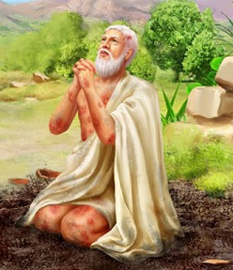
Job’s Final words attempt to declares his Righteousness (31)
Job claims to be innocent of:
1-12 All Sexual sins
13-15 Abuse of his servants
16-23 Abuse of poor, widows, orphans
24-25 Coveting riches
26-28 Idolatry
29-30 Joy over his enemy’s destruction
31-32 Failure to show hospitality
33-34 Attempting to hide his sins
38-40 Abuse of the land
How will he ever stay humble?
He still failed to realize that all his righteousness was really God’s

Slide 99
Job 31:35-37 (ESV)
Job’s final thoughts
35 Oh, that I had one to hear me! (Here is my signature! Let the Almighty answer me!) Oh, that I had the indictment written by my adversary! 36 Surely I would carry it on my shoulder; I would bind it on me as a crown; 37 I would give him an account of all my steps; like a prince I would approach him.
Job longs for an explanation of the indictment against him, so he can clear his character

Slide 100
Job’s Development through the Speeches Job’s Relationship with God
Job begins pleading with God to explain why He is punishing him so much
Job says he has lived in fear of God’s punishments in this life
He thinks God targets him, considers Job His enemy, and just watches for Job to sin
Asks God to leave him alone – Has no loving relationship with God
Wants his day in court to reason with God and make Him listen to Job’s defense
He is convinced he has a witness in heaven who will justify him and prove God wrong
Job is very frustrated that as great as God is, He does not allow us to understand Him
Job continues to justify himself with his own righteousness and blames God for all his troubles & feels God has been cruel
It’s a bit of conjecture, but in the end, Job finally realizes that God loves him, wants to train & save him, and never punished him at all
God patiently waits for Job to struggle

Slide 101
Job’s Development through the Speeches Job’s Relationship with His Friends
Job begins pleading with friends to comfort him and help him understand
Becomes disappointed by their comments & says they are miserable comforters
Pleads with them to listen & understand what he says about the wicked
Eventually considers them his enemies, loses patience with them for not listening
See what happens when we don’t listen! They were supposed to comfort him

Slide 102
Job’s Development through the Speeches Job’s Understanding about God’s dealings with us now
Originally thought God punished & blessed us according to our righteousness
Laments that everyone sees Job’s situation as God’s punishment of him for his sins
Came to realize that God doesn’t usually punish the wicked now
Still could not understand how God works
Seems in the end to realize that God is working to train & save, not punish His children
Job had to give up the prosperity gospel

Slide 103
Job’s Development through the Speeches Job’s awareness of Resurrection
Initially Job focuses on being justified in this life – not thinking about resurrection
As he considers he will probably die, turns his focus to justification at the resurrection
Eventually is convinced he will be resurrected and justified before God
The punishment of the wicked
Begins with the idea that God punishes the wicked in this life according to their sins
Job points out that the wicked are not always punished in this life – travelers know
He realizes some think God will then punish their children
Job becomes convinced that God deals with the righteous and wicked alike

Slide 104
Romans 10:1-3
Job had the legalist’s problem
Brethren, my heart's desire and prayer to God for Israel is that they may be saved. 2 For I bear them witness that they have a zeal for God, but not according to knowledge. 3 For they being ignorant of God's righteousness, and seeking to establish their own righteousness, have not submitted to the righteousness of God.
Every generation has to deal with this

Slide 105

God opposes the proud, but gives grace to the humble (Jam 4:6)

Slide 106

Becoming Effective Comforters
Helpful to know someone as a friend first so you can adjust your comforting to their specific needs
Not a good time to make personal accusations
So important to see God as your loving comforter so you can help understand what God is doing
Appeal to the suffer’s spiritual understanding – like Abigail & Jonathan
Need to help people understand God’s training program – so we need to understand it first!

Slide 107
Becoming Effective Comforters
Don’t say things about God which are not true
Listen first, then determine how you can help relieve their burden
Effective comforting involves risks – some in ecclesia may not agree with your way of helping
It’s a tempting time to think we are somehow above those we want to comfort (Gal 6)
Use the Psalms: many begin with our frustrations and end with confidence that God is in control
Not preferable to comfort someone of the opposite gender by yourself

