Slide 1
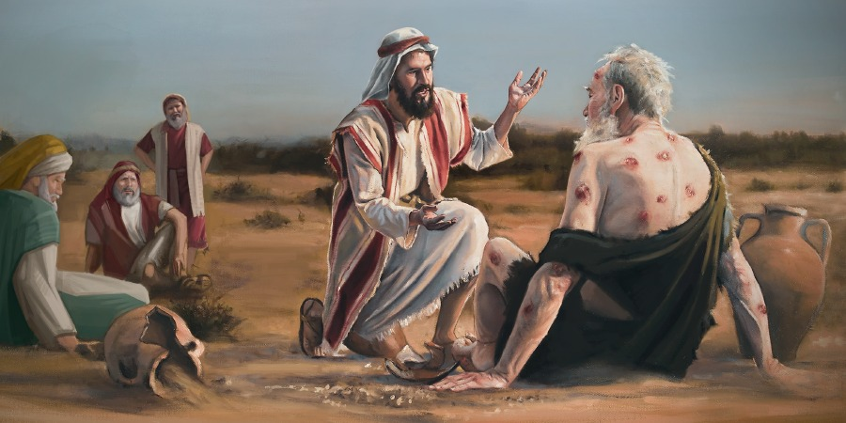
Job: Understanding How God Trains His Children
3) Elihu’s New Approach

Slide 2
Two very Diverse Opposing views about Elihu
Some consider Elihu a brash young man who offers nothing new in the discussion, and is therefore ignored by Job & God.
Others think Elihu adds new information to the discussion that causes Job to pause and consider his position, and that Elihu’s thoughts lead into God’s answer.
Depending on your viewpoint, it really changes how you see Elihu’s role

Slide 3
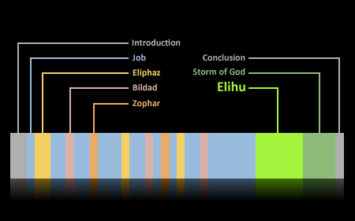
Note how much of the book of Job is taken up by Elihu’s words
1927
2088
1180
2830
905
word counts from KJV
Not very likely that Elihu should be ignored

Slide 4

According to the flow of the story, Elihu must introduce new ideas
Elihu is not happy with Job or his friends
Angry at Job because he justified himself, rather than justifying God (32:2)
Angry at 3 friends because they had no answers for Job, yet condemned him (32:3) – pretty clear that Elihu thinks he has something new to offer
Why bother including so much from Elihu in this story if he doesn’t add some critical information for Job

Slide 5
According to the flow of the story, Elihu must introduce new ideas
Elihu claims to speak for God – He directly attempts to answer Job’s false claims. His name means “God himself”
Job does not answer Elihu even tho Elihu directly answers Job’s claims
God does not correct Elihu, doesn’t require Job to pray for him
Elihu does not condemn Job for sins leading to his suffering – He offers alternative possibilities as to how God uses suffering
Elihu’s words & themes lead into God’s answer
If Elihu’s message seems like the 3 friends, then maybe we don’t understand him

Slide 6
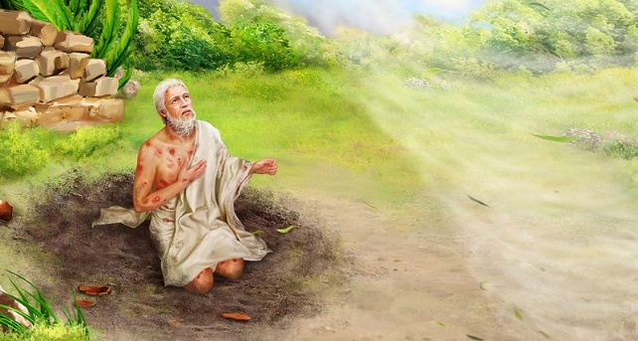
God Builds on some of Elihu’s Ideas
32:3 with 42:7 Elihu & God both angry at 3 friends for not answering Job
34:35 with 38:2; 42:3 Job speaks without knowledge
33:9-13 with 40:2 Job contended with God & he rebuked God
32:2 with 40:8 Job justified himself, not God
33:9; 35:2 with 40:14 Job wrong to say he was clean, without transgression & his righteousness was more than God’s
33:31-34 with 41:10; 42:3,6 Elihu & God challenged Job to answer, but Job could not defend himself to either
Taken from John Carter’s article: “Elihu’s place in the book of Job” [1950 Christadelphian]

Slide 7
Views of Job & his Friends
Job is suffering so much because God is punishing him for his great sin(s) he committed. They see God as a distant, severe master who keeps track of our mistakes and punishes us in this life according to the severity of our sins.
Eliphaz: God charges everyone with error – even angels. He only punishes the guilty, so they will change their ways. [Eliphaz claims an angel told him]
Bildad: The past clearly shows that God only destroys the wicked and blesses the righteous. [Bildad uses past experience as his authority]
Zophar: You are so bad that God punishes you less that your wickedness deserves – so repent! [Zophar hopes God will talk directly to Job]
During the 3 rounds of the discussion, the friends don’t introduce any new ideas about suffering, they simply intensify their personal accusations against Job

Slide 8
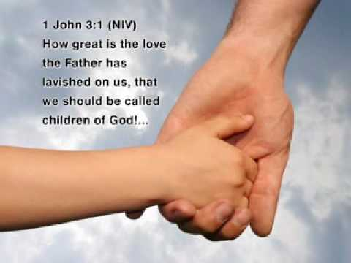
Job & his friends didn’t seem to have a relationship with God as their Father
They don’t mention God’s love or His mercy or His kindness or His faithfulness
It really affects how we view God’s work in our lives

Slide 9
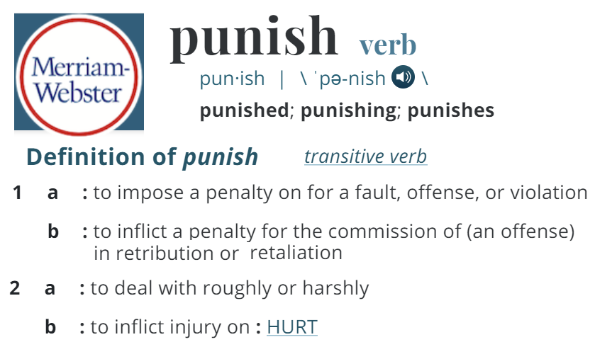
It is a penalty for what we deserve

Slide 10

Isaiah 53:5 (NKJV)
Chastisement or Punishment?
5 But He was wounded for our transgressions, he was bruised for our iniquities; The chastisement for our peace was upon Him, and by His stripes we are healed.
Isaiah 53:5 (NIV)
5 But he was pierced for our transgressions, he was crushed for our iniquities; the punishment that brought us peace was upon him, and by his wounds we are healed.
Did God punish Jesus or chasten him?

Slide 11
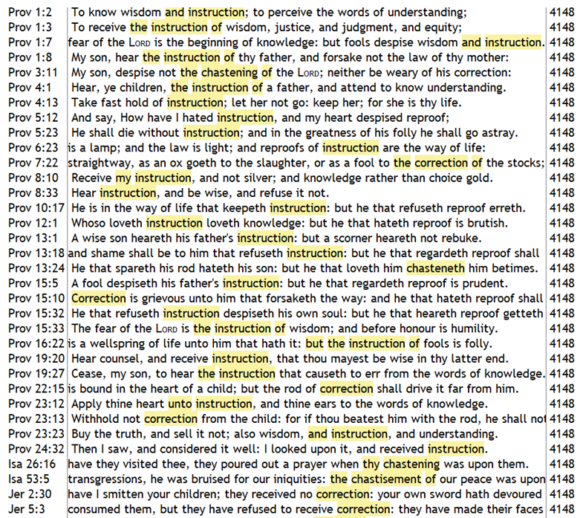
KJV

Slide 12

God loves His children & He trains them
8 The Lord is merciful and gracious, slow to anger and abounding in steadfast love. 9 He will not always chide, nor will he keep his anger forever. 10 He does not deal with us according to our sins, nor repay us according to our iniquities.
11 For as high as the heavens are above the earth, so great is his steadfast love toward those who fear him; 12 as far as the east is from the west, so far does he remove our transgressions from us.
13 As a father shows compassion to his children, so the Lord shows compassion to those who fear him. 14 For he knows our frame; he remembers that we are dust.
(Psalm 103:8-14 ESV)
God does not punish His children!

Slide 13
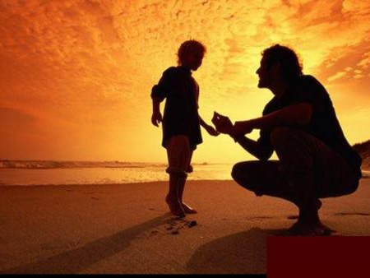
11 My son, do not despise the chastening of the Lord, nor detest His correction;
12 For whom the Lord loves He corrects,
Just as a father the son in whom he delights.
Proverbs 3:11-12

Slide 14
Job 32:1-5
Elihu waits to speak up
1 So these three men ceased answering Job, because he was righteous in his own eyes. 2 Then the wrath of Elihu, the son of Barachel the Buzite, of the family of Ram, was aroused against Job; his wrath was aroused because he justified himself rather than God. 3 Also against his three friends his wrath was aroused, because they had found no answer, and yet had condemned Job.
4 Now because they were years older than he, Elihu had waited to speak to Job. 5 When Elihu saw that there was no answer in the mouth of these three men, his wrath was aroused.
Elihu deals with Job’s attempt to justify himself & the friends failure to answer Job’s questions

Slide 15
Job 32:6-14
Elihu’s challenge to 3 friends
6 So Elihu, the son of Barachel the Buzite, answered and said:
"I am young in years, and you are very old; Therefore I was afraid, and dared not declare my opinion to you. 7 I said, 'Age should speak, and multitude of years should teach wisdom.'
8 But there is a spirit in man, and the breath of the Almighty gives him understanding. 9 Great men are not always wise, nor do the aged always understand justice.
Good to let elders go first, but age doesn’t always produce wisdom!

Slide 16
Job 32:6-14
Elihu’s challenge to 3 friends
10 "Therefore I say, 'Listen to me, I also will declare my opinion.' 11 Indeed I waited for your words, I listened to your reasonings, while you searched out what to say. 12 I paid close attention to you; and surely not one of you convinced Job, or answered his words —
13 Lest you say, 'We have found wisdom‘ [that they could not contradict]; God will vanquish him, not man. [so let God prove him wrong] 14 Now he has not directed his words against me; So I will not answer him with your words.
Elihu claims to introduce new ideas

Slide 17
Job 32:15-22
Elihu’s Challenge to Job
15 "They are dismayed and answer no more; words escape them. 16 And I have waited, because they did not speak, because they stood still and answered no more. 17 I also will answer my part, I too will declare my opinion. 18 For I am full of words; The spirit within me compels me. [Like Jeremiah 6:11]
19 Indeed my belly is like wine that has no vent; It is ready to burst like new wineskins. 20 I will speak, that I may find relief; I must open my lips and answer. 21 Let me not, I pray, show partiality to anyone; nor let me flatter any man. 22 For I do not know how to flatter, else my Maker would soon take me away.
Elihu had waiting long enough – He couldn’t wait any longer to reveal God’s ways

Slide 18
Job 33:1-7 (NIV)
Elihu is God’s human spokesman
"But now, Job, listen to my words; pay attention to everything I say. 2 I am about to open my mouth; my words are on the tip of my tongue. 3 My words come from an upright heart; my lips sincerely speak what I know. 4 The Spirit of God has made me; the breath of the Almighty gives me life. 5 Answer me then, if you can; prepare yourself and confront me. 6 I am just like you before God; I too have been taken from clay. [Elihu enters as a human spokesman for God who will not intimidate Job] 7 No fear of me should alarm you, nor should my hand be heavy upon you. [Job was afraid of God: 9:34; 13:21]
No intimidation: Job should answer

Slide 19
Job 33:8-12 (ESV)
Elihu answers Job’s false claims
8 "Surely you have spoken in my ears, and I have heard the sound of your words. 9 You say, 'I am pure, without transgression; I am clean, and there is no iniquity in me. 10 Behold, he finds occasions against me, he counts me as his enemy, 11 he puts my feet in the stocks and watches all my paths.‘
12 "Behold, in this you are not right. I will answer you, for God is greater than man.
You should expect something new to follow

Slide 20
Job 33:13-18 (NIrV)
God does speak to men
13 Why do you claim that God never answers any of our questions? [19:7] 14 He speaks in one way and then another. We might not even realize it. 15 He might speak in a dream or in a vision at night. That’s when people are sound asleep in their beds. [Abimelech, Neb, etc.] 16 He might speak in their ears. [Samuel, David 2Sam 7:27] And seals their instruction [NKJV] 17 He warns men in order to turn them away from sinning. He wants to keep them from being proud. [ New Idea: prevention!]18 He wants to stop them from going down into the grave. He doesn’t want them to be killed with swords.
God tries to prevent us from sinning! It’s not punishment!

Slide 21

Now to Him who is able to keep you from stumbling, and to present you without blemish before the presence of his glory with rejoicing (Jude 24)
It’s not just about forgiveness of sins

Slide 22
Job 33:19-24 (ESV)
Elihu brings new ideas about God
19 "Man is also rebuked with pain on his bed and with continual strife in his bones, 20 so that his life loathes bread, and his appetite the choicest food. 21 His flesh is so wasted away that it cannot be seen, and his bones that were not seen stick out. 22 His soul draws near the pit, and his life to those who bring death. 23 If there be for him an angel, a mediator, one of the thousand, to declare to man what is right for him [God’s righteousness], 24 and he is merciful to him, and says, 'Deliver him from going down into the pit; I have found a ransom;
Learning obedience & appreciating our merciful ransom through suffering!

Slide 23
Romans 3:19-26
Paul expands on Elihu’s ideas
19 Now we know that whatever the law says, it says to those who are under the law, that every mouth may be stopped, and all the world may become guilty before God. 20 Therefore by the deeds of the law no flesh will be justified in His sight, for by the law is the knowledge of sin.
Justification through God’s mercy, grace and righteousness

Slide 24
Romans 3:19-26
Paul expands on Elihu’s ideas
21 But now the righteousness of God apart from the law is revealed, being witnessed by the Law and the Prophets, 22 even the righteousness of God, through faith in Jesus Christ, to all and on all who believe. For there is no difference; 23 for all have sinned and fall short of the glory of God, 24 being justified freely by His grace through the redemption that is in Christ Jesus, 25 whom God set forth as a propitiation by His blood, through faith, to demonstrate His righteousness, because in His forbearance God had passed over the sins that were previously committed, 26 to demonstrate at the present time His righteousness, that He might be just and the justifier of the one who has faith in Jesus.
Justification through God’s mercy, grace and righteousness

Slide 25
Job 33:25-28 (ESV)
Elihu’s new ideas: teaching, not punishment
25 let his flesh become fresh with youth; let him return to the days of his youthful vigor'; 26 then man prays to God, and He accepts [“to be please with, specifically to satisfy a debt (ST) “pardoned” in Isa 40:2] him; He [God] sees his [man] face with a shout of joy, and He restores to man his righteousness. [because God loves man, not because man suffered and paid for his sins]
27 He sings before men and says: 'I sinned and perverted what was right, and it was not repaid to me. [Job’s friends thought it was] 28 He has redeemed my soul from going down into the pit, and my life shall look upon the light.'
Elihu introduces God’s training plan accomplished thru mercy, grace and kindness

Slide 26
Job 33:29-33 (ESV)
Suffering can be for discipline!
29 "Behold, God does all these things, twice, three times, with a man, 30 to bring back his soul from the pit, that he may be lighted with the light of life. [God wants to save you, not punish you!]
31 Pay attention, O Job, listen to me; be silent, and I will speak. 32 If you have any words, answer me; speak, for I desire to justify you. 33 If not, listen to me; be silent, and I will teach you wisdom."
Elihu gave Job lots of new ideas to consider. Job thinks, not speaks!

Slide 27
Hebrews 12:7-11
God’s training program is for all His children
7 If you endure chastening, God deals with you as with sons; for what son is there whom a father does not chasten [3809 paideia “tutorage, i.e. education or training”]? 8 But if you are without chastening, of which all have become partakers, then you are illegitimate and not sons. 9 Furthermore, we have had human fathers who corrected us, and we paid them respect. Shall we not much more readily be in subjection to the Father of spirits and live? 10 For they indeed for a few days chastened us as seemed best to them, but He for our profit, that we may be partakers of His holiness. 11 Now no chastening seems to be joyful for the present, but painful; nevertheless, afterward it yields the peaceable fruit of righteousness to those who have been trained by it.
Even Jesus learned obedience thru suffering (5:8)

Slide 28
Psalm 19:7-13 (NIrV)
David understood & prayed for God’s preventive ways
7 The law of the Lord is perfect. It gives us new strength. The laws of the Lord can be trusted. They make childish people wise. 8 The rules of the Lord are right. They give joy to our hearts. The commands of the Lord shine brightly. They give light to our minds. 9 The law that brings respect for the Lord is pure. It lasts forever. The directions the Lord gives are true. All of them are completely right. 10 They are more priceless than gold. They have greater value than huge amounts of pure gold. They are sweeter than honey that is taken from the honeycomb. 11 I am warned by them. In keeping them there is great reward.
12 Can I know my mistakes? Forgive my hidden faults. 13 Keep me also from the sins I want to commit. May they not be my master. Then I will be without blame. I will not be guilty of any great sin against your law.
God doesn’t just forgive our sins, He works daily to prevent us from falling into sin.

Slide 29

How is Elihu’s message different than the 3 friends
Elihu does not charge Job with being a terrible sinner that caused his troubles
Elihu does not present Job as God’s enemy who needs to be punished
Elihu claims that God does speak to people thru various means – suffering is one of them
Elihu introduces the concept that God uses suffering to chasten us to prevent us from sin
Elihu reveals that God forgives sins and shows mercy to us because of the work of a mediator who declares what is right for us, providing a ransom.
Job realized Elihu’s message was different. He thought about it and did not respond.

Slide 30
Job 34:1-9
God is Just!
1 Elihu further answered and said: [to 3 friends too!] 2 "Hear my words, you wise men; Give ear to me, you who have knowledge. 3 For the ear tests words as the palate tastes food. 4 Let us choose justice for ourselves; Let us know among ourselves what is good.
5 "For Job has said, 'I am righteous, but God has taken away my justice; (27:2; 13:18) 6 Should I lie concerning my right? My wound is incurable, though I am without transgression.'
7 What man is like Job, who drinks scorn like water [Job’s disrespect for God: 27:2; 10:3;], 8 who goes in company with the workers of iniquity, and walks with wicked men? 9 For he has said, 'It profits a man nothing that he should delight in God.' [9:21-22]
Job was pushed to claim there is no profit in serving God

Slide 31
Job 34:10-15
God is Just – Not partial or random
10 "Therefore listen to me, you men of understanding: Far be it from God to do wickedness, and from the Almighty to commit iniquity. 11 For He repays man according to his work, and makes man to find a reward according to his way. [not arbitrary!] 12 Surely God will never do wickedly, nor will the Almighty pervert justice. 13 Who gave Him charge over the earth? Or who appointed Him over the whole world? [He is the creator!] 14 If He should set His heart on it, if He should gather to Himself His Spirit and His breath, 15 all flesh would perish together, and man would return to dust. [but God’s mercy & kindness prevent this!]
God made everything & everyone and sustains them all, whether they deserve it or not. He doesn’t show partiality!

Slide 32
Job 34:16-20
God shows no partiality
16 "If you have understanding, hear this; listen to the sound of my words: 17 Should one who hates justice govern? Will you condemn Him who is most just? 18 Who [God] says to a king, 'Worthless one,‘ To nobles, 'Wicked ones'; [NASU] 19 He is not partial to princes, nor does He regard the rich more than the poor; For they are all the work of His hands. 20 In a moment they die, in the middle of the night; The people are shaken and pass away; The mighty are taken away without a hand. [when God decides to act]
God shows no partiality to either the rich or poor when He chooses to act.

Slide 33
Job 34:21-30
God’s judgment on the wicked is true
21 "For His eyes are on the ways of man, and He sees all his steps. 22 There is no darkness nor shadow of death where the workers of iniquity may hide themselves. 23 For He need not further consider a man, that he should go before God in judgment. 24 He breaks in pieces mighty men without inquiry, and sets others in their place. 25 Therefore He knows their works; He overthrows them in the night, and they are crushed. 26 He strikes them as wicked men in the open sight of others, 27 Because they turned back from Him, and would not consider any of His ways, [these are the wicked who do not follow God’s ways!] 28 So that they caused the cry of the poor to come to Him; For He hears the cry of the afflicted. [Deut 15:9; 24:15]
God doesn’t always judge in this life, but when He does, it is just and for the sake of the righteous

Slide 34
Job 34:21-30
God’s judgment on the wicked is true
29 But if he remains silent, who can judge him? If he turns his face away, who can see him? He rules over people and nations alike. [NIrV] 30 He keeps those who are ungodly from ruling. He keeps them from laying traps for others. [NIrV] [God’s judgments are designed to prevent wickedness from prospering to the detriment of the righteous]
God doesn’t always judge in this life, but when He does, it is just and for the sake of the righteous

Slide 35
Job 34:31-33 (NASB)
God’s chastening is just & has a purpose
31 "For has anyone said to God, 'I have borne chastisement; I will not offend anymore; 32 Teach me what I do not see; If I have done iniquity, I will not do it again'?
33 "Shall He recompense on your terms, because you have rejected it? [you reject God’s chastening] For you must choose, and not I; Therefore declare what you know.
Job had made a covenant with his eyes not to look on any young woman (31:1). He thought he could determine to sin no more!

Slide 36
Job 34:34-37 (NASB)
How Job is being perceived
34 "Men of understanding will say to me, and a wise man who hears me, 35 'Job speaks without knowledge, and his words are without wisdom. 36 'Job ought to be tried to the limit, because he answers like wicked men. 37 'For he adds rebellion to his sin; He claps his hands among us, [to make fun of us] and multiplies his words against God.'"
Some bible versions indicate these are words that the wise men will say to Elihu

Slide 37
How is Elihu’s message different than the 3 friends
God’s judgments on the wicked are designed for the sake of the righteous, so there are times when God chooses to remain silent
Elihu explains that no one can claim they will sin no more, so God has to constantly work at preventing us from sin
Elihu corrects Job himself:
God is aware of everything so when He does punish the wicked it is just and right.
God is not arbitrary and doesn’t show partiality when He brings punishment on the wicked or chastening to the righteous.
Job realized Elihu’s message was different. He thought about it and did not respond.

Slide 38
Job 35:1-4
Is there any value in righteousness?
1 Moreover Elihu answered and said:
2 "Do you think this is right? Do you say, 'My righteousness is more than God's'?
3 For you say, 'What advantage will it be to You? What profit shall I have, more than if I had sinned?'
4 "I will answer you, and your companions with you. [they never answered Job]
Elihu sets out to answer Job’s claim that “it profits a man nothing that he should delight in God” [34:9, 9:21-22]

Slide 39
Job 35:5-8
God is not really affected by our sins
5 Look to the heavens and see; and behold the clouds — They are higher than you. [you don’t affect the clouds & you don’t affect God] 6 If you sin, what do you accomplish against Him? Or, if your transgressions are multiplied, what do you do to Him? 7 If you are righteous, what do you give Him? Or what does He receive from your hand? 8 Your wickedness affects a man such as you, and your righteousness a son of man. [and the good you do only other human beings (NiRV)]
God may be excited or disappointed by our lives, but it doesn’t affect God himself

Slide 40
Job 35:9-16
God quietly uses trouble to cause people to seek Him
9 "Because of the multitude of oppressions they [the oppressed] cry out; They cry out for help because of the arm of the mighty. [cry for relief of suffering, but not to acknowledge God or respond to him] 10 But no one says, 'Where is God my Maker, who gives songs in the night, [God tries to use oppression & suffering to cause us to seek Him!] 11 Who teaches us more than the beasts of the earth, and makes us wiser than the birds of heaven?'
When life gets tough, God hopes we will seek Him – He does this in mercy & kindness

Slide 41
Job 35:9-16
God quietly uses trouble to cause people to seek Him
12 There they cry out, but He does not answer, because of the pride of evil men. 13 Surely God will not listen to empty talk, nor will the Almighty regard it. 14 Although you say you do not see Him [23:8 - Job finally does see him “but now my eyes sees you (42:5)], yet justice is before Him, and you must wait for Him. [God expects patience based on faith]
15 And now, because He has not punished in His anger, [there are times when God’s longsuffering waits] nor taken much notice of folly, 16 Therefore Job opens his mouth in vain; He multiplies words without knowledge."
When life gets tough, God hopes we will seek Him – He does this in mercy & kindness

Slide 42
How is Elihu’s message different than the 3 friends
God sometimes quietly uses suffering and troubles to encourage people to search for him – not to punish them
Elihu corrects Job himself:
Man’s righteousness is nothing when compared to God’s.
Living a righteous life does have value for us and those around us, but it does not affect God himself
Job realized Elihu’s message was different. He thought about it and did not respond.

Slide 43
Job 36:1-4
Elihu’s 4th reply to Job & Friends
1 Elihu also proceeded and said:
2 "Bear with me a little, and I will show you that there are yet words to speak on God's behalf. 3 I will fetch my knowledge from afar; I will ascribe righteousness to my Maker. 4 For truly my words are not false; One who is perfect in knowledge [used by Elihu of God in 37:16] is with you. [God is still with you Job!]
Elihu claims his words and explanations are from God

Slide 44
Job 36:5-12
God’s perfect knowledge & understanding
5 "Behold, God is mighty, but despises no one; He is mighty in strength of understanding. [God’s justice comes from His understanding of all] 6 He does not preserve the life of the wicked, but gives justice to the oppressed. 7 He does not withdraw His eyes from the righteous; but they are on the throne with kings, for He has seated them forever, and they are exalted. 8 And if they are bound in fetters, held in the cords of affliction, [when the righteous suffer] 9 Then He tells them their work [deeds or acts] and their transgressions — That they have acted defiantly. 10 He also opens their ear to instruction, and commands that they turn from iniquity.
God understands all and knows effective ways to try to reach people!

Slide 45
Job 36:5-12
God’s perfect knowledge & understanding
11 If they obey and serve Him, they shall spend their days in prosperity, and their years in pleasures. 12 But if they do not obey, they shall perish by the sword, and they shall die without knowledge. [they refused to try to understand why]
God understands all and knows effective ways to try to reach people!

Slide 46
Job 36:13-17 (NIV)
Suffering will help save us if we let it
13 "The godless in heart harbor resentment; even when he fetters them, they do not cry for help. [the unrighteous don’t respond to God’s chastisement] 14 They die in their youth, among male prostitutes of the shrines.
15 But those who suffer he delivers in their suffering; he speaks to them in their affliction. [God uses affliction to talk to us, turn us from evil, and save us!] 16 "He is wooing you from the jaws of distress to a spacious place free from restriction, to the comfort of your table laden with choice food.
Even though Satan suggested the trials, God used the trials to educate & discipline Job

Slide 47
Job 36:17-23 (ESV)
Job was starting to think like the wicked
17 "But you [Job] are full of the judgment of [YLT] the wicked; [the views of the wicked about God’s justice & judgment] judgment and justice seize you. [you will get God’s justice against the wicked] 18 Beware lest wrath [Job’s anger against God because he did not understand how God uses suffering] entice you into scoffing, and let not the greatness of the ransom turn you aside. [it takes suffering sometimes to educate us and teach us obedience by what we suffer – it’s strong, tough medicine!]
Don’t let the strength of God’s medicine to drive Sin away entice us to scoffing

Slide 48
Job 36:17-23 (ESV)
Job was starting to think like the wicked
19 Would your wealth or even all your mighty efforts sustain you so you would not be in distress? [NIV] 20 Do not long for the night [death], when peoples vanish in their place. 21 Take care; do not turn to iniquity, for this you have chosen rather than affliction.
22 Behold, God is exalted in his power; who is a teacher like him? 23 Who has prescribed for him his way, or who can say, 'You have done wrong'?
Don’t let the strength of God’s medicine to drive Sin away entice us to scoffing

Slide 49
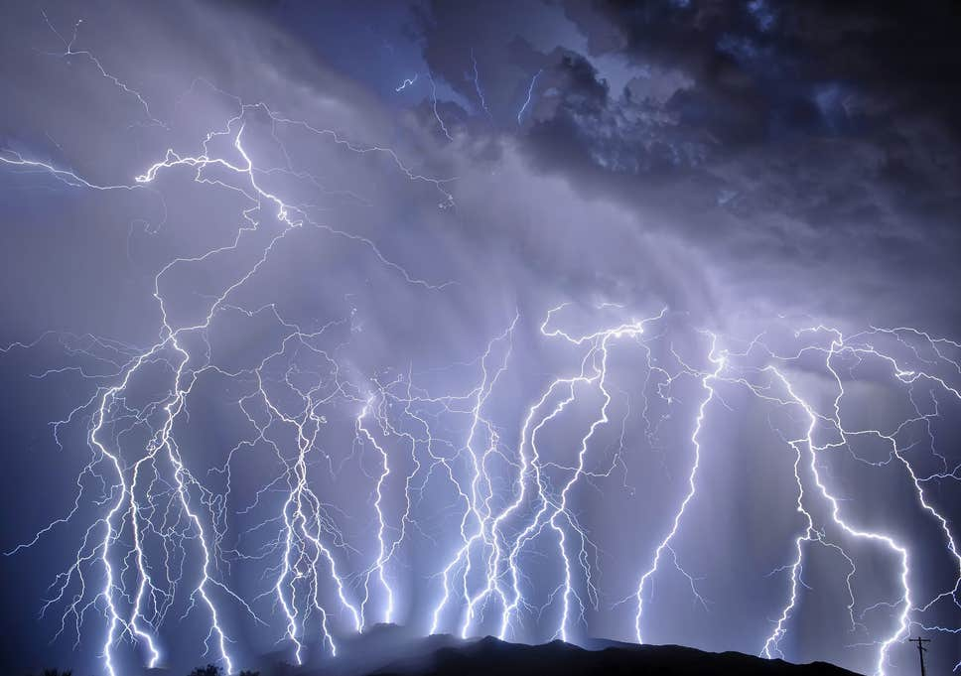
Job 37:1-8 (NIV)
The approaching storm!
"At this my heart pounds and leaps from its place. 2 Listen [everyone (pl)]! Listen to the roar of his voice, to the rumbling that comes from his mouth. 3 He unleashes his lightning beneath the whole heaven and sends it to the ends of the earth. 4 After that comes the sound of his roar; he thunders with his majestic voice. When his voice resounds, he holds nothing back. 5 God's voice thunders in marvelous ways; he does great things beyond our understanding.
6 He says to the snow, 'Fall on the earth,‘ and to the rain shower, 'Be a mighty downpour.' 7 So that all men he has made may know his work, he stops every man from his labor. 8 The animals take cover; they remain in their dens.
None can resist God’s awesome power

Slide 50
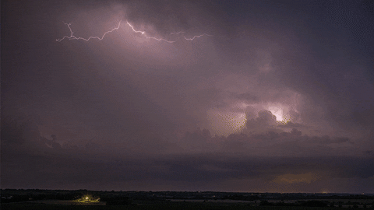
Job 37:9-13 (NASB)
God’s Power at Work
9 "Out of the south comes the storm, and out of the north the cold. 10 "From the breath of God ice is made, and the expanse of the waters is frozen. 11 "Also with moisture He loads the thick cloud; He disperses the cloud of His lightning. 12 "It changes direction, turning around by His guidance, that it may do whatever He commands it on the face of the inhabited earth. 13 "Whether for correction, or for His world, or for lovingkindness [or mercy, saving His people], He causes it to happen.
God uses His power to bring about good

Slide 51
Job 37:14-18 (NIV)
Pause & consider the wonder of God
14 "Listen to this, Job; stop and consider God's wonders [start trusting God!].
15 Do you know how God controls the clouds and makes his lightning flash? 16 Do you know how the clouds hang poised, those wonders of him who is perfect in knowledge? 17 You who swelter in your clothes when the land lies hushed [all living activity stops] under the south wind, 18 can you join him in spreading out the skies, hard as a mirror of cast bronze?
We don’t understand how God controls our world so how could we have the wisdom to know how He is saving us?

Slide 52
Job 37:19-24 (NiRV)
We can’t prepare a case to debate God
19 “Job, tell us what we should say to God. We can’t prepare our case because our minds are dark [lack of knowledge & wisdom]. 20 Should he be told that I want to speak? Would any man ask to be destroyed by him [in a debate]? 21 No one can look at the sun. It’s too bright after the wind has swept the skies clean. 22 Out of the north, God comes in his shining glory. He comes in all of his wonderful majesty. 23 We can’t reach up to the Mighty One. He is lifted high because of his power. Everything he does is fair and right. So he doesn’t crush people. 24 That’s why they have respect for him. He does not regard any who are wise of heart” (NASB) [wise in their own minds]
If God has the power & wisdom to control this world, His ways must be just

Slide 53
Romans 11:32-36 (ESV)
The wonder of God’s plan!
32 For God has consigned all to disobedience, that he may have mercy on all.
33 Oh, the depth of the riches and wisdom and knowledge of God! How unsearchable are his judgments and how inscrutable his ways! 34 "For who has known the mind of the Lord, or who has been his counselor?“ 35 "Or who has given a gift to him that he might be repaid?“ (Job 41:11)
36 For from him and through him and to him are all things. To him be glory forever. Amen.
This was Elihu’s message to Job

Slide 54

“For everything that was written in the past was written to teach us, so that through endurance and the encouragement of the Scriptures we might have hope”
(Rom 15:4)
Learn to use the Scriptures to comfort and encourage one another in our trials

Slide 55
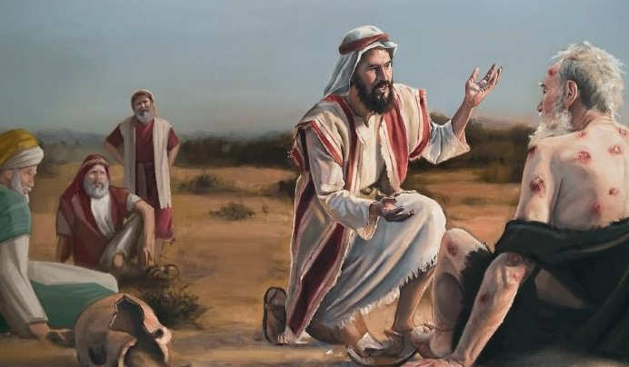
What did Elihu Accomplish
God does speak to man, but man many times does not perceive it because he does not understand how God works.
God’s wisdom & power to save His family is far beyond man’s understanding
God uses all His methods, including suffering, to humble His children and save His family – not to punish them
God’s righteousness must be upheld, not man’s
Now Job is ready to listen to God

Slide 56
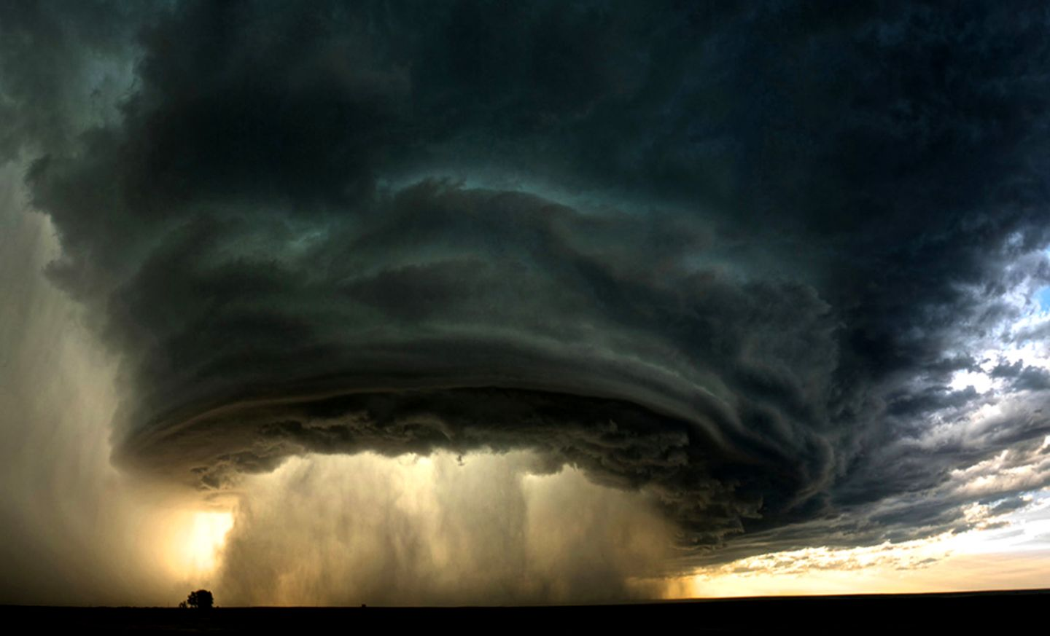
God has arrived to talk to Job! [through an angel]

