Slide 1
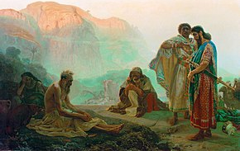
Job: Understanding How God Trains His Children
4) God is working to save His whole Family

Slide 2



Useful Resources on Job
John Roberts
Articles:
Elihu’s Place in the Book of Job – John Carter 1950
The Perfecting of Job – Fred Pearce 1950
Audio
Roy Styles
John Launchbury
John Pople
Neville Clark

Slide 3
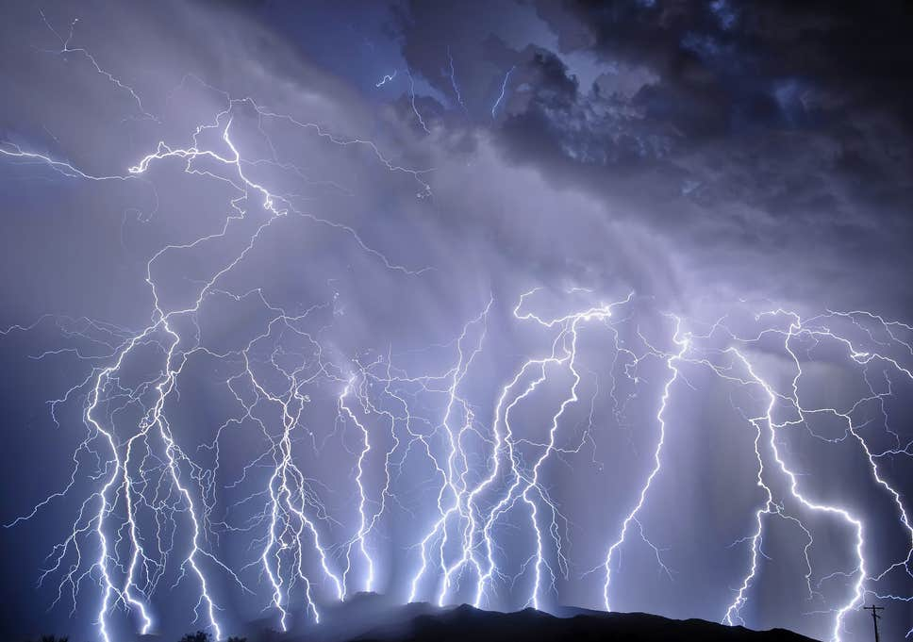

Job 37:1-8 (NIV)
The approaching storm!
"At this my heart pounds and leaps from its place. 2 Listen [everyone (pl)]! Listen to the roar of his voice, to the rumbling that comes from his mouth. 3 He unleashes his lightning beneath the whole heaven and sends it to the ends of the earth. 4 After that comes the sound of his roar; he thunders with his majestic voice. When his voice resounds, he holds nothing back. 5 God's voice thunders in marvelous ways; he does great things beyond our understanding.
6 He says to the snow, 'Fall on the earth,‘ and to the rain shower, 'Be a mighty downpour.' 7 So that all men he has made may know his work, he stops every man from his labor. 8 The animals take cover; they remain in their dens.
None can resist God’s awesome power

Slide 4
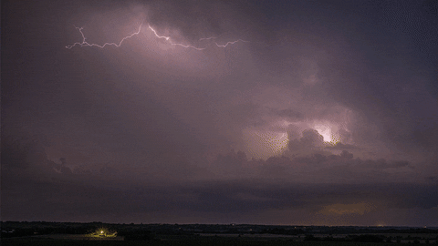
Job 37:9-13 (NASB)
God’s Power at Work
9 "Out of the south comes the storm, and out of the north the cold. 10 "From the breath of God ice is made, and the expanse of the waters is frozen. 11 "Also with moisture He loads the thick cloud; He disperses the cloud of His lightning. 12 "It changes direction, turning around by His guidance, that it may do whatever He commands it on the face of the inhabited earth. 13 "Whether for correction, or for His world, or for lovingkindness [or mercy, saving His people], He causes it to happen.
God uses His power to bring about good

Slide 5
Job 37:14-18 (NIV)
Pause & consider the wonder of God
14 "Listen to this, Job; stop and consider God's wonders [start trusting God!].
15 Do you know how God controls the clouds and makes his lightning flash? 16 Do you know how the clouds hang poised, those wonders of him who is perfect in knowledge? 17 You who swelter in your clothes when the land lies hushed [all living activity stops] under the south wind, 18 can you join him in spreading out the skies, hard as a mirror of cast bronze?
We don’t understand how God controls our world so how could we have the wisdom to know His plan to save us?

Slide 6
Job 37:19-24 (NiRV)
We can’t prepare a case to debate God
19 “Job, tell us what we should say to God. We can’t prepare our case because our minds are dark [lack of knowledge & wisdom]. 20 Should he be told that I want to speak? Would any man ask to be destroyed by him [in a debate]? 21 No one can look at the sun. It’s too bright after the wind has swept the skies clean. 22 Out of the north, God comes in his shining glory. He comes in all of his wonderful majesty. 23 We can’t reach up to the Mighty One. He is lifted high because of his power. Everything he does is fair and right. So he doesn’t crush people. 24 That’s why they have respect for him. He does not regard any who are wise of heart” (NASB) [wise in their own minds]
If God has the power & wisdom to control this world, His ways must be just

Slide 7

God doesn’t answer Job’s individual questions directly
God’s answers
Job’s questions
He explains big, general principles that cover all Job’s questions and more!

Slide 8
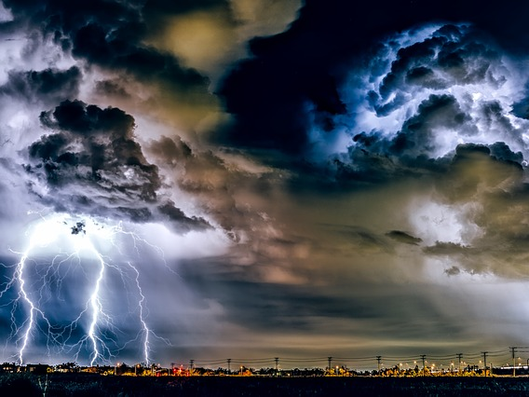
God’s Control and Wisdom in how He Made & Uses His Inanimate Creation Job 38
Shows God has the wisdom and power to control the wicked & save His children

Slide 9
Job 38:1-7
God answers Job
Then the Lord answered Job out of the whirlwind, and said:
2 "Who is this who darkens counsel by words without knowledge? [Job had (42:3)] 3 Now prepare yourself like a man; I will question you, and you shall answer Me. [Job had wanted his day to question God [9:35; 13:20-22; 31:35]
4 "Where were you when I laid the foundations of the earth? Tell Me, if you have understanding. 5 Who determined its measurements? Surely you know! Or who stretched the line upon it? 6 To what were its foundations fastened? Or who laid its cornerstone, 7 when the morning stars sang together, and all the sons of God [angels] shouted for joy?
Creation proves God has an intricate plan, based on His wisdom

Slide 10
Job 38:8-11
God can stop pride from advancing
God controls the sea like a newborn baby
8 "Or who shut in the sea with doors, when it burst forth and issued from the womb; 9 When I made the clouds its garment, and thick darkness its swaddling band; 10 When I fixed My limit for it, and set bars and doors; 11 When I said, 'This far you may come, but no farther, and here your proud waves must stop!' [God has the wisdom to set limits and stop pride from advancing]
Creation illustrates God has wisdom & power to control pride in His children

Slide 11
Job 38:12-18
Everyday God has morning reborn
12 "Have you commanded the morning since your days began, and caused the dawn to know its place, 13 That it might take hold of the ends of the earth, and the wicked be shaken out of it? [Job had accused God of allowing the wicked to hide in darkness (24:13-17)] 14 It [earth] takes on form like clay under a seal, and stands out like a garment. 15 From the wicked their light is withheld, and the upraised arm is broken. [Every day God limits the wicked by providing the sun]
God does put limits on the wicked by raising the sun every morning

Slide 12
Job 38:17-18
What about the depths of the earth?
16 "Have you entered the springs of the sea? Or have you walked in search of the depths? 17 Have the gates of death been revealed to you? Or have you seen the doors of the shadow of death? [Job knew about resurrection (19:25-27), but had no way to control it] 18 Have you comprehended the breadth of the earth? Tell Me, if you know all this.
God controls the gates of death & His children He is storing for resurrection

Slide 13
Job 38:19-21
Creation of Light & Darkness
19 "Where is the way to the dwelling of light? And darkness, where is its place, 20 That you may take it to its territory, that you may know the paths to its home? 21 Do you know it, because you were born then, or because the number of your days is great?
God has the power & wisdom to bring light into the world to control darkness

Slide 14
Job 38:22-30
God even uses weather for His purpose
22 "Have you entered the treasury of snow, or have you seen the treasury of hail, 23 Which I have reserved for the time of trouble, for the day of battle and war? 24 By what way is lightning [NIV] is dispersed, or the east wind scattered over the earth?
25 "Who has divided a channel for the overflowing water, or a path for the thunderbolt, 26 To cause it to rain on a land where there is no one, a wilderness in which there is no man; 27 To satisfy the desolate waste, and cause to spring forth the growth of tender grass? 28 Has the rain a father? Or who has begotten the drops of dew? 29 From whose womb comes the ice? And the frost of heaven, who gives it birth? 30 The waters harden like stone, and the surface of the deep is frozen.
God has complete knowledge & control. He doesn’t require man to further His plans

Slide 15
Job 38:31-33
God controls the constellations
31 "Can you bind the cluster of the Pleiades, or loose the belt of Orion? 32 Can you bring out Mazzaroth [a constellation (NASB)] in its season? Or can you guide the Great Bear with its cubs? 33 Do you know the ordinances of the heavens? Can you set their dominion over the earth? [Job admitted God made the constellations (9:9)]
Even the stars prove God has a carefully organized plan

Slide 16
Job 38:34-38
God can make it rain at the right time
34 "Can you lift up your voice to the clouds, that an abundance of water may cover you? 35 Can you send out lightnings, that they may go, and say to you, 'Here we are!'?
36 Who has put wisdom in the mind? Or who has given understanding to the heart?
37 Who can number the clouds by wisdom? Or who can pour out the bottles of heaven, 38 When the dust hardens in clumps, and the clods cling together?
God has the wisdom & power to bring about what His creation needs

Slide 17

What did God Explain in Job 38
Used the inanimate creation to show the unbelievable wisdom and power God has to make and sustain this creation
This should cause Job to rethink his challenges to God’s unjust treatment of him.
Illustrated to Job that God sometimes uses the natural components of our world to take care of His people and limit the wicked
This should cause Job to reconsider his claim that God does nothing to punish the wicked in this life.
Job is reflecting on all that has happened in a new light

Slide 18
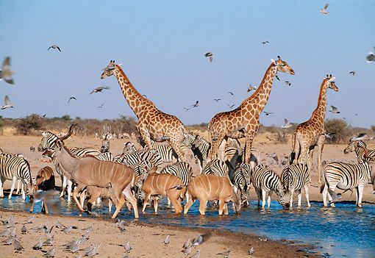
God’s control, wisdom & faithfulness in caring for the variety His animals & His Children - Job 39

Slide 19
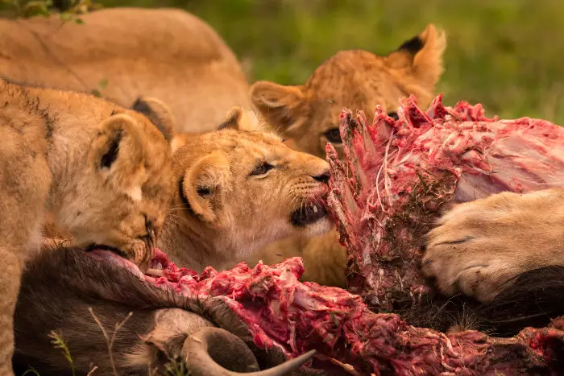
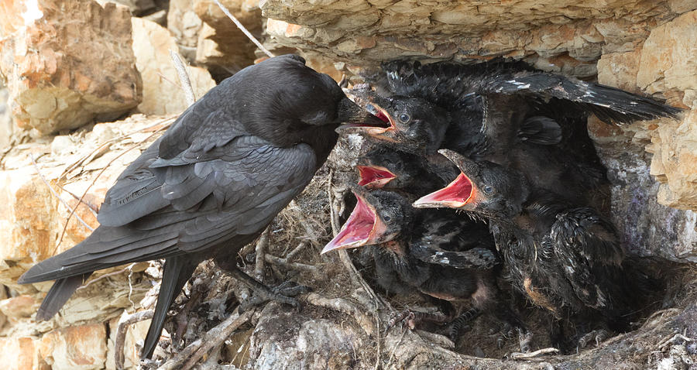
Job 38:39-41
God knows how to provide food for predators and scavengers
39 "Can you hunt the prey for the lion, or satisfy the appetite of the young lions, 40 When they crouch in their dens, or lurk in their lairs to lie in wait?
41 Who provides food for the raven, when its young ones cry to God, and wander about for lack of food?
Sometimes God feeds ravens through the leftovers of lions

Slide 20
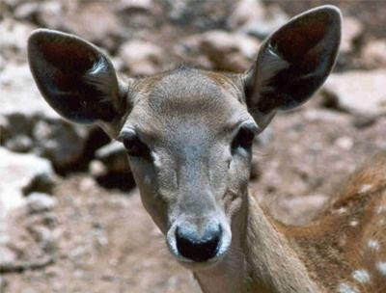
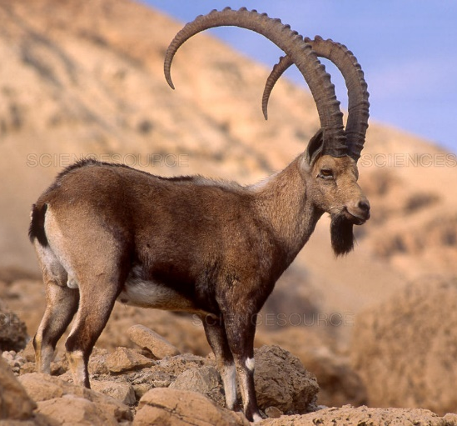
Job 39:1-4
God designed the birth of animals
"Do you know the time when the wild mountain goats bear young? Or can you mark when the deer gives birth? 2 Can you number the months that they fulfill? Or do you know the time when they bear young? 3 They bow down, they bring forth their young, they deliver their offspring. 4 Their young ones are healthy, they grow strong with grain; they depart and do not return to them. [independent of man]
God takes care of them all

Slide 21
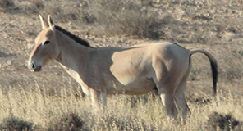
Job 39:5-8 (NASB)
God made the wild donkey a free spirit
5 "Who sent out the wild donkey free? And who loosed the bonds of the swift donkey, 6 to whom I gave the wilderness for a home and the salt land for his dwelling place? 7 "He scorns the tumult of the city, the shoutings of the driver he does not hear. 8 "He explores the mountains for his pasture and searches after every green thing.
He’s wild, but God still cares for him

Slide 22
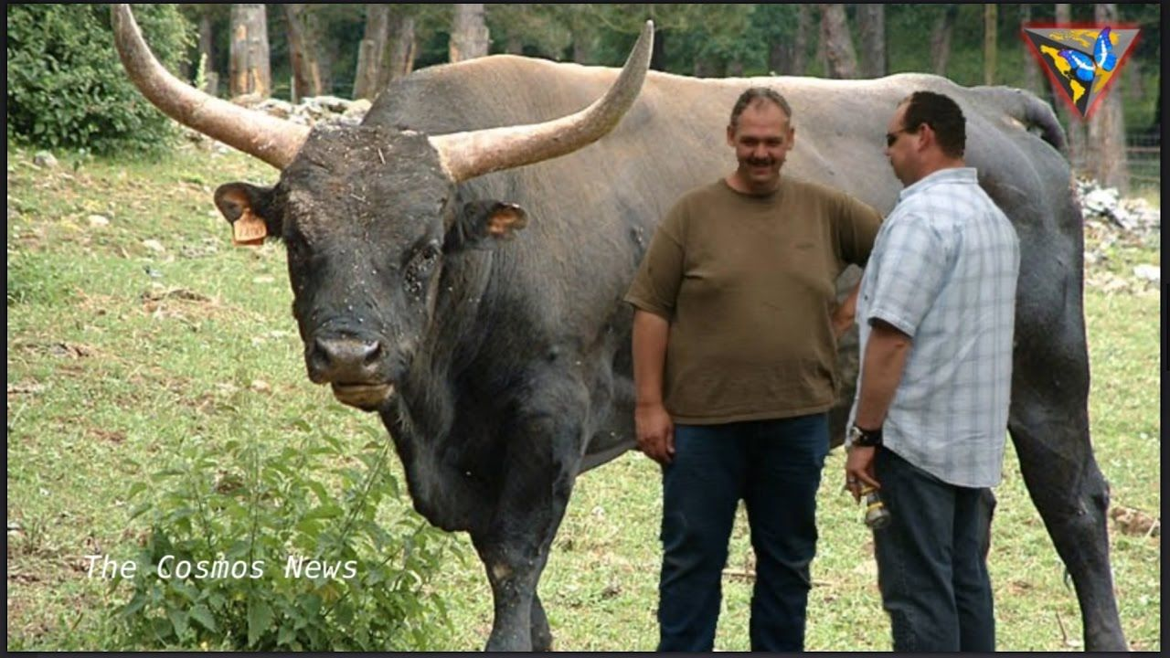
Job 39:9-12
You can’t control
9 "Will the wild ox [probably aurochs which are now extinct] be willing to serve you? Will he bed by your manger? 10 Can you bind the wild ox in the furrow with ropes [a harness]? Or will he plow the valleys behind you? 11 Will you trust him because his strength is great? Or will you leave your labor to him? 12 Will you trust him to bring home your grain, and gather it to your threshing floor?
God helping Job realize there are things in our world we cannot control

Slide 23
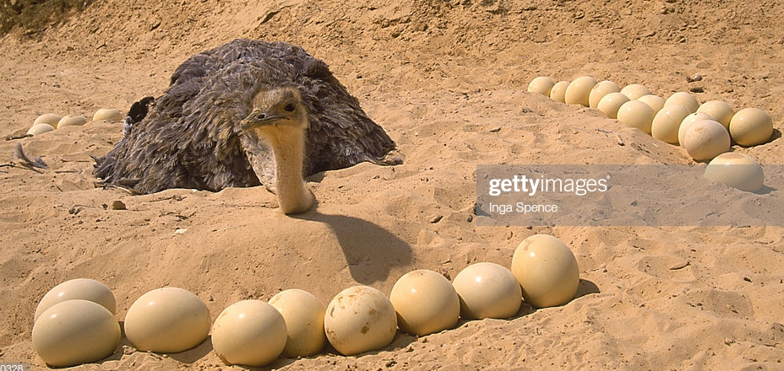
Job 39:13-18
The silly ostrich
13 "The wings of the ostrich [wild] wave proudly, but are her wings and pinions like the kindly stork's? 14 For she leaves her eggs on the ground, and warms them in the dust; 15 She forgets that a foot may crush them, or that a wild beast may break them. 16 She treats her young harshly, as though they were not hers; Her labor is in vain, without concern, 17 Because God deprived her of wisdom, and did not endow her with understanding. 18 When she lifts herself on high, she scorns the horse and its rider.
God made them this way and provides for them

Slide 24
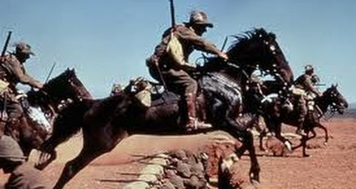
Job 39:19-25 (ESV)
God designed the horse
19 "Do you give the horse his might? Do you clothe his neck with a mane? 20 Do you make him leap like the locust? His majestic snorting is terrifying. 21 He paws in the valley and exults in his strength; he goes out to meet the weapons. 22 He laughs at fear and is not dismayed; he does not turn back from the sword. 23 Upon him rattle the quiver, the flashing spear and the javelin. 24 With fierceness and rage he swallows the ground; he cannot stand still at the sound of the trumpet. 25 When the trumpet sounds, he says 'Aha!‘ He smells the battle from afar, the thunder of the captains, and the shouting.
God gave him fearless courage for a reason

Slide 25
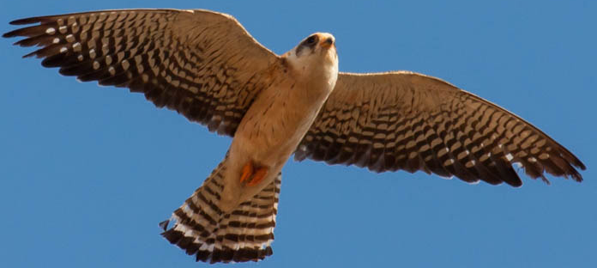
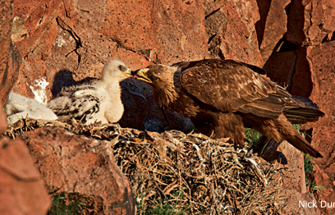
Job 39:26-30 (NASB)
Hawks & Eagles
26 "Is it by your understanding that the hawk soars, stretching his wings toward the south? 27 "Is it at your command that the eagle mounts up and makes his nest on high? 28 "On the cliff he dwells and lodges, upon the rocky crag, an inaccessible place. 29 "From there he spies out food; His eyes see it from afar. 30 "His young ones also suck up blood; and where the slain are, there is he."
God gives all His creatures what they need to survive

Slide 26
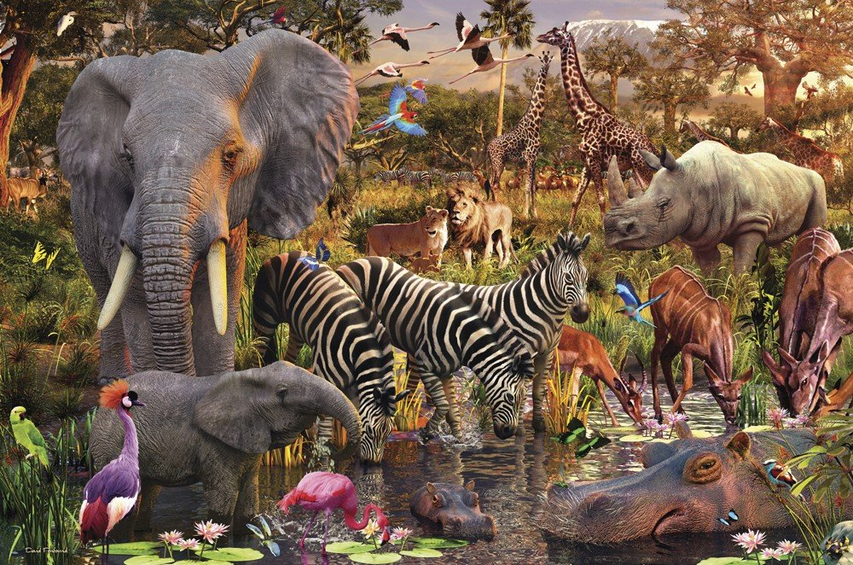
God made them all different and gave them what they need to survive
They are not treated the same!

Slide 27
What did God Explain in Job 39
Used animals to prove the unbelievable wisdom and power God has to make and sustain this creation
This should cause Job to realize that this whole creation is God’s and it is His to justify.
This should cause Job to rethink his challenges to God’s treatment of him.
Illustrated to Job that God designed and cares for all the varieties of His creation, so sometimes the innocent must die or suffer so others can live
This should cause Job to consider that God is not punishing Job by all that has happened to him, but possibly trying to save some that Job is not aware of.
Job is being forced to think beyond himself & his suffering situation

Slide 28
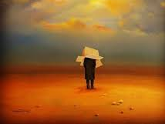
Job’s sufferings have limited his thinking to inside the box of his own life
God is trying to allow Job to see the bigger picture that God sees and controls

Slide 29
Job 40:1-5
God’s challenge to Job
Moreover the Lord answered Job, and said:
2 "Shall the one who contends with the Almighty correct Him? He who rebukes God, let him answer it."
3 Then Job answered the Lord and said:
4 "Behold, I am vile; What shall I answer You? I lay my hand over my mouth. 5 Once I have spoken, but I will not answer; Yes, twice, but I will proceed no further." [Job realized he had already said more than enough!]
Job has been humbled to acknowledge God’s wisdom & control of His creation, but Job still holds on to his own righteousness.
God has 2 more animals specific for Job

Slide 30
Job 40:6-10
God’s answer about who is Justified
6 Then the Lord answered Job out of the whirlwind, and said: 7 "Now prepare yourself like a man; I will question you, and you shall answer Me:
8 "Would you indeed annul [discredit NIV] My judgment? [9:19; 14:3; 19:7; 27:2] Would you condemn Me that you may be justified? [13:18; 23:4; 29:14] [God now answers Job’s challenge]
9 Have you an arm like God? or can you thunder with a voice like His? 10 Then adorn yourself with majesty and splendor, and array yourself with glory and beauty.
God invites Job to rule the creation

Slide 31
Job 40:11-14
God has a tough job
11 Disperse the rage of your wrath; Look on everyone who is proud, and humble him. 12 Look on everyone who is proud, and bring him low; Tread down the wicked in their place. 13 Hide them in the dust together, bind their faces in hidden darkness. 14 Then I will also confess to you that your own right hand can save you.
God’s challenge: How would you balance humbling proud people & destroying the wicked who don’t respond so they can be saved?

Slide 32


Warnings for Us!
!
!
When we consider ourselves above others, we have fallen into the trap of human pride
When we think God is too slow to act, we fail to realize His patience in redeeming His family. He works according to His plan & agenda, not ours.
When we complain about specific events in our lives, we really are complaining to God that we could do a better job than Him
When we get too caught up in our own righteousness & salvation, we slide into the mistake of thinking we have the wisdom to save ourselves without God’s overriding guidance & control though His angels
From The Education of Job (pg 290) by bro David Baird

Slide 33
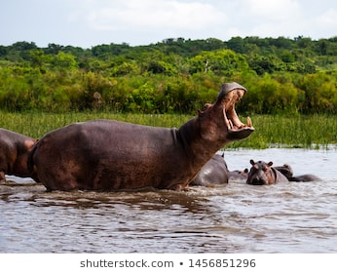
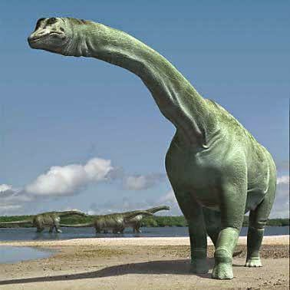
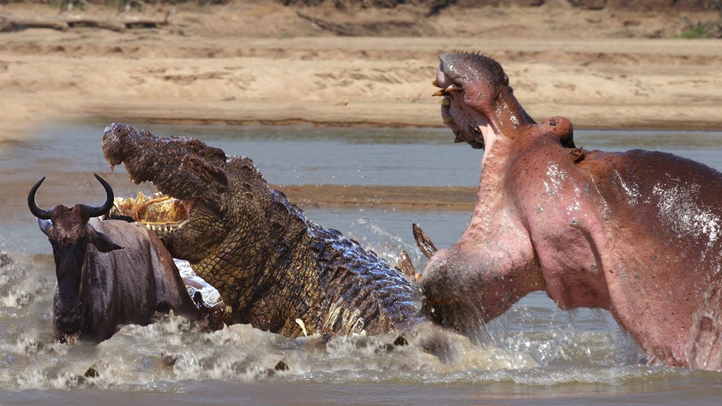
The Self-Confidence of Behemoth
Animals may have appeared different back then!

Slide 34
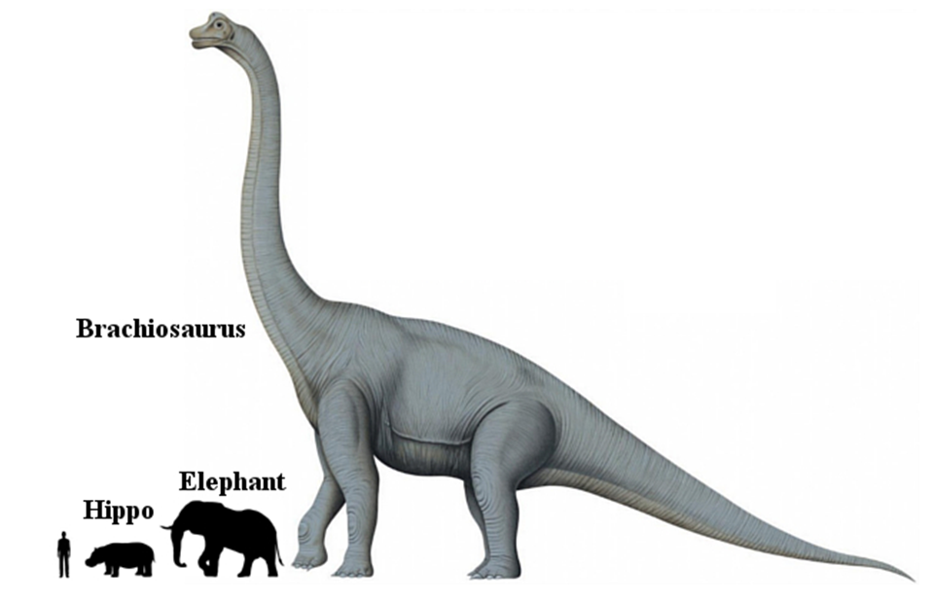
If Dinosaurs were still around
Which of these creatures has power in his stomach muscles, moves his tail like a cedar, bones like beams of bronze and “ranks first among the works of God?”

Slide 35
Job 40:15-19
Consider an animal of self-confidence….like you Job
15 "Look now at the behemoth, which I made along with you; He eats grass like an ox. 16 See now, his strength is in his hips, and his power is in his stomach muscles. 17 He moves his tail like a cedar; The sinews of his thighs are tightly knit. 18 His bones are like beams of bronze, his ribs like bars of iron. 19 He ranks first among the works of God [NIV]; Only He who made him can bring near His sword. [man cannot overpower him]
Not a predator, but amazingly powerful

Slide 36
Job 40:20-24 (ESV)
This animal thinks he can take on anything
20 For the mountains yield food for him where all the wild beasts play.
21 Under the lotus plants he lies, in the shelter of the reeds and in the marsh. 22 For his shade the lotus trees cover him; the willows of the brook surround him.
23 Behold, if the river is turbulent he is not frightened; he is confident though Jordan rushes against his mouth. 24 Can anyone capture him when he is on watch [NASB], or pierce his nose with a snare?
Do you have the wisdom & power to contain self-confidence that leads to self-righteousness?

Slide 37
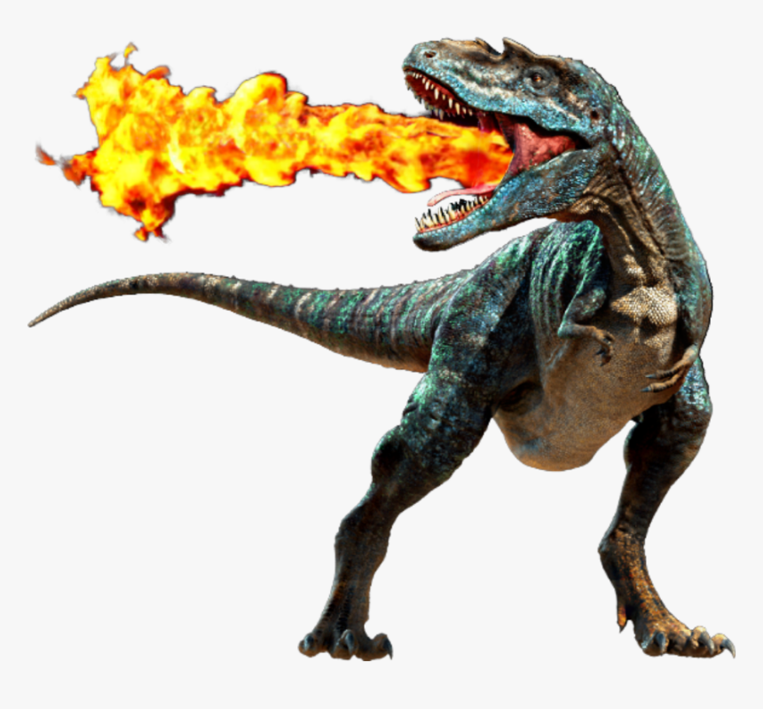
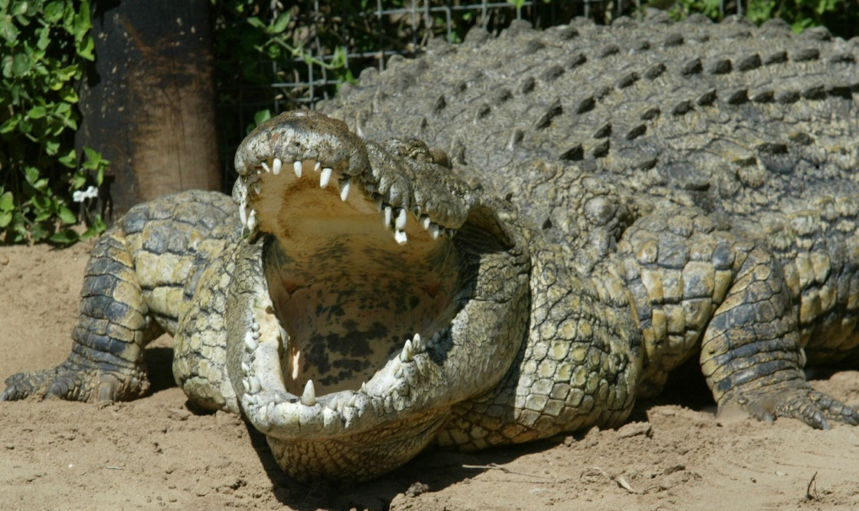
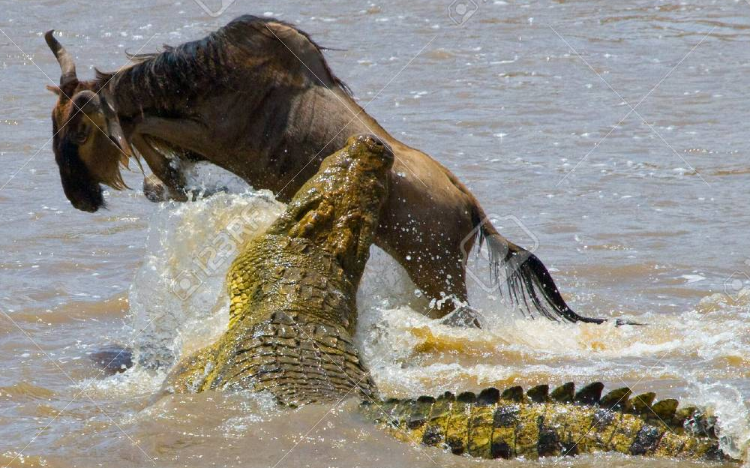
The Pride of Leviathan
Connects the serpent of Gen 3 to Daniel’s 4th beast and the dragon of Rev 12,13,17

Slide 38
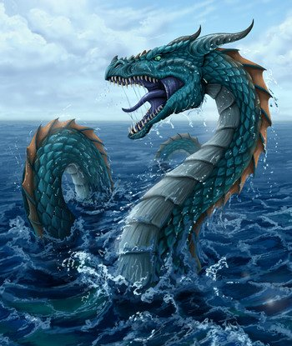
Leviathan in the Bible
Job 3:8 May those curse it who curse the day, those who are ready to arouse Leviathan.
Ps 74:14 You broke the heads of Leviathan in pieces, and gave him as food to the people inhabiting the wilderness.
Ps 104:26 There the ships sail about; There is that Leviathan which You have made to play there.
Isa 27:1 That day the Lord with His severe sword, great and strong, will punish Leviathan the fleeing serpent, Leviathan that twisted serpent; and He will slay the reptile that is in the sea.
and possibly Dan 7, Rev 12,13,17

Slide 39
Job 41:1-11
Untamable Leviathan: Deceitful Pride of Sin
1 "Can you draw out Leviathan with a hook, or snare his tongue with a line which you lower? 2 Can you put a reed through his nose, or pierce his jaw with a hook? 3 Will he make many supplications to you? Will he speak softly to you? 4 Will he make a covenant with you? [Job 31:1] Will you take him as a servant forever? 5 Will you play with him as with a bird, or will you leash him for your maidens? 6 Will the traders bargain over him?[NASB] Will they apportion him among the merchants? 7 Can you fill his skin with harpoons, or his head with fishing spears? 8 Lay your hand on him; Remember the battle — never do it again! 9 Indeed, any hope of overcoming him is false; Shall one not be overwhelmed at the sight of him? 10 No one is so fierce that he would dare stir him up.
No man can tame or control Sin without God

Slide 40
Job 41:10-11
No one can control Leviathan
Who then is able to stand against Me? 11 Who has preceded Me, that I should pay him? Everything under heaven is Mine.
Rom 11:32-36 (ESV)
32 For God has consigned all to disobedience, that he may have mercy on all. 33 Oh, the depth of the riches and wisdom and knowledge of God! How unsearchable are his judgments and how inscrutable his ways!
34 "For who has known the mind of the Lord, or who has been his counselor?“ 35 "Or who has given a gift to him that he might be repaid?"
36 For from him and through him and to him are all things. To him be glory forever. Amen.
God can do it, but who can repay Him?

Slide 41
Job 41:12-18 (ESV)
He is built for power & defense
12 "I will not keep silence concerning his limbs, or his mighty strength, or his goodly frame. 13 Who can strip off his outer garment? Who would come near him with a bridle? 14 Who can open the doors of his face? Around his teeth is terror. 15 His back is made of rows of shields, shut up closely as with a seal. 16 One is so near to another that no air can come between them. 17 They are joined one to another; they clasp each other and cannot be separated. 18 His sneezings flash forth light, and his eyes are like the rays of dawn [NIV].
Job: you cannot penetrate his defenses

Slide 42
Job 41:18-26
Everyone should be terrified by him
19 Out of his mouth go burning lights; Sparks of fire shoot out. 20 Smoke goes out of his nostrils, as from a boiling pot and burning rushes. 21 His breath kindles coals, and a flame goes out of his mouth. 22 Strength dwells in his neck, and sorrow dances before him. 23 The folds of his flesh are joined together; They are firm on him and cannot be moved. 24 His heart is as hard as stone, even as hard as the lower millstone. 25 When he raises himself up, the mighty are afraid; Because of his crashings they are beside themselves. 26 Though the sword reaches him, it cannot avail; Nor does spear, dart, or javelin.
Job: you cannot control him yourself

Slide 43
Job 41:27-34
The King of all the Proud
27 He regards iron as straw, and bronze as rotten wood. 28 The arrow cannot make him flee; slingstones become like stubble to him. 29 Darts are regarded as straw; he laughs at the threat of javelins. 30 His undersides are like sharp potsherds; He spreads pointed marks in the mire. 31 He makes the deep boil like a pot; He makes the sea like a pot of ointment. 32 He leaves a shining wake behind him; one would think the deep had white hair.
33 Nothing on earth is his equal — a creature without fear. 34 He looks down on all that are haughty; he is king over all that are proud." [NIV]
But God made him and can control him

Slide 44
What did God Explain in Job 40-41
How difficult it is for God to save men & women – He must humble them and drive out pride and Sin
God alone has the wisdom to save men & women – we cannot save ourselves
Any good and righteous character we have is all the result of what God has done in us – it’s all God’s righteousness, not our own.
Job was forced to think beyond himself & his suffering situation

Slide 45
Job 42:1-6
Having a Personal Relationship with God
Then Job answered the Lord and said:
2 "I know that You can do everything, and that no purpose of Yours can be withheld from You. 3 You asked, 'Who is this who hides counsel without knowledge?‘ Therefore I have uttered what I did not understand, things too wonderful for me, which I did not know. 4 Listen, please, and let me speak; You said, 'I will question you, and you shall answer Me.'
5 "I have heard of You by the hearing of the ear, but now my eye sees You. 6 Therefore I abhor myself, and repent in dust and ashes."
Job finally understood the deceitfulness of Sin & how far God has to go to save us

Slide 46
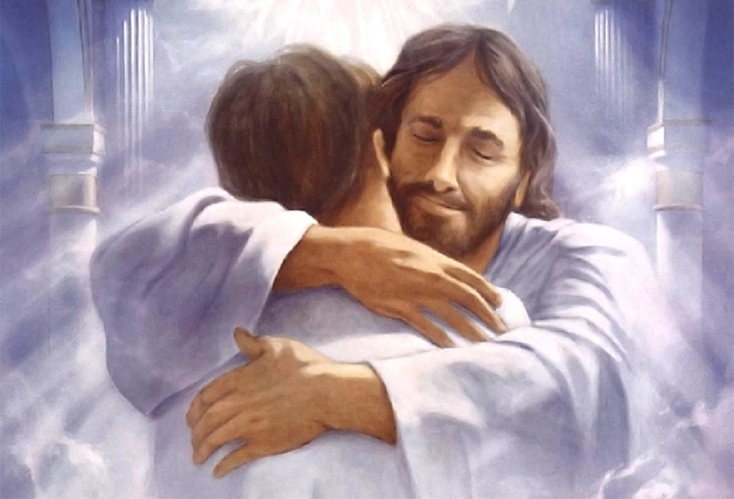
But God demonstrates His own love toward us, in that while we were still sinners, Christ died for us. (Rom 5:8-9)

Slide 47
1 John 4:16-19 (ESV)
Having a loving relationship with God brings confidence for the day of judgment
So we have come to know and to believe the love that God has for us. God is love, and whoever abides in love abides in God, and God abides in him. 17 By this is love perfected with us, so that we may have confidence for the day of judgment, because as he is so also are we in this world. 18 There is no fear in love, but perfect love casts out fear. For fear has to do with punishment, and whoever fears has not been perfected in love.
There is no fear in love

Slide 48
Job 42:7-8
God was angry at Job’s friends for their misrepresentation of God
7 And so it was, after the Lord had spoken these words to Job, that the Lord said to Eliphaz the Temanite, "My wrath is aroused against you and your two friends, for you have not spoken of Me what is right, as My servant Job has. 8 Now therefore, take for yourselves seven bulls and seven rams, go to My servant Job, and offer up for yourselves a burnt offering; and My servant Job shall pray for you. For I will accept him, lest I deal with you according to your folly; because you have not spoken of Me what is right, as My servant Job has."
We must get a correct understanding of how God works and justifies His sinful children

Slide 49


Slide 50
Job 42:9-11
Job was restored when he prayed for his friends
9 So Eliphaz the Temanite and Bildad the Shuhite and Zophar the Naamathite went and did as the Lord commanded them; for the Lord had accepted Job. 10 And the Lord restored Job's losses when he prayed for his friends. Indeed the Lord gave Job twice as much as he had before. 11 Then all his brothers, all his sisters, and all those who had been his acquaintances before, came to him and ate food with him in his house; and they consoled him and comforted him for all the adversity that the Lord had brought upon him. Each one gave him a piece of silver and each a ring of gold.
Everyone knew God brought adversity & Job could now explain why

Slide 51
Job 42:12-17
God blessed Job again
12 Now the Lord blessed the latter days of Job more than his beginning; for he had fourteen thousand sheep, six thousand camels, one thousand yoke of oxen, and one thousand female donkeys. 13 He also had seven sons and three daughters. 14 And he called the name of the first Jemimah, the name of the second Keziah, and the name of the third Keren-Happuch. 15 In all the land were found no women so beautiful as the daughters of Job; and their father gave them an inheritance among their brothers.
16 After this Job lived one hundred and forty years, and saw his children and grandchildren for four generations. 17 So Job died, old and full of days.
God let Job live long so he could explain the righteousness of God for many years to come

Slide 52
