Slide 1
The Last Day of Our Lord

Slide 2
Timeline of events
~7PM – Last Supper Sunset @ 7PM
~10PM – Gethsemane (Jn 13:30; Mt 26:40)
12AM – HP’s house… Peter’s 1st denial (Mk 14:68)
3AM – HP’s house… Peter’s 3rd denial (Mk 14:72)
6AM – Before Pilate… (Mt 27:1; Mk 15:1)
9AM – Jesus Crucified (Mk 15:25)
12PM – Darkness for 3 hrs (Mt 27:45)
3PM – Jesus Died (Mt 27:46)

Slide 3
Seating at Last supper
Disciple
Disciple
Disciple
Disciple
Disciple
Table, seating at the Last Supper
Disciple
Disciple
Judas
Disciple
“chief seat”
Jesus
Disciple
John
Peter
Source: The Life and Times of Jesus the Messiah, Edersheim

Slide 4
3 predictions of denial
On 3 occasions, Jesus tried to prepare Peter for his denial
1) Upper room w/ Judas present (Lk 22:31-32)
³¹Simon, Simon, behold, Satan hath desired to have you^{A}, that he may sift you as wheat:
³²But I have prayed for thee^{B}, that thy faith fail not: and when thou art converted, strengthen thy brethren.
^{A}: Plural ‘all of you’ → all 12 disciples
^{B}: Singular ‘you’ → Peter specifically (footnote in ESV)
Jews after all 12, but Jesus pray for Peter to make it

Slide 5
3 predictions of denial
Occurrence |  | Self-focus/confidence | Readiness | Loyalty
1st Prediction Lk 22:31-34 | Peter | I | am ready | With thee… prison, death
 | Jesus | prayed for you strengthen brethren | faith fail not converted | Deny know me 3x
2nd Prediction Jn 13:36-38 | Peter | Why can’t I, I, my | now | lay down life for you
 | Jesus | will you? | can’t… now …afterward | deny me 3x
3rd Prediction Matt 26:33-35 Mk 14:27-31 | Peter | all these stumble, not I I, I (v.35) | ‘vehemently’ argues | never offended not deny with thee
 | Jesus | all you offended | this night (2x) | deny me 3x
Put your confidence in God, not self
Strengthen others, don’t promote self
You are not truly ‘with me’ now
Peter, you’re not ready yet!
When you see you’re not ready, don’t give up - convert and follow me!

Slide 6
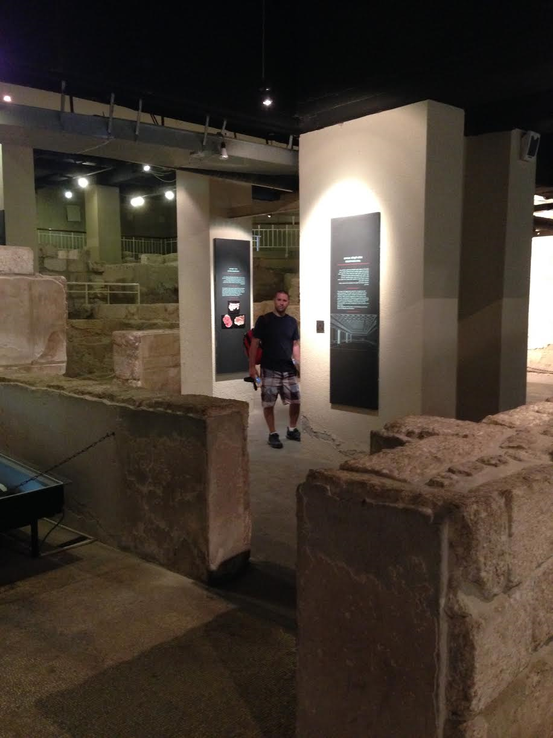
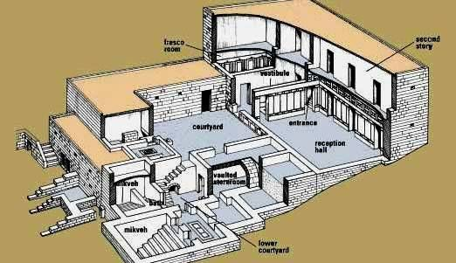
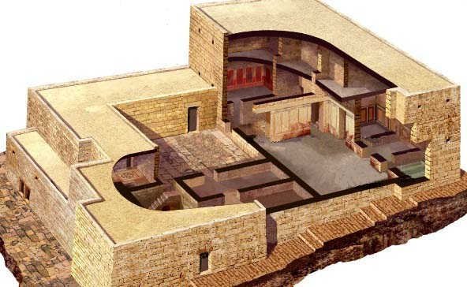
The house of the high priest

Slide 7
Timeline of events
~7PM – Last Supper Sunset @ 7PM
~10PM – Gethsemane (Jn 13:30; Mt 26:40)
12AM – HP’s house… Peter’s 1st denial (Mk 14:68)
3AM – HP’s house… Peter’s 3rd denial (Mk 14:72)
6AM – Before Pilate… (Mt 27:1; Mk 15:1)
9AM – Jesus Crucified (Mk 15:25)
12PM – Darkness for 3 hrs (Mt 27:45)
3PM – Jesus Died (Mt 27:46)

