Slide 1
judges
Radical action
Perth EOYS 2020

Slide 2
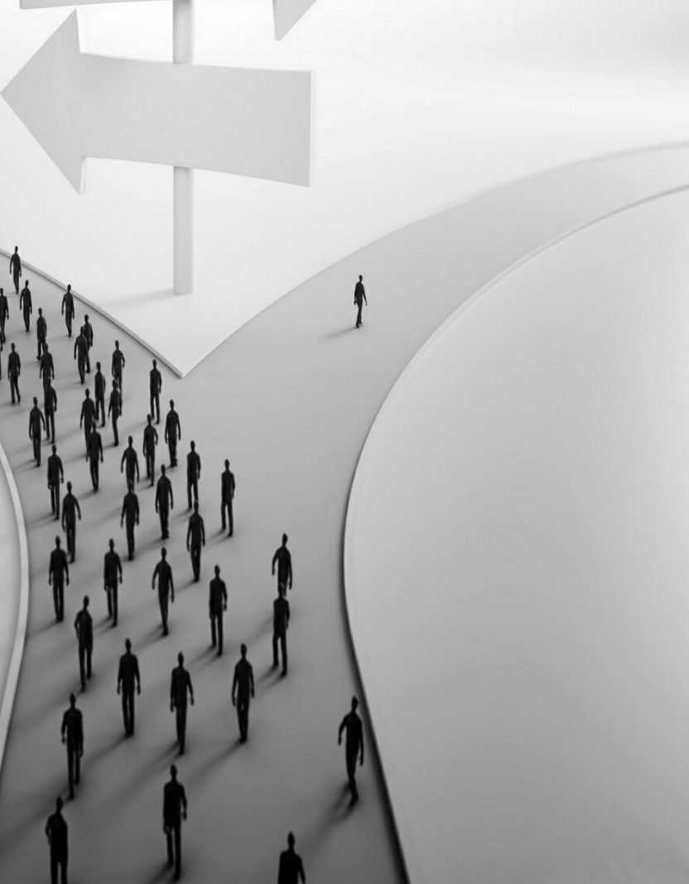
Choose God
Stand up & be counted
Be ambitious - take your inheritance

Slide 3
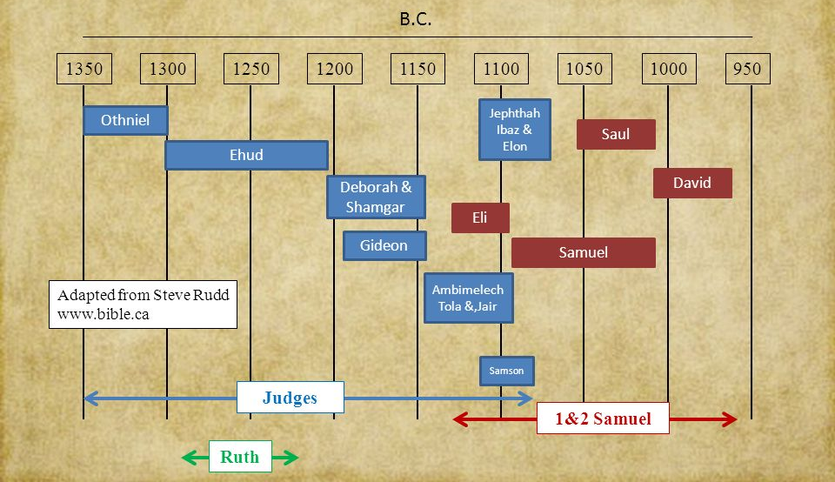
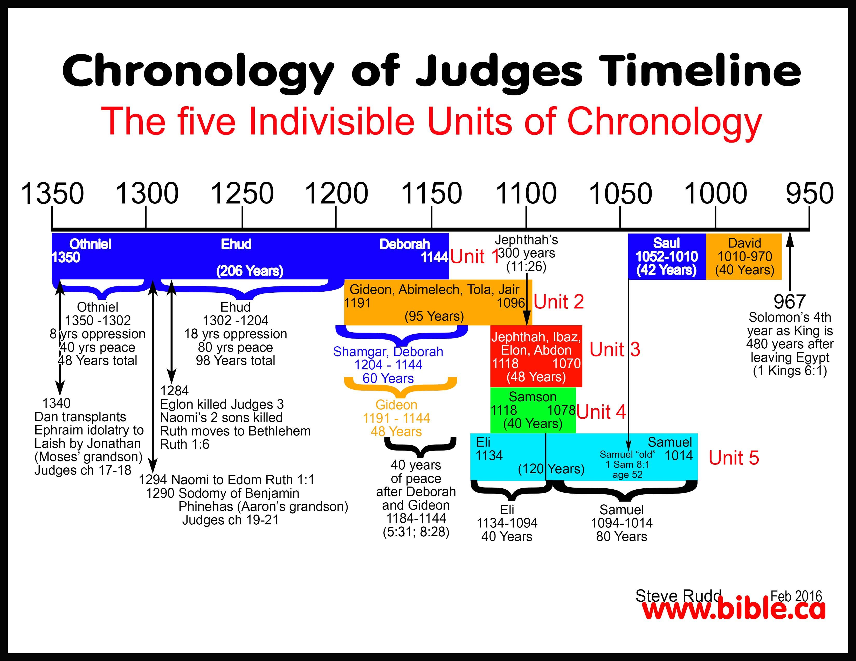
Characters of Judges
*
Jephthah
Othniel
Deborah
Ibaz, Elon
Ehud
Shamgah
David
Abdon
*
Gideon
Eli
Saul
*
*
Samuel
Abimelech
Tola, Jair
Samson
1350
1300
1250
1200
1150
1100
1050
1000
950
Judges
Ruth
1 & 2 Samuel

